Slide 1

Understanding
Emotions
Your
October 7, 2020
Parent Training Session 1
Notes:
Line spacing + Page numbers

Slide 2
Agenda
01 Introduction
02 Personality
www.16Personalities.com
03 Core Values
04 Core Emotions
Cycle of Emotions
05 Emotions and Stress
How to Make Stress Your “Friend” – TEDTALK
06 What’s Next

Slide 3



Introduction
01
When you know yourself well- when you understand your emotions, social identities, core values and personality – you gain clarity on your purpose in life and in work. Being anchored in purpose makes you able to deal with setbacks and challenges.

Slide 4
Personality
02

Slide 5
Personality
A great deal of the way we work, live and socialize, and perhaps even feel, has to do with our personality — yet many
of us don’t have this awareness and can’t draw connections between our personalities and our preferences for how to spend a sunny
Saturday or how we like to get information from our supervisors.

Slide 6
16personalities.com
For a free personality quiz that will give you an overview of your personality type, click on www.16personalities.com.
There is a great deal of nuance and complexity to this framework, and it is meant to provide insight and to provoke
questions about yourself. It’s not a hard science or determinant of what you can do – but it is very interesting.

Slide 7

Modern and Reliable Framework
Our personality model incorporates the latest advances in psychometric research, combining time-tested concepts with robust and highly accurate testing techniques.
Why 16personalities.com ?

Slide 8
Identifying Core Values
03
Figuring out your core values ...
Read through the attached list of values and circle 10 that you feel are MOST important to you.
2. Cross out five of those values, leaving you with the five that are most important
3. Now, from you list of five values, cross off two, leaving you with the three values that are most
important to you. These are your core values.

Slide 9
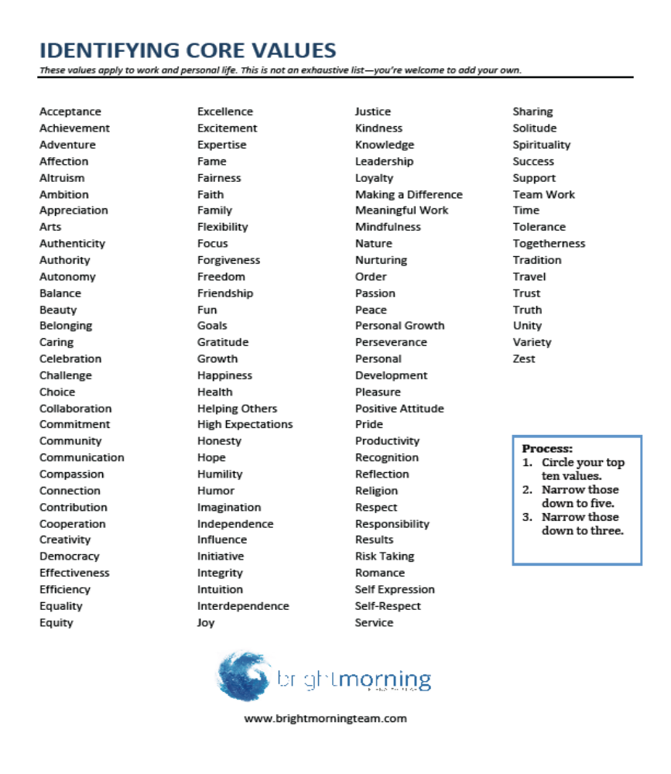

Slide 10
Identifying Core Values
03
Think about those core values, write them on a piece of paper and hang it on your fridge.
Reflect over the next few days ...
· How does it feel to read your list of values?
· One year ago, what do you suspect your core values might have been? Ten years ago, what do you
think they might have been?
· What are some ways in which your core actions reflect your core values? Think of one example of how
actions you take reflect on your core values.

Slide 11
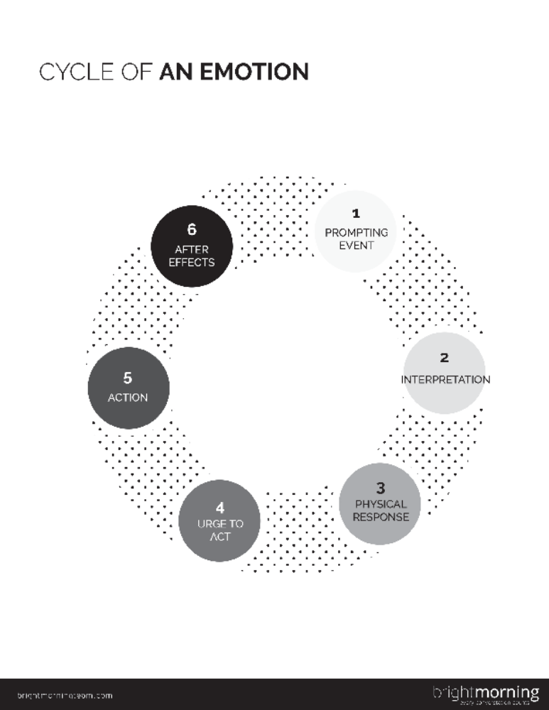
Cycle of
Emotion
04
What are emotions? Take a minute to consider these questions:
• How comfortable are you thinking about and talking about
emotions?
• How might your professional and personal life be different if
you had greater knowledge and understanding of emotions?
• How might your life be different if you had more tools to
respond to your emotions when they arise?

Slide 12
Cycle of Emotion
Prompting Event This is the stuff that happens outside you (cancelled meeting, crying children) or inside you (thoughts, memories)
Interpretation Your mind makes sense of what happened. The event is filtered through your evaluation, understanding, beliefs, and assumptions. It’s your own interpretation of the event and how you explain it to
yourself.
Physical Response The event and your interpretation result in a physical response- you may produce stress hormones that make your heart race, your throat close, your hands shake, etc.

Slide 13
Cycle of Emotion
Urge to Act: Almost simultaneous to the physical response, you feel an urge to do something. You may or may not act on impulse – but it is very useful to notice what you feel compelled to do in those first moments.
Action: Then there is what you actually “do”. You may or may not feel as though you are in control of your behavior at this point. Later after the urgency has passed you may opt to act or choose a self-soothing action.
Aftereffects: Finally, the emotion affects other emotions, thoughts and behaviors, and your body. The aftereffects can be a prompting event that set off another emotion cycle. Sometimes the original emotion needs more processing; other times, a secondary emotion is triggered. For example, your fear can lead to a cycle of
anger or anxiety. All of this can leave you physically exhausted.

Slide 14
Emotions and Stress
05

Slide 15
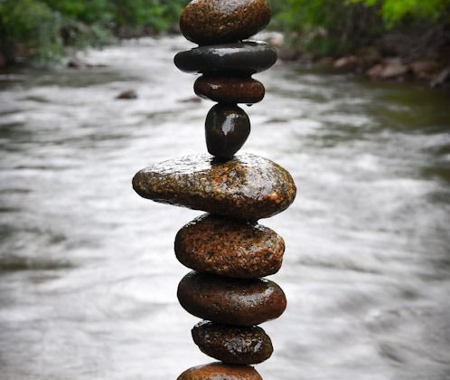
How to Make Stress Your Friend
Stress. It makes your heart pound, your breathing quicken, and your forehead sweat.
But while stress has been made into a public health enemy, new research suggests that stress may only be bad for you if you believe that to be the case.

Slide 16
What’s next
04

Slide 17
Stress Anxiety and Self-Care
November 18, 2020
10:00 a.m.

Slide 18

Thank you !
See you next month

