Slide 1

US History EOC
10-DAY STAAR
REVIEW
Written by Chris Jackson, Ed.D.
www.hedgehoglearning.com
© Hedgehog Learning

Slide 2
US History EOC Review
All clipart and images used in this review are either created by Hedgehog Learning, found in public domain, or used with permission from iStockphoto, iClipart, Microsoft, or www.123rf.com

Slide 3
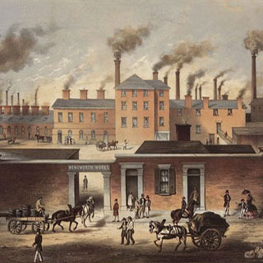
US History EOC Review
DAY 1
Industrialization and Transition in American Society
READINESS STANDARDS – TEKS 3A, 3B, 3C, 12A, 13A, 15B, 26A, and 27A
Today’s Objectives:
I will explain and analyze…
The impacts of industrialization on the American society.
The effect of political issues during the industrial revolution.
The effects of industrialization on American settlement.
The relationship between government and businesses.
The impact of technological advancement.

Slide 4
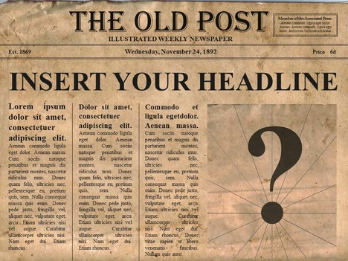
The United States in 1880
Brainstorm what newspaper headlines might you have seen in 1880?

Slide 5
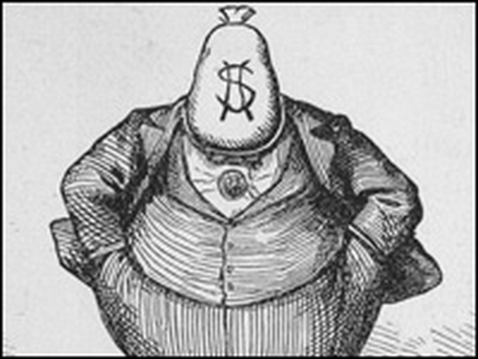
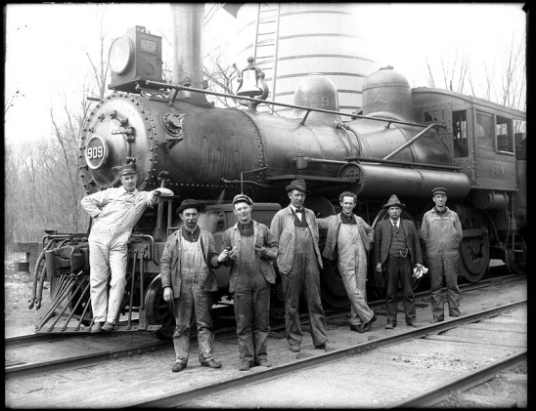
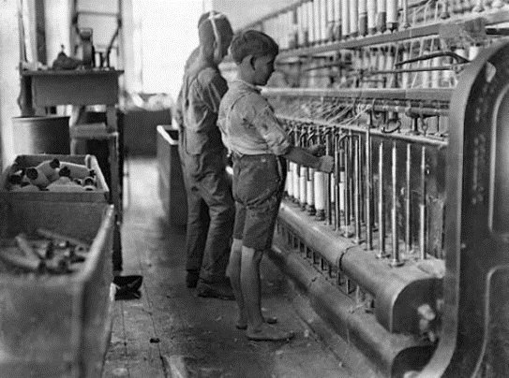
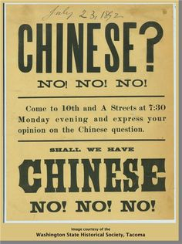
The United States in 1880
Characteristics of the United States in 1880:
Advances in technology
Economic development
Entrepreneurship
Child labor
Monopolies
Formation of labor unions
Political machines and bosses
Rapid Immigration
Urbanization
Nativism
Indian reservations
Gold rushes

Slide 6
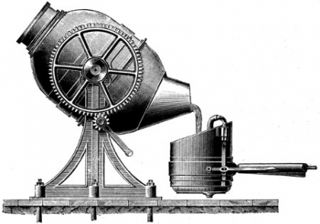
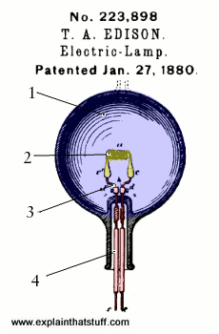
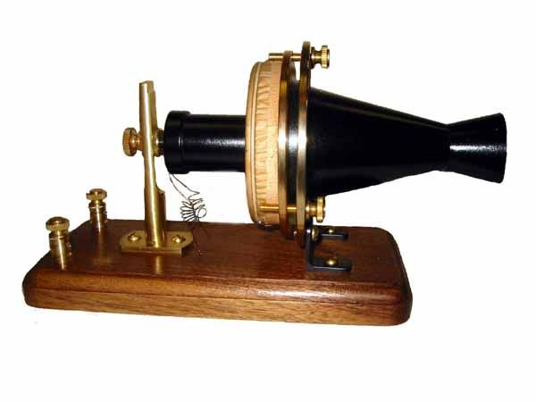
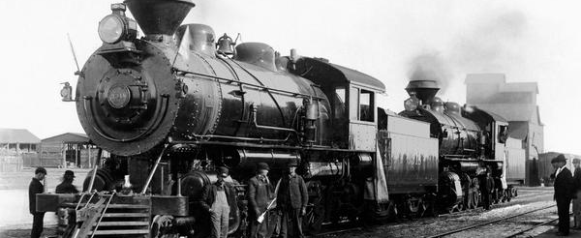
Technological Advances: 1880-1900
Efficient steel production
Bell invents the telephone
Edison invents the electric light bulb
180,000 miles of railroad tracks are laid
Invention of the internal combustion engine drives the need for oil refining

Slide 7
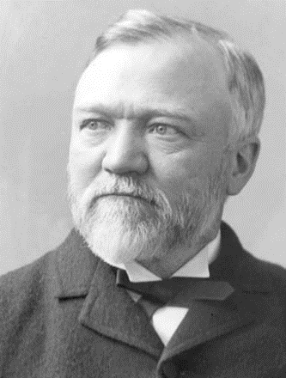
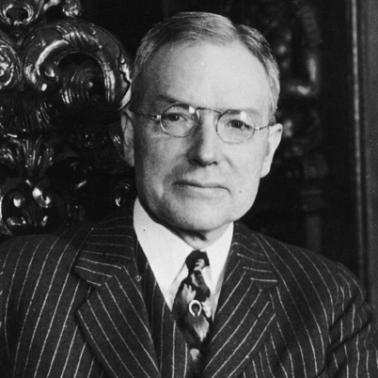
Entrepreneurs and Philanthropists
Andrew Carnegie
John D. Rockefeller
Founded Carnegie Steel Corporation in 1892
Paid workers low wages for 12-hour shifts
Gave $350 million to libraries and universities
Founded Standard Oil Company in 1870
Monopolized 90% of oil refining in the U.S.
Gave millions of his fortune to education and science

Slide 8
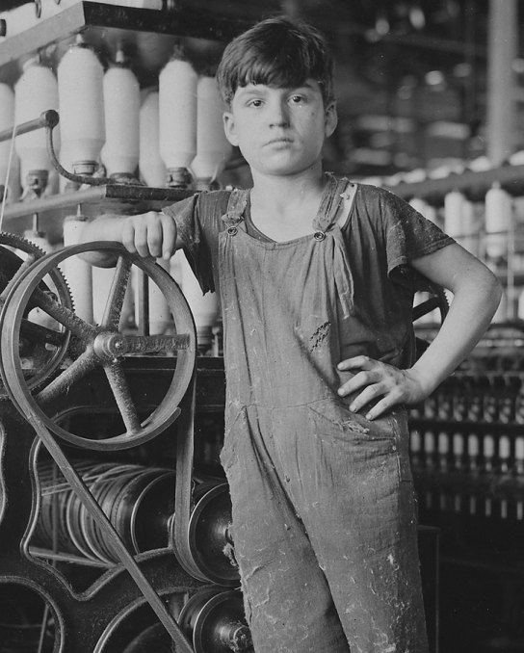
Child Labor and Labor Unions
It was common to employ children for low wages.
12-hour, 6-day shifts were normal.
Workers began to collectively bargain for better working conditions and pay.
Knights of Labor (1869) and the American Federation of Labor (1881) were formed.

Slide 9
Urbanization of the U.S.
Year | Rural Areas (percent of population) | Urban Areas (percent of population)
1800 | 92% | 8%
1850 | 85% | 15%
1900 | 60% | 40%
1950 | 45% | 55%
2000 | 22% | 78%
In 1865, only New York and Philadelphia had a population of 500,000.
By 1900, New York, Philadelphia, Chicago, Kansas City, Pittsburg, and Washington, D.C. all had more than 500,000.

Slide 10
Free Enterprise vs.
Government Regulation
Free Enterprise
Government Regulation
Wanted “laissez-faire”, or no government control
Desired the most efficient means of profit
Opposed labor unions
Big business could seize complete control, or monopoly, of an industry
Passage of anti-trust acts to stop unfair business practices and breakup monopolies
  Interstate Commerce Act (1887)
  Sherman Anti-Trust Act (1890)
Government is petitioned to pass child labor protection laws

Slide 11
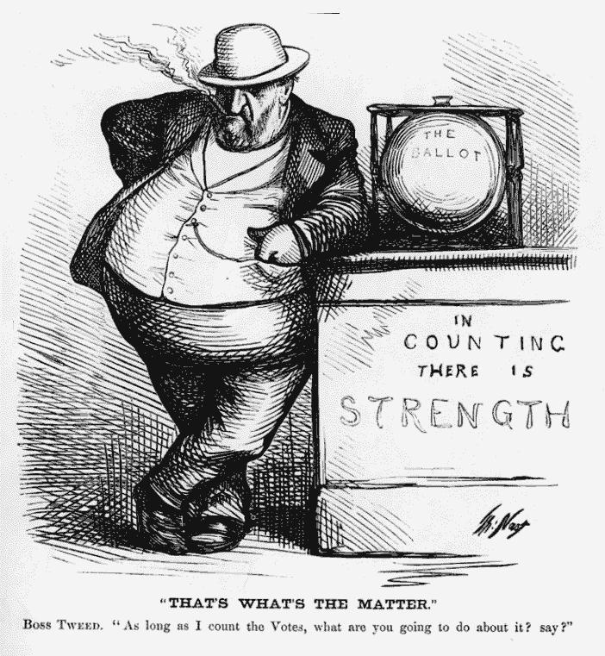
Political Machines and Bosses
Powerful officials, known as political bosses, gave social benefits to the poor in exchange for votes.
Many levels of government were corrupted by these political machines.
BOSS TWEED

Slide 12
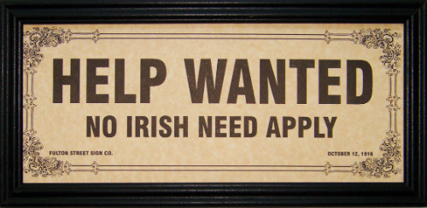
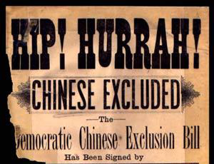
Nativism and Immigration
32 million people immigrated to the U.S. between 1880 and 1920.
  Push factors: persecution, poverty, and war
  Pull factors: freedom and opportunity
Many Americans, known as nativists, opposed the immigration of “new” people.

Slide 13
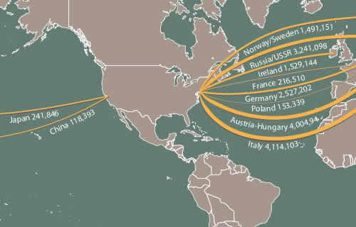
Immigration from 1880 to 1930

Slide 14
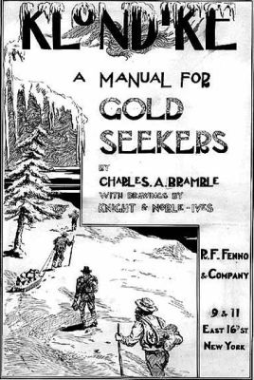
Go West! (and North)
Westward movement for many was a way to escape the harsh urban life of eastern cities.
Many found opportunities in:
  Gold Rushes
    California and Alaska
  Farming and Cattle Ranching
    Great Plains
New railways and trails opened the west for expansion.

Slide 15
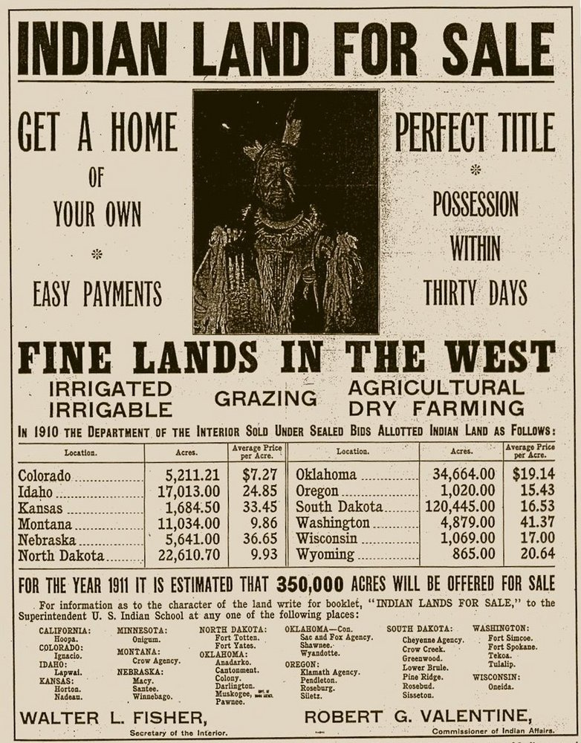
Indian Affairs of the US
Indian wars were common in the western U.S. as people moved west in search of land and gold.
Native Americans were forced onto dedicated reservations.
The Dawes Act of 1887 turned tribal land into private property for Native Americans, which was then often sold to settlers.

Slide 16
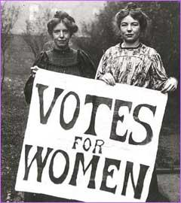
US History EOC Review
DAY 2
The Progressive Era and the American Empire
READINESS STANDARDS – TEKS 3A, 3C, 4A, 5A, 9A, 12A, 15D
Today’s Objectives:
I will explain and analyze…
Service reform and Populism.
Issues affecting women and the Social Gospel.
Significance of the Spanish-American War, expansionism, and missionaries
Contributions of A. Mahan, T. Roosevelt, and S. Dole.
Impacts of Progressive Era reforms and the 16th – 19th amendments.

Slide 17
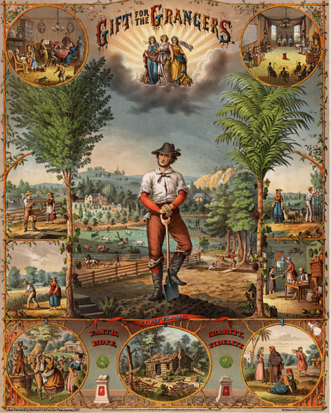
The Rise of Populism
Farmers in the late 19th century faced overproduction with new, more efficient machinery.
Food prices fell, but the cost-of-living remained the same for farmers.
The Grange Movement, organized by farmers, wanted the government to regulate commerce and the railroads.
Congress passed the Interstate Commerce Act in 1887.
Farmer organized with industrial workers and miners to form a Populist Party.

Slide 18
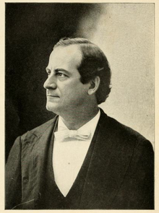
The Populist Party
The Populist Party believed that a shortage of currency was the cause of failing prices and campaigned for the free coinage of silver.
Although the Populist Party lost the 1890, many of the political views were absorbed by the Democratic Party in the 1896 election.
Populists supported Democrat William Jennings Bryan as their presidential candidate in 1896 and 1900. He narrowly lost both elections.
William Jennings Bryan, 1896

Slide 19
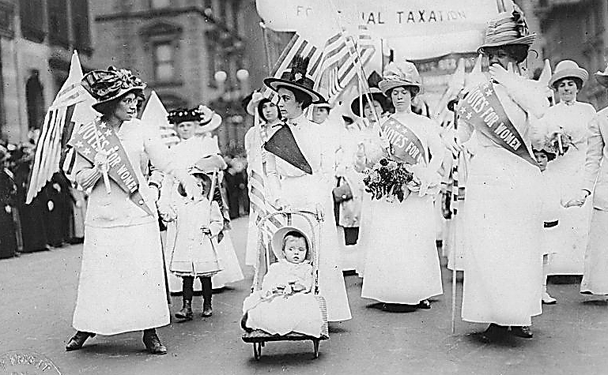
The Progressive Era & Women’s Rights
During the early 1900s, many people sought to correct abuses of corrupt business and government.
The Social Gospel Movement declared reform was required on moral, biblical grounds.
Progressives also fought for women’s suffrage and were instrumental in the passage of the Nineteenth Amendment in 1920.

Slide 20
New Constitutional Amendments
PROGESSIVE ERA AMENDMENTS
Amendment | Purpose | Date Ratified
16th Amendment | Created the Federal Income Tax | 1913
17th Amendment | Direct Election of U.S. Senators | 1914
18th Amendment | Prohibition of Alcohol | 1919
19th Amendment | Voting Rights for Women | 1920

Slide 21
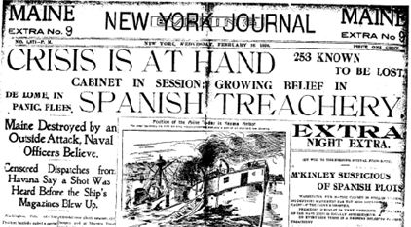
The Spanish-American War - 1898
The U.S. intervened in Spain’s harsh occupation of Cuba, Puerto Rico, and the Philippines.
The sinking of the U.S.S. Maine triggered the U.S. to act.
Spain was defeated in 4 months, and the U.S. became a world naval power.

Slide 22
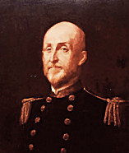
U.S. Imperialism
Following the Spanish-American War, the U.S. inherited control of Cuba, the Philippines, Guam, and Puerto Rico.
Many felt this was an opportunity to expand American influence around the world. Admiral Alfred Mahan was a supporter of creating a large powerful navy using these colonies as naval bases.
Hawaii became strategic naval station, and President Sandford Dole worked out plans for it to be annexed by the United States in 1898.

Slide 23
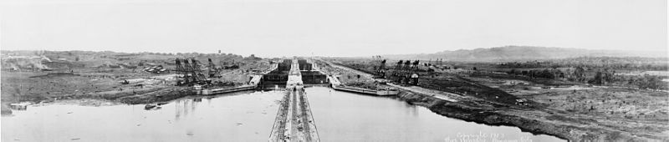
The Panama Canal
President Roosevelt agreed to protect and recognize Panama’s independence from Columbia in exchange for control of a 10-mile wide strip of rainforest through the center of Panama.
The U.S. built the Panama Canal in 10 years at the cost of thousands of lives and $400 million.
The Panama Canal reduced a trip from New York to San Francisco by 10,000 miles and 50 days.

Slide 24
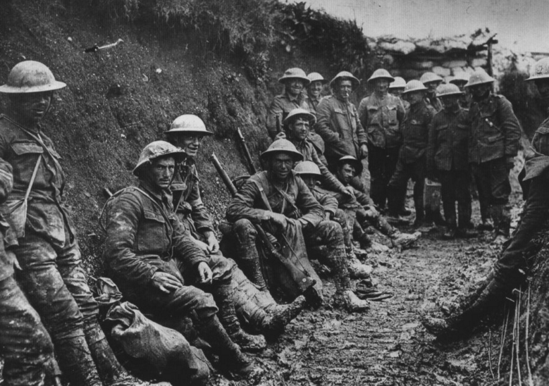
US History EOC Review
DAY 3
World War I
READINESS STANDARDS – TEKS 4A, 4C, 4F, 15D, 19B
Today’s Objectives:
I will explain and analyze…
The causes of World War I
Issues of isolationism and neutrality
Woodrow Wilson’s Fourteen Points and the Treaty of Versailles
Economic impact of WW I on the U.S.
Constitutional issues raised by government policy during WW I

Slide 25
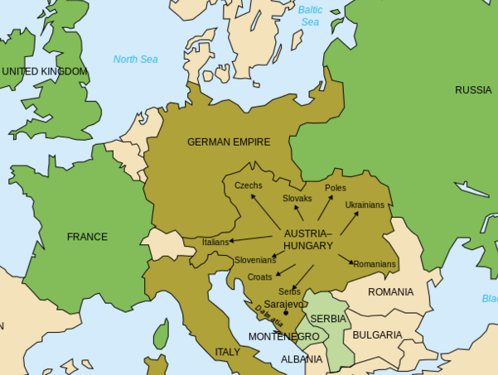
Reasons for World War I
Europe was divided into two major political and military alliances.
These two alliances had competing economic interests.
World War I began in 1914 when Archduke Franz Ferdinand was assassinated by Serbian nationalists. Austria responded by invading Serbia.
Central Powers: Germany & Austria–Hungary
Allied Powers: Great Britain, France, & Russia

Slide 26
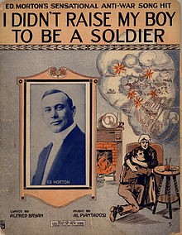
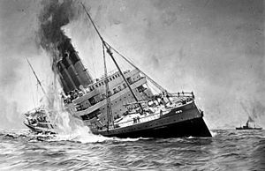
U.S. Isolationism
At the beginning of World War I, President Wilson follows a policy of neutrality. The belief that the U.S. should not become involved in foreign conflicts is referred to as isolationism.
However, due to the U.S.’s close ties with Great Britain, the Zimmerman Telegraph, and the sinking of the Lusitania in 1916 by a German U-Boat, which killed more than a 1,000 passengers, including 128 Americans, the U.S. enters the war.

Slide 27
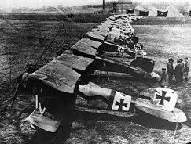
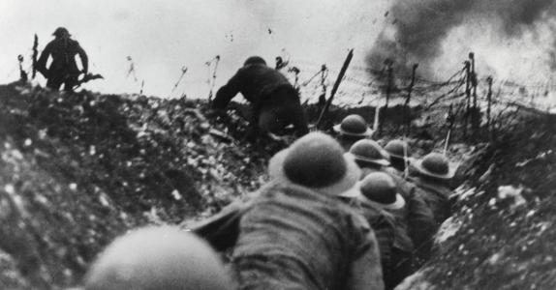
A New Kind of Warfare
World War I was the most destructive war ever known at that time. New lethal technology and combated methods included:
  Trench Warfare
  Poison Gas
  Submarines
  Military Aircraft
  Tanks
  Machine Guns

Slide 28
Impact of WWI in the U.S.
Wartime production spurred U.S. industries and lead economy into the “Roaring Twenties”.
Civil Liberties were curtailed during the war under the Espionage Act of 1917.
Millions of American men were required to register for draft under the new Selective Service Act in 1917.
American war heroes were created, such as Alvin York and General John Pershing of the American Expeditionary Force. Congress awarded more than 3,400 Medals of Honor.

Slide 29
Wilson’s Fourteen Points
American troops broke the deadlock in Europe and the Allied Forces prevailed in 1918. President Wilson proposed Fourteen Points as a bases for a peace treaty, including:
  An end to secret diplomacy
  Removal of trade barriers
  Freedom of sea navigation
  Reduction in armaments
  Independent Polish state
  Division of Austria-Hungary and Ottoman Empire
  Formation of a League of Nations
Opposition to U.S. membership in the League of Nation was led by Henry Cabot Lodge. The U.S. never joined the League of Nations.

Slide 30
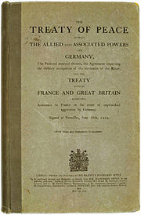
The Treaty of Versailles
The Treaty of Versailles in 1919 officially ended World War I.
The terms of the treaty imposed harsh sanctions on Germany.
The League of Nations was created, but the U.S. did not join due to strong objections from the Senate.
Austria-Hungary and Ottoman Empire were divided into smaller new nation states.

Slide 31
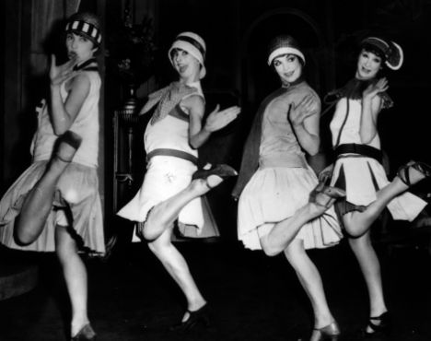
US History EOC Review
DAY 4
The Roaring Twenties
READINESS STANDARDS – TEKS 5A, 6A, 13A, 25B, 27C
Today’s Objectives:
I will explain and analyze…
Social Darwinism, eugenics, prohibition, women’s issues, and race relations in the 1920s
The effects of the Red Scare, KKK, and Nativism
Immigration and migration patterns
The impact of Tin Pan Alley and the Harlem Renaissance
Improvements in production and manufacturing

Slide 32
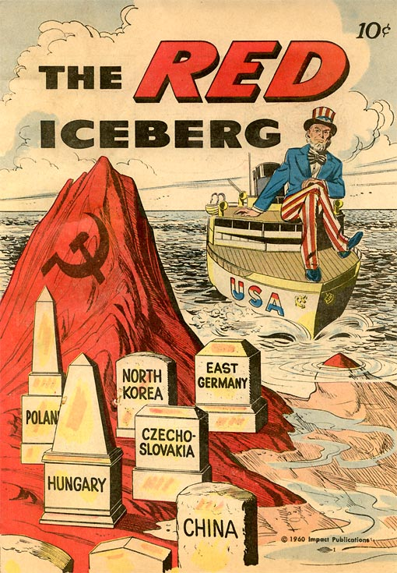
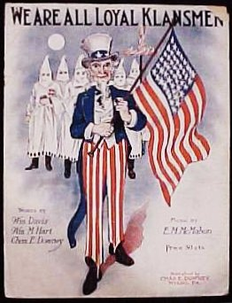
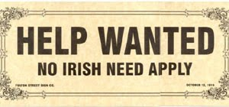
Post World War I in America
America retreated into isolationism after World War I and experienced a time of great cultural fear, including:
  Racism in a renewed Ku Klux Klan
  Nativism and a distrust of foreigners
  Fear of communism, known as the Red Scare

Slide 33
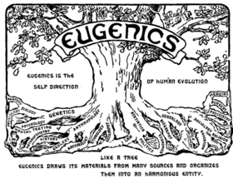
Social Darwinism and Eugenics
Contributing to social fears of race, communism, and ethnicity of the 1920s was a belief in the superiority of Anglo-Saxons.
Eugenics was a pseudo-science based on the thought that a super-race of humans could be created by breeding superior parents of desired qualities.
Social Darwinism, related to Eugenics, was a belief that the most superior race of humans would survive.

Slide 34
Social Darwinism and Eugenics
Contributing to social fears of race, communism, and ethnicity of the 1920s was a belief in the superiority of Anglo-Saxons.
Eugenics was a pseudo-science based on the thought that a super-race of humans could be created by breeding superior parents of desired qualities.
BECAME POPULAR IN GERMANY AND LATER GAVE RISE TO NAZISM
Social Darwinism, related to Eugenics, was a belief that the most superior race of humans would survive.

Slide 35

Women in the 1920s
Women in the 1920s experienced greater freedoms such as voting, wearing expressive clothing, working outside the home, and going to college.
Many women supported prohibition as a way to keep their husbands sober and committed to their family.

Slide 36
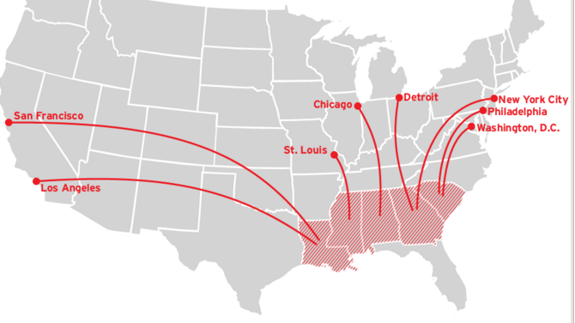
The Great Migration
African Americans moved out of the South in the 1920s to escape racism, sharecropping, tenant farming, and low wages. By moving to the North, Midwest, and West Coast, they hoped to find higher-paying industrial jobs and social acceptance.

Slide 37
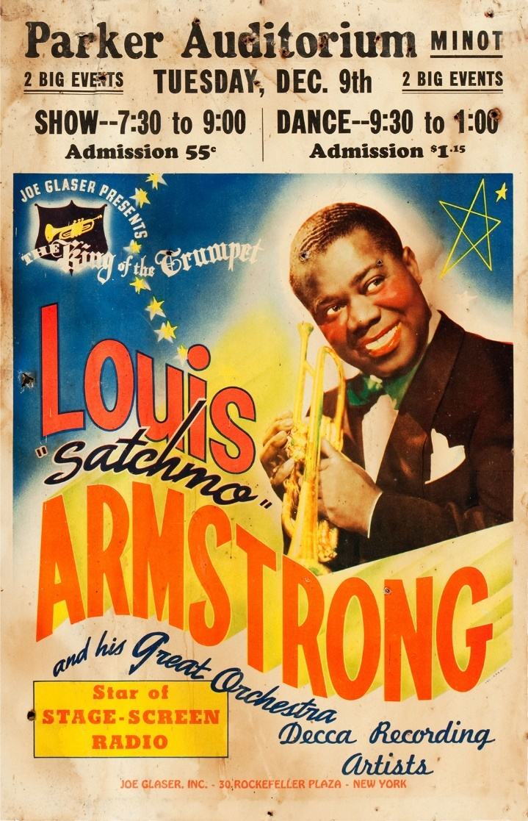
Tin Pan Alley & Harlem Renaissance
Originating in Harlem, a growth in middle-class African Americans gave a new confidence and pride in their heritage.
African Americans, such as Langston Hughes and Alain Locke, began to express themselves in literature, art, and music.
Tin Pan Alley was a melting pot of music publishing in New York and helped popularize jazz music.

Slide 38
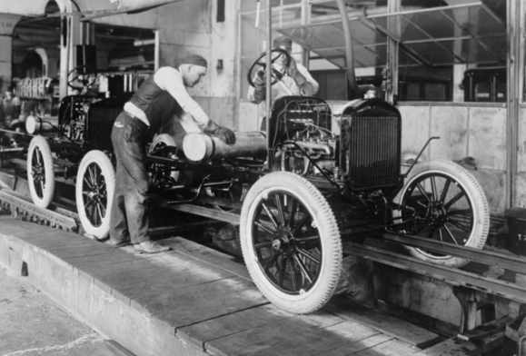
The Rise of the Assembly Line
Mass production of goods skyrocketed in the 1920s due to innovations in production technology.
The assembly line, introduced by Henry Ford, helped his company produce 1.6 million cars a year at a price less than $300.
Mass consumption and buying on credit set the stage for the 1929 stock market crash.

Slide 39
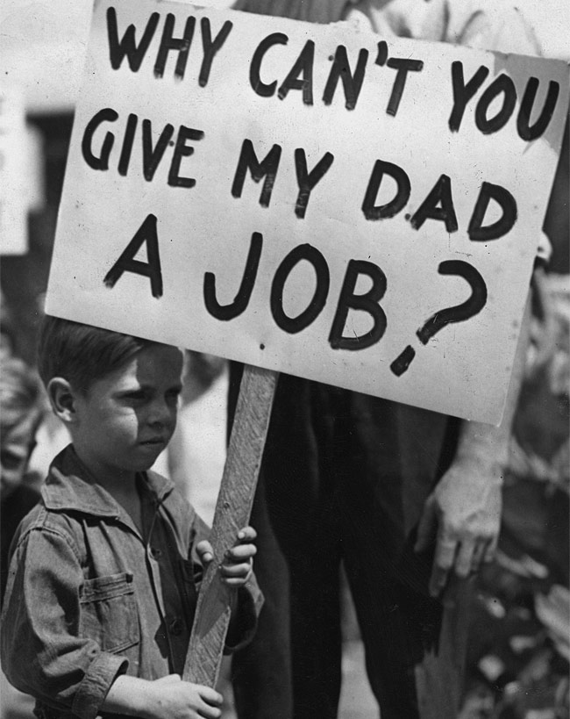
US History EOC Review
DAY 5
The Great Depression and the New Deal
READINESS STANDARDS – TEKS 12A, 16B, 16C, 19A, 19B, 20B
Today’s Objectives:
I will explain and analyze…
The causes of the Great Depression
The effect of the Great Depression on the economy
The impact of New Deal legislation
Issues raised by government policies during the Great Depression
Impact of the Dust Bowl
FDR’s attempt to increase the number of Supreme Court justices

Slide 40


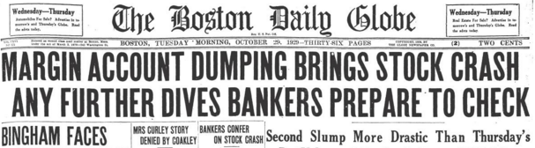
Setting the Stage for 1929
OVERPRODUCTION
  U.S. companies were producing more goods than they could sell.
BUYING STOCKS ON MARGIN
  Investors were buying stocks on installment plans and loans.
UNREGULATED BANKING
  Banks were extending loans to consumers who could not afford it.
HIGH TARIFFS ON TRADE
  Producers could not sell abroad.

Slide 41
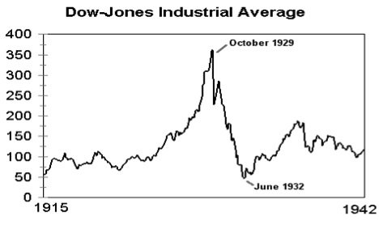
Stock Market 1915 - 1942

Slide 42
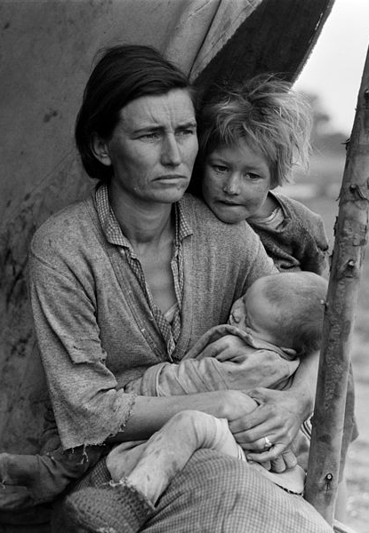
The Great Depression under Hoover
President Hoover initially practiced laissez-faire capitalism and rejected government bailouts and economic safety nets.
Housing prices tumbled because people could not pay their rent or mortgage.
Hundreds of thousands of homeless Americans
25% unemployment rate
Nearly 1 out of 2 banks failed in the U.S.
Shanty towns of homeless called “Hoovervilles” sprang up on the outskirts of U.S. cities
Photograph by Dorothea Lange, famous photographer of the Great Depression

Slide 43
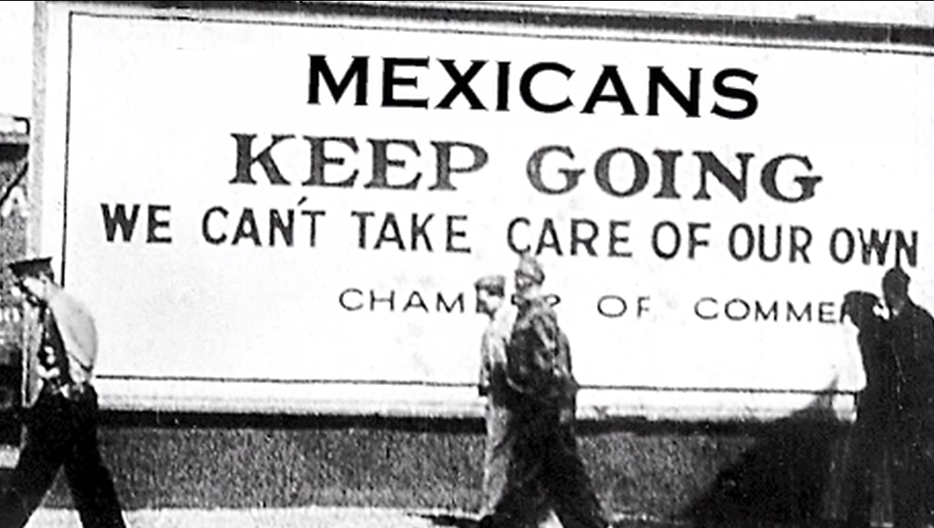
Mexican Repatriation Act
With a multitude of white American farmers looking for jobs many turned to jobs filled by Mexican immigrants.
President Hoover authorized the Mexican Repatriation Act which forcibly sent more than half a million Mexican immigrants back to Mexico during the Great Depression.

Slide 44
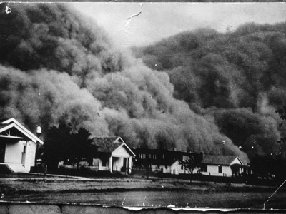
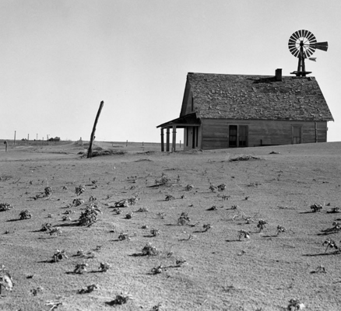
The Dust Bowl
To make problems worse during the Great Depression, the Great Plains faced a natural disaster.
The Dust Bowl was created by the combination of over-tilling the ground for farming and extreme drought.
Over a million farmers were driven from the Great Plains and abandoned their farms.

Slide 45
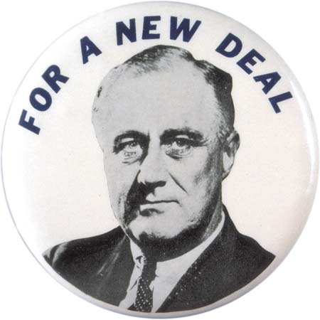
FDR and the New Deal
Franklin D. Roosevelt won the Presidential Election of 1932 and proposed a “New Deal”, a series of government programs and policies to bring the U.S. out of the Great Depression.
FDR’s wife, Eleanor Roosevelt, served as a role model and a voice of encouragement for women fighting for their families during the Depression.

Slide 46
The New Deal and the 3 R’s
FDR summarized his New Deal in terms of three R’s:
  RELIEF – Closed banks until they are found to be financially sound; provided emergency loans to homeowners; provided public jobs through the CCC, PWA, and WPA.
  RECOVERY – Pumped money into the economy by increasing government spending; purchased crops from farmers and stored them to raise crop prices
  REFORM – Established the FDIC to insure bank deposits; established the Tennessee Valley Authority to built dams; created the Securities and Exchange Commission to regulate the stock market; passed the Social Security Act to provide insurance and pensions

Slide 47
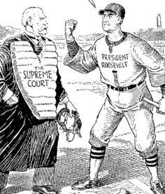
FDR and the Supreme Court
In 1935 and 1936, the Supreme Court ruled two of FDR’s New Deal programs were unconstitutional.
President Roosevelt feared that the Supreme Court would overturn other New Deal programs so he proposed a plan to replace each Supreme Court Justice over 70 ½ years old.
The proposal was rejected by Congress , but the Supreme Court stopped overruling New Deal programs.

Slide 48

US History EOC Review
DAY 6
World War II
READINESS STANDARDS – TEKS 7A, 7D, 7G, 17A, 19B
Today’s Objectives:
I will explain and analyze…
The reasons for U.S. involvement in World War II
The Holocaust, internment of German and Japanese Americans, and the development of atomic weapons
The role of women in WWII
American patriotism and contributions during WWII
Economic impact of WWII
Constitutional issues raised in WWII

Slide 49
A Picture of the World in 1939
The League of Nations was too weak without the U.S. as a member.
Military leaders took power in Japan and sought to seize control of much of Asia and the Pacific.
Fascists took power in Italy under Mussolini.
Great Britain and France initially appeased German aggression in an attempt to avoid war.
Hitler became dictator and leader of the Nazis in Germany.
Racist and anti-Semitic beliefs spread through Germany.

Slide 50
A Picture of the World in 1939
The League of Nations was too weak without the U.S. as a member.
Military leaders took power in Japan and sought to seize control of much of Asia and the Pacific.
GERMANY INVADES POLAND IN SEPTEMBER 1939 AND
WORLD WAR II BEGINS
Fascists took power in Italy under Mussolini.
Great Britain and France initially appeased German aggression in an attempt to avoid war.
Hitler became dictator and leader of the Nazis in Germany.
Racist and anti-Semitic beliefs spread through Germany.

Slide 51

The United States in 1940
Although the U.S. wanted to avoid involvement in World War II, President Roosevelt and Congress:
  Authorized a peacetime draft
  Increased military spending
  Supported Great Britain by selling military supplies
  Protected British shipments with U.S. battleships
Churchill and Roosevelt, 1940

Slide 52



Japan Attacks Pearl Harbor
“A DATE WHICH WILL LIVE IN INFAMY”
The U.S. enters World War II following a surprise attacked by Japanese on Pearl Harbor on December 7, 1941.

Slide 53

Executive Order 9066
Soon after the U.S. entered World War II, FDR ordered the internment of Japanese Americans in guarded camps.
Although a smaller number, German and Italian Americans were also interned.
The Supreme Court upheld challenges to these internments on the grounds that constitutional liberties may be limited in wartime.

Slide 54



Women in World War II
During World War II, 6.5 million women went into the work force producing ammunition, manufacturing aircraft and tanks, or joined the Women’s Army Corps as nurses or clerical support.

Slide 55



American Life in World War II
American patriotism soared during WWII. Citizens were asked or required to support the war effort by:
  Buying War Bonds to finance the $350 billion war cost
  Planting Victory Gardens to decrease the demand on food resources
  Complying with rationing policies on food, fuel, tires, and clothing

Slide 56
Stories of Heroism in World War II
THE TUSKEGEE AIRMEN
  The first African American fighter pilots in the U.S. Armed Forces who escorted Allied bombers in WWII.
FLYING TIGERS
  This group of volunteer pilots bravely fought the Japanese to protect British supply routes on the Burma Road
NAVAJO CODE TALKERS
  Navajo Americans were used to communicate military messages in their native language to prevent the Japanese from deciphering.

Slide 57


Holocaust in Europe
As Allied forces pushed forward in Europe, they discovered horrible atrocities committed by the Nazis.
In an effort to “cleanse” Europe of all Jews, Hitler ordered large concentration camps to be built.
6 million Jews, or two-thirds of European Jews, were killed in concentration camps.

Slide 58


The Manhattan Project
President Roosevelt authorized a secret project to develop an atomic weapon known as the Manhattan Project.
The team successfully detonated an atomic bomb in 1945.
On August 6, 1945, the U.S. dropped an atomic weapon on Hiroshima, Japan.
A second bomb was dropped on Nagasaki on August 9.
A total of 230,000 Japanese were killed.
Japan surrendered shortly after the second explosion.

Slide 59

The End of World War II
Germany surrendered on May 7, 1945 following the fall of Berlin to Allied forces.
Japan surrendered on August 14, 1945 following the dropping of the atomic bombs.
U.S. economy recovered from the Great Depression from the billions of dollars spent on production for war equipment and resources.
U.S. and Soviet forces meet in Berlin after the defeat of German army in May 1945.

Slide 60

US History EOC Review
DAY 7
The Cold War and Civil Rights
READINESS STANDARDS – TEKS 8A, 8C, 9A, 9F, 9H, 17B, 21A, 23A
Today’s Objectives:
I will explain and analyze…
U.S. responses to Soviet aggression after WWII including the Truman Doctrine, NATO, the Marshall Plan and the Berlin Airlift
The reasons for U.S. involvement in the Korean War
The Baby Boom of the 1950s
Events in the civil rights movement of the 1950s and 1960s
The effects of Brown v. Board

Slide 61

Soviet Aggression after WWII
Immediately following WWII, the U.S. sought to contain the spread of communism.
The Soviet Union wanted to exert its influence of communism in Korea, Latin America, South Asia and Eastern Europe.
The Soviet Union quickly developed its own atomic weapons after WWII, adding to the tensions between the U.S. and the U.S.S.R.

Slide 62
U.S. Responses to Communism
FORMATION OF THE NORTH ATLANTIC TREATY ORGANIZATION (NATO)
  The U.S. and Western European countries agreed to a policy of collective security. U.S. nuclear weapons would defend NATO countries if attacked.
U.S. POLICY OF CONTAINMENT
  The Truman Doctrine – Offered military aid to countries to resist communism
  The Marshall Plan – Created fair distribution of aid to worn-torn European countries, including Germany
THE BERLIN AIRLIFT
  A massive airlift to supply West Berlin with food and supplies following a Soviet ground blockade

Slide 63

The Korean War
In 1950, North Korean troops invade South Korea in an attempt to unify the country under communist rule.
President Truman orders troops to be sent to protect South Korea.
In 1953, now under President Eisenhower, the U.S. signs an armistice agreement creating a “demilitarized zone” between North and South Korea.

Slide 64

The Baby Boom and the GI Bill
After WWII, a large number of veterans came home and started families, resulting in the Baby Boom.
Many of these veterans were also able to go to college using the new GI Bill established in 1944.

Slide 65
Civil Rights Timeline: 1944 - 1965
INTEGRATION OF ARMED FORCES – 1944
  WWII is considered by some to be the starting point of the Civil Rights Movement of the 1950s and 1960s.
  President Truman ordered the integration of the U.S. Armed Forces in 1944.
  Everyone wore the same uniform and fought for the same freedom.
BROWN v. BOARD OF EDUCATION – 1954
  Unanimous Supreme Court decision that overturned the Plessy v. Ferguson “separate but equal” doctrine in public education

Slide 66
Civil Rights Timeline: 1944 - 1965
MONTGOMERY BUS BOYCOTT – 1955/1956
  Boycott lead by Martin Luther King, Jr. when Rosa Parks was arrested for refusing to give up her seat on a bus to a white passenger.
  Federal court stated that segregated buses violated the “equal protection” clause of the 14th Amendment.
CIVIL RIGHTS ACT – 1957
  President Eisenhower and Congress passed legislation that created the Civil Rights Commission and gave federal courts the power to register African American voters.

Slide 67
Civil Rights Timeline: 1944 - 1965
MARCH ON WASHINGTON – 1963
  Martin L. King, Jr. and other Civil Rights leaders organized a March on Washington campaigning for comprehensive reforms.
  Promoted and advocated for non-violent protesting.
CIVIL RIGHTS ACT - 1964
  Following the assassination of JFK, President Johnson helped pass the most comprehensive reform to date.
  Prohibited discrimination based on race, color, religion, or ethnic origin in hotels, restaurants, and all places of employment doing business with the federal government.

Slide 68

Civil Rights Timeline: 1944 - 1965
VOTING RIGHTS ACT – 1965
  Following the Selma, Alabama marches, President Johnson introduced new legislation that ended poll taxes and literacy tests designed to keep African Americans from voting.

Slide 69

US History EOC Review
DAY 8
Protest and Change
READINESS STANDARDS – TEKS 6A, 8A, 8D, 8F, 19B, 21A, 25B
Today’s Objectives:
I will explain and analyze…
The Cuban Missile Crisis
The reasons for U.S. involvement in the Vietnam War and the Domino Theory
The anti-war movement and the role of the media
Supreme Court decisions on constitutional rights
Art and music of the 1960s and 1970s

Slide 70

The Domino Theory
According to the Domino Theory, if one country in a region fell to communism, the entire surrounding region (and countries) would also fall to communism.
Belief in the Domino Theory explains the U.S.’s involvement in the Korean War and the Vietnam War, as well as supplying arms and aid to numerous groups around the world fighting communism.

Slide 71

The Cuban Missile Crisis
The closest the U.S. and the Soviet Union ever came to actual nuclear war.
The Soviet Union placed nuclear missiles in Cuba, only 90 miles from the U.S.
President Kennedy ordered a naval blockade of Cuba and put U.S. bombers on alert.
The Soviet Union agreed to remove its missiles from Cuba in exchange for the U.S. removing its nuclear missiles from Turkey.
A U-2 spy plane photograph of nuclear missiles in Cuba in 1962

Slide 72

The Vietnam War
Believing in the Domino Theory, President Johnson sent U.S. troops to South Vietnam in 1964 to stop the communist aggression from the North Vietnamese.
By 1968, the U.S. had over 500,000 troops in South Vietnam.
New weapons like napalm and Agent Orange were used by the U.S.
The North Vietnamese were successful in guerilla warfare in the jungle.
Communist leader Ho Chi Minh was also popular among the Vietnamese.

Slide 73
Protest in the U.S.
The Vietnam War is the first instance of publicizing of the day-to-day tragedies of war on national TV and newspapers.
President Nixon insisted a “silent majority” of citizens supported U.S. action in Vietnam.
Many distrusted the government’s handling of the war, referred to as the “credibility gap”.
Anti-war protests were common across the U.S., and some were hostile, such as the Kent State incident in 1969 where 4 college students were killed.

Slide 74

The Result of the Vietnam War
The U.S. agrees to withdraw from the war in 1973 in exchange for the North Vietnamese releasing POWs.
Over 58,000 American troops had been killed.
Cost of over $25 billion per year to U.S. taxpayers
Communist North Vietnamese captured Saigon in 1975 (now called Ho Chi Minh City)
Released POWs from North Vietnamese prison camps in 1973

Slide 75
Civil Rights and the Supreme Court
HERNANDEZ v. TEXAS – 1954
  Hernandez , convicted of murder, appealed because his jury was all white and was not a fair representation of his peers.
  The Supreme Court stated that the 14th Amendment protects both race and ethnicity, which includes Mexican Americans.
WISCONSIN v. YODER – 1972
  Yoder, an Amish father, was required to send his son to public school despite religious objection.
  The Supreme Court ruled school attendance law violated their 1st Amendment right of freedom exercise of religion.
WHITE v. REGESTER – 1973
  Bexar and Dallas county election districts were drawn to put minority representation at a disadvantage.
  Supreme Court ruled this was discriminatory.

Slide 76

Arts and Literature, 1950 - 1970
BEAT GENERATION
  Founded by Allen Ginsberg and Jack Kerouac in the 1950s
  Rebelled against conformity; counter-cultural
  Experimented with sexuality and drugs
  Evolved into the “hippie movement” of the 1960s and 1970s
CHICANO MURAL MOVEMENT
  Mexican American murals in the barrios throughout the Southwest that depicted the need for identity and justice.

Slide 77

Music, 1950 - 1970
Country and Western music developed during WWII, but emerged in the 1950s as a “poor man’s swing” in the rural areas of Texas and Oklahoma.
Rock and Roll music began in the late 1950s and gained popularity in the 1960s and 1970s
  Blend of jazz, gospel, blues, and country and western
  Would not have been possible without the invention of the electric guitar and popularization of “mobile” radios.
Elvis Presley, 1957

Slide 78

US History EOC Review
DAY 9
Crisis and Recovery
READINESS STANDARDS – TEKS 10D, 11A, 13A, 17E, 21A
Today’s Objectives:
I will explain and analyze…
The end of the Cold War
U.S. involvement in the Middle East such as the Camp David Accords, Iran-Contra Affair, Iran Hostage Crisis, and the Gulf War
Trade policies and alliances such as NAFTA, OPEC, and GATT
Free speech issues addressed in Tinker v. Des Moines
Migration patterns within the U.S.

Slide 79

Freedom of Speech
TINKER v. DES MOINES – 1969
  During the Vietnam War, two students were suspended for wearing arm bands to school to protest the war.
  The Supreme Court ruled that the students cannot be deprived of their 1st Amendment right of speech as long as it does not “substantially interfere…with the operations of the school.”

Slide 80

The End of the Cold War
The end of the Cold War is most often associated with the Fall of the Berlin Wall (1989) and the dissolving of the Soviet Union (1991)
Towards the end of the Cold War, the U.S. turned its attention to issues in the Middle East involving Egypt, Israel, Iraq, and Iran.

Slide 81


Key Issues in the Middle East
CAMP DAVID ACCORDS – 1977
  Peace deal negotiated by President Jimmy Carter between Israel and Egypt. Israel returned the Sinai Peninsula to Egypt in exchange for normal diplomatic recognition.
IRAN HOSTAGE CRISIS – 1979
  U.S. embassy workers in Tehran were taken hostage for over a year by Fundamentalist Shiite Muslims after a coup.

Slide 82


Key Issues in the Middle East
BOMBINGs IN BEIRUT – 1983
  U.S. Embassy bombed on April 18, killing 63.
  U.S. Marine barracks bombed on October 23, killing 299 Americans.
  Both were suicide bombings by Lebanese rebels tied to Iran.
IRAN-CONTRA AFFAIR – 1986
  Secret operation in the Reagan Administration to sell arms to Iran in exchange for American hostages in Lebanon. Profits from these sales were sent to anti-communist “contra” rebels in Nicaragua.

Slide 83


Key Issues in the Middle East
THE GULF WAR – 1990-1991
  Operation Desert Shield
  Iraq invades Kuwait in August 1990
  The U.N. gave Iraqi until January 15, 1991 to withdraw from Kuwait.
  Under U.S. leadership, a large coalition force began massive airstrikes and ground invasion to free Kuwait from occupation.
  Saddam Hussein, Iraq’s leader, quickly withdrew after more than 20,000 Iraqi troops were killed and another 300,000 deserted.

Slide 84

Rust Belt to the Sun Belt
During the 1970s and 1980s, the “Rust Belt” suffered a steady loss of manufacturing.
Many of the people moved south and west to the “Sun Belt” in search of jobs.

Slide 85

OPEC and the 1973 Embargo
ORGANIZATION of the PETROLEUM EXPORTING COUNTRIES
  Formed in 1960
  13 member countries
  75% of the world’s oil reserves
  Middle East countries account for 2/3 of OPEC’s exports
OIL EMBARGO OF 1973
  OPEC declared an oil embargo on the U.S. for its support of Israel in the Yom Kippur War.
  U.S. gas stations limited the amount of fuel that could be purchased.

Slide 86

International Trade Policies
NAFTA – North American Free Trade Agreement
  Proposed under President Bush and finalized under President Clinton, it eliminated tariffs between the U.S., Canada, and Mexico.
  Critics say it has led to the loss of U.S. jobs to Mexico.
GATT (now known as the World Trade Organization)
  Regulates worldwide tariffs on commodities and has accelerated globalization

Slide 87

US History EOC Review
DAY10
The U.S. in the 21st Century
READINESS STANDARDS – TEKS 11A, 12A, 19B, 20B, 26C, 27A, 27C, 28A
Today’s Objectives:
I will explain and analyze…
9/11 and the War on Terror
Impact of Hurricane Katrina
Presidential Election of 2000
Technological innovations in communication, production, and transportation

Slide 88


Presidential Election of 2000
The Presidential Election of 2000 was historic in that:
Al Gore won the popular vote.
Bush won the electoral college.
Extremely narrow margin for Bush in Florida.
The Supreme Court ruled in favor of Bush in Bush v. Gore to stop the Florida recount.

Slide 89

September 11, 2001
09/11/2001
  Islamic terrorist operates for al-Qaeda hijacked four U.S. airliners.
  Two airliners flew into the World Trade Towers in NYC.
  One plane flew into the Pentagon in Washington, D.C.
  Another plane crashed in Pennsylvania after passengers resisted the terrorists
  Over 3,000 people were killed.
  U.S. quickly turned its attention to the Taliban in Afghanistan and al-Qaeda.
  This began the global War on Terror.

Slide 90


The War on Terror
USA PATRIOT ACT of 2001
  Restricted some personal liberties in order to gain important intelligence on al-Qaeda
INVASION OF AFGHANISTAN and IRAQ
  U.S. forces invaded Afghanistan in 2001 and Iraq in 2003 to directly combat governments suspected of supporting terrorism.
GLOBAL WAR ON TERROR TODAY
  Continues on in a different form against ISIL.

Slide 91


Hurricane Katrina Disaster
Hurricane Katrina hit New Orleans on August 29, 2005
Most costly natural disaster ever to hit the U.S. with $108 billion in damage and 1,500 people killed.
Direct hit to New Orleans, a city which is built in a “bowl” below the water level of the Mississippi River and Lake Pontchartrain.
80% of New Orleans was flooded due to levee breaches.
800,000 residents of New Orleans had to move from the city.
Work repairing New Orleans continues even today.

Slide 92


Technological Innovations
GLOBAL POSITIONING SYSTEM
  GPS has changed the way we navigate ourselves on a trip or how packages are delivered to our door.
INTERNET COMMUNICATION
  Although the internet is 20 years old, it continues to increase business productivity and shape how we communicate with one another.
GLOBALIZATION
  The internet, the speed of travel, and computerized management have “shrunk” our world’s economy.

Slide 93


Production Innovations
TIME-STUDY ANALYSIS
  Industrial scientists are continuing to discover the most efficient ways to produce goods by studying the rate of production for each individual worker.
ROBOTICS
  The use of robots to complete repetitive tasks has increased both quality and quantity in production.
JUST-IN-TIME PRODUCTION
  Eliminates the need for large inventories by allowing computers to track and order supplies as they are needed.

Slide 94
US History EOC
10-Day STAAR Review
Best wishes to you on the Social Studies STAAR EOC!
You will do great!
Written by Chris Jackson, Ed.D.
www.hedgehoglearning.com
© Hedgehog Learning

