Slide 1

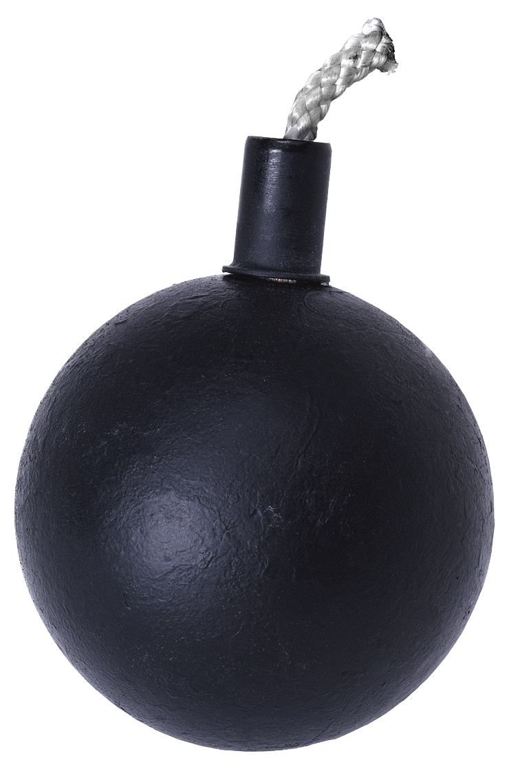
PREVENTION and intervention
BULLYING

Slide 2
BULLYING
Bullying and, in particular, cyber-bullying, is a major risk factor for suicide.
Think about it. Why is this?

Slide 3
NATIONAL STATISTICS
28% of U.S. students in grades 6-12 experienced bullying.
  9% of students grades 6-12 experienced repeated cyber-bullying (2010)
  15% of students grades 6-12 experienced repeated cyber-bullying (2013)
  55.2% of LGBTQ students experienced cyber-bullying
  Approximately 30% of young people admitted to bullying others.
  70.6% of young people say they have seen bullying their schools.
  70.4% of school staff have seen bullying.
  www.stopbullying.gov (Youth Risk Surveillance Survey/CDC)

Slide 4
TENNESSEE STATISTICS
2013-2014 BULLYING COMPLIANCE REPORT:
  10,160 Reported case of bullying
  6,959 Total number of cases indicating bullying occurred
    326 cases involved race, color, national origin
    1,329 cases involved sex or gender-based discrimination
    188 cases involved disability
    665 cases involved use of electronic technology

Slide 5
BULLYING DEFINED
WHAT IS BULLYING?
  Any act that substantially interferes with a student’s education benefits, opportunities or performance.
  The act takes place on school grounds, at any school-sponsored activity, on school-provided equipment or transportation, or at any official school bus stop and has the effect of:
    Physically harming a student or damaging a student’s property
    Knowingly placing a student or students in reasonable fear of physical harm to the student or damage to the student’s property;
    Causing emotional distress to a student or students; or
    Creating a hostile educational environment

Slide 6
BULLYING DEFINED
WHAT IF THE ACT IS OUTSIDE OF SCHOOL?
  If the act takes place off school property or outside of a school-sponsored activity, it is considered bullying if:
    It is directed specifically at a student or students, and
    Has the effect of creating a hostile educational environment or otherwise creating a substantial disruption to the educational environment or learning process.
    T.C.A. 49-6-4502

Slide 7
HAZING DEFINED
HAZING IS:
  Any intentional or reckless act, on or off school property, by one student acting alone or with others, against any other student that endangers, or that induces or coerces a student to endanger, the mental or physical health of that student.
      Does not include customary athletic events or similar contests or competitions.
      Limited to actions taken and situations created in connection with initiation into an affiliation with any organization.

Slide 8
HARASSMENT DEFINED
HARASSMENT:
  This conduct may take many forms:
    Verbal acts, name-calling
    Graphic written statements (including cell phone and internet)
    Conduct that may be physically threatening, harmful, or humiliating
    HARASSMENT creates a hostile environment when the conduct is sufficiently severe, pervasive (everywhere in the school environment/culture), or persistent so as to interfere with or limit a student’s ability to participate in or benefit from the services, activities or opportunities offered by a school.
    (Dear Colleague Letter, 2010)

Slide 9
BULLYING DEFINED
FOUR COMPONENTS OF BULLYING:
  Imbalance of power (real or perceived)
  Intent to harm
  Threat of further aggression
  Terror (not only as a means to an end, but as an end in itself)

Slide 10
WHAT CONSTITUTES AN IMBALANCE OF POWER?
Physical characteristics
Social status
Member of a minority group
A group vs. an individual
Presence of weapons
The defining questions is:
  Can the child make this stop on his/her own?

Slide 11
TYPES OF BULLYING
PHYSICAL BULLYING:
  Physical bullies use force and body strength to overpower their victims.
  Physical bullying can include kicking, hitting, punching, stealing or other physical attacks.
  This type of bullying is easier to observe than others.

Slide 12

TYPES OF BULLYING
VERBAL BULLYING:
  Verbal bullies intimidate and harm their victims using words.
  Verbal bullying includes the use of relentless insults and teasing and may include making fun of a peer’s lack of physical capabilities, appearance, school performance, SES, etc.
  This type of bullying may go unnoticed and unreported for long periods of time.

Slide 13
TYPES OF BULLYING
RELATIONAL BULLYING:
  Relational bullies work to damage a victim’s social status and relationships.
  Relational bullying is common among girls, especially teen girls.
  Bullies who practice relational bullying often do it to increase their own social standing or to control others.
  This type of bullying may go on for some time before an adult notices.

Slide 14
TYPES OF BULLYING
CYBERBULLLYING:
  Cyber-bullies use electronic forums, such as email, cell phones, and social networking sites, to harass their victims.
  Cyber-bullying allows the bully to remain anonymous. It is easier to bully in cyberspace than it is to bully face to face.
  Over 25% of adolescents and teens have bullied through their cell phones or the internet.

Slide 15
BULLYING: MYTH OR FACT
ONLY BOYS BULLY.
    Myth. People think that physical bullying by boys is the most common form of bullying; however, verbal, relational and physical bullying happen among boys and girls.
  SPREADING RUMORS IS A FORM OF BULLYING.
    Fact. Spreading rumors name calling, excluding others and embarrassing them are all forms of bullying that can cause serous and lasting harm.

Slide 16
BULLYING: MYTH OR FACT
NOTHING CAN BE DONE AT SCHOOL TO REDUCE BULLYING.
Myth. School initiatives to prevent and stop bullying have reduced bullying by 15-20%.
PEOPLE WHO BULLY HAVE POWER OVER THOSE THEY BULLY.
Fact. People who bully others usually pick on those who have less social power (popularity), psychological power (know how to harm others) or physical power (size, strength).

Slide 17
BULLYING: MYTH OR FACT
KIDS WILL OUTGROW BULLYING.
Myth. For some, bullying continues as they become older.
Children who bully are more likely to be engaged in other antisocial, violent, or troubling behavior.
BULLYING OFTEN RESOLVES ITSELF IF YOU IGNORE IT.
Myth. Bullying reflects an imbalance of power that happens again and again. Ignoring the bullying teaches students who bully that they can bully others without consequences.

Slide 18
WHAT SOCIAL AGGRESSION LOOKS LIKE
IN CHILDREN:
  Threaten to end friendships
  Huddle together
  Refuse to listen by covering their ears
  Threaten not to invite to social events
  Create secret languages
  Create exclusive clubs

Slide 19
WHAT SOCIAL AGGRESSION LOOKS LIKE
IN TEENS:
  Gossip
  Rolls eyes, laughing, dirty looks
  Ignores/silent treatment
  Rumor spreading
  Embarrass in public/practical jokes
  Become friends with another as revenge

Slide 20
WHAT SOCIAL AGGRESSION LOOKS LIKE
IN ADULTS:
  Openly dismisses other’s opinions or work
  Steals boyfriend or girlfriend
  Reduces or increases work responsibilities
  Pretends to be hurt to make another feel guilty
  Reduces another’s ability to express opinions
  Saying something hurtful that appears rational

Slide 21
IMPACTS OF BULLYING
TARGETS:
  Higher rates of anxiety
  Headaches and stomach aches
  Depression
  Changes in sleeping and eating patterns
  Physical health problems
  Low self-esteem
  Poor academic performance
  Loss of interest in activities
  Suicidal ideation
  Post-traumatic stress
  Impact into adulthood

Slide 22
IMPACTS OF BULLYING
BYSTANDERS:
  Have increased risk factors – especially for substance use/abuse
  Have increased depression and anxiety
  Miss or skip school
  Stress of fear

Slide 23
TYING IT ALL TOGETHER TO MAKE A DIFFERENCE
If you have concerns about a student, you need to consult with your school counselor and/or administrator.

Slide 24
RESOURCES
http://www.stopbullying.gov/topics/warning_signs/index.html
www.CampusSafetyMagazine.com
www.cfchildren.org/issues/bully/bullybus/index
www.csmonitorcom/2005/0419/p12s01-legn.htm
www.tolerance.org/teach/magazine/features.jsp?ar=608
http://www.bullypolice.org/
http://www.micheleborba.com/blog/2011/02/23/mobilizing-bystanders-to-stop-bullying-6-teachable-skills-to-stop-a-bully/

