Slide 1

Impact Aid Form
The What, the Why and How to fill it out.

Slide 2
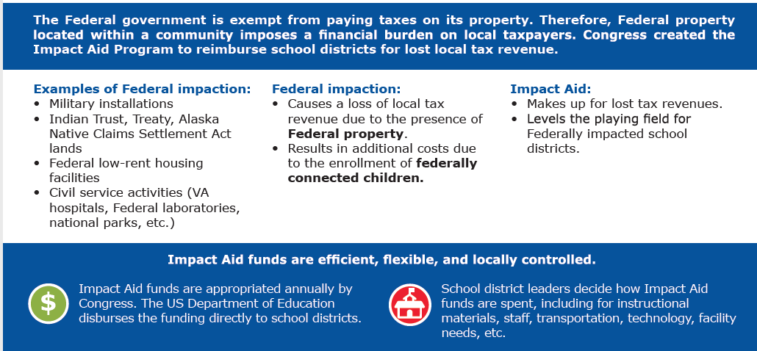

IMPACT AID OVERVIEW

Slide 3
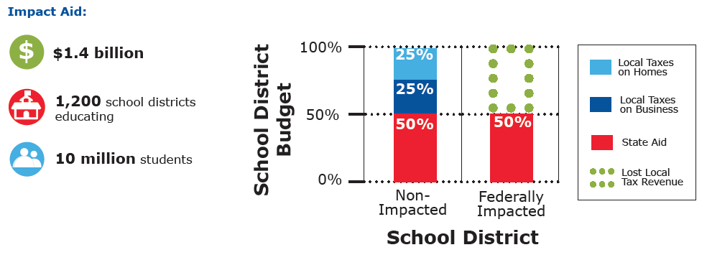

Slide 4
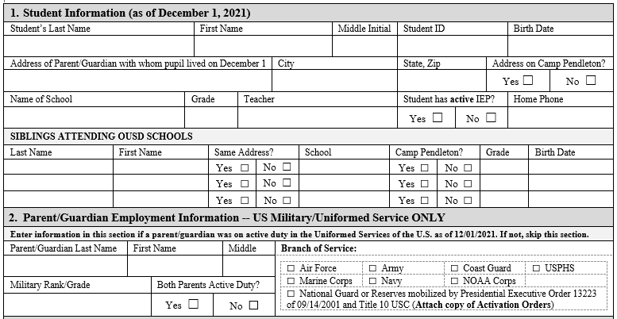
Each year school districts must provide current data to the government to show the “impact” the government land has on the district. We use the data based on a specific date or “snapshot” of the school year.

Slide 5
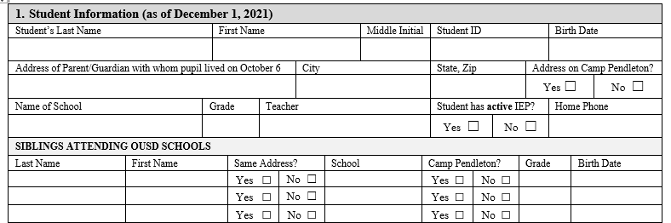
In most cases, section 1 of the card will be pre-populated with your child’s information.
Up to 3 siblings can be added to a card eliminating the need to fill out multiple cards.
Check the yes or no boxes to indicate if you student has an active IEP.
It is important that you check whether your address is located within Camp Pendleton.
* If you need to make any changes, please initial anything you mark out or change.

Slide 6
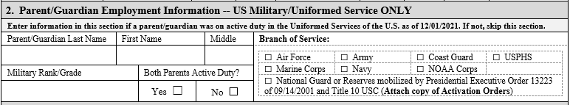
Section 2
Section 2 of the card is to be filled out by Active Duty Military members. If neither parent/guardian is active duty military, please skip to section 3.
If you are active duty military, please fill out your rank and then check the box corresponding to the branch of service. If both parents are active duty, check the yes box and try to fit both names and ranks in the boxes provided. It does not matter if the child lives with the active duty parent or not.

Slide 7
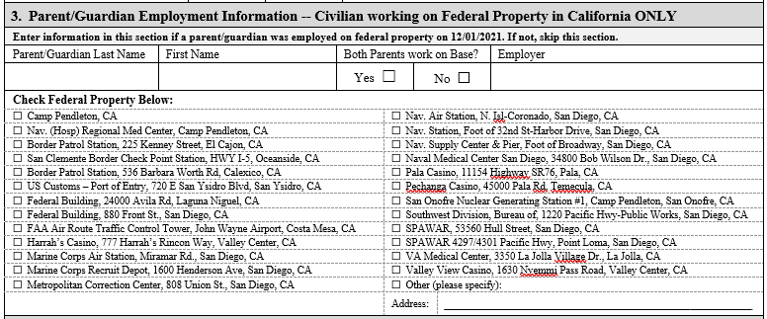
Section 3 is to be filled out if either parent/guardian works on Federal property but is not Active Duty military.
There are many more Federal properties in San Diego and surrounding counties than what is listed. If you are not sure but you think you may work on Federal land, please check the “Other” box and place the address in the line provided. Our auditors will look up the address or may contact you if they need more information.
Be sure to also include the Employer name. For example, if you check the box for Camp Pendleton then also include your employer’s name whether it be Sodexo, Lake O’Neill or a restaurant on base, etc.

Slide 8
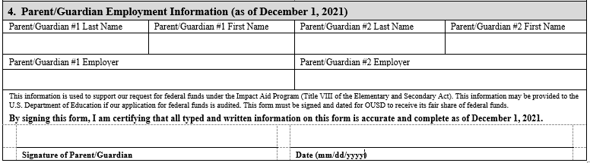
Section 4
This last section is where parents will fill out their employer name. It is helpful to fill out the address as well , especially, if you think you may have worked on Federal property on Impact Aid day. If you work for OUSD, please list the school you worked at on Impact Aid date. Our auditors will contact you if they need more information.
ANY Corrections to the form must be initialed.
Please remember to sign and date the card. The date MUST be on or after the Impact Aid snapshot date which is listed several places on the card.

Slide 9

Final step-
Please return the card to your child’s school either by dropping it off, returning with your student or mailing it back as soon as possible.
All data is compiled for the final report. Federal auditors do not see your actual card unless they audit our report and ask to view the records.
Any questions about Impact Aid or how to fill out your form can be directed to Cathy Roldan (760) 966-4013 or emailed to cathy.roldan@oside.us.

