Slide 1

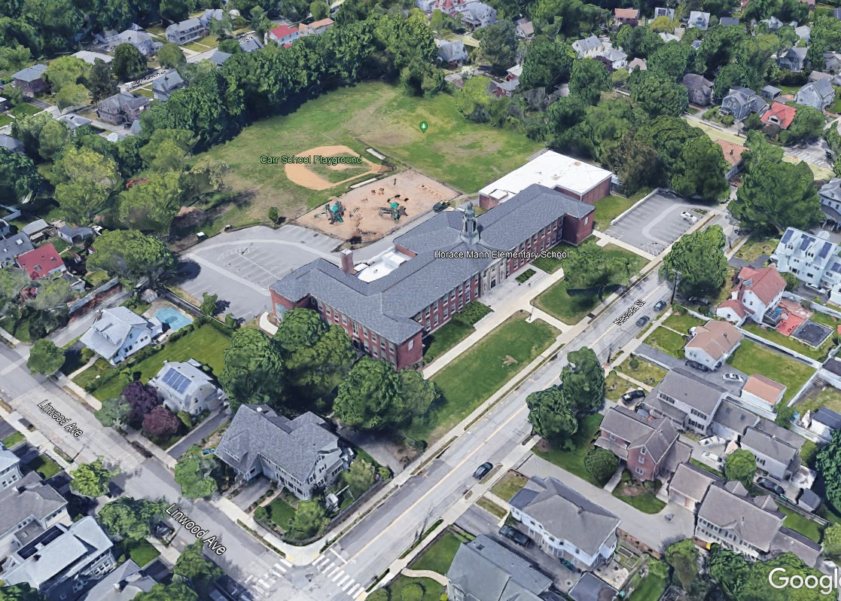
HORACE MANN ELEMENTARY SCHOOL
PROJECT
School Building Committee Meeting
January 27, 2022

Slide 2
Agenda
January 27, 2022
HORACE MANN
SCHOOL BUILDING
COMMITTEE
Introduction – Committee Membership
Project Process – Overview
Preliminary Project Timeline
Committee Role, & Approvals
Committee Organization & Recommendations
Summary of Work Completed to Date
Existing Conditions
Aligning to MSBA Space Guidelines
Site Review and Opportunities
Meeting and Milestone Dates
Next Steps - Questions & Answers

Slide 3
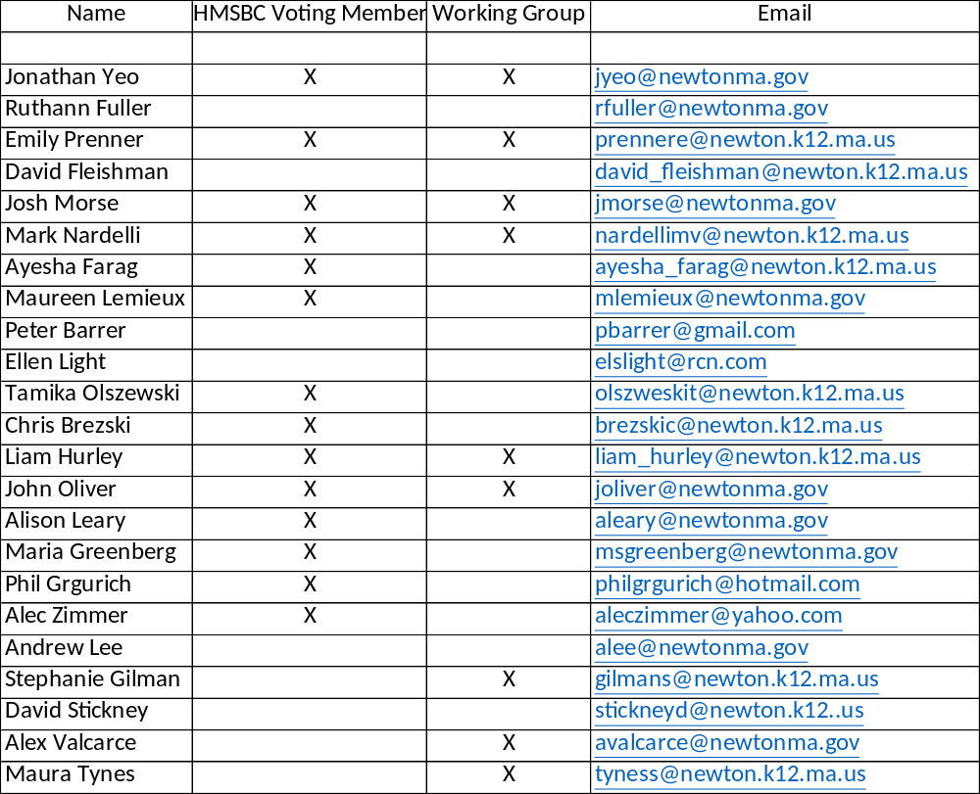
HMSBC
Committee Members
HORACE MANN
SCHOOL BUILDING
COMMITTEE
The School Building Committee composition follows the MSBA model to be consistent with Newton’s other School building projects.

Slide 4
Project Process
Overview
HORACE MANN
SCHOOL BUILDING
COMMITTEE
Duration
Team & SBC Selection
3 - months
Feasibility
Study
6 - months
Schematic Design
9 - months
Project
Funding
6 - months
Design / Documents
15 - months
Construction
21- months
Close Out
2 months

Slide 5
Project Process
Overview
HORACE MANN
SCHOOL BUILDING
COMMITTEE
TEAM SELECTION
SELECT DESIGNER – RDA SELECTED IN 2020
City advertises Request for Qualifications for Designer
Designer Selection Committee Interviews and Ranks Candidates
Mayor Selects Designer
City Negotiates Design Services Contract.
APPOINT SCHOOL BUILDING COMMITTEE COMPLETED
School Department and School Principal recommend candidates for the School Building Committee
Mayor and School Committee make appointments
Councilors and School Committee members are identified to serve on the committee
City staff appointments follow MSBA for consistency
FEASIBILTY STUDY
CONDUCT PROGRAMING / FEASIBILITIY STUDY
Designer & NPS Develop Program
School Committee to Review and Confirm Program and Enrolment
Feasibility Study Alternative Concepts are presented/discussed with the SBC
Alternatives presented to City Council and School Committee
SBC approves Preferred Alternative
DRC provides input to assist the SBC, and approves Preferred Alternative

Slide 6
Project Process
Overview
HORACE MANN
SCHOOL BUILDING
COMMITTEE
DEVELOP SCHEMATIC DESIGN / SITE PLAN APPROVAL
SCHEMATIC DESIGN
Design Team develops Final Design Program and Robust Schematic Design
Establishes Scope, Budget and Final Schedule
SBC and Design Review Committee, DRC approve Schematic Design & Site Plan
Public Facilities Committee votes on Site Plan Approval
PROJECT
FUNDING
APPROVE PROJECT FUNDING
Finance Committee votes on Funding Approval
City Council votes Project Approval
DESIGN & CONSTRUCTION DOCUMENTS
Design Team advances design and construction documents
DRC reviews project design progress
CONSTRUCTION
City with Designer monitor construction progress
PROJECT CLOSE-OUT
City with Designer perform final review and acceptance

Slide 7
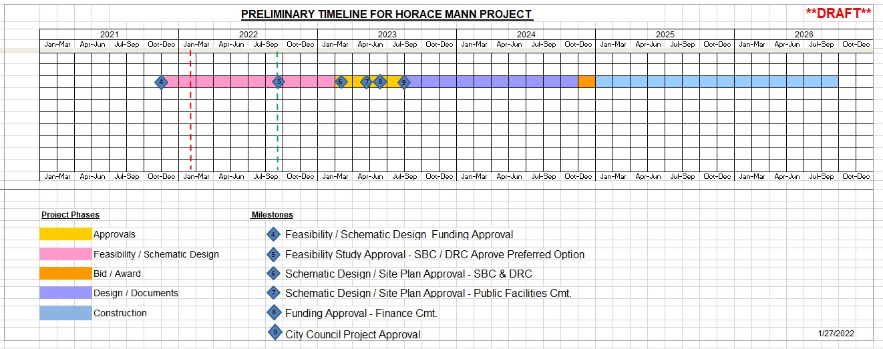
Preliminary Project
Timeline
HORACE MANN
SCHOOL BUILDING
COMMITTEE

Slide 8


School Building Committee
Role & Process
HORACE MANN
SCHOOL BUILDING
COMMITTEE
Design Review Committee
City Council
School Building Committee
School
Committee
SBC
Working Group
Executive Office

Slide 9

Feasibility & Design Approvals
HORACE MANN
SCHOOL BUILDING
COMMITTEE
Design Review Committee
City
Council
School Building Cmte
School Building Cmte
School Committee
Design Review Committee
MSBA
City
Council
SBC
Working Group

Slide 10
Working Group Versus School Building Committee
School Building Committee
Working Group Roles
HORACE MANN
SCHOOL BUILDING
COMMITTEE
School Building Committee, SBC – Appointed body made up of staff, elected officials, and residents. This committee typically meets monthly, reviews and guides the design evolution, and votes on the preferred conceptual option. These are public meetings, that are posted, joined by the Design Review Committee, and allow for public dialog. The SBC votes occasionally at key steps in the process.
Working Group – Informal steering group made up of staff and elected officials to help manage the process. This group helps to manage political and internal processes and schedules, reviews presentations prior to presenting to the public, and helps with the minutia and day-to-day grind of design and program details. This group does not vote, nor has the capacity or authority to do so.

Slide 11
Project Process
Overview
HORACE MANN
SCHOOL BUILDING
COMMITTEE
Duration
Team Selection
3 - months
Feasibility
Study
6 - months
Schematic Design
9 - months
Project
Funding
6 - months
Design / Documents
15 - months
Construction
21- months
Close Out
2 months

Slide 12
Committee Organization
And Recommendations
HORACE MANN
SCHOOL BUILDING
COMMITTEE
Committee Organization:
Determine Requirements for a Quorum
Committee Recommendations:
Determine Number of Votes Required for
Committee Recommendations

Slide 13
Committee Organization
and Recommendations
HORACE MANN
SCHOOL BUILDING
COMMITTEE
Members Required for A Quorum:
Motion:
Moved that a majority of the voting members of the Horace Mann School Building
Committee constitute a quorum.
Vote required for Approval of Matters:
Motion:
Moved that matters coming before the Horace Mann School Building Committee
that require a vote be approved by a majority of those voting members present.

Slide 14
Work to Date
Summary
HORACE MANN
SCHOOL BUILDING
COMMITTEE
April Vacation 2019
• Expansion of second floor Classroom 211 from 613 square feet to 775 square feet by ‘rightsizing’ the adjacent SPED Learning Center (Rm 210) from 528 square feet to 369 square feet.
Summer 2019
• Expansion of first floor Classroom 141 from 858 square feet to 1,012 square feet. This space was originally to be used as an Art classroom but was instead used as a Kindergarten classroom.
• Subdivision of the After-School Program space adjacent to the Cafeteria for use as the DAD Afterschool Office and Staff Room.
December 2019 – August 2020
• Expansion of second floor Classroom 202 from 723 square feet to 870 square feet.
• Creation of a Safe Room on the second floor.
• The installation of two modular classrooms and exterior connectors between the modular classrooms and the main building. This added two 919 square foot Classrooms and two 415 square foot Small Group spaces to the school, allowing for the subsequent Summer 2020 expansion of five undersized classrooms within the main building.
• Acoustical Upgrades at All Classrooms, the Cafeteria, and the Music Room.

Slide 15
Work to Date
Summary Cont.
HORACE MANN
SCHOOL BUILDING
COMMITTEE
Summer 2020
• The expansion of two undersized first floor Classrooms (116 and 117) from 724 and 773 square feet respectively to 950 and 970 square feet respectively by relocating the
Literacy/Book Room.
• The expansion of two undersized second floor Classrooms (212 and 214) from 789 and 763 square feet respectively to 950 and 960 square feet respectively by right-sizing the 737 square foot ‘break out and OT/Speech space that had been a small classroom into a 370 square foot OT/Speech small group room.
• The expansion of an undersized 734 square foot Kindergarten Classroom (102) on the first floor to 895 square feet by incorporating an adjacent Art Storage Room and Safe Room.
• The repurposing of the Teaching Supply Room on the first floor into a 222 square foot
Breakout Room that will double as a Safe Space.
• The installation of new accessible sinks at four locations along the second-floor corridor, providing water for all second-floor classrooms that had not previously been outfitted with sinks during the 2013 work (as had classrooms on the first floor).
• The replacement of two drinking fountains at the second-floor corridor with accessible drinking fountain/bottle filler stations.

Slide 16
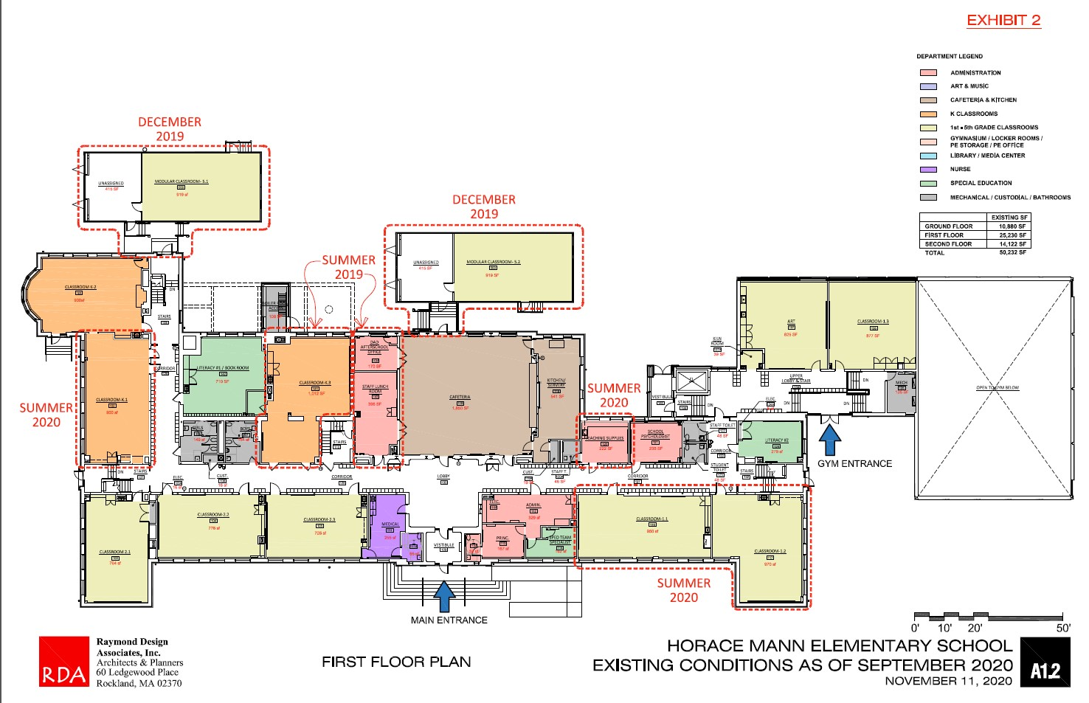
HORACE MANN
SCHOOL BUILDING
COMMITTEE
Existing First Floor Plan
September 2020
Design Enrollment Remains 396-414 Students and
18 Classrooms

Slide 17
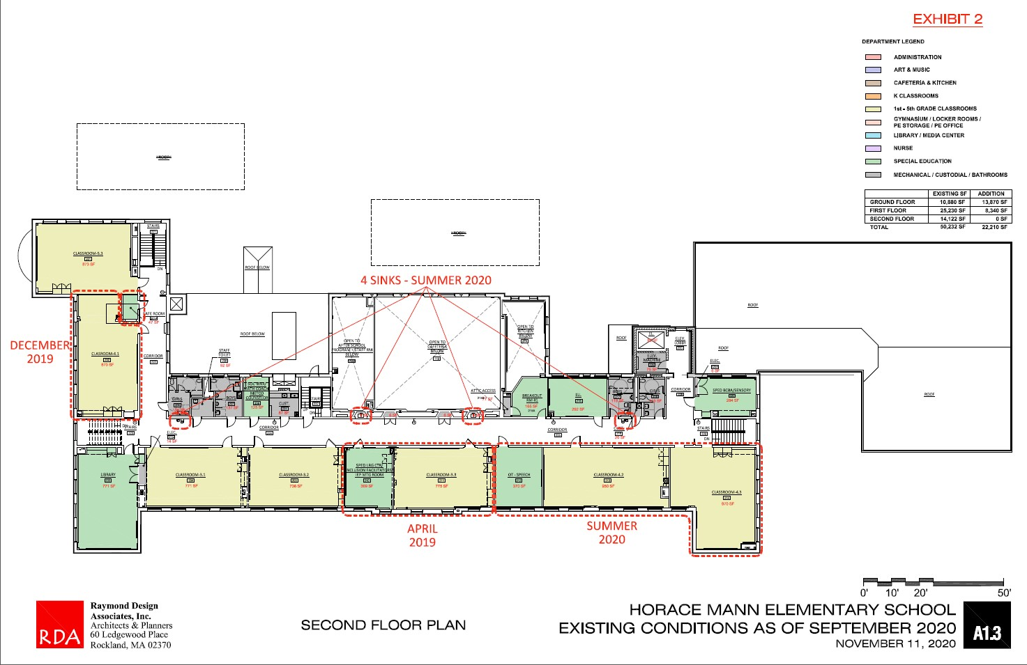
HORACE MANN
SCHOOL BUILDING
COMMITTEE
Existing Second Floor Plan
September 2020
Design Enrollment Remains 396-414 Students and
18 Classrooms

Slide 18
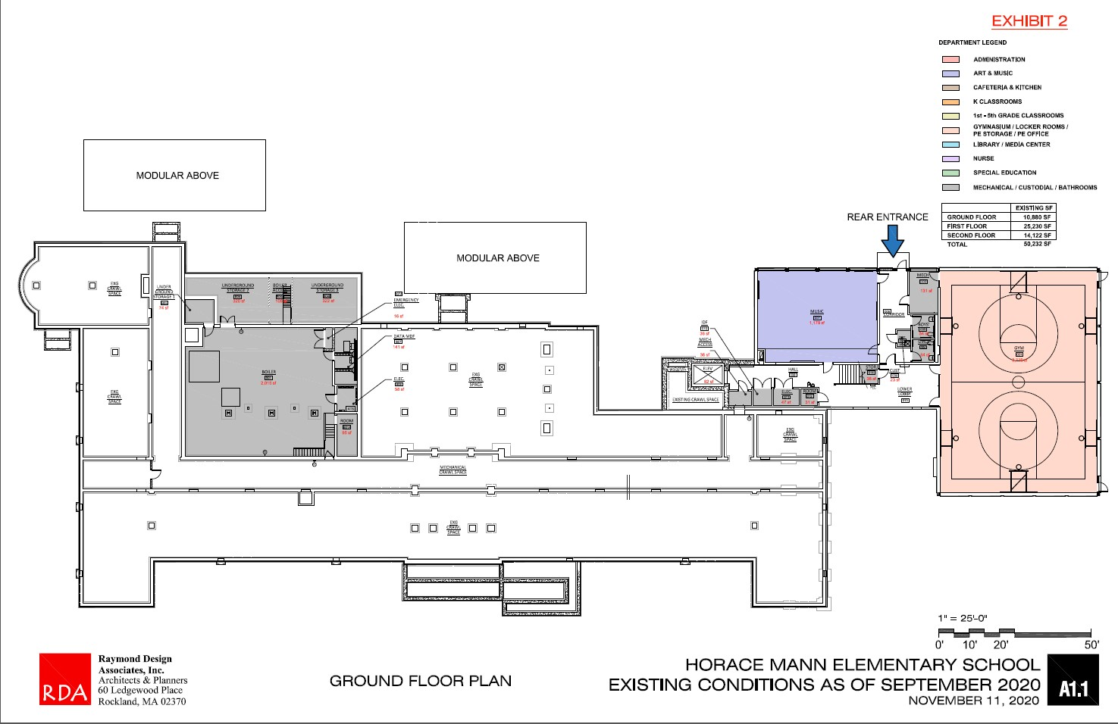
HORACE MANN
SCHOOL BUILDING
COMMITTEE
Existing Ground Floor Plan
September 2020
Design Enrollment Remains 396-414 Students and
18 Classrooms

Slide 19
Existing Conditions Versus MSBA Guidelines
Aligning to MSBA
Guidelines
HORACE MANN
SCHOOL BUILDING
COMMITTEE

Slide 20
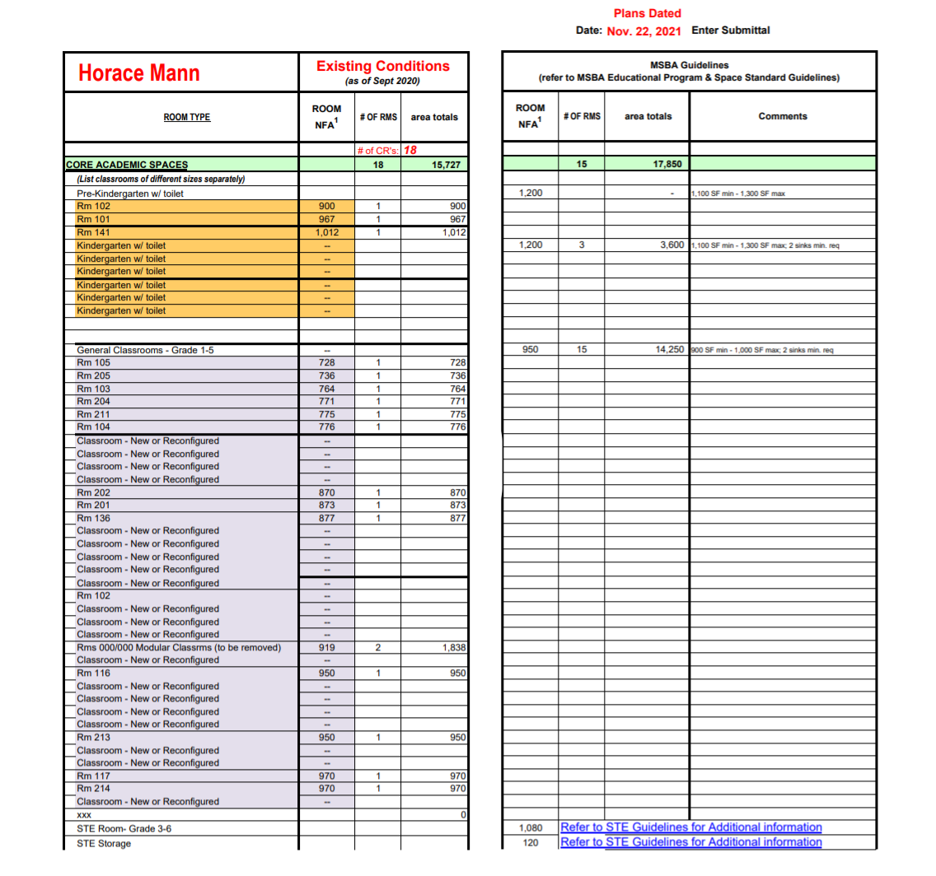
Aligning to MSBA
Guidelines
HORACE MANN
SCHOOL BUILDING
COMMITTEE
Proposed Space Summary-Elementary Schools
Proposed Space Summary – Elementary Schools

Slide 21
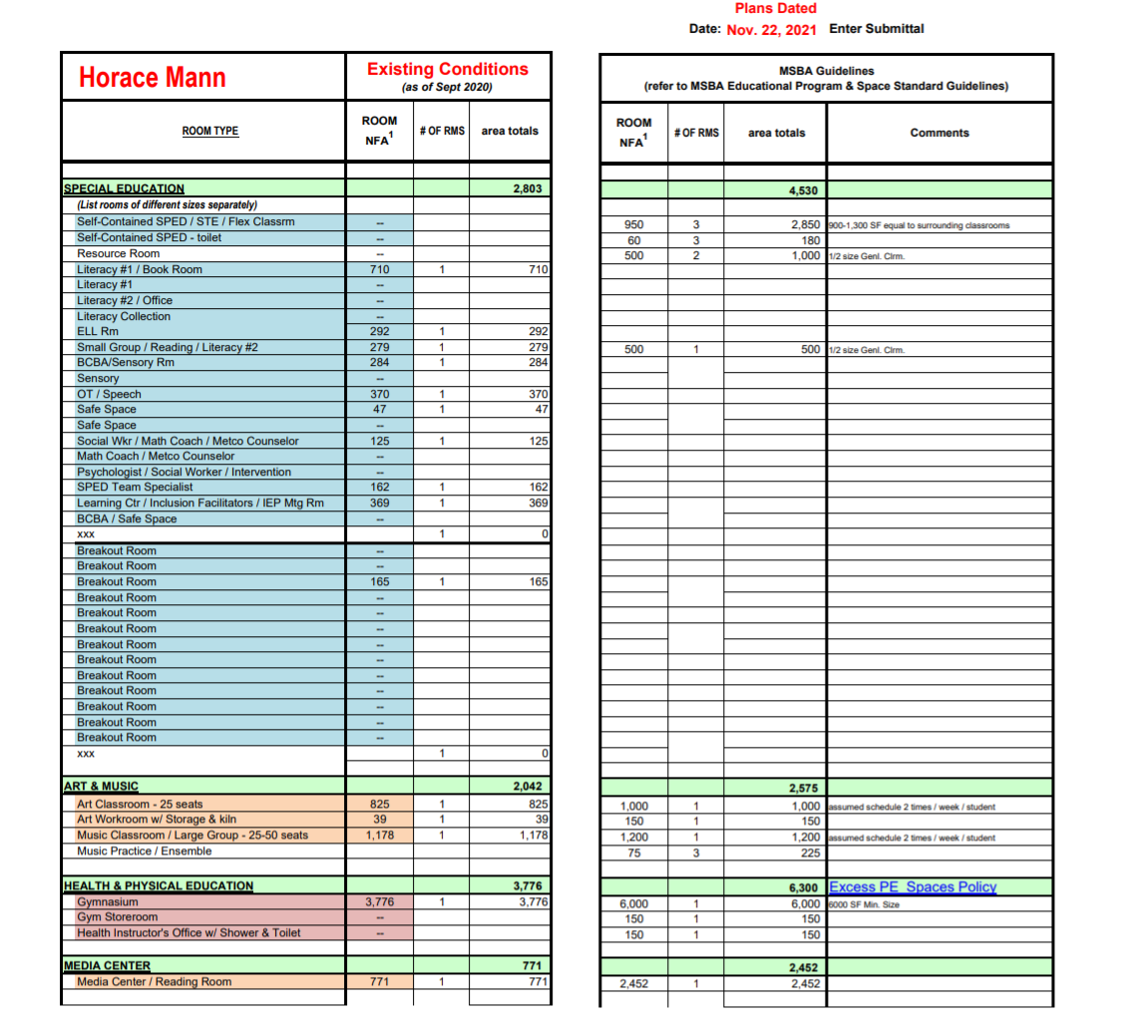
Aligning to MSBA
Guidelines
HORACE MANN
SCHOOL BUILDING
COMMITTEE
Proposed Space Summary-Elementary Schools

Slide 22
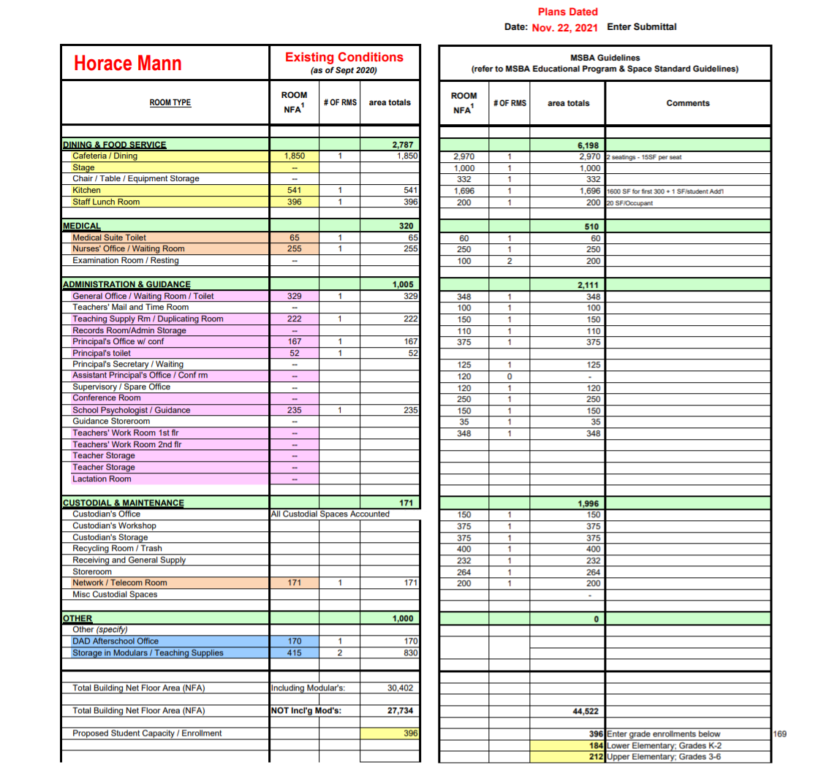
Aligning to MSBA
Guidelines
HORACE MANN
SCHOOL BUILDING
COMMITTEE
Proposed Space Summary-Elementary Schools

Slide 23
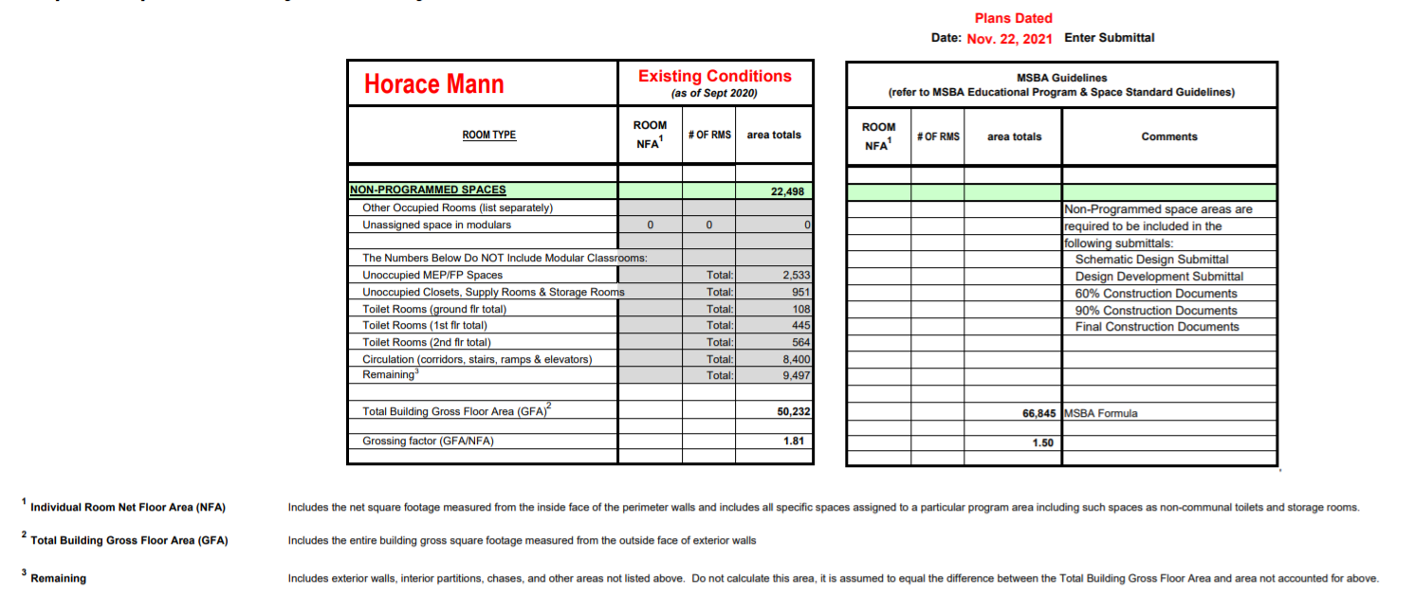
Aligning to MSBA
Guidelines
HORACE MANN
SCHOOL BUILDING
COMMITTEE
Proposed Space Summary-Elementary Schools

Slide 24
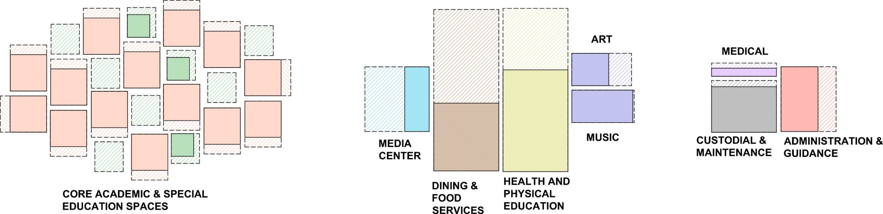
Square Footage Challenges
January 2020
K-5 + SPED Core
Academics
Admin &
Health
Specials
Art
75%
Nurse
Gym
31%
Caf
63%
45%
Music
100%
Library-
Media
Center
Admin
Existing: 18,530 sf
MSBA: 22,380 sf
Existing is 83% of MSBA
3 K’s < 1,200 sf
6 Grade 1-5 CR’s < 850 sf
SPED is 1,500-2,000 sf shy
Breakout Space Needed
Existing: 1,325 sf
MSBA: 2,621 sf
Existing is 50% of MSBA
Exist
Existing: 9,376 sf
MSBA: 17,525 sf
Existing is 53% of MSBA
Overall 27,734 Net Square Feet
= 62% of 44,522 gsf MSBA
Overall 50,232 Gross Square Feet
=75% of 66,845 gsf MSBA
**NOTE: MSBA Guidelines are often applied to schools of higher enrollments. We still need to work with NPS, HM Staff,
and the Community to align project goals with enrollment and the specific needs of the Horace Mann School.

Slide 25
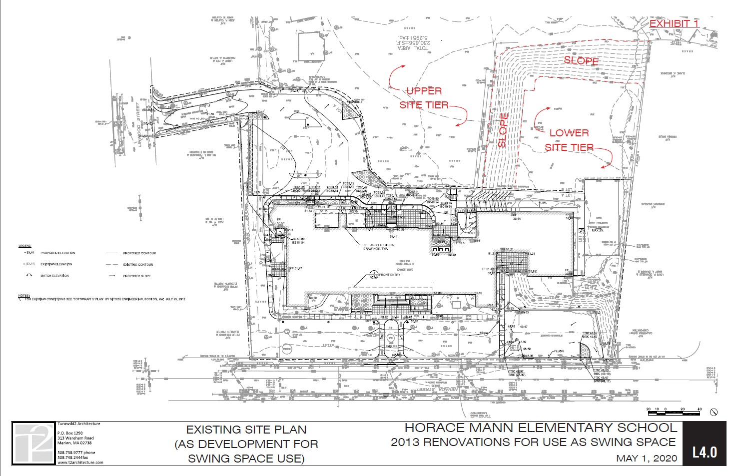
Site Review and Opportunities
HORACE MANN
SCHOOL BUILDING
COMMITTEE

Slide 26
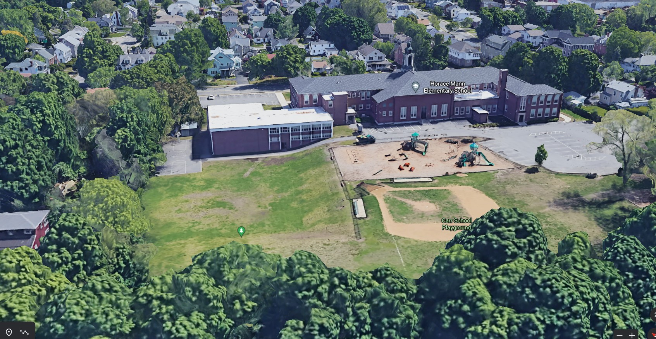
HORACE MANN
SCHOOL BUILDING
COMMITTEE
Site Review and Opportunities
(Image is Prior to Modular CR Installation)
Lower Site Plateau

Slide 27
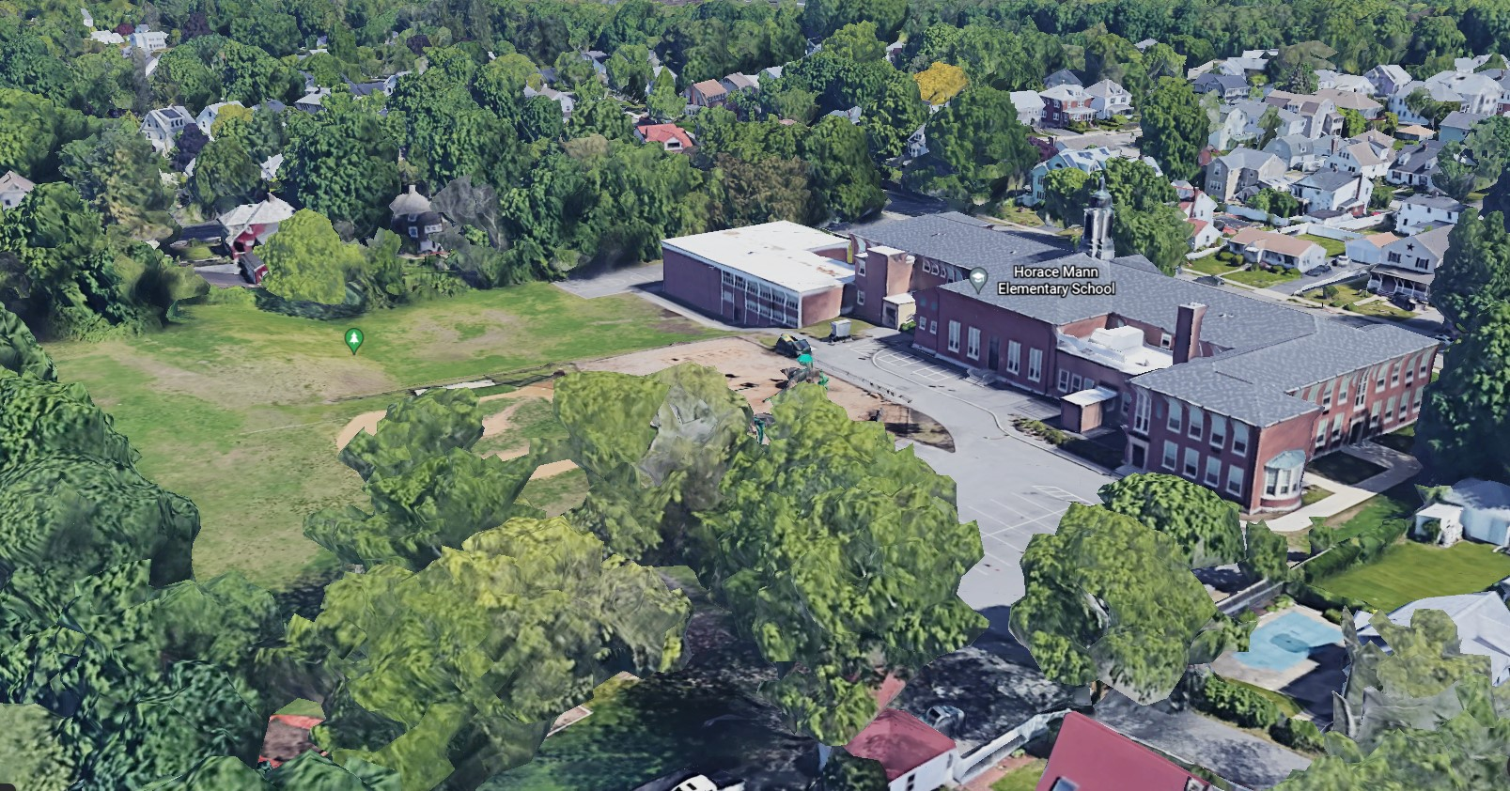
HORACE MANN
SCHOOL BUILDING
COMMITTEE
Site Review and Opportunities
(Image is Prior to Modular CR Installation)

Slide 28
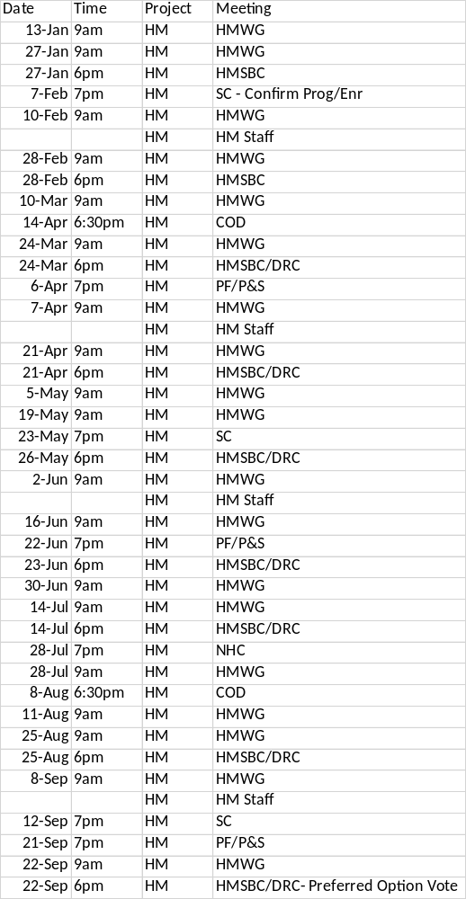
Feasibility Meeting and
Milestone Dates
HORACE MANN
SCHOOL BUILDING
COMMITTEE
What’s Ahead?
HOLD ON TIGHT!

Slide 29
Next Steps
Questions & Answers
HORACE MANN
SCHOOL BUILDING
COMMITTEE
Next Steps:
Feasibility Study Kick-Off January-February 2022
Questions and Answers:
Information and Updates:
Project E-Mail HoraceMann@newtonma.gov
Contact
Josh Morse or Alex Valcarce
Newton Public Buildings
617 796 1600
Meeting Concluded:
Thank You for your Participation

Slide 30
HORACE MANN ELEMENTARY SCHOOL
PROJECT
School Building Committee Meeting
January 27, 2022

Slide 32


School Building Committee
Role & Process
HORACE MANN
SCHOOL BUILDING
COMMITTEE
Design Review Committee
School Building Committee
City Council
Executive Office
School
Committee

Slide 33
Selection of
Designer
HORACE MANN
SCHOOL BUILDING
COMMITTEE
City Council
Executive Office
Selects & Negotiates
School Building Cmte
Designer Selection Cmte
School
Committee
MSBA
Working Group

