Slide 1



Getting the MOST out of the Media Center
-Mr. Hinz

Slide 2
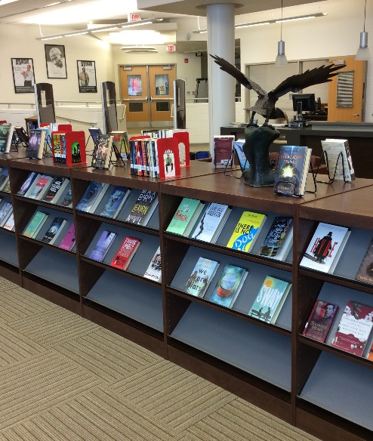

Inside the Media Center
Printing assignments
Taking out a Book
H/W or Studying
Collaborate with other students
Place to relax after school

Slide 3

Research Time
STOP USING WIKEPEDIA
AND ONLY RELYING ON GOOGLE
Use the following
EBSCOHOST
PROQUEST
JSTOR
All housed within MACKIN
for seamless use without a password

Slide 4

Useful Links
Media Center Home Page check us out
https://www.monroe.k12.nj.us/domain/173
Mackin Via eBooks-Databases-and More
https://monroe.mackinvia.com/

Slide 5

Survey
https://forms.gle/Da6UtuMgwwmmojjE6

