Slide 1


Voices of the Past Speak to the Future Veteran’s Oral History Project
Army Heritage Center
Foundation

Slide 2
1940:
World War II and Korean War Veterans’ Background
Lt Col (Ret) Clarence Bouchat
Silver Springs Veterans Memorial Committee
bouchatc@hotmail.com

Slide 3
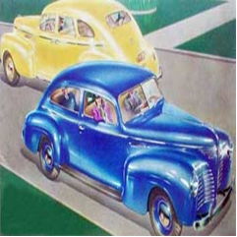
America in 1940
- People
- population: 132 million
- 42% rural
- life expectancy: 63 yrs
- new: penicillin, plasma
- End of the Depression
- Economy size: $101 billion, or $765 /person
- 28% farmers, 32% factory–few women worked
- 32% graduate high school, only 5% college
- car: $800, gas: 18c/gl, teacher earns: $1374/yr
- new: PA Turnpike first US super highway

Slide 4
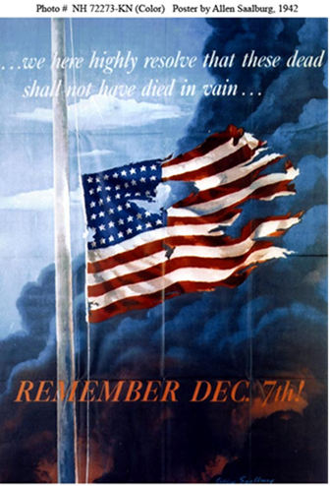
America in 1940
- Entertainment:
- Music: Bugle Boy http://www.last.fm/music/The+Andrews+Sisters/_/Boogie+Woogie+Bugle+Boy
- Movies: Pinocchio
- Olympics: cancelled
- newspapers and radio
Politics
- Alaska/Hawaii not states
- Japan in China
-- Germany in France
- Selective Service Draft
- Roosevelt elected to third term as president

Slide 5
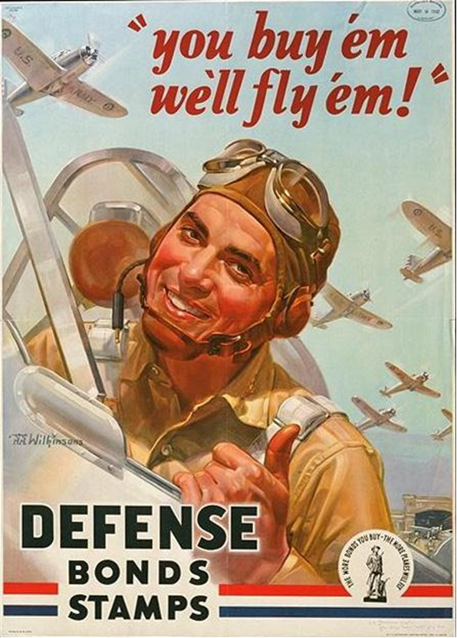
OHP Veterans Background
- Combat Veterans
- 8 WW2:Pearl Harbor, Iwo Jima
D-Day, 2 bomber pilots, POW
- 1 Korean War
Only 10% in combat
- medical, maintenance, trainers
The generation that built!
- GI Bill sent many to college
- Inter-states, moon missions,
reversed Jim Crow, cured polio
- Korea was the forgotten war, start of Cold War
Notes:
Ferri - Omaha Beach
Gentile – WW2 and Korea
Heim – Pearl Harbor, B-17 and B-29 over Japan
Hurne – in Russian Zone of German
Mattson – B-25 North Africa and Italy
Moran – Iwo Jima
Richwine - POW
Donofrio Op Torch, Omaha Beach, Bulge, Inchon, Yalu
Ferri Omaha Beach
Heim B-17, B-29 Pearl Harbor
Kusnir POW
Lockard 1 of 2 radar operators at Pearl Harbor
Massey Navy LST, wheel chair and speech machine
Mayberry Bulge POW
Miller B-29 A/C commander
Neumyer USN invasions of Marshalls, Palau, Marianas
Olsen, Europe POW
Troutman, Marine in Korean War air wing

Slide 6
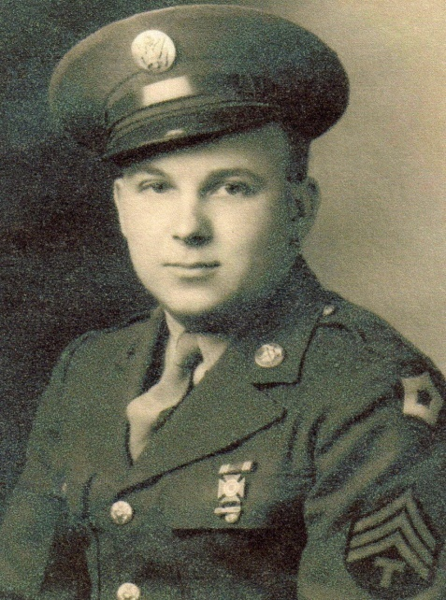
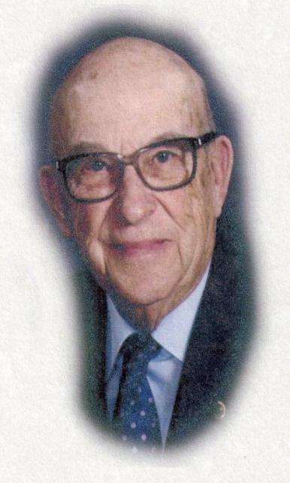
OHP Veterans Today
- Today how old is a soldier who was 18 in 1942?
- not as technology savvy as you
- plagued by old age aliments, or old war wounds
- may be irritable: not as strong or independent
- some will confuse events, 70 years later
- some may become incapacitated or die
TSgt Richard C. Smith, US Army, WWII

Slide 7
Interacting with Veterans
- Be patient and accommodating
- ask about training, duties, what it meant to serve
- be prepared, respectful, reliable, punctual
- for some this will be first time talking about war
- communicate often – use postal mail too!
Start with prepared questions then ad lib
  Use AHEC overview questions given to you
  Record music from that era and play to start meeting
  Ask to see photos or memorabilia and ask questions

Slide 8
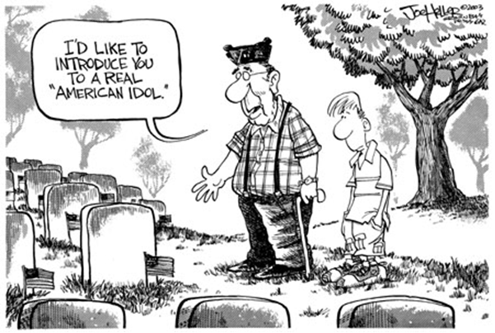
Any Questions?

