Slide 1


Voices of the Past Speak to the Future Veteran’s Oral History Project
Army Heritage Center
Foundation

Slide 2

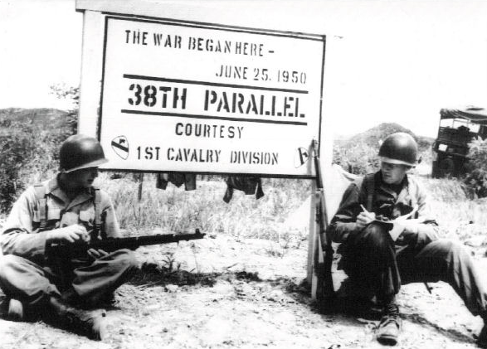
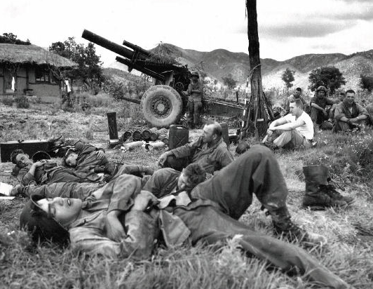
How to Conduct Interviews
Equipment
  Digital audio or video
  External microphone
Please do not use:
  Mini or micro audiocassettes.
  Built-in camera or recorder microphone unless necessary
Test all equipment before using.
Test equipment immediately prior to starting the interview to make sure the setup works.
Double check your equipment is running before starting the interview.

Slide 3
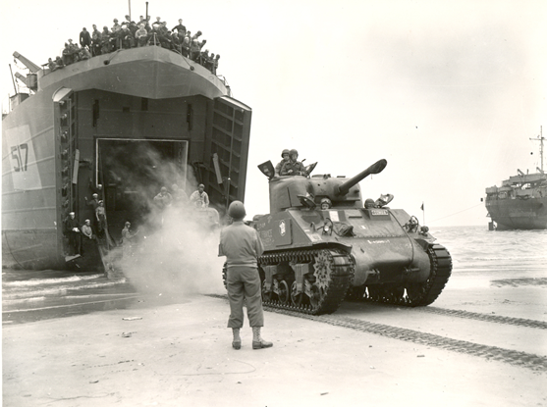
How to Conduct Interviews
Where to Interview
  Interview the Veteran in a quiet area with soft surfaces (carpeting, upholstered furniture) for better sound quality.
  The Veteran should be in a fixed seat, not a rocking chair or a recliner.
  Avoid background noises: chiming clocks, air vents, air conditioners, ringing telephones, TV’s, radios, computers, and noisy pets. Even soft noises you can barely hear can cause a loud noise in the recording.
  Set the microphone 6-12 inches from the Veteran.
  Focus the camera on the Veteran’s upper body,
  Do not use the zoom feature.
  Test your equipment for sound levels to make sure the setup produces an audible recording,

Slide 4
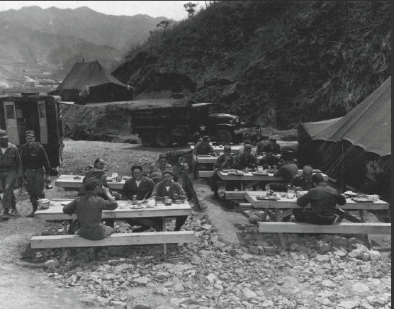
How to Conduct Interviews
Before you start
  Learn about your Veteran’s experiences and research his or her background.
    If you know your Veteran served in a particular battle or campaign, research it.
  Ask the Veterans if he or she has any materials to bring to the interview.
    Personal photographs, letters, military records, personal items, and other memorabilia may help jog the Veteran’s memory.
  Work with the Veteran to complete the Biographical Data Form and other paperwork.
  Have a conversation with your Veteran before you start recording to help you all relax.
  Everyone should use the restroom to avoid unnecessary interruptions.

Slide 5
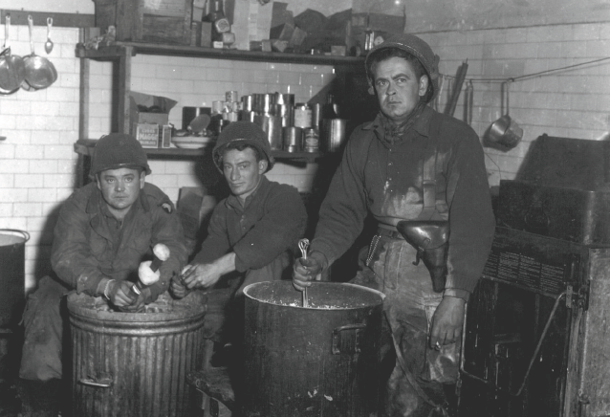
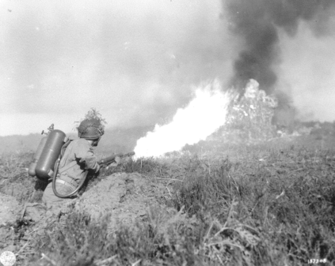
How to Conduct Interviews
Conducting the Interview
  At the beginning of the interview announce the following after starting the recording:
    The Veteran’s name.
    His or her birthdate.
    War served in and branch of service.
    Highest rank achieved.
    Date and place (town and state but not address) of recording
    The interviewer’s name and relationship to the interviewee.
    The names of anyone else present.
  Keep your own comments to a minimum and let the Veteran do the talking.
  Do not interrupt.
  Keep the interview moving. However if the Veteran is telling a significant story do not push.
    If the interview seems to be bogging down simply ask another questions.

Slide 6
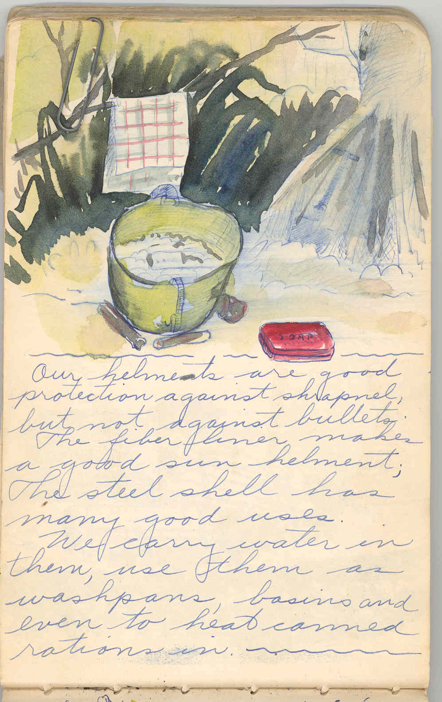
How to Conduct Interviews
What to ask:
  The USAHEC Veteran’s Surveys contain carefully designed questions.
  The survey provides an outline, you do not need to ask every question.
  Provide the Veteran a copy of the survey they can fill out if they want to.
  Listen to the Veteran’s responses and ask for clarification on any points you don’t understand.
  Generally you want to cover:
    Basic biographical data
    Early days of service: enlistment/draft/training
    Wartime service: unit/location/buddies/communication with home/recreation
    Homecoming: end of war experience/reception/contact with fellow veterans
    Reflections on value of service and lessons learned

Slide 7
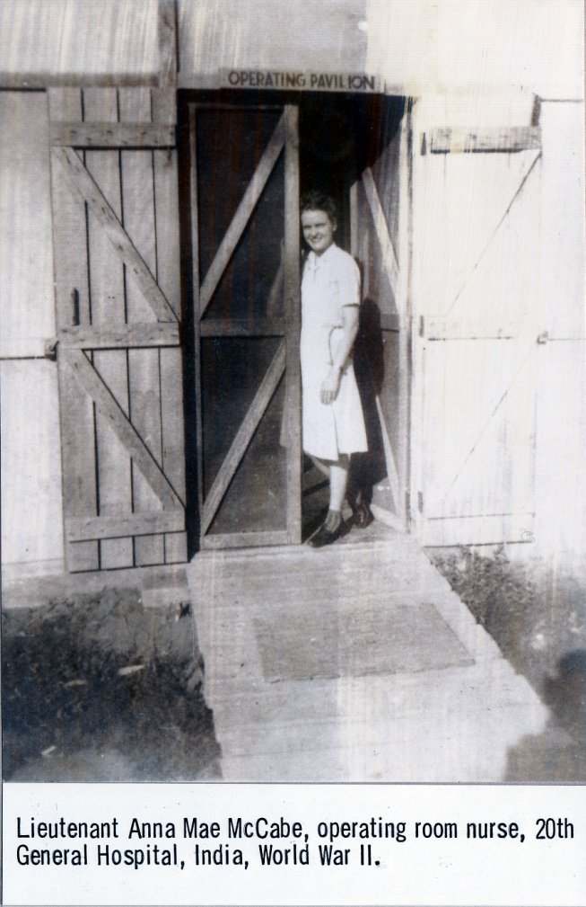
How to Conduct Interviews
Issues during the interview:
If the Veteran becomes emotional:
  Allow the Veteran time to work through the emotions.
  Pause the recording if necessary.
If the Veteran wants to stop the interview:
  Stop the interview
  Thank the Veteran
  Ask if the veteran would like to resume at a later date
  If not, ask if you may use the material you have gathered so far
If you become emotional and/or need to stop the interview:
  If you need a brief break pause the recording and excuse yourself
  You may say “Your story is very powerful and I need some time to thing about it before I’m ready to continue.”
If you need help with any issues that arise during the interview process please seek assistance from your teacher.

Slide 8
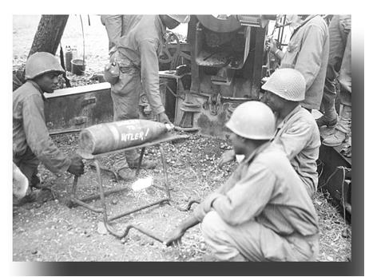
How to Conduct Interviews
Historical accuracy
  Memory is fallible
  These events occurred 50 - 70 years ago.
  Many of the Veterans have never spoken about their experiences.
  Your job does not include correcting or confronting a Veteran if their story strikes you as historically inaccurate.
  Try to keep the focus on their personal experiences, not their understanding of the broad historical picture.
  If you find something that does not seem right bring it to your teacher’s attention.
  A few minor inaccuracies do not invalidate the entire interview.

