Slide 1
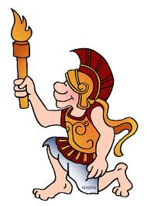
Ancient Greece

Slide 2
The Minoans
Named after King Minos
Lived on the island of Crete (3000-1100 B.C.)
Accustomed to comfort, luxury, and beauty
Influenced trade and colonization
The Myceneans
1600 B.C. to 1200 B.C.
Defeated Troy in the Trojan War

Slide 3
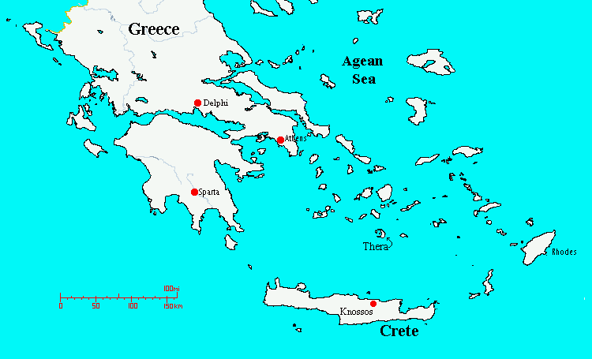

Slide 4
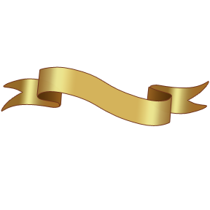
The Dark Age
The 300 year period after the fall of the Mycenean civilization
Dorians invaded Greece
Greeks Adapted the Phoenicians’ written signs to create the first true alphabet
Greece was not politically unified
This period was called “The Dark Age” because no written evidence exists from it

Slide 5

Greco- Persian Wars
Athens and Sparta were two powerful city-states
Defeated the Persians
Success in defeat credit is given to Athenians win at the Battle of Marathon and the Battle of Salamis

Slide 6
Pericles and the Golden Age of Athens
Athenian empire rose due to their role in the war
Athenian democracy experienced a Golden Age under Pericles
He fostered high ideals/ impressive new public architecture and art
Sparta, Athens’s greatest rival, was a totalitarian society who had a strong and disciplined army
Sparta controlled most of the city- states in Peloponnesus map

Slide 7
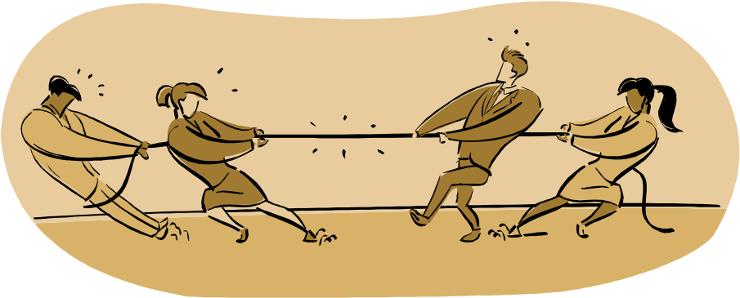
The Peloponnesian War
Greece was divided between Athens and Sparta
The two city-states fought each other in the war
Sparta won

Slide 8
Alexander the Great
After the defeat of Athens, it was Macedonia instead of Sparta that emerged powerfully
Macedonia was ruled by King Phillip, father of Alexander the Great
Alexander the Great was known for his military skills
Alexander’s armies spread Greek language and culture throughout what is today known as Egypt, Turkey, Iraq, Iran, and India

Slide 9

Greek Religion: The Gods
Gods were personifications of war, plague, love, the sea… etc
The Greeks held festivals in order to honor the gods (Zeus in the Olympic Games)
Gods often intervened in the lives of the mortals
Gods gave true signs, but it was the nature of mortals to misinterpret those signs

Slide 10
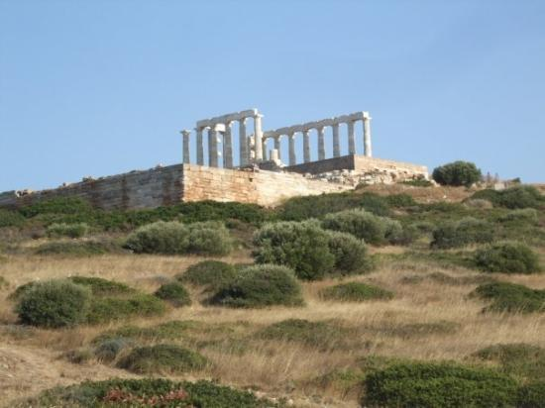
The Delphic Oracle
Mouthpiece for the God Apollo
Located in the city of Delphi on Mount Parnassus
People would come to ask questions about war or other political questions map

Slide 11

Greek Philosophy
Socrates
-uncovered truth by asking probing questions
Plato
- envisioned a realm of changeless, perfect forms
Aristotle
-pioneered subjects of logic, zoology, and psychology

Slide 12
On your index card…..
3 things you have learned today
2 things you found interesting
1 question you still have

