Slide 1
The Epic

Slide 2
What is an epic?
“An epic is a long narrative poem about a larger-than-life hero who is engaged in a dangerous journey, or quest, that is important to the history of a nation or people” (14)

Slide 3
Types of Epic
Folk Epic
Literary Epic
Originally recited or sung as entertainment
Passed down orally
Specific author

Slide 4
Elements of the Epic
Epic Hero
Epic Conflict
Heroic Quest
Divine Intervention

Slide 5
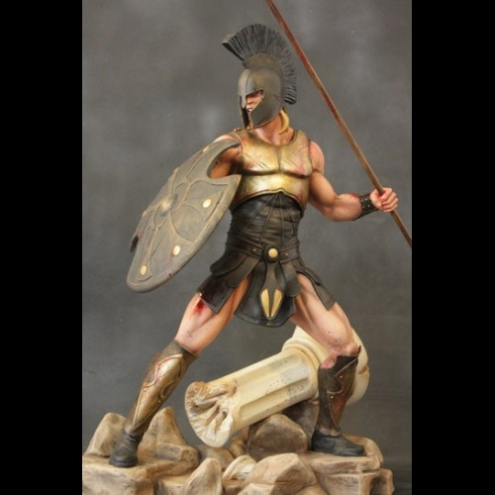
Epic Hero
Main character of an epic
Holds high status in society
Characteristics:
  Strong
  Brave
  Loyal

Slide 6
Epic Conflict
The struggles and obstacles that the hero has to endure in the plot.
Hero eventually proves his strength, loyalty, and wisdom upon completion of the conflict

Slide 7
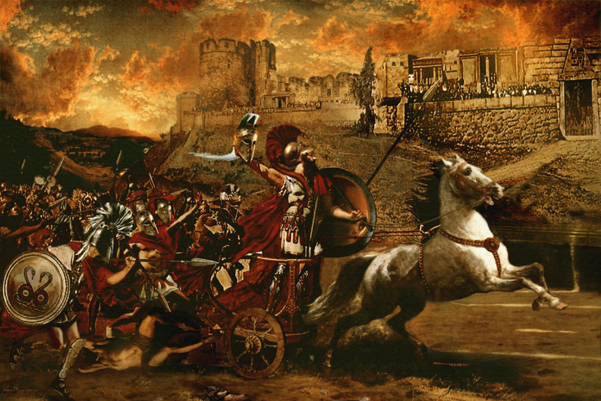
Heroic Quest
The journey that the hero takes in search of something of value to his people

Slide 8
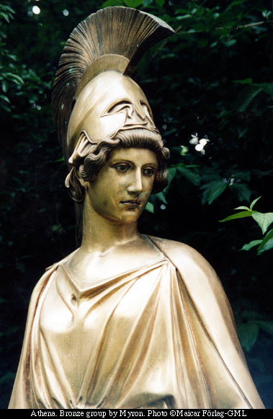
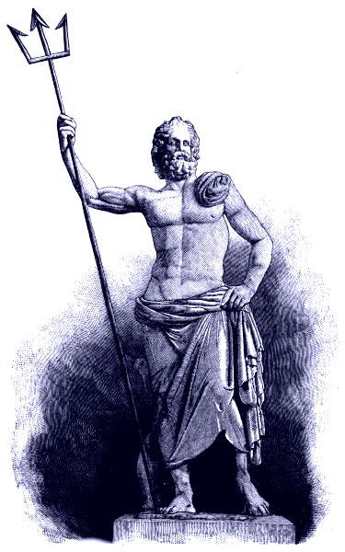
Divine Intervention
Hero receives help from a god or other supernatural force
Another god may also work against the hero

Slide 9
Works Cited
http://www.arhstatues.com/index.php?route=product/product&product_id=47
http://www.wikishareideas.com/adminsarticle/iliad
http://www.citelighter.com/history/history/knowledgecards/athena
http://www.greek-islands.us/greek-gods/poseidon/poseidon.jpg

