Slide 1
Unit 1:
Limits
The foundation of calculus

Slide 2
Lessons
1.2 Definition of a Limit (Graphically and Numerically)
1.3A Evaluating Limits Analytically
1.3B Properties of Limits
1.3C Special Trig Limits
1.5 Infinite Limits (Vertical Asymptotes)
3.5 Limits at Infinity (End Behavior)
Review on Limits
1.4 Continuity
1.5 Continuity and Limits
Review

Slide 3
1.2 Definition of a Limit
What is a Limit?

Slide 4
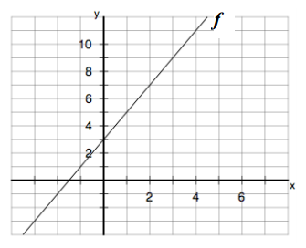



The Idea of a Limit
The graph of f(x)=2x+3 is shown to the right.
What happens to f(x) as x gets close to 3?
From the left
From the Right

Slide 5
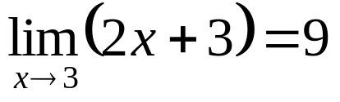
The Idea of a Limit
Since in our previous example, as x got closer and closer to 3 from the left and right hand sides, the y value got closer and closer to 9, we say that
The limit of f(x)=2x+3 as x approaches 3 is equal to 9 or…

Slide 6
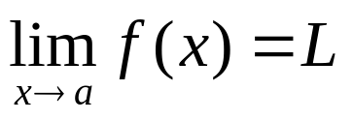
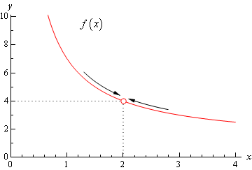
Definition of a Limit
As x approaches a, the limit of f(x) is L
As x gets close to some number a, y (or f(x)) is approaching some number L.
Limits give us an idea of what y-values graphs are heading towards around certain x values.

Slide 7
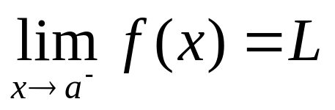
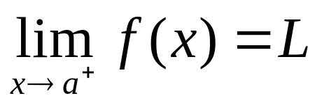
One Sided Limits
The limit as x approaches a from the left
The limit as x approaches a from the right
For a limit to exist both the limit from the left AND the right must be the same

Slide 8
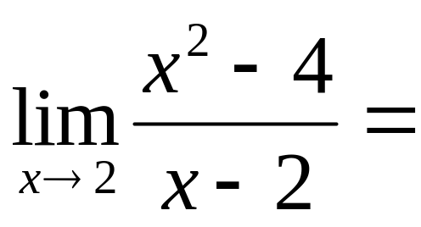
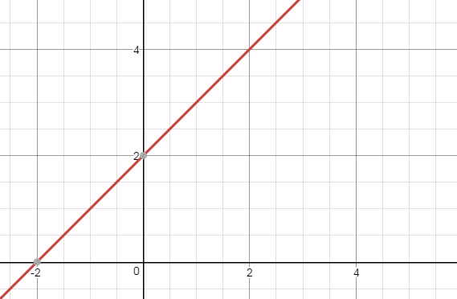
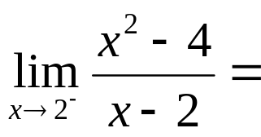
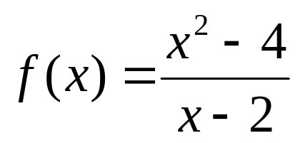
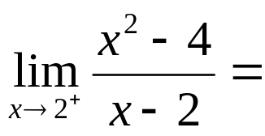
Find
Step 1: Find the y-value as x approaches 2 from the left
Step 2: Find the y-value as x approaches 2 from the right
Step 3: If both y-values are the same,
that y-value is the limit!

Slide 9
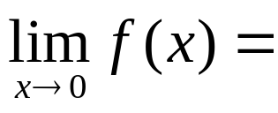
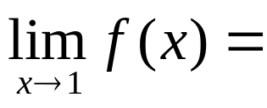
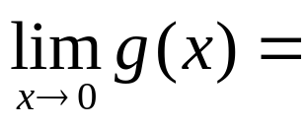

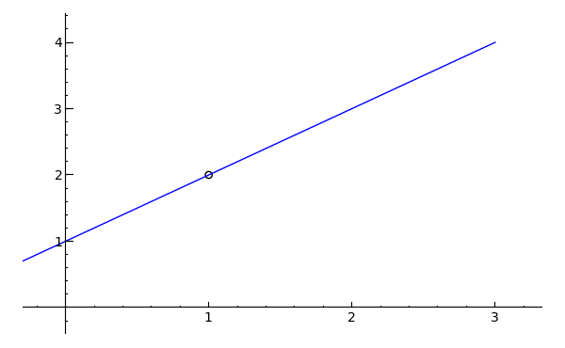
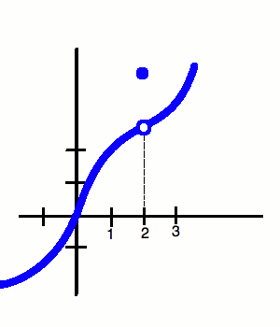
Find Each Limit

Slide 10
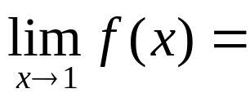

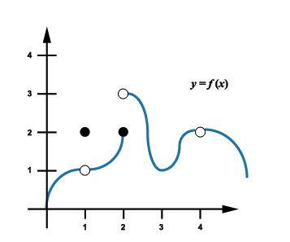


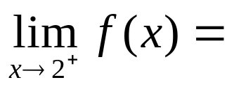
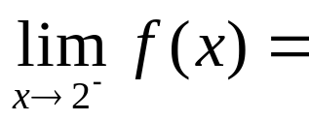


Examples
1)
2)
3)
4)
5)
6)
7)
8)

Slide 11
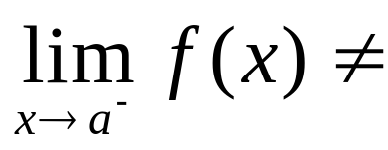
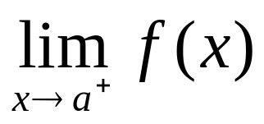
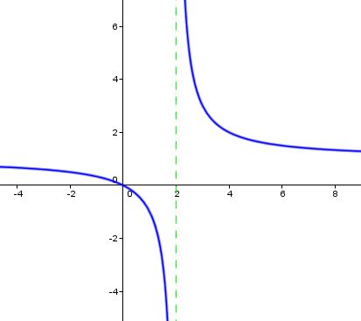
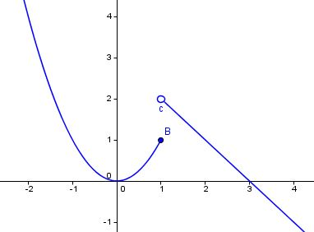
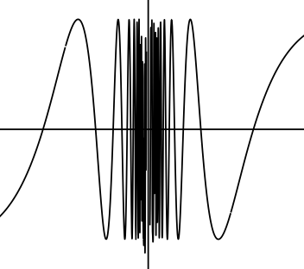
When a Limit Does Not Exist
If a limit approaches different y-values from the left and right then the limit
“does not exist.”
Limits that go to infinity also do not exist. Write the answer as ∞ or - ∞.

Slide 12
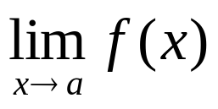

In summary
The limit of f(x) as x approaches some number a is written as
The answer to a limit problem is…
  A y-value: If the graph approaches the same y-value from the left and right
  DNE: If the graph does not approach the same y-value from the left and right
  if both sides head towards negative or positive infinity from the left and right. Limits that go towards infinity Do Not Exist.

Slide 13
Homework
  HW 1.2: pg 54-58 #9-16, 25, 26, 49-52 (Just graph to find limits, don't write paragraph)

Slide 15
1.3A Evaluating Limits Analytically
How do we evaluate limits using algebra?

Slide 16
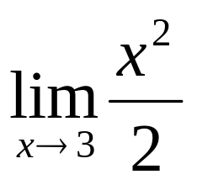
Another way to find limits
We don’t always have a nice graph of the function readily available to us.
When this is the case oftentimes it is helpful to take limits without having to graph them.

Slide 17
Methods we will talk about Today
Plan A: Direct Substitution
Plan B: Algebraic Simplification
Plan C: Multiply by Conjugate (Rationalizing)
Plan D: Piecewise Functions

Slide 18
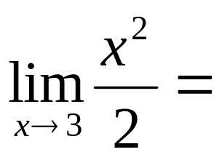
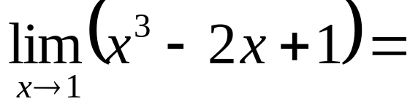
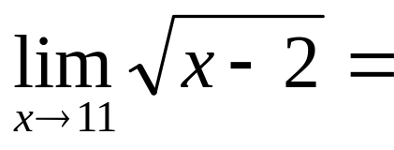
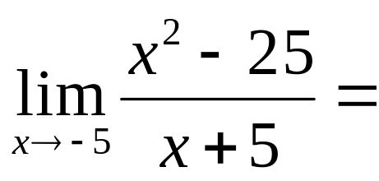
Plan A: Direct Substitution
Just plug in the value for the limit and see if you get a defined value!

Slide 19

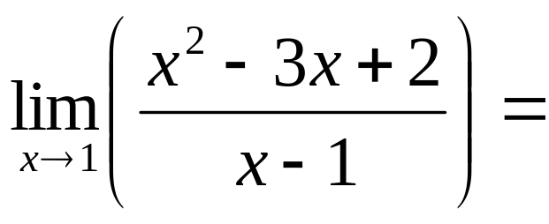
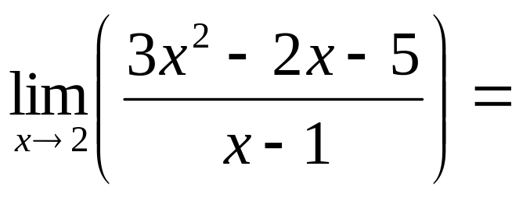
Plan B: Algebraic Simplification
If you end up with try to factor and get something to cancel so you can use direct substitution.
*

Slide 20
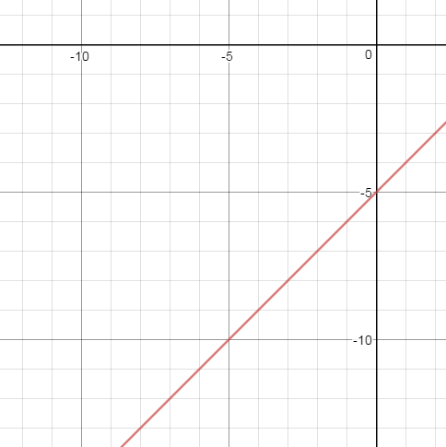
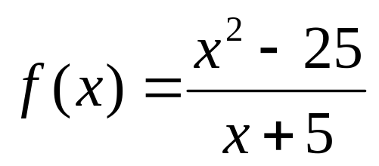
A hole or removable discontinuity
Removable Discontinuity: A point at
which a graph is not connected but
can be made connected by filling in
a single point. (Same as a “hole” on
a graph)
How can we rewrite f(x) as a simpler function?
f(x)=___________

Slide 21
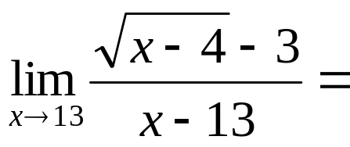
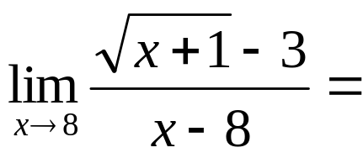
Plan C: Multiply by Conjugate (Rationalizing the Numerator)
If you end up with and there is nothing to factor, try multiplying by the conjugate if you have square roots in the numerator.

Slide 22
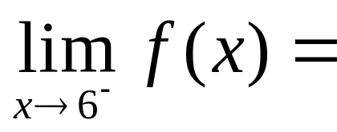
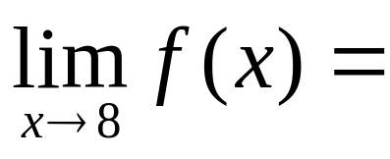
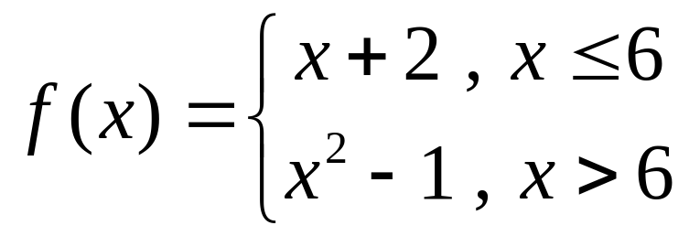
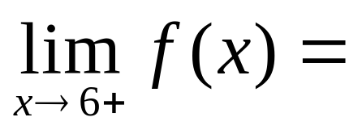

Plan D: Piecewise Functions
When taking limits of a piecewise function, use direct substitution on both parts of the graph if you want to take the limit of where the function switches over.

Slide 23
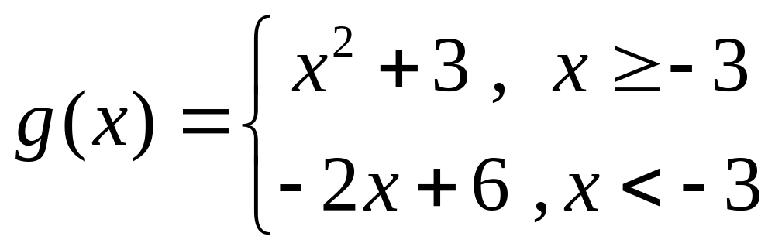
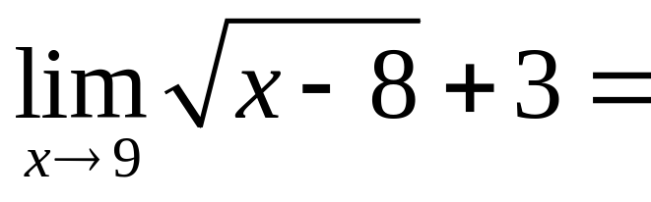
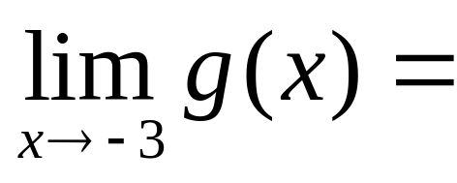
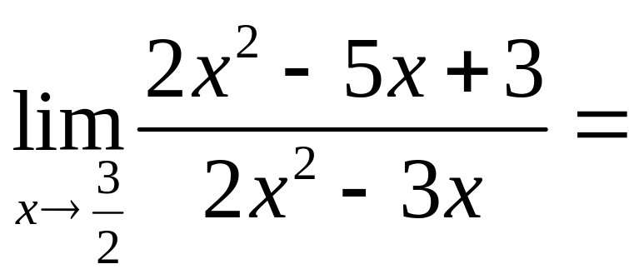
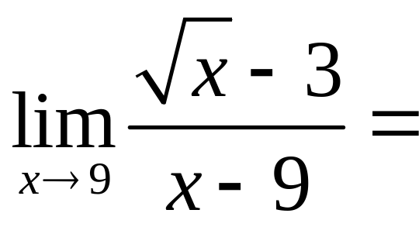
Practice:
Evaluate Each Limit
1)
2)
3)
4)

Slide 24
In Summary
Plan A: Direct Substitution: Plug in the x value (may not work)
Plan B: Algebraic Simplification: Factor and Simplify etc. so that x-values can be plugged in
Plan C: Multiply by Conjugate (Rationalizing the Numerator):
Multiply by conjugate of numerator and cancel so that x-values can be plugged in. (Use if you see square roots)
Plan D: Piecewise Functions:
Make sure to use direct substitution from left AND right hand sides if taking the limit of a place where the function switches over.

Slide 25
Homework
  HW 1.3A: pg 67-68 #1, 4, 9, 13, 15, 17, 23, 41-43, 49, 50, 51, 52, 55

Slide 27
1.3B Properties of Limits
What are some properties of limits?
How do we work with ∆x Limits Approaching 0?

Slide 28
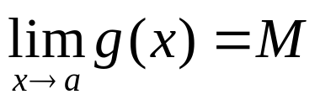
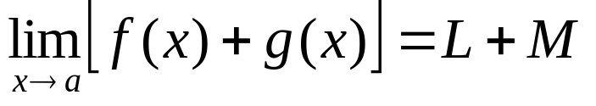
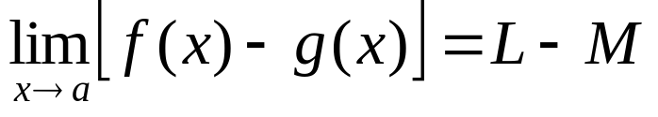
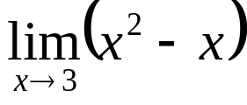

Properties of Limits
1) Sum Rule: The limit of a sum of two functions equals the sum of their limits
2) Difference Rule: The limit of a Difference of two functions equals the difference of their limits
Vs.

Slide 29



Properties of Limits
3) Product: The limit of a product of two functions equals the product of their limits
4) Quotient: The limit of a quotient of two functions equals the quotient of their limits
5) Constant Rule: The limit of a constant times a function is the constant times the limit of the function.

Slide 30







Examples
Lets say that and
Find…
3)
4)
5)
1)
2)

Slide 31

Delta X Notation For Limits
If f(x) = 4x-1 find:
Idea: First find f(x+∆x). Write it down.
Plug in f(x+∆x) and f(x) into the formula. Be careful with parenthesis.
Since plugging in 0 for ∆x gives us a 0 in the
denominator we need to do some algebra. The ∆x should cancel.
Note: ∆x is a different variable than x.

Slide 32

Examples
Remember that ∆x and x are different variables. You may end
up with x’s in your answer but not ∆x ‘s since you should be
Substituting 0 in for ∆x.
Find for each function.
1) f(x)= -2x+6 2) f(x) = x² 3) f(x) = x³

Slide 33

In Summary
Simplifying Limits in the Delta X Formula
To get the numerator, plug in
∆x-x into the function to find f(∆x-x) Then subtract the original function.
2) Since plugging in 0 for ∆x gives us a 0 in the denominator we need to do some algebra to find the limit.
1) Sum:
2) Difference:
3) Product:
4) Quotient:
5) Constant:

Slide 34
Homework
  HW 1.3B: pg 67-69 #18,25,37,45-48, 56, 59, 83, 85, 113, 114, 116, 117

Slide 36
1.3C Special Trig Limits
What are Some special Trig Limits we need to Know?
What trig is most important to remember for the AP Test?

Slide 37






Know your Unit Circle
There will be questions that will require unit circle knowledge throughout calculus. If you don’t know them you will need to study!
1)
2)
3)
4)
5)
6)

Slide 38






Know your Unit Circle ANSWERS
There will be questions that will require unit circle knowledge throughout calculus. If you don’t know them you will need to study!
1)
2)
3)
4)
5)
6)

Slide 39



Most Important Trig Identities To Remember

Slide 40


Special Trig Limits
Need to memorize these for AP Test!
Will be used in many trig limit problems

Slide 41






Examples
1)
2)
3)
4)
5)
6)

Slide 42






Examples
ANSWERS
1)
2)
3)
4)
5)
6)

Slide 43

In Summary
Make sure you are confident with your trig. If you need to make flash cards to review, do so!
Don’t forget these 2 special limits. Be careful! They only apply if x approaches 0.

Slide 44
Homework
  HW 1.3C: pg 67-69 #3, 27-36, 67-75, 77

Slide 46
1.5 Infinite Limits
What are some properties of limits?
How do we work with ∆x Limits Approaching 0?

Slide 47




Find the Vertical Asymptotes for Each Function
1)
2)
3)
4)

Slide 48
Find the Vertical Asymptotes for Each Function ANSWERS
1)
2)
3)
4)
x=7
x= -6
x=0, x= -5
x= ±√2

Slide 49



Finding Limits at Infinity using a Graphing Calculator
1) Using a Graph
  Input the function in y=
  Observe the graph
2) Using the table feature-> Go to Setup
  Table start: Choose the value of the asymptote
  Set ∆tbl to a small value like .01 and save. Then view the table.
  Observe the values on the left and right side of the asymptote

Slide 50


Graphing Calculator Examples

Slide 51




Infinite Limits
1) Whenever you have a limit approaching a vertical asymptote you will have one of 3 possibilities. Be sure to check left and right side!
  DNE
  ∞
  -∞
  2) To see which one it is we will use an informal notation
  VS=Very small number (super close to 0)
  VB= Very big number (super close to infinity)

Slide 52
Solving These Problems without a Graphing Calculator

Slide 53




Find each limit without a calculator
1)
2)
3)
4)

Slide 54

Find each limit without a calculator
ANSWERS
1)
2)
3)
4)
-∞
DNE
∞
-3

Slide 55
Homework
  HW 1.5: pg 88-89 #2,11-13,15,19,23,27,30, 31, 33-43 odd. Try first without calculator

Slide 57
3.5 Limits at Infinity
How do we Evaluate Limits Approaching ∞ ?
How do we evaluate Absolute value Limits?

Slide 58
Limits approaching Infinity
To find out what is happening to a function as x approaches infinity, we must look at the behavior of the function for very large values of x.
Limits approaching infinity are closely related to the end behavior of the function
Also closely related to horizontal asymptotes

Slide 59




Limits at Infinity
The limit of any constant function is a constant
The limit of a linear function is infinity
The limit of a polynomial function depends on leading term
The limit of a polynomial function depends on leading term If Even=> ∞ If odd=> -∞

Slide 60




Examples
1)
2)
3)
4)

Slide 61




Limits at Infinity for Rational Functions
All rules of horizontal asymptotes apply.
Look at the leading terms of the top and bottom
  If the degree of the top is less than the bottom the limit approaches 0
  If the degree of the bottom and top are =, the limit is the ratio of the leading terms
  If the degree of the top is higher than the bottom it will approach
a)
b)
c)

Slide 62






Examples
5)
6)
7)
8)
9)
10)

Slide 63
Examples (ANSWERS)
5)
6)
7)
8)
9)
10)
1
0
1/3
∞
-1/3
-3/2

Slide 64




Absolute Value Limits
Remember that Absolute Value functions are PIECEWISE FUNCTIONS
11)
12)
13)

Slide 65


In Summary
Limits at infinity work like End behavior/Horizontal Asymptotes
  You will either get a number
  They will approach ±∞
  Or the limit will not exist
  Limits at a boundary point for absolute value functions need to be checked from both sides like a piecewise function.

Slide 66
Homework
  HW 3.5A: pg 205-207 #17,18,20-27,30-32, 34, 58,65,69

Slide 68
Limits Review
How do we find any limit?

Slide 69
Kahoot Review
https://play.kahoot.it/#/?quizId=e3ea41e3-66af-4708-9363-9f97713d7152

Slide 70
Homework
HW 3.5B: Limit Review A Worksheet

Slide 71
Continuity
How do we determine if a function is continuous?
What is the Intermediate value Theorem?
What are some types of Discontinuities?

Slide 72
Continuous Functions
Can be drawn without picking up your pencil
Most real life scenarios involve continuous functions
Continuity of a function is an important piece of information in a calculus problem because it allows us to do many other processes that we will learn later.

Slide 73



Draw Examples of each Function
1) is undefined 2) DNE 3)

Slide 74


To show a Function is Continuous
….at a given point, the following three things must ALL be true.
1) is defined
2) exists
3)
A function is continuous on an open interval (a,b) if it is continuous at every point in (a,b).
If it is not the function is considered discontinuous on that interval.

Slide 75

To show a Function is Continuous
….at a given point, the following three things must ALL be true.
1) is defined
2) exists
3)

Slide 76

To show a Function is Continuous
….at a given point, the following three things must ALL be true.
1) is defined
2) exists
3)

Slide 77


To show a Function is Continuous
….at a given point, the following three things must ALL be true.
1) is defined
2) exists
3)

Slide 78



Types of Discontinuities
Removable Discontinuity/Hole: When the limit exists at x=a but f(x) is undefined at a.
Non Removable Discontinuity
Vertical Asymptote (infinite): When the graph approaches ±∞ at x=a
Jump Discontinuity: When a function approaches two different numbers at x=a from opposite sides. (Happens in piecewise functions)

Slide 79
Examples of Continuous Functions
1) Polynomials
2) Sin and Cos
3) Rational Functions on a restricted interval
  Ex: tan(x) from -π/2 to π/2 or f(x)=1/x for x>0.
4) Square Root Functions (along it’s defined values)
5) Absolute value functions
6) Exponential and logarithmic functions
7) Piecewise functions that connect

Slide 80



Determine if the functions are continuous for all real numbers.
If they aren’t, state the types of discontinuities they contain (if they have any)
1)
2)
3)

Slide 81

Intermediate Value Theorem
Intermediate Value Theorem (IVT): A function that is continuous on [a,b] takes on every y value between f(a) and f(b) on that interval.

Slide 82

Intermediate Value Theorem Examples
4) Given that f(x) is continuous on [-1,6] what is the minimum number of zeroes that f(x) must have on [-1,6]?

Slide 83

Intermediate Value Theorem Examples
5) Prove that there exists a c in the interval [0,3] for
such that f(c)=6.

Slide 84
Homework
  HW 1.4A: pg 78-82 #2,3,5,7-12,15,18,25, 26,29,31,37,40

Slide 86
Review on Limits
What are the Big Ideas with Limits

Slide 87
Review On Limits
Plan A: Direct Substitution: Plug in the x value (may not work)
Plan B: Algebraic Simplification: Factor and Simplify etc. so that x-values can be plugged in
Plan C: Multiply by Conjugate (Rationalizing the Numerator):
Multiply by conjugate of numerator and cancel so that x-values can be plugged in. (Use if you see square roots)
Plan D: Piecewise Functions:
Make sure to use direct substitution from left AND right hand sides if taking the limit of a place where the function switches over.

Slide 88
Special Trig Limits
Need to memorize these for AP Test!
Will be used in many trig limit problems

Slide 89
Infinite Limits
1) Whenever you have a limit approaching a vertical asymptote you will have one of 3 possibilities. Be sure to check left and right side!
  DNE
  ∞
  -∞
  2) To see which one it is we will use an informal notation
  VS=Very small number (super close to 0)
  VB= Very big number (super close to infinity)

Slide 90
Limits at Infinity for Rational Functions
All rules of horizontal asymptotes apply.
Look at the leading terms of the top and bottom
  If the degree of the top is less than the bottom the limit approaches 0
  If the degree of the bottom and top are =, the limit is the ratio of the leading terms
  If the degree of the top is higher than the bottom it will approach
a)
b)
c)

Slide 91

To show a Function is Continuous
….at a given point, the following three things must ALL be true.
1) is defined
2) exists
3)

Slide 92
Types of Discontinuities
Removable Discontinuity/Hole: When the limit exists at x=a but f(x) is undefined at a.
Non Removable Discontinuity
Vertical Asymptote (infinite): When the graph approaches ±∞ at x=a
Jump Discontinuity: When a function approaches two different numbers at x=a from opposite sides. (Happens in piecewise functions)

Slide 93
Intermediate Value Theorem
Intermediate Value Theorem (IVT): A function that is continuous on [a,b] takes on every y value between f(a) and f(b) on that interval.

