Slide 1

Hello!
Please feel free to start this lesson when you are able. The lessons I am providing at this point will be available for the rest of the school year. This lesson will be for grades 3rd – 5th. If you have questions, please feel free to contact me via email or Instagram and I will do my best to help you.
Thank you and stay healthy!
–Mrs. Billy

Slide 2
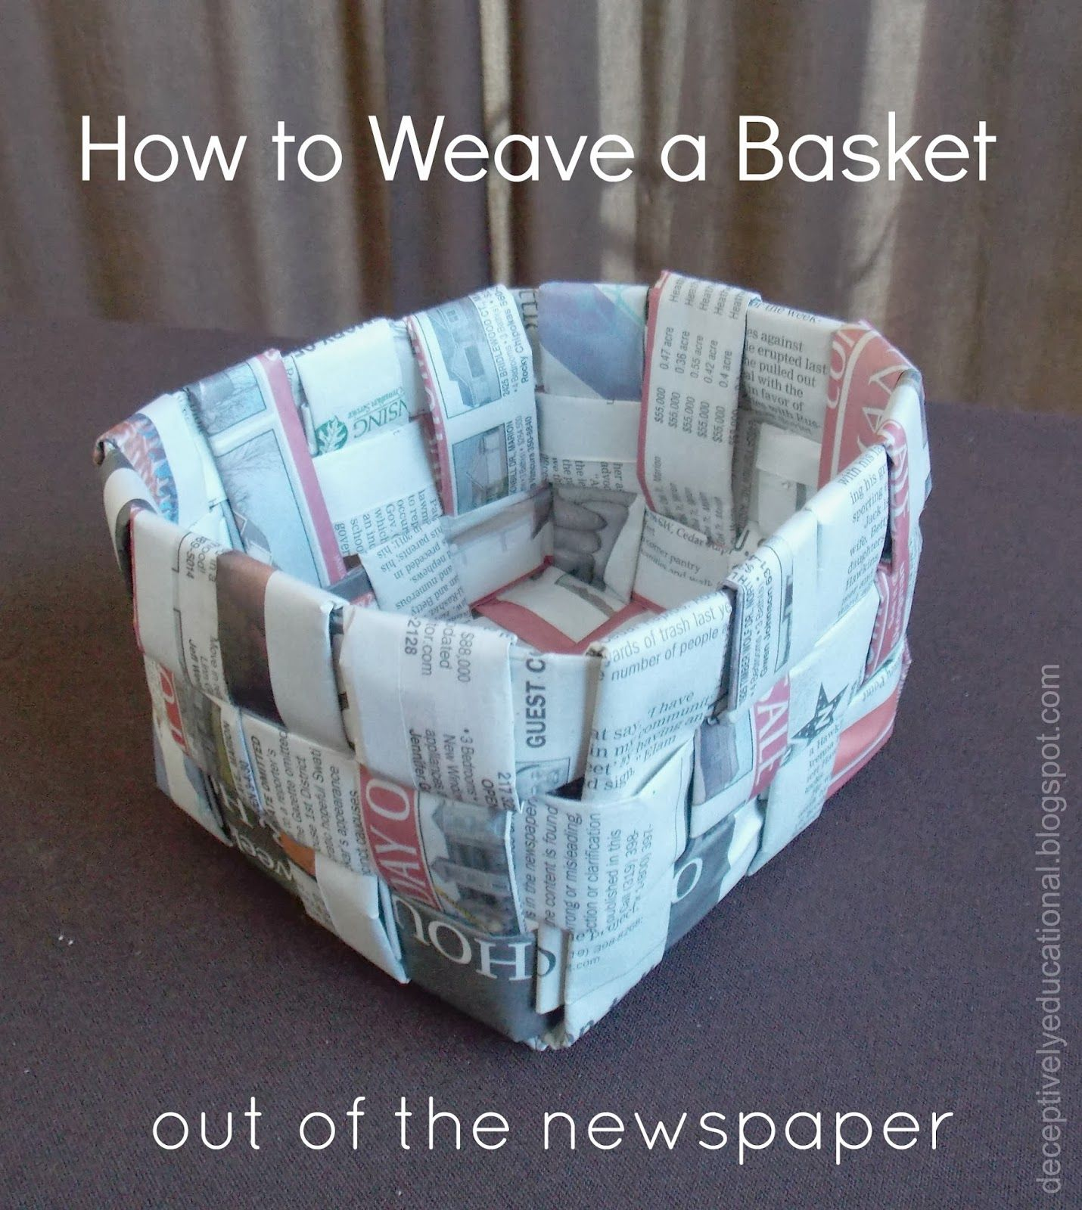

Slide 3



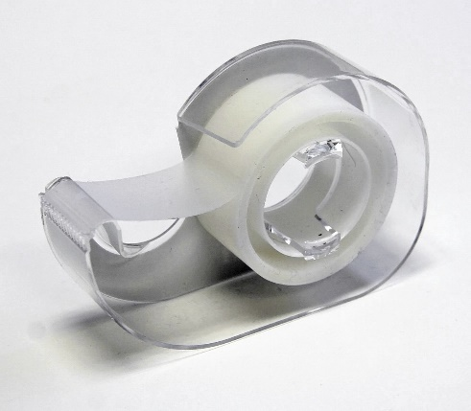
Supplies:
Newspaper (about 12 pages)
Glue stick or tape
scissors

Slide 4
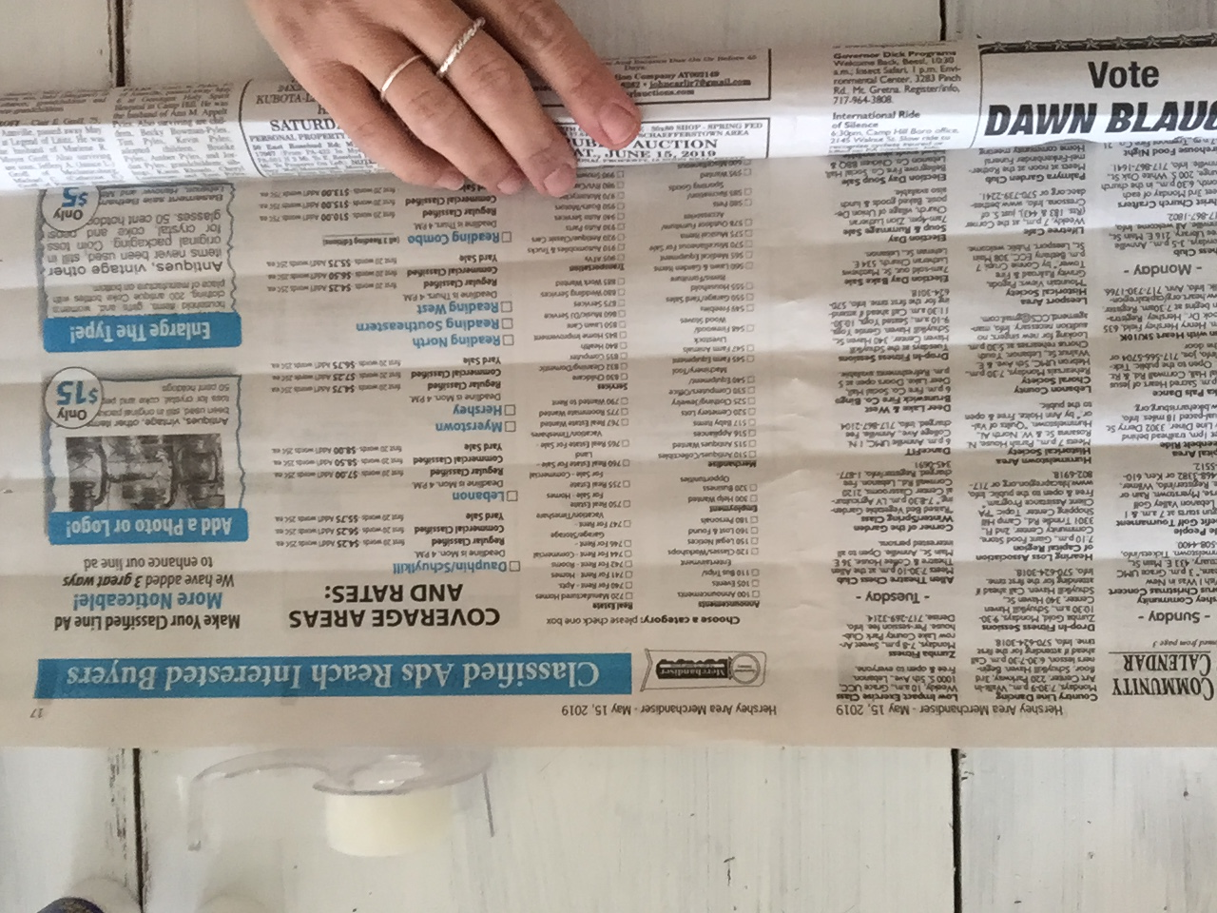
Step 1: Roll 1 piece of newspaper into a tight roll.

Slide 5
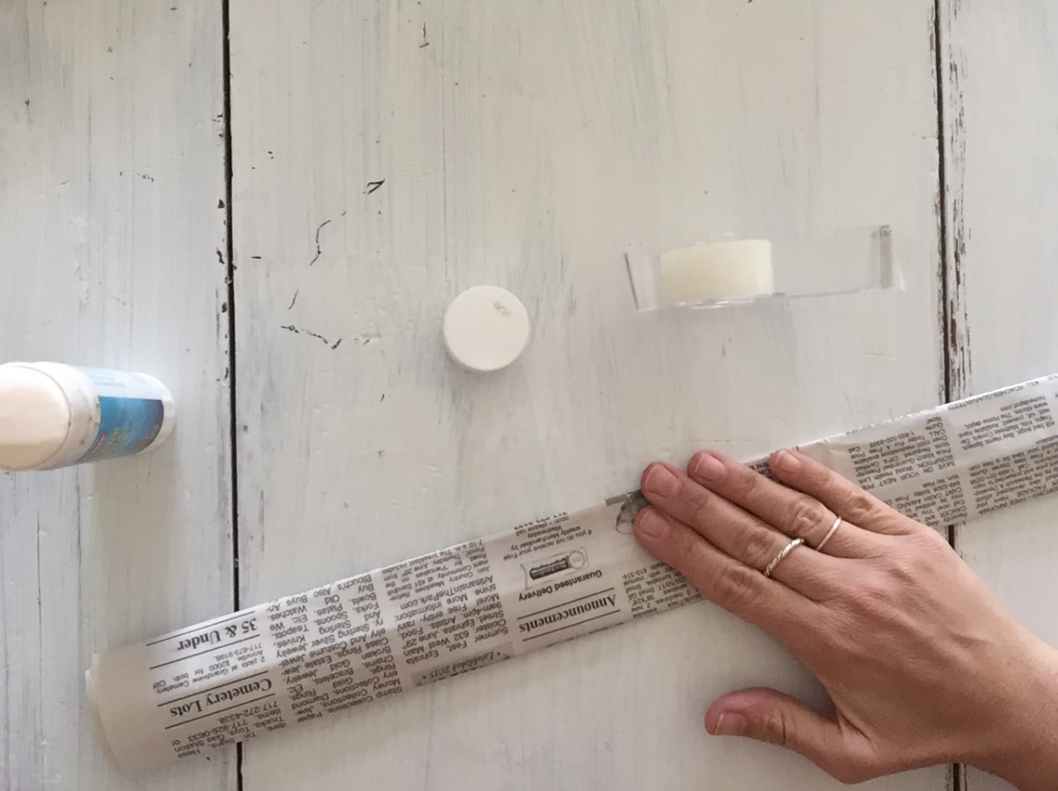
Step 2:
After rolling, glue or tape end of newspaper to roll and flatten into a strip. Repeat 7 more times.

Slide 6
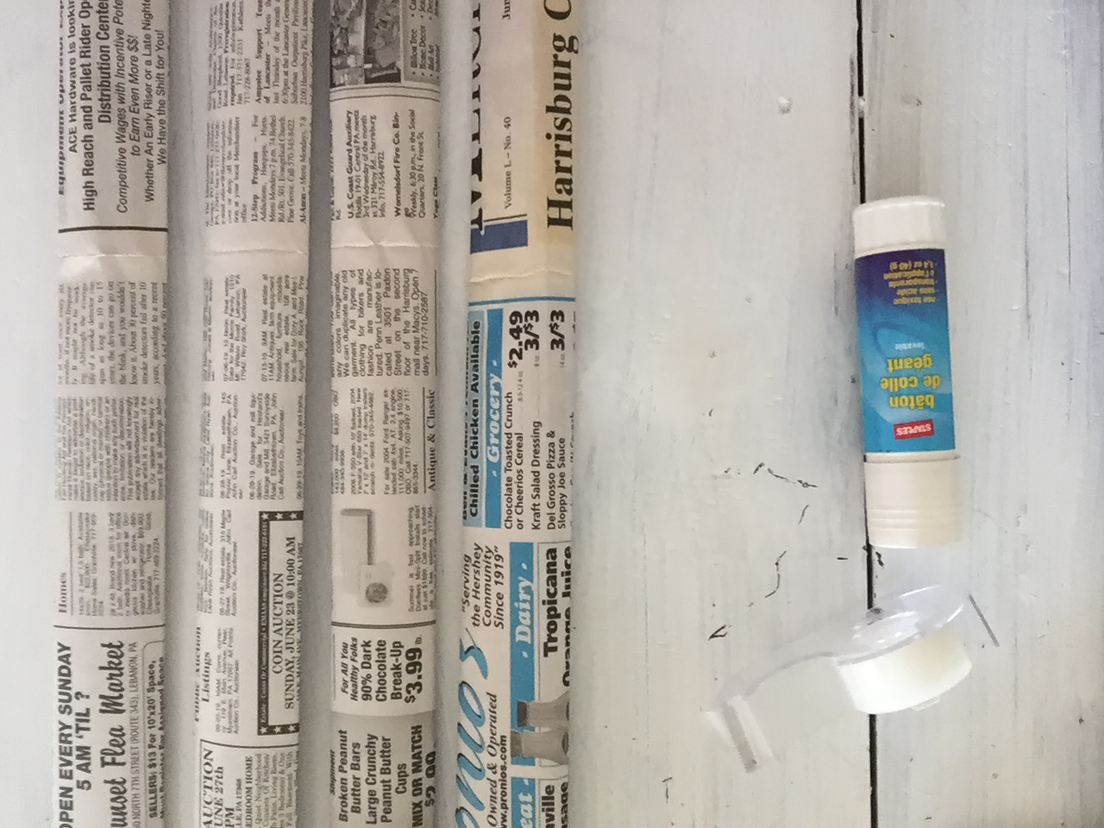

Slide 7
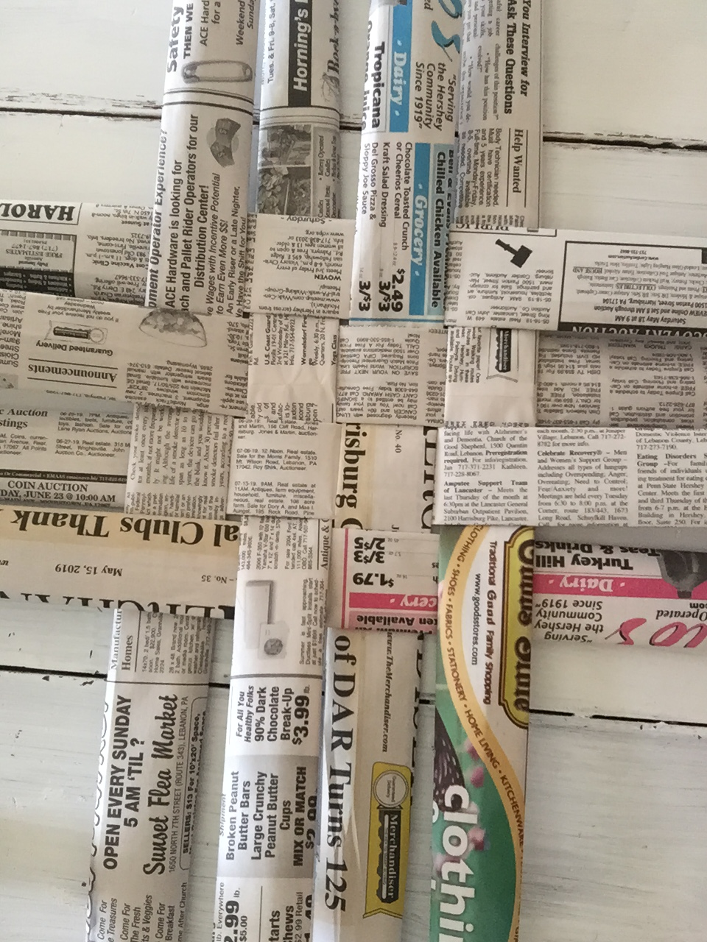
Step 3:
Once you have 8 strips ready. You are ready to weave the bottom of the basket. Lay out four pieces vertically and weave 4 pieces horizontally with an under/over pattern. Just like with our weavings in class. Weave as tightly as possible.

Slide 8
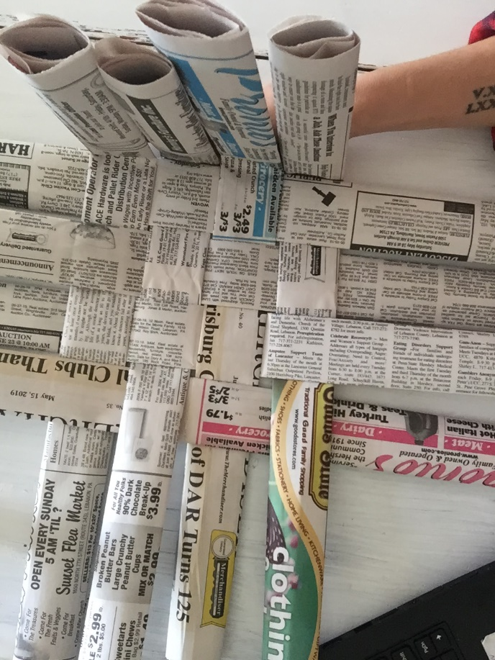
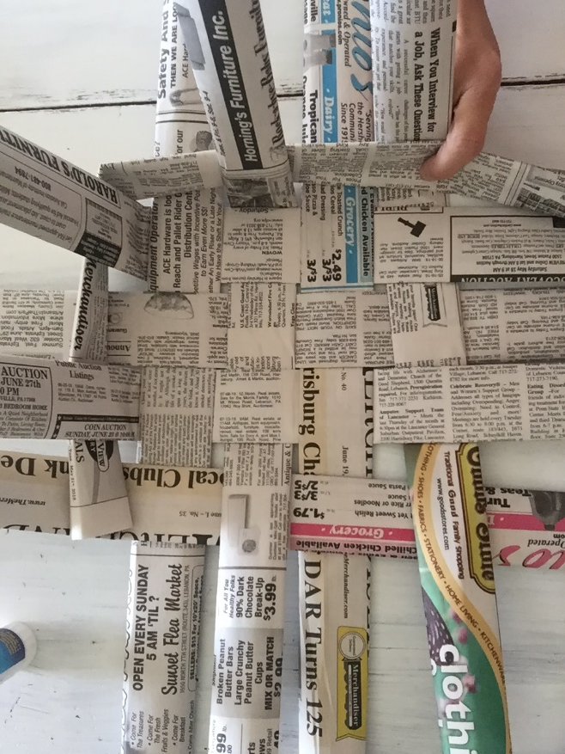
Step 4: Once the bottom is woven, you will need to roll 2-4 more newspaper strips for the sides. You can do this at the beginning and have them ready for this step also. Begin by folding ends of strips upwards and weave a strip through those ends. Taping it or gluing it helps to hold the strip in place.

Slide 9
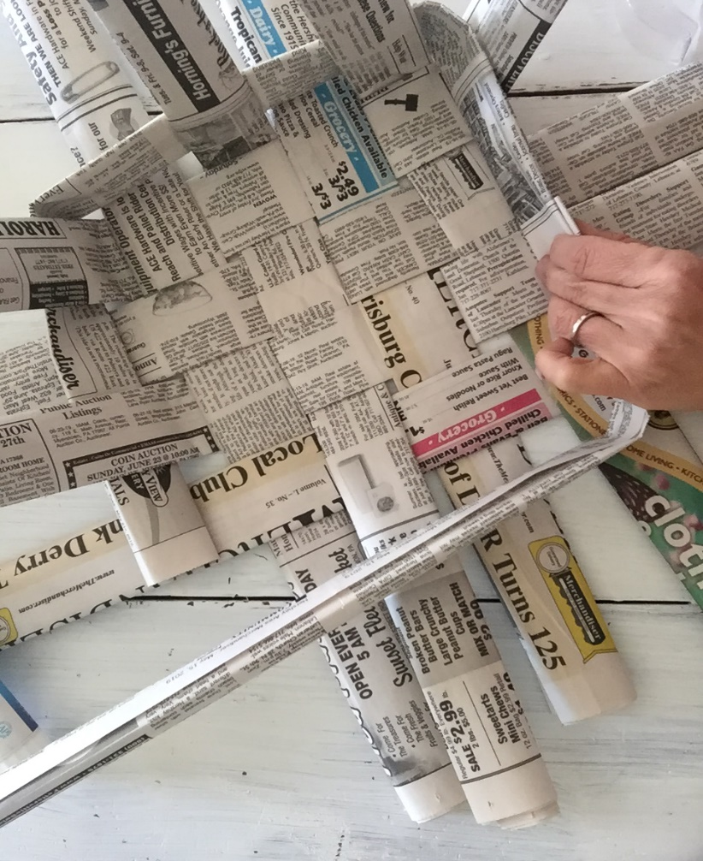
Step 5:
As you run out of weaving strip, add another where you left off and finish the first row. You can use tape or glue to connect them. Begin the second row and weave the same way. More than 2 rows can be woven. It depends on how much room you have and how big your basket becomes. They all end up a little different.

Slide 10
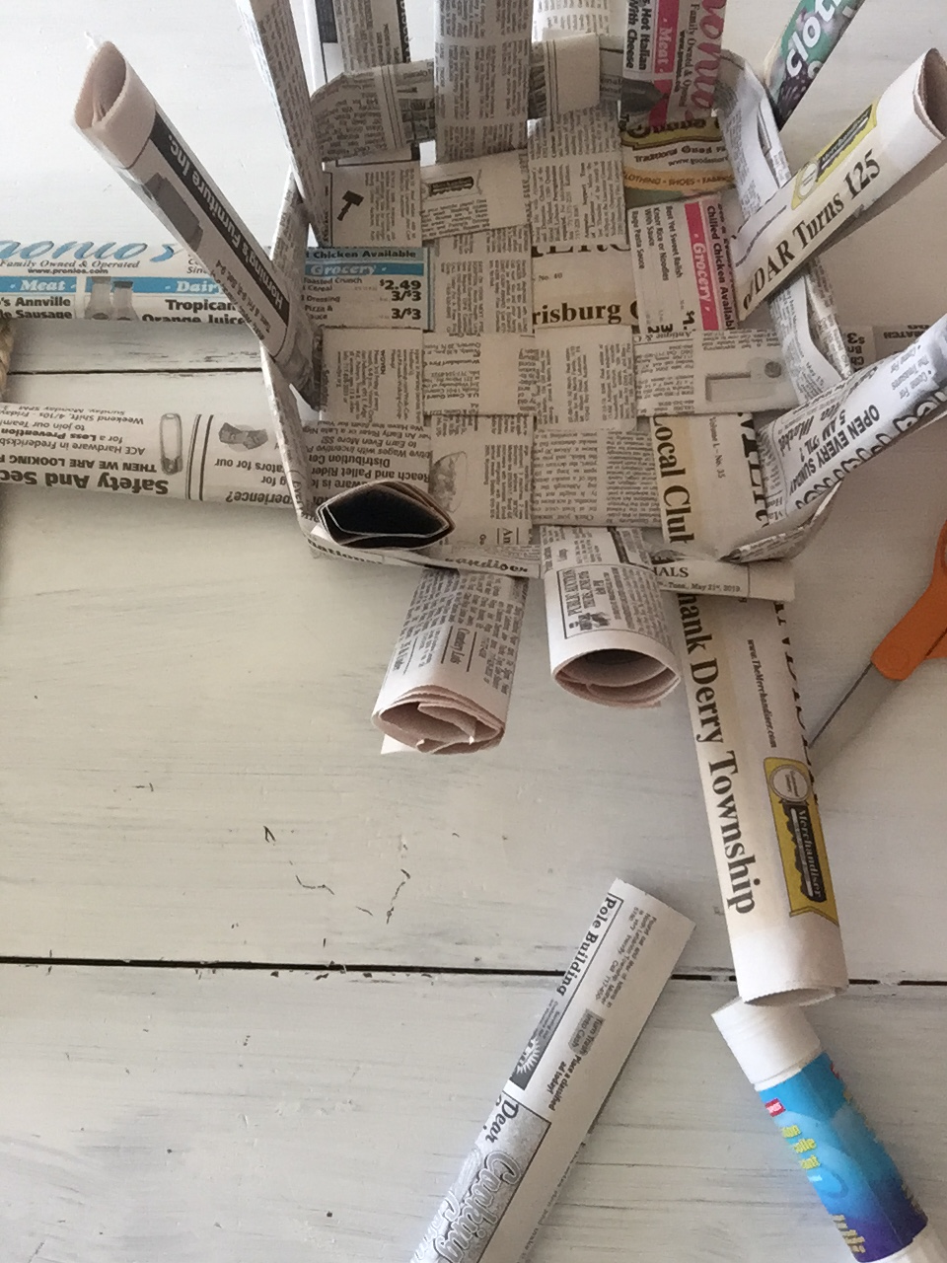
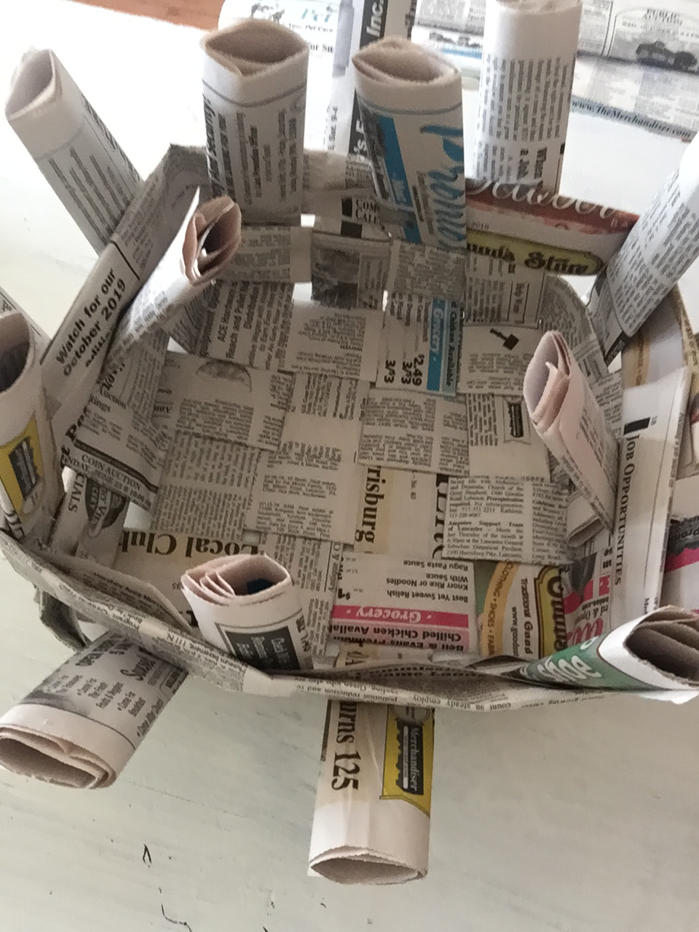

Slide 11
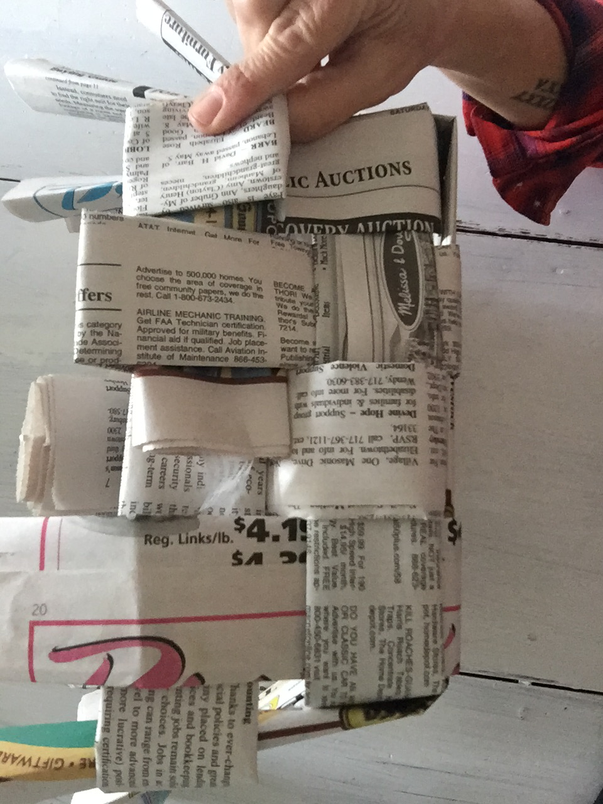
Step 6: Once you get 2-3 rows woven, you will begin to fold the ends of the newspaper strips down and tuck them under the woven strips. You will need to tighten the strips as you go and also use glue or tape to keep them in place.

Slide 12
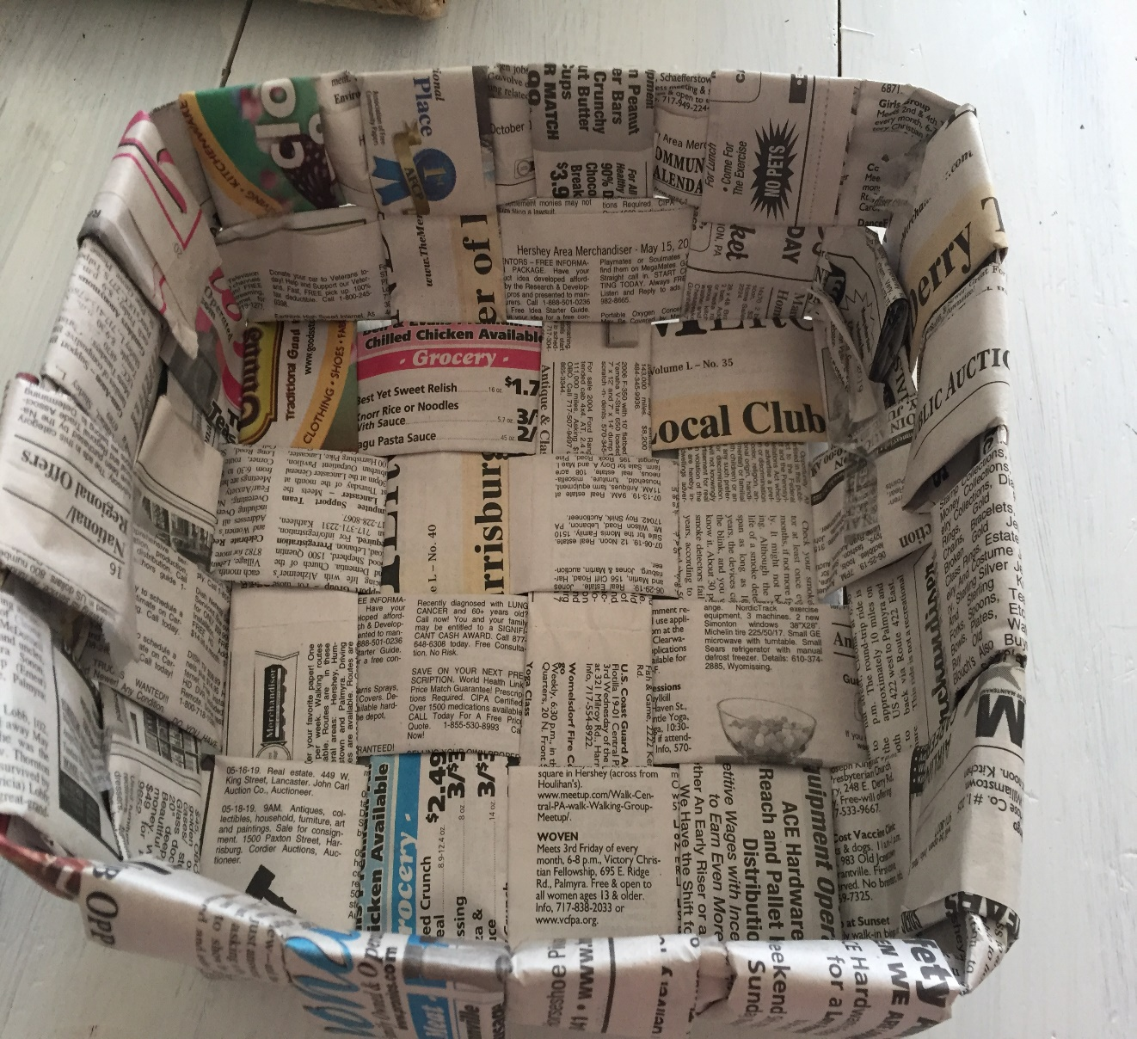
Finished!
As you can see, this one is different than the first basket. It may take some practice so don’t worry if it takes some time to put together.
Once you are finished you can add a handle, paint, or fill with Easter grass and eggs or candy.

Slide 13

Please let me know if you have any questions about this lesson or send pictures to: abilly@ldsd.org or message me on Instagram @easthanoverart

