Slide 1
Recycled Art
Earth friendly crafts

Slide 2
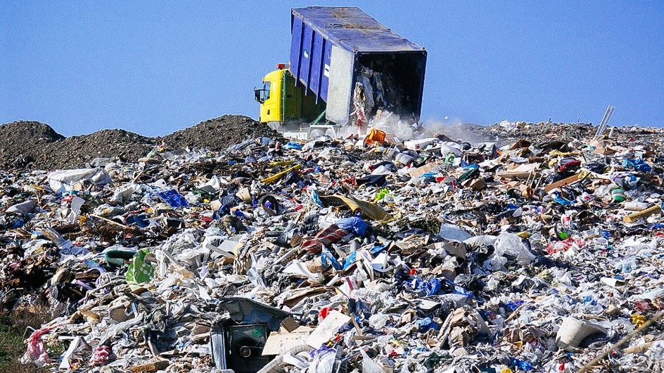
What is recycled art?
Using trash or unused stuff to make art
If you celebrated EARTH DAY last week, you may have learned that reusing things, saves the earth. Why? Because it doesn’t produce more waste. More waste to go in landfills. Landfills fill up the earth with more trash. YUK!

Slide 3
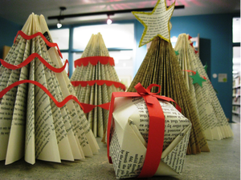
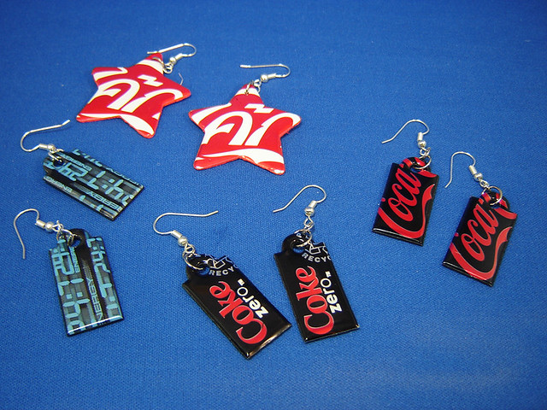
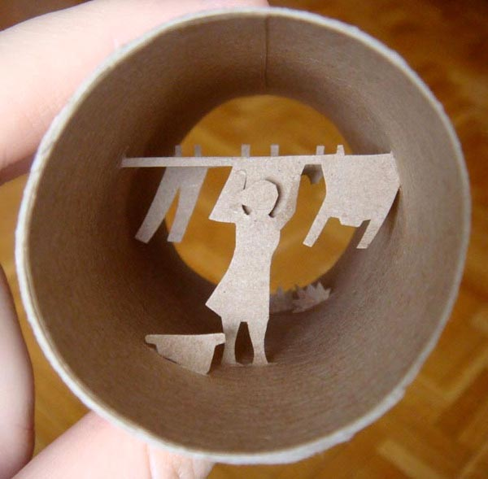
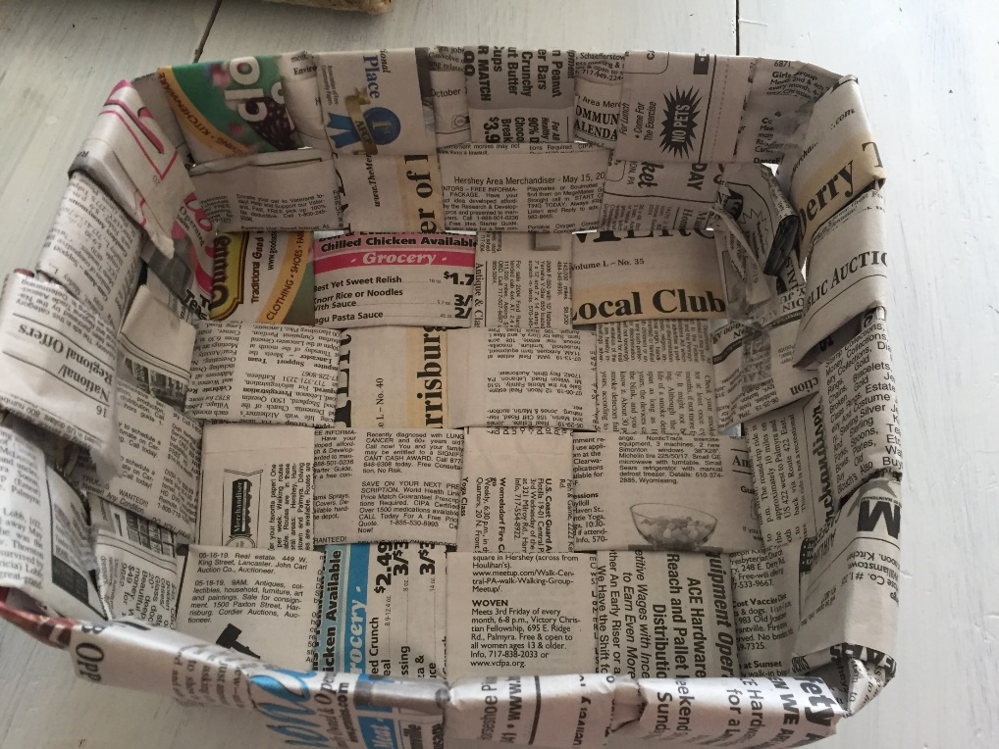
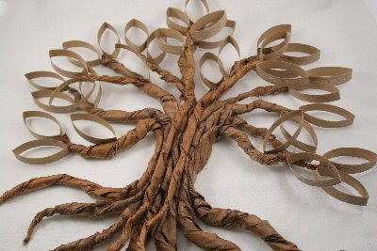

Slide 4
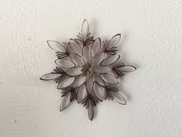
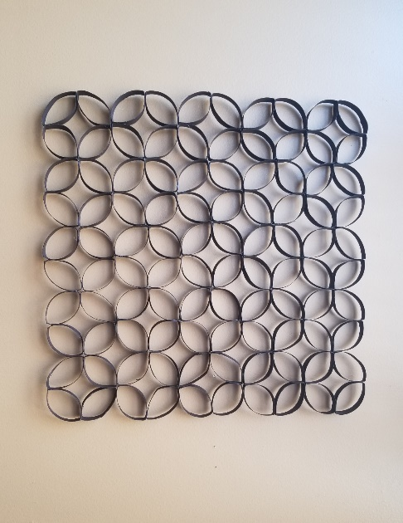
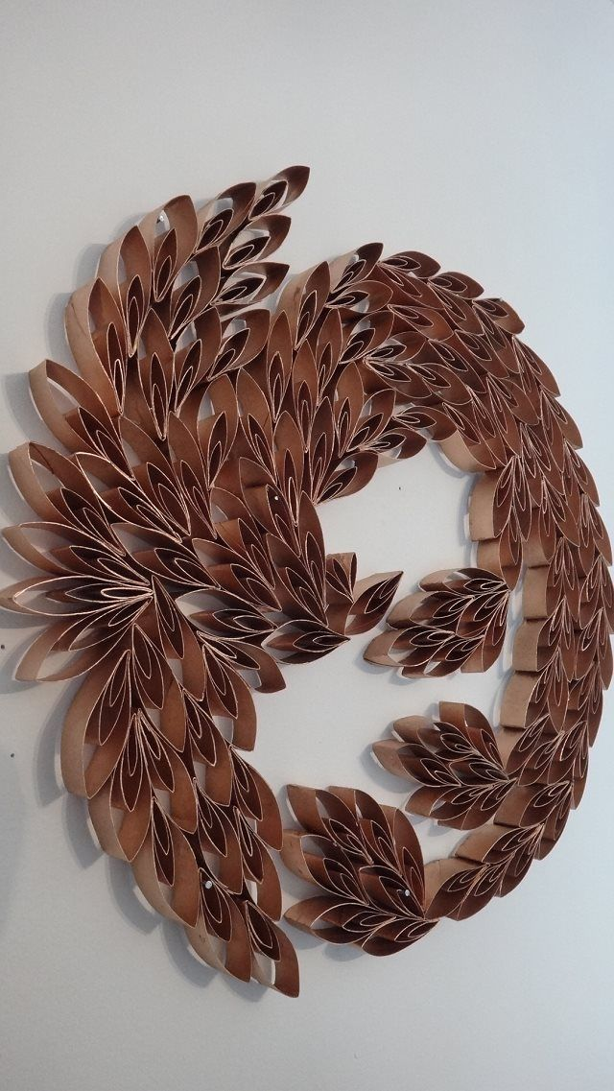
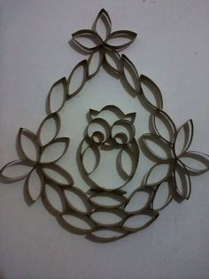
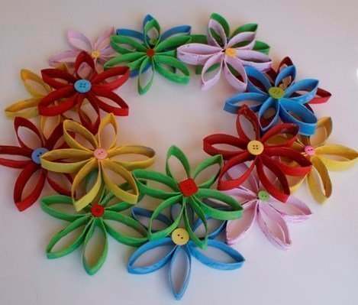
Toilet paper roll wall art (Why not?)

Slide 5
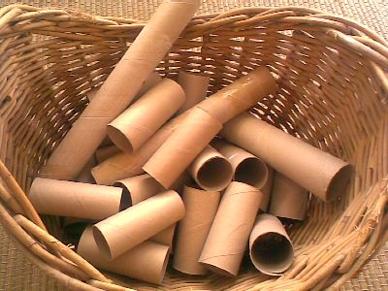

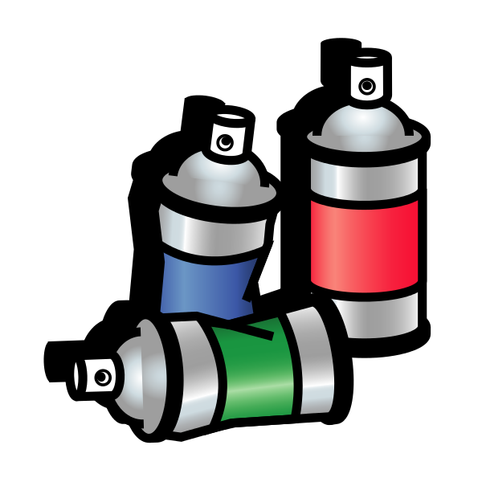
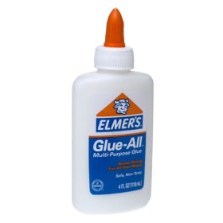
Supplies: toilet paper/paper towel rolls glue (hot glue or any liquid glue)
Paints(optional) paper(Optional)

Slide 6
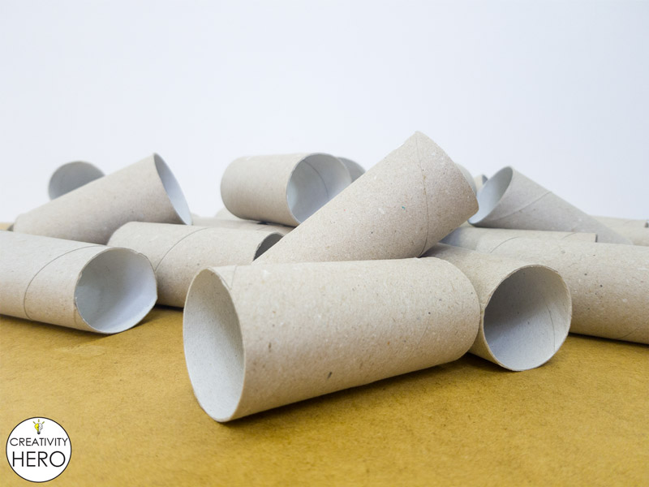
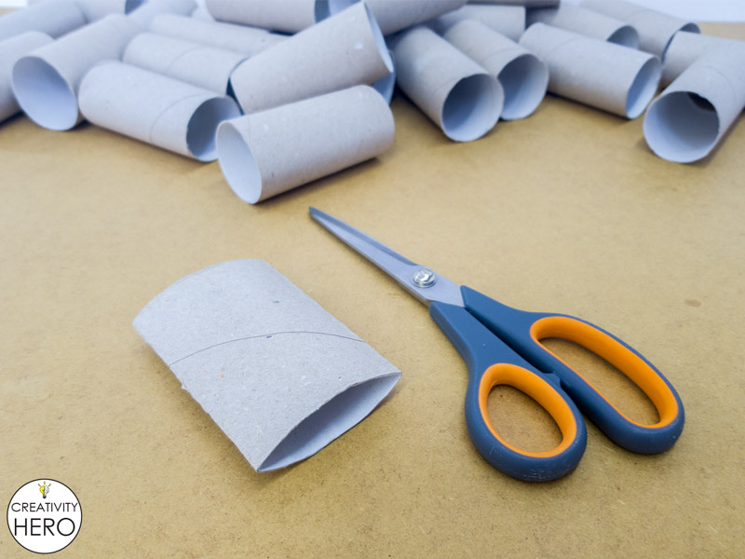
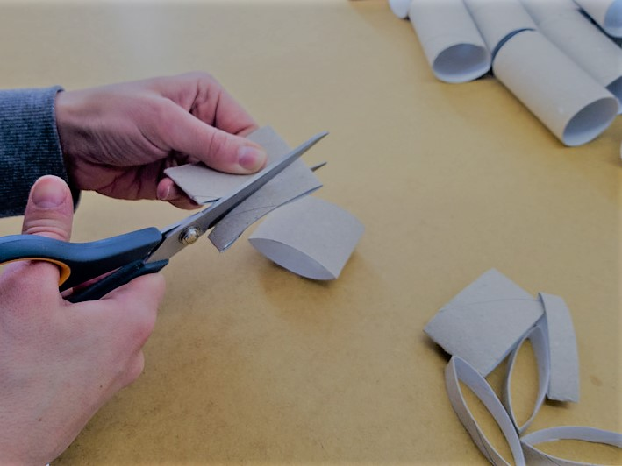
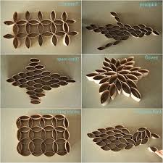
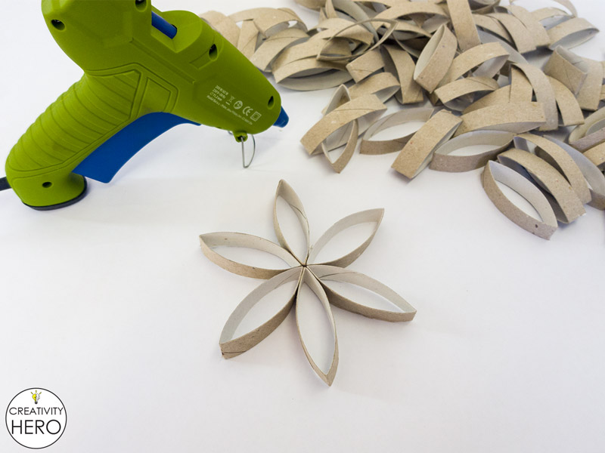
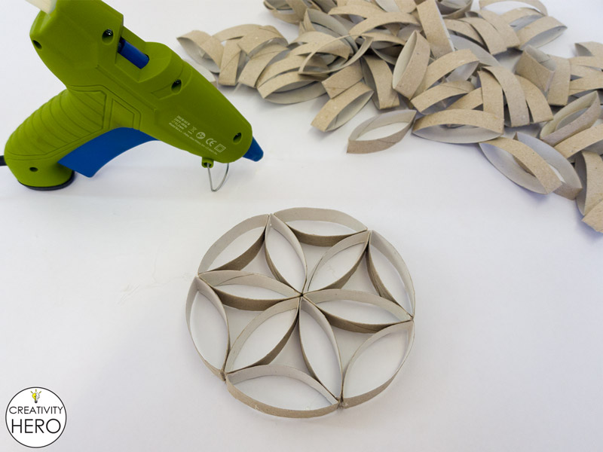
This is how you begin cutting the rolls and one way that you can begin planning your design. You can begin your design anyway, but always plan it out before you glue. You can add other materials, beads, rolled paper, buttons, etc. You can keep adding as much as you like. Glue to a flat surface or hang freely. Paint when you are finished or leave it all natural. Note: one roll of TP = about 15 cut pieces

Slide 7
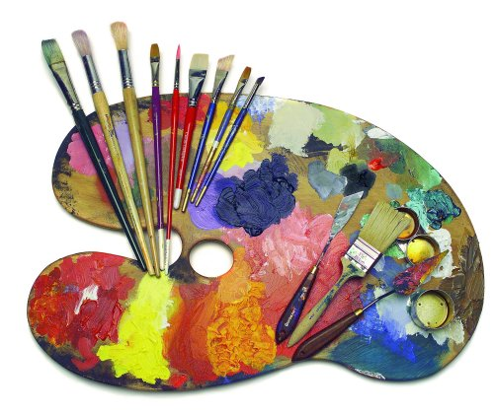
Please send pictures of finished art work and any questions to me at abilly@ldsd.org, @easthanoverart on Instagram, or message me in Class DoJo.
Thank you and have a fun! – Mrs. Billy

