Slide 1
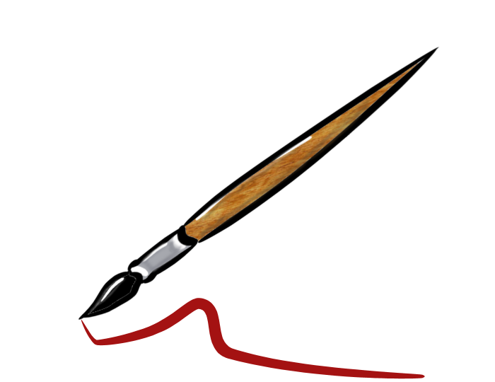
Hello!
Please feel free to start this lesson when you are able. The lessons I am providing at this point will be available for the rest of the school year. This lesson will be for grades K-2nd. If you have questions, please feel free to contact me via email or Instagram and I will do my best to help you.
Thank you and stay healthy!
–Mrs. Billy

Slide 2
What is a collage?
From the French word coller, “to glue” or “to stick together”. A collage may include magazine clippings, ribbons, paint, wrapping paper, photographs, scraps of cardboard and other found objects.

Slide 3
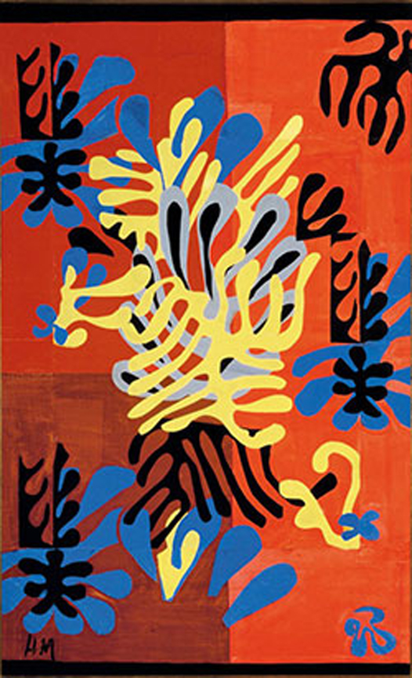
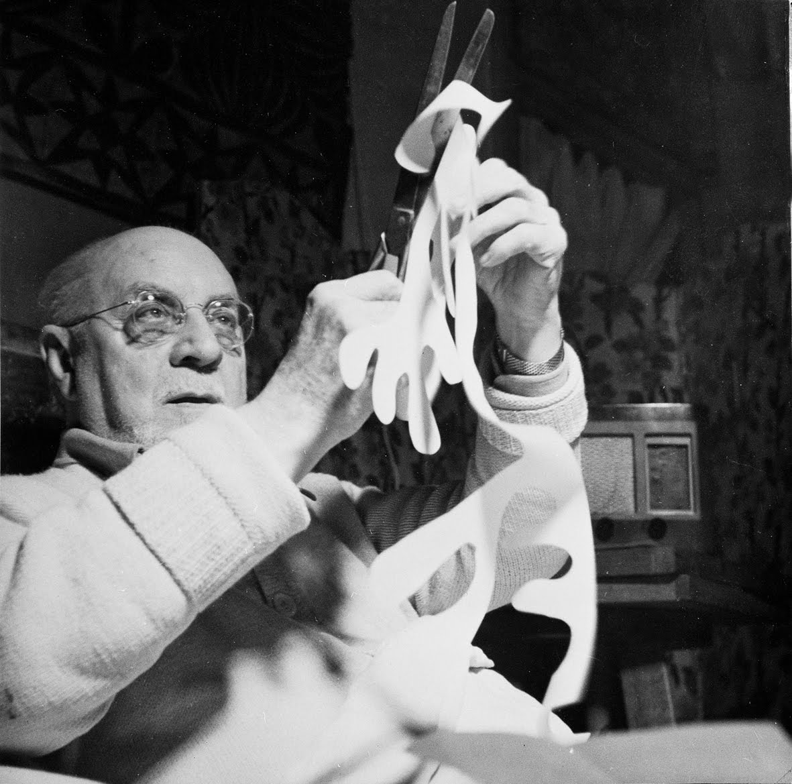
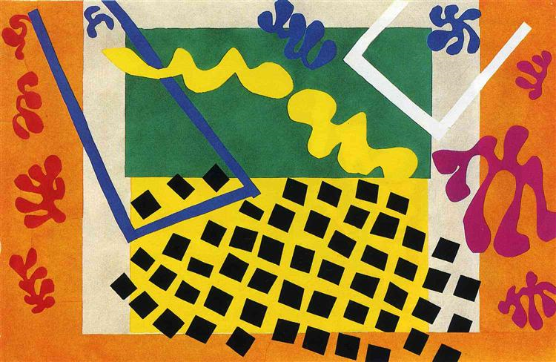
Famous “collage” artists
Henri Matisse

Slide 4
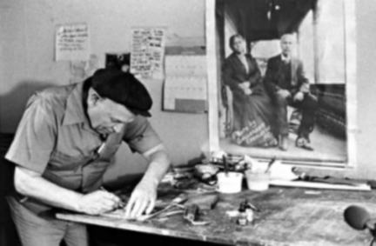
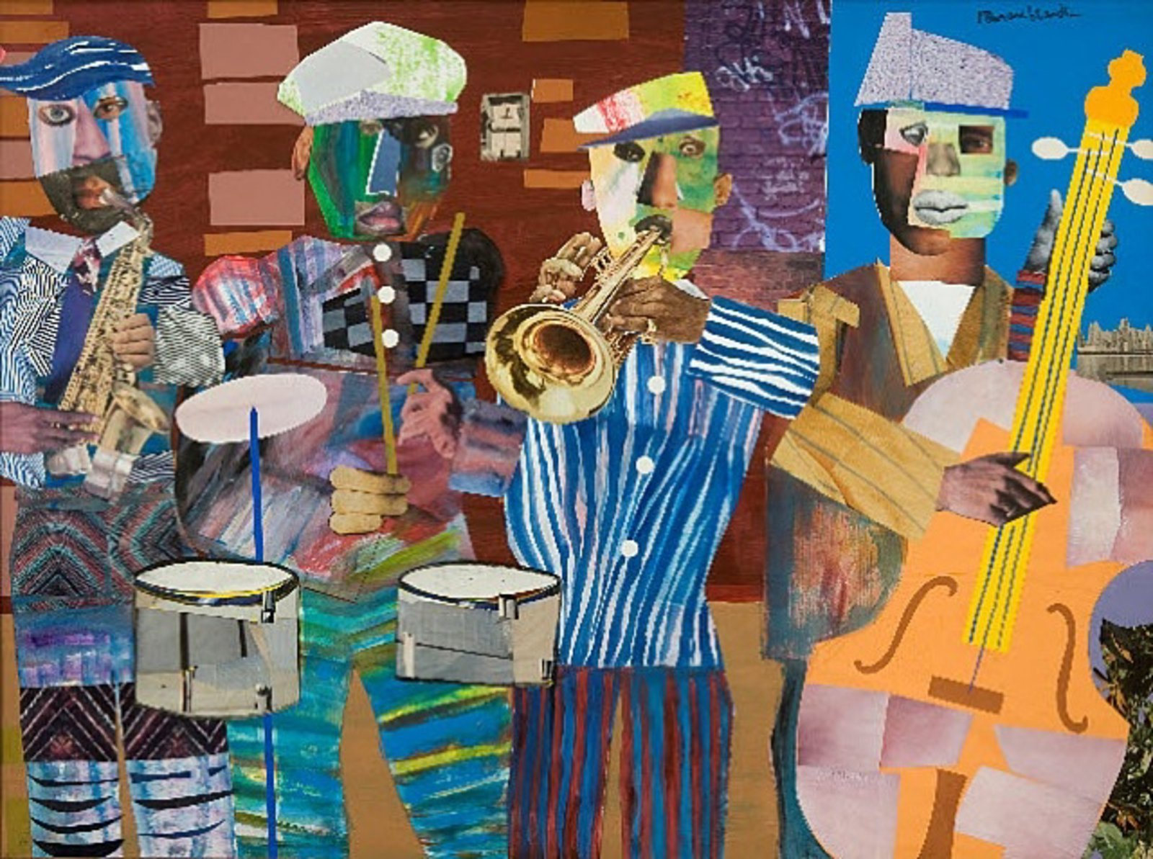
Romare Bearden

Slide 5
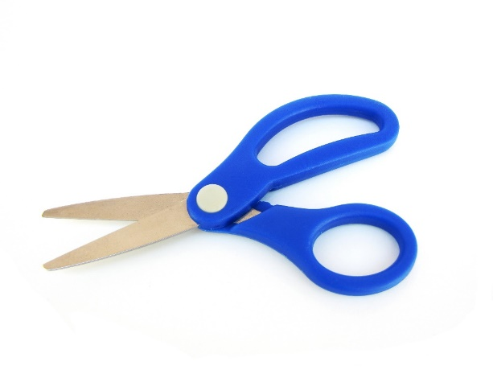
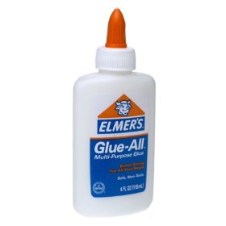
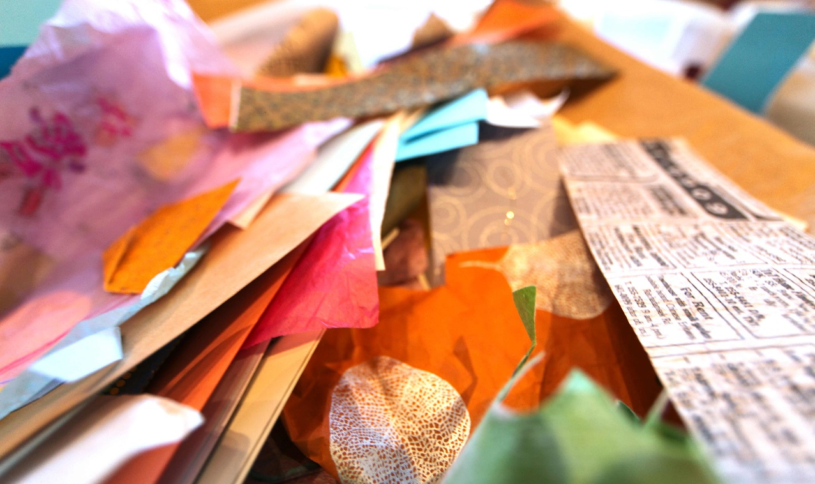
Supplies:
Glue, scissors, and found things such as: cardboard, paper scraps, yarn, fabric scraps, magazine pages, old photos, ribbon, paint, small toys, beads, food labels/boxes, plastic lids, anything with color!
Use your imagination!

Slide 6
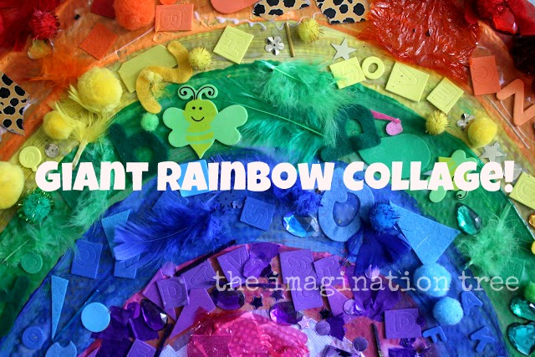
You will create a rainbow collage!

Slide 7



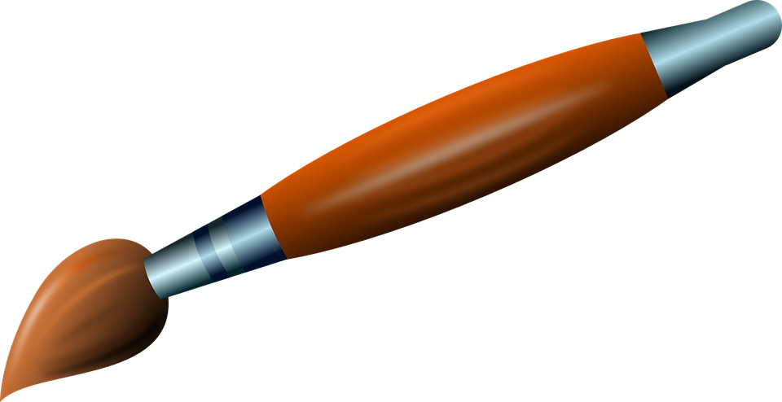
1)Begin with a background (cardboard is best.)
2)Start searching around the house for colors. red
3) Create! orange yellow green blue violet

Slide 8
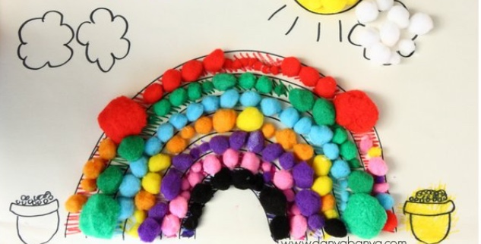
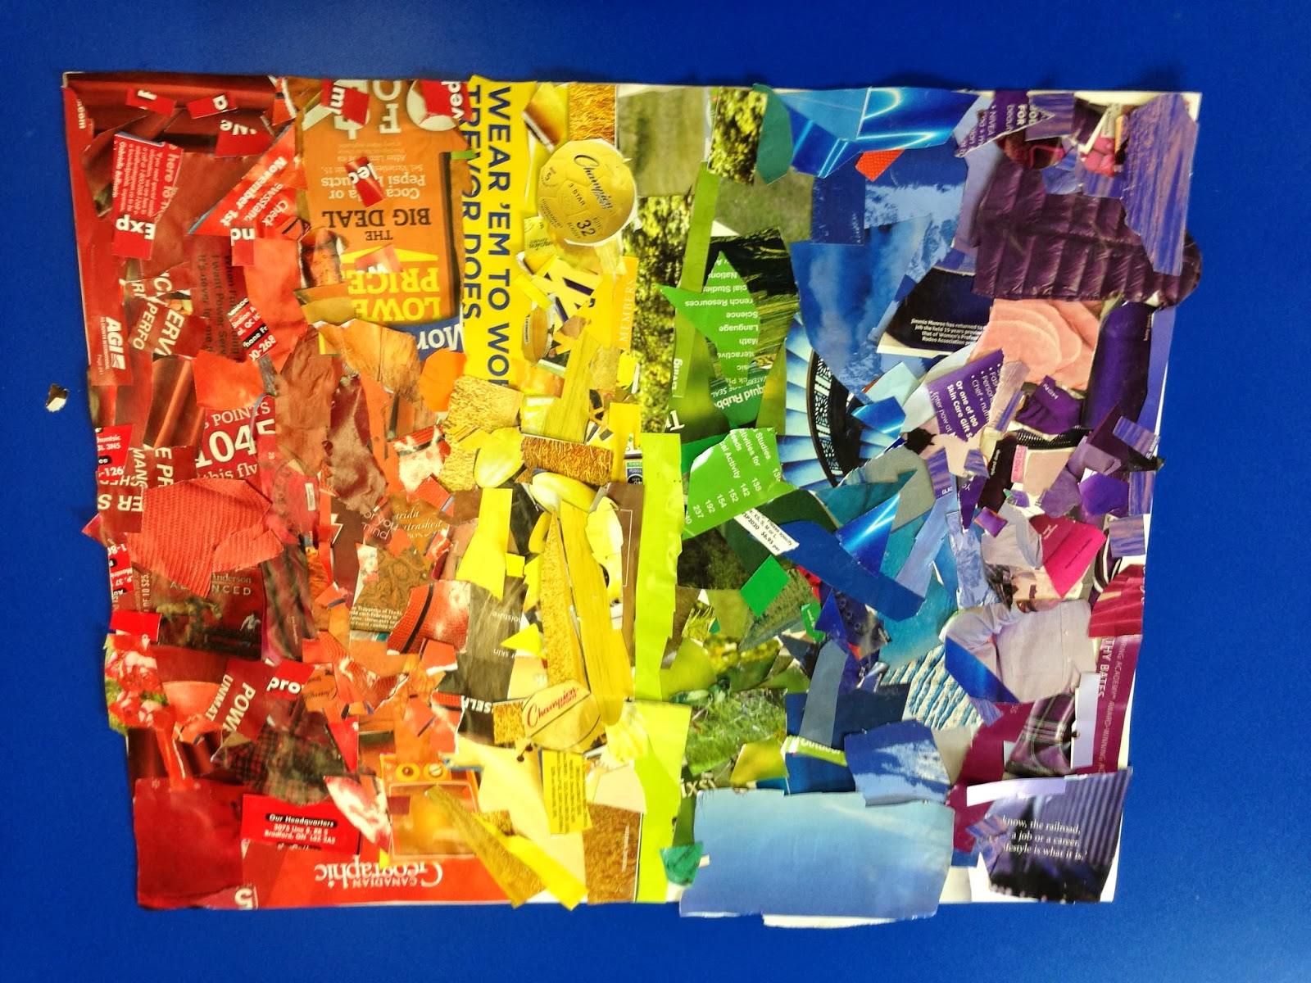
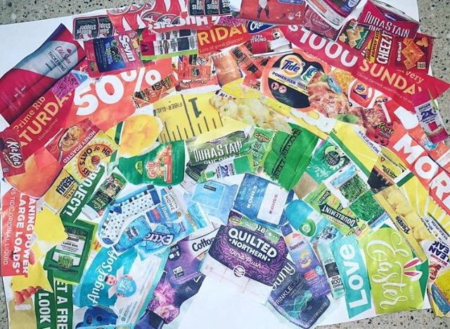
Examples

Slide 9
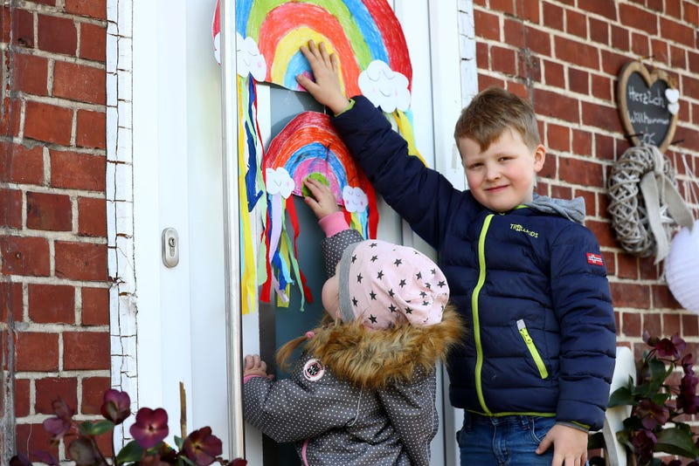
Please let me know if you have any questions about this lesson or send pictures to: abilly@ldsd.org or message me on Instagram @easthanoverart
For an inspiring way to share your kids art, place in your window for all to see. Please see the story below and share if you like.
https://www.popsugar.com/family/kids-put-drawings-up-in-windows-during-coronavirus-outbreak-47324293
I look forward to seeing all
of your rainbows!

