Slide 1

FY’23
SCHOOL COMMITTEE BUDGET
APRIL 4, 2022
NORWELL PUBLIC SCHOOLS
Managing Resources

Slide 2
FY’23 BUDGET DEVELOPMENT PROCESS
September - October | GOAL SETTING: Identification of Budget Assumptions and Priorities Faculty and Staff Congress of Councils Assume Full Return to In-person Learning COVID-19 Recovery Initiatives | Proposed FY’23 Budget | Percent Increase | Dollar Increase
November - December | INITIAL REQUEST: Identification of Resources Needed Faculty and Staff Building Principals Program Directors Strategic Staffing Levels | INITIAL $32,000,983 | 6.36% | $1,913,655
December - January | EXECUTIVE BUDGET: Continued Academic Access and Facility Preservation Superintendent and Staff Essential Staffing Levels | EXECUTIVE $31,170,471 | 3.60% | $1,083,143

Slide 3
EXECUTIVE BUDGET SUMMARY
Areas to address:
District wide inclusion specialist
Address and monitor out-of-district special education tuitions
HS music teacher
Elementary technology teacher
Facilities planning scheduler
4 kindergarten aides
MS and HS math tutor / aides
COVID-19 recovery initiatives
Strategic Plan initiatives
Future Capital projects
Clipper Community Complex needs

Slide 4
DISTRICT-WIDE INCLUSION SPECIALIST
Support in-program development to allow more students to remain in-district
Make recommendations for future programming development
Provide advice and expertise to teachers, students and the school community to support the creation of consistent and effective academic, behavioral, and social/emotional learning experiences for students with disabilities

Slide 5
OUT-OF-DISTRICT SPECIAL EDUCATION TUITIONS
Continue to address out-of-district special education tuitions
  Circuit Breaker reserves are highly strained at this time
  We will be asking to increase the out-of-district special education tuition stabilization fund by $300,000 during the Special Town meeting
  We will be asking to authorize the use of $395,000 for out-of-district special education tuitions to be used in FY’23 during the Regular Town meeting
  We are currently projecting a $528,000 gap between our Circuit Break receipts and yearly rollover

Slide 6
HIGH SCHOOL MUSIC TEACHER
During the FY’22 school year we funded the High School music teacher through the ESSER III grant
This program has met our year one expectations
Student engagement for students interested in music has increased
New courses offer a more well-rounded comprehensive music experience

Slide 7
ELEMENTARY INSTRUCTIONAL TECHNOLOGY TEACHER
This position will complete our efforts to have one technology teacher in each elementary school
Provides direct instruction to all students grades K-5
State Digital Literacy Standards and appropriate technology use incorporated
New emphasis on keyboarding allowing students to independently apply technology skills in a school setting

Slide 8
FACULTY FTEs
During the FY’22 school year, the Vision Specialist was eliminated due to programing changes
There have been four faculty retirements for the FY’23 budget
There is a net add of two FTEs for the district faculty
These positions address student learning, engagement, and efficiencies

Slide 9
FACILITIES PLANNER SCHEDULER - RESTRUCTURE
Reallocate 16th custodial position (hired during COVID)
Manage state inspections (elevators, health, smoke alarms)
Manage vendor scheduling and ordering
Manage bidding and engineering relationships
Capital projects
Organize work orders and parts ordering
Allow facilities manager to directly impact school upgrades
Allow a greater reliance on in-house repairs versus vendor contracts

Slide 10
FOUR ELEMENTARY KINDERGARTEN AIDES
Kindergarten academic requirements have changed significantly over the last 10 years
The kindergarten program has evolved from a half-day structure to a full-day choice structure
Kindergarten aides are well established in surrounding South Shore communities
Last year we added four elementary kindergarten aides
We need to add four more aides to complete the process
Like last year two of these aides become a part of the budget and two become a part of the full-day kindergarten fee structure
Depending on kindergarten enrollment we may need to adjust kindergarten fees in May
The aides support teacher-directed instructional modifications, cooperative play, integration of daily routines, monitoring, and supervising

Slide 11
MIDDLE AND HIGH SCHOOL MATH TUTOR / AIDES
The Middle and High School math tutor / aides have been funded out of ESSER III grant funds in FY’22
They will be funded out of ESSER II grant funds for FY’23
The aides serve students who have either not received the instruction for certain math topics or have not had the repetition or practice to develop mastery for certain skills due to the pandemic

Slide 12
ELEMENTARY ACTIVITY PROGRAM
The elementary schools are seeking to pilot 5 activity programs during the FY’23 school year
These activities are modeled on the Middle School Activity program where activities run for six weeks with a $300 stipend
5 activities have been proposed at each school
These activities engage students in learning and or leadership activities before or after school

Slide 13
OUT-OF-DISTRICT SPECIAL EDUCATION TUITIONS
After the Executive Budget was finalized, the Chapter 70 projected allocation increase came in higher than expected at $659,529
A School Committee Sub Committee met with the Town Administrator and Selectboard Chair on 3/2
Out-of-district special education tuitions were a main focus
The Stabilization fund will be addressed at the Special and Town Meetings
There is an understanding that a 5% or more operational increase will be needed to address special education services and out-of-district special education tuition for the FY’24 budget

Slide 14
CHAPTER 70
  The Chapter 70 program is the major program of state aid to public elementary and secondary schools. In addition to providing state aid to support school operations, it also establishes minimum spending requirements for each school district and minimum requirements for each municipality's share of school costs. (DESE)
  Chapter 70 is a formula based upon many elements including student enrollment that provides state aid to school districts through their municipality

Slide 15
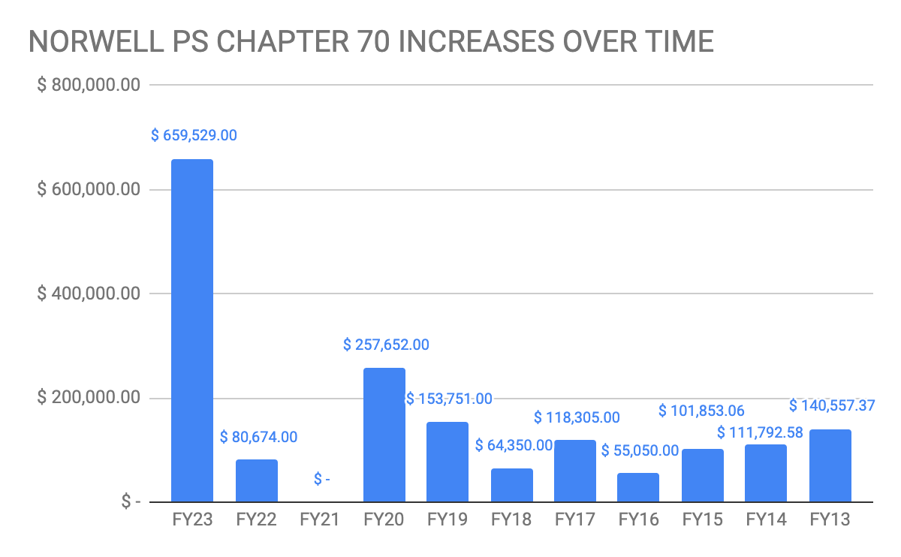

Slide 16
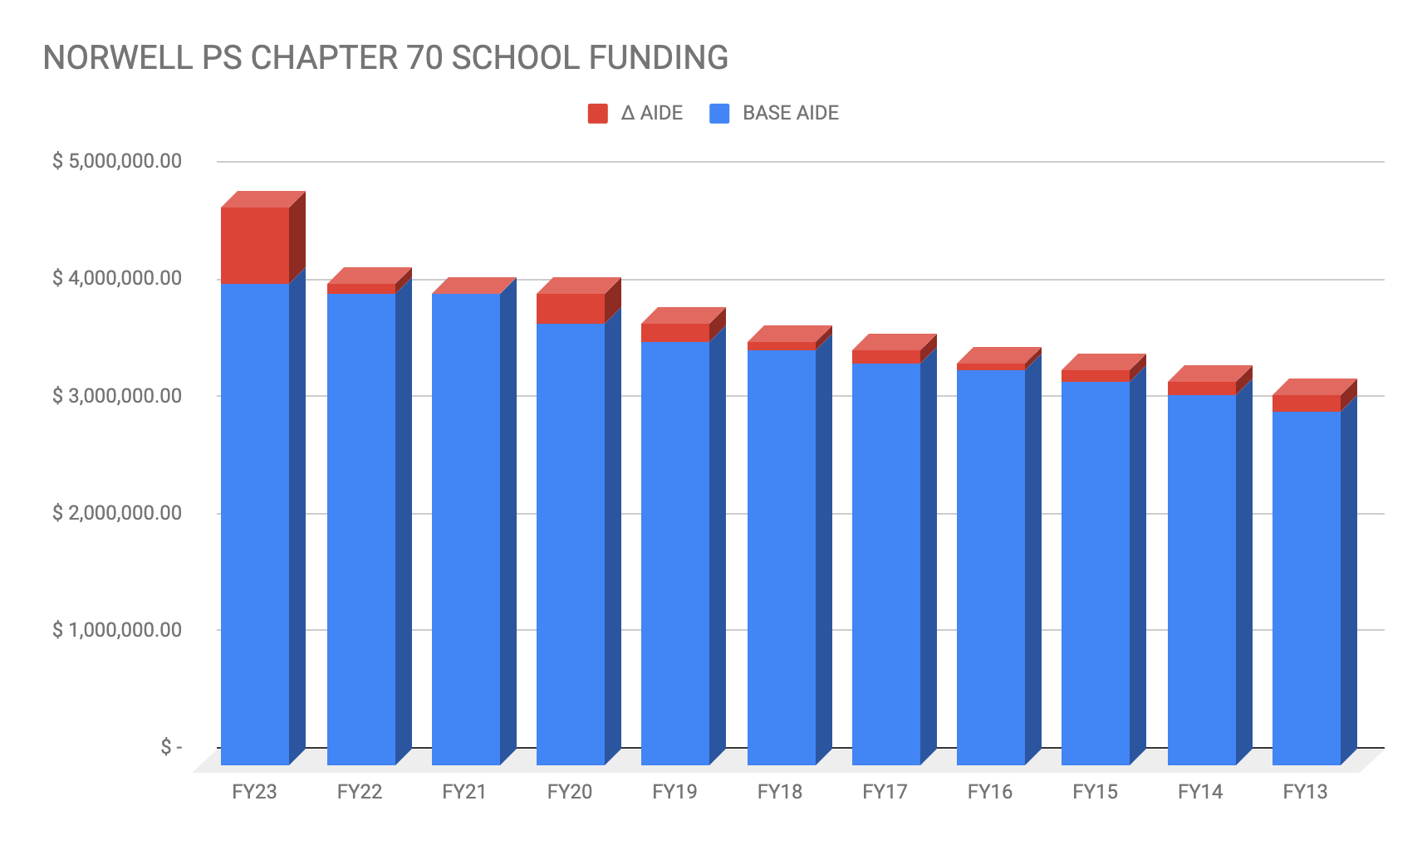
CHAPTER 70

Slide 17
SPECIAL EDUCATION SERVICES ARE AN ENTITLEMENT
  Public schools have a State and Federal responsibility to provide a Free and Appropriate Public Education (FAPE) to students (ages 3-21) with disabilities
  Our first dollars must be applied to this entitlement
  If we are unable to meet the requirements the overall budget must be reduced during the school year

Slide 18
EXTERNAL SPECIAL EDUCATION NEEDS
  Special education students placed by the district in out-of-district special education programs
    Case management (29 students)
      monitor progress
      course selection for NPS diploma
      maintain connections to district through co-curricular activities
      onsite observation of the programs
      schedule, attend, and complete regulated paperwork, annual meetings, and re-evaluation meetings

Slide 19
EXTERNAL SPECIAL EDUCATION NEEDS
  Special education students receiving equitable services
  Students placed by the parent in a private school or home school who require special education services
    Case management (14 students)
      monitor progress
      schedule, attend, and complete regulated paperwork annual meetings and re-evaluation meetings
      require a State IEP and a Federal service plan
      four meetings a year around service plans and one for IEPs
      propose a schedule to receive services within the district and propose a schedule to receive their services identified in their service plan
      required and regulated by our IDEA grant application and allocation

Slide 20
EXTERNAL SPECIAL EDUCATION NEEDS-SERVICE
  Currently performed by the Director of Student Services and District- Wide Behavior Specialist
  The proposed District-Wide Inclusion Specialist will support these needs, but the focus needs to be internal so that programming can be developed to keep students in district and return to the district
  The Special Education department will need a full-time Out-of-District Coordinator to address all external special education needs
  The pandemic has exponentially increased the demands of case management for external placements
  The effects of the pandemic on students is yet to be fully understood
  Academic, social emotional, and behavioral needs continue to be exposed due to the pandemic
  Approved special education schools have had difficulty maintaining staff and programing, resulting in students placements constantly changing

Slide 21
INTERNAL SPECIAL EDUCATION NEEDS
  Special education students served within the District
    Case management (360 students)
      Assistant Principals chair eligibility meetings - over 100 a year each
      Each student has a case manager
      Case managers responsible for all regulated paperwork: schedule meetings, write the IEP, write progress reports with each report card, all documents reviewed by Director of Student Services, participate in IST meetings, and provide specially designed instruction outlined in each student’s IEP

Slide 22
INTERNAL SPECIAL EDUCATION NEEDS-SERVICE
  Case managers need to spend quality time providing student services
  Quality time is disrupted by student dysregulation and absences
  Support needed for regulatory paperwork
  Specifically the coordinating of meetings with staff and families, inclusive of appropriate space and teacher coverage
  Support from the District-Wide Inclusion Specialist is expected to provide strategies, training, and support an increase in student regulation

Slide 23
OUT-OF-DISTRICT SPECIAL EDUCATION TUITIONS (Actuals-FY’21)
 | FY’16 | FY’21 | Total Increase | % increase
SC Budget | $24,587,972 | $29,159,539 | $4,571,567 | 18.6%
Special Ed Tuitions Budget | $949,607 | $1,420,000 | $470,393 | 49.54%
Expended from Operational Budget | $1,128,922 | $1,771,389 | $642,467 | 56.91%
Total Expenditure on Tuitions | $1,975,002 | $2,675,943 | $700,941 | 35.49%

Slide 24
OUT-OF-DISTRICT SPECIAL EDUCATION TUITIONS
Other sources of revenue applied to out-of-district special education tuitions
In 2016 the Town approved the Special Education Stabilization Fund for the purpose of funding extraordinary statutorily mandated special education out-of-district costs
  2017 - Special Town Meeting approved $50,000
  2018 - Special Town Meeting approved $50,000
Circuit Breaker Extraordinary Relief
  2016 - State granted NPS $116,653
  2018 - State granted NPS $47,513
Note: Circuit Breaker has not been fully rolled over year to year since FY’15 into FY’16

Slide 25
CIRCUIT BREAKER
What is Circuit Breaker? The state special education reimbursement program, started in FY’04 to provide additional state funding to districts for high-cost special education students.
Threshold: Circuit breaker is designed to cover a portion of tuition. The threshold for eligibility is tied to four times the state average foundation budget per pupil as calculated under the chapter 70 program, with the state paying up to 75 percent of the costs above that threshold.
Reimbursement: Circuit breaker reimbursements are for the district’s prior year’s expenses. Each summer, districts submit claim forms to DESE listing the types and amounts of special education instructional services provided to each student during the previous fiscal year. Administrative, evaluation and overhead costs are not reimbursable.
Carryover: Districts may expend these funds in the year received or carryover into the following fiscal year for any special education related purposes.
Expenditures: Amount of circuit breaker used to cover tuition costs in current year.
Balance: Circuit breaker funds in reserve.

Slide 26
CIRCUIT BREAKER EXAMPLE
Circuit Breaker Example
If a student is placed at a Private School at $72,000 per year
Tuition: $72,000
Less threshold: $45,792
$26,208 x 75% = $19,656 (reimbursed by State)
Actual cost to district: $52,344

Slide 27
CIRCUIT BREAKER EXAMPLE WITH TRANSPORTATION (TBD)
Circuit Breaker Example
If a student is placed at a Private School at $72,000 per year
Tuition: $72,000
Less threshold: $45,792
$26,208 x 75% = $19,656 (reimbursed by State)
Transportation: $16,000
Eligible Transportation: $16,000 x 50% = $8,000
$8,000 x 75% - $6,000
New Circuit Breaker reimbursement: $19,656 + $6,000 = $25,656

Slide 28
CONTINUUM OF SPECIAL EDUCATION SERVICES
FAPE: All students with disabilities are eligible for a Free and Appropriate Public Education.
In District Programs: Services delivered: a general education environment with supports.
Out of District Programs: A special education program located in a building or facility outside of the general education environment that provides educational services primarily to students with disabilities.
Private Schools: A private day or residential school, within or outside Massachusetts, that has applied to and received approval from DESE.
Collaborative Programs: Educational Collaboratives are formed by local school districts to create special education programs that supplement and strengthen the programs and services of member school districts.
Other Mass Districts: A program operated by a public school district in Massachusetts for resident students.

Slide 29
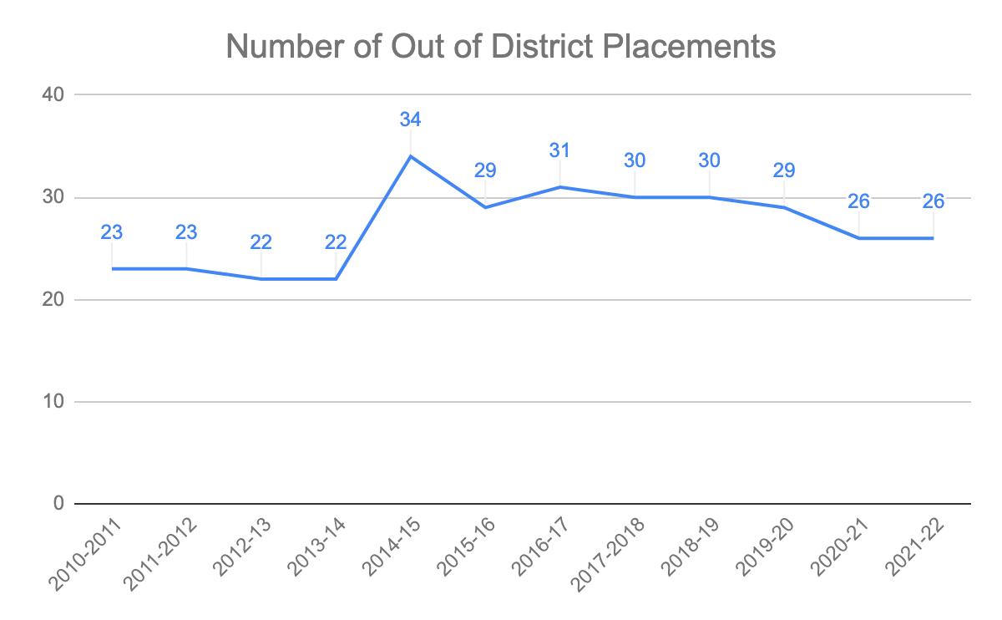
OUT-OF-DISTRICT SPECIAL EDUCATION TUITIONS (10/1/21)

Slide 30
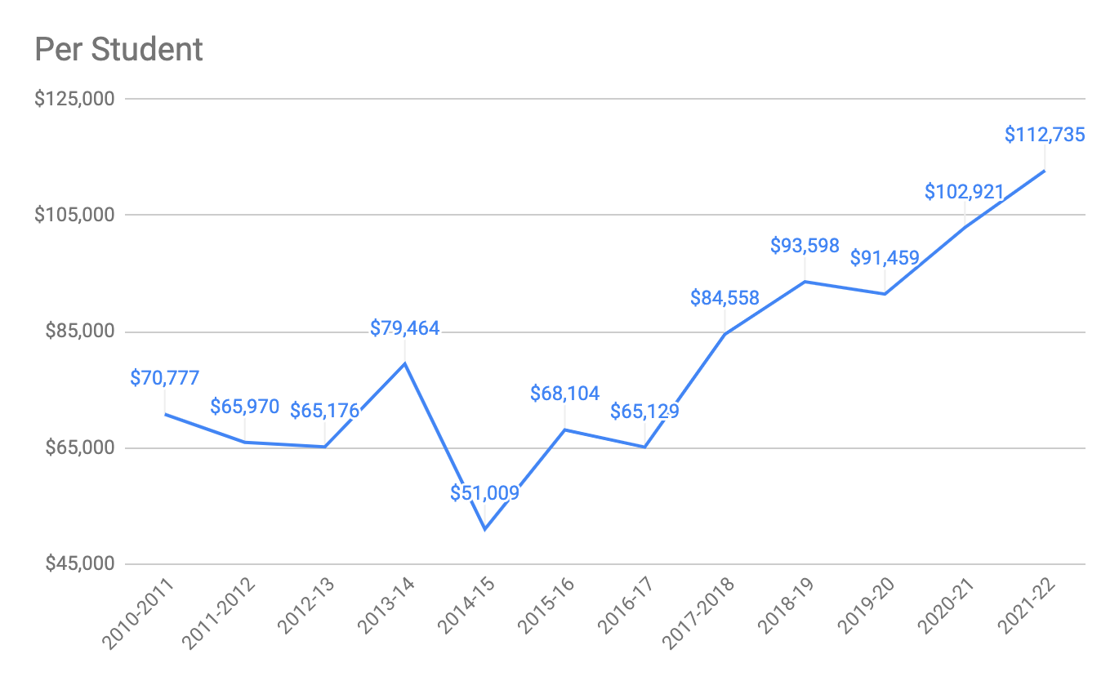
OUT-OF-DISTRICT SPECIAL EDUCATION TUITIONS

Slide 31
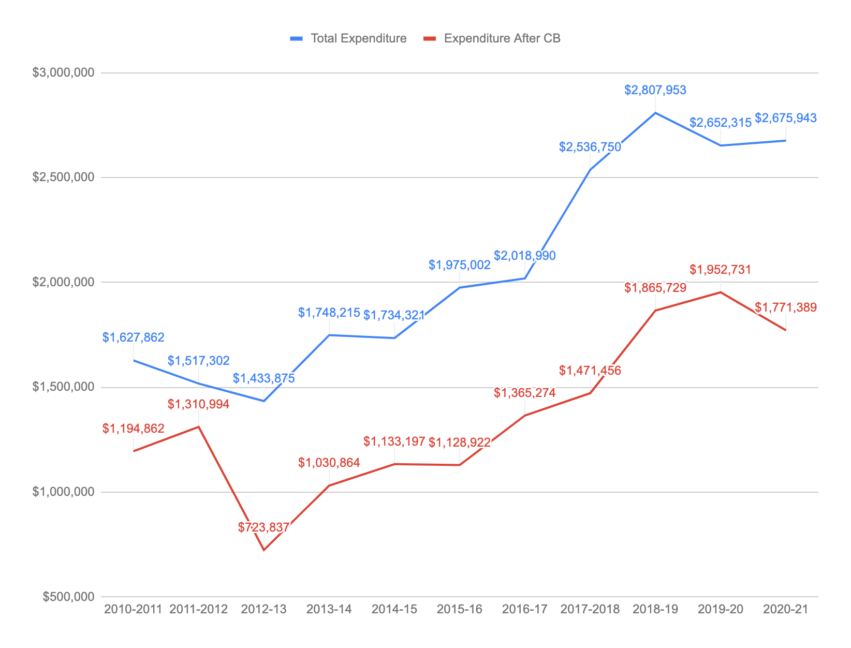
OUT-OF-DISTRICT SPECIAL EDUCATION TUITIONS

Slide 32
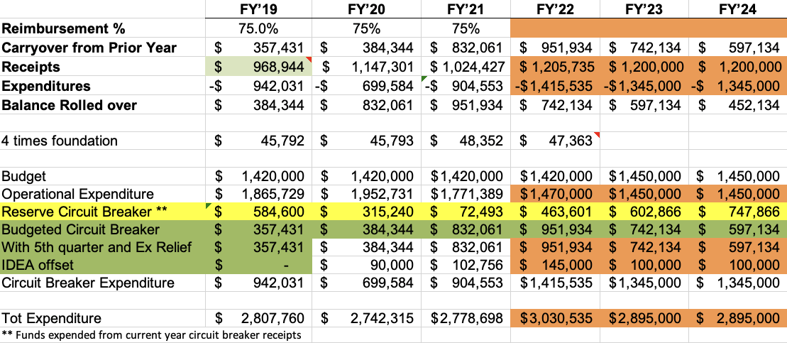
OUT-OF-DISTRICT SPECIAL EDUCATION TUITIONS PROJECTED FY’23 2/2/2022

Slide 33
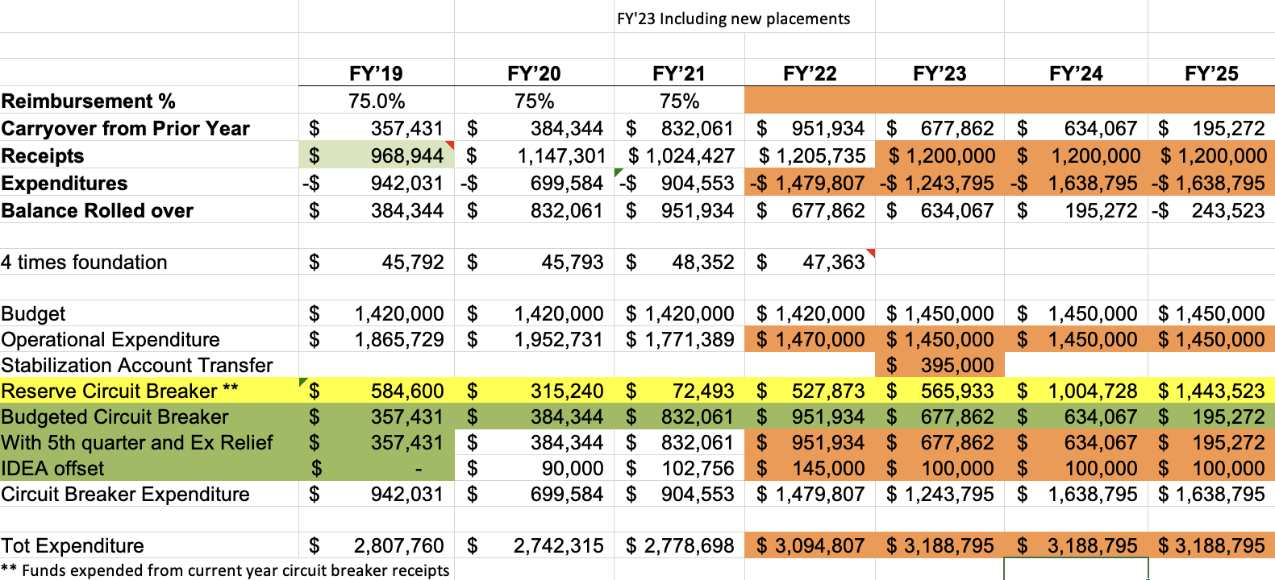
OUT-OF-DISTRICT SPECIAL EDUCATION TUITIONS PROJECTED FY’23 3/2/2022

Slide 34
STRATEGIC PLAN INITIATIVES/
COVID-19 RECOVERY INITIATIVES
Maintain
  Learning environment needs
  Assessment tools
  Instructional resources
  COVID-19 recovery initiatives
    2 math tutor / aides (ESSER grants)
  Safe learning environment
  Student academic and social/emotional confidence
  Academic stamina

Slide 35
STUDENT OPPORTUNITIES ACT (SOA)
SOA passed under MGL Chapter 132 of the Acts of 2019 on November 26, 2019
Districts are required to target Chapter 70 funds to close accountability gaps among student subgroups
NPS has submitted the required amendment to its three year plan to the Department of Elementary and Secondary Schools
Focus areas include High School music participation, kindergarten aides to support holistic student needs, and an early literacy elementary Fundations phonics program
Districts are required to implement metrics to track student progress and subgroup gap closing
While the SOA provides school funding, it does not provide funding for the oversight and implementation of the programs or regulations

Slide 36
EXECUTIVE BUDGET
The budget roll up by category shows the Initial and Executive Budgets

Slide 37
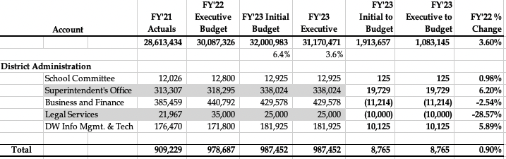
FY'23 EXECUTIVE BUDGET BY CATEGORY

Slide 38
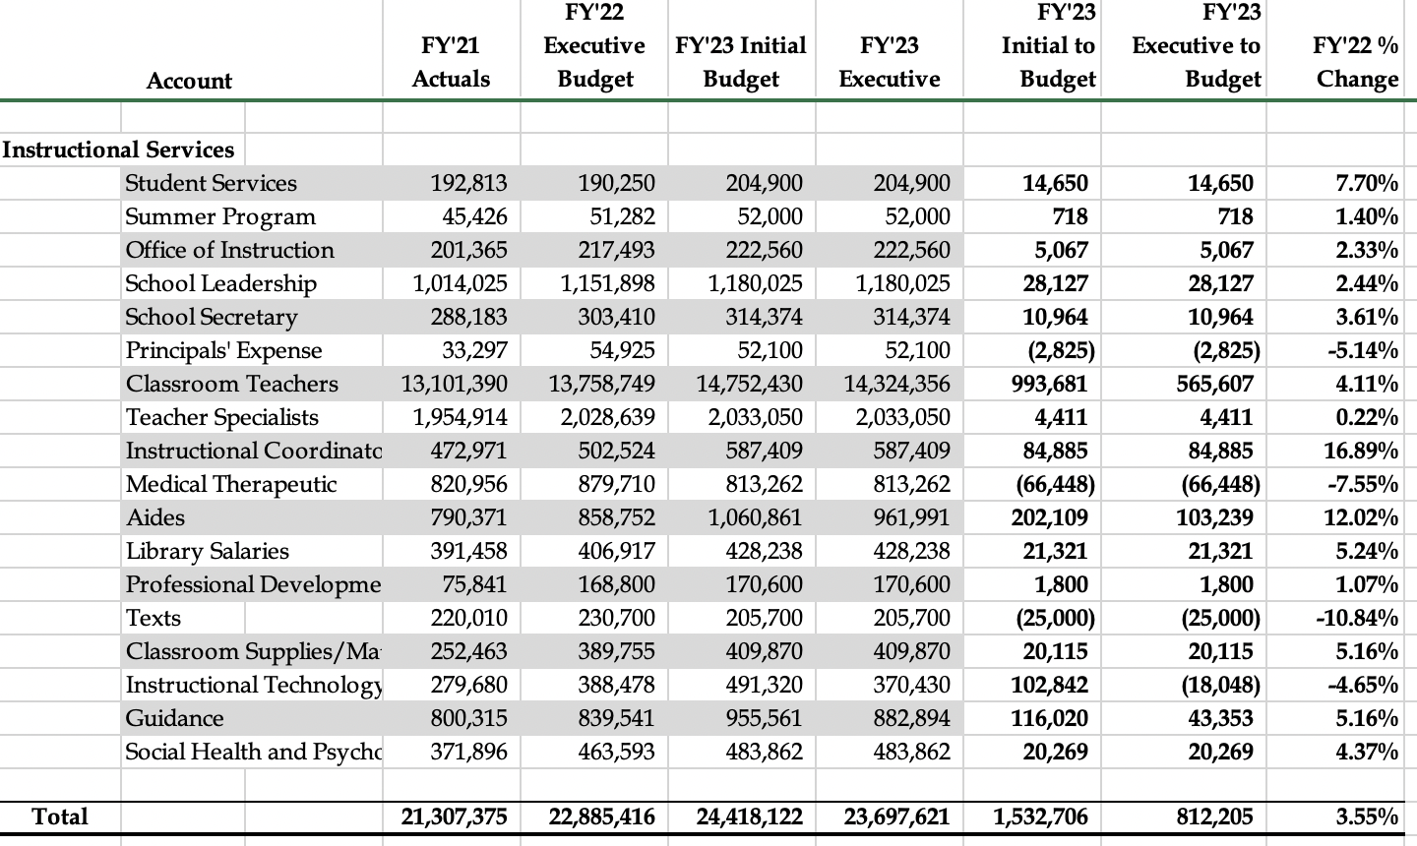
FY'23 EXECUTIVE BUDGET BY CATEGORY

Slide 39
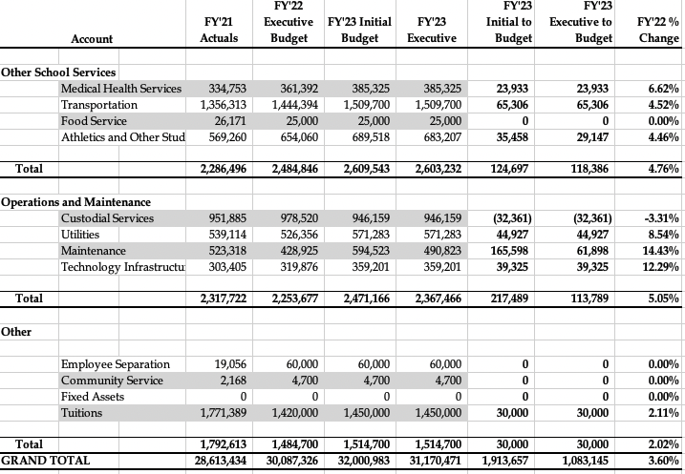
FY'23 EXECUTIVE BUDGET BY CATEGORY

Slide 40
CUTS FROM INITIAL BUDGET
Staffing Requested:
  elementary 1 math specialist
  elementary 1 STEM specialist
  elementary .8 specialist FTE
  elementary 2 building based aides
  middle school 1 guidance counselor
  middle school 1 math specialist

Slide 41
FY’23 EXECUTIVE BUDGET VARIANCE TO FY’22 BUDGET
District Administration
  Flat
Instructional Services
  Summer program - (grant)
  Classroom teachers + (1 technology teacher)
  Instructional coordinators + (1 DW special education teacher)
  Aides + (4 kindergarten aides)
  Medical therapeutic - (contract reduction)
  Instructional technology - (hardware)

Slide 42
FY’23 EXECUTIVE BUDGET VARIANCE TO FY’22 BUDGET
Other School Services
  Transportation + (known contract, McKinney-Vento), + (athletics and co-curricular stipends)
Operations and Maintenance
  Maintenance + (projects and increased rates)
  Utilities + (rates and usage)
Other: Special education out of district tuitions +
Other variances due to hiring and/or contractual
requirements

Slide 43
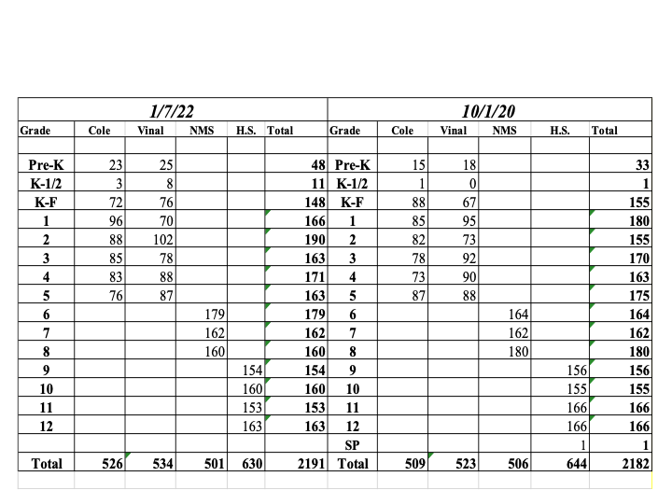
ENROLLMENT REPORT

Slide 44
CURRICULUM REVIEW
AND ADOPTION
2021-2022
Elementary Schools | Math and ELA
Middle School | World Language and Science
High School | World Language, Science, and Math
District | Initial Resource Requests
2022-2023
Elementary Schools | Math
Middle School | Science
High School | Science and Social Studies
District | Initial Resource Requests

Slide 45
TECHNOLOGY
2021-2022
Elementary Schools | Recycle portable labs and iPad carts
Middle School | Add new iPads for incoming 6th graders Upgrade teacher computers
High School | Add new iPads for 9th graders
District | Continue to improve deployment strategies
2022-2023
Elementary Schools | Recycle portable labs and iPad carts
Middle School | Add new iPads for incoming 6th graders
High School | Add new iPads for 9th graders
District | Continue to improve deployment strategies

Slide 46
FACILITY MAINTENANCE TRACKING
FY’16 - $111,661
FY’17 - $74,957
FY’18 - $93,655
FY’19 - $122,857
FY’20 - $132,688
FY’21 - $257,023*
*Does not include Plymouth County

Slide 47
PROACTIVE FACILITY MAINTENANCE FY’22
Aggressive pursuit of maintaining all facility areas
  Gym floor refinishing, Vinal, Middle, High
  Gym floor repairs, Middle
  Added water fill stations, Cole, Vinal
  Replace floor tiles, Cole, Vinal, Middle
  Replace entryway carpets, Middle
  Preventive maintenance throughout the District
    HVAC, boilers, furnaces, and painting

Slide 48
CAPITAL REQUESTS FROM FY’22
Middle School kitchen equipment
Vinal School fire panel
Vinal School HVAC
Sparrell building abatement lead
Sparrell building abatement asbestos
High School bleacher repair
Sparrell building generator

Slide 49
CAPITAL REQUESTS PENDING FY’23
Capital Requests Pending
  School kitchen equipment
  Vinal School HVAC (additional funds needed)
  Sparrell building generator (additional funds needed)
  School custodial van
  Sparrell building elevator replacement
Please see supplemental materials for more capital request information

Slide 50
MASSACHUSETTS SCHOOL BUILDING AUTHORITY (MSBA)
The Massachusetts School Building Authority ("MSBA") is a quasi-independent government authority created to reform the process of funding capital improvement projects in the Commonwealth’s public schools
The MSBA strives to work with local communities to create affordable, sustainable, and energy efficient schools across Massachusetts
Accepted projects can receive a 40% reimbursement

Slide 51
MASSACHUSETTS SCHOOL BUILDING AUTHORITY (MSBA)
Accelerated Repairs Program
Use updated processes developed for the Green Repair Program
Typically roof, window, and boiler projects
May allow for multiple projects
Project Completion: within 24 months of date of Board approved Project Scope & Budget

Slide 52
MSBA CAPITAL PROJECTS
Projected MSBA projects to be approved over the next three years.
Boiler Replacement HS - $3,433,000
Boiler Replacement Cole - $995,000
Boiler Replacement MS - $821,000
Roof Replacement MS - $1,170,000
Cost assessment study by Arise Engineering, January of 2022

Slide 53
CLIPPER COMMUNITY COMPLEX
The replacement cycle for the track and two turf fields need to be done in the next 2-6 years
Track rebuild within 2 years $230,000
Stadium turf within 2-4 years $500,000
Multi-purpose field 4-6 years $600,000
Current Stabilization Account approximately $550,000

Slide 54
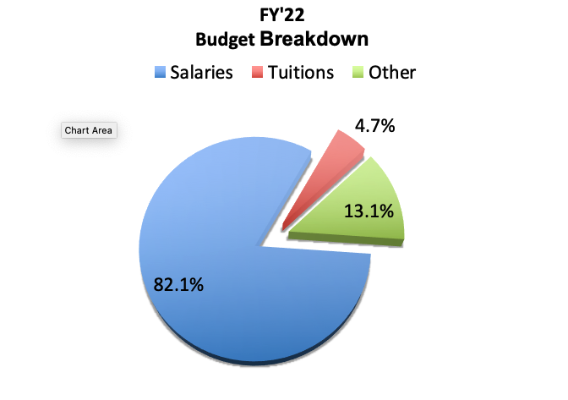
FY‘22 BUDGET BREAKDOWN PIE CHART

Slide 55
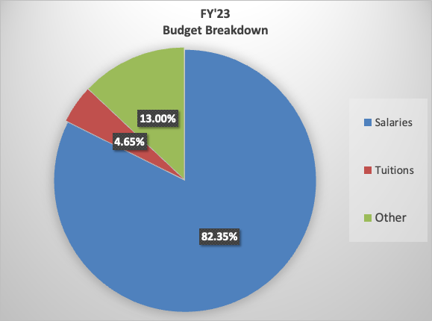
FY’23 BUDGET BREAKDOWN PIE CHART

Slide 56
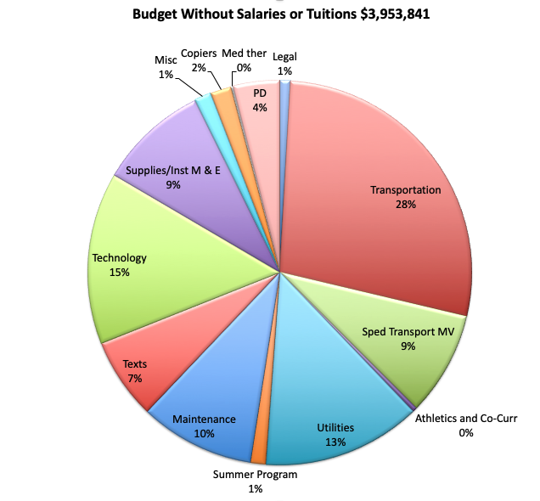
FY‘22 BUDGET BREAKDOWN PIE CHART

Slide 57
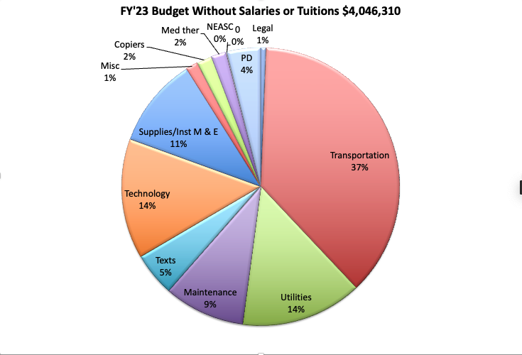
FY’23 BUDGET BREAKDOWN PIE CHART

Slide 58
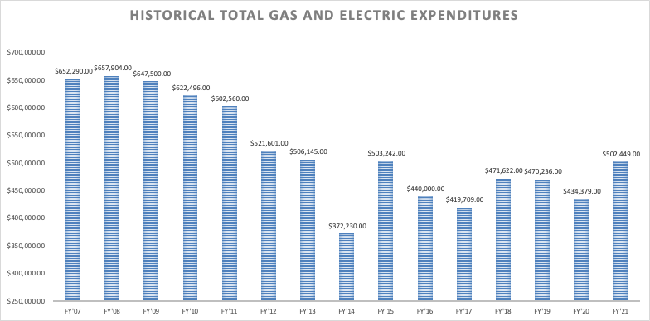
UTILITIES EXPENDITURE

Slide 59
THANK YOU
QUESTIONS?

Slide 60
TOWN SOLAR CREDITS
Solar Credits are also utilized by the street light and Town Hall electric accounts
Fiscal Year | Paid for Solar | Received in Credits | Net Gain
FY’19 | $70,272.86 | $152,436.07 | $82,163.21
FY’20 | $68,089.66 | $130,271.08 | $62,181.42
FY’21 | $64,555.40 | $114,420.14 | $49,864.74
FY’22 (Through Nov) | $42,053.85 | $77,469.77 | $35,405.92

Slide 61
CHAPTER 70 STATE AID
 | School Committee |  |  |  |  | Ch 70
 | Operational Budget | Other Funds Non Budget | Total Budget | School Committee Increases | Total increase | Aide | Increase From Prior | Net SC Budget after Ch70 impact
FY’16 | $24,587,972 |  | $24,587,972 | 3.38% | 3.38% | $3,417,653 | $55,050 | 3.15%
FY’17 | $25,444,800 | $50,000 | $25,444,800 | 3.48% | 3.48% | $3,535,958 | $118,305 | 3.00%
FY’18 | $26,332,976 | $50,000 | $26,332,976 | 3.49% | 3.49% | $3,600,308 | $64,350 | 3.24%
FY’19 | $27,251,768 |  | $27,251,768 | 3.49% | 3.49% | $3,754,059 | $153,751 | 2.91%
FY’20 | $28,178,328 |  | $28,178,328 | 3.40% | 3.40% | $4,011,711 | $257,652 | 2.57%
FY’21 | $28,459,539 | $600,000 | $29,059,539 | 1% | 3.03% | $4,011,711 | $0 | 3.03%
FY’22 | $30,087,328 |  | $30,087,328 | 3.54% | 3.54% | $4,092,385 | $80,674 | 3.26%

Slide 62
FUNDS RETURNED TO THE GENERAL FUND
 | Medicaid |  | McKinney-Vento | Articles | Total
 | Receipts | Fee to Town | Aide | Returned Article Money | Returned
FY’13 | $47,170 | $3,066 | $16,350 | $63,114 | $123,568
FY’14 | $131,523 | $8,549 | $11,985 | $918 | $135,877
FY’15 | $93,195 | $6,058 | $12,763 | $0 | $99,900
FY’16 | $105,182 | $6,837 | $25,474 | $0 | $123,819
FY’17 | $19,782 | $1,286 | $17,938 | $2,293.15 | $38,727.15
FY’18 | $69,369 | $4,509 | $14,685 | $0 | $79,545
FY’19 | $68,212 | $4,434 | $17,458 | $39,717 | $120,953
FY’20 | $16,878 | $1,097 | $38,735 | $54 | $54,570
FY’21 | $50,639 | $3,292 | $0 | $3,531 | $50,878

Slide 63
STATE & FEDERAL GRANTS
IDEA (Special Education) (FY’22 - $485,119)
● Special Education Transportation, Aides and
Tuitions. Medical Therapeutic Contracts
ARP IDEA (Special Education) (FY’22 - $111,588)
Early Childhood (FY’22 - $15,103)
ARP Early Childhood (FY’22 - $9,929)
ESSER 3 emergency relief (FY’22 - $170,448)
Title I (Disadvantaged Student) (FY’22 - $39,379)
Title II (Teacher Quality, PD) (FY’22 - $22,118)

