Slide 1

Norwell Middle School
Kindness Campaign
Recognizing the importance of being kind and ensuring that our actions demonstrate kindness towards ourselves and others.
Notes:
The Golden Rule.
If you don’t have anything nice to say, don’t say it at all.

Slide 2
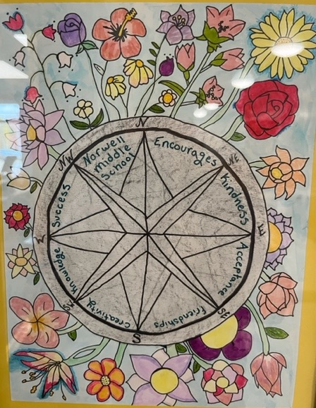
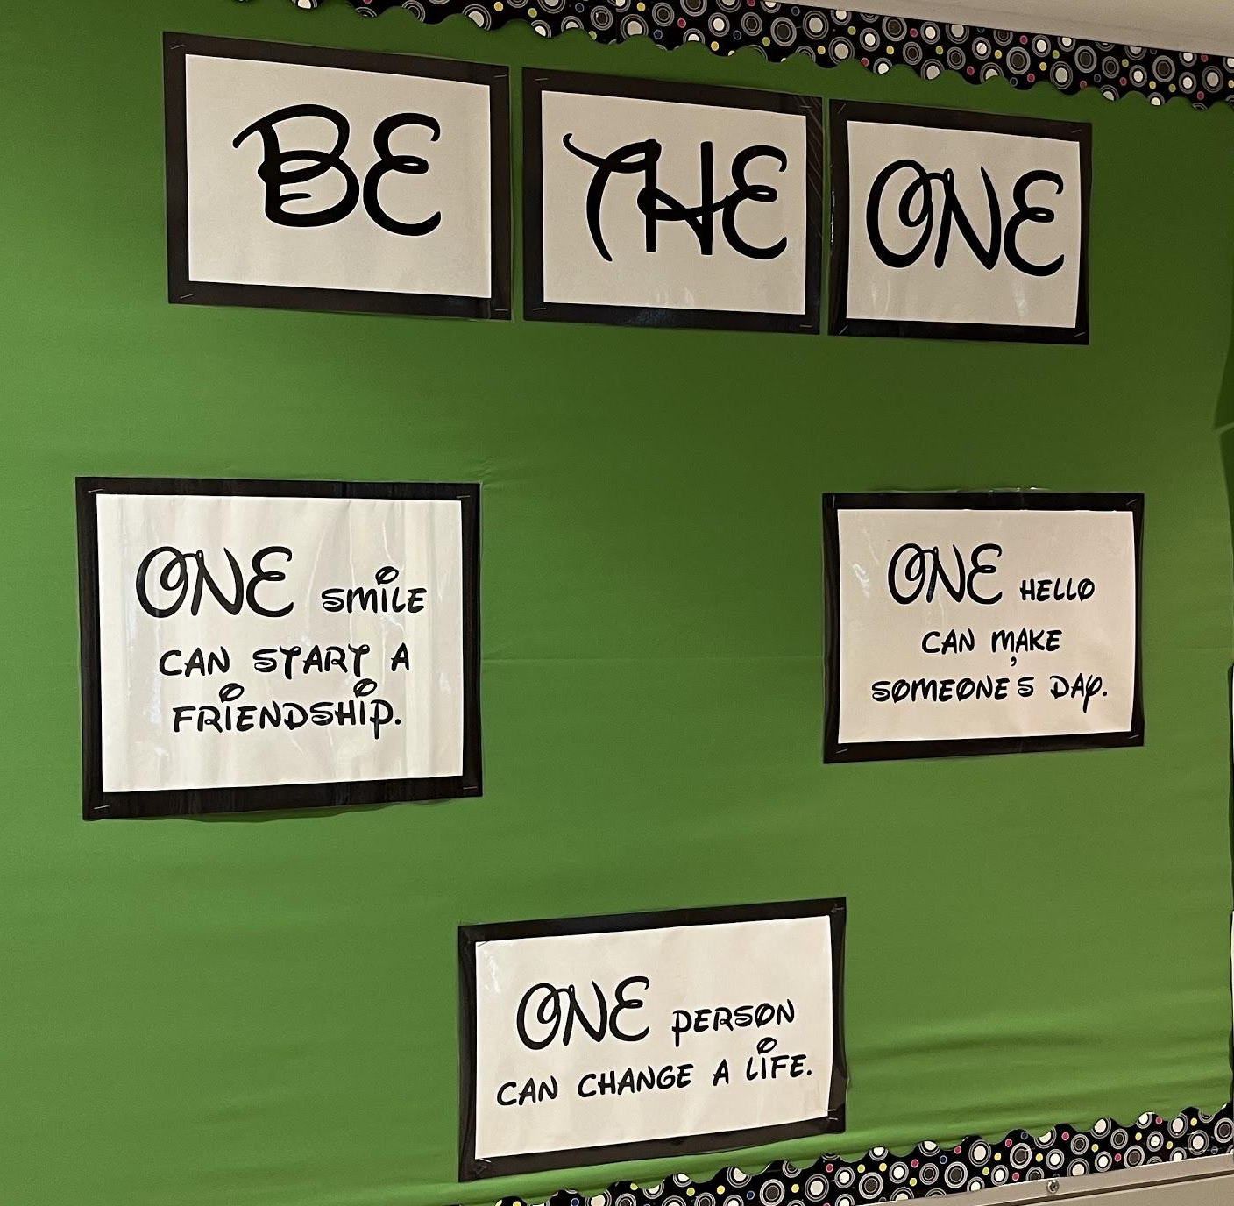
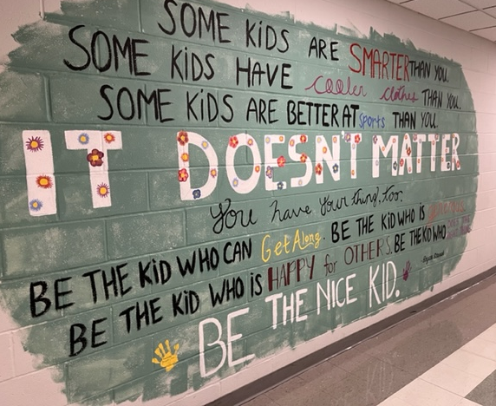
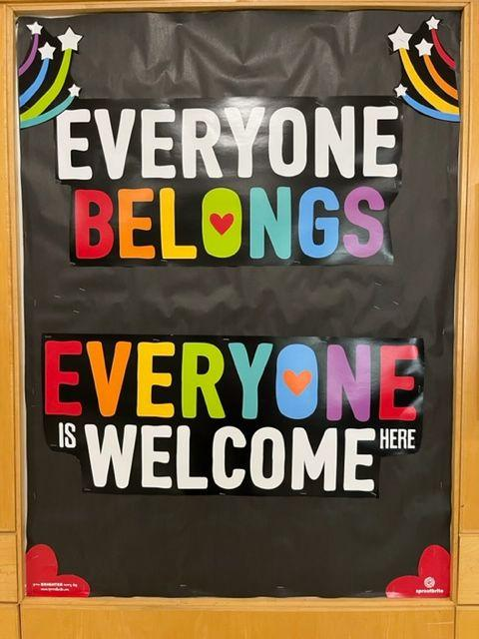
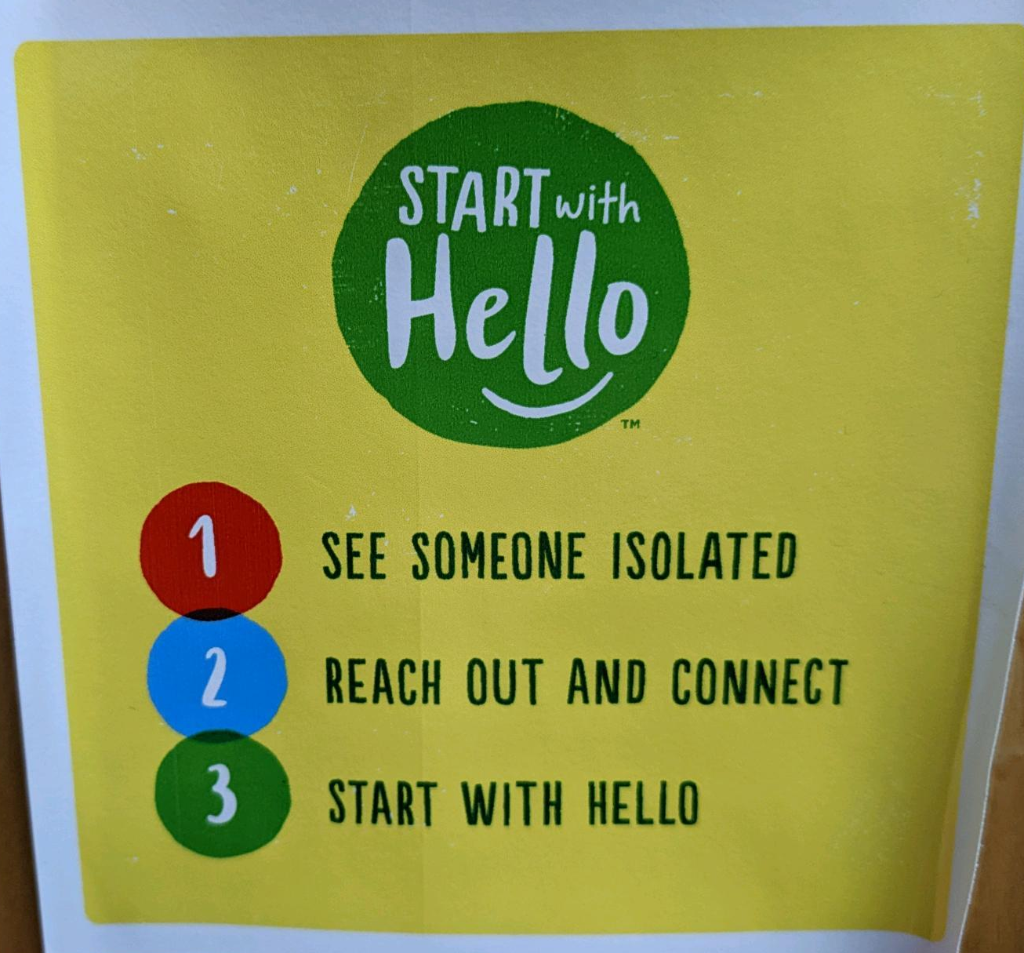
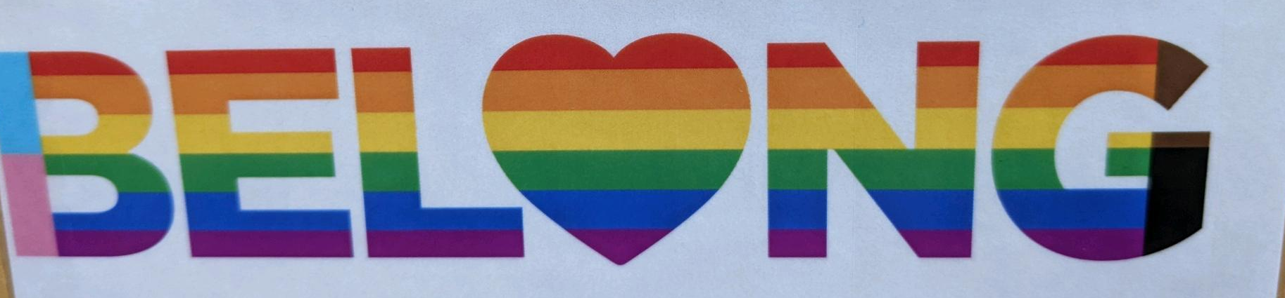
Some examples of the kind messages we see around Norwell Middle School school
Notes:
The Golden Rule.
If you don’t have anything nice to say, don’t say it at all.

Slide 3
Some examples of NOT kind messages we have seen around Norwell Middle School school
Negative comments about someone’s personal interests or situations.
“My friend didn’t have lunch money on his account and when they told him that, the kid behind him laughed. There was no reason to laugh.”
Saying “hi there”, with a sarcastic tone, to someone then walking away and laughing.
Students rolling their eyes at each other when another student answers a question in class.
“Eeew, look how ugly they are.” - students loudly commenting on student photos.
One student was seen mouthing “stupid” to another student when she answered the question wrong.
Assigning nicknames and using them without kids permission.
Unkind Tik Toks and group chats, that encourage people to make rude comments.
“I can’t really think of a time when I saw someone be kind.”
Notes:
The Golden Rule.
If you don’t have anything nice to say, don’t say it at all.

Slide 4

Celebrity Anti-Bullying Video

Slide 5
Takeaways - Related to Norwell Middle School
A person’s true value is found beneath the surface and we all have something special to offer.
If you have made mistakes in the past, it is never too late to make positive changes. You can make a change and act with kindness!
If you have been a bystander in the past, it it never too late to use your power and influence by speaking up
Building your confidence from within rather than building your confidence by putting others down.
Middle school has been a difficult time for a lot of people and if that’s going to change, the change starts with you.
It’s about building a culture, a culture where people can belong, be themselves and feel good about that.
Notes:
The Golden Rule.
If you don’t have anything nice to say, don’t say it at all.

Slide 6
Takeaways…cont…
No one is better than anyone else, you all have your own strengths and weaknesses
Think about who you want to be! What kind of person do you want to be and make sure your actions match that.
You give mean people/bullies power when you stay silent.
Create a culture where everyone is valued.
Create a culture where it’s not cool to be a bully/be mean.
Your actions and words can hurt people.
Don’t be the one who makes someone’s day worse.
Treat other people the way you want them to treat you.
Do you think it takes more strength to stand up, or join in?

Slide 7
WHAT’S NEXT?
Kindness Action Plan
Notes:
The Golden Rule.
If you don’t have anything nice to say, don’t say it at all.

