Slide 1

Norwell Middle School
Kindness Campaign
Recognizing the importance of being kind and ensuring that our actions demonstrate kindness towards ourselves and others.
Notes:
The Golden Rule.
If you don’t have anything nice to say, don’t say it at all.

Slide 2
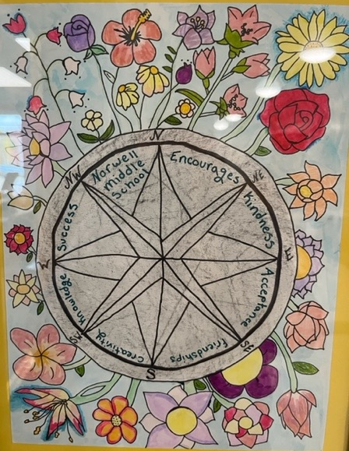
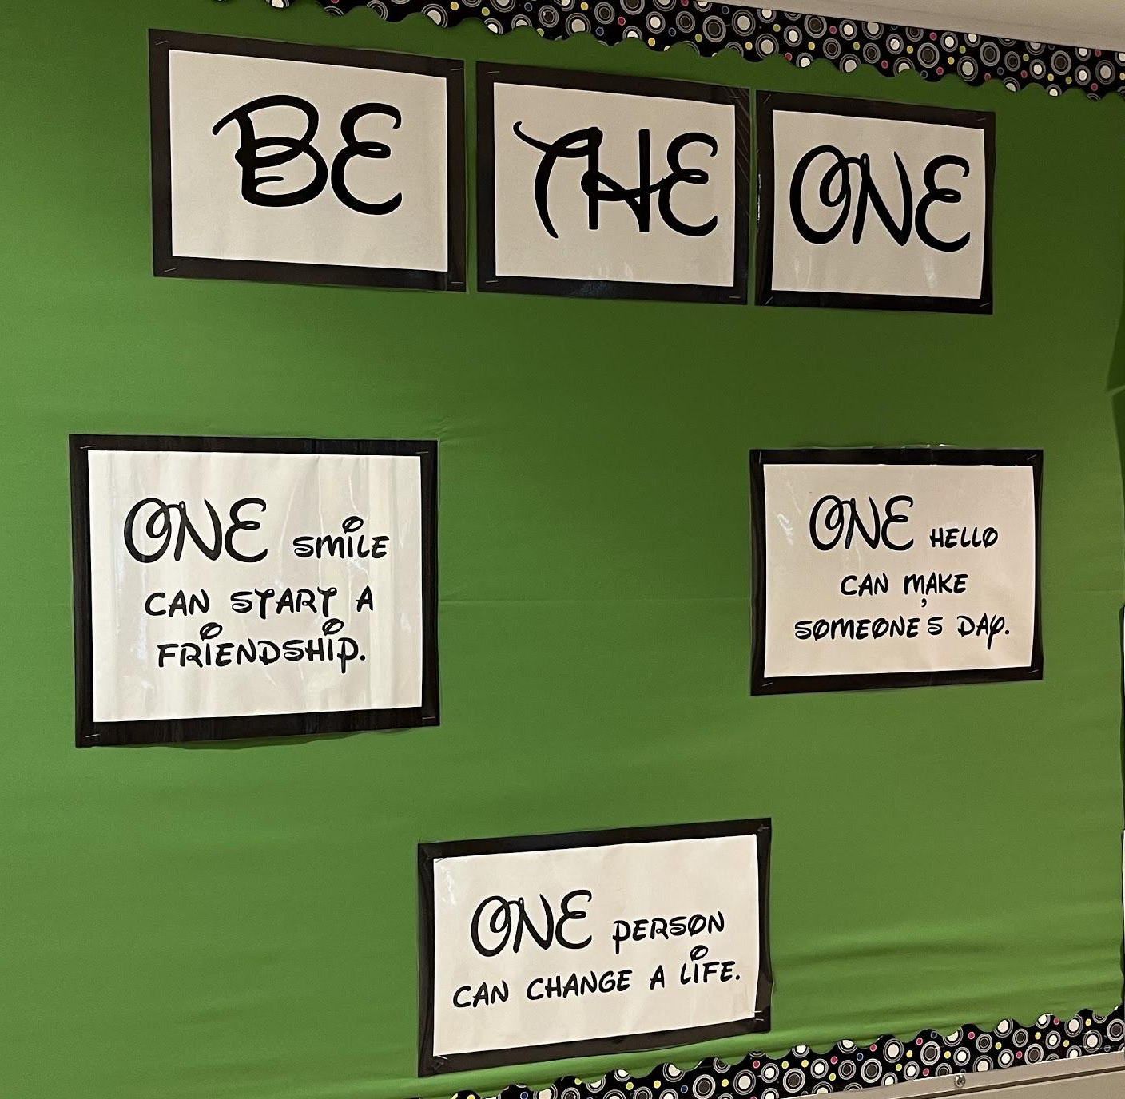
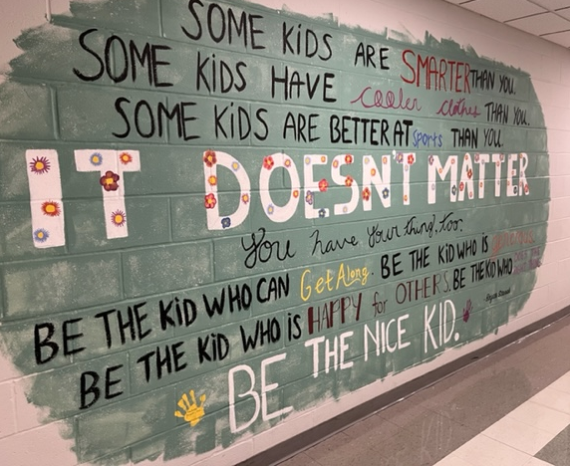
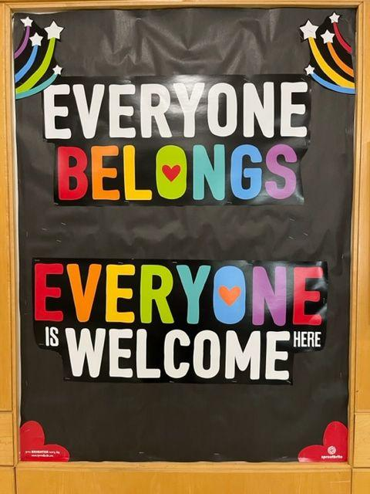
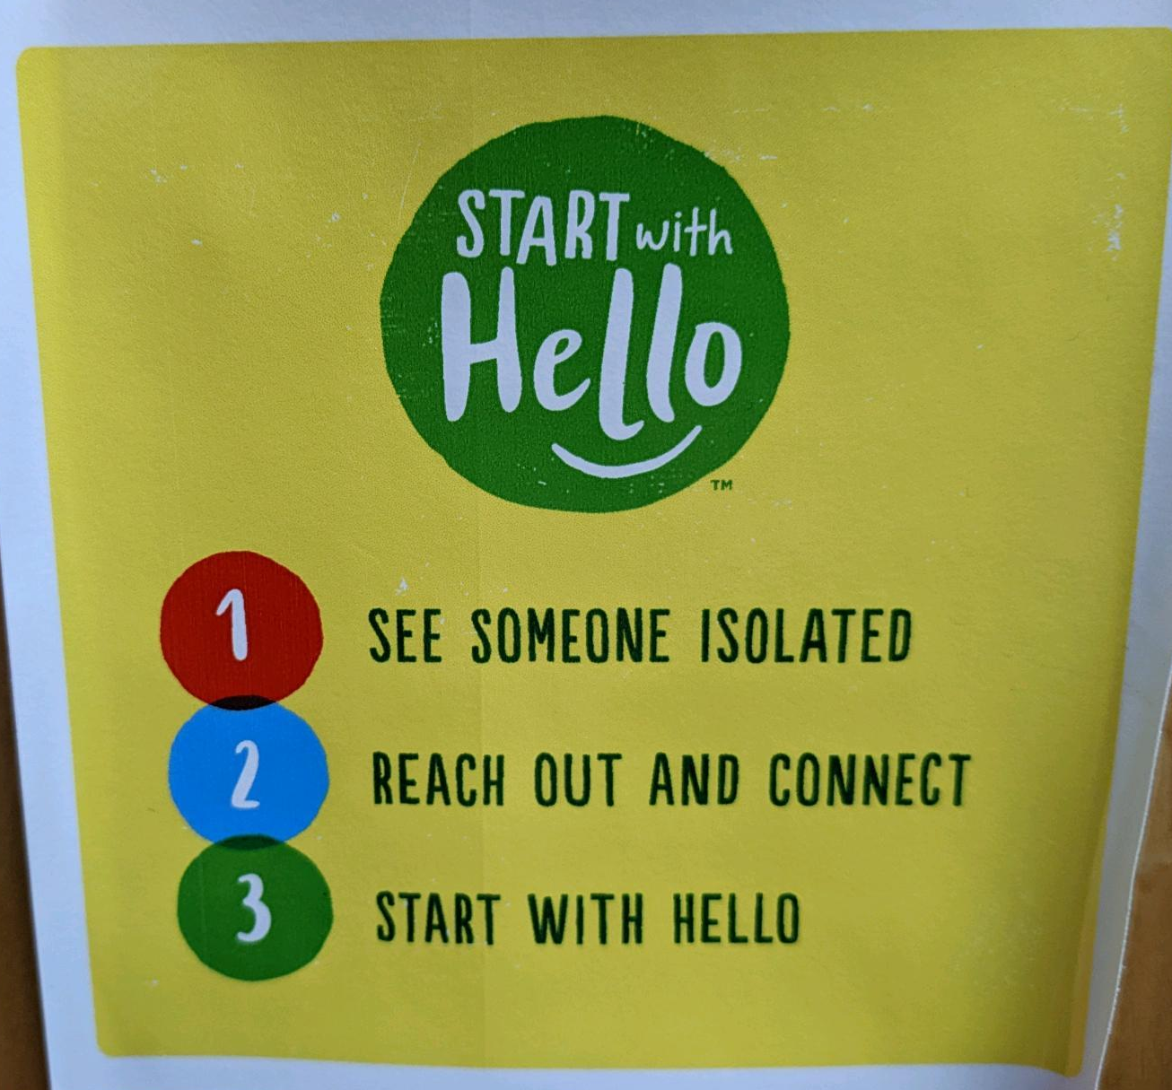
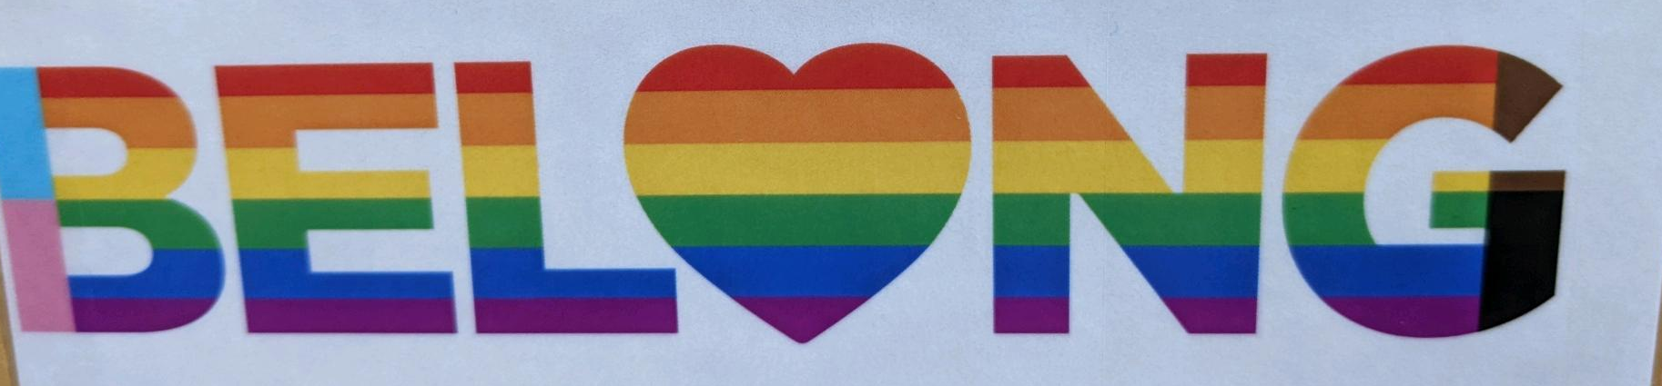
Some examples of the kind messages we see around Norwell Middle School school
Notes:
The Golden Rule.
If you don’t have anything nice to say, don’t say it at all.

Slide 3
Some examples of NOT kind messages we have seen & heard around Norwell Middle School
Negative comments about someone’s personal interests or situations.
“My friend didn’t have lunch money on his account and when they told him that, the kid behind him laughed. There was no reason to laugh.”
Saying “hi there”, with a sarcastic tone, to someone then walking away and laughing.
Students rolling their eyes at each other when another student answers a question in class.
“Eeew, look how ugly they are.” - students loudly commenting on student photos.
One student was seen mouthing “stupid” to another student when she answered the question wrong.
Assigning nicknames and using them without kids permission.
Unkind tiktoks and group chats, that encourage people to make rude comments.
“I can’t really think of a time when I saw someone be kind.”
Notes:
The Golden Rule.
If you don’t have anything nice to say, don’t say it at all.

Slide 4
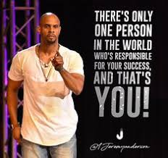
JEREMY ANDERSON ANTI-BULLYING
As a youngster, Jeremy experienced many academic and social challenges that led to failing classes and the abuse of alcohol and drugs. Jeremy turned
his life around and now shares what he learned from his life’s
experiences with schools, foundations and companies around
the globe. Jeremy and his wife also own several businesses.
Jeremy’s passion and life's work are to help students and teachers
become the best version of themselves.

Slide 5
Takeaways - related to Norwell Middle School
If you have made mistakes in the past, it is never too late to make positive changes. You can make a change and act with kindness!
If you have been a bystander in the past, it it never too late to use your power and influence by speaking up
We are a community, we all have the right to come to school and feel safe and respected (we should be encouraging others rather than putting others down)
Building your confidence from within rather than building your confidence by putting others down.
No one is better than anyone else, you all have your own strengths and weaknesses
Think about who you want to be! What kind of person do you want to be and make sure your actions match that.
Notes:
The Golden Rule.
If you don’t have anything nice to say, don’t say it at all.

Slide 6
Takeaways…cont…
Do you want to be someone who hurts people?
Or do you want to be someone who stands up for people?
You give mean people/bullies power when you stay silent.
Create a culture where everyone is valued.
Create a culture where it’s not cool to be a bully/be mean.
Your actions and words can hurt people.
Don’t be the one who makes someone’s day worse.
Treat other people the way you want them to treat you.
Do you think it takes more strength to stand up, or join in?

Slide 7
WHAT’S NEXT?
Kindness Action Plan
Notes:
The Golden Rule.
If you don’t have anything nice to say, don’t say it at all.

