Slide 1

Norwell Middle School
Kindness Campaign
Recognizing the importance of being kind and ensuring that our actions demonstrate kindness towards ourselves and others.
Notes:
The Golden Rule.
If you don’t have anything nice to say, don’t say it at all.

Slide 2
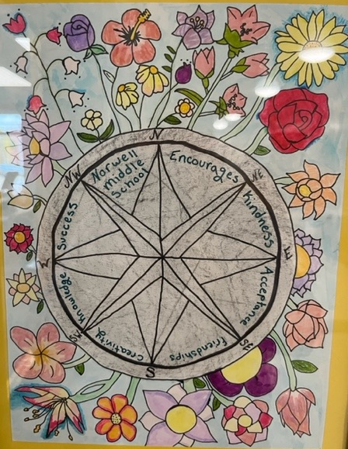
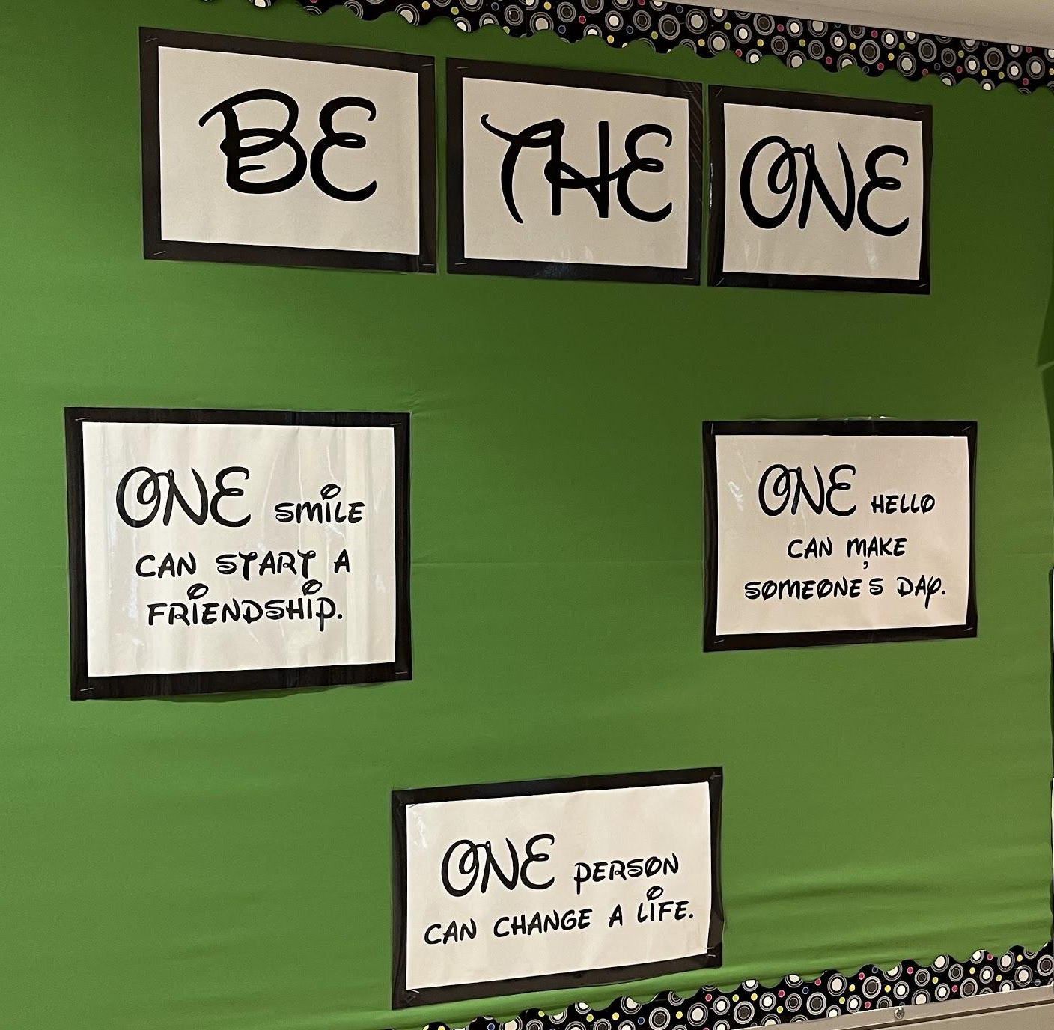
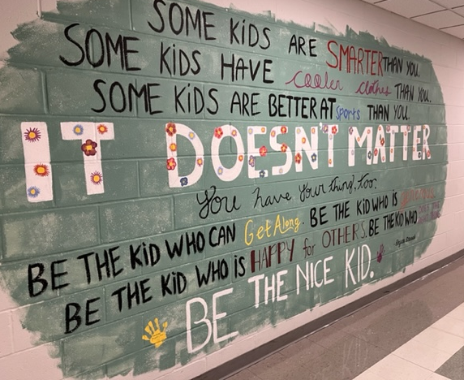
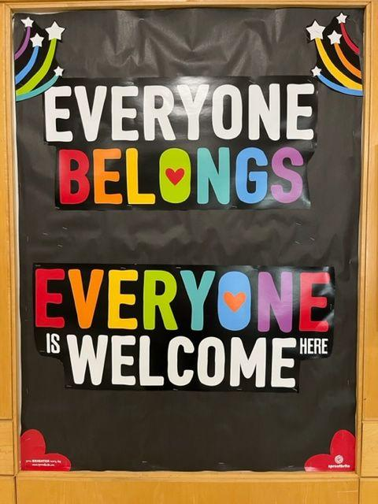
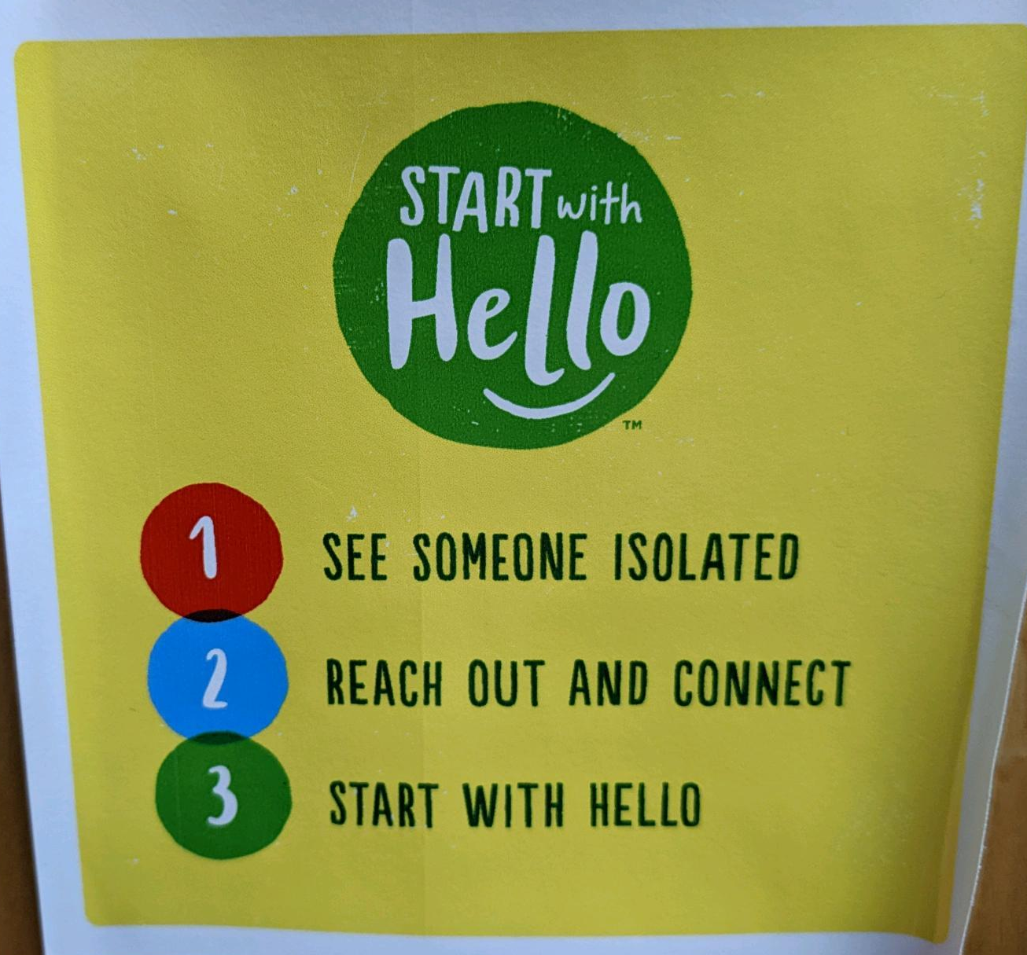
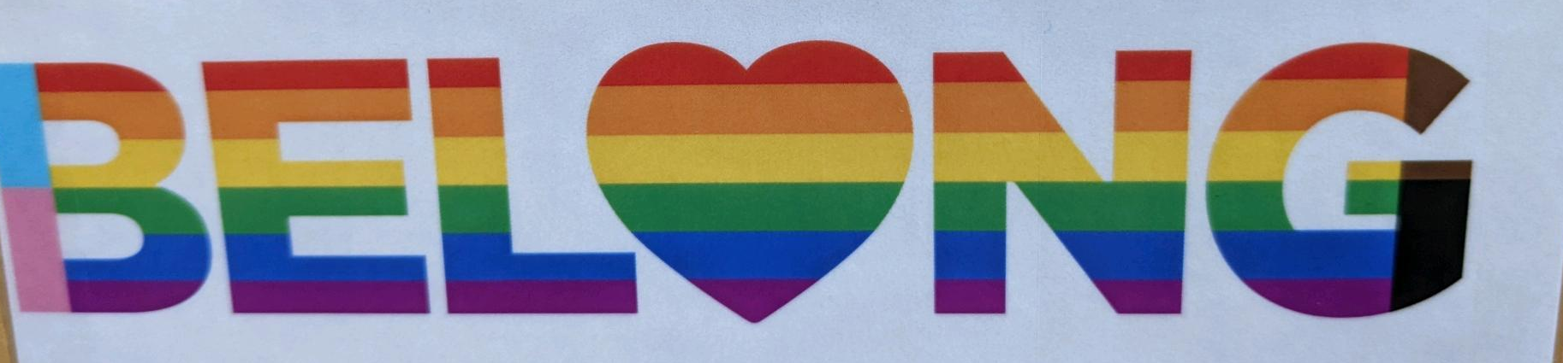
Some examples of the kind messages we see around Norwell Middle School school
Notes:
The Golden Rule.
If you don’t have anything nice to say, don’t say it at all.

Slide 3
Some examples of NOT kind messages we have seen around Norwell Middle School school
Negative comments about someone’s personal interests or situations.
“My friend didn’t have lunch money on his account and when they told him that, the kid behind him laughed. There was no reason to laugh.”
Saying “hi there”, with a sarcastic tone, to someone then walking away and laughing.
Students rolling their eyes at each other when another student answers a question in class.
“Eeew, look how ugly they are.” - students loudly commenting on student photos.
One student was seen mouthing “stupid” to another student when she answered the question wrong.
Assigning nicknames and using them without kids permission.
Unkind TikToks and group chats, that encourage people to make rude comments.
“I can’t really think of a time when I saw someone be kind.”
Notes:
The Golden Rule.
If you don’t have anything nice to say, don’t say it at all.

Slide 4
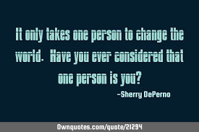
Anti-bullying - It Only Takes One

Slide 5
Takeaways - Related to Norwell Middle School
Would you have the courage to stand up to someone who is bullying someone else?
A true friend is someone who stands up for you, and stands up with you.
Is it okay to forgive someone who has been mean to you?
When you see something wrong going on, it’s important to recognize it, trust your instincts and not join in.
Not joining in is a step, but saying “no” or “don’t do that” is important too.
You should never stand back and film someone being harassed or bullied, that makes you just as bad as the person doing the bullying.
When the people held hands at the end they were changing the culture of the scene, and it’s important to create that strong culture together.
Notes:
The Golden Rule.
If you don’t have anything nice to say, don’t say it at all.

Slide 6
Takeaways…cont…
No one is better than anyone else, you all have your own strengths and weaknesses
Think about who you want to be! What kind of person do you want to be and make sure your actions match that.
You give mean people/bullies power when you stay silent.
Create a culture where everyone is valued.
Create a culture where it’s not cool to be a bully/be mean.
Your actions and words can hurt people.
Don’t be the one who makes someone’s day worse.
Treat other people the way you want them to treat you.
Do you think it takes more strength to stand up, or join in?

Slide 7
WHAT’S NEXT?
Kindness Action Plan
Notes:
The Golden Rule.
If you don’t have anything nice to say, don’t say it at all.

