Slide 1
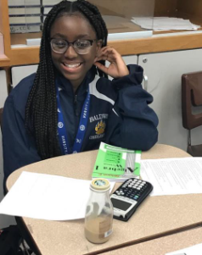
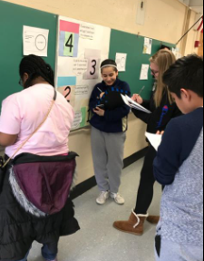
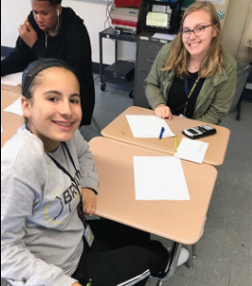
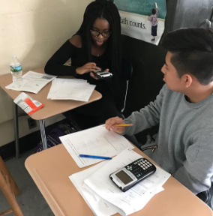

Middle School Math Information Night September 14th, 2023

Slide 2

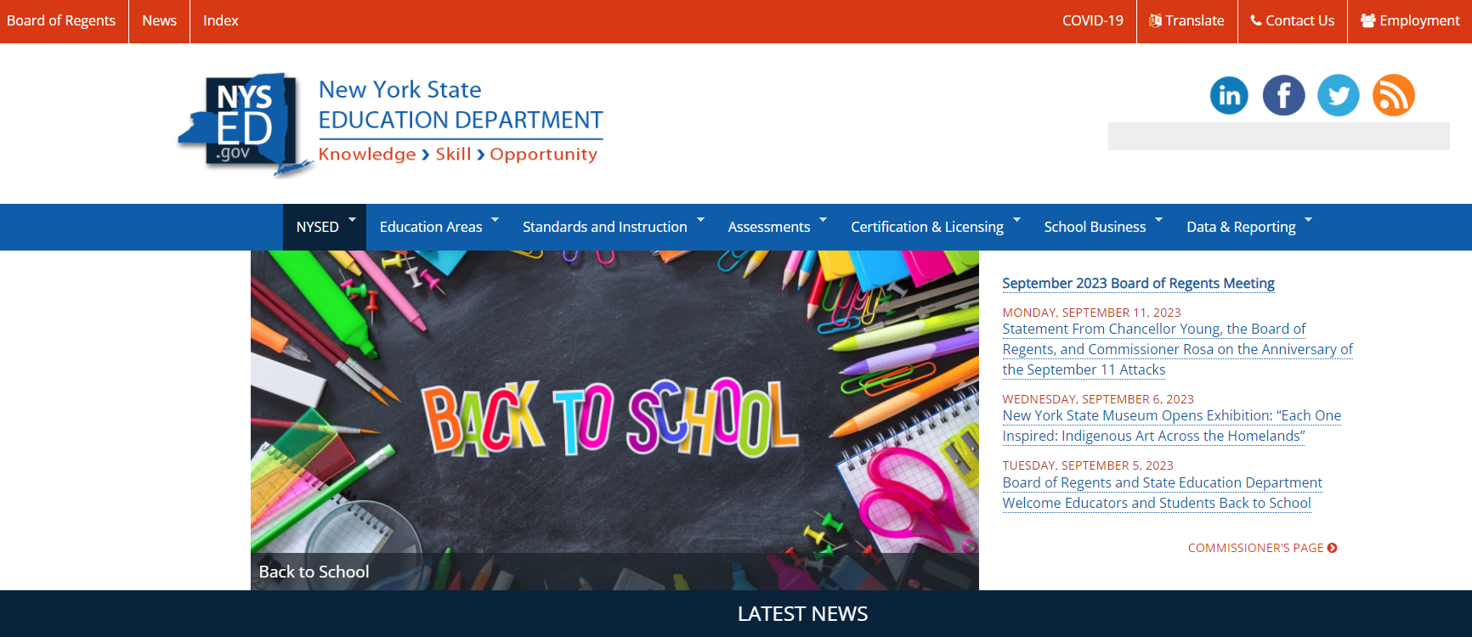
New York State Education Department website
Nysed.gov
Seven learners qualified to earn the Special Appeal.

Slide 3
New York State Education Department website
Nysed.gov
Seven learners qualified to earn the Special Appeal.

Slide 4

New York State Education Department website
Nysed.gov
Seven learners qualified to earn the Special Appeal.

Slide 5
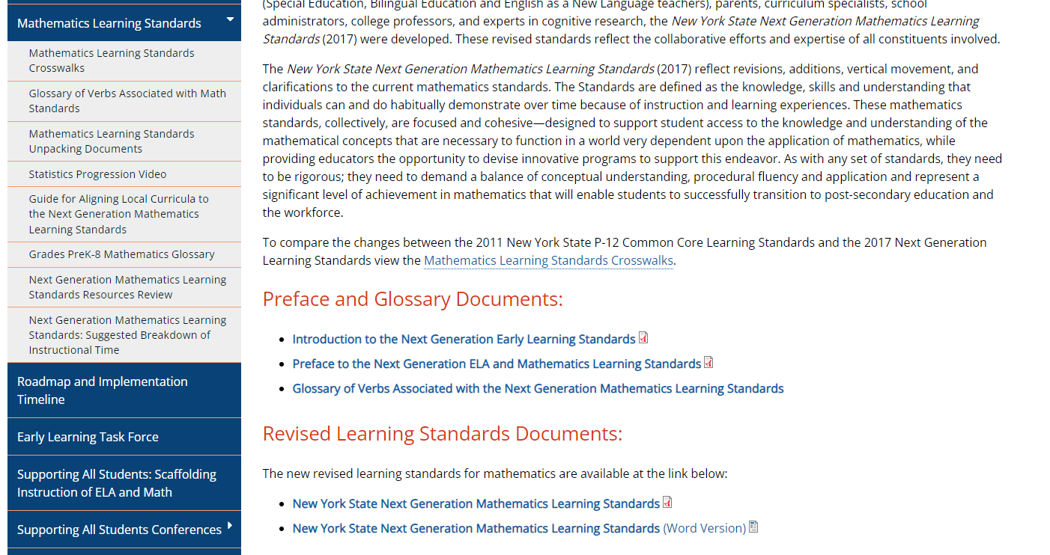
New York State Education Department website
Nysed.gov
Seven learners qualified to earn the Special Appeal.

Slide 6
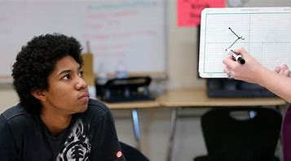

NYS Next Generation
Mathematics Learning Standards

Slide 7
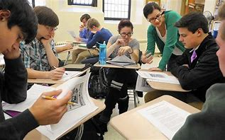
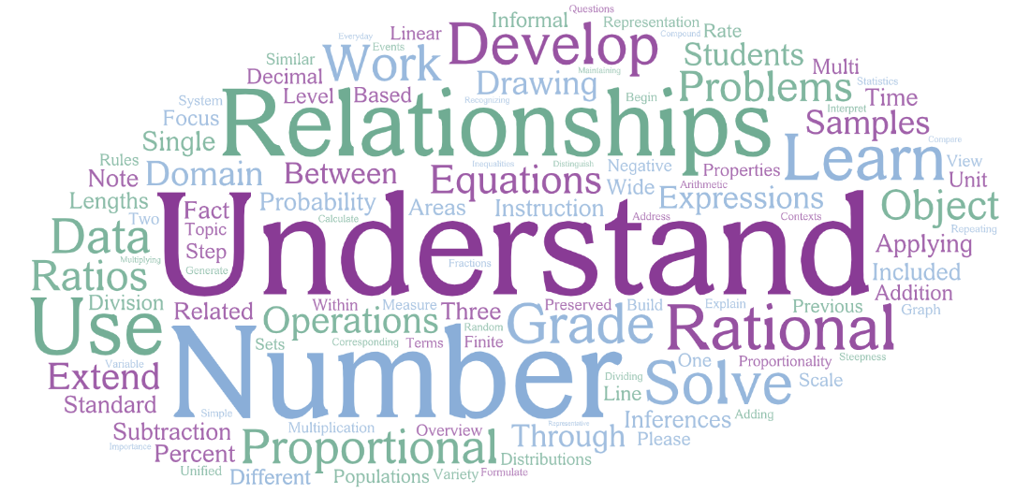
Grade 7 Overview
Overview
  Ratios and Proportional Relationships
  Number System & Expressions, Equations, and Inequalities
  Statistics & Probability

Slide 8
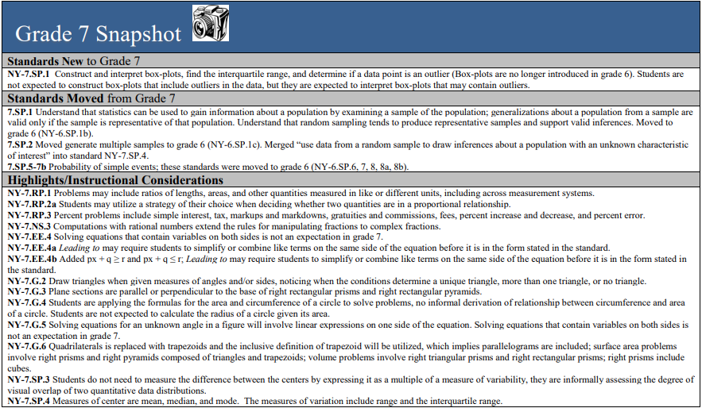
Grade 7 Snapshot

Slide 9
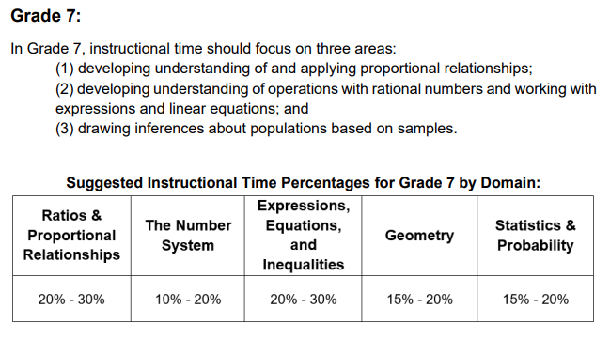
Grade 7
Suggested Breakdown

Slide 10

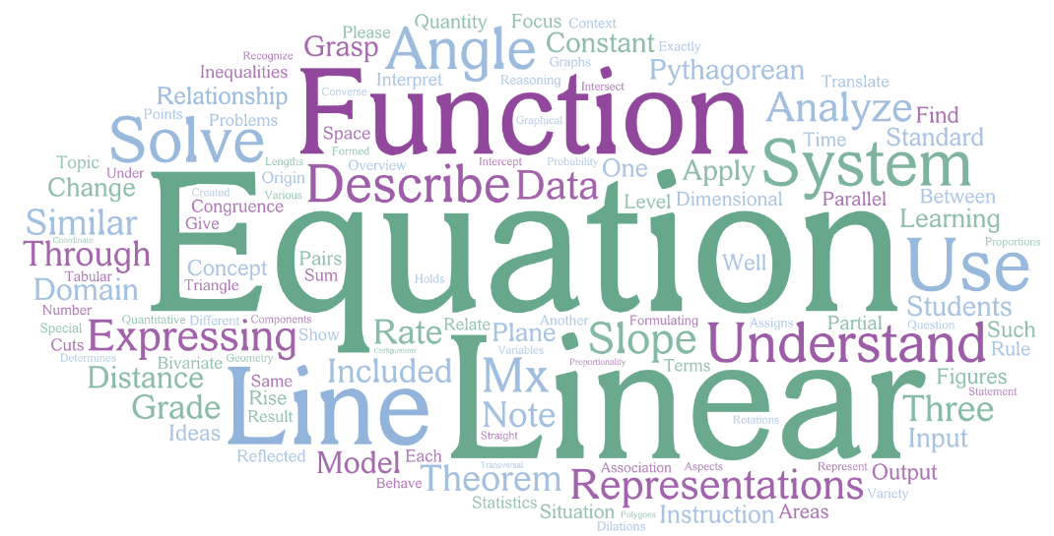

Grade 8 Overview
Overview
  Number System, Expressions, Equations, and Inequalities & Probability/Statistics
  Functions & Expressions, Equations, and Inequalities
  Geometry

Slide 11
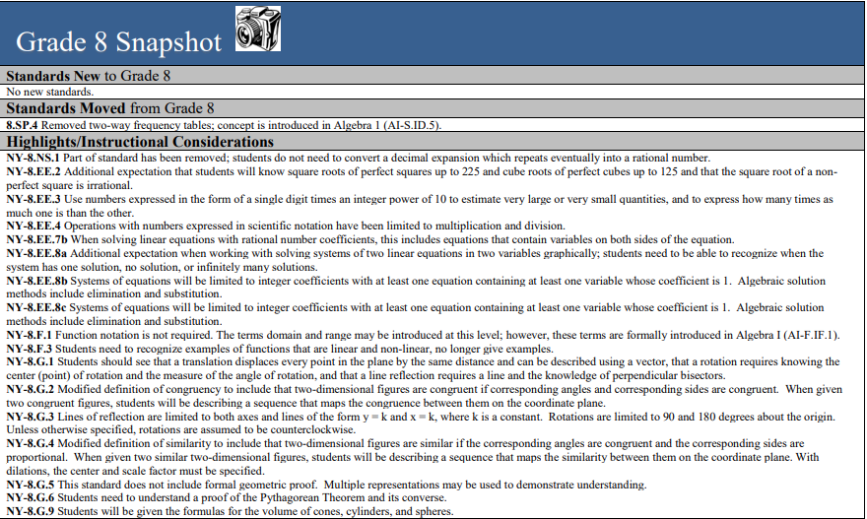
Grade 8 Snapshot

Slide 12
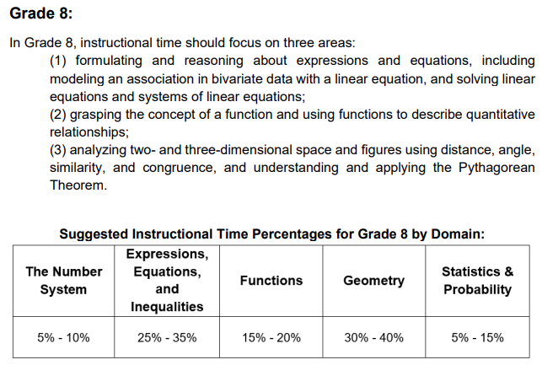
Grade 8 Snapshot

Slide 13
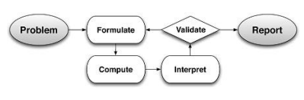
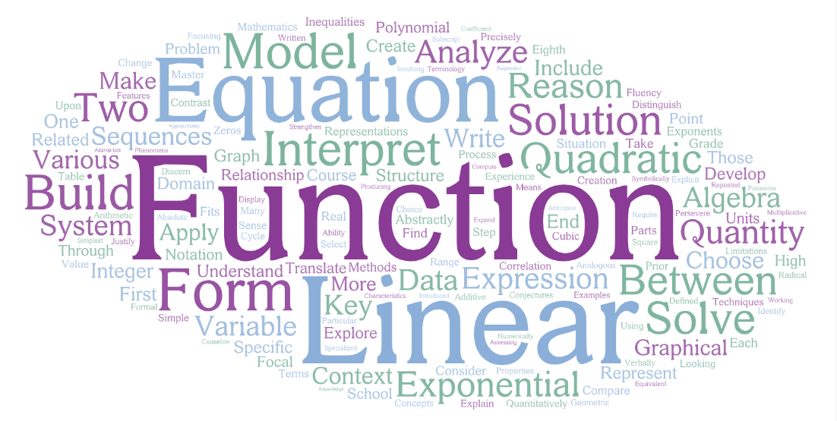
Algebra 1
Overview

Slide 14
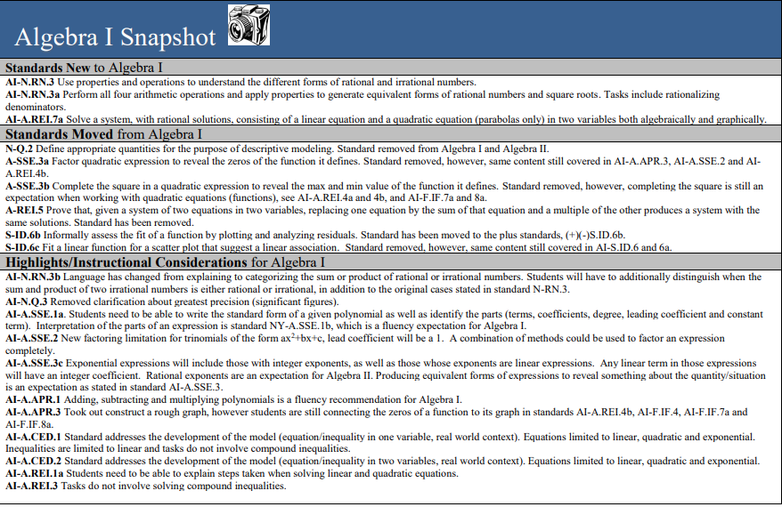
Algebra 1 Snapshot

Slide 15
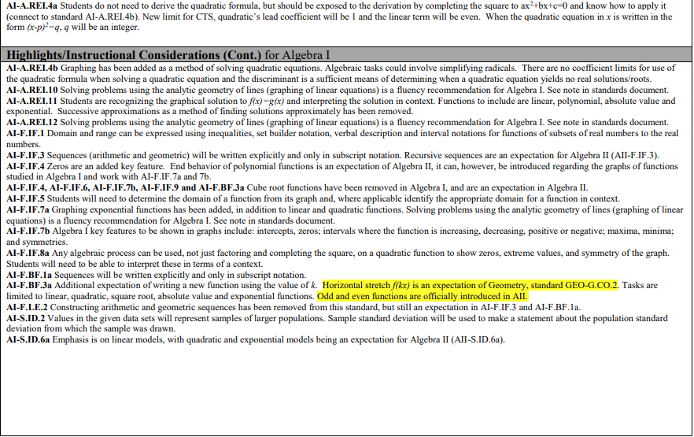
Algebra 1 Snapshot

Slide 16
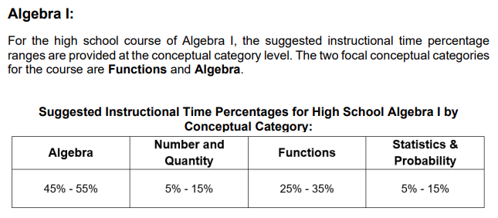
Algebra 1
Suggested Breakdown
Regents Exam
Tuesday, June 4th

Slide 17
Partnership with Families
Effectively Manage Homework
  Ask your child to explain to you what they are learning
  How do you REALLY do math homework?
Check the Parent Portal daily/weekly
  Homework grades, test
Insist on Daily Attendance
Help your Child Set High Academic Goals
See all progress reports and report cards
Encourage your child to attend extra help
Check the Teacher Webpage/Google Classroom
Attend Parent meetings and programs
Help with time management
Seven learners qualified to ern the Special Appeal.

Slide 18
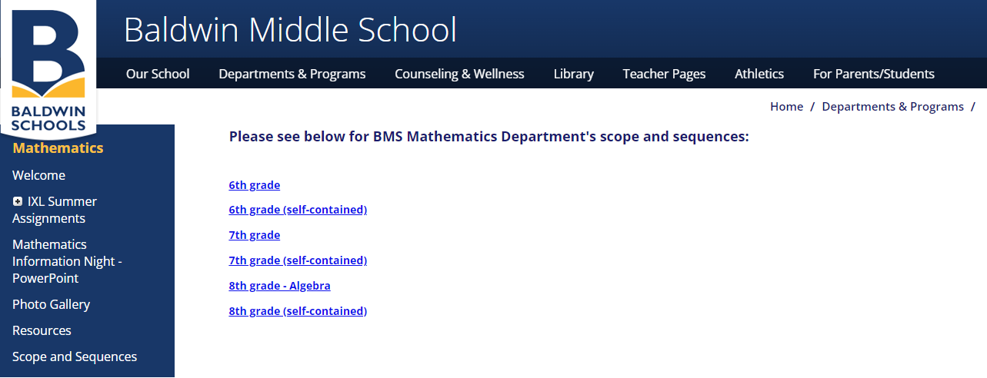
Scope & Sequences
Seven learners qualified to earn the Special Appeal.

Slide 19
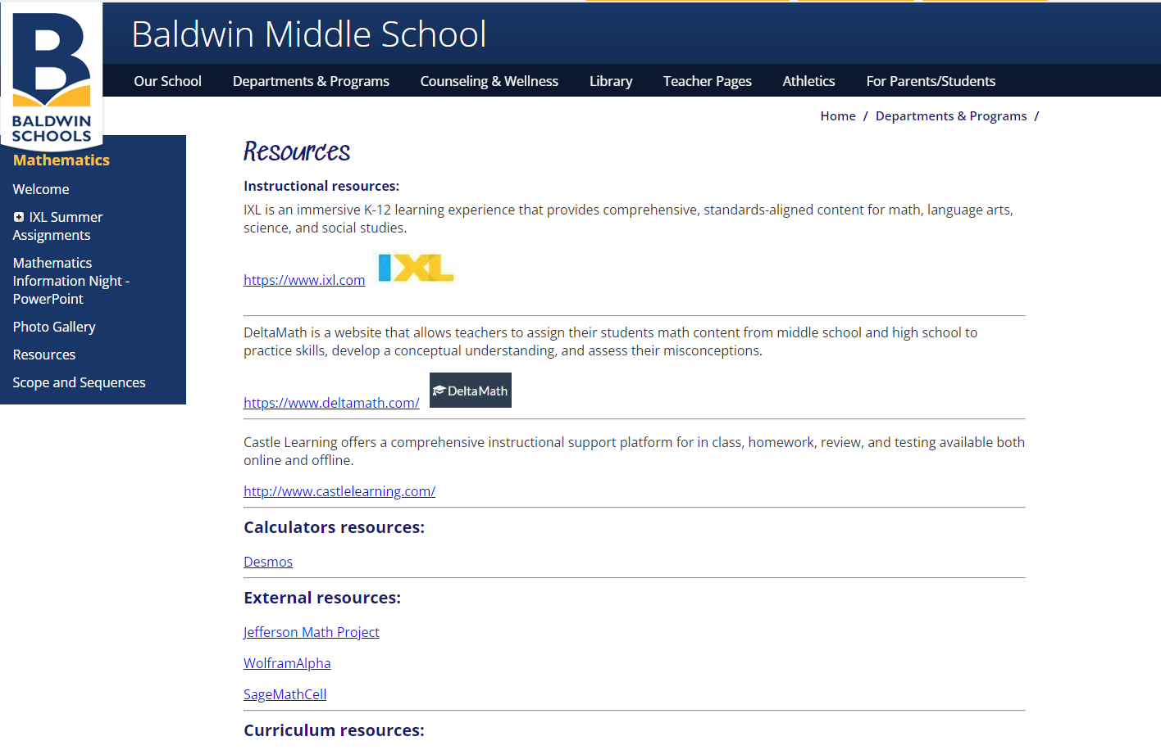
Resources
Seven learners qualified to earn the Special Appeal.

Slide 20


Mathematics
Thank You!!!
Matthew Baruch
Supervisor of Mathematics 6-12
baruchm@baldwinschools.org
516-434-6248
We are Innovative,
We are Inclusive,
We are Involved,
We are Baldwin!

