Slide 1
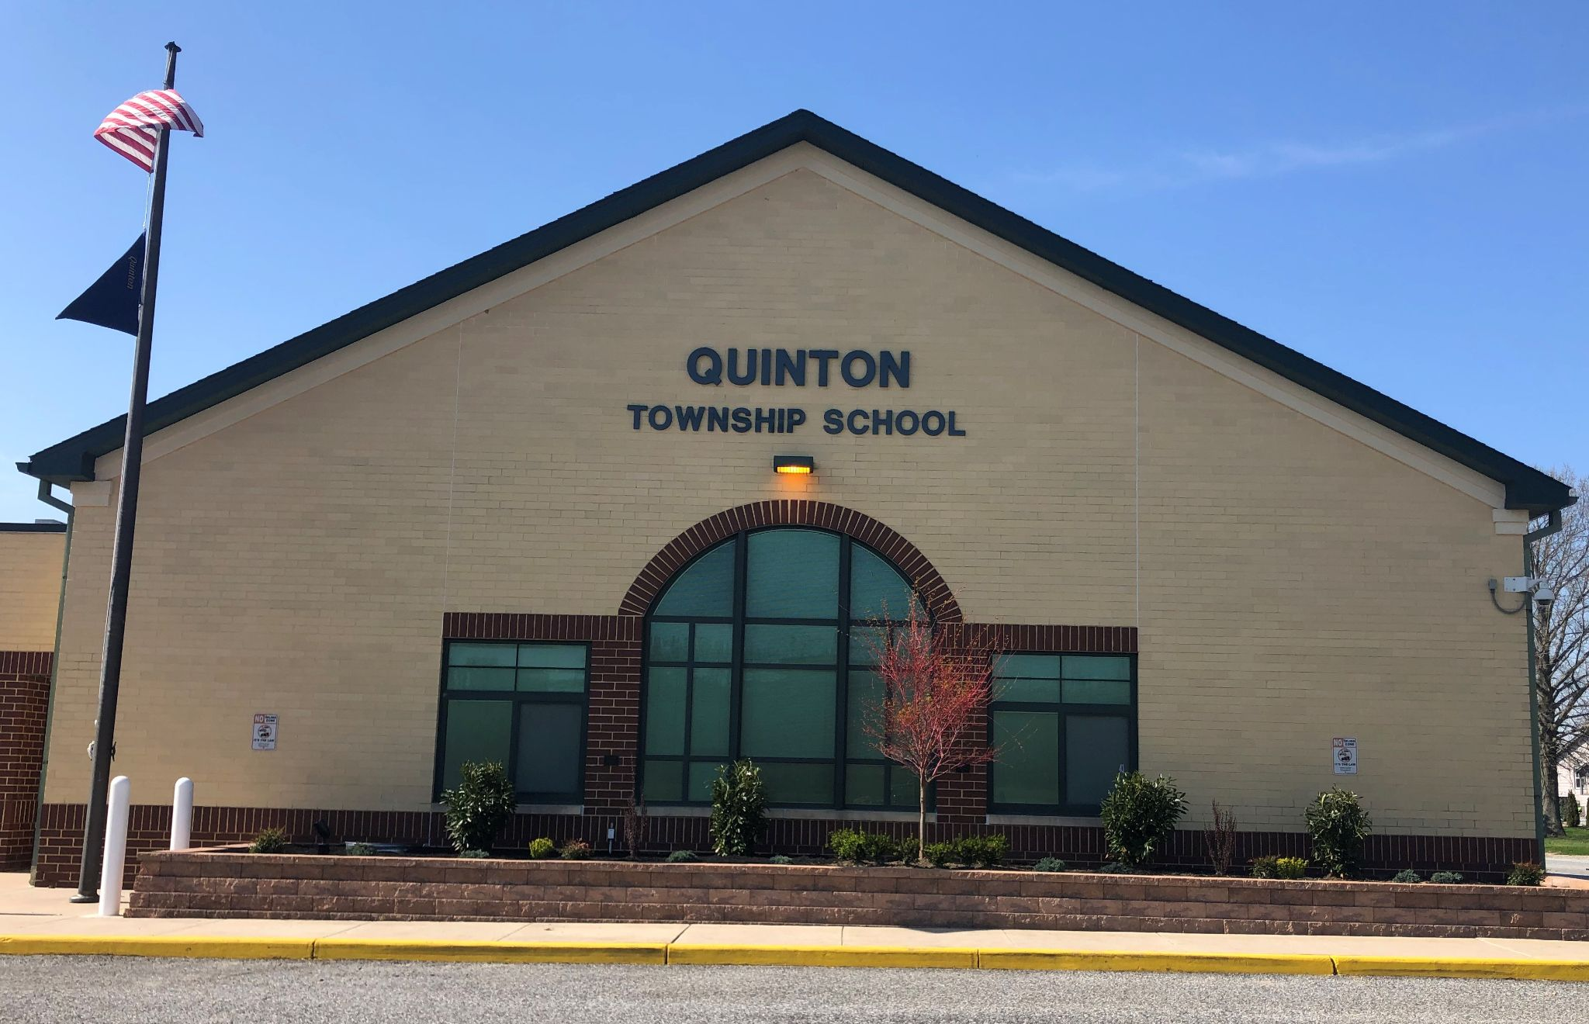
Quinton Township
Board of Education
2021-2022 PUBLIC HEARING ON THE BUDGET
APRIL 29, 2021

Slide 2

Mission Statement
We, the collective members of the Quinton Township School and its community, aspire to provide every student with access to equal educational opportunities.
In order to realize this mission, our teachers and staff pledge to serve as advocates who:
*provide a caring, safe, nurturing environment.
*establish a challenging and diverse learning climate in which every student's needs are met, exceeded, and supported.
*embrace high expectations that all children can flourish as successful learners.
As a result of our advocacy, we aspire to develop students who:
*demonstrate advanced proficiency in accordance with the Core Curriculum Content Standards.
*are self-motivated life-long learners.
*understand the perspective of others despite their differences.
*exhibit mutual respect while collaborating to achieve a goal.
*are empowered learners who can thrive in an ever-changing global society.
This mission is embodied in the philosophy that school is not just about children; it encompasses families, parents, community, stakeholders, society, the environment and the world.

Slide 3
Budget Goals
Maintain status in Salem County as a High Achieving School District.
Maintain a teaching staff that provides effective coverage of all mandated CCCS and CCSS for both regular and special education populations.
Maintain administrative staff to provide continued support for instructional improvement, student safety and a positive and productive learning environment.
Maintain our paraprofessional staff to meet Special Education, Basic Skills, and Early Childhood needs in a cost effective manner.
Maintain and improve our school building and property.

Slide 4
Budget Supports
Staffing Levels & Programs Including:
  Full day 3 & 4 yr old Preschool and Kindergarten Programs
  Mandated Support Services (CST, I&RS, BSI, Counselor)
  Full Range of Special Area Programs including Art, Music, Spanish, Physical Education, Health (Gr 6-8) & Computers
  Continued Support of the Revised Teacher Evaluation System (AchieveNJ)
  Professional Development
  Phonics First/Response to Intervention Program
  Support Programs
  (Homework Center, Math Tutoring, Literacy Tutoring, etc.)
  Curriculum and Materials that are current & aligned with CCSS
  21st Century/College and Career Readiness:
    One-to-one Chromebooks for Grades 1-8
    One-to-one iPads for Grades PK-K

Slide 5
2021-2022 State Aid
0.016%
Increase
 | 2020-2021 | 2021-2022 | Inc/(Dec)
General Fund Aid | $3,664,535 | $3,560,477 | ($104,058)
Special Revenue Fund Aid | $404,085 | $636,240 | $232,155
Debt Service Fund Aid | $89,940 | $27,006 | ($62,934)
Subtotal State Aid | $4,158,560 | $4,223,723 | $65,163
Assessment for Debt Service on SDA Funding | ($36,143) | ($36,143) | $0
Grand Total State Aid | $4,122,417 | $4,187,580 | $65,163
Notes:
Now let’s review our State Aid for the 2009-2010 School Year.
You will notice increases in General, Special Revenue, and Debt Service.
The overall increase is 5%.

Slide 6
Other Sources of Income
Grants = $169,445 (Estimated at 80 % of Current Year)
Title I - Used to offset Basic Skills Salaries
Title IIA - Used for Literacy & Math Coaches, SEL, and Professional Development
Title IV - Used for a portion of Guidance Counselor salary
IDEA - Used to offset Out-of-District tuition costs
REAP - Used to expand on technology resources
SRECS (Solar) = $10,000

Slide 7
Measures to DECREASE Tax Rate
Shared Services
  Business Administrator
  Related Services (OT & PT)
  Virtual Algebra
  Technology Services
  Transportation
Purchasing Discounts
  State Contract Pricing (Supplies, Copy Paper, etc)
  CO-OPs (ESCNJ, CCESC & Garden State Co-op)
  Consortiums (ACT & ACES)
  Internet Access Discounts (E-Rate)
Insurance
  Joint Insurance Fund for Health Insurance
  Member of ERIC South for General Insurance

Slide 8
Budget Constraints
Salem High School Tuition $855,852
Salem County Vo Tech Tuition $268,153
Out-of-District Special Education Costs $425,725
Out-of-District One-on-One Aide Costs $115,500
Transportation Costs $458,421
Assessment for Debt Service on SDA Funding $36,143

Slide 9
Tuition Analysis
Salem High School | 2020-2021 | 2021-2022 | Difference Inc/(Dec)
Full Time | $784,000 | $798,000 | $14,000
Shared Time | $7,000 | $0 | ($7,000)
Tuition Adjustment | $101,010 | ($15,248) | ($116,258)
Resource Room | $33,750 | $38,100 | $4,350
Salem Tuition Total | $925,760 | $820,852 | ($104,908)
Estimated # Students | 56 FT & 1 ST | 57 FT & 0 ST | 0.5
Tuition Rate per Student | $14,000 FT & $7,000 ST | $14,000 FT & $7,000 ST | No Change

Slide 10
Tuition Analysis Cont’d
Salem County VoTech | 2020-2021 | 2021-2022 | Difference Inc/(Dec)
Tuition | $291,600 | $303,750 | $12,150
Tuition Adjustment | $45,120 | ($35,597) | ($80,717)
VoTech Tuition Total | $336,720 | $268,153 | ($68,567)
Estimated # Students | 72 | 75 | 3
Tuition Rate per Student | $4,050 | $4,050 | No Change

Slide 11
Tuition Analysis Cont’d
Out Of District Special Education | 2020-2021 | 2021-2022 | Difference Inc/(Dec)
Tuition | $455,779 | $337,107 | $118,672
Tuition Adjustments | $27,579 | ($1,382) | $28,961
Out-of-District Tuition Total | $483,358 | $335,725 | $147,633
Estimated # Students | 11 | 8 | (3)

Slide 12
Tax Levy
Tax Levy Increase (including debt service)
$32,351
1.7 Cents over the 2020-2021 budget
Savings to Taxpayers
Preschool Expansion Aid applied for in November 2020
Funding received to cover 100% of the costs of the Preschool program
Program was expanded to offer FREE Preschool to
3 year old students
Notes:
What does all this really mean to the Average Taxpayer?
Average decrease of $92.91 per household based on the average assessment of $157,594 or 25¢ per day.

Slide 13
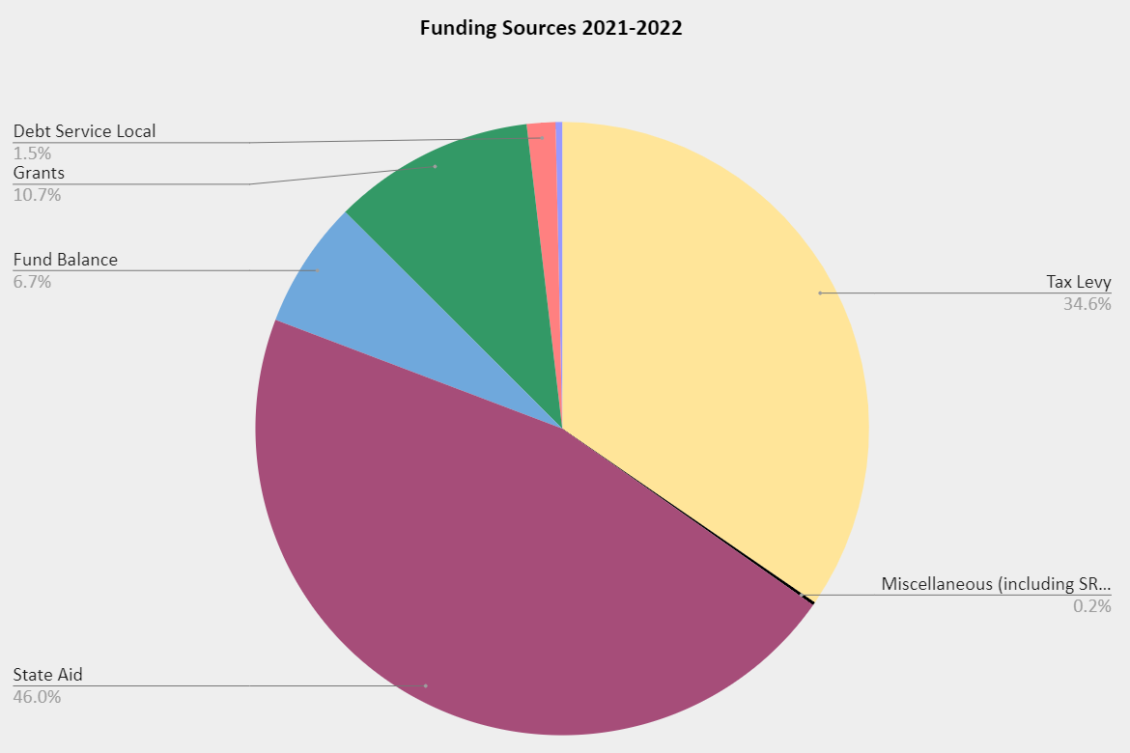
Where does the money come from?

Slide 14
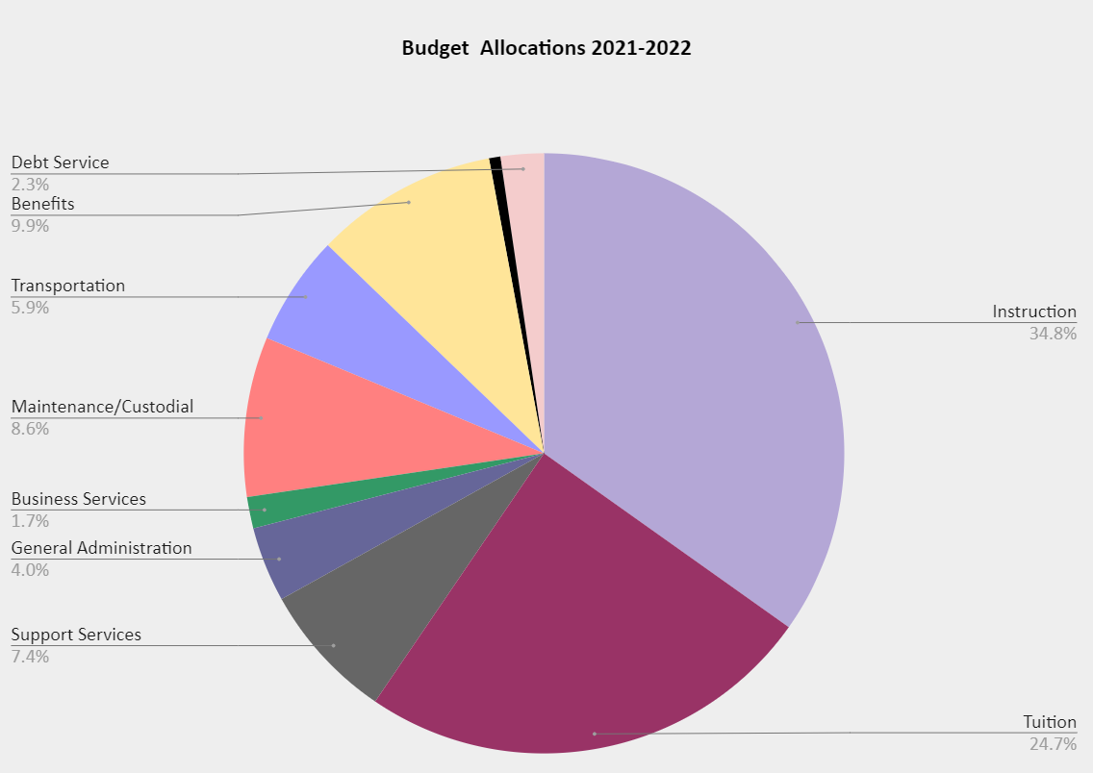
Where does all the money go?

