Slide 1



Strategic Planning
Vision Retreat

Slide 2

Welcome and Introductions
Who is in the room?
What are we here to do?
Why is this an important event?

Slide 3

Communication
Collaboration
Grace
Carbondale High School
District 165
Strategic Plan Logo

Slide 4

FOUNDATION OF CONTINUOUS IMPROVEMENT
Pillars | Guiding Question
MISSION | What is our fundamental purpose; why do we exist?
VISION | What must we become in order to accomplish our fundamental purpose?
GOALS | How will we know if we are making a difference?
VALUES | How must we behave to achieve our mission, vision and goals?

Slide 5

Strategic Planning Process
Where do we want to be?
Where are we now?
How will we get to where we want to be?
What
are we learning?
Vision and
Mission
Needs
Assessment
Goal Setting
Action
Planning
Monitor
Adjust
Improve
Stakeholder Input/ Impacts
Defining Key Areas To Improve
Gap Analysis
SMART Goals
Strategies
Best Practice
Staff Development
Adjust
Structures &Processes
Review and Revise
Implement
Strategies
Implement
Strategies
Annual- Formative
Multi-Year: Summative

Slide 6

Strategic Plan’s Foundational
Questions:
What business are we in and why?
Mission, Vision, and Core Values
Where are we going?
Long-Range Goals
What are the key issues that are urgent to address?
Strategy
How will we know we are growing and improving?
Key Indicators, measures, and targets (KPIs)

Slide 7

It is good to have an end to journey toward;
but it is the journey that matters in the end.
Ursula K. LeGuin 1999
WHERE DO WE WANT
TO BE?
HOW DO WE GET FROM
WHERE WE ARE TO
WHERE WE WANT TO BE?
WHERE ARE WE NOW?
CONTINUOUS IMPROVEMENT

Slide 8

"If schools are not imagining a different future, they will amplify their efforts to do what they have always done."
-Grant Lichtman, #EdJourney: A Roadmap to the Future of Education

Slide 9

We know who we are. We have the opportunity to envision who we want to be.

Slide 10

COMMON VOCABULARY

Slide 11

VISION RETREAT OUTCOMES
Answer the question “Where do we want to be? How will we look, sound, and feel differently 5 years down the road than we do today?”
Reflect on STAKEHOLDER FEEDBACK to revise our SWOT analysis from the Data Retreat.
Envision what a great PREFERRED Future Statement looks like.
Investigate schools and districts to identify practices and ideas to inform A PREFERRED FUTURE FOR THE DISTRICT.
Explore Student, Adult, and System Portraits to describe a future vision
Invent a PREFERRED FUTURE (Mission and Vision) to move the district to an even high level of performance.
Develop a set of CORE VALUES that will guide the actions and behaviors of the district as its works toward achieving its Preferred Future

Slide 12

How do we want to be different 5 years from now than we are today?
Mission
Vision
Core Values

Slide 13
REVIEW and REFINE
45 minutes
Reflect on stakeholder feedback to revise our SWOT analysis from the Data Retreat

Slide 14

SWOT ANALYSIS
S TRENGTHS
W EAKNESSES
O PPORTUNITIES
T HREATS

Slide 15
SWOT ANALYSIS EXAMPLE
STRENGTHS: What are we most proud of? What do we consider to be our results of our best work? What advantages do we have? What do others say about us in positive ways? Graduation Rate Clarity and Variety in Academic and Course Offerings/Program Coherence Extracurricular Activities, Athletics, Clubs, & Offerings Financial Stability and Stewardship State Highest Recognition for Finance Management Diversity, Inclusion, Equity, Continuous Improvement Teacher-Student Trust Teacher Retention, Advanced Degrees and Talented Staff 1:1 Technology Belief in Continuous Improvement, Diversity, Inclusion and Equity | WEAKNESSES: What do we consider to be our weaknesses? What are we most criticized for or receive the most complaints about? What do we seem to have a hard time doing well? Student Achievement Gaps- Low Income and Black vs Others Math Instruction Demographic Disparity Among English and Math Tracks with Rigor Demographic Disparity Among Behavioral Referrals, In-School Suspensions, Tardies Chronic Absenteeism Schedule Flexibility- 6 period day, block schedules, opportunities to take electives, etc. Student Perception of Importance of High School Community and Family Involvement and Partnerships Student Perception of Family Supportiveness
OPPORTUNITIES: What opportunities for improvement do we know about, but have not addressed? Where with a little work could we change a weakness into a strength? What are we not doing currently that might be the opportunity for us to improve. Reimagine Student Academic Interventions in mathematics and English Reimagine Student Behavior Interventions and Consequences Recruitment and Hiring of a more diverse staff Communication, Collaboration, Alignment with Feeder Districts Collaboration with SIU and JALC Expansion of Career Education and CTE options Use of space, building upgrade plans Professional Learning leading to innovation, project based, real world relevance and high quality of student discussion Expand learning opportunities for students, staff and families beyond the day and year Increase in inquiry-based 3-year science instruction for graduation | THREATS: Who or what threatens us the most? What challenges are coming that we must respond to? What might block our progress? What do we have little control over that might impact our resources? False Perceptions of CCHS Increases in Low Income and Mobility Within Student Population Equalized Assessed Valuation decreasing and tax rate increasing Business Development and Residential Attraction Covid Slide and Recovery Teacher Shortage, Substitute Shortage State and National Funding and Stability/Political Climate

Slide 16

Review Activity Directions 45 min
Examine stakeholder feedback reports:
Understand the process used to gather feedback from stakeholders
Understand how the feedback report was constructed
Look for themes
Add to the previous SWOT
Prioritize Top Ten
  Strengths AND Opportunities Weaknesses AND Threats

Slide 17
Activity One Part A: PREFERRED FUTURE STATEMENT
10 Minutes
Learn about the characteristics of a
great Preferred Future Statement.

Slide 18
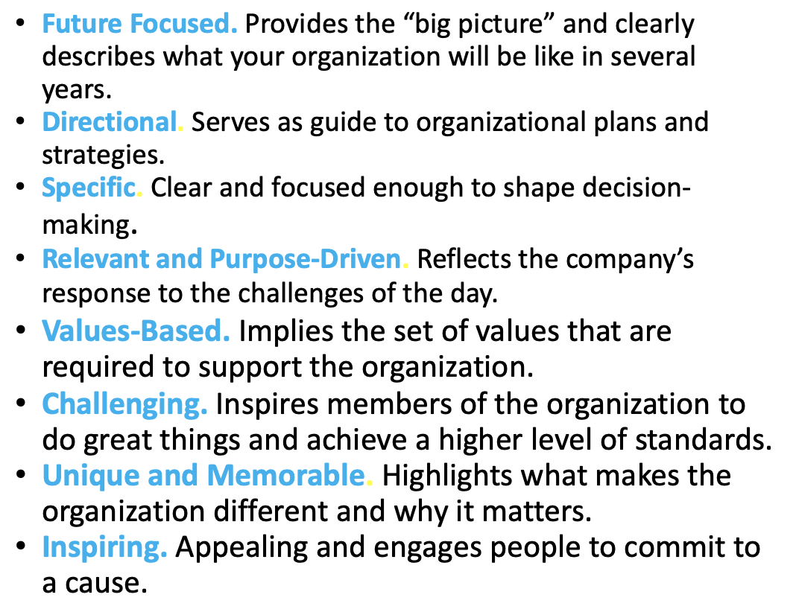
Characteristics of a Great Preferred Future Statement

Slide 19
ACTIVITY ONE: Part B
20 minutes
ILLINOIS
VISION
2020
Teams will explore Vision 2020.

Slide 20

Illinois Vision 2020
Mission: Public education must play a defining role in ensuring equal opportunity for learning.
Vision: It is our collective duty to do all we can to guarantee every student, no matter his or her demographic or geographic identity, has equal access to a quality education. We will do this through the following priorities:
21st Century Learning
Highly Effective Educators
Shared Accountability
Equitable and Adequate Funding

Slide 21

21st Century Learning
For success in life, students need more than knowledge of math and reading. It is time to expand the definition of student learning, commit to the development of the “whole child”,” and invest in policies proven to link all schools to 21st century learning tools.

Slide 22

Highly Effective Educators
The quality of teachers and school leaders is the greatest predictor of student achievement schools can influence. By attracting, developing, and retaining our state’s best educators, we can have a profound impact on student learning.

Slide 23

Shared Accountability
A quality education for all Illinois students cannot be ensured without the collaboration, compromise, and hard work of both educators and legislators. With that in mind, it is necessary to expand educator responsibility in the legislative process, create a shared accountability model, and restructure mandates to allow more local district flexibility.

Slide 24

Equitable and Adequate Funding
All students in Illinois are entitled to a quality education. It is our duty to ensure our students have access to all necessary resources by improving equity in the funding model, appropriating adequate dollars for education, and allowing local school districts the autonomy needed to increase efficiency.

Slide 25
Core Values
Vision 2020 is based on the following Core Values
High Expectations and Quality
Shared Accountability
Innovation
Equity
Transparency
Continuous Improvement
Partnerships

Slide 26
ACTIVITY ONE: Part C
10 minutes
Teams will Hopes, Dreams & Aspirations.

Slide 28


Characteristics, IL Vision 2020, and Hopes, Dreams and Aspiration ideas that lead to Visionary Out-of-the box thinking
Record ideas:

Slide 29

BREAK
10 MIN
Notes:
Time: 15 minutes

Slide 30


Slide 31


Slide 32
From To
Boring
Real Life
Traditional
Innovative
Memorization
Application
Book Driven
Multi source Driven
Traditional
Real Life
Test driven
Interest Driven

Slide 33

INVESTIGATE a Preferred Future
Gain a deep understanding of the three articles chosen by the District’s Core/Edit Team and
Electronically learn about three schools/districts who are inventing a modern approach to teaching and learning. Discover how their approach is similar or different to our current approach.

Slide 34

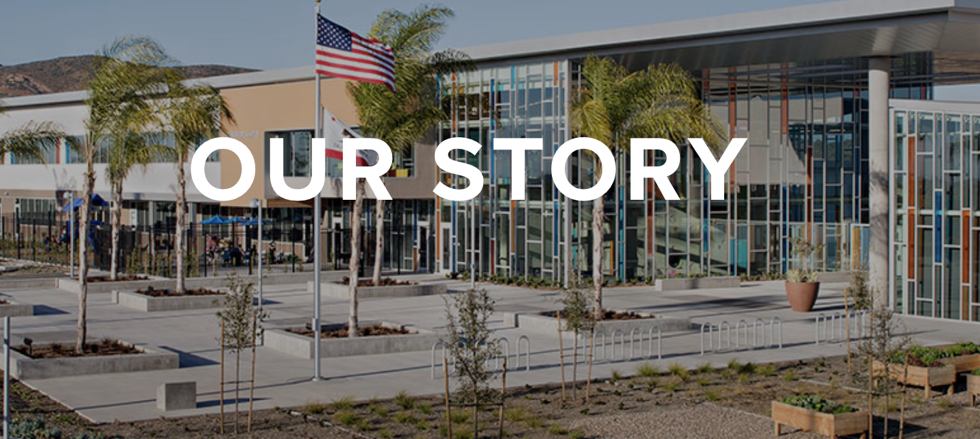
Homework Investigations
Articles School Sites

Slide 35
ACTIVITY TWO:
60 minutes
Investigation
Teams will jigsaw the three articles read and share their 5 key concepts.
Teams will jigsaw the three investigation sites previewed and share their 5 key concepts.

Slide 36



Homework
Articles
B
A
C

Slide 37
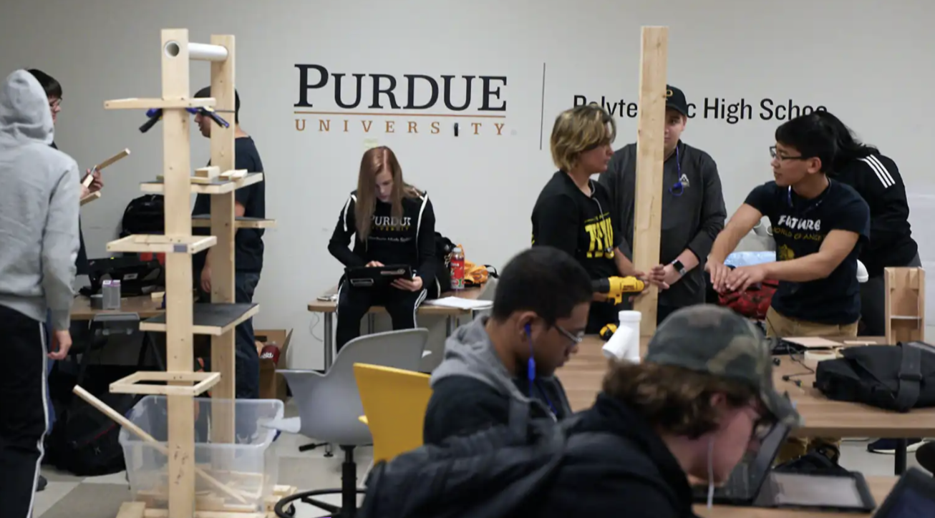
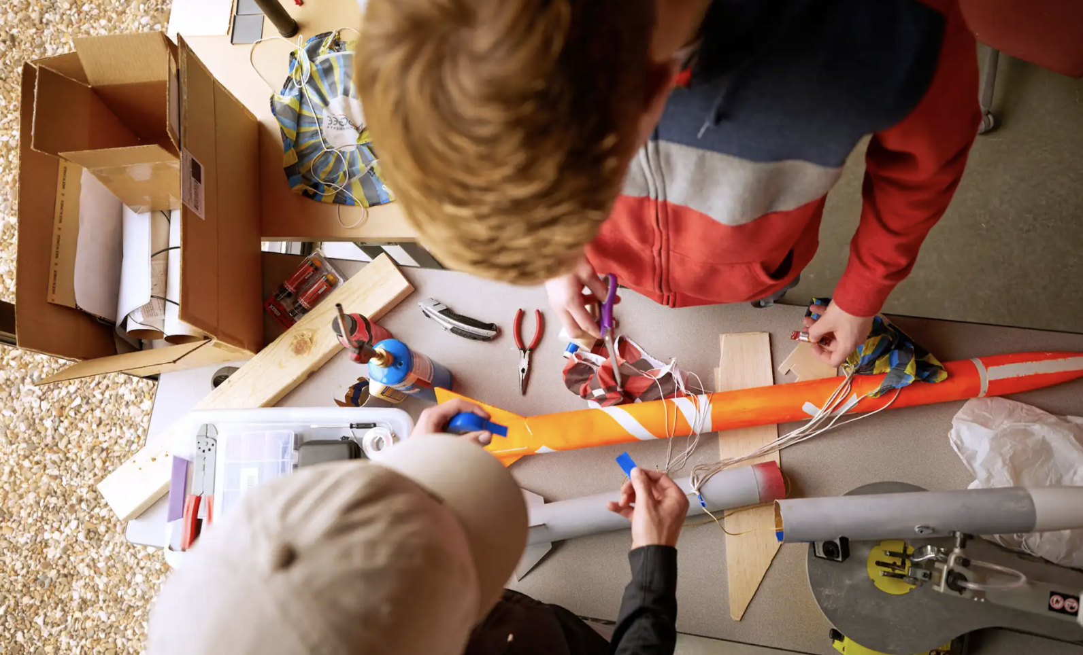

Homework Investigations
A
B
C

Slide 38
What might help us better define what we want to become?
Article Key Concepts
1
2
3
4
5
Site Key Concepts
1
2
3
4
5

Slide 39
ACTIVITY THREE
20 minutes
Student Agency
Teams will learn about the importance of student agency-engagement, ownership, voice, and choice.

Slide 40

What is the power of student agency?
Why should we consider student agency in our Preferred Future Statement?
What words inspire that concept?

Slide 41

Student Agency:
What provides student agency or responsibility for their learning?

Slide 42
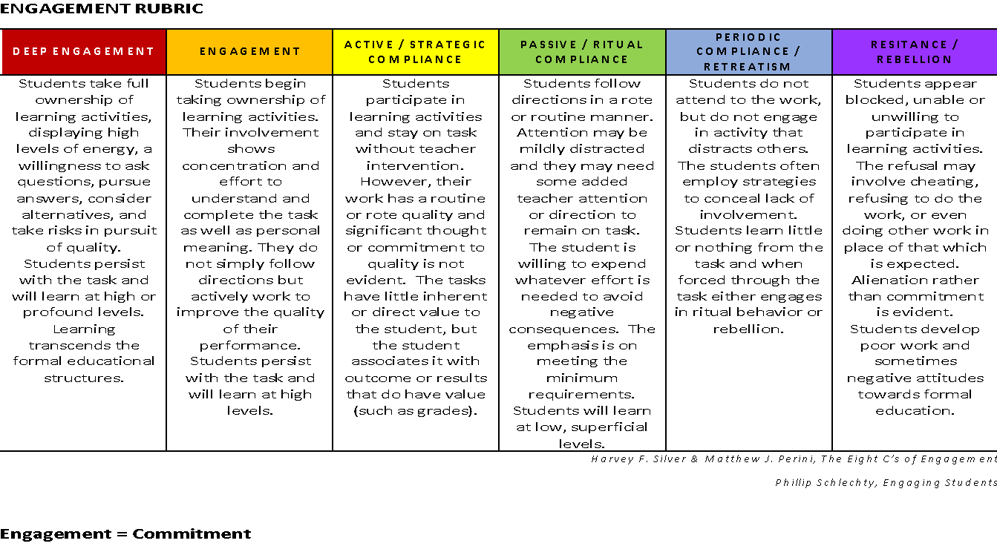
Handout p. 11

Slide 43

Student Agency ideas that lead to Visionary
Out-of-the box thinking
Record ideas:

Slide 44
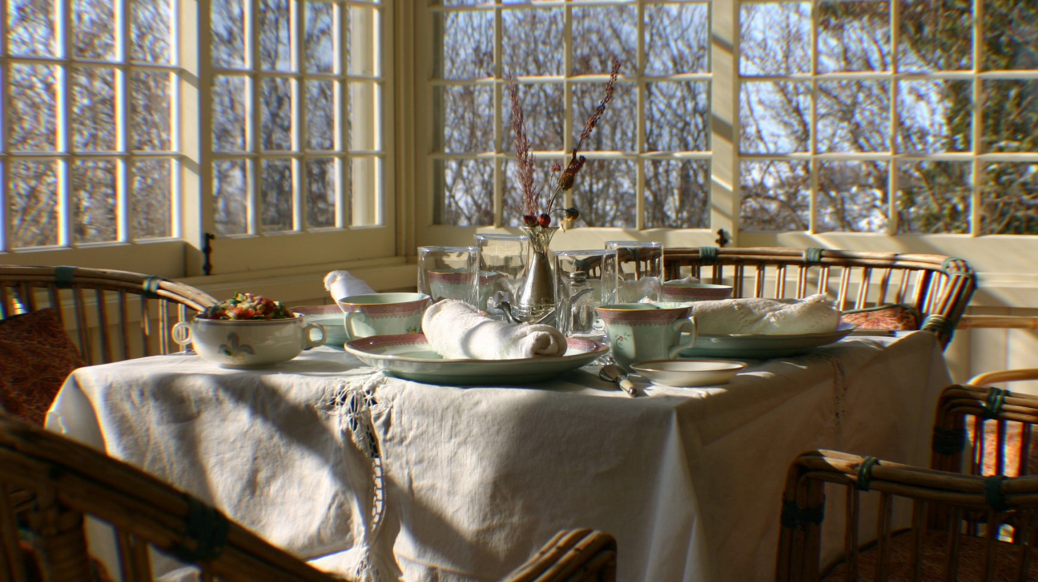
LUNCH
45 minutes
Notes:
Time: 12:00 -12:30
Purpose: Indicates lunch time
Lecture Notes:
Activity Notes: Play music or use timer (optional). Sound the reminder, 5 minutes before returning.
Resources Required:
Audience Reaction:

Slide 45


Slide 46

CCHS District’s
North Star
A “vision” is a bold leap into the future, painting a vivid picture of a destination—a “north star” that guides collective action and shapes the strategies to make it a reality.

Slide 47

The Strategic Plan Team will explore how schools
can best prepare students for their future.

Slide 48

How do we ACT on our Preferred Future?

Slide 49
ACTIVITY FOUR
60 minutes
Portrait of the Future
Teams will explore Graduate, Adult, and System Portraits to describe a vision for the future.

Slide 50
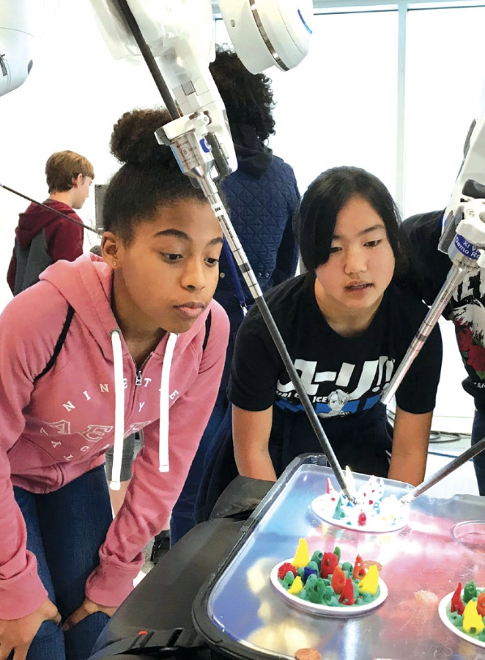
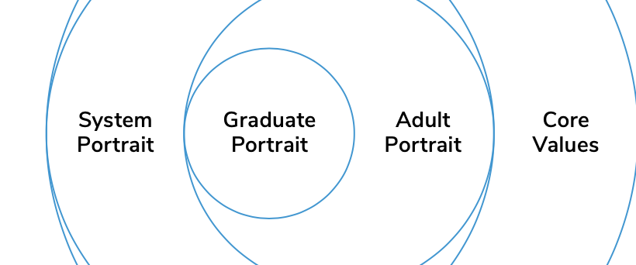
Vision 2030
Thanks to the Santa Clara Unified School District and their Vision 2035 process

Slide 51
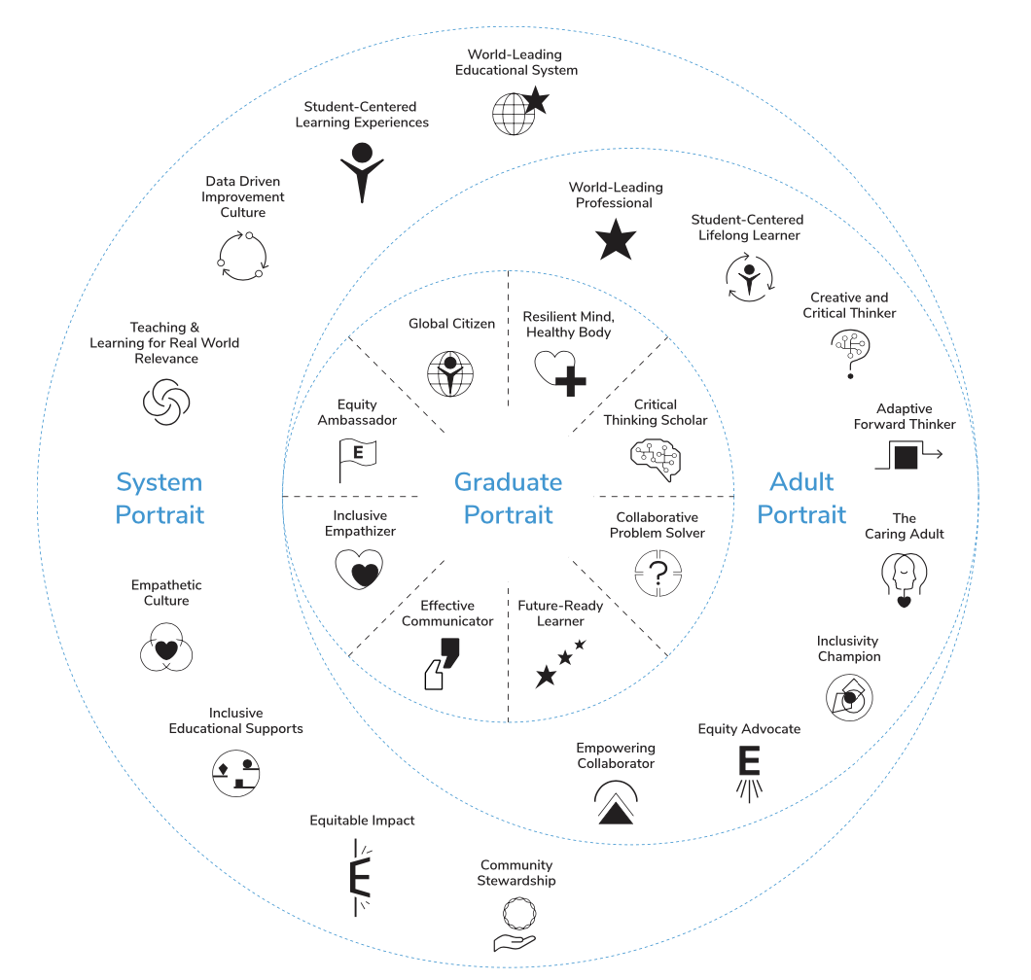

Slide 52
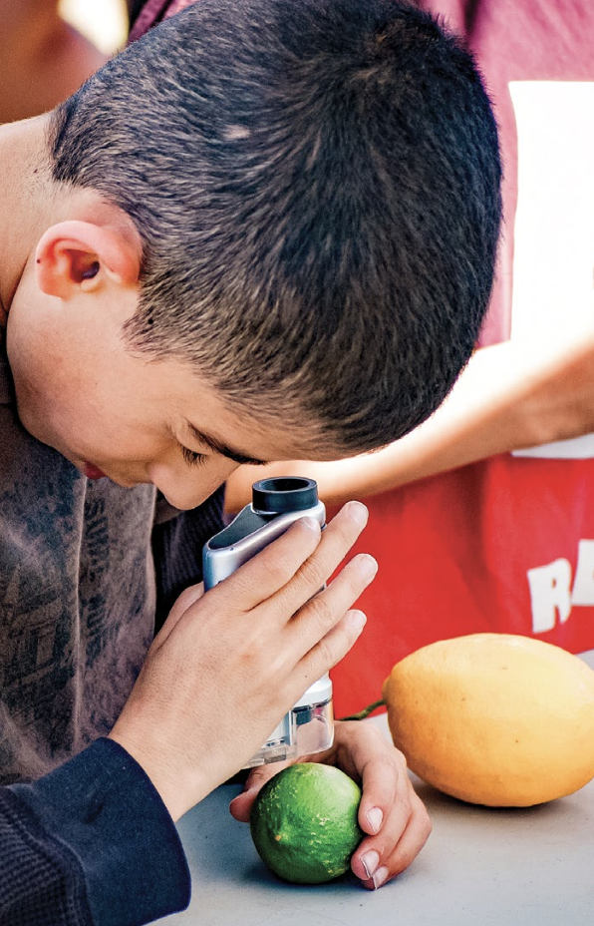
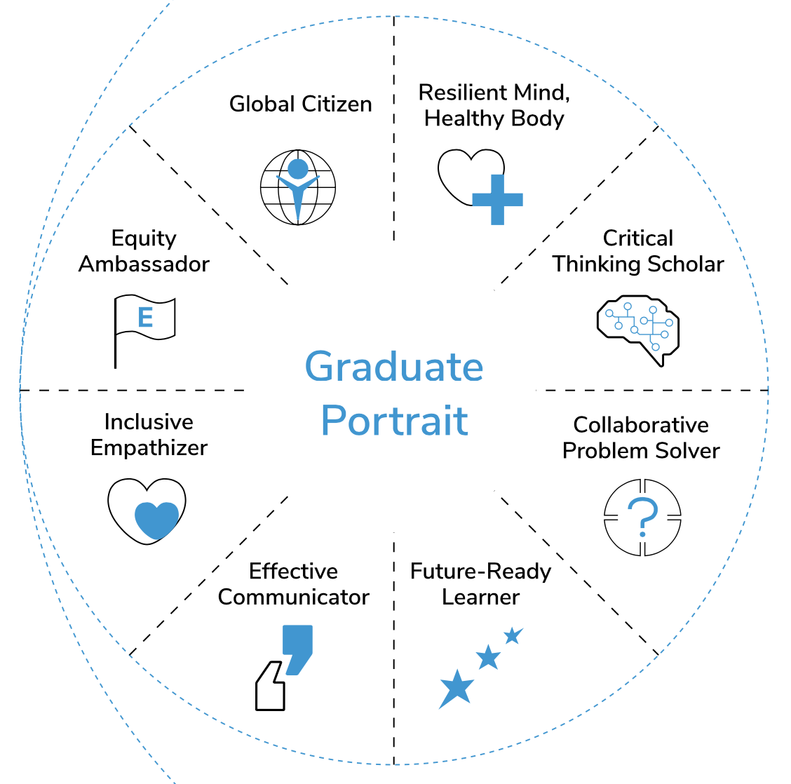

Slide 53

KEY QUESTIONS for a Graduate Portrait :
What 21st century skills, character traits, and/or social-emotional competencies do all students need to succeed in college, career,
and life?
How has the world changed, and how will it continue to change? What skills and mindsets will be necessary in a rapidly changing and complex world?
What are the skills and traits that community member take pride in and hope to pass on to their students and children?

Slide 54
Graduate Portrait Outcome Possibilities
Creative Thinkers | Engaged Collaborators | College & Career Ready | Creators and Innovators | Adaptable and Resilient Learners
Team Player | Passionate & Empathetic | Engaged Citizens | Personally Responsible | Culturally Aware
Skilled Communicators | Ethical Character | Problem Solvers | Critical Thinkers | Perseverant & Patient
Empowered and Self-Sufficient | Growth Mindset | Confident and Secure | Civic and Global Contributor | Digitally Literate
Other | Other | Other | Other | Other

Slide 55

What are the skills to ensure student success?

Slide 56
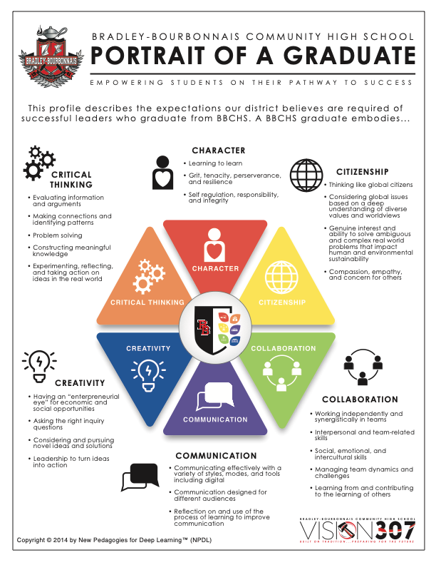
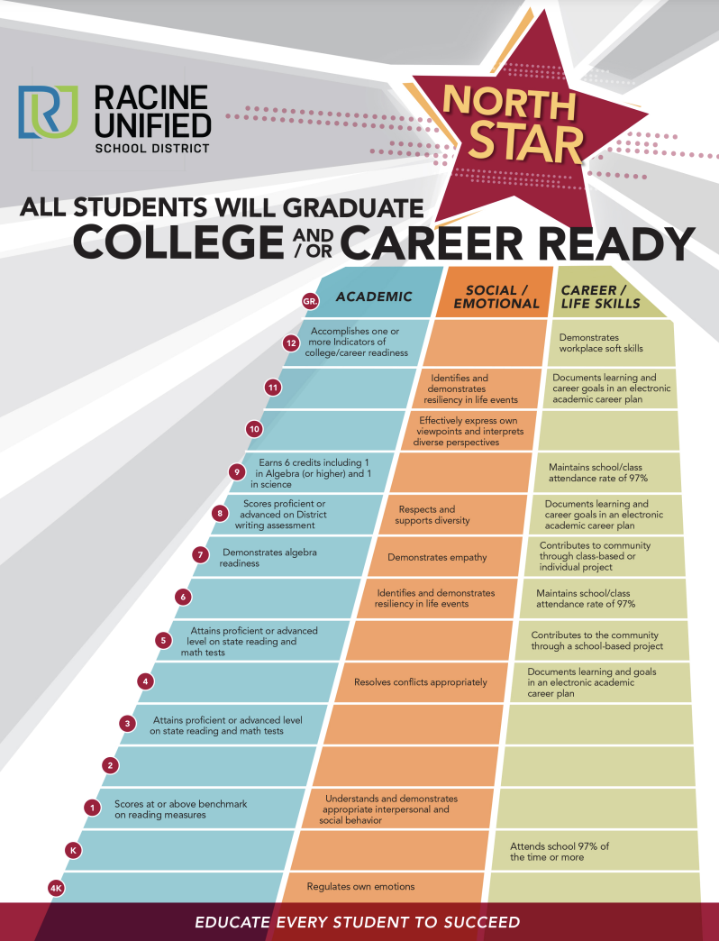

Slide 57

What are the skills to ensure student success?

Slide 58
Our team’s TOP TEN
Graduate Portrait

Slide 59
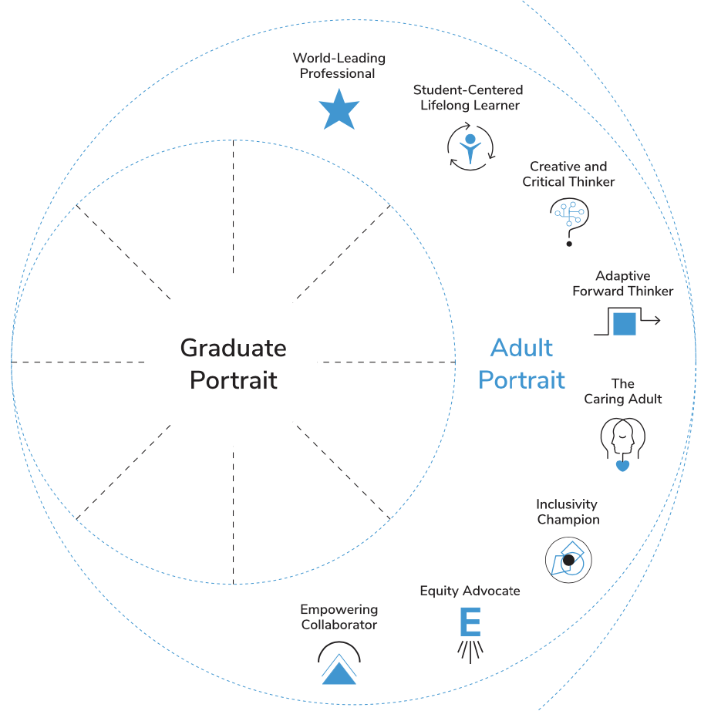

ADULT PORTRAIT

Slide 60

KEY QUESTIONS for an Adult Portrait:
What are the critical 21st Century characteristics of an effective team member?
What 21st Century characteristics contribute to a successful and efficient culture or climate?
What 21st Century adult characteristics contribute to the development of successful and passionate learners?

Slide 61
Adult Portrait Outcome Possibilities
Prepared | Engaged Collaborator | Love Teaching and Learning | Creator and Innovator | Display a Personal Touch
Team Player | Passionate & Empathetic | Engaged Citizen | Personally & Collectively Responsible | Culturally Aware
Skilled Communicator | Ethical & Trusting Character | Problem Solver | Respectful of Students and Parents | Sense of Humor
Empowered and Self-Sufficient | Growth Mindset | Confident and Secure | Civic and Global Contributor | Digitally Literate
Adaptable and Resilient Learners | Perseverant & Patient | Forgiving | Other | Other

Slide 62

Growth
Mindset
Digitally Literate
Team
Player
Passionate
& Empathetic
Skilled Communicator
Problem
Solver
TEAM
Portrait of an ADULT. This Portrait describes the expectations our District believes are required of adults who ensure all students are successful. A CCHS adult embodies:

Slide 63

ADULT PORTRAIT
Leading Professional Development
Student Centered Lifelong Learner
Creative and critical Thinker
Adaptive Forward Thinker
Caring and Compassionate Adult
Inclusivity Champion
Equity Advocate
Empowering Collaborator

Slide 64

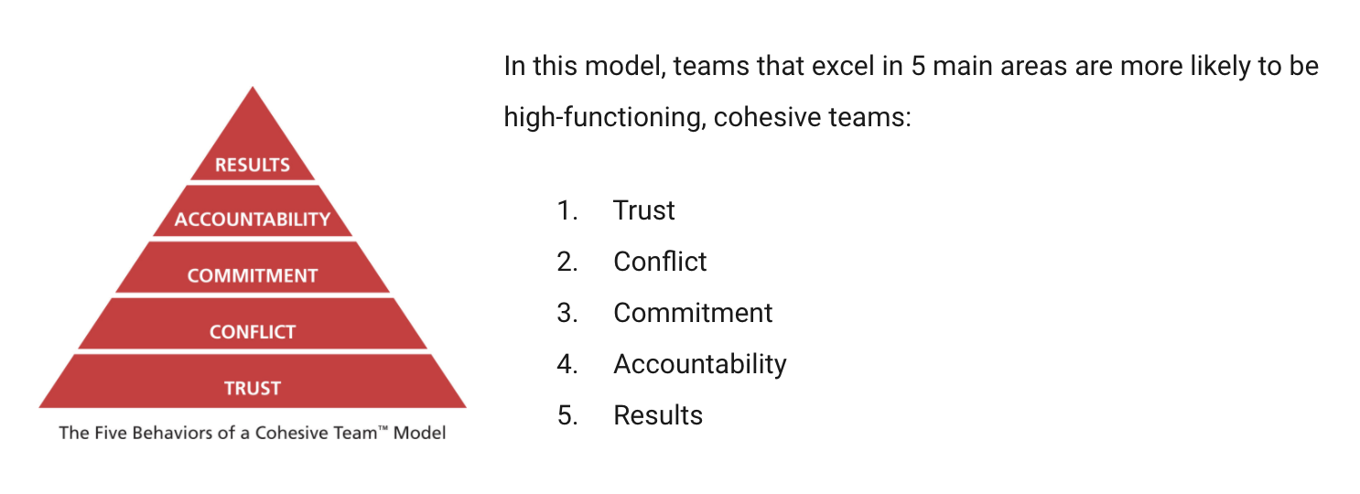
Adult Portrait

Slide 65
Our team’s TOP TEN
Adult Portrait

Slide 66
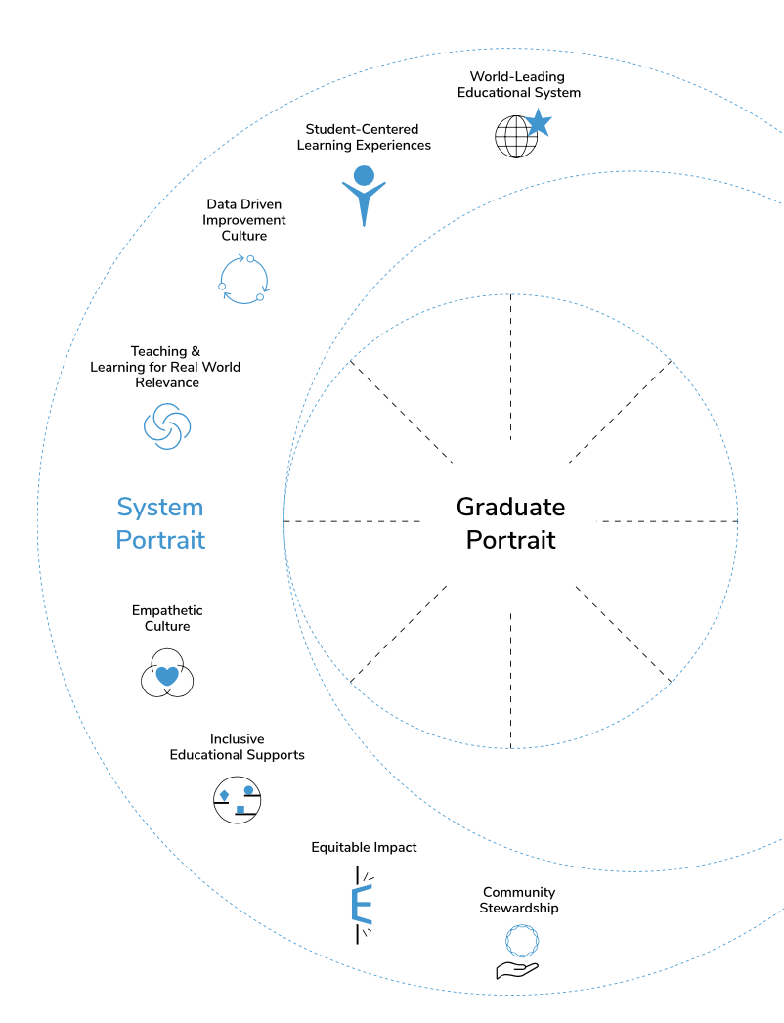

SYSTEM PORTRAIT

Slide 67

KEY QUESTIONS for a System Portrait:
What 21st Century District System Characteristics define an effective 21st century school system?
What 21st Century District System Characteristics do we want to guarantee every student, every family, every staff member to ensure high productivity and satisfaction?

Slide 68
System Portrait Outcome Possibilities
Clear Purpose with Focus | Documented | Balance Growth and Accountable | Value its Staff | Foster Collaboration
Repeatable | Foster Clear Communication | Ensure Consistency around Policy and Procedures | Promote Continuous Improvement | Value Diversity and Be Culturally Aware
Value Shared Decision-making | Value Ethical & Trusting Relationships | Promote Cohesion- Working Toward Common Goals | Respectful of Students, Parents & Staff | Sense of Humor
Empowered and Self-Sufficient | Growth Mindset | Develop Sense of Community & Belonging | Civic and Global Contributor | Promote Digital Literacy
Adaptable and Resilient Partners | Value Innovation and Risk Taking | Excellent Stewards of Resources | Other | Other

Slide 69
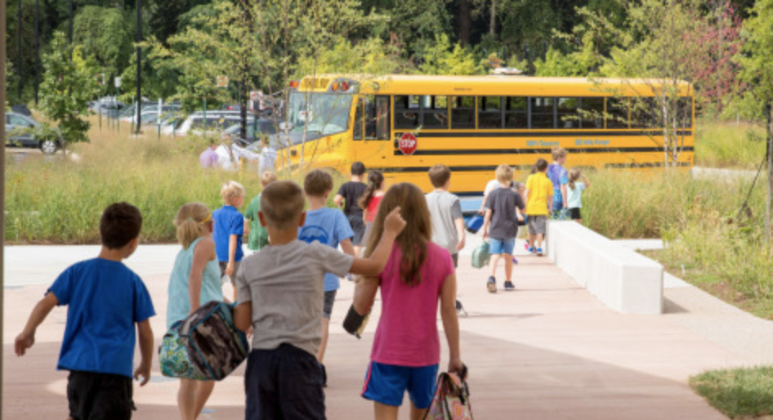
We strive to ensure these five attributes of a high-quality school system
1. Leadership
A successful school districts promotes shared leadership and decision-making.
2. High Expectations
A successful school district holds high expectations for all students and teachers.
3. Ongoing Evaluation
A successful school district personalizes instruction to know what each learner knows an needs to know next.
4. Goals and Direction
A successful school district is focused through clear goals and direction,
5. Secure and Organized
A successful school district promotes a safe, nurturing and secure culture.

Slide 70

System Portrait
Competitive Educational System
Data Driven Continuous Improvement Culture
Teaching and Learning for Real World Relevance
Empathetic Culture
Inclusive Educational Supports
Equitable Impact
Community Stewardship

Slide 71

System Portrait:
Visionary Leadership
Continuous Improvement
Data-Driven Decision making
Innovative and Happy Staff
Inclusive Supports
Future-Oriented Curriculum
Social and Emotional Priorities
Effective Communication and Collaboration
Equitable Impact
Trusting and Respectful Stewardship
Happy and Engaged Customers

Slide 72
Our team’s TOP TEN
System Portrait

Slide 73
ACTIVITY
90 minutes
Forecasting the Future
Teams will draft key characteristics for a Graduate, Adult, and System Portrait

Slide 74
Graduate Portrait | Adult Portrait | System Portrait

Slide 75
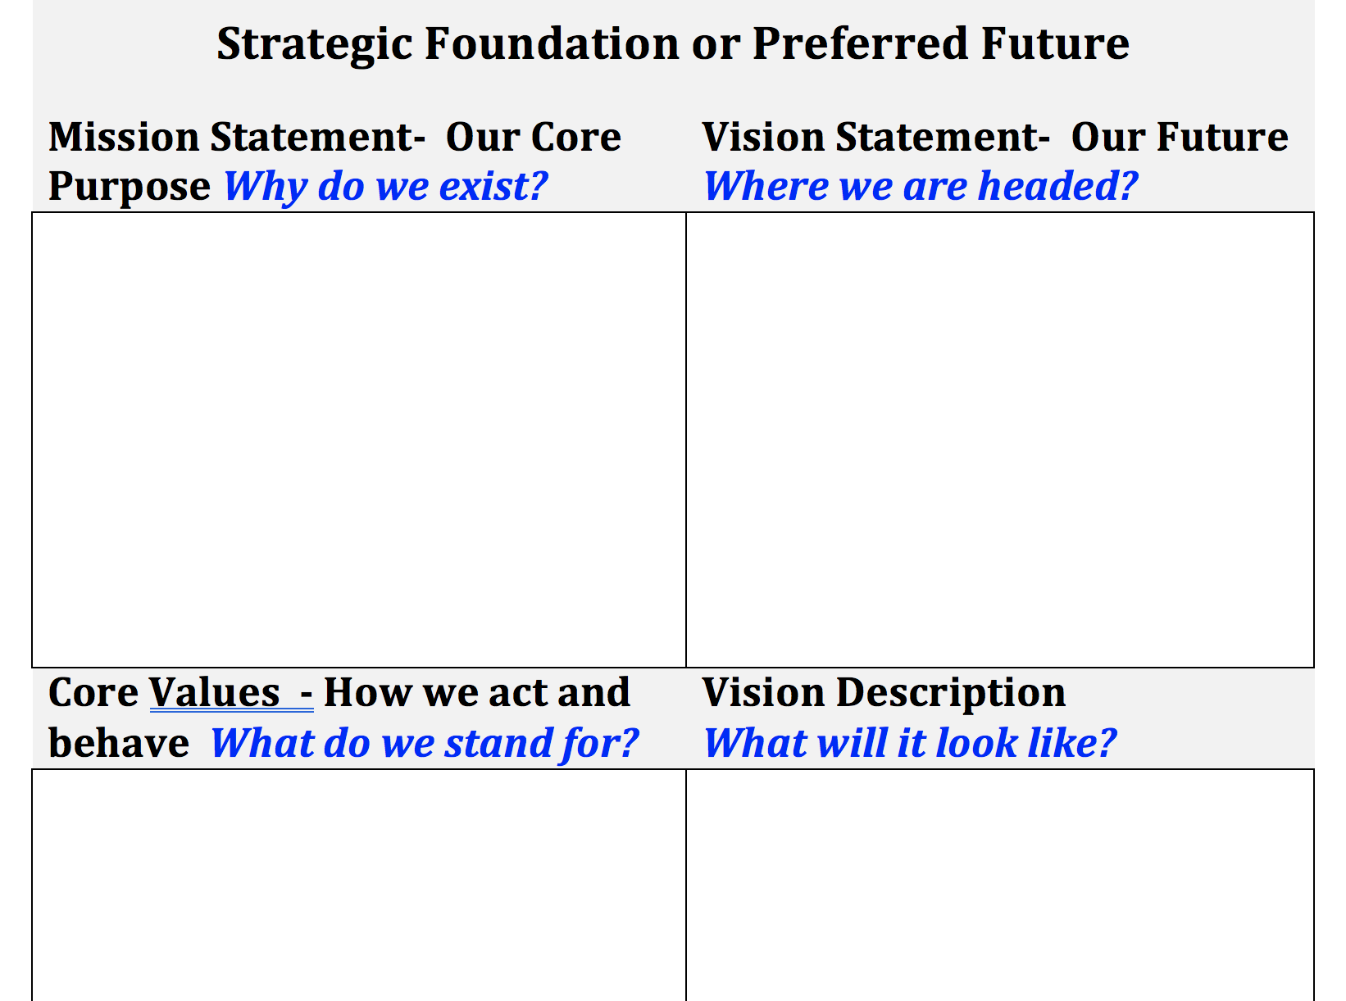

Slide 76
ACTIVITY FIVE
35 minutes
Mission & Vision
Teams will draft a Mission Statement

Slide 77
The FOUR Pillars of a Strategic Plan
Mission
Who we are? Why do we exist?
Vision
What must we become?
Values
How must we behave?
Goals and Objectives
How we gauge our success?
Definitions
Connections
Criteria for Success

Slide 78


Slide 79
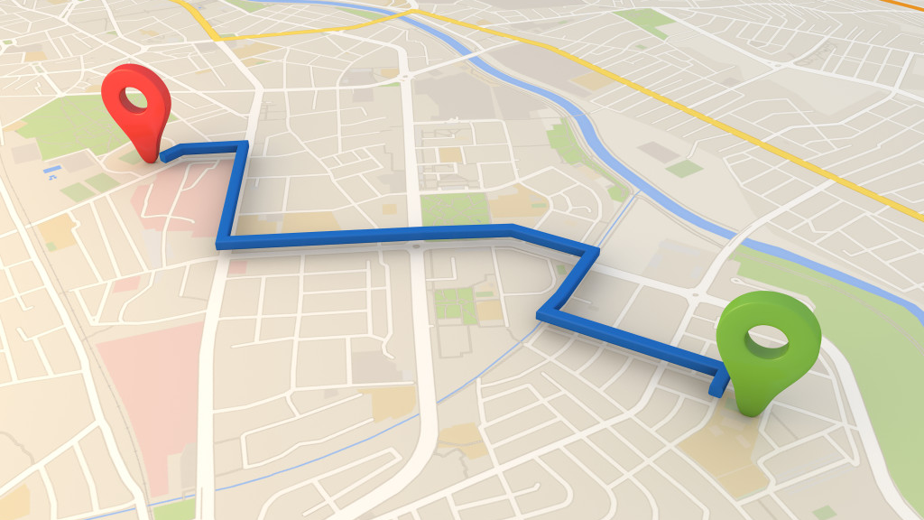
From where we are to where we want to be

Slide 80
MISSION
VISION
From where we are to where we want to be
CORE VALUES
Beliefs that guide our behaviors and actions

Slide 81
The words of mission and vision statements are not worth the paper they are written on unless people begin to do something differently.

Slide 82

MISSION
MISSION: The mission pillar asked the question, “WHY?” More specifically, it asks “Why do we Exist?” The intent of this question is to help reach agreement regarding the fundamental purpose of the organization. This clarity of purpose can help establish priorities and becomes an important factor to guide decisions.”
(DuFour, DuFour, Eaker, and Many, Learning By Doing, Second Edition: Solution-Tree, 2010)

Slide 83


Slide 84

Criteria for evaluating a mission statement:
Is it clear and understandable?
Is it brief enough for most people to remember and say in one breath?
Does it clearly specify the school’s fundamental purpose?
Does is have a primary focus on a single strategic thrust (such as learning)?
Does it reflect the distinctive competence and culture of this school?
Is it broad enough to allow flexibility in implementation, but not so broad as to create lack of focus?
Will it help school personnel, parents, and community members make decisions?
Is it energizing and compelling? Does it motivate and inspire employee commitment?
Does it say what you want your district to be remembered for?

Slide 85
Directions- Mission
Words
Phrases
Sentence

Slide 86

ACTIVITY SIX
45 minutes
Core Values
Teams will draft Core Values aligning to the Mission & Vision

Slide 87


Slide 88

CORE VALUES – 45 minutes
CORE VALUES: The values pillar asks “How must we behave?”—that is, “What beliefs must we all share to achieve our mission and vision?” In pursuing this question, the district attempts to clarity commitments everyone must share and be responsible and accountable for to move the district forward to. Core values are few in number, easy to remember, be guiding principles defining a code of conduct and behavior.
(DuFour, DuFour, Eaker, and Many, Learning By Doing, Second Edition: Solution-Tree, 2010)

Slide 89
Criteria for evaluating a core value or belief:
Does it manifest our mission and vision?
Is it compelling and based on a belief we would not compromise?
Is it a guiding principle that guides behaviors and actions?
Is it clear and easy to understand?
Does it create an unwavering and unchanging guide?
Is it something we will hold each other responsible and accountable for our actions?
Is it something we would want future staff members to support?
Does it have a commitment to describe what we would do to move the belief to action?

Slide 90
Core is Core
Vision Characteristics
Core Values

Slide 91
Directions
Read about what makes great Core Values
Discuss with your team what you learned from your investigations that might inform a new set of Core Values
Write a new set
  Review current Values
  Review the criteria for what makes a good set of Core Values
  Write your ideas for a new set of Core Values

Slide 92
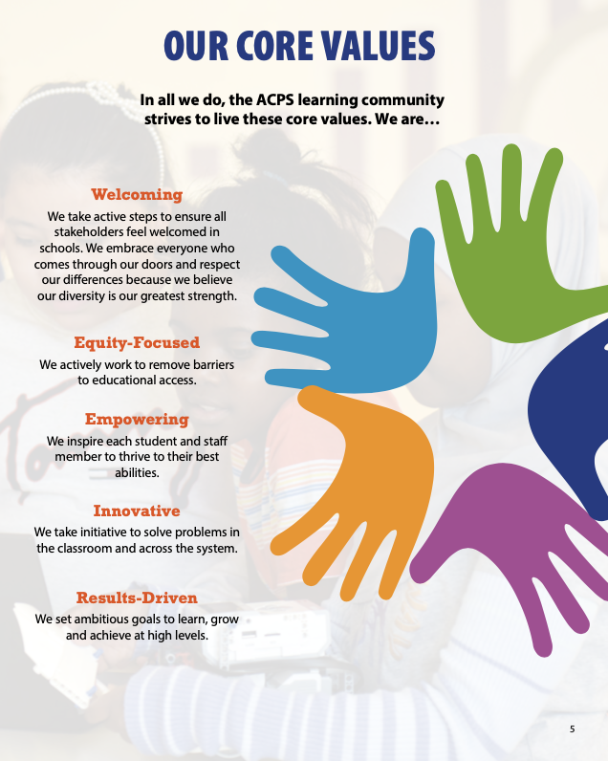
Core Values

Slide 93

Following approval of the strategic plan, the district should develop:
A welcoming brochure of mission, vision, and core values for new families to the district
An induction brochure of mission, vision, and core values for new employees to the district
A video to put on the website to bring the mission, vision, and core values alive.

Slide 94
Next Meeting
The SETTING DIRECTION RETREAT ANSWERS THE QUESTION, “How do we great from where we are to where we want to be?”
Long–range Goals: Indicators, Measures and Targets
Strategies: Gaps that must be addressed during the span of this strategic plan to achieve the mission, vision and goals of the district.

Slide 95


Thanks for a great day!
Setting Direction Retreat
  Seek Feedback
  Review the Feedback
  Revised Preferred Future Statement
  Consider Long-Range Goals
  Provide feedback to Goal Indicators and measures
  Determine high leverage strategies to focus priority work for next 3-4 years.

