Slide 1
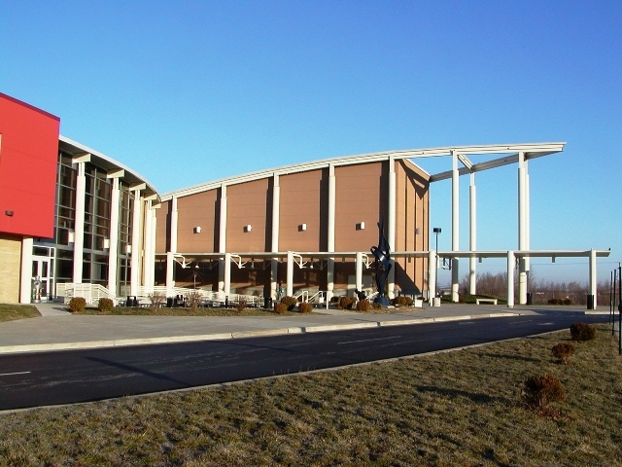
Welcome to Carbondale Community High School
Class of 2024

Slide 2
Mr. Ryan Thomas
Principal

Slide 3
Important Items
Correct Phone Numbers & Address
Correct E-Mail Addresses
Plan for Freshman Physical & Dental Exam

Slide 4
Jessica Trimble
School Nurse

Slide 5
Requirements for incoming freshmen:
Must have school physical & dental exam BEFORE going through registration in August
Must have Tdap, 2nd Varicella booster and
Meningitis
Information and forms on display and also available on the school website

Slide 6

Terrier Care
Hours: 8:00 AM – 4:30 PM (Mon-Fri)
Location: Room J120
Stacia Herring, CMA
Felicia Kimbrough, APN-FNP

Slide 7
Assistant Principals
Ms. Terica Doyle
Ms. Gwen Poore
Dean of Students
Mr. Alejandro Ruiz

Slide 8

Summer Enrichment Program
Summer Sessions-we anticipate it to be June 1st to June 19th
Two sessions: 1 to 2 weeks each
Schedule of classes will be available in April
Brochures will be mailed home
On-line registration will be open on our website in late April
Check Terriernet for more information

Slide 9
Mr. Mark Albertini
Athletics

Slide 10
Athletic Programs at CCHS
Boys Sports
Girls Sports
Basketball
Bass Fishing
Bowling
Cheerleading
Cross Country
Dance
Golf
Soccer
Softball
Tennis
Track
Volleyball
Baseball
Basketball
Bass Fishing
Bowling
Cross Country
Football
Golf
Soccer
Tennis
Track
Wrestling

Slide 11
Ms. Franciene Sabens​
Class of 2024 School Counselor​
Franciene.Sabens@cchs165.com​
457-3371 ext. 224​
**Remind text messaging info provided in your packet**​

Slide 12
CCHS Counseling Department​
School Counselors are vital members of the education team and maximize student success.​
Help all students:​
  Apply academic achievement strategies​
  Manage emotions and apply interpersonal skills​
  Plan for post-secondary options (higher education, military, workforce)​
Academic
Career
Social/Emotional

Slide 13
School Counseling Services​
Individual & small group counseling​
Academic skills support​
Organizational, study and test-taking skills​
Education in understanding others​
Education in understanding self, including strengths and weaknesses
Coping strategies​
Peer relationships & effective social skills​
Communication, problem solving, decision-making and conflict resolution​
Academic & career planning (4 year plans)​
​School counseling core curriculum​
Referral to outside agencies/services​
Know your School Counselor​

Slide 14
Top 10 Tips for Freshman​
Protect your GPA​
Remember, your attendance and all of your semester grades are on your transcript​
Attend free Terrier Tutoring weekly and create a study space and study schedule at home​
Check in with your teachers during ARP (8:00-8:20 AM every day)​
Read your email daily -- check it before Snapchat, Tic Tok, Instagram etc.​
Join a club or a sport within the first month of high school​
Listen to the Daily Announcements - you can also read them online via Terriernet​
Show up, set goals, and do your best each day​
Check in with your School Counselor often & complete all assigned Naviance tasks (4 year plan)​
Remember, you are responsible for your results. Manage your time well, make healthy choices and seek independence​

Slide 15
FEEDER SCHOOL VISITS
Unity Point Feb 24th at TBA
Desoto Feb 26th at 8:20 am
CMS Feb 27th at 8:15 am
Giant City Feb 28th at 12:45 pm
Private Schools TBA

Slide 16

Welcome to CCHS

