Slide 1
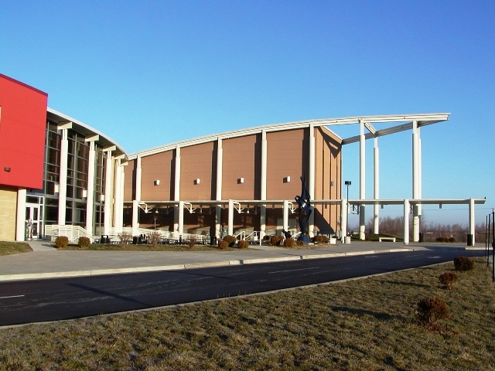
Welcome to Carbondale Community High School
Class of 2024

Slide 2
Mr. Ryan Thomas
Principal

Slide 3
Important Items
Correct Phone Numbers & Address
Correct E-Mail Addresses
Plan for Freshman Physical

Slide 4
Ms. Brandi Jones
Student Activities Coordinator

Slide 5

Mentoring & Student Activities
Extra-Curricular Opportunities
Freshman Mentoring Program
Freshman Orientation
???

Slide 6
Assistant Principals
Ms. Terica Doyle
Ms. Gwen Poore
Dean of Students
Mr. Alejandro Ruiz

Slide 7

Summer Enrichment Program
Summer Sessions-we anticipate it to be June 1st to June 19th
Two sessions: 1 to 2 weeks each
Schedule of classes will be available
in April
Brochures will be mailed home
On-line registration will be open on our website in late April
Check Terriernet for more information

Slide 8
Rena Weller
Tyler/ Registration

Slide 9
Tyler Access
Attendance, Grades & Homework
Assessments and Transcript Information
Discipline, Lunch balance and menu
E-mail and messaging options( to Faculty and Staff)
“Green” options for Report Cards & Progress Reports
Registration-will be open online in July

Slide 10
Tyler Login Information
Student and parent access to Tyler system is now available.
Student Tyler login, password and school email address is on the label on the student folder
Parents will receive password by email. In the Student Folder there is a Parent Information Sheet. Please make sure that everything is correct and turn it in.

Slide 11
Other Information
Student use of computers and the Internet may be monitored by the school.
Students may bring their own devices to school (computers, tablets, etc.) and are able to connect to wireless network.
Primary phone number listed in Tyler is used for the automated system for snow days.

Slide 12
Jessica Trimble
School Nurse

Slide 13
Requirements for incoming freshmen:
Must have school physical BEFORE going through registration in August
Must have Tdap, Varicella 2nd booster and Meningitis
Information and forms on display and also available on the school website

Slide 14

Terrier Care
Hours: 8:00 AM – 4:30 PM (Mon-Fri)
Location: Room J120
Stacia Herring, CMA
Felicia Kimbrough, APN-FNP

Slide 15
Ms. Amy Prudencio
School Social Worker
Amy.Prudencio@cchs165.com
(618) 457-3371 ext. 217

Slide 16
Helping students balance peer relationships, academics, and navigating personal development:
Counseling services
Mental health and behavioral health support
Referral to outside agencies/services

Slide 17
Promoting a positive and supportive school climate to help students feel engaged and connected.
PBIS First Day kick-off, end of semester "Terrier Fest" celebrations
Individualized student interventions
Student Mentoring Program- Linking students up with a faculty/staff member in the building
Be Here, Be Ready, Be Respectful,
Be Responsible, Be Involved!

Slide 18
Student Resources
Terrier Giving- Holiday giving program to provide winter coats and warm clothing
Weekly food bag program
School Supplies/Backpacks

Slide 19
Ms. Franciene Sabens​
Class of 2024 School Counselor​
Franciene.Sabens@cchs165.com​
457-3371 ext. 224​
**Remind text messaging info provided in your packet**​

Slide 20
CCHS Counseling Department​
School Counselors are vital members of the education team and maximize student success.​
Help all students:​
  Apply academic achievement strategies​
  Manage emotions and apply interpersonal skills​
  Plan for post-secondary options (higher education, military, workforce)​
Academic
Career
Social/Emotional

Slide 21
School Counseling Services​
Individual & small group counseling​
Academic skills support​
Organizational, study and test-taking skills​
Education in understanding others​
Education in understanding self, including strengths and weaknesses
Coping strategies​
Peer relationships & effective social skills​
Communication, problem solving, decision-making and conflict resolution​
Academic & career planning (4 year plans)​
​School counseling core curriculum​
Referral to outside agencies/services​
Know your School Counselor​

Slide 22
Transition Tips for Freshman Adult Supports​
Listen: Make time for 1 on 1​
Encourage goal setting​
  Minimum 2.8 gpa & 98% attendance rate​
Encourage independent problem solving​
Be aware & informed and set boundaries​
Set & enforce study place and time (Terrier Tutoring)​
Check grades weekly with your freshman​
Connect with teachers early and often. All teacher email addresses are in Tyler​
Parent Toolkit​

Slide 23
Materials in the packet
SAT8 Scores
Course Description Book
Four Year Planning sheet
Demographic Sheet – check & update
List of Your Required classes
Pre-Registration Form - Electives
  If you would like to change any of your electives, contact the Counseling Office by May 10th

Slide 24
FEEDER SCHOOL VISITS
Unity Point Feb 24th at TBA
Desoto Feb 26th at 8:20 am
CMS Feb 27th at 8:15 am
Giant City Feb 28th at 12:45 pm
Private Schools TBA

Slide 25
Tonight’s Schedule
6:00 – 6:45 General Meeting
6:55 – 7:10 Science, English, or Math (Depending on the color of your sheet)
7:15 – 7:30 Social Studies, Foreign Language,
        Career Ed, PE & Health, Fine Arts
        Counseling and Student Services
7:35 – 7:50 Science, English, or Math (Depending on the color of your sheet)
7:55 – 8:10 Social Studies, Foreign Language,
        Career Ed, PE & Health, Fine Arts
        Counseling and Student Services
8:15 – 8:30 Science, English, or Math (Depending on the color of your sheet)

Slide 26

Enjoy your evening at CCHS.

