Slide 1

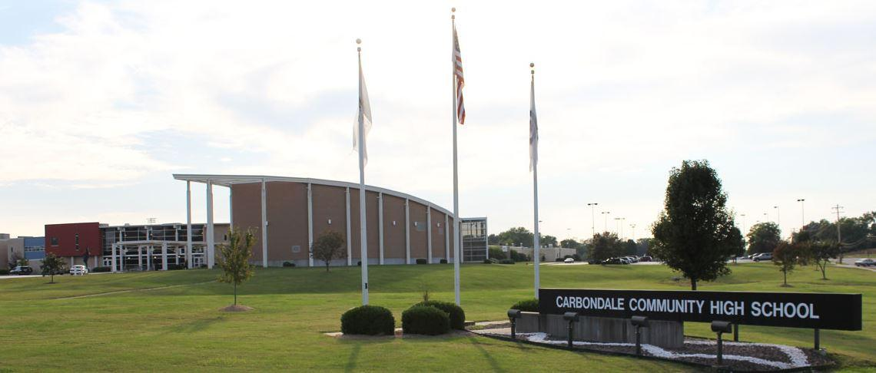
CARBONDALE COMMUNITY HIGH SCHOOL
STUDENT ACHIEVEMENT DATA
2021 Strategic Planning
Data Retreat
Notes:
EG

Slide 2
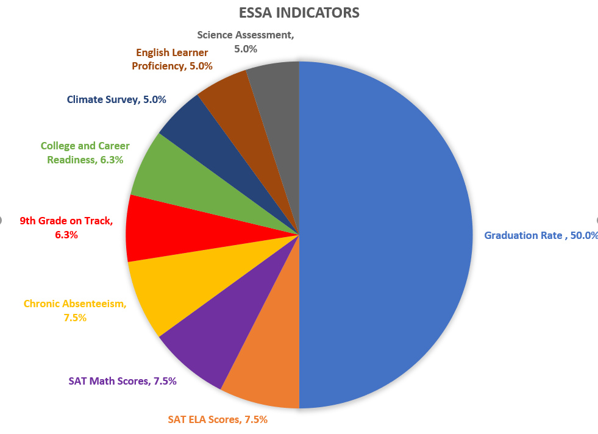
EVERY STUDENT SUCCEEDS ACT
Graduation Rate 50%
SAT ELA Scores 7.5%
SAT Math Scores 7.5%
Chronic Absenteeism 7.5%
9th Grade on Track 6.25%
College and Career Readiness 6.25%
Climate Survey 5%
English Learner Proficiency 5%
Science Assessment 5%
Fine Arts Participation (future)
Notes:
EG

Slide 3
ENGLISH DEPARTMENT PATHWAYS
State required – 4 years
SSP English 1/2 and 3/4 - Placed based on IEP
Reading A/B: Placement based on dora reading score and teacher recommendation
Track 3 – Reading: 30th percentile and below, teacher recommendation
Track 2 – Reading: 30-80th percentile
Track 1 – Reading: 80th percentile and above, teacher recommendation
Honors (Year 10, 11, 12): Track 1, application, and teacher recommendation
Notes:
CH

Slide 4
MATH DEPARTMENT PATHWAYS
SEQ 1 | SEQ 2 | SEQ 3 | SEQ 4
IAG1 | ALGEBRA 1 | ACCL ALGEBRA 1 | ACCL GEOMETRY
IAG2 | GEOMETRY | HON GEOMETRY | HON ALGEBRA 2
IAG3 | ALGEBRA 2 | HON ALGEBRA 2 | HON PRECALC
TRANSITION TO QL | TRIG or STATS/CONTEMP | HON PRECALC | AP CALCULUS
Notes:
BB
Emphasize completion of Algebra 2 as goal.

Slide 5
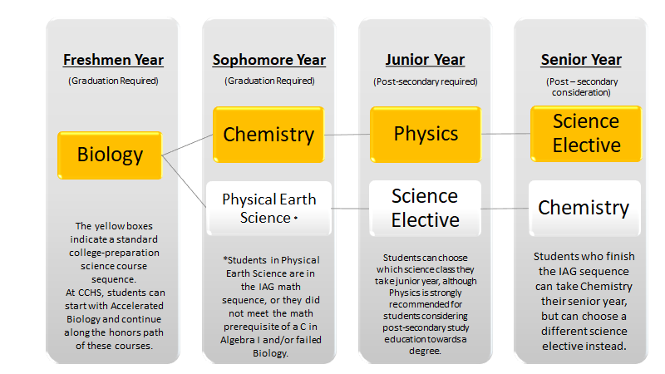
SCIENCE DEPARTMENT PATHWAYS
Notes:
LD

Slide 6
FRESHMAN YEAR SUCCESS INDICATORS
9th Grade on Track
English Track Placement
Reading Scores
Successful completion of Algebra 1 or better
Notes:
EG

Slide 7
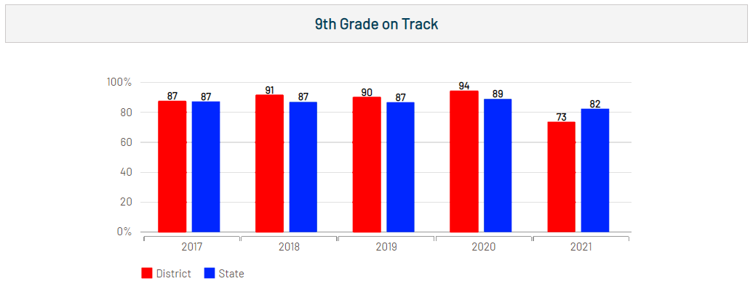
FRESHMAN YEAR SUCCESS INDICATORS
9th Grade on Track
Notes:
EG
9th Grade on Track:
Earned 5 credits (10 semesters)
No more than 1 F in a required subject
Key indicator of high school success

Slide 8
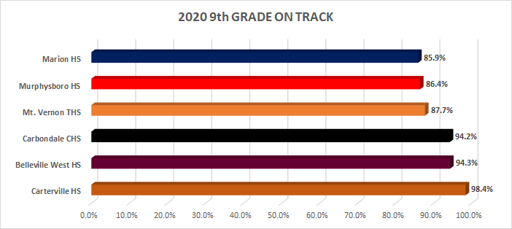
Notes:
EG
Explain demographics of these schools

Slide 9

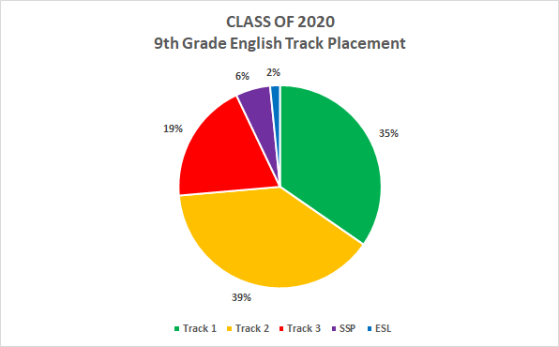
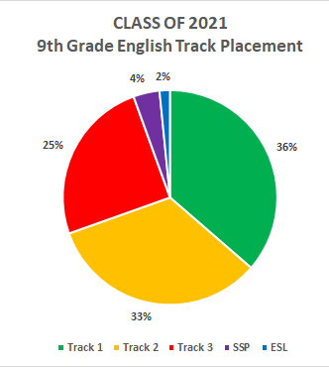
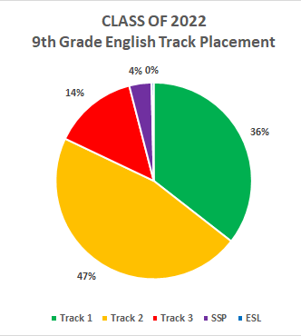
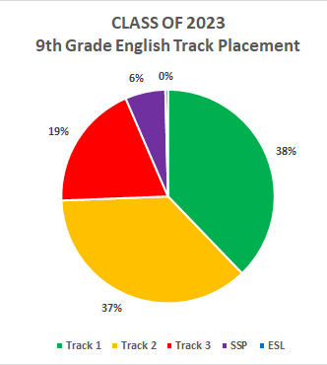
FRESHMAN YEAR SUCCESS INDICATORS
English track placement
Notes:
CH

Slide 10
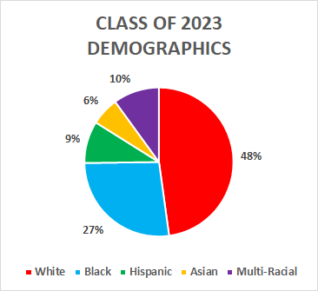
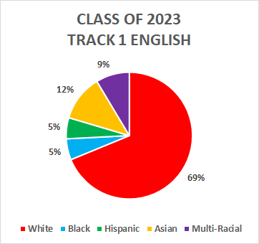
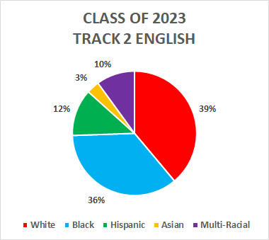
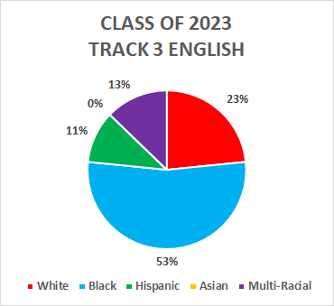
FRESHMAN YEAR SUCCESS INDICATORS
English track placement
Notes:
CH

Slide 11
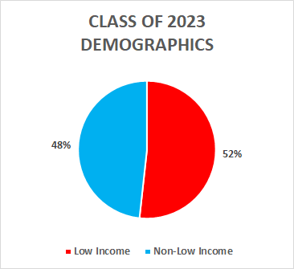
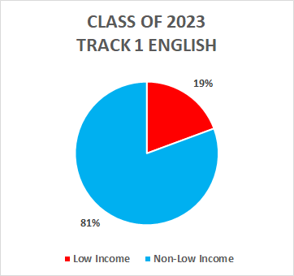
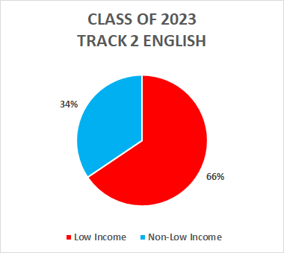
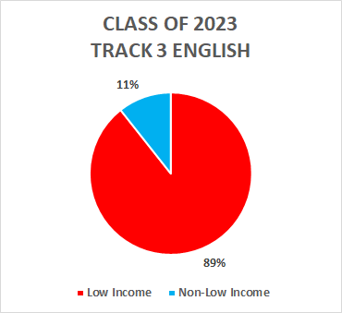
FRESHMAN YEAR SUCCESS INDICATORS
English track placement
Notes:
CH

Slide 12
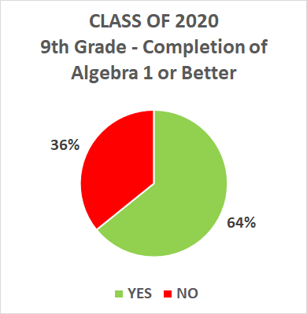
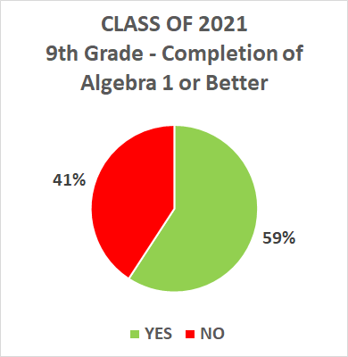
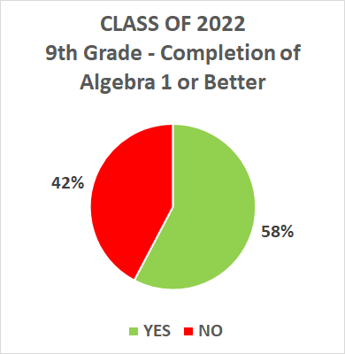

FRESHMAN YEAR SUCCESS INDICATORS successful completion of algebra 1 or better
Notes:
BB
NO = SSP, IAG, Algebra 1 Fs
YES = Algebra 1, Acc Alg 1, Acc Geom, Hon Alg 2 passing grades

Slide 13
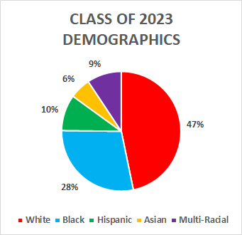
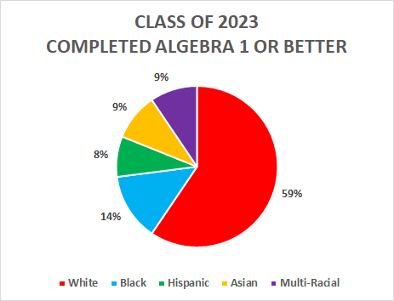
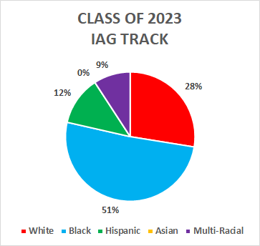
FRESHMAN YEAR SUCCESS INDICATORS successful completion of algebra 1 or better
Notes:
BB

Slide 14
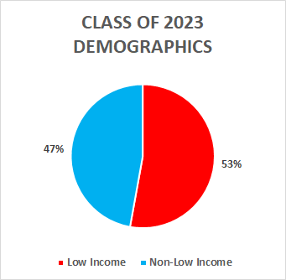
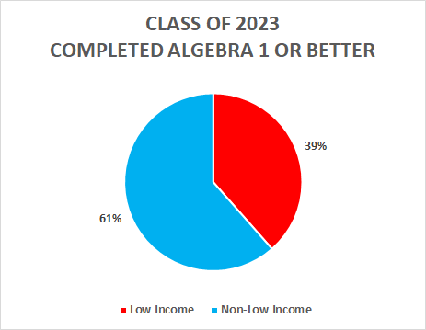
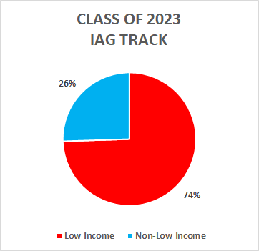
FRESHMAN YEAR SUCCESS INDICATORS successful completion of algebra 1 or better
Notes:
BB

Slide 15
JUNIOR YEAR SUCCESS INDICATORS
SAT English/Reading/Writing
SAT Math
Final English track placement
Junior Year Science Enrollment
Notes:
EG

Slide 16
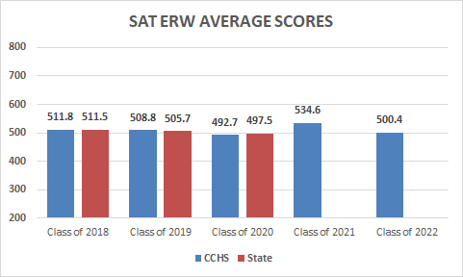
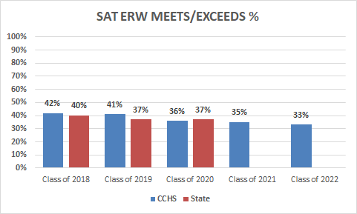
JUNIOR YEAR SUCCESS INDICATORS
SAT
ENGLISH/READING/WRITING
Notes:
CH
Meets/Exceeds is the place to look – this is what the state measures.
Average score went up in 21 and 22 because less students took the test. Meets/Exceeds went down – those that didn't take the test did not meet.
State data is not available for 2 classes because they took the test late.

Slide 17
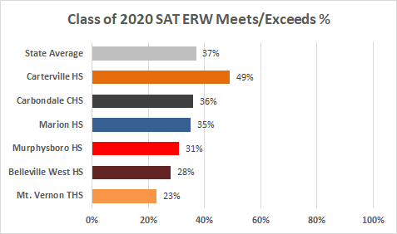
Notes:
CH

Slide 18
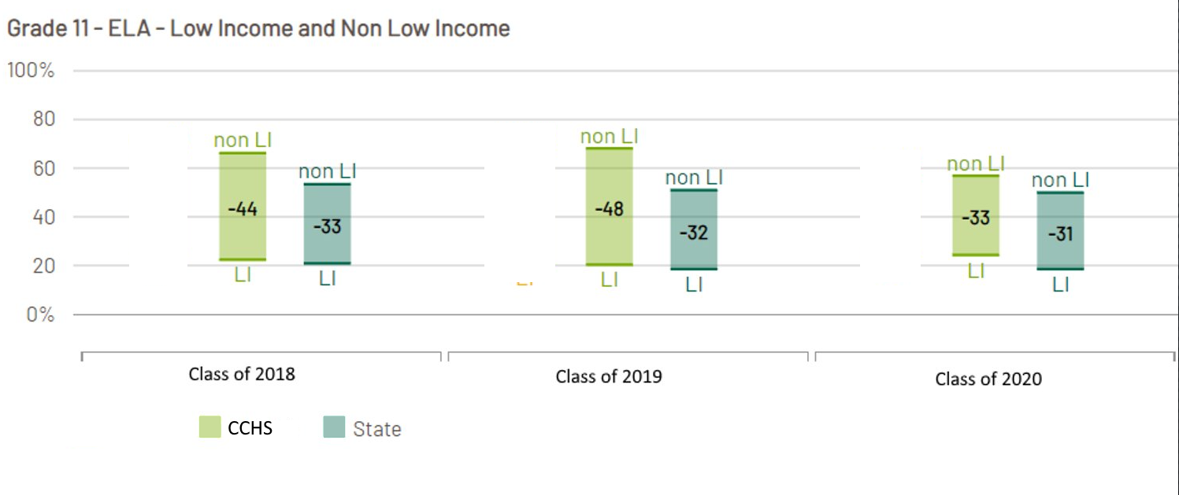
SAT ERW ACHIEVEMENT GAPS
Notes:
EG
Achievement gap is higher because our non-low income group is higher than the sate group. Our low income group also outperforms the state low income group.

Slide 19
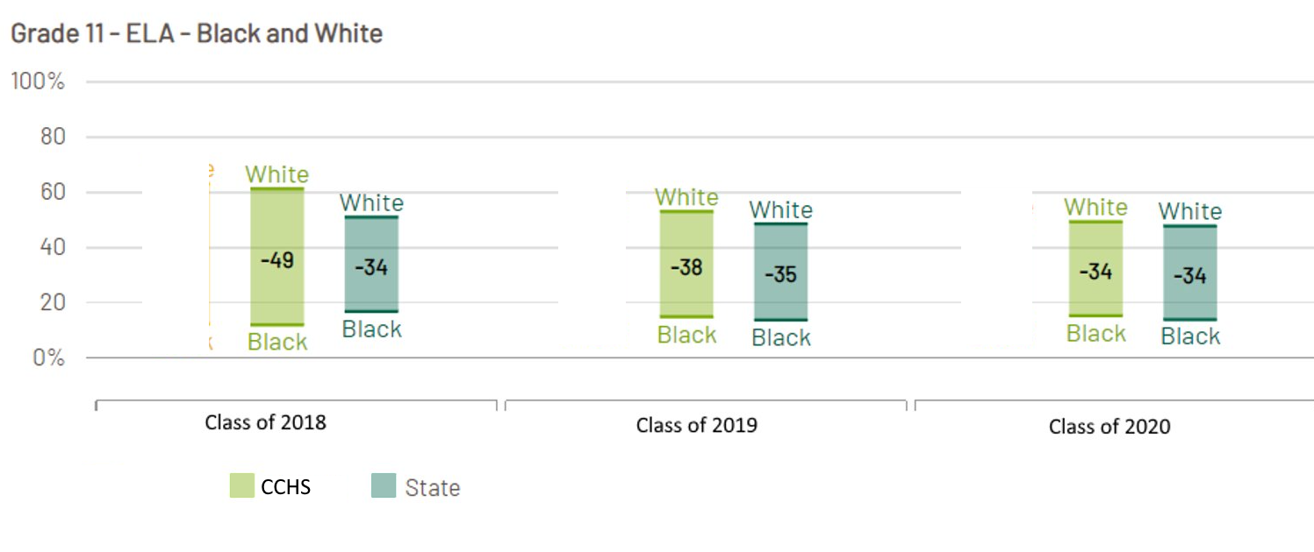
SAT ERW ACHIEVEMENT GAPS
Notes:
EG

Slide 20
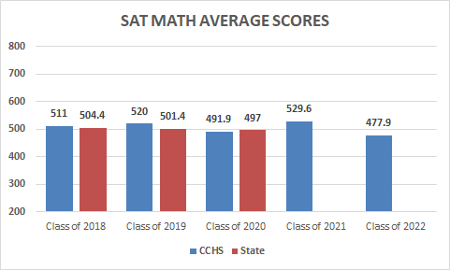
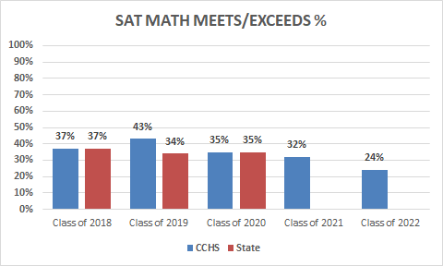
JUNIOR YEAR SUCCESS INDICATORS
sat math
Notes:
BB

Slide 21
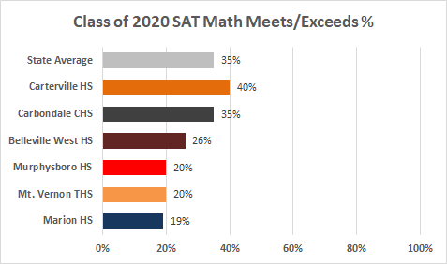
Notes:
BB

Slide 22
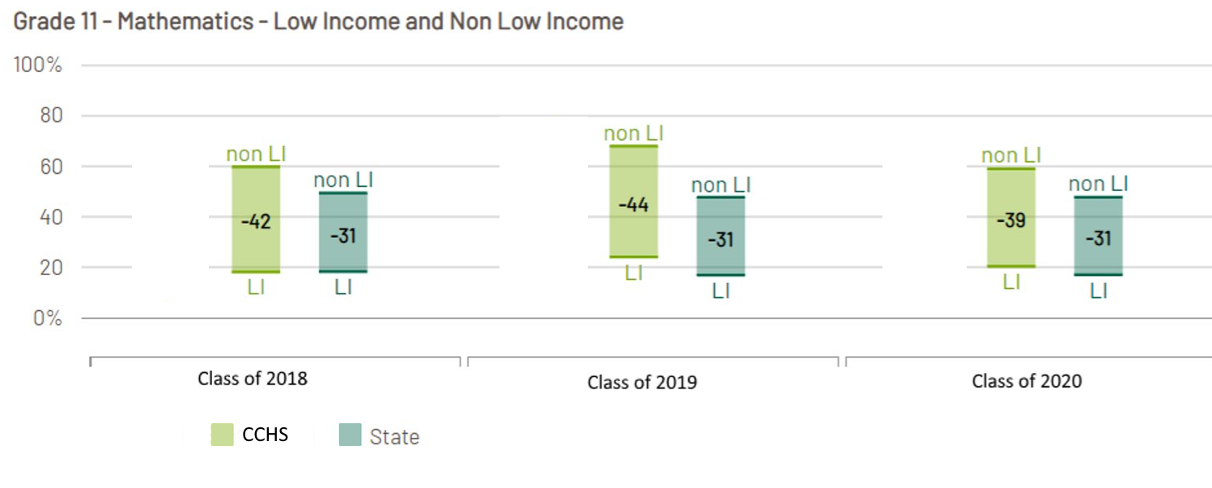
SAT MATH ACHIEVEMENT GAPS
Notes:
EG

Slide 23
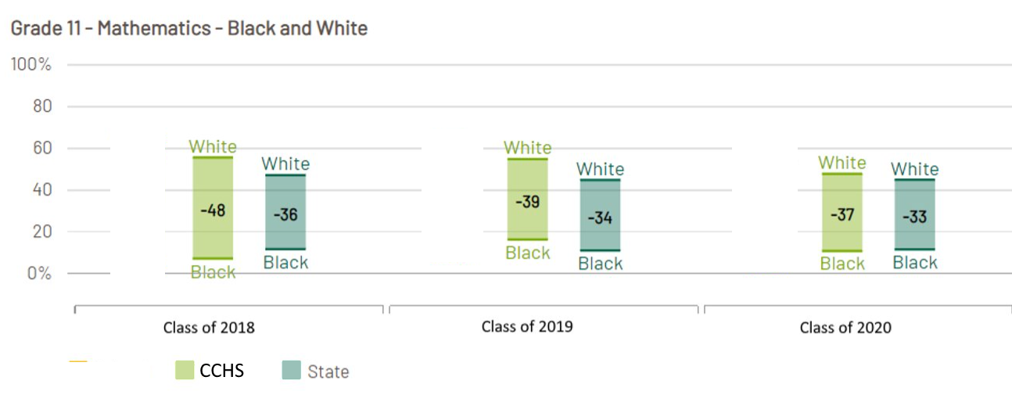
SAT MATH ACHIEVEMENT GAPS
Notes:
EG

Slide 24
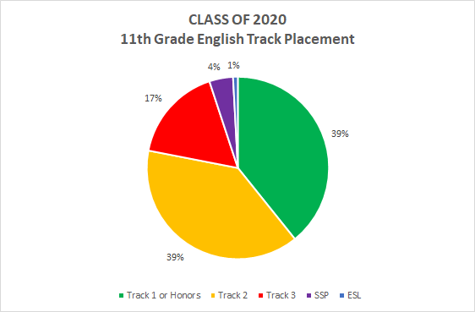
JUNIOR YEAR SUCCESS INDICATORS final English track placement
Notes:
CH

Slide 25
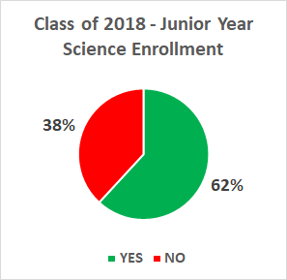

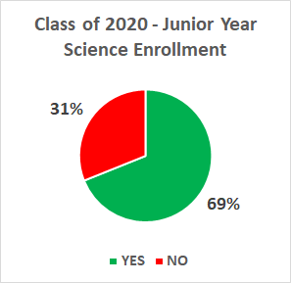
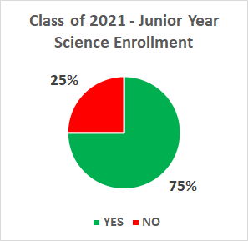
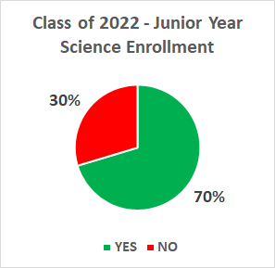
JUNIOR YEAR SUCCESS INDICATORS junior year science enrollment
Notes:
LD

Slide 26
Senior YEAR SUCCESS INDICATORS
Graduation Rate
GPA 2.75 or Better
Science credits at graduation
CTE pathways & certificateS
Notes:
EG

Slide 27
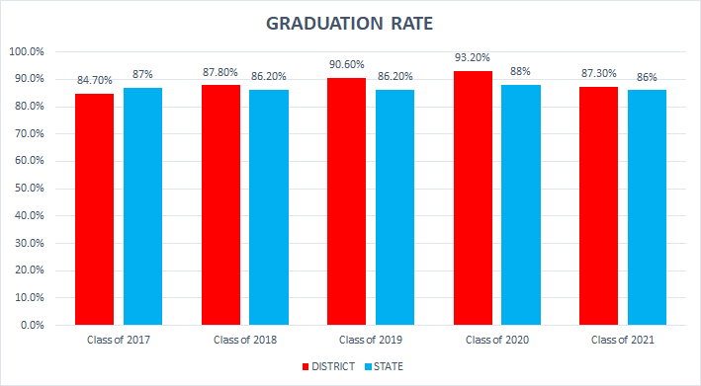
Senior YEAR SUCCESS INDICATORS graduation rate
Notes:
EG

Slide 28
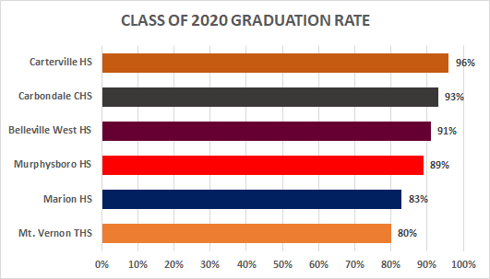
Notes:
EG

Slide 29
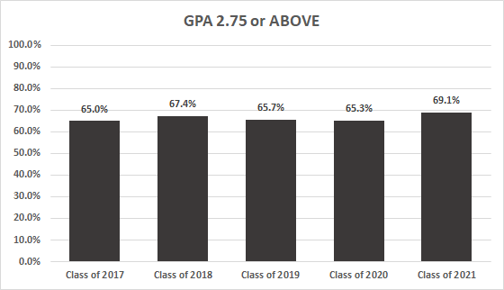
Senior YEAR SUCCESS INDICATORS gpa 2.75 or better
Notes:
KA

Slide 30
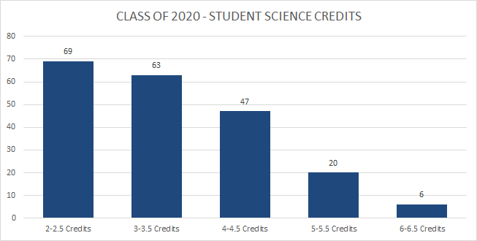
Senior YEAR SUCCESS INDICATORS science credits at graduation
CLASS OF 2020 – Average Science Credits at Graduation: 3.33
Distribution:
Notes:
LD

Slide 31
Senior YEAR SUCCESS INDICATORS cte pathways or certificates
Accounting / Marketing
Architecture and Engineering
Carpentry
Clothing/Textiles
CNA Program
Computer Programming
Culinary Arts
Education
Electrical Trades
Multimedia Development
Robotics
Small Engines
Automotive (Off Campus)
Construction (Off Campus)
Welding (Off Campus)
*Students in highlighted pathways can earn certificates.
Notes:
KA
List of offerings. We don't have data yet – it will be collected for the first time this school year.
Highlighted offer certificates

Slide 32
Advanced coursework
AP Course Enrollment
AP Scores
Dual Credits Earned
Honors Course Demographics
Notes:
EG

Slide 33
Advanced coursework
AP COURSE OFFERINGS
AP Biology
AP Calculus
AP Chemistry
AP Environmental Science
AP Government
AP Physics 1
AP Physics 2
AP Physics C
AP Spanish 4
AP US History
AP World History
Notes:
EG

Slide 34
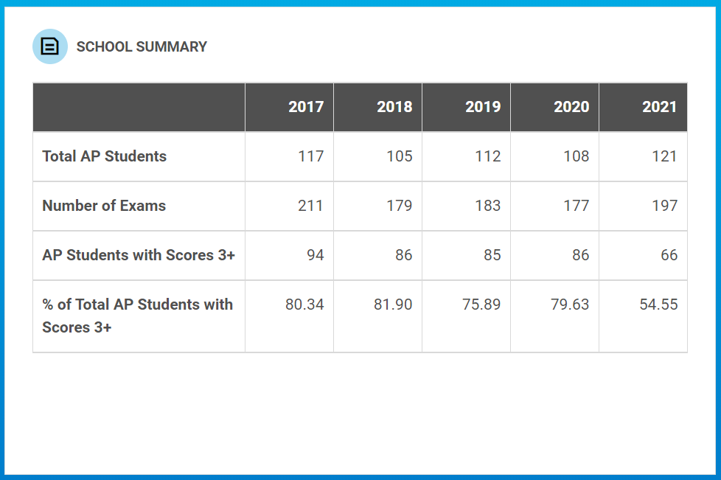
Advanced coursework ap course enrollment
Notes:
EG

Slide 35
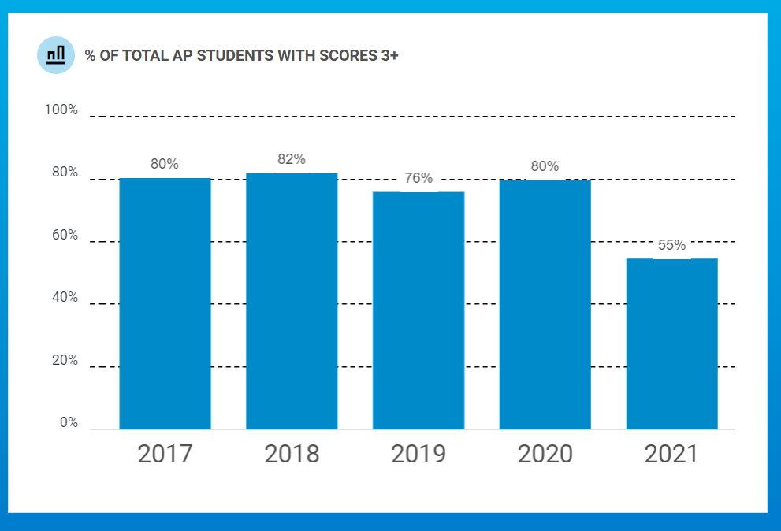
Advanced coursework ap scores
Notes:
EG
This lists the percent of students that got at least 1 3+ score.

Slide 36
Advanced coursework dual credits earned
 | 16-17 | 17-18 | 18-19 | 19-20 | 20-21 | TOTAL
English 4 - Tech Writing | 47 | 83 | 61 | 63 | 34 | 288
Spanish 3 | 31 | 48 | 42 | 40 | 35 | 196
Ceramics | 61 | 62 | 16 | 40 | 14 | 193
Statistics | 19 | 39 | 36 | 54 | 35 | 183
Medical Terminology | 35 | 42 | 20 | 30 | 19 | 146
Environmental Science | 24 | 20 | 31 | 14 | 30 | 119
CNA | 14 | 15 | 17 | 23 | 30 | 99
Spanish 4 | 12 | 7 | 16 | 28 | 32 | 95
Contemporary Math | - | - | - | 43 | 27 | 70
Electrical Trades | 10 | 8 | 6 | 10 | 13 | 47
Human Development | - | - | - | 12 | 7 | 19
Off-Campus - ASL | 4 | 5 | 0 | 4 | 1 | 14
Off-Campus - Welding | 0 | 4 | 0 | 3 | 1 | 8
Off-Campus - Automotive | 1 | 1 | 1 | 2 | 2 | 7
Off-Campus - Construction | - | - | - | - | 2 | 2
TOTAL | 258 | 334 | 246 | 366 | 281 | 1486
Notes:
EG
Teachers are required to have 18 graduate level hours in the subject area to be qualified to teach Dual Credit.

Slide 37
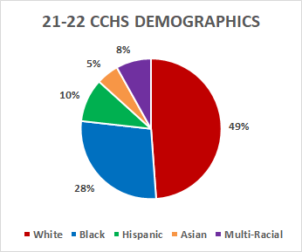
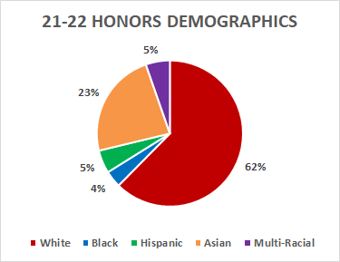
Advanced coursework
HONORS COURSE DEMOGRAPHICS
Notes:
EG

Slide 38
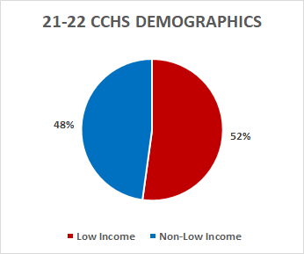

Advanced coursework
HONORS COURSE DEMOGRAPHICS
Notes:
EG

Slide 39
SUMMATIVE DESIGNATION
CCHS – Rated "Commendable" by the state every year
since 2018 (when summative designations began)
RATINGS:
  Exemplary – Top 10% of schools in the state
  Commendable – No underperforming student groups, grad rate >67%
  Targeted – One or more student groups performing below bottom 5% of schools
  Comprehensive – Bottom 5% of school in the state or grad rate <67%
Notes:
EG
Introduce designations.

