Slide 1


Carbondale Community High School District 165 Strategic Plan
OUR VISION
This Portrait serves as a “North Star” for system transformation. Providing strategic direction for the redesign of the overall education experience, CCHS District 165 for students, this collective vision invigorates and engages
students, staff, and community stakeholders.
This destination describes where the district aspires to be by 2030.

Slide 2
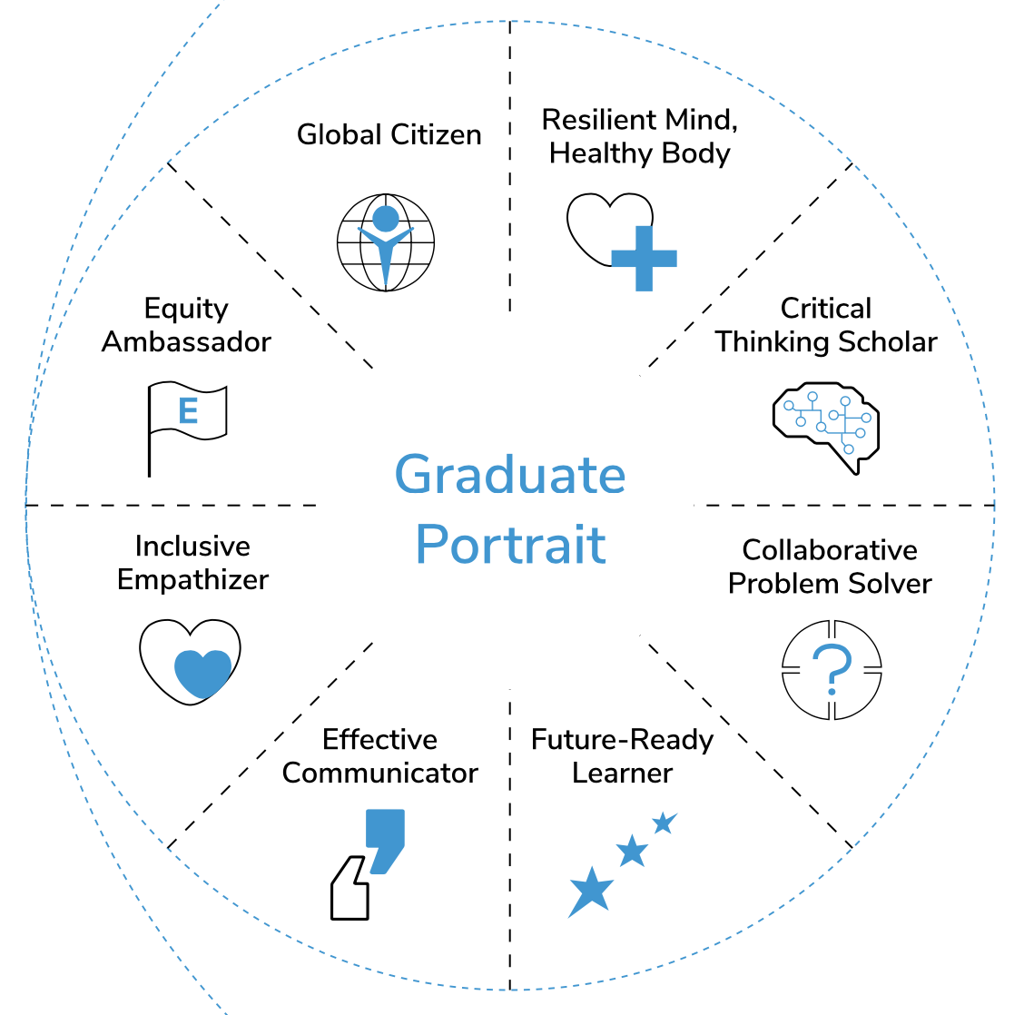
Graduate Portrait: Each graduate will be:
College, Career & Life Ready
A Critical & Creative Thinker
A Skilled Communicator & Engaged Collaborator
Digitally Literate
An Adaptable & Resilient Learner
An Empowered & Self-Sufficient Learner
Personally Responsible with a Growth Mindset
Carbondale Community High School District 165 Strategic Plan

Slide 3
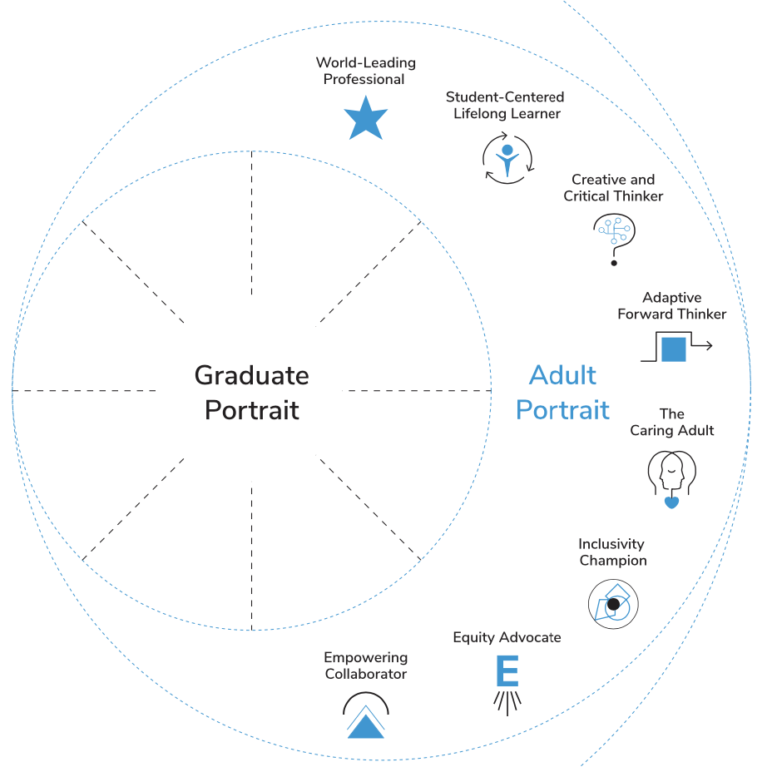
Adult Portrait: Each faculty and staff will:
Love Teaching and Learning
Be Respectful of Students & Parents
Be a Culture & Equity Advocate
Be an Adaptive, Forward-Thinking Team Player
Be Digitally Literate
Be a Skilled Communicator and Engaged Collaborator
Be an Ethical & Trusting Relationship Builder
Carbondale Community High School District 165 Strategic Plan

Slide 4
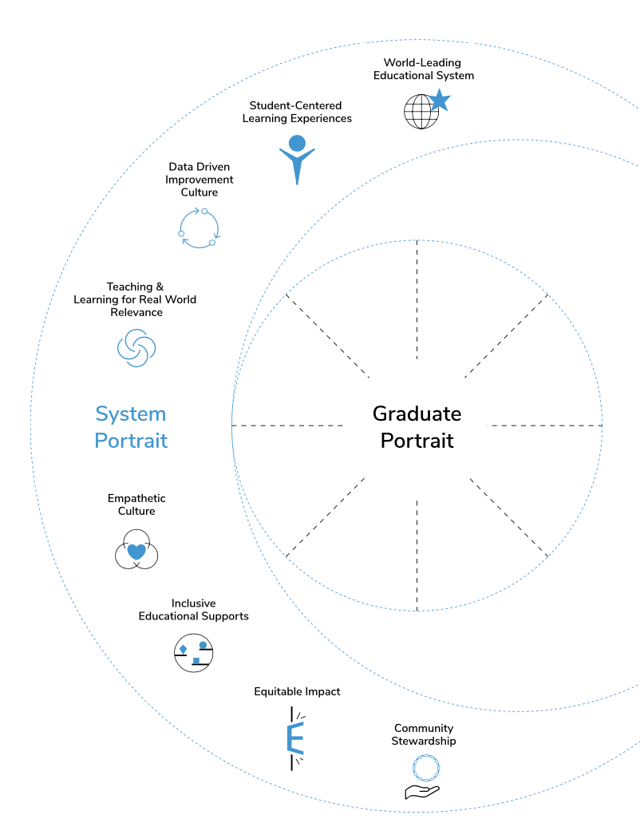
System Portrait: The system will:
Ensure Clarity of Purpose & Focus
Value Its Staff
Promote Growth & Continuous Improvement
Value Shared Decision-making & Collaboration
Develop a Sense of Community & Belonging
Promote Cohesion in Working Toward Common Goals
Foster Clear, Two-way Communication
Be an Excellent Steward of Resources
Carbondale Community High School District 165 Strategic Plan

Slide 5
Equity & Fairness
We acknowledge that our current social, economic, and political systems are unjust, in large part because of racism. We marshal our resources to advance equitable opportunities and outcomes for all. .
.
Diversity & Inclusion
We respect and appreciate differences in age, gender, ethnicity, education, physical abilities, race, and religion among individuals. We build an inclusive learning and working environment welcoming to people of all backgrounds.
Growth & Continuous
Improvement
We are unwavering in bettering ourselves and our students by setting aggressive but achievable growth goals. We are driven to create sustainable change that
dramatically improves the lives of our students for generations to come.
Communication &
Collaboration
We value being heard and making sure we hear others. We place importance on forming and maintaining relationships with stakeholders through conversation and engagement. We commit to working together towards a common goal. We value teamwork and shared decision-making.
Responsibility & Accountability
We acknowledge and own up to the responsibility we have to our students, their families, our community, our profession and to one another. We are accountable for our results. We are good stewards of our resources. We commit to public education.
Trusting Relationships &
Partnerships
We believe in our students, their families, and our community, and ensure they can believe in us. We ensure honesty and empathy by cultivating relationships and partnerships that empower others and ourselves to be our best.
CCHSD 165
CORE
VALUES
Carbondale Community High School District 165 Strategic Plan
WHAT WE STAND FOR
Innovation &
Future Focus
We are constantly developing new technologies, solutions, and workarounds that can change the world. We show unwavering dedication to the initiatives and projects that matter the most. We value focus on defined direction and measure and report progress toward that focus.
Core Values are Non-negotiable and Guide our Behaviors and Action

