Slide 1

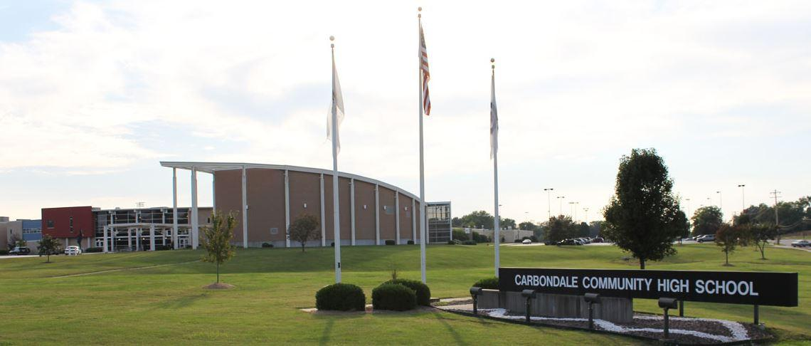
CARBONDALE COMMUNITY HIGH SCHOOL
Finances, Facilities, and Technology
2021 Strategic Planning
Data Retreat

Slide 2
Finance Overview
Revenues
  Revenue by Source
  Days Cash on Hand
  Tax Levy
Expenditures
  Expenditures by Categories
  Operating Expense Per Pupil
  Salary Comparison
Fund Balance
Financial Profile

Slide 3
FY22 Estimated Revenues

Slide 4
Sources of Revenue

Slide 5
Days of Cash on Hand

Slide 6
Tax Levy
Levy
  Amount of property tax revenue requested
Equalized Assessed Value (EAV)
  1/3 of Fair Market Value of Property
Property Tax Extension Limitation Law (PTELL)
  Law that caps the amount of revenue district may receive in property taxes
Extension
  Amount of property tax revenue approved
Consumer Price Index (CPI)
  Variation in prices paid by typical customers for retail goods and other items

Slide 7
Tax Levy Cont.
Why is it important?
  Largest and most stable source of District’s revenue
Tax Capped
  CCHS 165 is a tax-capped district, meaning its largest source of revenue cannot be increased more than the prior year’s Consumer Price Index For All Urban Consumers (CPI) or 5% of previous tax years extension, whichever is less.

Slide 8
Tax Rate Equation
District Tax Capped Funds + Debt Service Levy = Tax Rate
Equalized Assessed Value (EAV)

Slide 9
2020 Tax Rate Per Fund
Education $1.87248
Operations and Maintenance $0.33749
Transportation $0.11683
IMRF $0.05401
Social Security $0.05711
Tort $0.07140
Working Cash $0.04760
Health Life Safety $0.04328
Special Education $0.02218
Debt Service $0.03946
Total $2.66184

Slide 10
Tax Rates

Slide 11
2020 Tax Rates

Slide 12
Tax Rate Cont.
Example:
$300,000 (Market Value of Home/ 3 (Assessed Value) - $6,000 (Homeowners Exemption) = $94,000 (Equalized Assessed Value)
$94,000 (EAV) x 7.48762 (Tax Rate)/100 = $7,038.36 Taxes Due

Slide 13
Tax Rate Cont.
Carbondale #95 (Plus CCHS 165)
  Tax Rate (7.48762) on a $100K home = $2,047 in Taxes
  Tax Rate (7.48762) on a $200K home = $4,542 in Taxes
Desoto #86 (Plus CCHS 165)
  Tax Rate (7.19533) on a $100K home = $1,967 in Taxes
  Tax Rate (7.19533) on a $200K home = $4,365 in Taxes
Giant City #130 (Plus CCHS 165)
  Tax Rate (5.89405) on a $100K home = $1,611 in Taxes
  Tax Rate (5.89405) on a $200K home = $3,576 in Taxes
Unity Point #140 (Plus CCHS 165)
  Tax Rate (5.52176) on a $100K home = $1,509 in Taxes
  Tax Rate (5.52176) on a $200K home = $3,350 in Taxes
Marion #2
  Tax Rate (4.43780) on a $100K home = $1,213 in Taxes
  Tax Rate (4.43780) on a $200K home = $2,692 in Taxes

Slide 14
EAV Comparison
2010
  Equalized Assessed Value
    $ 471,222,603
  Tax Rate
    2.03205
2020
  Equalized Assessed Value
    $456,198,976
  Tax Rate
    2.66184

Slide 15
Equalized Assessed Value (EAV)

Slide 16
Consumer Price Index (CPI)

Slide 17
FY22 Estimated Expenditures

Slide 18
Expenditures

Slide 19
2020 Illinois School District Operating Expense Per Pupil (OEPP)
District Type | Number of Districts | OEPP
Elementary | 368 | $14,057.75
High School | 97 | $18,805.73
Unit | 386 | $12,024.57
State | 851 | $12,842.01

Slide 20
2020 Illinois School District Operating Expense Per Pupil (OEPP)
District Name | Average Daily Attendance (ADA) | OEPP
CCHS 165 | 867.34 | $16,371.24
Murphysboro CUSD 186 | 1,826.56 | $11,818.94
Marion CUSD 2 | 3,715 | $9,026.32
Herrin CUSD 4 | 2,221.99 | $9,653.62
Mt. Vernon Township 201 | 949.17 | $16,668.73
Carterville CUSD 5 | 2,029.34 | $8,740.14

Slide 21
Teacher Average Annual Salary Comparison

Slide 22
Administrator Average Annual Salary Comparison

Slide 23
Fund Balances –
Education Fund

Slide 24
Fund Balances – Operations & Maintenance

Slide 25
Fund Balances – Transportation

Slide 26
Financial Profile Designations
Financial Recognition (3.54 – 4.00)
  Highest score with low risk and little to no involvement from ISBE
Financial Review (3.08 – 3.53)
  Limited review by ISBE and monitored for potential downward trends
Financial Early Warning (2.62 – 3.07)
  ISBE monitors district closely and offered proactive assistance
Financial Watch
  Highest risk category, evaluated for potential Financial Oversight Panel

Slide 27
School District Financial Profile Score - FY21
Category | Score
Fund Balance to Revenue Ratio - The overall financial strength of the district | 4
Expenditure to Revenue Ratio - How much has been expended for each dollar received | 4
Days Cash on Hand - Estimated number of days the district could sustain operational expenditures if no additional revenues were received | 4
Percentage of Short-Term Borrowing Maximum Remaining - Short-term debt is typically anything that can be paid back in the same fiscal year | 4
Percentage of Long-Term Debt Margin Remaining - Long-term debt are big projects, such as building renovations and purchasing equipment | 4

Slide 28
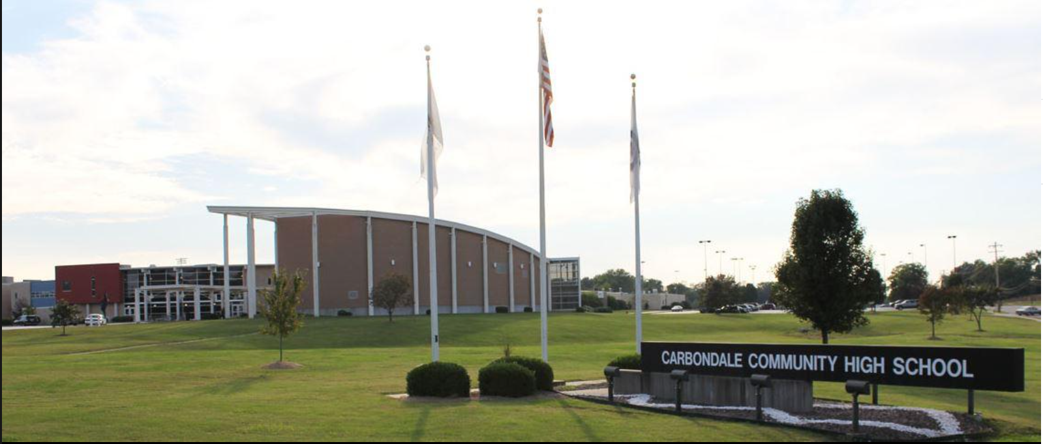
Facilities Data Retreat Presentation

Slide 29
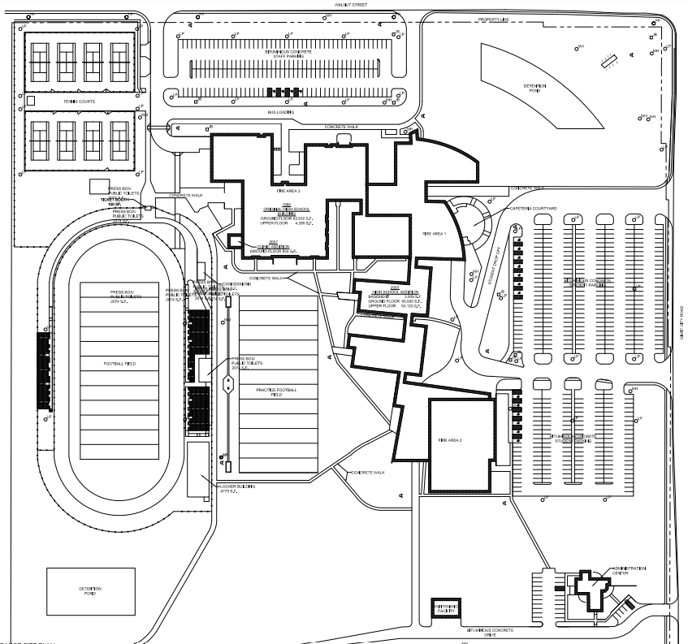
CCHS Main Campus Layout

Slide 30
Building Specifications
Original high school (9th grade campus) built in 1966 – 68,202 sf.
New high school addition built in 2003 – 152, 959 sf.
Terrier Care clinic addition built in 2007
Total size - 221,160 sf
Rebound Campus built in 1965 – 11,752 sf.
High School campus is 41 acres
Superblock is 20 acres
District serves students within almost 130 square miles of the campus

Slide 31
Facilities Funding Streams
ESSER II - $2 million
ESSER III - $5 million
Facilities Sales Tax – Approximately $900,000 per year

Slide 32
ESSER Funding
The District plans to use its ESSER grant money in three major areas:
  Addressing student learning loss
  Improving school district air quality to prevent the spread of viruses
  Improving space to assist with social distancing through capitol projects

Slide 33
ESSER II Approvals
Cafeteria Expansion $700,000
Replace C&D Wing Roof Top Units $300,000
Replace Gym 20 ton Package Units $300,000
Replace (2) 200 ton Air Cooled Chillers $600,000
All projects will be completed before start of 2022-23 school year.

Slide 34
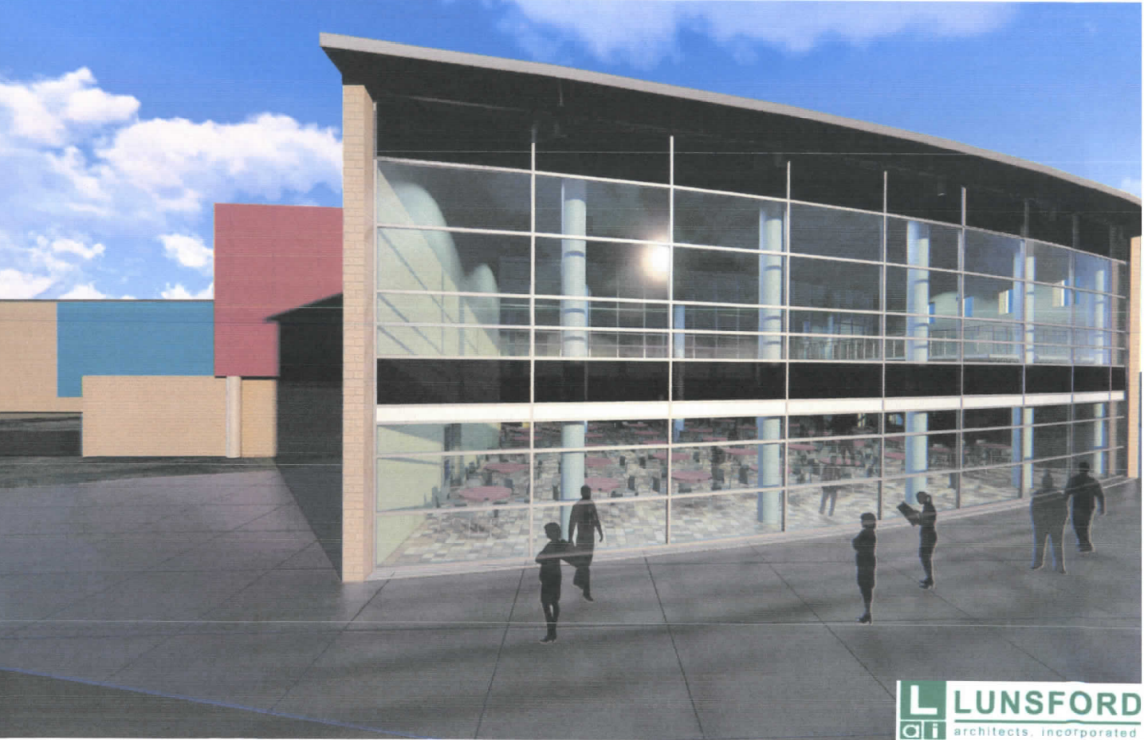

Slide 35
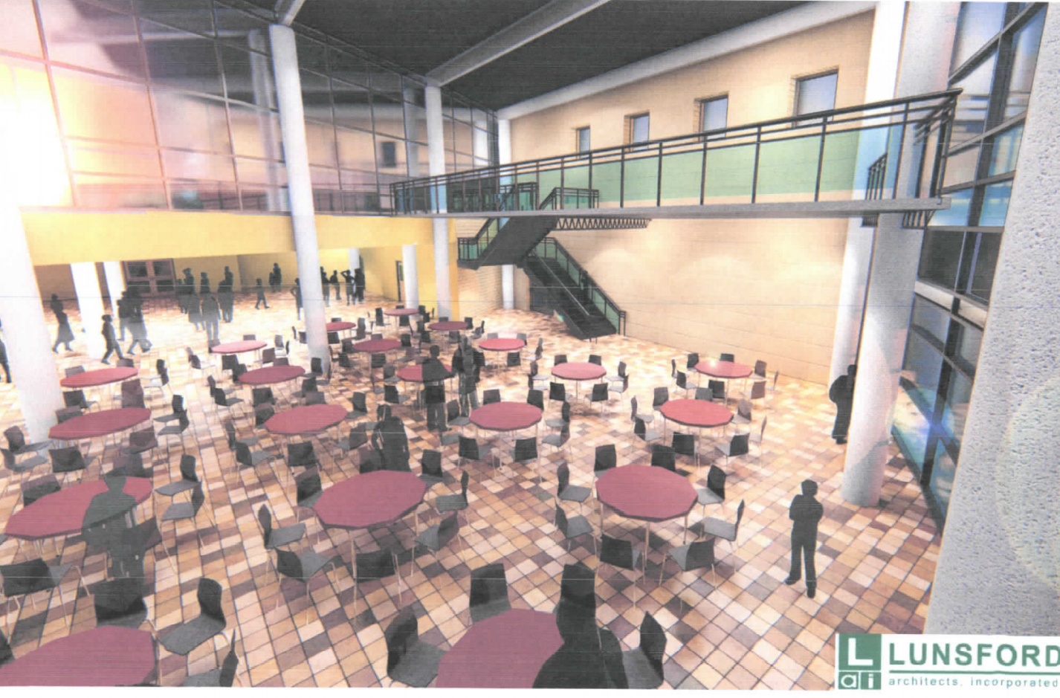

Slide 36
ESSER III Approvals
  Replacement of 1960’s boiler and piping systems to improve HVAC performance - $1 million
  Roof replacement to assist with insulation and to improve HVAC and airflow performance - $500,000
  Shop/CTE Expansion - $700,000
  D-Wing Science Addition - $1.6 million
  Walnut Street Security Entry addition - $200,000

Slide 37
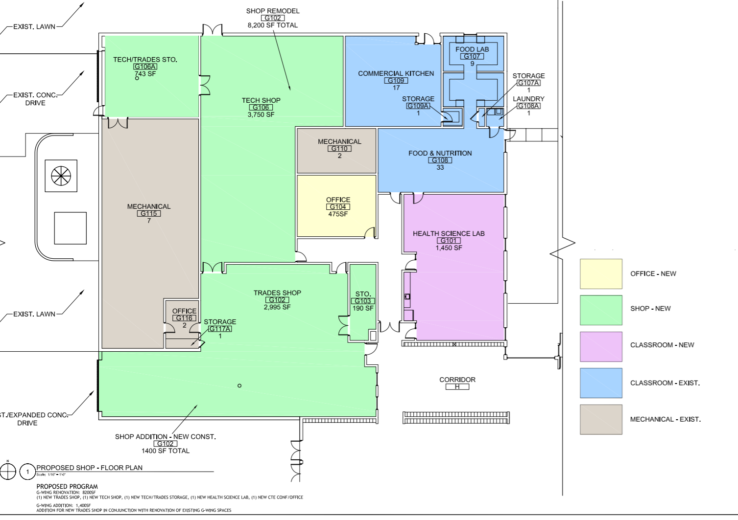
CTE Expansion

Slide 38
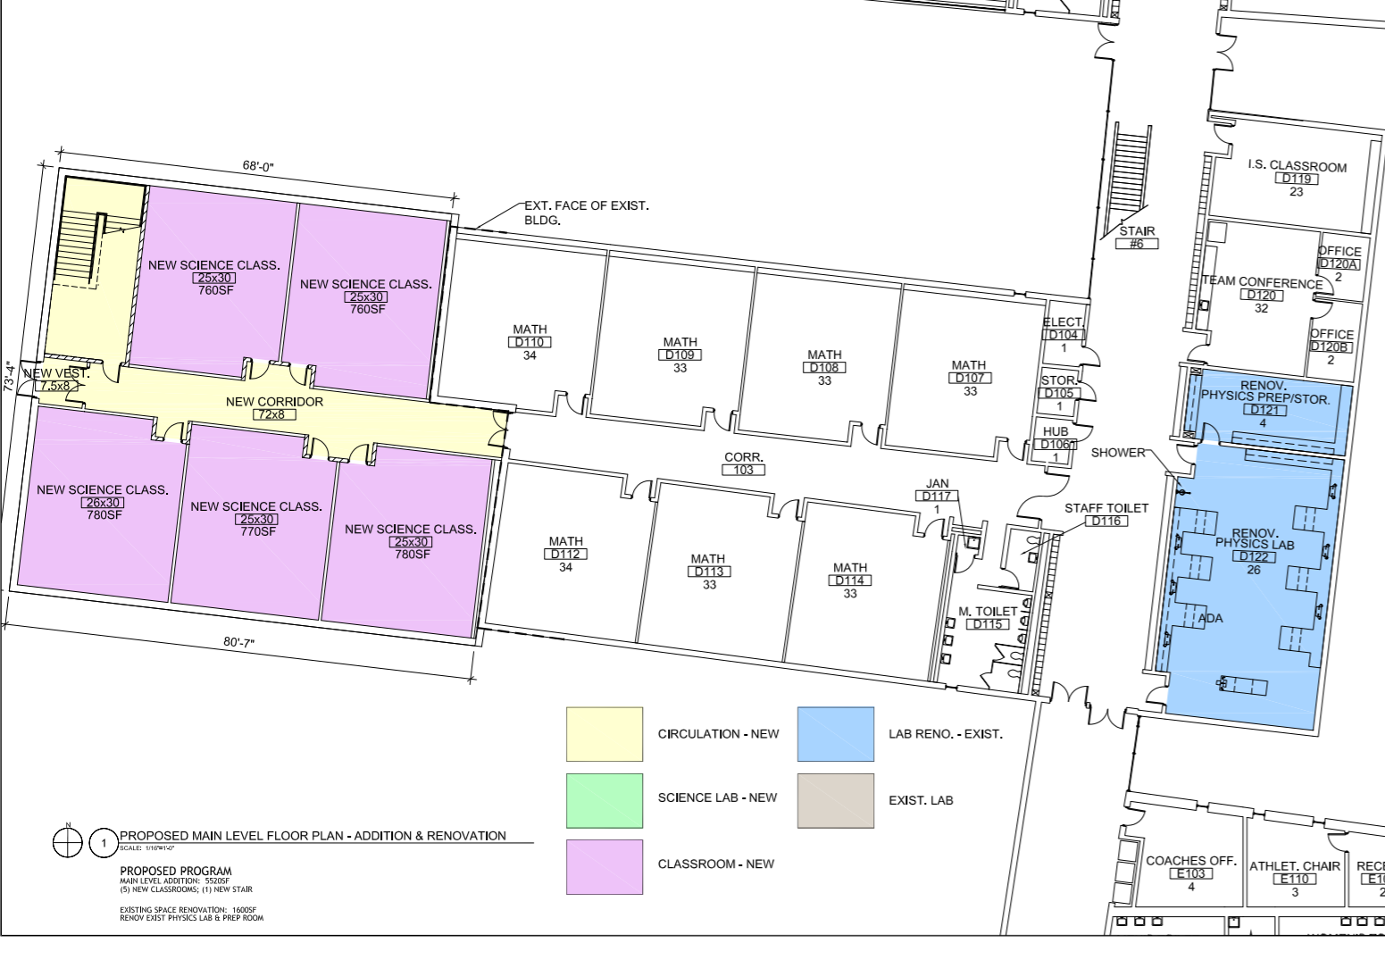
D-Wing Downstairs Science Additions

Slide 39
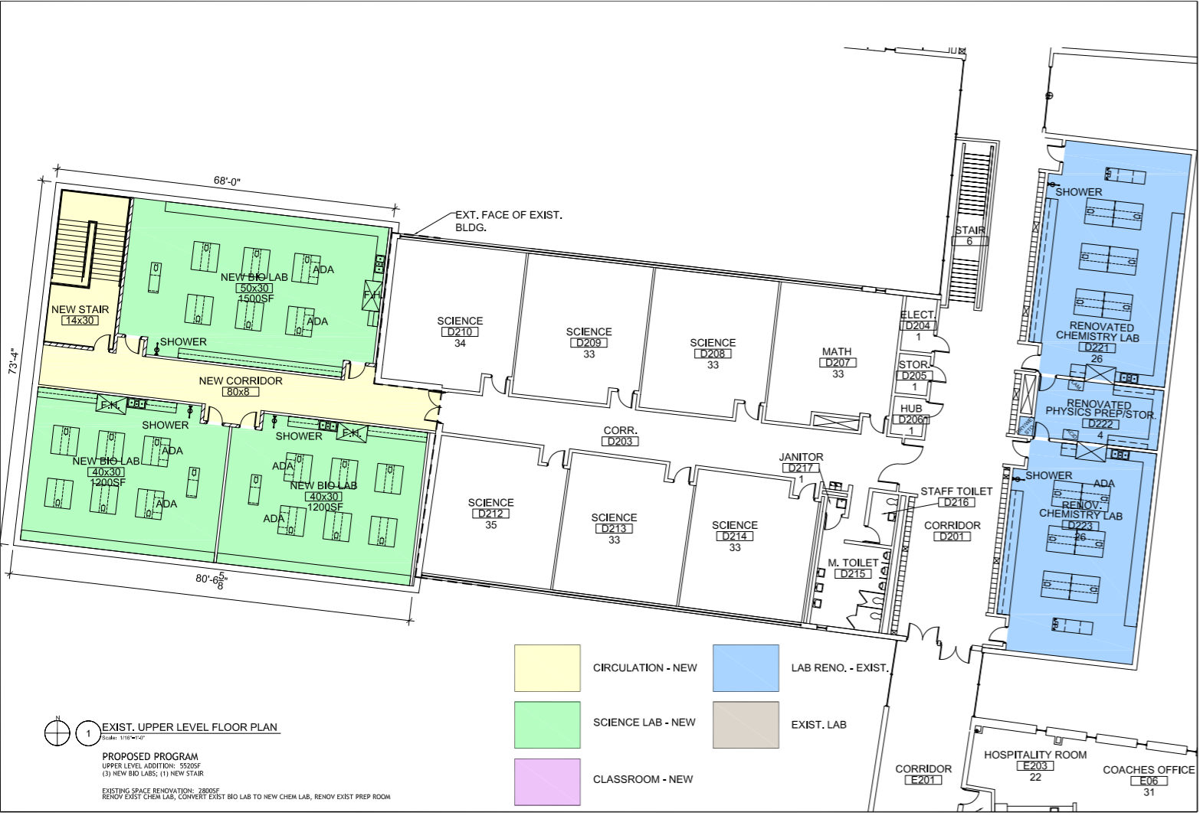
D-Wing Upstairs Addition (Science)

Slide 40
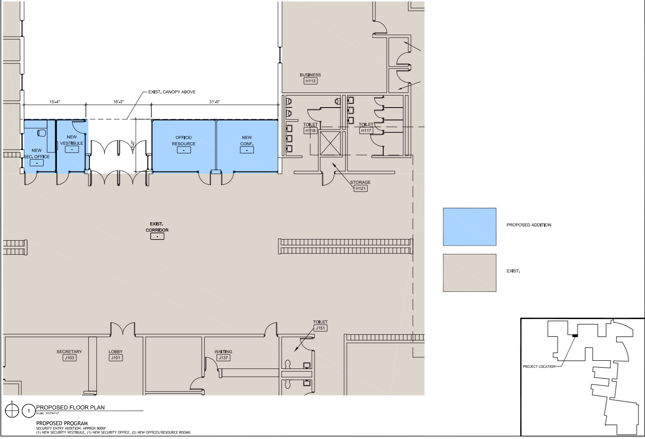
Security Entrance

Slide 41
Facility Sales Tax Approvals

Slide 42
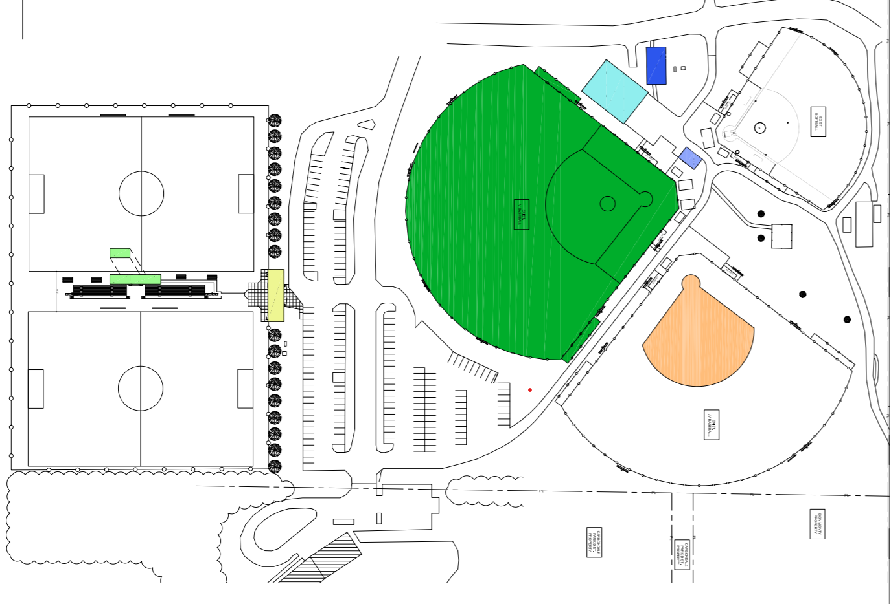
Superblock Layout

Slide 43
Building and Grounds Committee
Current committee is working to make recommendations to the Board for future building and grounds needs and wants.
Committee will report to the Board in early 2022.
Approval of future projects may lead to the District bonding against their FST money for major renovations and upgrades for the District.

Slide 44
10 year Health Life Safety Survey
Completed in 2017
3 items left to be done
  C-Wing exterior stairs
  Kitchen Floor Epoxy
  C & D Roof Top Unit Replacements (Currently under contract for completion.)

Slide 45
Technology
1:1 student to Chromebook ratio
10GB Lan network
1GB Internet line with a 1GB backup
Desktop computer in each classroom for teacher use
Projector in every classroom
  Looking to use grant funds to update as needed in coming months/years
Wireless internet throughout building and athletic areas

Slide 46
Technology
Emergency Connectivity Grant
  Approved in October
  $325,000 in funds that will support the purchase of 1,000 chrome books, and 200 hotspots for our students. This will allow us to continue giving each student a laptop computer for school work over the next 4 years.

Slide 47
            Questions?

