Slide 1



Strategic Planning
Final Plan Team Meeting

Slide 2


Welcome and Introductions
Who is in the room?
What are we here to do?
Why is this an important event?

Slide 3

Communication
Collaboration
Grace
Carbondale High School
District 165
Strategic Plan Logo

Slide 4

FOUNDATION OF CONTINUOUS IMPROVEMENT
Pillars | Guiding Question
MISSION | What is our fundamental purpose; why do we exist?
VISION | What must we become in order to accomplish our fundamental purpose?
GOALS | How will we know if we are making a difference?
VALUES | How must we behave to achieve our mission, vision and goals?

Slide 5

Strategic Planning Process
Where do we want to be?
Where are we now?
How will we get to where we want to be?
What
are we learning?
Vision and
Mission
Needs
Assessment
Goal Setting
Action
Planning
Monitor
Adjust
Improve
Stakeholder Input/ Impacts
Defining Key Areas To Improve
Gap Analysis
SMART Goals
Strategies
Best Practice
Staff Development
Adjust
Structures &Processes
Review and Revise
Implement
Strategies
Implement
Strategies
Annual- Formative
Multi-Year: Summative

Slide 6

It is good to have an end to journey toward;
but it is the journey that matters in the end.
Ursula K. LeGuin 1999
WHERE DO WE WANT
TO BE?
HOW DO WE GET FROM
WHERE WE ARE TO
WHERE WE WANT TO BE?
WHERE ARE WE NOW?
CONTINUOUS IMPROVEMENT

Slide 7
Mission
Who we are? Why do we exist?
Vision
What must we become?
Values
How must we behave?
Goals and Objectives
How we gauge our success?
The FOUR Pillars of a Strategic Plan
Definitions
Connections
Criteria for Success

Slide 8

FINAL MEETING OUTCOMES
Answer the question “What will be our final recommendation to the Board of Education to set forth a new district strategic plan?”
Reflect on STAKEHOLDER FEEDBACK to revise the DRAFT of the strategic plan from our work at the Setting Direction Retreat.
  Mission
  Vision
  Core Values
  Long-Range Goals
  Urgent Strategies for Improvement
  Outline NEXT STEPS toward plan approval and implementation

Slide 9

Stakeholder Feedback Report

Slide 10
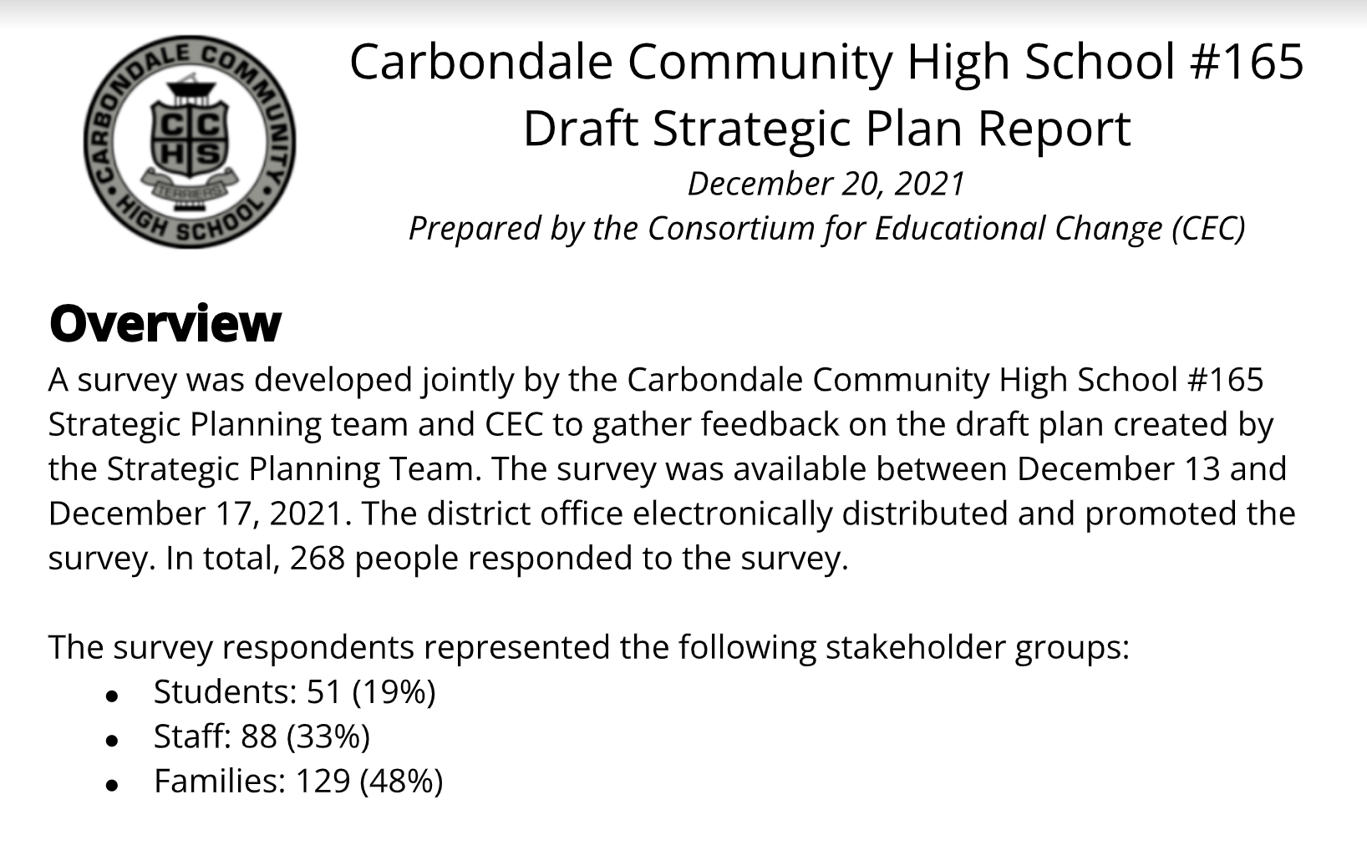

Slide 11
Stakeholder Feedback on Draft of Strategic Plan
Component | Support | Not Support | Suggestions
Overall | 93% | 7% | NA
Mission | 93% | 7%
Vision- Graduate Portrait | 97% | 3%
Vision- Adult Portrait | 96% | 4%
Vision- System Portrait | 98.5% | 1.5%
Core Values | 94.5% | 5.5%
Goal One and Aligned Strategies | 95% | 5%
Goal Two and Aligned Strategies | 94% | 6%
Goal Three and Aligned Strategies | 93% | 7% | Staff Diversity
Goal Four and Aligned Strategies | 97% | 3%
Goal Five and Aligned Strategies | 99% | 1%

Slide 12
ACTIVITY ONE: 75 minutes
Reflect on STAKEHOLDER FEEDBACK to revise the DRAFT of the strategic plan from our work at the Setting Direction Retreat.
  Long-Range Goals
  Aligned Urgent Strategies for Improvement

Slide 13

Each table team will begin with one of the following documents: Goal One and aligned strategies Goal Two and aligned strategies Goal Three and aligned strategies Goal Four and aligned strategies Goal Five and aligned strategies
1
2
3
4
5

Slide 14
Long-Range Goals, Indicators and Strategies Long Range Goals identify what we hope to achieve as we work on the strategic plan. Strategies specifically address what data and information told the strategic plan team are the critical initiatives that need attention and improvement. Indicators suggest what we will measure to see our impact and ensure we are growing and improving with our behaviors and actions.
Long Range Goal Statement | Aligned Strategies | Suggested Indicators
Student Growth and Achievement: Prepare all students for college, career, and post-secondary success. | Improve overall student achievement while reducing current achievement gaps among subgroup student populations. Enhance with student input the overall student day and year through reimagining the daily schedule, course offerings, electives, periods in the day, and after day and summer learning opportunities. Enhance Career Readiness through CTEs, Dual Credit Opportunities, New Course Offerings, and Partnerships with Business and Educational Community Organizations. | Graduation Rate State Assessments in ELA and Mathematics 9th Grade on Track English Language Proficiency Grade Point Average AP/CTE/ Dual Credit Participation Senior Exit Survey

Slide 15
Long-Range Goals, Indicators and Strategies Long Range Goals identify what we hope to achieve as we work on the strategic plan. Strategies specifically address what data and information told the strategic plan team are the critical initiatives that need attention and improvement. Indicators suggest what we will measure to see our impact and ensure we are growing and improving with our behaviors and actions.
Long Range Goal Statement | Aligned Strategies | Suggested Indicators
Learning Environment: Promote an environment that is respectful, innovative, inclusive, and supportive. | Reimage student academic interventions to achieve equity, inclusiveness, and continuous improvement. Reimagine opportunities to enhance student life skills, social emotional needs, behaviors, and attendance. | Student Enrollment Attendance/Chronic Absenteeism Class Size Student Behaviors Demographic Diversity Data Student Climate Survey 5E SEL Survey Life Success Survey Survey Participation Rates

Slide 16
Long-Range Goals, Indicators and Strategies Long Range Goals identify what we hope to achieve as we work on the strategic plan. Strategies specifically address what data and information told the strategic plan team are the critical initiatives that need attention and improvement. Indicators suggest what we will measure to see our impact and ensure we are growing and improving with our behaviors and actions.
Long Range Goal Statement | Aligned Strategies | Suggested Indicators
High-Quality Workforce: Recruit, develop, and retain a high-quality workforce to ensure and strengthen workplace competencies, collaboration, and satisfaction. | Recruit and hire a more diverse workforce who collaborates with others to enhance cultural awareness and respect. Enhance professional learning leading to Innovation, project-based, real-world relevance, high quality student discussion, and student voice. | Staff Enrollment by Diversity Staff Education Staff Retention Staff Performance Evaluation National Board-Certified Teachers Staff Satisfaction 5E Survey Staff Exit Survey Salaries & Benefits Professional Development

Slide 17
Long-Range Goals, Indicators and Strategies Long Range Goals identify what we hope to achieve as we work on the strategic plan. Strategies specifically address what data and information told the strategic plan team are the critical initiatives that need attention and improvement. Indicators suggest what we will measure to see our impact and ensure we are growing and improving with our behaviors and actions.
Long Range Goal Statement | Aligned Strategies | Suggested Indicators
Family and Community Partnerships: Cultivate partnerships with families and the community to support and expand learning opportunities for students. | Enhance communication, collaboration, and alignment with all feeder elementary districts to ready students for high school. Enhance relationships with SIU, JALC, SIH, and other community partners to further the interests of all parties toward student success. | Parent Engagement, Attendance at Conferences, & Volunteerism Parent Satisfaction 5E Survey External Community Survey Parent Use of Digital Reporting Community and Stakeholder Engagement Number of Community Partners Number of Students Participating in Co-op Programs Community/Families Points of Contact Events and Activities

Slide 18
LLong-Range Goals identify what we hope to achieve as we work on the strategic plan. Strategies specifically address what data and information told the strategic plan team are the critical initiatives that need attention and improvement. Indicators suggest what we will measure to see our impact and ensure we are growing and improving with our behaviors and actions.
Long Range Goal Statement | Aligned Strategies | Suggested Indicators
Resources: Make effective and efficient use of resources to maximize educational success. | Continue to make facility upgrades and provide better space utilization to enhance teaching and learning. | Annual Revenue Sources & Fund Balances Expenditures Equalized Valuation/Tax Rate State Financial Profile Operating & Instructional Expense Per Pupil Audit Findings Grant/Other Resources Space Utilization Life Safety Compliance Long-Range Facility Plan on Track Safety and Security

Slide 19

Within your team room assignment for each document: Review stakeholder feedback and identify themes. Make any changes on the Google Doc Delete, Add, Combine, or Edit

Slide 20

Combine
Goal One: Improve overall student achievement while reducing current achievement gaps among subgroup student populations.
Goal Two: Reimage student academic interventions to achieve equity, inclusiveness, and continuous improvement.
Goal One: Improve overall student achievement and reimagine student academic interventions to address achievement gaps and achieve equity, inclusiveness, and continuous improvement.

Slide 21
Combine
Goal One: Enhance Career Readiness through CTEs, Dual Credit Opportunities, New Course Offerings, and Partnerships with Business and Educational Community Organizations.
Goal Four: Enhance relationships with SIU, JALC, SIH, and other community partners to further the interests of all parties toward student success.
Goal Four: Further relationships with business and educational partners to enhance college, career, and life readiness through CTEs, Dual Credit Opportunities, New Course Offerings, and other two-way communication and collaboration.

Slide 22

Edit
Goal Four: Enhance communication, collaboration, and alignment with all feeder elementary districts to ready students for high school.
Goal Four: Enhance communication, collaboration, and articulation with all feeder elementary districts to ready students for high school.

Slide 23


Add or Delete
Is there any other urgent action that we left out as we review the SWOT Analysis and the Preferred Future Statement?
If so, add it.
Is there any strategy listed that is not urgent? Remember less is more.
If so, delete it.

Slide 24
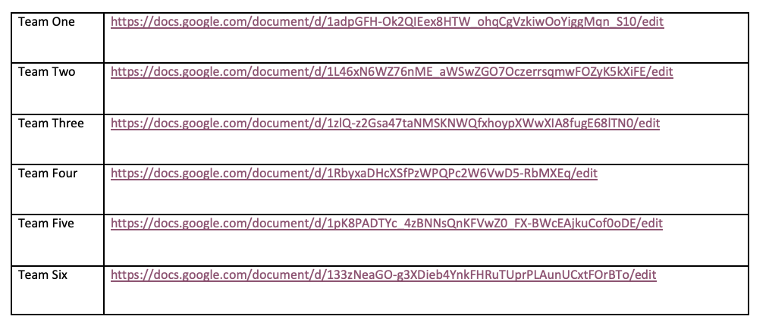

Slide 25
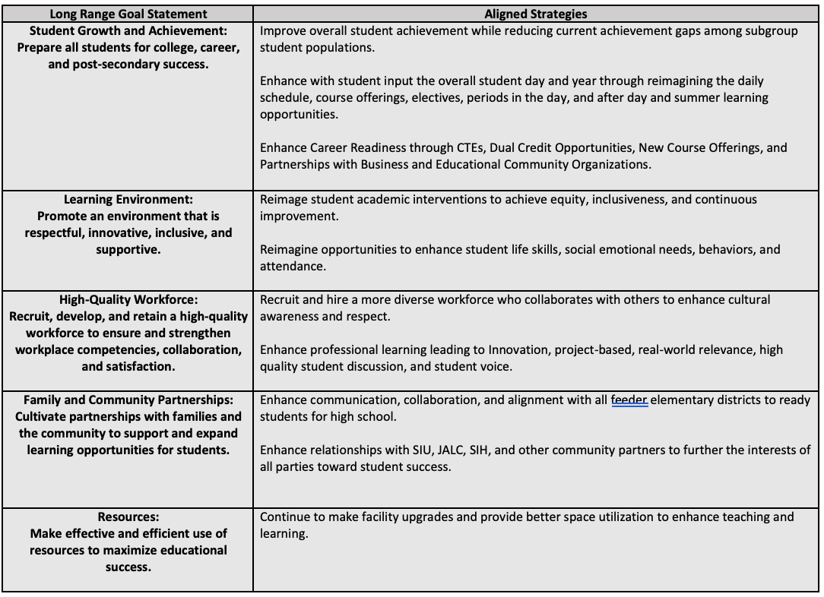

Slide 26
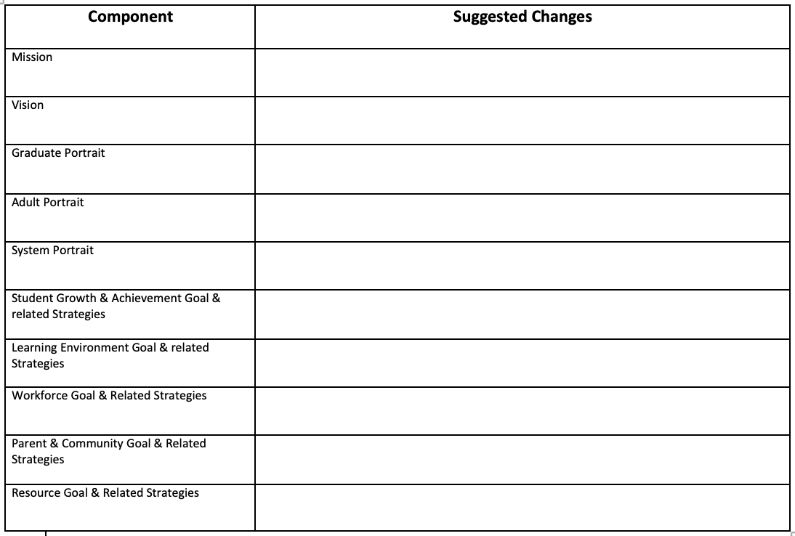

Slide 27
ACTIVITY TWO: 30 minutes
Reflect on STAKEHOLDER FEEDBACK to revise the DRAFT of the strategic plan from our work at the Setting Direction Retreat.
  Mission
  Vision
  Core Values

Slide 28
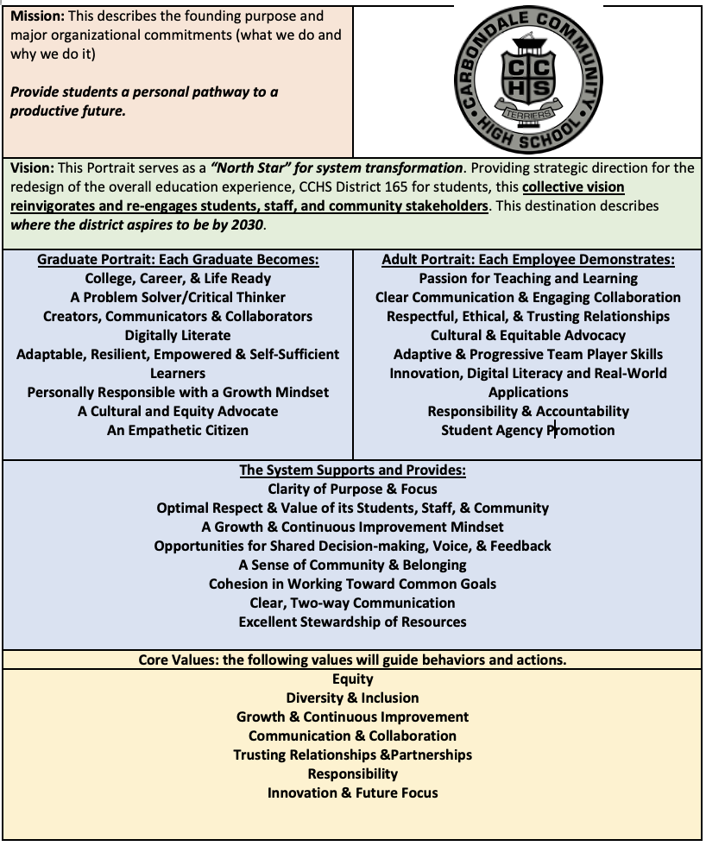

Slide 29
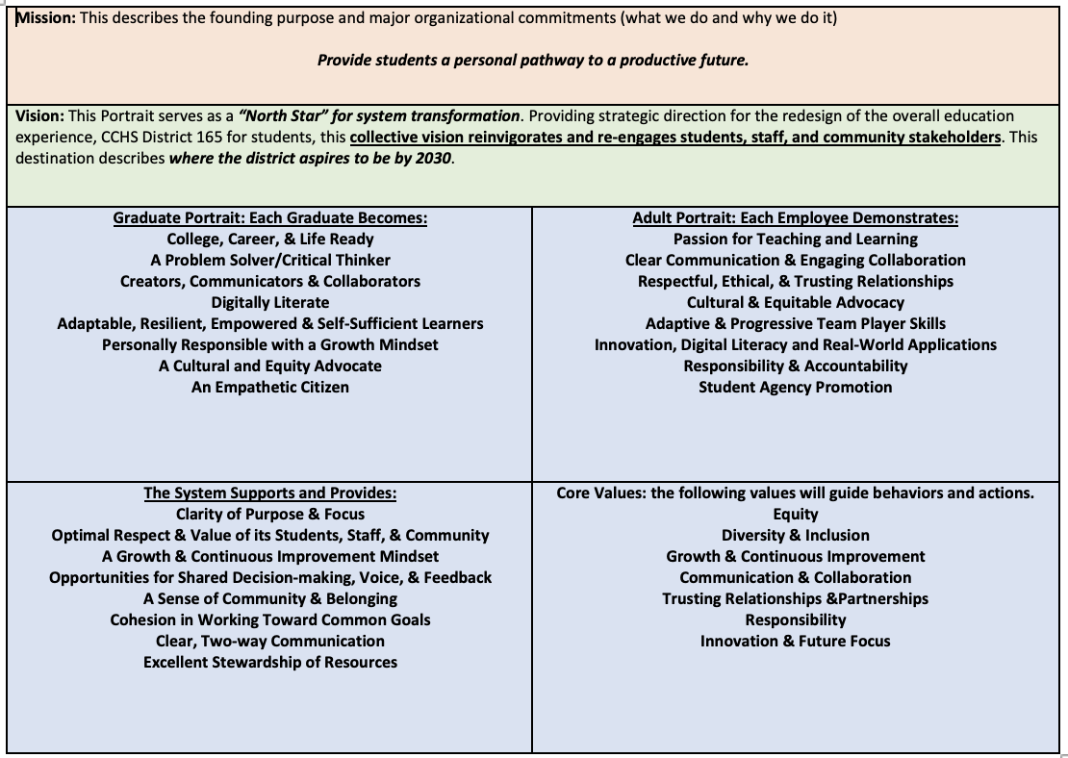

Slide 32

After you are inside your room:
Pick a timekeeper
Pick a recorder
Have the recorder clink on the team link sent to you for copied from the chat of the opening presentation today
Record your changes on each document
Return to main room when you are finished OR by 11:10 whichever comes first

Slide 33
ACTIVITY THREE: 5 minutes
Outline NEXT STEPS toward plan approval and implementation.

Slide 34

Deliverables
One Page Strategic Plan- Vision, Mission, Core Values, Goals & Aligned Strategies
Support Document containing details related to the One-Page Plan

Slide 35

CEC Facilitator
Steps toward Implementation

Slide 36


LIVING THE PLAN

Slide 37
Align goals and strategies to a data system
Identify key indicators, measures, and targets for all goals and strategies
Align the data system to a progress monitoring and reporting system for all stakeholders.
Progress monitor and report growth and achievement while making adjustments to ensure improved results
Align the Plan to the work structures and shared decision-making processes
Align the plan to school, team, department and program structures and processes to ensure ownership, responsibility and accountability
Align the Plan to individual and team performance and program evaluation
Align individual, team, school, and program goals and feedback to the data system
Align the Plan strategies to PDSA action plans
Align budget and meeting agendas to the Plan to ensure focus and priority.
Align the Plan to resources of time and money
Make sure strategy actions plans follow a consistent SMART process to develop a two-way collaborative communication system

Slide 38
Superintendent
Final recommendation to Team January 10
First reading BOE January 20
Presentation and Approval BOE February 17
Steps toward approval

Slide 39

Thanks to the Strategic Plan Team

