Slide 1
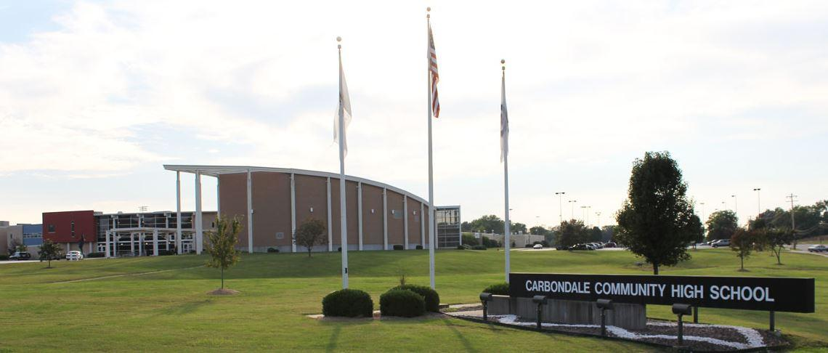
CARBONDALE COMMUNITY HIGH SCHOOL
CLIMATE AND CULTURE
2021 Strategic Planning
Data Retreat

Slide 2
CCHS Highlights
College & Career Counselor
Restorative Practice/Student Support Specialist
Trauma & Resiliency Team
PBIS Committee
5 School Counselors + 1 School Social Worker
Terrier Tutoring (Performed by Certified Staff)
Credit Recovery Lab (During the School Day)
Summer & After School Credit Recovery
Rebound (CCHS Alternative Education Option)
Late Bus
Terrier Giving Program
Media Center Specialist
Summer Enrichment
New Student Ambassador
Freshman Orientation
Student Advisory Committee
Parent Advisory Committee
New Teacher Program/Mentoring
Terrier Care/School Based Health Center
Outside Counseling Services (on campus)
School Resource Officer
Terrier Connection Newsletter
Terrier All-Stars

Slide 10
19-20 Demographics by School

Slide 11
Terminology Defined
IEP – Individualized Education Plan. The Individuals with Disabilities Education Act (IDEA). Special Education Services.
504 - Section 504 of the Rehabilitation Act of 1973 protects the rights of individuals with disabilities. Students who qualify for a 504 might need accommodations in order to have “equal access”.
ELL Student: English Language Learner – Students whose first language is not English and do not meet criteria on English language proficiency assessments.

Slide 12
Terminology Defined
Low Income – The Illinois State Board of Education determines eligibility based on household net income and the number of individuals living in the household.
Ex: A household of 4 with a net income of under $49,000 is considered low income.
Homeless – Individuals who lack a fixed, regular and adequate nighttime residence.
Student Mobility – Students who enroll after October 1st or exit before May 10th.
Chronic Absenteeism – Students missing 10% or more of a school year; approximately 18 days a year, or two days every month.

Slide 23
19-20 OSS by Race and Low Income

Slide 27
19-20 ISS by Race and Low Income

Slide 30
CCHS STUDENT:TEACHER RATIO
16:1

Slide 33
CCHS STUDENT:ADMIN RATIO
99:1

Slide 37
National Board Certification
National Board-Certified Teachers - 2
National Board-Certified Teachers
In Process - 4

Slide 39
CCHS Clubs & Organizations
French Club
Freshman Mentors
FBLA
FFA
Gay Straight Alliance
German Club
Global Initiative Org.
History Club
Interact
International Club
Japanese Club
Key Club
Lifesavers
Maker Club
Math Team
African American History Club
Art Club
BuJo Club
Career Club
Chess Club
Color Guard
Computer Club
Creative Writing Club
DIAL Yearbook
Educators Rising
Environmental Club
Film Club
FCCLA
FCA
Fitness Club
Minority Student Council
Model U.N.
Photography Club
National Honor Society
Robotics
Scholar Bowl
Science Club
Scrapbook Club
Show Choir
Skills USA
Spanish Club
Speech Club
Stationary/Journaling Club
Student Council
Table Tennis Club
Table Top Gaming Club
Terrier Historical Society
Terrier Dance Team
Terrier Times Newspaper
Women in Leadership
WYSE

Slide 40
CCHS Highlights
College & Career Counselor
Restorative Practice/Student Support Specialist
Trauma & Resiliency Team
PBIS Committee
5 School Counselors + 1 School Social Worker
Terrier Tutoring (Performed by Certified Staff)
Credit Recovery Lab (During the School Day)
Summer & After School Credit Recovery
Rebound (CCHS Alternative Education Option)
Late Bus
Terrier Giving Program
Media Center Specialist
Summer Enrichment
New Student Ambassador
Freshman Orientation
Student Advisory Committee
Parent Advisory Committee
New Teacher Program/Mentoring
Terrier Care/School Based Health Center
Outside Counseling Services (On Campus)
School Resource Officer
Terrier Connection Newsletter
Terrier All-Stars

