Slide 1

Supporting Your Child through Organization Skills
Leslie Hawa
Program Specialist II
Burbank Unified School District

Slide 2
Do any of your children:
Have trouble waiting for their turn, or blurting out answers?
Have difficulty sustaining attention?
Have difficulty planning and organizing?
Have difficulty keeping track of time and finishing work on time?
Have difficulty with multi-step directions?
Have difficulty recalling information?

Slide 3
What’s going on?
  Are your children lazy, disorganized and unmotivated?
  OR
  Do they have a deficit in one or more executive functioning skills?

Slide 4
Executive Functioning Definition(s)
The CEO of the brain
The directive capacities of the brain (not auto-pilot)
Mental skills that help the brain organize and act on information
Using hindsight and foresight to make a plan for present action to reach a desired goal
Using self-regulation in the present moment for later or long term goals

Slide 5
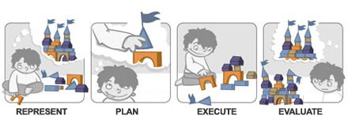
If executive functioning is working well and the task is fairly simple, the brain may go through these steps in a matter of seconds. If not, performing even a simple task can be challenging.

Slide 6
How common are Executive Functioning issues?
EF issues are not uncommon
Students may exhibit difficulties in one, some or all of these functions
Genes & Heredity matter – Kids differ in how they use EF skills, but chances are your child uses them the same way you do
Kids with ADHD and dyslexia often struggle with EF. So do kids with neurological conditions, mood disorders, autism and acquired brain injury
Scientists are studying whether the prefrontal cortex in kids with EF issues works differently than in other kids

Slide 7
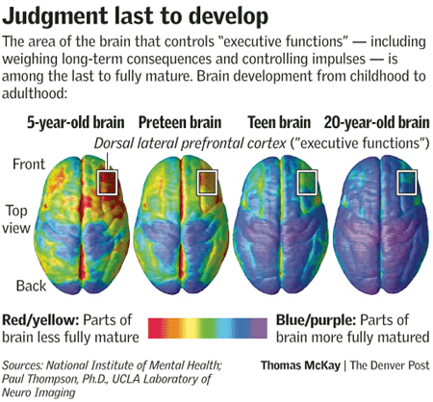

Slide 8
Examples of Executive Functioning Skills:
Self Monitoring
Task Initiation and Organization
Planning and Prioritizing

Slide 9
2. Working Memory
(The Process of Learning)
This is your organized brain.
This is your brain with cognitive overload.
Cognitive overload occurs when too much information is presented or when the information is too complex for the student’s current skills.

Slide 10
Organization
Organization lets your students keep track of things physically and mentally and helps their brain. Kids with weak organization skills can lose their train of thought, as well as their cell phone and homework

Slide 11


Slide 12
How can parents help?
ALWAYS, ALWAYS, TELL your children the PLAN!!
The Homework Chain
Environmental Modifications
Teach Organizational skills
Allow flexibility in when an assignment is completed
Use a visual timer

Slide 13
Routines
Create a routine for everything.
    This creates a structure for time awareness.
    Helps kids know what to expect.

Slide 14
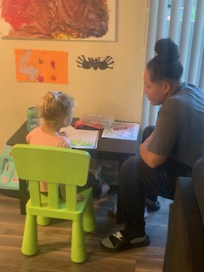

Slide 15
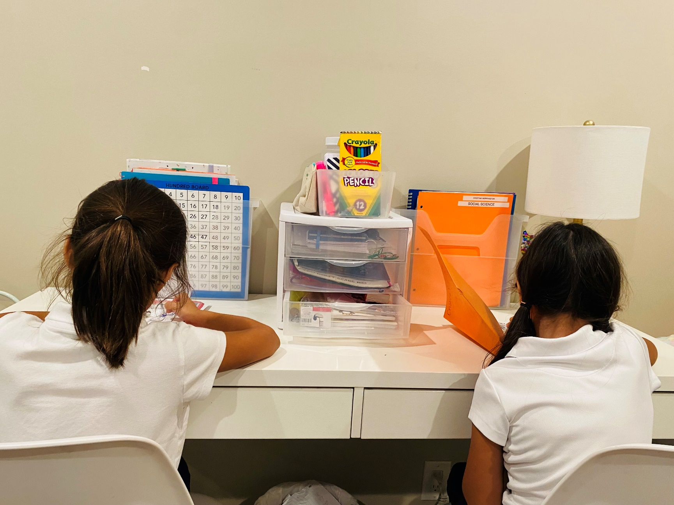

Slide 16
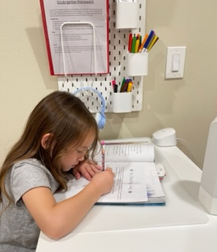

Slide 17
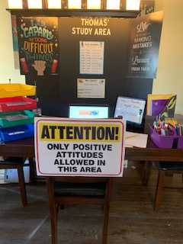
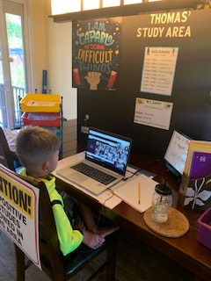
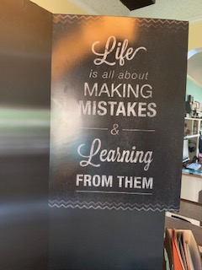

Slide 18
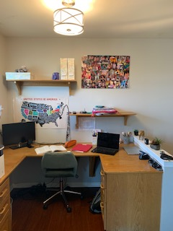

Slide 19
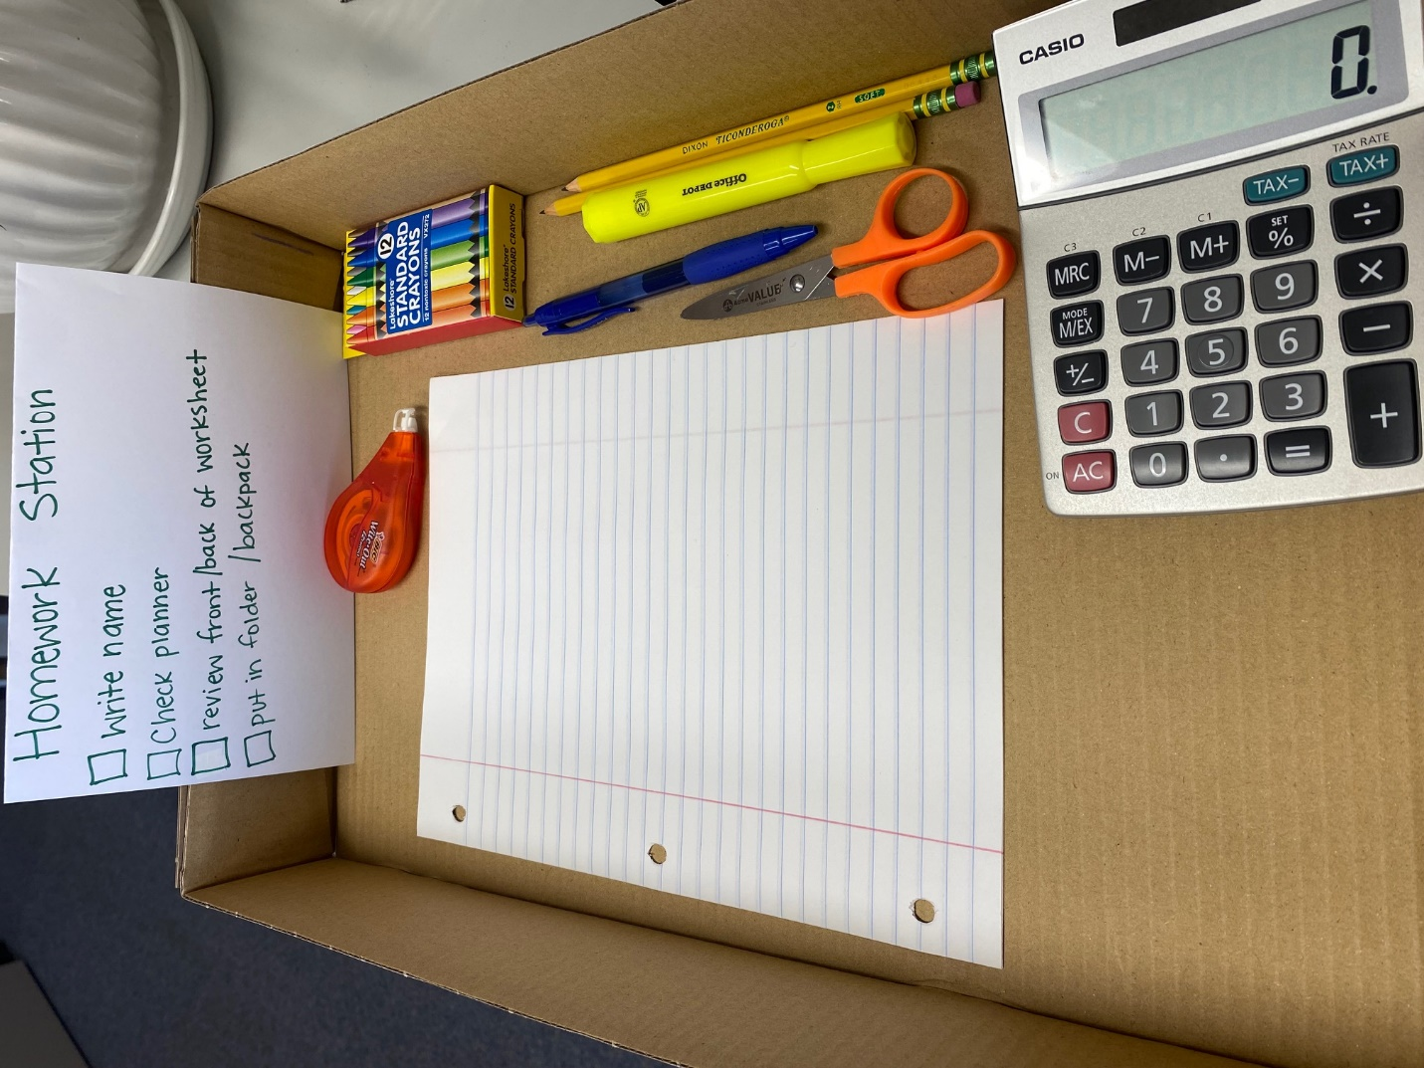

Slide 20
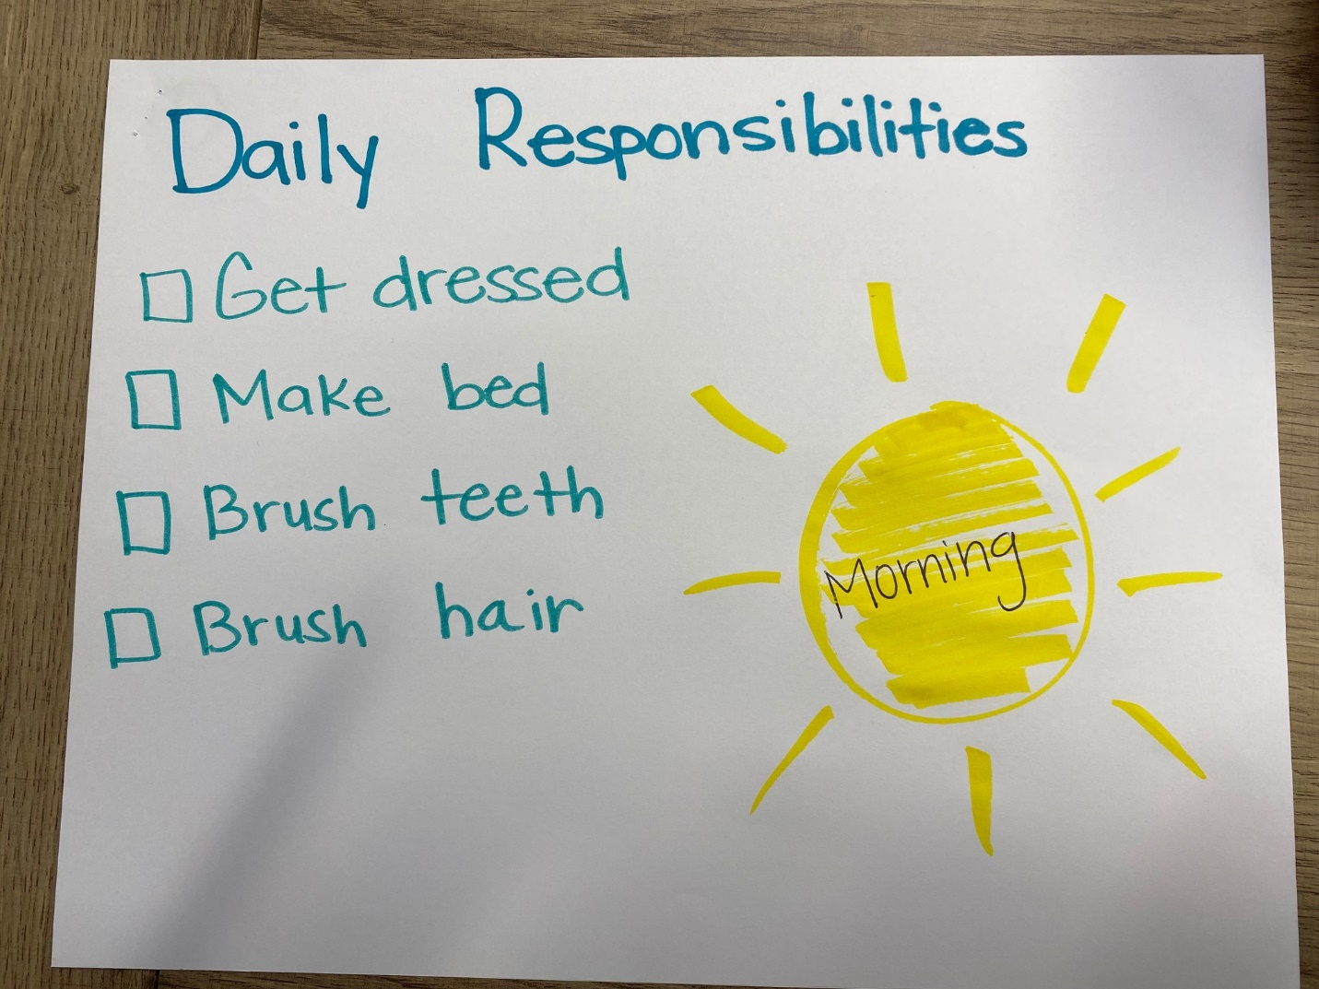

Slide 21
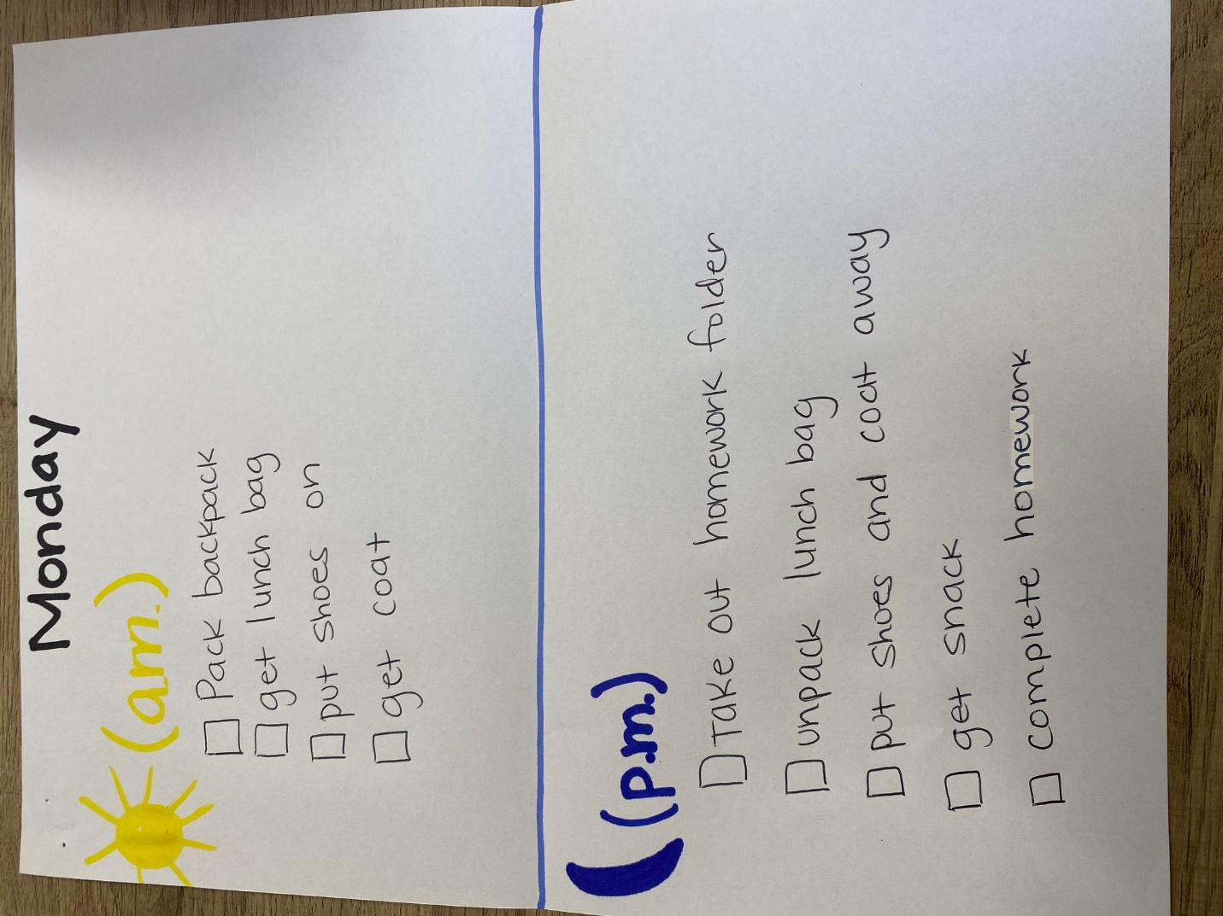

Slide 22
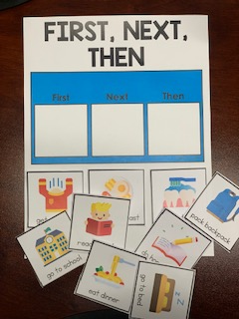

Slide 23
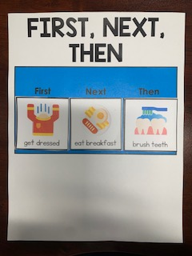
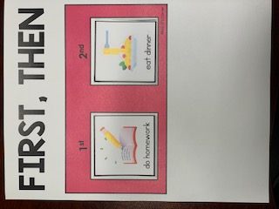

Slide 24
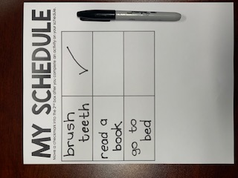
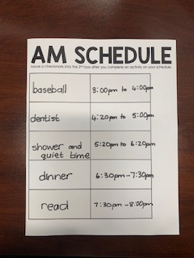

Slide 25
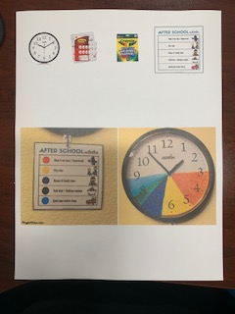

Slide 26
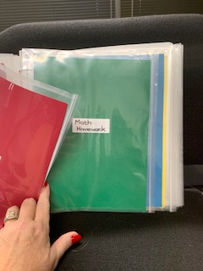
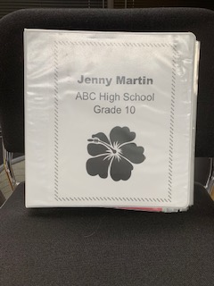
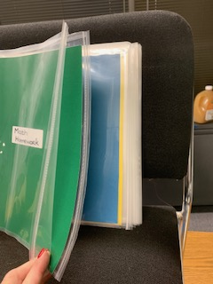

Slide 27
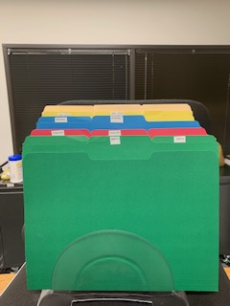
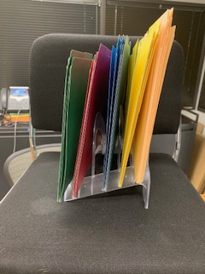

Slide 28
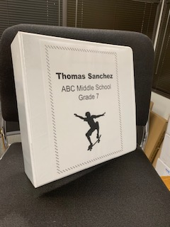
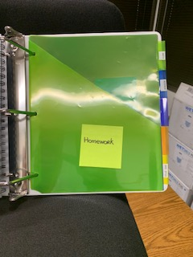
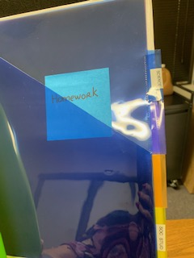

Slide 29
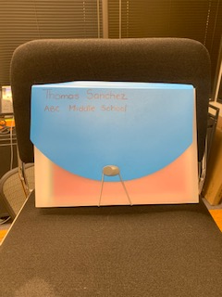
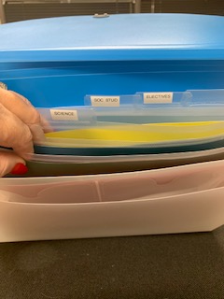

Slide 30
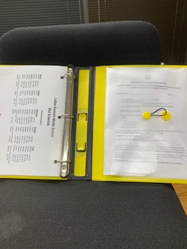
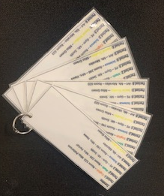
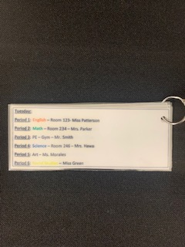

Slide 31
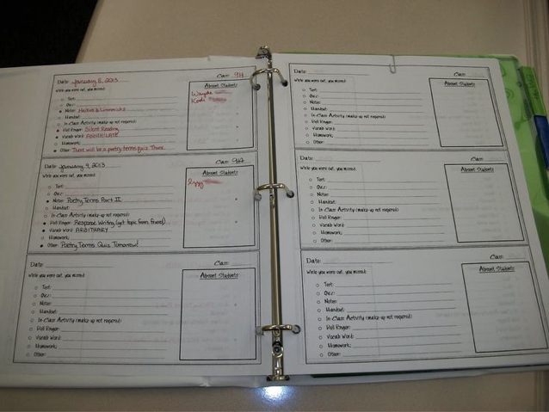
Reminder Binder

Slide 32
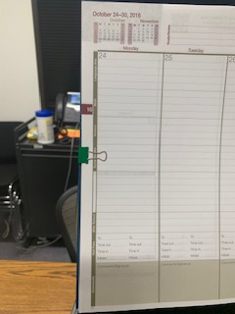
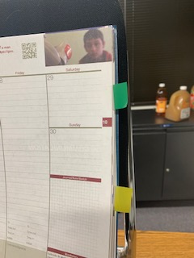
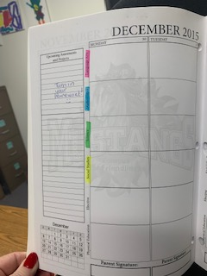
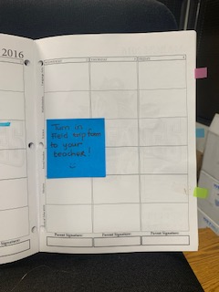

Slide 33
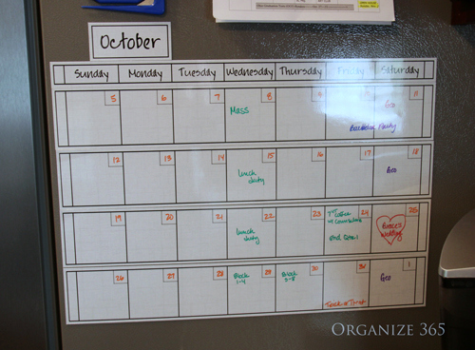
Interventions for Planning – Refrigerator Calendar

Slide 34
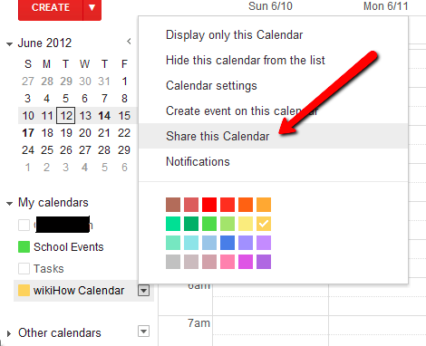
Online Calendar
Teaches your child to record due dates.
Online calendars such as Google Calendars can be shared with you so that you can monitor the due dates “behind the scenes.”

Slide 35
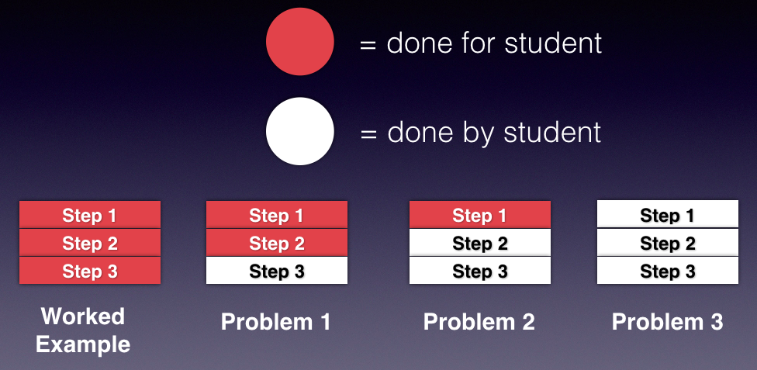
Math

Slide 36
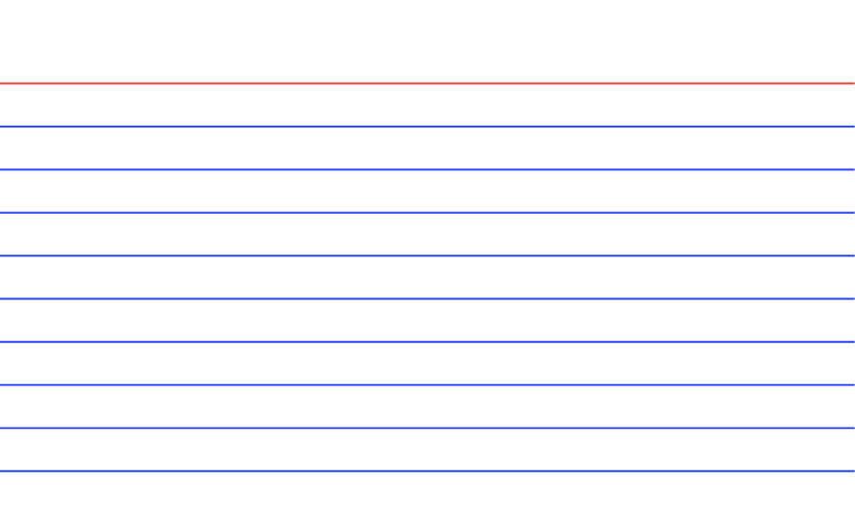
Self-Monitoring When Reading
1. Do I understand?
2. What is the main point?
3. What else do I know that is related?

Slide 37

Long-term Projects
Break tasks (i.e., book reports) into small segments with breaks in-between.
Assist with developing time management skills.
    Set soft-deadlines for long-term projects.

Slide 38
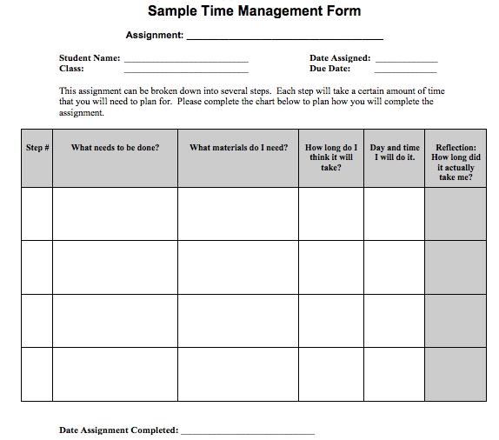

Slide 39
What You May Not Know About Attention Difficulties
May result in difficulty conceptualizing time.
    How long it takes to do something.
    What “10 minutes” feels like.
Timers can help!

Slide 40
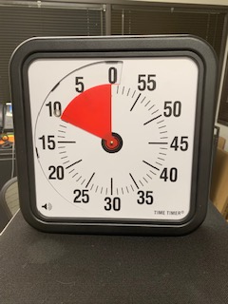
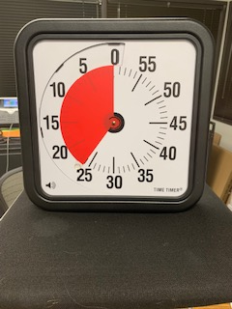

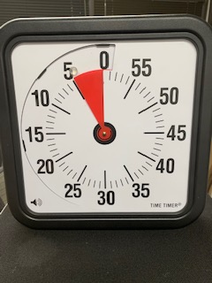
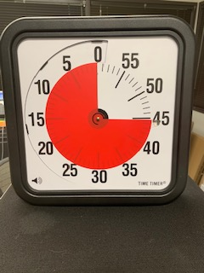

Slide 41

Thank You For Participating!

