Slide 1
HANDS-ON TECHNOLOGY FOR Benchmark Advance,
Go Math & i-Ready
Presented by:
Shari Auproux angie D’Mello Kristy bovee
Curriculum Specialist ELD Specialist Computer Tech
Alice Khachikian
Armenian Translation

Slide 2
Benchmark Advance
BUSD website: www.burbankusd.org
PARENTS AND STUDENTS TAB
Click on Student Software
Click on Benchmark Universe Icon
Log in with your child’s log in

Slide 3
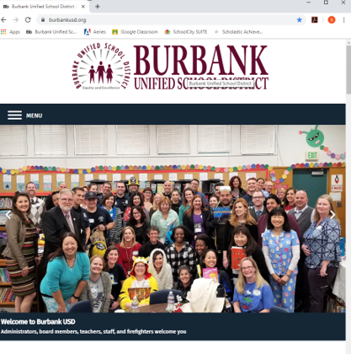
burbankusd.org - Menu - Parents And Students

Slide 4
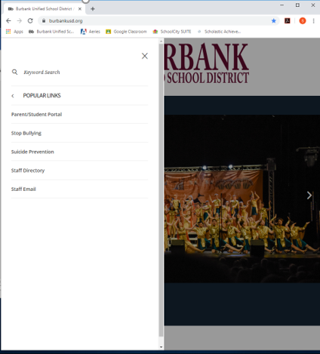
Student Software &
Technology

Slide 5
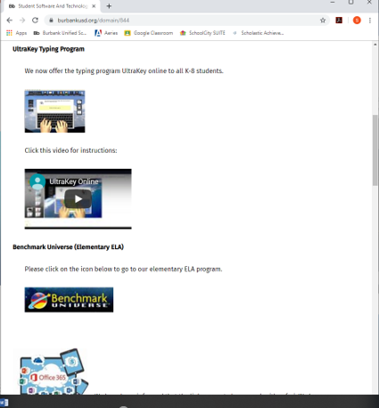
Benchmark Universe

Slide 6
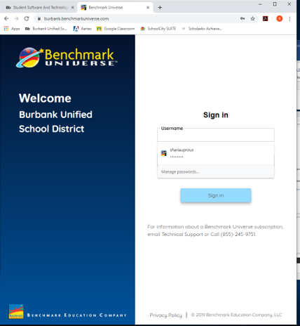
User Name begins with the year
Your student will graduate high
school, first initial, middle initial (if any) and last name
(example: 30eemerson)
Password is the last 4 numbers
of your student’s permanent ID twice
(example: 12341234)

Slide 7
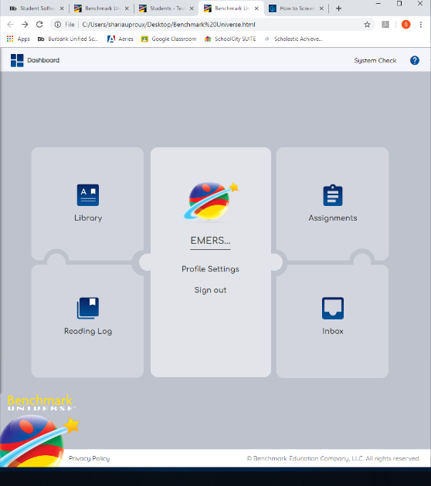
Click “Library –
Benchmark Advance”

Slide 8
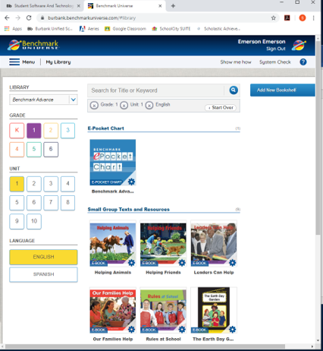
Click Library Benchmark Advance
Click Grade Level
Click Unit number
Click Language
Click desired E Book

Slide 9
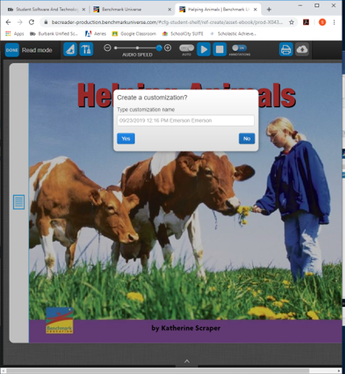
To have
E Book read aloud only,
press “No”.

Slide 10
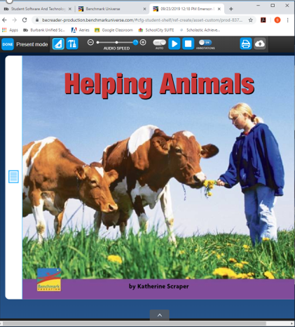
To have book read aloud in Present Mode:
Turn AUTO on
Push play button
To stop push square button
Push “Done” to return to Dashboard

Slide 11
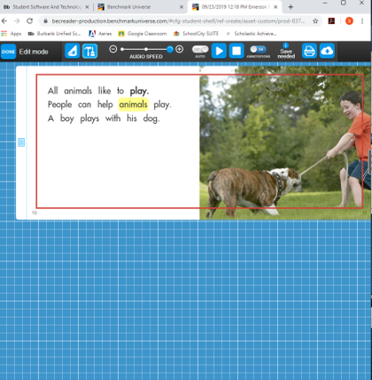
Student can click on an individual word to hear it said aloud.

Slide 12
To use Tools:
Click “Yes”
Click paper to access
space for Close Reading notes

Slide 13
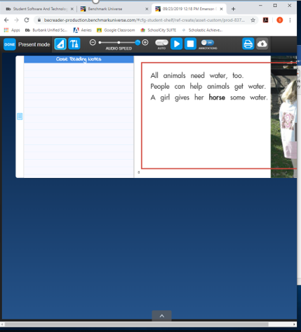
Type in notes for Close Reading notes.
Click tools to access pen, highlighter, eraser, etc.

Slide 14
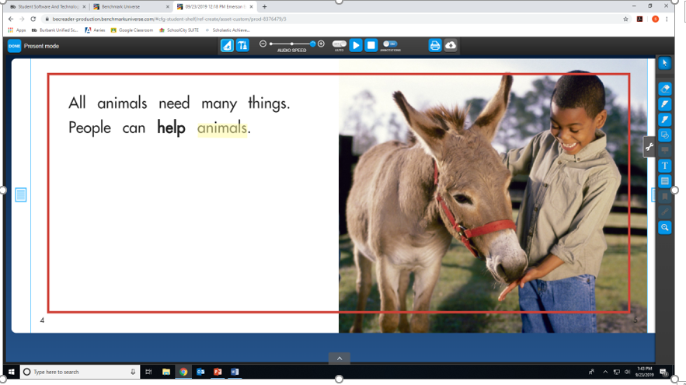
Click on
tool you would like to use

Slide 15
Click on
“Assignments”
to access assigned
work

Slide 16
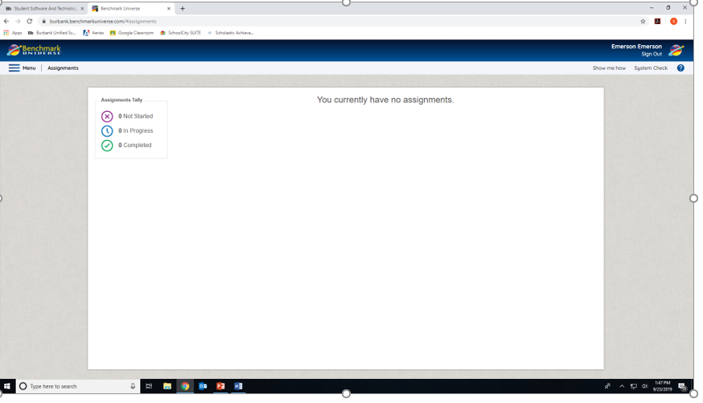
Click on
“Assignment”
and follow teacher’s directions

Slide 17
Go Math
BUSD website: www.burbankusd.org
PARENTS AND STUDENTS TAB
Click on “Student Software and Technology”
Click on “Go Math”
Log in with your child’s log in

Slide 18
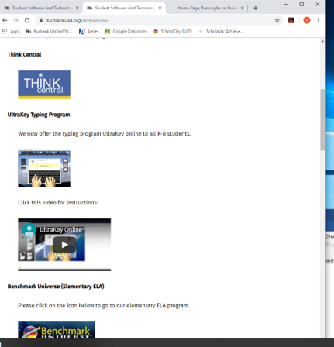
Go Math
Click on
Think Central

Slide 19
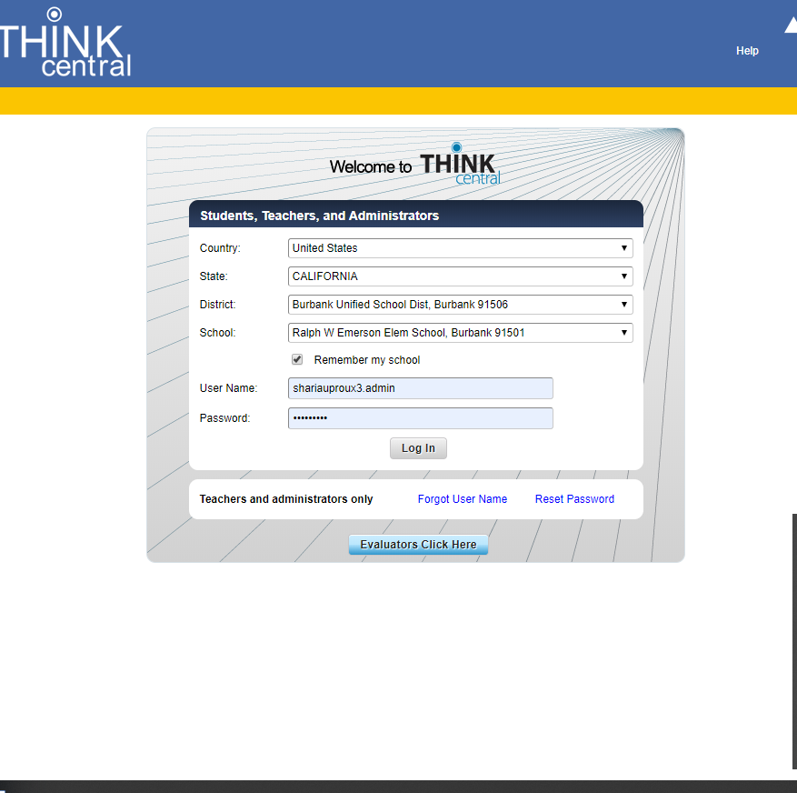
User Name begins with the year
Your student will graduate high
school, first initial, middle initial (if any) and last name
(example: 30eemerson)
Password is the last 4 numbers
of your student’s permanent ID twice
(example: 12341234)v

Slide 20
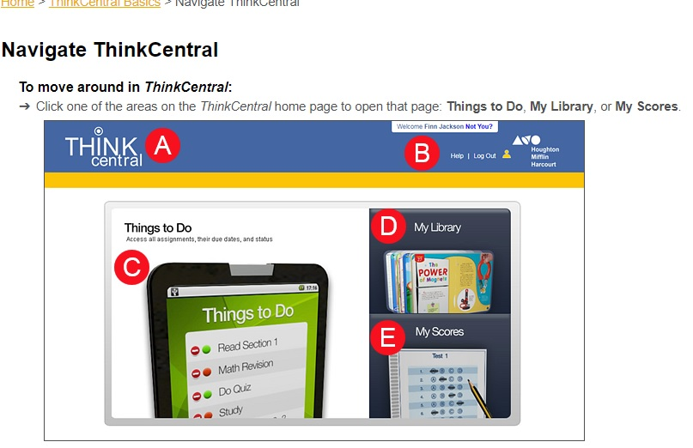
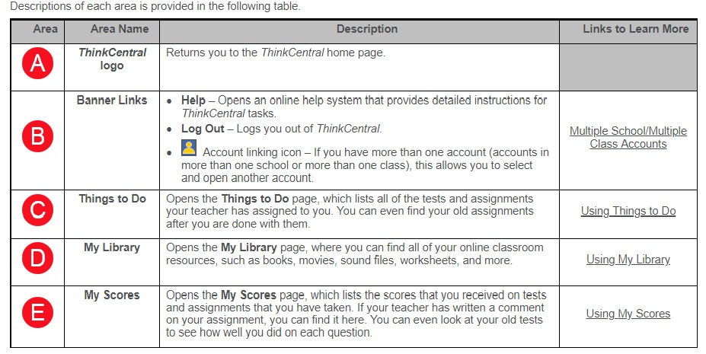
Dashboard

Slide 21
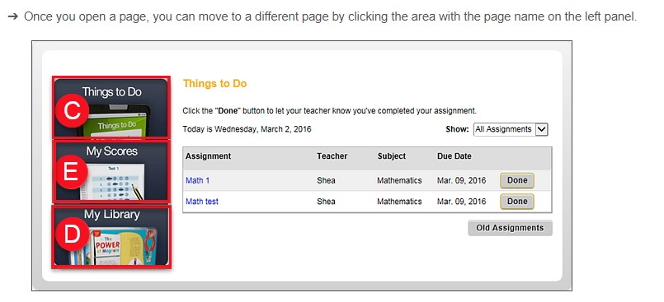
Navigating

Slide 22
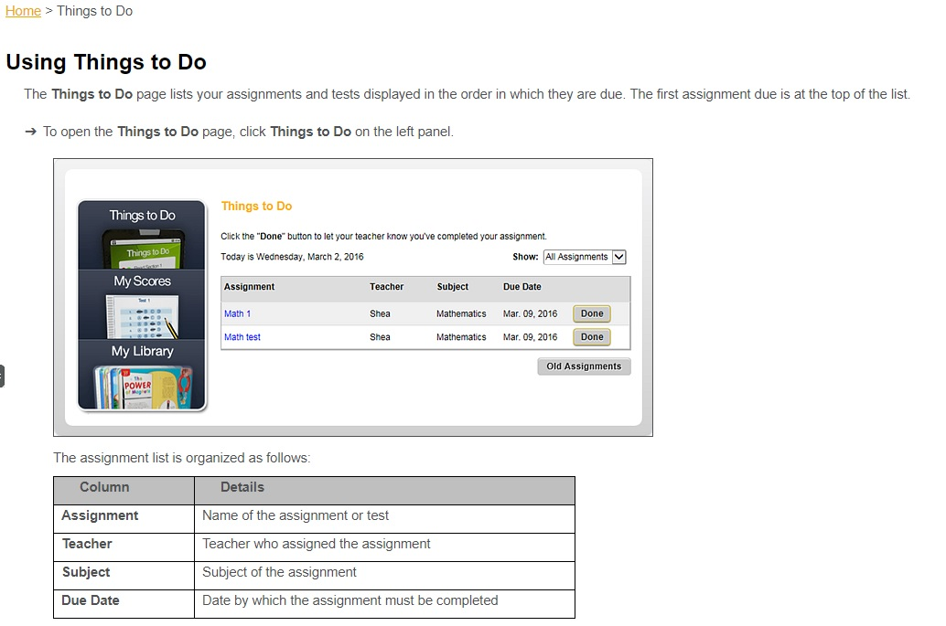
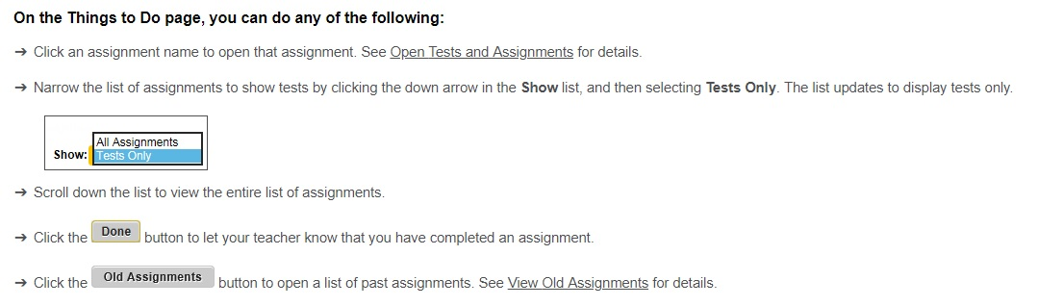

Slide 23
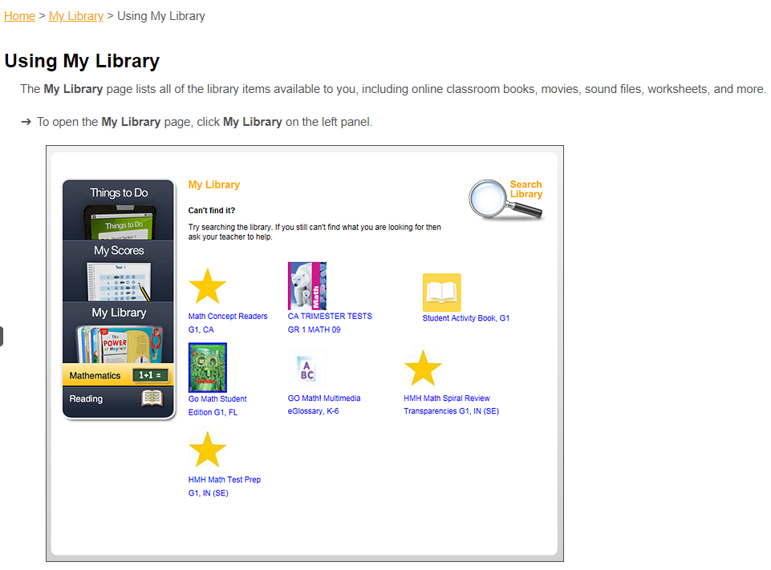
Using my
Library

Slide 24
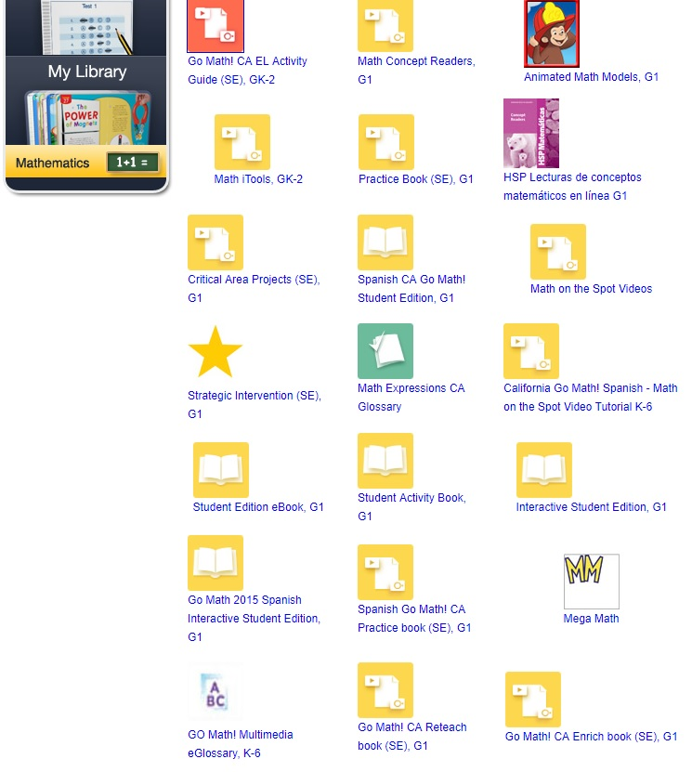
Textbook help
Student Edition eBook. G
Practice Book (SE) G
Go Math! CA Reteach book (SE). G
Go Math! CA Enrich book (SE). G

Slide 25
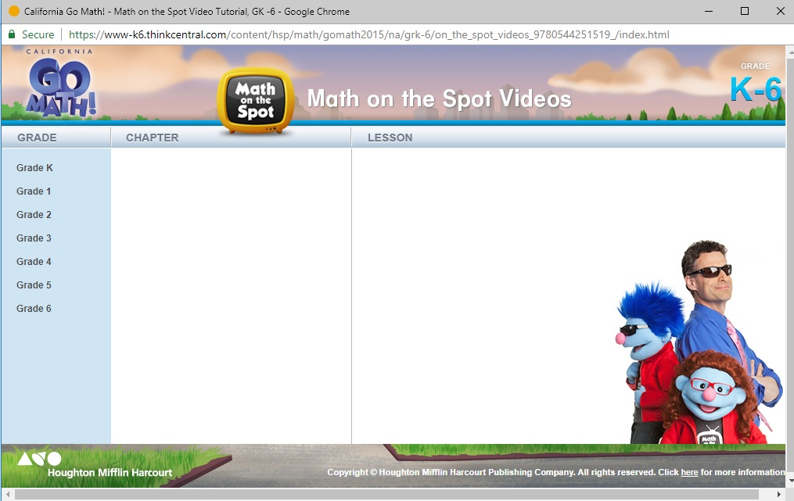
Math on the Spot Videos

Slide 26
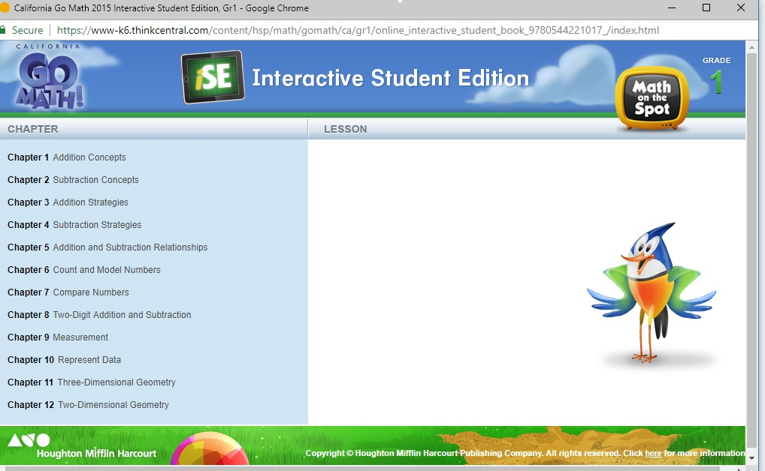
Interactive Student Edition

Slide 27
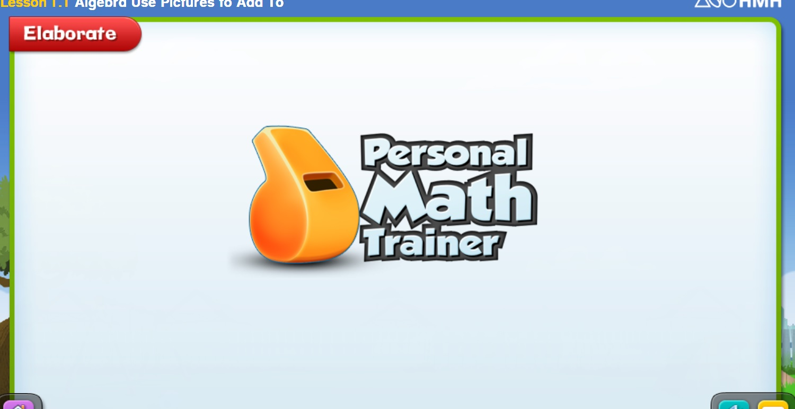

Slide 28
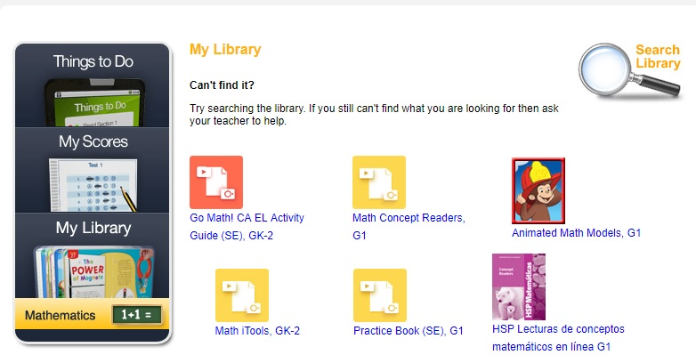
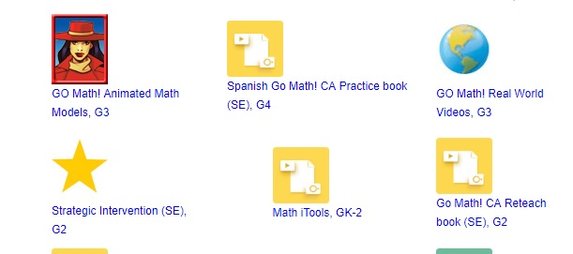
Animated Math Models

Slide 29
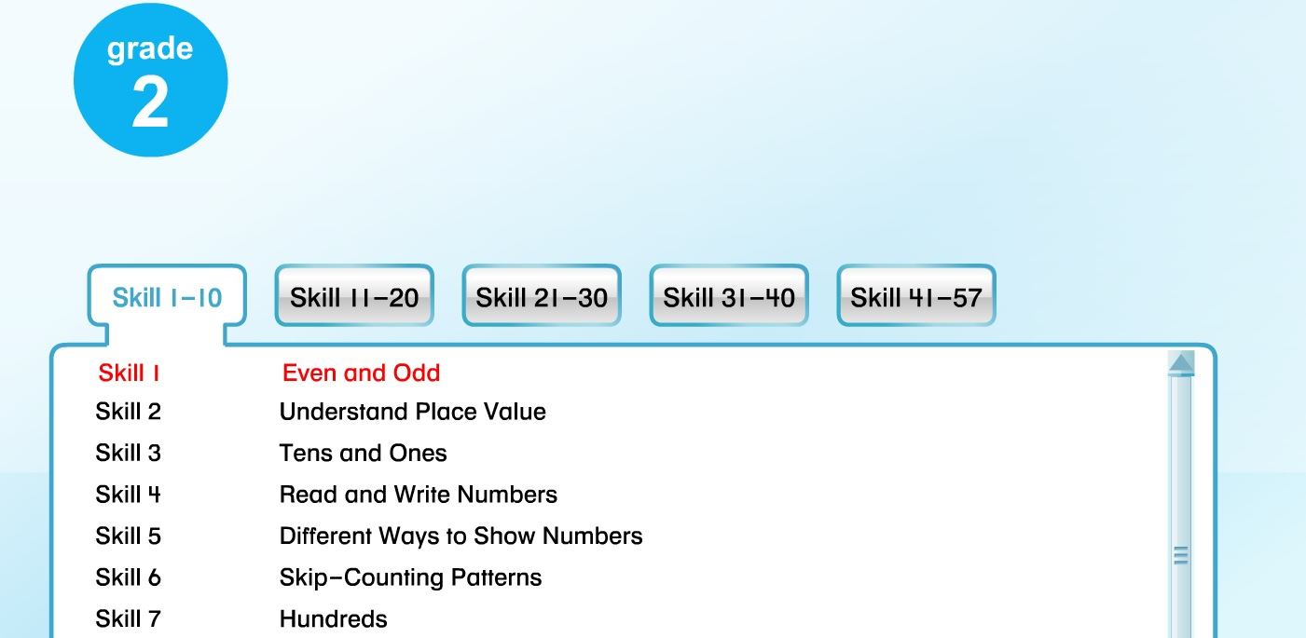
Listed by Skills

Slide 30
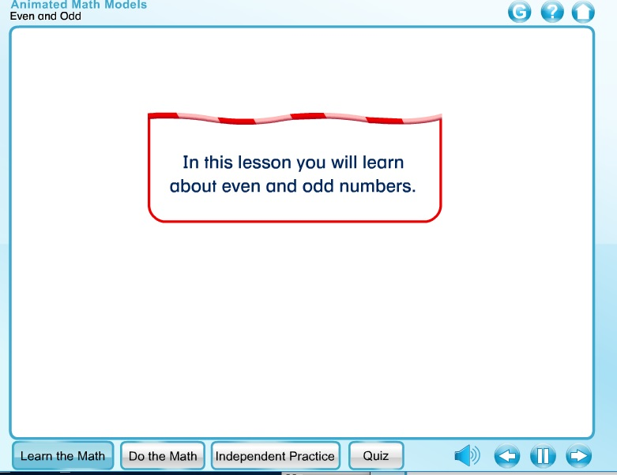
Learn the Math

Slide 31
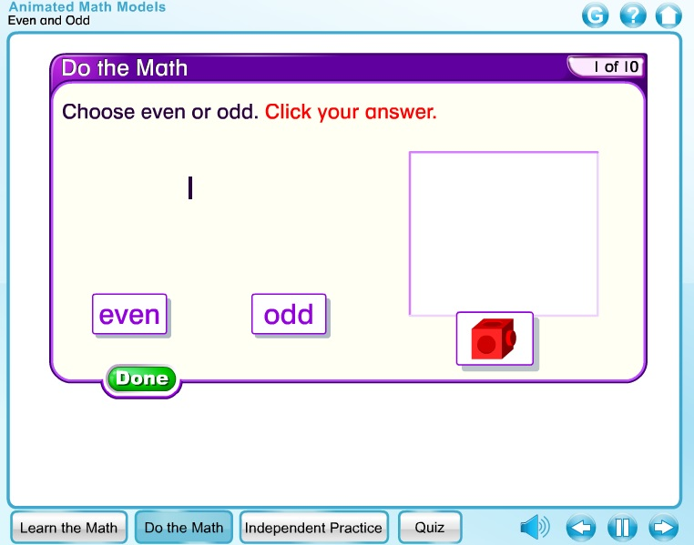
Do The Math

Slide 32
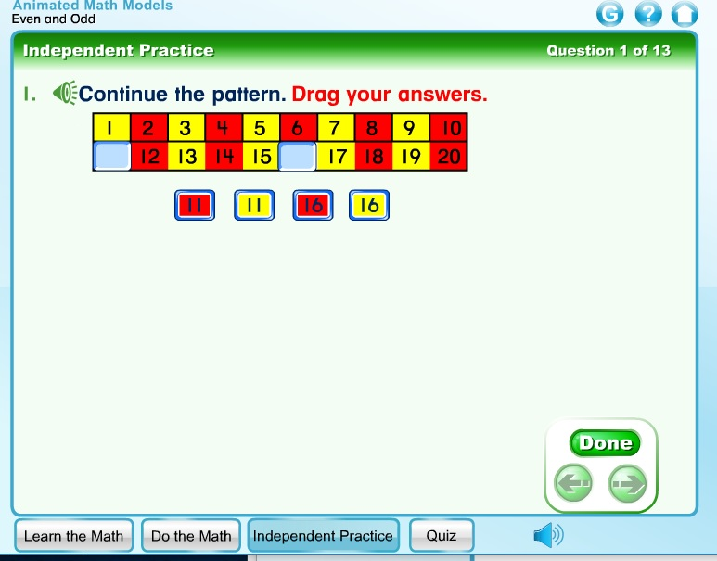
Independent Practice

Slide 33
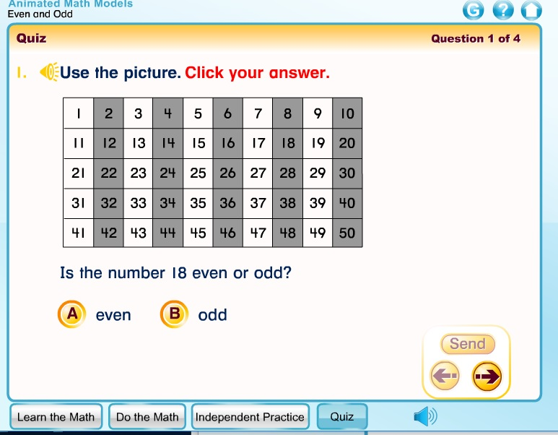
Quiz

Slide 34
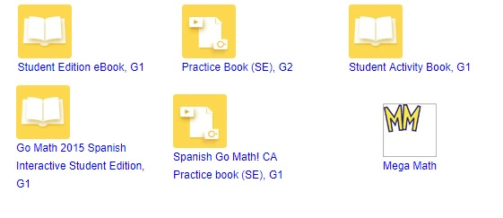
Mega Math Games

Slide 35
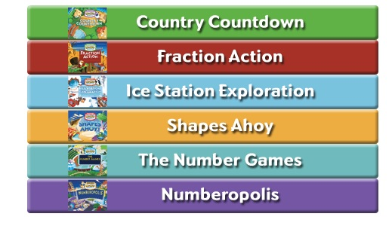
Different Math Games

Slide 36
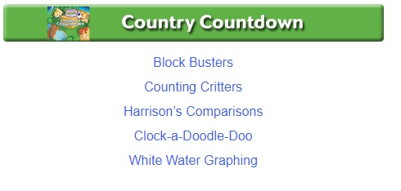
Different Skills

Slide 37
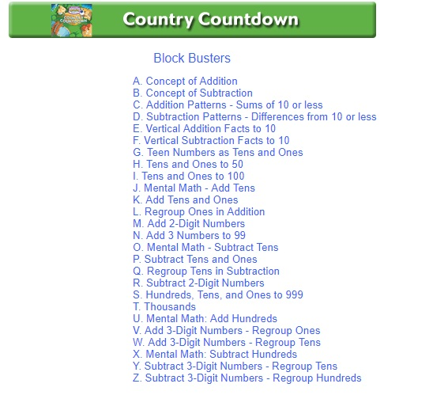
Different Skill Levels

Slide 38
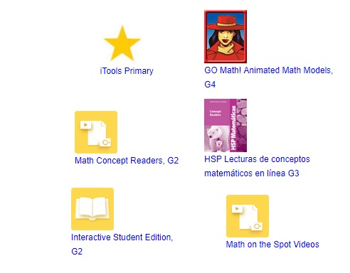
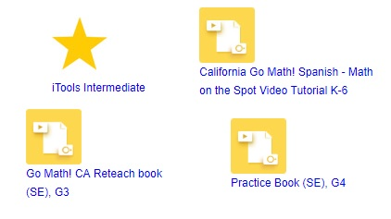
iTools

Slide 39
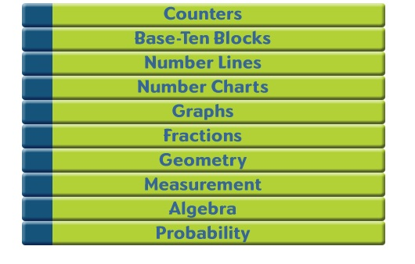
Choose a Tool

Slide 40
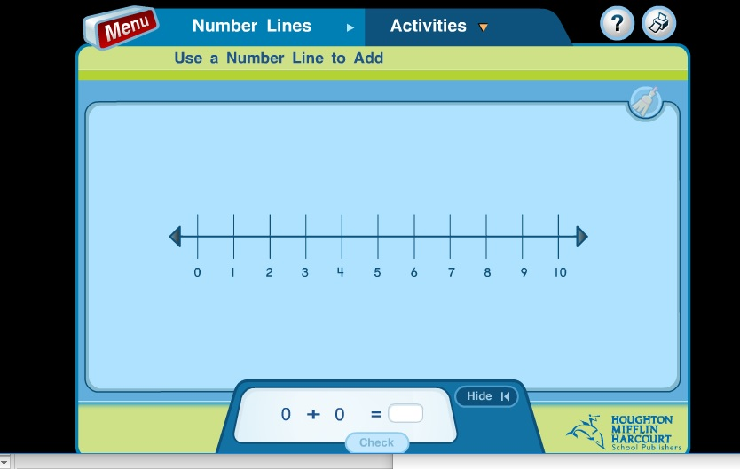
The Tool Appears

Slide 41
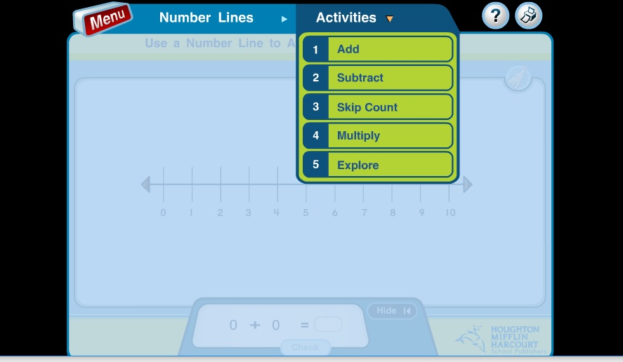
Choose an Activity

Slide 42
i-Ready – Reading & Math
Website : login.i-ready.com
log in with your child’s log in
Password begins with “b”
Make sure your select California for state

Slide 43
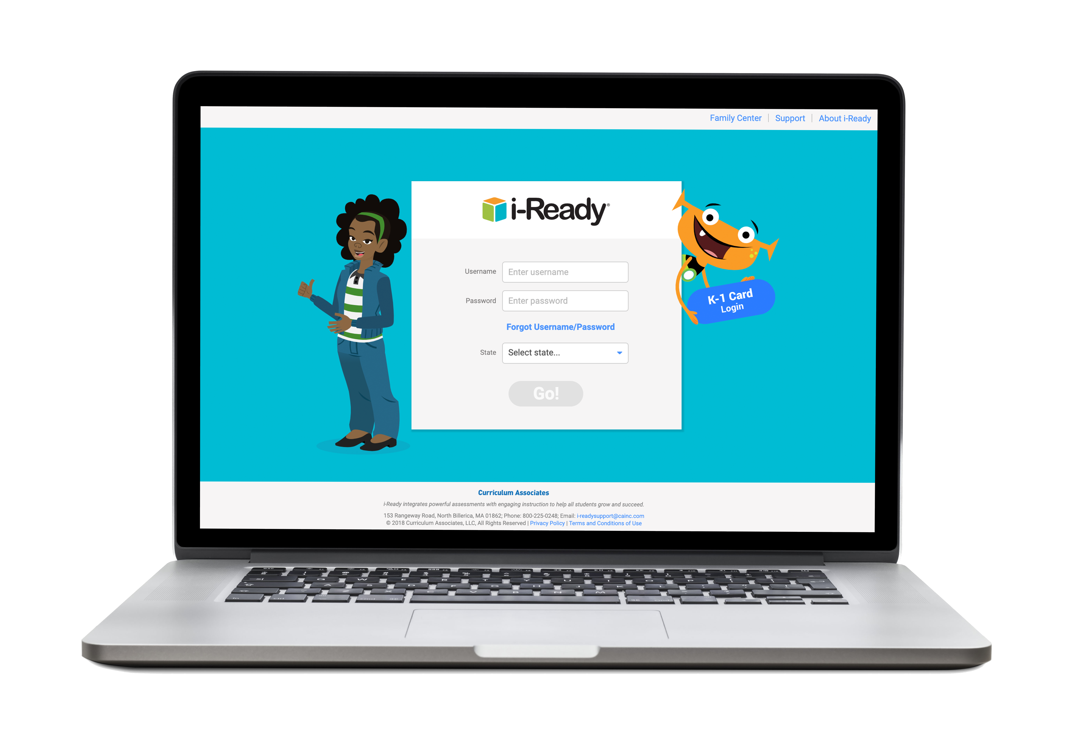
Add a “b” before your numeric password

Slide 44
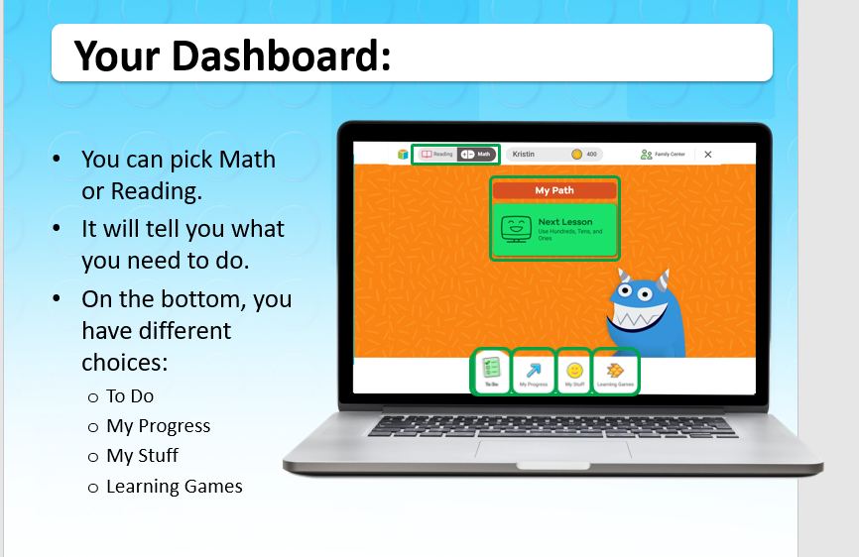
K-2
Choose reading or Math

Slide 45
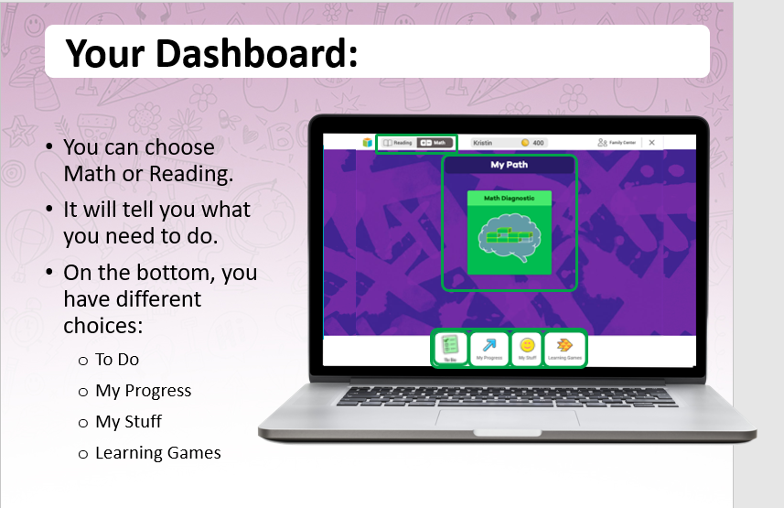
3-5

Slide 46
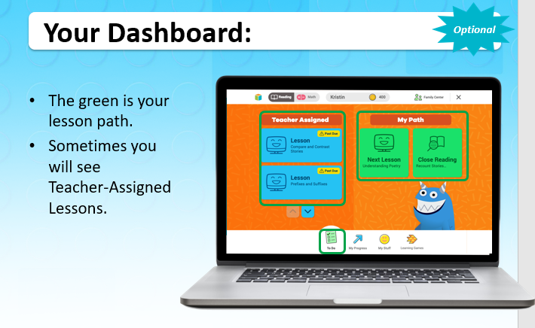

Slide 47
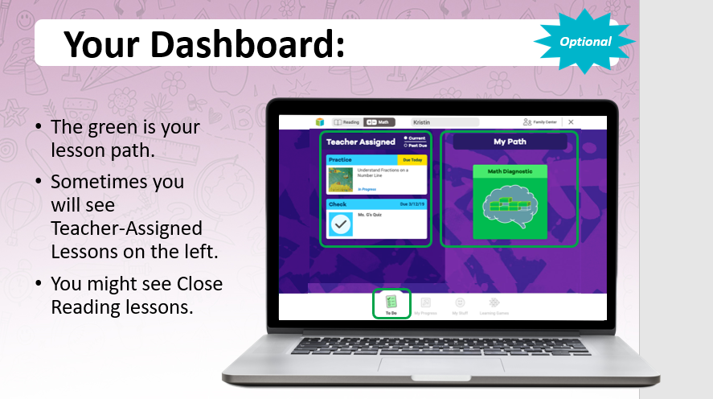

Slide 48
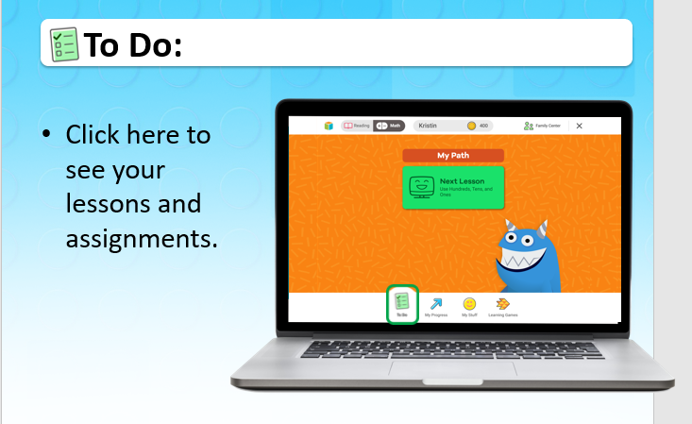

Slide 49
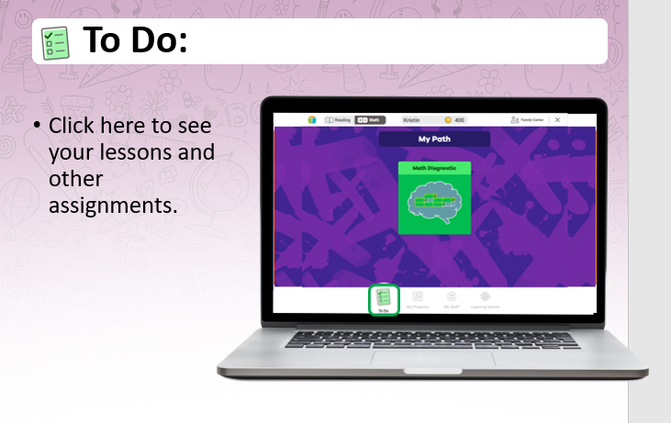

Slide 50
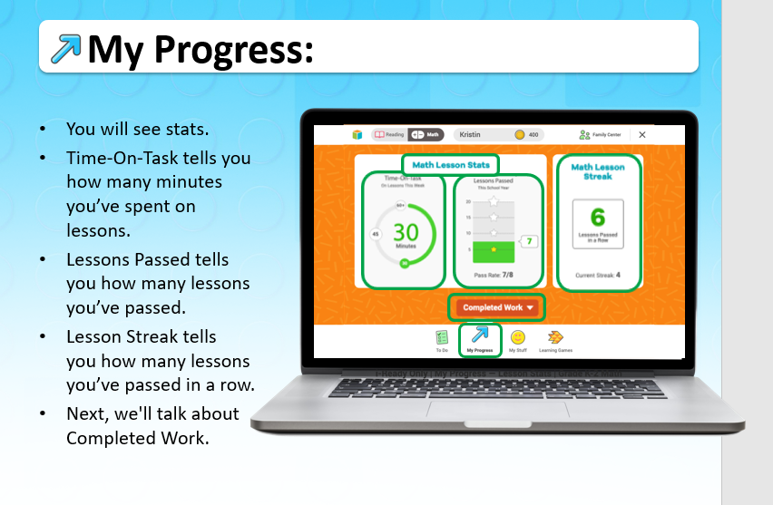

Slide 51
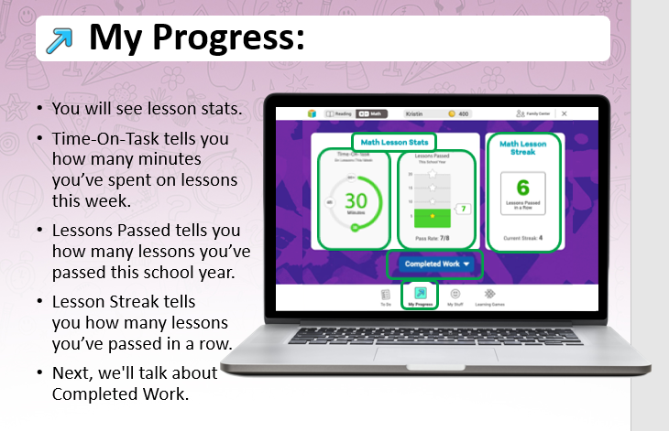

Slide 52
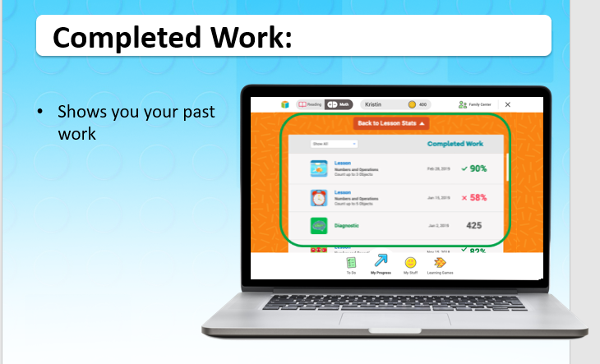

Slide 53


Slide 54


Slide 55


Slide 56


Slide 57


Slide 58


Slide 59

i-readycentral.com

Slide 60


Slide 61


Slide 62

Lexile.com/fab/i-ready

Slide 63


Slide 64


Slide 65
Thank you for coming!
If you have any further questions please contact us at:
Shari Auproux – shariauproux@burbankusd.org - (818) 558-5419 ext. 10371
Angie D’Mello – angiedmello@burbankusd.org – (818) 558-5419 ext. 10373

