Slide 1
Instructional Services… through the lens of the Local Control Accountability
Plan (LCAP)
Presented by:
Sharon Cuseo, Assistant Superintendent, Instructional Services
Peter Knapik, Ed.D., Director of Elementary Education

Slide 2
Overview of instructional services
Instructional Services
  Elementary Education
  Special Education
  Child Development
  Instructional Technology
  Arts & Career Technical Education
  Induction

Slide 3
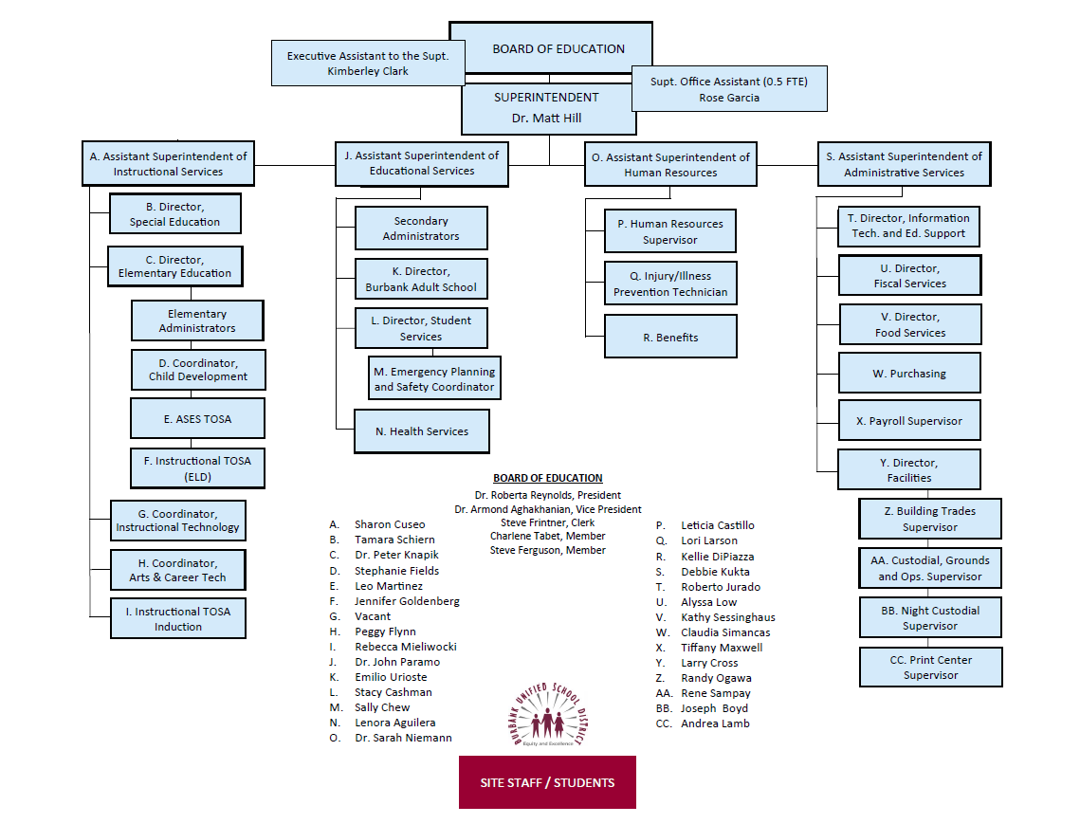
Organizational Chart

Slide 4
Instructional Services
Organizational Chart
ASSISTANT SUPERINTENDENT
Director of Special Education Director of Elementary Education
- Elementary Administrators
- Coordinator, Child Development
- ASES
- Instructional TOSA – English Lang Dev
Coordinator, Instructional Technology Coordinator, Arts & Career Technical Education Instructional Technology TOSA & Induction TOSA

Slide 5
LCAP Base and Supplemental Funds
Base Funding (Calculated with Student Average Daily Attendance (ADA) in grades TK-3; 4-6; 7-8; 9-12)
Supplemental Funding (Unduplicated student count/Counted once)
  English Language Learners
  Students in Foster Care
  Students who are Homeless
  Students who are Socio-Economically Disadvantaged
  (Participate in National School Lunch Program)

Slide 6
instructional Services staffing
Administrators (5)
Teacher on Special Assignment (2)
Classified (3)

Slide 7
Instructional services - lcap evaluation
IMPROVE LEARNING AND ACHIEVEMENT FOR TARGETED SUBGROUPS - ELA
Metric: CAASPP ELA DATA | Baseline 2018-2019 | Expected Outcome 2019-2020 | Expected Outcome 2020-2021 | Progress over Time 2014-15/2018-2019
English Learners | 25.54% | Increase by 3% | Increase by 3% | 11% 14.54% 25.54%
Socioeconomically Disadvantaged | 52.41% | Increase by 3% | Increase by 3% | 31% 21.41% 52.41%
Homeless | 44.27% | Monitor Individual Student Achievement
Foster | *
Students with Disabilities | 26.01% | Increase by 3% | Increase by 3% | 14% 12.01% 26.01%
Hispanic | 40.56% | Increase by 3% | Increase by 3% | 32% 8.56% 40.56%
GATE | 96.5% | Increase by 3% | Increase by 3% | 96%
Notes:
Recommend changing increase to 2% - over time there is a lot of variability in the progress of subgroups.

Slide 8
Instructional services - lcap evaluation
IMPROVE LEARNING AND ACHIEVEMENT FOR TARGETED SUBGROUPS - Math
Metric: CAASPP ELA DATA | Baseline 2018-2019 | Expected Outcome 2019-2020 | Expected Outcome 2020-2021 | Progress over Time 2014-15/2018-19
English Learners | 23.39% | Increase by 3% | Increase by 3% | 16% 7% 23%
Socioeconomically Disadvantaged | 37.50% | Increase by 3% | Increase by 3% | 27% 10.5% 37.5%
Homeless | 19.67% | Increase by 3% | Increase by 3%
Foster | * | Increase by 3% | Increase by 3%
Students with Disabilities | 17.44% | Increase by 3% | Increase by 3% | 10% 7.44% 17.44%
Hispanic | 35.99% | Increase by 3% | Increase by 3% | 25% 10.99% 35.99%
GATE | 94.4% | Increase by 3% | Increase by 3% | 91% 3.4%

Slide 9
Instructional services - lcap evaluation
IMPROVE LEARNING AND ACHIEVEMENT FOR ALL STUDENTS - ela
Metric: CAASPP DATA Increase by 3% | Baseline 2018-2019 | Expected Outcome 2019-2020 | Expected Outcome 2020-2021 | Progress over Time 2014-15/2018-19
CAASPP ELA | 64.71% Met or Exceeded Standard | Increase by 3% | Increase by 3% | 56% 64.71% 8.71%
CAASPP Math | 51.19% Met or Exceeded Standard | Increase by 3% | Increase by 3% | 40% 11.19% 51.19%
English Learner Proficiency Assessments for California | 56.5% making progress towards English language proficiency | Increase by 3% | Increase by 3%
English Learner Reclassification Rate | 18.8% of English Learners Reclassified | Increase by 3% | Increase by 3% | 22.3% 18.8%
Fully Credentialed Teachers | 100% Compliance | 100% Compliance | 100% Compliance | 100% Compliance
New Baseline for 2018-2019
Notes:
Recommend a
2% growth target to address variability for CAASPP
2% growth target for English Learner Reclassification past 22.3%, 15%, 13.2%, 18.4%, 18.8% Skills they come with – number

Slide 10
Instructional services lcap evaluation- Graduation rate
Metric: Graduation Rate Increase by 2% | Baseline 2018-2019 | Expected Outcome 2019-2020 | Expected Outcome 2020-2021 | Progress over Time 2014-15/2018-19
All Students | 92.3% graduated | Increase by 2% | Increase by 2% | 93% 0.7% 92.3
English Learners | 86.5% graduated | Increase by 2% | Increase by 2% | 88.8% 2.3% 86.5
Socio-economically Disadvantaged | 90.7% graduated | Increase by 2% | Increase by 2% | 91% 0.3% 90.7%
Homeless | 88.9% graduated | Increase by 2% | Increase by 2% | NA
Foster | No performance color | Increase by 2% | Increase by 2% | 20%
Students with Disabilities | 85.6% graduated | Increase by 2% | Increase by 2% | 83.5% 2.1% 85.6%
Hispanic | 89.5% graduated | Increase by 2% | Increase by 2% | 91.4% 1.9% 89.5%
Notes:
Consider Increase by 1% to match California Dashboard

Slide 11
Instructional services lcap evaluation
Metric | Baseline 2018-2019 | Proposed Metric 2019-2020 | Baseline 2018-2019 |  | Progress over Time 2014-15/2018-19
“D” and “F” Grades Rate Decrease by 5% | Fall 2018 9.41% Spring 2018 11.25% | Grades by Grade Span | Spring 2019 ES: 18.3% MS: 8.5% HS: 12.1% | Fall 2019 ES: NA MS: 8.05% HS:11.23% | Fall 9.83% 0.42% 9.41% Spring 13.62% 2.37% 11.25%
Drop-Out Rate Decrease by 2% | Dropout rate (2017-2018) 2.0% | Dashboard: Graduation Rate | 92.3% Green |  | 3.1% 2.0% 1.1%
EAP English Increase by 3% | 27.1% Ready for College 30.1% Ready for College Conditionally | Dashboard: College and Careers | Prepared: 67.6% Approaching Prepared: 13.6% Not Prepared: 18.8% |  | 23% 4.1% 27.1% 33% -2.9% 30.1
Notes:
Recommendations:
For the future we look at this data by grade span and that for elementary we only look at Trimester 3.
Eliminate Drop Out metric since it does not appear in the dashboard.

Slide 12
Instructional services
Lcap evaluation
Metric | Baseline 2018-2019 | Expected Outcome 2019-2020 | Expected Outcome 2020-2021 | Progress over Time
A – G Requirements Completion Rate | 49.2% | Increase by 5% | Increase by 5% | 2014-15/ 2018-19 37.8% 49.2% 11.4%
Credit Recovery Rate | Traditional 84% Online 70% | Increase by 5% | Increase by 5% | 2011-12/ 2018-19 Traditional 69% 84% 15% Online 63% 70% 7%
AP Exam Passing Rate (3 or better) | 69.3% | Increase by 5% | Increase by 5% | 2013-14/ 2018-19 65% 69.3% 4.3%

Slide 13
Instructional services lcap evaluation
Metric | Baseline 2018-2019 | Expected Outcome 2019-2020 | Expected Outcome 2020-2021
Ratio between Music Teacher and Students | 1:600 (5 teachers/3,131 students in grades 3, 4, and 5) | 1:600 (with 5 teachers) 2:1,010 (with 2 teachers in grades 4 and 5) | Maintain
Grades 3, 4 and 5 Instructional Minutes | Grade 3: 30 minutes Grade 4 and 5: 45 minutes |  | Maintain? (TBD)

Slide 14
elementary education Oversight role and responsibility
District Office Oversight
  Budget
  Staffing
  Enrollment
  General Support
  Crisis Response
  Curriculum and Instruction
  Professional Development
  Accountability (Assessments)
  Parent Engagement
  Facilities

Slide 15
Elementary school staffing
JK/ETK/TK-5 Administrators (12) (6,375 students)
  $2,097,395
JK/ETK/TK-5 Classified Office Staff (25.19)
  $1,419,002
JK/ETK/TK-5 General Education Teachers (255.4)
  $304,003
JK/ETK/TK-5 Classified Instructional Staff (72.11)
$2,954,742

Slide 16
instructional services budget elementary education
Actions Items | 2019-2020 Supplemental Budget | 2019-2020 Base Budget | 2020-2021 Proposed Supplemental Budget | 2020-2021 Proposed Base Budget
Curriculum Specialists (11) | $1,292,905 | $0 | $1,323,580 | $0
Library Assistants (11) | $303,534 | $0 | $328,920 | $0
Class Size Reduction Grades 4 and 5 (2) | $195,678 | $0 | $202,855 | $0
Extended Transitional Kindergarten (2) | $143,231 | $0 | $132,700 | $0

Slide 17
Instructional Services
English learner programs
Identification of English Learners
Administration of the English Learner Proficiency Assessments for California (ELPAC)
Core Subject Matter Support
Professional Development
Parent Involvement
Dual Immersion Program
State and Federal Government Reporting
English Learner Count: 1,331

Slide 18
instructional services budget
English learner programs
Action Items | 2019-2020 Supplemental Budget | 2019-2020 Base Budget | 2020-2021 Proposed Supplemental Budget | 2020-2021 Proposed Base Budget
English Learner Program, Maintenance of Effort | $1,128,000 | $0 | $1,128,000 | $0
Elementary ELD Specialists | $476,848 | $0 | $487,174 | $0
Elementary ELD Instructional Assistants (22 Part Time) | $374,419 | $0 | $383,575 | $0
Dual Immersion Teacher Cost Share | $471,341 | $0 | $524,343 | $0
Dual Immersion Instructional Assistants (8) | $110,153 | $0 | $112,676 | $0

Slide 19
EDUCATIONAL Services budget
English learner programs
Action Items | 2019-2020 Supplemental Budget | 2019-2020 Base Budget | 2020-2021 Supplemental Budget | 2020-2021 Base Budget
Secondary Designated ELD Teachers 0.2s (11) | $207,130 | $0 | $240,244 | $0
ELD Project GLAD Professional Development | $65,000 | $0 | $65,000 | $0
Interpreters for Second Language Learner Parents | $65,000 | $0 | $65,000 | $0
Extended Learning for English Learners (Summer) | $52,000 | $0 | $52,000 | $0

Slide 20
Instructional services budget
English learner programs
Action Items | 2019-2020 Supplemental Budget | 2019-2020 Base Budget | 2020-2021 Supplemental Budget | 2020-2021 Base Budget
EL Support for Schools with Low EL Population | $90,249 | $0 | $90,249 | $0
Elementary Summer School for Targeted Subgroups | $148,250 | $0 | $148,250 | $0
Secondary World Languages at Middle School | $0 | $260,176 | $0 | $268,231

Slide 21
Educational services child development
Horace Mann Child Development Center (111 children)
Monterey (8 children)
Children’s Centers State Subsidized Preschool
Emerson (1 student)
Harte (38 students)
Washington (28 students)
Elementary School Around the Bell (646 students)

Slide 22
Educational services
Child development
Administrators (3) and Clerical (4.5)
$729,808
Teachers (30.844)
$1,928,417
Classified Instructional Assistants (39.875)
$1,969,775

Slide 23
Educational Services
Child Development
Action Item | 2019-2020 Supplemental Budget | 2019-2020 Base Budget | 2020-2021 Supplemental Budget | 2020-2021 Base Budget
Child Development One Classroom (1 Teacher; 1 Aide) | $108,647 | $0 | $111,906 | $0

Slide 24
Instructional services professional development
Induction
English/Reading/Language Arts Special Education
Dual Immersion GATE
Mathematics English Learners
Science
History-Social Science
Physical Education
Arts and Music

Slide 25
Instructional services budget
PROFESSIONAL DEVELOPMENT
Actions Items | 2019-2020 Supplemental Budget | 2019-2020 Base Budget | 2020-2021 Supplemental Budget | 2020-2021 Base Budget
Professional Development Day for All Teacher (1/2 day) | $200,000 | $0 | $200,000 | $0
Engagement Strategies TOSA (0.2 FTE) | $19,082 | $0 | $19,773 | $0
Induction Professional Development | $149,884 (frozen) | $0 | TBD | $0
Elementary TOSA | $87,534 (frozen) | $0 | TBD | $0

Slide 26
Instructional services
PROFESSIONAL DEVELOPMENT
Action Items | 2019-2020 Supplemental Budget | 2019-2020 Base Budget | 2020-2021 Supplemental Budget | 2020-2021 Base Budget
Professional Development Support Standards Implementation | $50,000 | $0 | $50,000 | $0

Slide 27
Instructional services
Gifted and talented Education (GATE)
Program Development and Implementation
Identification and Assessment
Parent Involvement
Professional Development
Program Monitoring
GATE Student Count: 1,790 (16%)

Slide 28
Instructional services gifted and talented education budget
Action Items | 2019-2020 Supplemental Budget | 2019-2020 Base Budget | 2020-2021 Supplemental Budget | 2020-2021 Base Budget
Professional Development | $5,000 | $0 | $5,000 | $0
Annual Identification Process | $20,000 | $0 | $20,000 | $0
Coordinator (FTE .033) 30/900 | $17,673 | $0 | $17,802 | $0

Slide 29
Instructional services instructional technology
Classroom Instructional Support
Professional Development
District Assessments
State Testing

Slide 30
Instructional services instructional technology
Action Item | 2019-2020 Supplemental Budget | 2019-2020 Base Budget | 2020-2021 Supplemental Budget | 2020-2021 Base Budget
Coordinator (FTE 1.0) | $0 | $177,531 | $0 | $177,940
Media Technology Specialists | $0 | $491,227 | $0 | $510,083

Slide 31
Instructional services arts and career technical education
Arts
Music
Theatre
Dance
Visual Arts
Media Arts
Culinary Arts

Slide 32
Instructional services arts and career technical education
Career Pathways / Articulation Agreements/ Dual Enrollment
UC/CSU a-g Approved Courses
Animation NAF Academies
Broadcast Journalism Medical
Digital Media Production Engineering
Digital Media Director’s Cut Business
Digital Photography
Play Production
Photo
Stagecraft

Slide 33
Instructional services arts & career technical education
Action Items | 2019-2020 Supplemental Budget | 2019-2020 Base Budget | 2020-2021 Supplemental Budget | 2020-2021 Base Budget
Coordinator | $0 | $180,524 | $0 | $181,743
Elementary Music Teachers (2) | $0 | $250,374 | $0 | $252,435
Musical Instrument Repair & Replacement | $0 | $20,000 | $0 | $20,000
Secondary Arts Supplies | $0 | $14,000 | $0 | $14,000

Slide 34
Instructional services arts & career technical education
Action Item | 2019-2020 Supplemental Budget | 2019-2020 Base Budget | 2020-2021 Supplemental Budget | 2020-2021 Base Budget
Arts Professional Development | $0 | $20,000 | $0 | $20,000
CTE Course Offerings | $0 | $820,000 | $0 | $820,000 ($570,000)

Slide 35
Instructional services miscellaneous
Additional Programs Supported by LCAP

Slide 36
Instructional services miscellaneous
Action Item | 2019-2020 Supplemental Budget | 2019-2020 Base Budget | 2020-2021 Supplemental Budget | 2020-2021 Base Budget
Hanover Research Council (survey) | $0 | $39,690 | $0 | $39,690

Slide 37
Questions

Slide 38
Contact Information
Sharon Cuseo, Assistant Superintendent, Instructional Services
818-729-4455
Peter Knapik, Director of Elementary Education/State & Federal Programs
818-729-4482

