Slide 1
EDUCATIONAL SERVICES… through the lens of the local control accountability plan (LCAP)
Presented by:
John Paramo, Ed.D., Assistant Superintendent, Educational Services
Peter Knapik, Ed.D., Director of Elementary Education

Slide 2
Overview of educational services
Educational Services
  Secondary Schools
  Burbank Adult School
  Student Services
  Emergency Planning and Safety
  Health Services

Slide 3
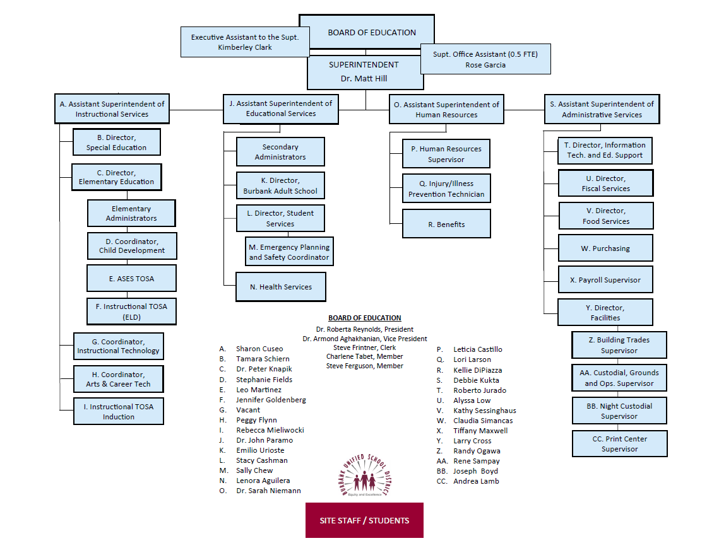
Organizational Chart

Slide 4
Educational services
Organizational Chart

Slide 5
LCAP Base and Supplemental Funds
Base Funding (Calculated with Student Average Daily Attendance (ADA) in grades TK-3; 4-6; 7-8; 9-12)
Supplemental Funding (Unduplicated student count/Counted once)
  English Language Learners
  Students in Foster Care
  Students who are Homeless
  Students who are socio-economically disadvantaged (National School Lunch Program)

Slide 6
Educational Services staffing
Assistant Superintendent (1)
Administrative Assistant (1)
Supervisor to Staff Ratio 1:1
Cost of Salary and Benefits $297,735
Total LCAP Budget Supplemental $3,427,485
Total LCAP Budget Base $759,018

Slide 7
Secondary school staffing
6-8 Administrators (8) (3,508 students)
  $1,303,523
9-12 Administrators (10) (5,270 students)
  $1,729,591
Alternative Schools Administrators (2) (249 students)
  $304,003

Slide 8
secondary schools Oversight role and responsibility
District Office Oversight
  Budget
  Staffing
  Enrollment
  General Support
  Crisis Response
  Curriculum and Instruction
  Professional Development
  Accountability (Assessments)
  Parent Engagement
  Facilities

Slide 9
Educational services budget
Actions Items | 2019-2020 Supplemental Budget | 2019-2020 Base Budget | 2020-2021 Proposed Supplemental Budget | 2020-2021 Proposed Base Budget
High School Counselors (2) | $218,630 | $0 | $228,988 | $0
Middle School Counselors (3) | $317,789 | $0 | $333,917 | $0
Monterey Teachers (4) | $445,986 | $0 | $462,170 | $0
Monterey Assistant Principal (1) | $172,002 | $0 | $172,610 | $0

Slide 10
Educational services budget
Action Items | 2019-2020 Supplemental Budget | 2019-2020 Base Budget | 2020-2021 Proposed Supplemental Budget | 2020-2021 Proposed Base Budget
Community Day School Teachers (2) | $221,042 | $0 | $225,374 | $0
Community Day School Instructional Assistants (4) | $157,314 | $0 | $158,278 | $0
Independent Learning Academy Online Courses | $0 | $509,994 | $0 | $509,994
Intervention Sections | $160,000 | $0 | $160,000 | $0

Slide 11
EDUCATIONAL Services budget
Action Items | 2019-2020 Supplemental Budget | 2019-2020 Base Budget | 2020-2021 Supplemental Budget | 2020-2021 Base Budget
FSA Counseling Program | $30,000 | $0 | $30,000 | $0
Advanced Placement Testing Fees for Students | $40,000 | $0 | $40,000 | $0
English Initial Credit Summer School | $25,000 | $0 | $25,000 | $0
Online Credit Recovery | $220,478 | $0 | $220,478 | $0

Slide 12
Educational services measurement
Action Item | Baseline 2018-2019 | Expected Outcome 2019-2020 | Expected Outcome 2020-2021
Intervention Sections | Fall rate 9.83% Spring rate 13.45% | Decrease % of D and F grades by 2% | Decrease % of D and F grades by 2%
Online Credit Recovery | Credit deficiency BHS 329 students JBHS 380 students | Decrease students credit deficiency by 5% | Decrease students credit deficiency by 5%
High School Counselors (2) | Graduation rate 92.3% All Students Hispanic Orange Students with Disab. Yellow A-G Completion rate JBHS 47.41% BHS 47% D and F grades rate Fall rate 9.83% Spring rate 13.45% Drop-out rate 2.5% | Maintain or increase graduation rate on the California Dashboard Increase students who meet A-G course requirements by 3% Decrease % of D and F grades by 2% Decrease drop-out rate to 1% | Maintain or increase graduation rate on the California Dashboard Increase students who meet A-G course requirements by 3% Decrease % of D and F grades by 2% Decrease drop-out rate to 1%

Slide 13
Educational services measurement
Action Item | Baseline 2018-2019 | Expected Outcome 2019-2020 | Expected Outcome 2020-2021
Monterey Teachers (4) | Credit deficiency All students Graduation rate 50% | Decrease the number of students who are credit deficient by 5% Maintain or increase the graduation rate | Decrease the number of students who are credit deficient by 5% Maintain or increase the graduation rate
Monterey Assistant Principal (1) | Credit deficiency All students Graduation rate 50% | Decrease the number of students who are credit deficient by 5% Maintain or increase the graduation rate | Decrease the number of students who are credit deficient by 5% Maintain or increase the graduation rate
Middle School Counselors (3) | Fall rate 9.83% Spring rate 13.45% | Decrease % of D and F grades by 2% | Decrease % of D and F grades by 2%

Slide 14
Educational services measurement
Action Item | Baseline 2018-2019 | Expected Outcome 2019-2020 | Expected Outcome 2020-2021
Community Day School Teachers (2) | Credit deficiency All students 92.3% Dashboard rate | Decrease the number of students who are credit deficient by 5% Maintain or increase the graduation rate | Decrease the number of students who are credit deficient by 5% Maintain or increase the graduation rate
Community Day School Instructional Assistants (4) | Credit deficiency All students No Dashboard data available | Decrease the number of students who are credit deficient by 5% Maintain or increase the graduation rate | Decrease the number of students who are credit deficient by 5% Maintain or increase the graduation rate
Advanced Placement Testing Fees for Students | A-G completion rate 48% | Increase the number of students who meet A-G course requirements by 3% | Increase the number of students who meet A-G course requirements by 3%

Slide 15
Educational services measurement
Action Item | Baseline 2018-2019 | Expected Outcomes 2019-2020 | Expected Outcomes 2020-2021
English Initial Credit Summer School | Credit deficiency BHS 382 students JBHS 407 students Graduation rate 92.3% | Decrease the number of students who are credit deficient by 5% Maintain or increase the graduation rate | Decrease the number of students who are credit deficient by 5% Maintain or increase the graduation rate
Independent Learning Academy Online Courses | No Dashboard data available No Dashboard data available | Decrease the number of students who are credit deficient by 5% Maintain or increase the graduation rate | Decrease the number of students who are credit deficient by 5% Maintain or increase the graduation rate
FSA Counseling Program | Survey 63% of students “my school provides resources for supporting students’ mental health” | Increase percentage of surveyed students by 3% | Increase percentage of surveyed students by 3%

Slide 16
Burbank adult school
District Office Oversight
  Staffing
  Budget
  Enrollment
  Support
  Crisis Response
  Curriculum and Instruction
  Professional Development
  Accountability (Assessments)

Slide 17
Adult school budget
Adult Education Administrators (1)
Teachers (7.08 plus hourly assignments)
Instructional Assistants (9.2688)
Office Staff (8.1687)
Operating Budget $4,246,365

Slide 18
Student services
Director (1)
Attendance Specialist (2.5)
Emergency Planning and Safety Coordinator (1)
Administrative Secretary (1)
Senior Secretary (1)
Salary and Benefits $648,807

Slide 19
Student services role and responsibility
Enrollment and Permits
Permits
Parent Data Confirmation
Annual Notification to Parents
Attendance Boundaries
Positive Behavioral Interventions and Supports (PBIS)
Homeless Education Program
Foster Youth Program
Discipline
Tobacco, Vaping & Dug Use Resources

Slide 20
Student support
Action Item | 2019-2020 Supplemental Budget | 2019-2020 Base Budget | 2020-2021 Supplemental Budget | 2020-2021 Base Budget
Secondary At-Risk Intervention Specialists (6) | $484,203 | $0 | $483,560 | $0
Elementary At-Risk Intervention Specialists (11) | $840,041 | $0 | $825,098 | $0
PBIS (substitutes) | $95,000 | $0 | $95,000 | $0

Slide 21
Student services measurement
Action Item | Baseline 2018-2019 | Expected Outcome 2019-2020 | Expected Outcome 2020-2021
Secondary At-Risk Intervention Specialists (6) | 60% of students reported via Climate Survey that “my school provides resources for supporting students’ mental health” Chronically absent rate 6.7% English learners Orange Students/ Disab. Orange Suspension rate 2.7% Hispanic Yellow English learners Yellow Students/ Disab. Yellow | Increase the percentage of students who report (via survey) that “my school provides resources for supporting students’ mental health by 3% Maintain or decease absenteeism rate on California Dashboard Maintain or decrease suspension rate on California Dashboard | Increase the percentage of students who report (via survey) that “my school provides resources for supporting students’ mental health by 3% Maintain or decease absenteeism rate on California Dashboard Maintain or decrease suspension rate on California Dashboard

Slide 22
Student services measurement
Action Item | Baseline 2018-2019 | Expected Outcomes 2019-2020 | Expected Outcomes 2020-2020
Elementary At-Risk Intervention Specialists (11) | Chronically absent rate 6.7% Suspension rate 2.7% English learners Yellow Students/Disab. Yellow | Maintain or decease absenteeism rate on California Dashboard Maintain or decrease suspension rate on California Dashboard | Maintain or decease absenteeism rate on California Dashboard Maintain or decrease suspension rate on California Dashboard
PBIS (substitutes) | Chronically absent rate 6.7% Suspension rate 2.7% Hispanic Yellow English learners Yellow Students/ Disab. Yellow | Maintain or decease absenteeism rate on California Dashboard Maintain or decrease suspension rate on California Dashboard | Maintain or decease absenteeism rate on California Dashboard Maintain or decrease suspension rate on California Dashboard

Slide 23
Emergency Planning and Safety
Safety Committee
Safe School Plans
Safety Procedures
Earthquake
Fire
Lockdown
Emergency Response
Police and Fire Department Liaison
Traffic

Slide 24
Emergency planning and safety measurement
Action Item | Baseline 2018-2019 | Expected Outcome 2019-2020 | Expected Outcome 2020-2021
School Safety Plans | All school safety reviewed and revised | Annual Revision of Safety Plans from Each School | Annual Revision of Safety Plans from Each School
Safety Procedures Earthquake Fire Lockdown | Procedures outlined and communicated to staff, students and parents | Ongoing communication and clarity on safety procedures | Ongoing communication and clarity on safety procedures
Communication with Police Department and Fire Department | Contacts with PD and FD as needed Satisfaction with emergency responses Staff Students Parents | Clarification of roles and responsibilities Satisfaction with emergency responses Staff Students Parents | Clarification of roles and responsibilities Satisfaction with emergency responses Staff Students Parents

Slide 25
Health Services Budget
Nurses (9.8)
Health Assistants (7.8)
Total Cost Salary and Benefits: $1,319,484

Slide 26
Health Services
Immunizations
Dispensing Medication
Health Examinations
Oral Health
Return to School After Injury
Health Services Support for Specific Conditions (Diabetes, et al)
Allergies, Asthma, et al
Lice, Measles and Other
Cold and Flu
Meal Accommodations
Air Quality

Slide 27
Health Services Budget
Action Items | 2019-2020 Supplemental Budget | 2019-2020 Base Budget | 2020-2021 Supplemental Budget | 2020-2021 Base Budget
Nurses (3) | $0 | $249,024 | $0 | $226,964
Nurses from General Fund (6.8) | $0 | $642,315 | $0 | $649,705
Health Assistants (7.8) | $0 | $428,145 | $0 | $448,393

Slide 28
Health Services Measurement
Action Item | Baseline 2018-2019 | Expected Outcome 2019-2020 | Expected Outcome 2020-2021
Nurses (3) | Chronically absent rate 6.7% Hispanic Yellow English learners Yellow Students/Disab. Yellow | Increase districtwide rate of attendance by 2% | Increase districtwide rate of attendance by 2%
Health Assistants (7.8) | Chronically absent rate 6.7% Hispanic Yellow English learners Yellow Students/Disab. Yellow | Increase districtwide rate of attendance by 2% | Increase districtwide rate of attendance by 2%

Slide 29
Questions

Slide 30
Contact Information
John Paramo, Ed.D., Assistant Superintendent, Educational Services
818-729-4451
Peter Knapik, Director of Elementary Education/State & Federal Programs
818-729-4482

