Slide 1
Human Resources
LCAP Funded Services
Presented By:
Sarah Niemann, Ed.D., Assistant Superintendent
Peter Knapik, Ed.D., Director of Elementary Education

Slide 2
Overview
Personnel Costs
  Human Resources Division
  TK-12 Administrators
  TK-12 Teachers
  TK-12 Classified Staff
Staffing Ratios
Salary Comparisons
Health and Welfare Benefits
Aspiring Administrators
Diversity

Slide 3
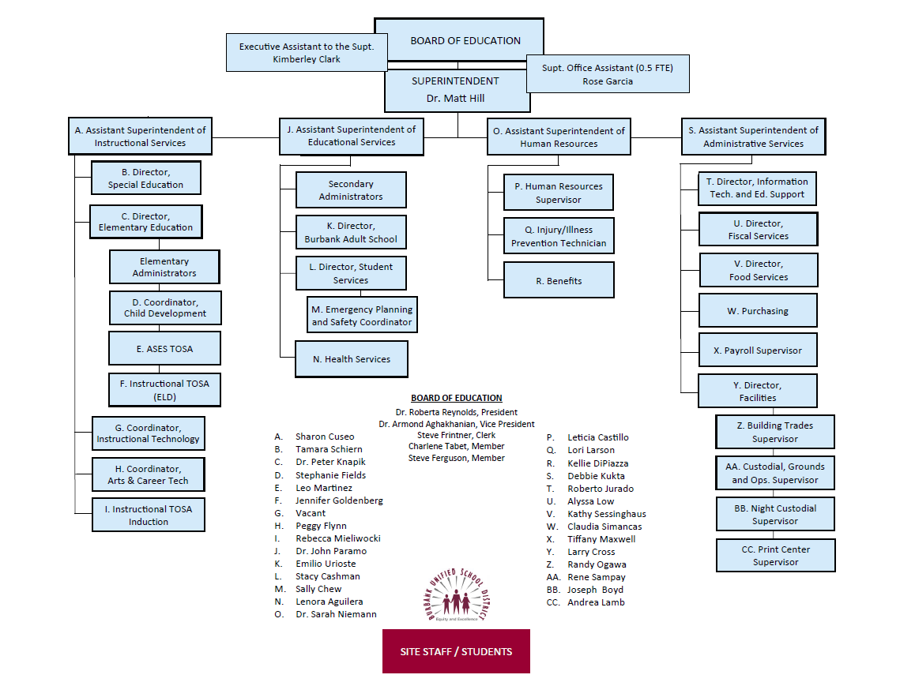
Organizational Chart

Slide 4
Role and Responsibilities
Strategic Management
Workforce Planning and Employment
Recruitment and Selection
Compensation and Benefits
Negotiations with Labor Partners
Policy Formation
Employee and Labor Relations
Risk Management (Employee Safety and Health)

Slide 5
Human Resources Staffing
Assistant Superintendent (1)
Supervisor (1)
Executive Assistant (1)
Classified (Elementary, CC, Food Service) (1)
Classified (Secondary, Maintenance, SPED) (1)
Classified (Subs) (1)

Slide 6
Human Resources Staffing
Certificated (TK-5, Adult, CC, DO, Admin) (1)
Certificated (6-12, ROP, SpEd, Speech) (1)
Certificated (Subs) (1)
Risk Management (1)
Benefits (2)
Reception/Mailroom (1)

Slide 7
Human Resources
Supervisor to Staff Ratio 2:5.5
Cost of Salary and Benefits
  Administrators $353,085
  Staff: $645,823

Slide 8
School Administrative Staffing
33 School Administrators
JK/ETK/TK-5 Administrators (12) (6,375 students)
  $2,097,395
6-8 Administrators (8) (3,508 students)
  $1,303,523
9-12 Administrators (10) (5,270 students)
  $1,729,591
Alternative Schools Administrators (2)
  $304,003
Adult Education Administrators (1)
  $216,140

Slide 9
School Office Staff
70 Site Office Staff
JK/ETK/TK-5 Classified Staff: 25.19
  $1,419,002
6-8 Classified Staff: 11.78
  $748,719
9-12 Classified Staff: 21.85
  $1,397,984
Alternative School Classified Staff: 2.97
  $176,379
Adult Education Classified Staff: 8.17
  $494,681

Slide 10
School Site Teachers
576 General Education Teachers
JK/ETK/TK-5 Teachers: 255.4
  $28,295,293
6-8 Teachers: 125.6
  $13,605,115
9-12 Teachers: 178.2
  $19,569,520
Alternative School Teachers: 17
  $1,363,063
Adult Education Teachers: 0.6000 + Hourly
  $64,546 + $819,820

Slide 11
School Site Classified Staff
138 Classified Staff at Schools
ETK/TK-5 Classified Staff: 72.11
  $2,954,742
6-8 Classified Staff: 23.08
  $1,379,417
9-12 Classified Staff: 24.28
  $1,342,739
Alternative Education Classified Staff: 7.60
  $431,109
Adult Education Classified Staff: 6.31
  $294,451

Slide 12
Special Education Teachers
96 SPED Teachers
Special Education Preschool (SEED): 6.00
  $647,394
ETK/TK-5 Teachers: 37.50
  $3,930,467
6-8 Teachers 21.20
  $2,324,028
9-12 Teachers: 24.30
  $2,710,624
Alternative School Teachers: 3.40
  $436,319
Adult Education Teachers: 3.48
  $429,150

Slide 13
Special Education Classified
117 SPED Classified Staff
Special Education Preschool (SEED) Classified Staff: 4.84
  $222,234
ETK/TK-5 Classified Staff: 46.03
  $2,089,209
6-8 Classified Staff: 26.56
  $1,217,616
9-12 Classified Staff: 29.31
  $1,365,110
Alternative School Classified Staff: 3.25
  $186,805
Adult Education Classified Staff: 7.12
  $332,423

Slide 14
List of 21 Districts in the Comparative Group
Comparative Analysis of District Income and Expenditures (CADIE)
Alhambra Unified
Paramount Unified
Lynwood Unified
Pleasanton Unified
Ventura Unified
Walnut Valley Unified
Oceanside Unified
Ceres Unified
Santa Barbara Unified
Burbank Unified
Rowland Unified
Tracy Joint Unified
Antioch Unified
Napa Valley Unified
Porterville Unified
Central Unified
Pasadena Unified
Turlock Unified
Simi Valley Unified
Baldwin Park Unified
Santa Rosa City Schools

Slide 15
Staffing Ratios – 2017-18
Statistic | Burbank | Comparative Group | Burbank’s Ranking
Average Class Size | 27.70 | 26.92 | 10 of 23
Student Enrollment per Pupil Services and Special Education Employee | 277.39 | 200.22 | 18 of 23
Student Enrollment per Non-Administrative Certificated Employee | 19.97 | 19.91 | 12 of 23
Student Enrollment per All Certificated Employees | 18.61 | 18.48 | 14 of 23
Student Enrollment per Paraprofessional Classified Employee | 98.87 | 84.01 | 15 of 23
Data Source: School Services CADIE Report

Slide 16
Staffing Ratios – 2017-18
Statistic | Burbank | Comparative Group | Burbank’s Ranking
Student Enrollment per Clerical Employee | 116.36 | 105.06 | 14 of 23
Student Enrollment per Other Classified Employee | 68.70 | 52.78 | 21 of 23
Student Enrollment per All Classified Employees | 30.06 | 24.87 | 21 of 23
Student Enrollment per Adults with Student Contact | 16.61 | 16.10 | 15 of 23
Student Enrollment per School Level Administrator | 474.90 | 399.27 | 20 of 23
Student Enrollment per District Level Administrator | 644.29 | 726.21 | 4 of 23
Data Source: School Services CADIE Report

Slide 17
Goal:
Recruit and Retain
Challenges around competitive salaries
Not able to keep up with Cost of Living Adjustment (COLA)
Increases to health and welfare benefits cost to both the employee and the employer

Slide 18
Three Year Increase in Maximum Salary for Teachers with Credentials Based upon 2017-18 data

Slide 19
BUSD Receives Less Funding than Surrounding Districts

Slide 20
How do we measure up to other Districts?
CERTIFICATED STAFFING SALARIES
The Los Angeles County Department of Education (LACOE) publishes salary comparison data annually for certificated staff.
47 unified school districts participate
LACOE divides the data into quartiles with Quartile 4 being the highest

Slide 21
How do we measure up to other Districts?
CERTIFICATED STAFFING SALARIES
Beginning salary with no experience:
    Just above the median (almost dead center) of all unified districts and in the 3rd quartile.
Maximum column and step placement:
    Bottom quartile. There are only 9 unified districts in LA county that pay lower than BUSD.
Five year increase in salary
    Bottom quartile.

Slide 22
How do we measure up to other Districts?
CLASSIFIED STAFFING SALARIES
Every year, the California School Employees Association (CSEA) releases a state wide and county wide comparison.
Each district is given a statewide rank, 0-100 (100 being the highest).

Slide 23
How do we measure up to other Districts?
CLASSIFIED STAFFING SALARIES
Classification | Rank
Clerk Typist | 5.3
Account Clerk | 6.4
Credentials Tech | 8.2
Health Assistant | 30.3
Library Media Tech | 13.2
Payroll Clerk | 10.2
Personnel Tech | 21.6
Classification | Rank
Receptionist | 5.4
Cafeteria Manager | 6.2
HS. Secretary | 33.3
Food Service | 21.8
Data Processing | 3.7
Instructional Asst. | 31.7
Custodian | 28.8

Slide 24
How do we measure up to other Districts?
CERTIFICATED STAFFING BENEFITS
Los Angeles County Office of Education (LACOE) also compares district contributions to health and welfare benefits.
This is a negotiated item with unions.
BUSD falls below the median and sits in quartile 2. 31 of the 47 unified school districts in Los Angeles County contribute more to health and welfare benefits.

Slide 25
Goal: Form Health and Welfare Joint Benefit Committee
The Joint Benefits Committee:
Started process of educating employees about current benefit plans
Is exploring other health and welfare options and is analyzing current plans and costs
Is planning wellness opportunities and education for all employees

Slide 26
Aspiring Administrators
The program provides a learning opportunity for employees who are interested in becoming a school administrator.
8 sessions over the course of the year.
Mock interviews and application support at the end of the program.
Topics include subjects like:
  School and district finance, human resources, SPED, student discipline, leadership development, instruction, etc.

Slide 27
Goal: Focus on Equity, Diversity and Inclusion
Analysis: work with collective bargaining partners to develop optional surveys to analyze the diversity of our workforce in comparison to the diversity of our students
Recruitment: Identify additional opportunities to recruit a more diverse candidate pool
Professional Development: Allocate LCAP funding for training – (i.e., implicit bias, diversity, and culturally responsive teaching)
**Need: HR would need $50,000 from LCAP to support professional development for staff

