Slide 1
Special Education Focus… through the lens of the Local Control Accountability
Plan (LCAP)
Presented by:
Tamara Schiern, Director of Special Education
Sharon Cuseo, Assistant Superintendent, Instructional Services
Peter Knapik, Ed.D., Director of Elementary Education

Slide 2
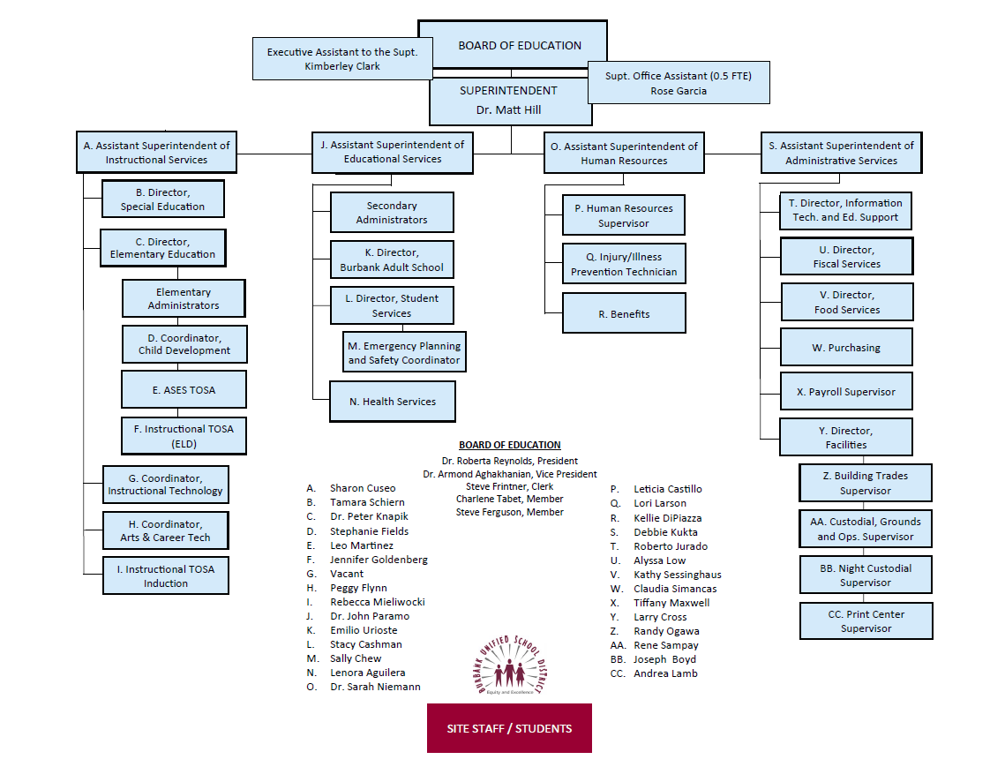
Organizational Chart

Slide 3
Instructional Services
Organizational Chart
ASSISTANT SUPERINTENDENT
Director of Special Education Director of Elementary Education
- Elementary Administrators
- Coordinator, Child Development
- ASES
- Instructional TOSA - ELD
Coordinator, Instructional Technology Coordinator, Arts & Career Technical Education Instructional Technology TOSA & Induction TOSA

Slide 4
Instructional services special education
Individualized Education Program Development and Implementation
Services and Placements:
Specialized Academic Instruction (SAI)
Push-In Classes
  Special Education Teacher goes into the General Education classroom at the Elementary Level
  Collaborative classes at the Secondary Level supported by a Special Education teacher or Instructional Assistant
Pull Out Classes
  Resource Specialist Program (RSP) at Elementary Level (28 student capacity)
  Basic and Fundamental Classes at Secondary Level (28 student capacity)
Special Day Classes
  Specialized Academic Instruction (SAI) for majority of the school day
  8-15 students per class
  3-6 adults per class
Non-Public School or SELPA School Placements

Slide 5
Instructional services special education
Special Education Related Services:
Speech and Language Services
Occupational Therapy
Adaptive Physical Education
Individual Counseling
Counseling and Guidance
Parent Counseling
Deaf and Hard of Hearing
Transportation
Nursing Services
Intensive Individual Services
Behavior Intervention Services
Sign Language Interpreting

Slide 6
Instructional services special education
SELPA Provided Services (District funds a portion):
Itinerant Deaf and Hard of Hearing Services
Specialized Vision Services
Orientation and Mobility
Early Start
Audiology

Slide 7
Educational services special education
Contracted Out Services:
(No District Provider, but contracted on an as-needed basis)
Vision Therapy Services
Physical Therapy Services
Social Work Services

Slide 8
Instructional services special education
Identification and Assessment of Individuals with Disabilities
Student Progress Monitoring
Parent Involvement, Collaboration and Consultation
Professional Development
State Reporting
Implementation, Support and Oversight of All Special Education Programs and Services
Special Education Student Count: 1,992

Slide 9
Instructional services special education
Administrators (2)
$370,449
Program Specialists (3.8)
$582,110
Psychologists (13)
$1,915,950
Deaf/Hard Hearing and Assistive Technology - Teachers of Special Assignment (1) Assistive Tech Assistant - $48,101
$107,431
APE - Teachers on Special Assignment (2)
$244,454
Speech and Language Pathologists (18.9)
$1,831,966
Speech and Language Pathology Agency Costs SLPA Assistant (1) - $58,305
S664,430
Occupational Therapists (10)
$1,356,552
Itinerant Teachers (5.32)
$469,595

Slide 10
Instructional services special education
96 SPED Teachers
Special Education Preschool (SEED): 7.00
  $669,952
ETK/TK-5 Teachers: 38.50
  $4,083,529
6-8 Teachers 17.00
  $1,996,040
9-12 Teachers: 25.90
  $2,880,973
Alternative School Teachers: 3.40
  $4442,039
Adult Education Teachers: 3.60
  $439,626

Slide 11
Instructional services
Special education classified
111 SPED Classified Staff
Special Education Preschool (SEED) Classified Staff: 7.97
  $371,220
ETK/TK-5 Classified Staff: 41.25
  $2,015,004
6-8 Classified Staff: 24.31
  $1,145,347
9-12 Classified Staff: 32.87
  $1,587,806
Alternative School Classified Staff: 1.56
  $89,769
Adult Education Classified Staff: 5.87
  $296,980

Slide 12
Instructional services special education
Action Items | 2020-2021 Supplemental Budget | 2020-2021 Base Budget | 2021-2022 Supplemental Budget | 2021-2022 Base Budget
Psychologists (2) | $293,809 | $0 | $290,958 | $0
Behavior Interventionists (2) | $127,567 | $0 | $138,705 | $0

Slide 13
Questions

Slide 14
Contact Information
Sharon Cuseo, Assistant Superintendent, Instructional Services
818-729-4455
Tamara Schiern, Director of Special Education
818-729-4524

