Slide 1
EDUCATIONAL SERVICES… through the lens of the local control accountability plan (LCAP)
Presented by:
John Paramo, Ed.D., Assistant Superintendent, Educational Services
Peter Knapik, Ed.D., Director of Elementary Education

Slide 2
Overview of educational services
Educational Services
  Secondary Schools
  Burbank Adult School
  Student Services
  Emergency Planning and Safety
  Health Services

Slide 3

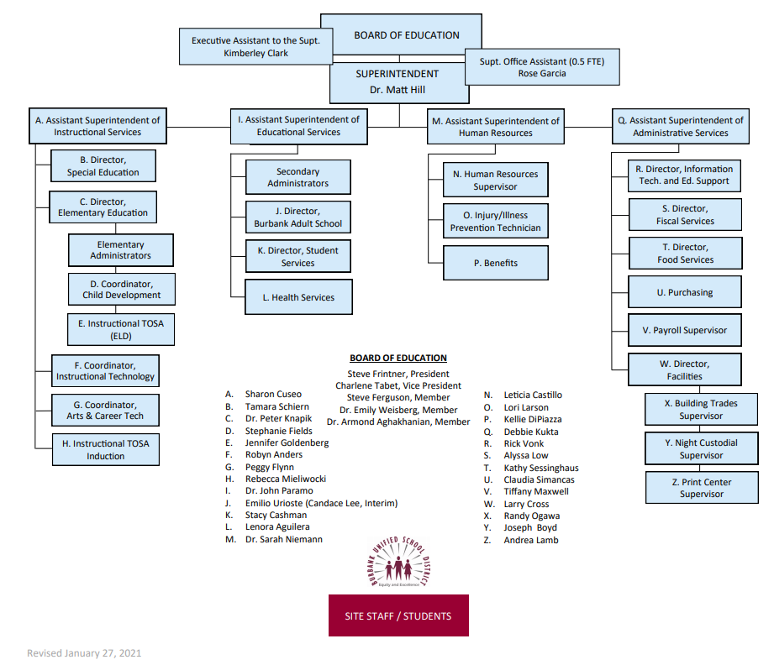
Organization Chart

Slide 4
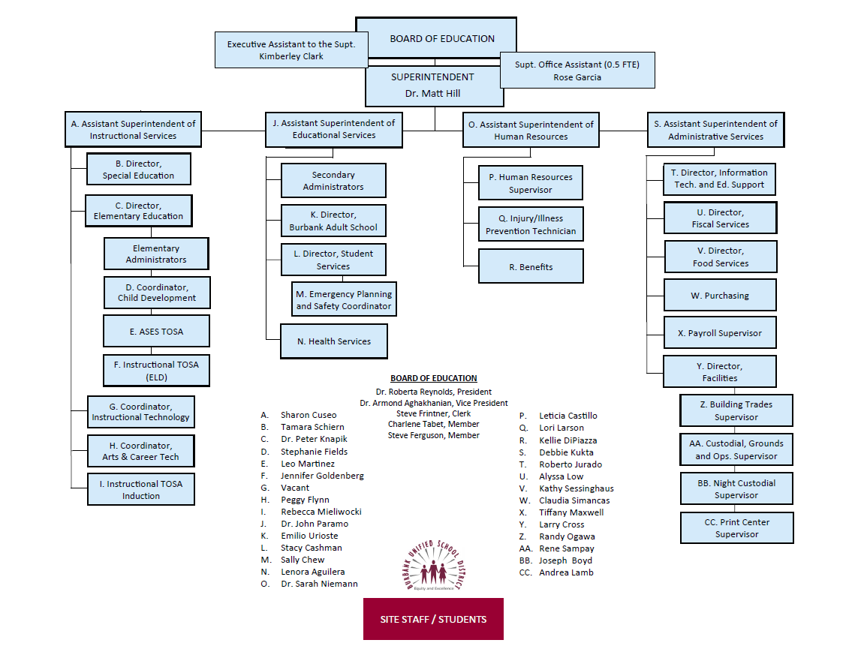
Educational services
Organizational Chart

Slide 5
LCAP Base and Supplemental Funds
Base Funding (Calculated with Student Average Daily Attendance (ADA) in grades TK-3; 4-6; 7-8; 9-12)
Supplemental Funding (Unduplicated student count/Counted once)
  English Language Learners
  Students in Foster Care
  Students who are Homeless
  Students who are socio-economically disadvantaged (National School Lunch Program)

Slide 6
Educational Services staffing
Assistant Superintendent (1)
Administrative Assistant (1)
Supervisor to Staff Ratio 1:1
Cost of Salary and Benefits $297,735
Total LCAP Budget Supplemental $3,067,334
Total LCAP Budget Base $1,835,056

Slide 7
Secondary school staffing
6-8 Administrators (8) (3,393 students)
  $1,320,252
9-12 Administrators (10) (5,131 students)
  $1,748,169
Alternative Schools Administrators (2) (177 students)
  $472,610

Slide 8
secondary schools Oversight role and responsibility
District Office Oversight
  Budget
  Staffing
  Enrollment
  General Support
  Crisis Response
  Curriculum and Instruction
  Professional Development
  Accountability (Assessments)
  Parent Engagement
  Facilities

Slide 9
Educational services budget
Actions Items | 2020-2021 Supplemental Budget | 2020-2021 Base Budget | 2021-2022 Proposed Supplemental Budget | 2021-2022 Proposed Base Budget
High School Counselors (2) | $228,276 | $0 | $232,099 | $0
Middle School Counselors (3) | $328,953 | $0 | $333,900 | $0
Monterey Teachers (8) | $410,289 | $0 | $874,266 | $0
Monterey Assistant Principal (1) | $173,310 | $0 | $173,297 | $0

Slide 10
Educational services budget
Action Items | 2020-2021 Supplemental Budget | 2020-2021 Base Budget | 2021-2022 Proposed Supplemental Budget | 2021-2022 Proposed Base Budget
Community Day School Teachers (4) | $226,276 | $0 | $449,328 | $0
Community Day School Instructional Assistants (4) | $146,658 | $0 | $145,459 | $0
Independent Learning Academy Online Courses | $0 | $509,994 | $0 | $509,994
Intervention Sections | $160,000 | $0 | $146,790 COVID funds | $0

Slide 11
EDUCATIONAL Services budget
Action Items | 2020-2021 Supplemental Budget | 2020-2021 Base Budget | 2021-2022 Supplemental Budget | 2021-2022 Base Budget
FSA Counseling Program | $30,000 | $0 | $30,000 | $0
Advanced Placement Testing Fees for Students | $0 | $0 | $0 | $0
English Initial Credit Summer School | $52,000 | $0 | $52,000 | $0
Online Credit Recovery | $191,407 | $0 | $220,478 | $0

Slide 12
Educational services measurement
Action Item | Baseline 2018-2019/2019-2020 | Baseline 2019-2020 | Expected Outcome 2021-2022
Intervention Sections | D and F grades rate Fall rate 9.83% Spring rate 13.45% | D and F grades rate Fall rate 17% Spring rate 8% | Decrease % of D and F grades by 2%
Online Credit Recovery | Credit deficiency BHS 329 students JBHS 380 students | Credit deficiency BHS 415 students JBHS 455 students 532 recovered credit in summer school 82 students recovered through credit recovery | Decrease students credit deficiency by 5%
High School Counselors (2) | Graduation rate 92.3% BLUE ELL, Homeless, SED, SPED; GREEN All Students Hispanic; ORANGE Hispanic, African American A-G Completion rate JBHS 47.41% BHS 47% District 48% D and F grades rate Fall rate 9.83% Spring rate 13.45% | Graduation rate 91.6% A-G Completion rate JBHS 57% BHS 55% District 50% D and F grades rate Fall rate 17% Spring rate 8% | Maintain or increase graduation rate on the California Dashboard Increase students who meet A-G course requirements by 3% Decrease % of D and F grades by 2%

Slide 13
Educational services measurement
Action Item | Baseline 2018-2019 | Baseline 2019-2020 | Expected Outcome 2021-2022
Monterey Teachers (4) | Credit deficiency All students Graduation rate 50% | Decrease the number of students who are credit deficient by 5% Graduation rate NA | Decrease the number of students who are credit deficient by 5% Increase the graduation rate by 25%
Monterey Assistant Principal (1) | Credit deficiency All students Graduation rate 50% | Decrease the number of students who are credit deficient by 5% Graduation rate NA | Decrease the number of students who are credit deficient by 5% Increase the graduation rate by 25%
Middle School Counselors (3) | D and F grades rate Fall rate 9.83% Spring rate 13.45% | D and F grades rate Fall rate 17% Spring rate 8% | Decrease % of D and F grades by 2%

Slide 14
Educational services measurement
Action Item | Baseline 2018-2019 | Baseline 2019-2020 | Expected Outcome 2021-2022
Community Day School Teachers (2) | Credit deficiency All students Graduation rate 92.3% | Decrease the number of students who are credit deficient by 5% Graduation rate NA | Decrease the number of students who are credit deficient by 5% Maintain or increase the graduation rate
Community Day School Instructional Assistants (4) | Credit deficiency All students Graduation rate 92.3% | Decrease the number of students who are credit deficient by 5% Graduation rate NA | Decrease the number of students who are credit deficient by 5% Maintain or increase the graduation rate
Advanced Placement Testing Fees for Students | A-G completion rate 49.2% | A-G completion rate NA | Increase the number of students who meet A-G course requirements by 3%

Slide 15
Educational services measurement
Action Item | Baseline 2018-2019 | Baseline 2019-2020 | Expected Outcomes 2021-2022
English Initial Credit Summer School | Credit deficiency BHS 382 students JBHS 407 students Graduation rate 92.3% | Credit deficiency BHS 415 students JBHS 532 students Graduation rate 91.6% | Decrease the number of students who are credit deficient by 5% Increase the graduation rate by 2%
Independent Learning Academy Online Courses | Credit deficiency NA Graduation rate NA | Decrease the number of students who are credit deficient by 5% Maintain or increase the graduation rate | Decrease the number of students who are credit deficient by 5% Maintain or increase the graduation rate
FSA Counseling Program | Survey 63% of students “my school provides resources for supporting students’ mental health” | Increase percentage of surveyed students by 3% | Increase percentage of surveyed students by 3%

Slide 16
Burbank adult school
District Office Oversight
  Staffing
  Budget
  Enrollment
  Support
  Crisis Response
  Curriculum and Instruction
  Professional Development
  Accountability (Assessments)

Slide 17
Adult school budget
Adult Education Administrators (1)
Teachers (7.08 plus hourly assignments)
Instructional Assistants (7.8125)
Office Staff (10.30)
Operating Budget $4,246,365

Slide 18
Student services
Director (1)
Attendance Specialist (2.5)
Emergency Planning and Safety Coordinator (1)
Administrative Secretary (1)
Senior Secretary (1)
Salary and Benefits $648,807

Slide 19
Student services role and responsibility
Enrollment and Permits
Permits
Parent Data Confirmation
Annual Notification to Parents
Attendance Boundaries
Positive Behavioral Interventions and Supports (PBIS)
Homeless Education Program
Foster Youth Program
Discipline
Tobacco, Vaping & Dug Use Resources

Slide 20
Student support
Action Item | 2020-2021 Supplemental Budget | 2020-2021 Base Budget | 2021-2022 Supplemental Budget | 2021-2022 Base Budget
Secondary At-Risk Intervention Specialists (6) | $429,786 | $0 | $459,791 | $0
Elementary At-Risk Intervention Specialists (11) | $758,232 | $0 | $805,513 | $0
PBIS (substitutes) | $5,000 | $0 | $65,000 | $0

Slide 21
Student services measurement
Action Item | Baseline 2018-2019 | Baseline 2019-2020 | Expected Outcome 2021-2022
Secondary At-Risk Intervention Specialists (6) | 60% of students reported via Climate Survey that “my school provides resources for supporting students’ mental health” Chronically absent rate 6.7% ORANGE ELLs, SWDs YELLOW African American, Foster, Hispanic, Homeless Suspension rate 2.7% YELLOW ELLS, Hispanic, Homeless, SWDs | Increase the percentage of students who report (via survey) that “my school provides resources for supporting students’ mental health by 3% Chronically absent NA Suspension rate NA | Increase the percentage of students who report (via survey) that “my school provides resources for supporting students’ mental health by 3% Maintain or decease absenteeism rate on California Dashboard Maintain or decrease suspension rate on California Dashboard

Slide 22
Student services measurement
Action Item | Baseline 2018-2019 | Baseline 2019-2020 | Expected Outcomes 2021-2022
Elementary At-Risk Intervention Specialists (11) | Chronically absent rate 6.7% ORANGE ELLs, SWDs YELLOW African American, Foster, Hispanic, Homeless Suspension rate 2.7% YELLOW ELLS, Hispanic, Homeless, SWDs | Chronically absent NA Suspension rate NA | Maintain or decease absenteeism rate on California Dashboard Maintain or decrease suspension rate on California Dashboard
PBIS (substitutes) | Chronically absent rate 6.7% ORANGE ELLs, SWDs YELLOW African American, Foster, Hispanic, Homeless Suspension rate 2.7% YELLOW ELLS, Hispanic, Homeless, SWDs | Chronically absent NA Suspension rate NA | Maintain or decease absenteeism rate on California Dashboard Maintain or decrease suspension rate on California Dashboard

Slide 23
Emergency Planning and Safety
Safety Committee
Safe School Plans
Safety Procedures
Earthquake
Fire
Lockdown
Emergency Response
Police and Fire Department Liaison
Traffic

Slide 24
Emergency planning and safety measurement
Action Item | Baseline 2018-2019 | Baseline 2019-2020 | Expected Outcome 2021-2022
School Safety Plans | All school safety reviewed and revised | Annual Revision of Safety Plans from Each School | Annual Revision of Safety Plans from Each School
Safety Procedures Earthquake Fire Lockdown | Procedures outlined and communicated to staff, students and parents | Ongoing communication and clarity on safety procedures | Ongoing communication and clarity on safety procedures
Communication with Police Department and Fire Department | Contacts with PD and FD as needed Satisfaction with emergency responses Staff Students Parents | Clarification of roles and responsibilities Satisfaction with emergency responses Staff Students Parents | Clarification of roles and responsibilities Satisfaction with emergency responses Staff Students Parents

Slide 25
Health Services Budget
Nurses (9.8)
Health Assistants (7.8)
Total Cost Salary and Benefits: $1,319,484

Slide 26
Health Services
Immunizations
Dispensing Medication
Health Examinations
Oral Health
Return to School After Injury
Health Services Support for Specific Conditions (Diabetes, et al)
Allergies, Asthma, et al
Lice, Measles and Other
Cold and Flu
Meal Accommodations
Air Quality

Slide 27
Health Services Budget
Action Items | 2020-2021 Supplemental Budget | 2020-2021 Base Budget | 2021-2022 Supplemental Budget | 2021-2022 Base Budget
Nurses (3) | $0 | $249,024 | $0 | $226,964
Nurses from General Fund (6.8) | $0 | $642,315 | $0 | $649,705
Health Assistants (7.8) | $0 | $428,145 | $0 | $448,393

Slide 28
Health Services Measurement
Action Item | Baseline 2018-2019 | Baseline 2019-2020 | Expected Outcome 2020-2021
Nurses (3) | Chronically absent rate 6.7% ORANGE ELLs, SWDs YELLOW African American, Foster, Hispanic, Homeless Attendance ADA 94.97% | Chronically absent NA Attendance ADA 96.3% | Decrease chronic absenteeism by 2% Increase districtwide rate of attendance by 1%
Health Assistants (7.8) | Chronically absent rate 6.7% ORANGE ELLs, SWDs YELLOW African American, Foster, Hispanic, Homeless Attendance ADA 94.97% | Chronically absent NA Attendance ADA 96.3% | Decrease chronic absenteeism by 2% Increase districtwide rate of attendance by 1%

Slide 29
Questions

Slide 30
Contact Information
John Paramo, Ed.D., Assistant Superintendent, Educational Services
818-729-4451
Peter Knapik, Ed.D., Director of Elementary Education/State & Federal Programs
818-729-4482

