Slide 1

Administrative Services
Through the Lens of LCAP
Presented by:
Debbie Kukta, Assistant Superintendent
Peter Knapik, Director of Elementary Education

Slide 2
Agenda
Organization Information – Administrative Services
Overview of Administrative Services Departments

Slide 3
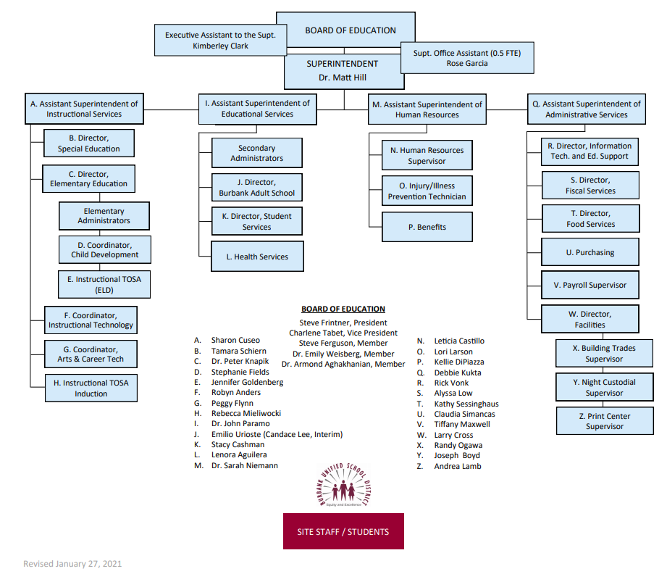
Organization Chart

Slide 4
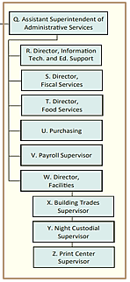
Organization Chart

Slide 5

Administrative Services
Department Overview
Administrative Services
Fiscal Services: Budget & Finance
Payroll
Purchasing
Food Services
Facilities
  Custodial & Grounds
  Building & Trades
Print Services & Warehouse
Technology Services

Slide 6
Administrative Services
Responsibilities/services provided
  Responsible for all day-to-day and long-range business matters of the district
  Provide a myriad of services in support of K-12 schools, childcare centers, and the adult school
  Goal: Deliver business services that support and enhance the learning environment in a responsible and cost-effective manner
  Risk management
Number of full-time equivalent staff members in department
  2
Estimated cost of salary and benefits
  $349,444
Supervisor to staff ratios
  1 : 1
Categorize funding: Unrestricted

Slide 7

Fiscal Services
Budget & Finance
Responsibilities/services provided
  Develop policy for and operate the financial infrastructure of the district, including payments, collections, cash management, financing, central accounting, and delinquent debt collection
Number of full-time equivalent staff members in department
  15.75
Estimated cost of salary and benefits
  $1,561,585
Supervisor to staff ratios
  2 : 13.75
Categorize funding:
  Restricted/special program: $87,397
  Unrestricted: $1,474,188

Slide 8
Purchasing
Responsibilities/services provided
  Provide goods and services at the most affordable pricing with needed delivery requirements while adhering to BUSD’s policies, California Ed Code regulations, and all other state and federal regulations, laws, rules, policies and procedures
Number of full-time equivalent staff members in department
  3
Estimated cost of salary and benefits
  $234,952
Supervisor to staff ratios
  1 : 3
Categorize funding: Unrestricted

Slide 9
Payroll
Responsibilities/services provided
  Process payroll (salary and benefits) for over 2,100 employees (includes hourlies and subs)
Number of full-time equivalent staff members in department
  4
Estimated cost of salary and benefits
  $367,341
Supervisor to staff ratios
  1 : 3
Categorize funding: Unrestricted

Slide 10

Food Services
Responsibilities/services provided
  Serving safe, nutritious, and quality meals in an effort to support the academic growth and success of BUSD students
Number of full-time equivalent staff members in department
  44.032
Estimated cost of salary and benefits
  $2,245,839
Supervisor to staff ratios
  8 : 36.032
Categorize funding: Restricted program, fee for service
Operational Budget - $3,852,533

Slide 11

Facilities Services
Custodial and Grounds
Responsibilities/services provided
  Custodial: Maintain and clean the buildings/classrooms, equipment, and furnishings
  Grounds: Maintain grounds in a safe and attractive condition
Number of full-time equivalent staff members in department
  74
Estimated cost of salary and benefits
  $5,225,779
Supervisor to staff ratios
  3.5 : 70.5
Categorize funding: Unrestricted

Slide 12
Facilities Services
Custodial Staffing Standards
Custodial Staffing Standards
CASBO (California Association of school Business Officials)
FCMAT (Fiscal Crisis & Management Assistance Team)
One custodian for every 13 teachers/classrooms
One custodian for every 325 students
One custodian for every 18,000 square feet

Slide 13
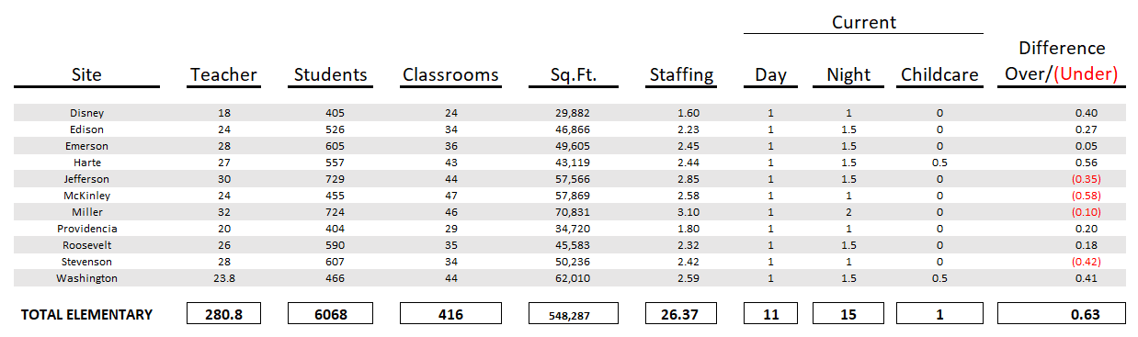
Facilities Services
Custodial Staffing Standards - Elementary

Slide 14
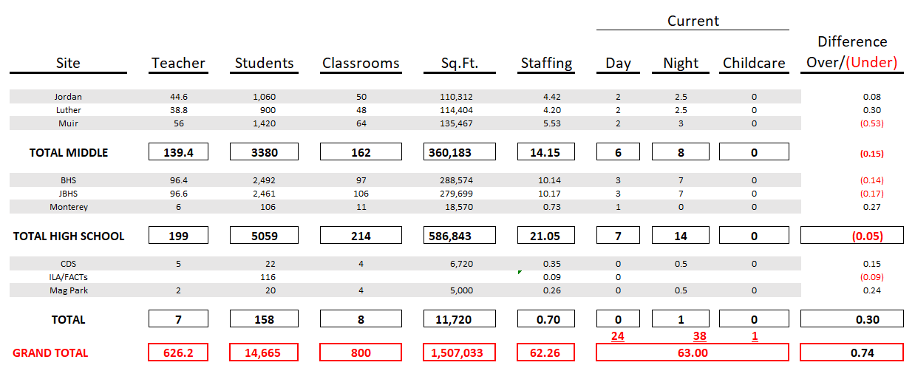
Facilities Services
Custodial Staffing Standards - Secondary

Slide 15
Facilities Services
Custodial Staffing – Additional Positions
POSITION | NUMBER
Balance from Previous Slide | 63
Floor Crew | 3
Night/Weekend Security | 2
Track and Fields (High Schools) | 2
Pools (High Schools) | 1
Day Supervisor | 1
Night Supervisor | 1
Supervisor – M&O | 1
TOTAL CUSTODIAL STAFF | 74

Slide 16
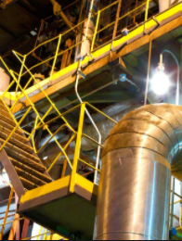
Facilities
Building and Trades
Responsibilities/services provided
  Maintains sites through planned maintenance and work orders
  Oversees the planning, funding, construction, modernization, expansion, and facilities rentals for the district
  Interacts with local, state, and federal agencies on all issues pertaining to planning, development, finance, environmental impact, population growth, and construction
Number of full-time equivalent staff members in department
  39.5
Estimated cost of salary and benefits
  $3,587,812
Supervisor to staff ratios
  1.5 : 38
Categorize funding: Unrestricted/special program

Slide 17

Print Services and Warehouse
Responsibilities/services provided
  Operate central Print Center
  Receive and store district supplies
  Deliver completed print jobs and supply orders to sites
  Instrumental this year in PPE distribution
Number of full-time equivalent staff members in department
  3.625
Estimated cost of salary and benefits
  $319,098
Supervisor to staff ratios
  1 : 2.625 (plus one staff provided under contract with Sharp for Print Center)
Categorize funding: Unrestricted/special program

Slide 18

Technology Services
Responsibilities/services provided
  Supports all computers, networks, and telephones throughout the district
  Works closely with teachers, staff, administrators, and community members to provide support for a positive instructional and administrative setting
Number of full-time equivalent staff members in department
  15
Estimated cost of salary and benefits
  $1,723,562
Supervisor to staff ratios
  2 : 13
Categorize funding: Unrestricted, E-rate, bond

Slide 19
Questions?
Debbie Kukta, CPA, CGMA, Assistant Superintendent, Administrative Services
DebbieKukta@BurbankUSD.org (818)729-4473
Dr. Peter Knapik, Director of Elementary Education
PeterKnapik@BurbankUSD.org (818)729-4492

