Slide 1

The McKinney-Vento Act
Back to School Review
2021

Slide 2

Today’s Agenda
Background and definition of homelessness
School stability and transportation
Immediate enrollment
Support for academic success
Resources

Slide 3

1.35 million
Students experiencing homelessness, preK-12, identified by public schools in 2016-2017.
7% increase over 4 years.
Source: National Center for Homeless Education (2019). National Overview.

Slide 4

Definition: Who is eligible?
Children and youth who lack a fixed, regular, and adequate nighttime residence.
Sharing the housing of others due to loss of housing, economic hardship, or similar reason. [75.8% of identified MV students in 2016–17]
Living in motels, hotels, trailer parks, or camping grounds due to lack of alternative adequate accommodations.
[Motels: 6.6% of identified MV students in 2016–17]
Notes:
Shared housing is not always “homeless”. Refer to the full definition, and use these questions as guides:
Where would you go if you couldn’t stay here?
What led you to move in to this situation?

Slide 5
Definition: Who is eligible?
Children and youth who lack a fixed, regular, and adequate nighttime residence. 11434a(2)
Living in emergency or transitional shelters.
[13.9% of identified MV students in 2016–17]
Living in a public or private place not designed for or regularly used as accommodations.
Living in cars, parks, abandoned buildings, substandard housing, bus or train stations, or similar settings.
  What is substandard? Check utilities; infestations; mold; dangers.
“Determining Eligibility” brief:
https://nche.ed.gov/downloads/briefs/det_elig.pdf

Slide 6
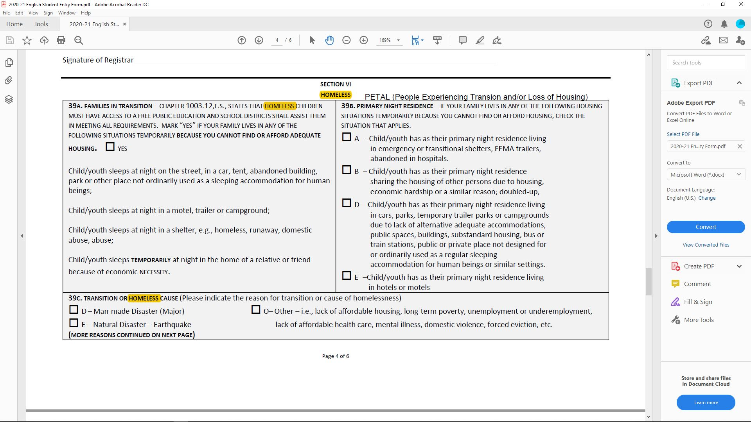
Homeless Identification on Student Entry Form

Slide 7

Unaccompanied Homeless Youth
Definition
A child or youth who meets the McKinney-Vento definition of homelessness and is not in the physical custody of a parent or guardian.

Slide 8

Unaccompanied Homeless Youth
Youth run away due to abuse or neglect.
40-60% of unaccompanied youth were abused physically at home.
17-35% of unaccompanied youth were abused sexually at home.
Research links parental substance abuse and youth running away from home.
Notes:
Research shows that seventeen to thirty-five percent of unaccompanied youth were abused sexually in their homes, while forty to sixty percent were abused physically. Robertson, Marjorie J., Toro, Paul A. (2012). Homeless Youth: Research, Intervention, and Policy. https://goproject.org/wp-content/uploads/2012/06/Homeless-Youth.pdf.
Research also has found a clear link between parental substance abuse and youth running away from home. Robertson; Benoit-Bryan, Jennifer. (2013). Family Characteristics and Runaway Youth. https://www.1800runaway.org/wp-content/uploads/2015/05/Family-Characteristics-and-Runaway-Behavior-final2.pdf.

Slide 9
Unaccompanied Homeless Youth
Parents force youth out of the home due to conflicts.
Pregnancy
Sexual orientation and gender identity
The circumstances of homelessness force families apart.
Families become separated due to poverty, lack of space in living situations, or shelter policies.
47% of youth experience homelessness both with families and on their own.
Unaccompanied youth resources:
https://www.nn4youth.org/
Notes:
Being a single parent is the second highest risk factor for unaccompanied youth homelessness (after lacking a GED).
LGBTQ youth have 2.2 times the risk of experiencing homelessness as heterosexual youth.
All data from Chapin Hall at the University of Chicago (2017). Voices of Youth Count.

Slide 10
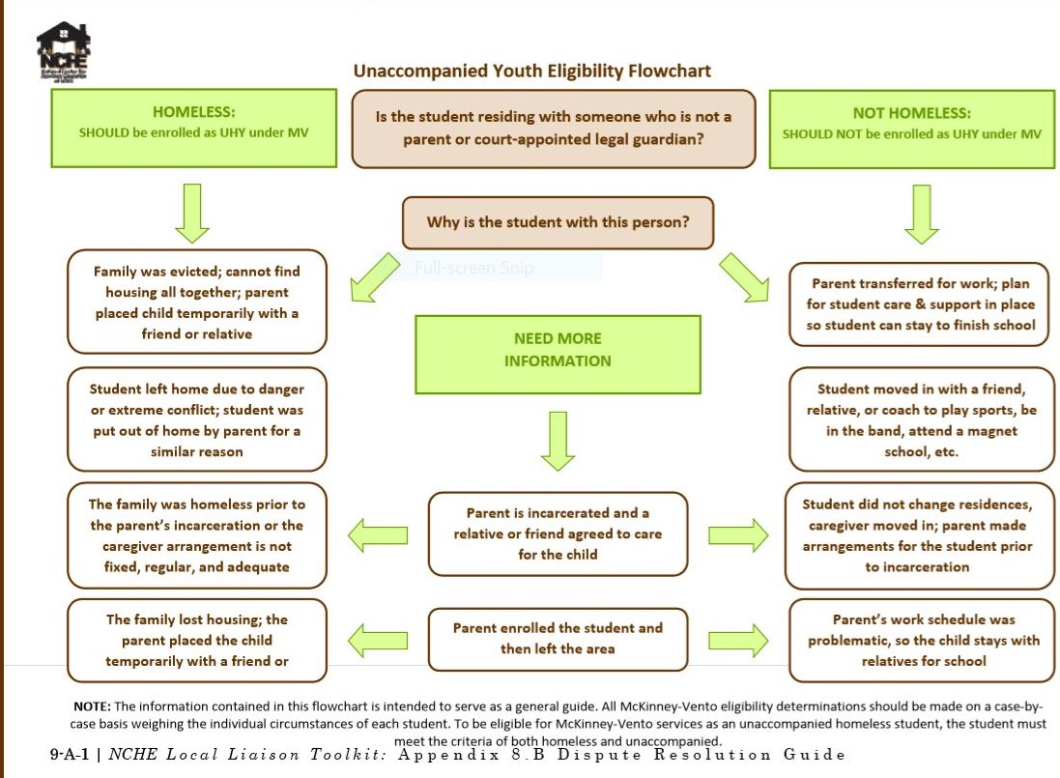
Eligibility Flow Chart

Slide 11
School of Origin: Definition
The school attended when permanently housed or the school in which last enrolled, including a preschool.
Includes the designated receiving school at the next grade level for all feeder schools, when the student completes the final grade level served by the school of origin.
Help with school of origin and preschool:
www.schoolhouseconnection.org/learn/early-childhood/

Slide 12
Staying in the School of Origin
Each LEA shall, according to the child’s or youth’s best interest:
Keep the student in the school of origin for the duration of homelessness, and until the end of the academic year in which the student becomes permanently housed; or
Enroll the student in any public school that housed students living in the attendance area where the student is living are eligible to attend. 11432(g)(3)(A)
Notes:
Highly mobile students have lower test scores and worse overall academic performance than peers who do not change schools.
Mobility also hurts non-mobile students; study found average test scores for non-mobile students were significantly lower in high schools with high student mobility rates.
Students who changed high schools even once during high school were less than half as likely as stable students to graduate, even controlling for other factors.

Slide 13
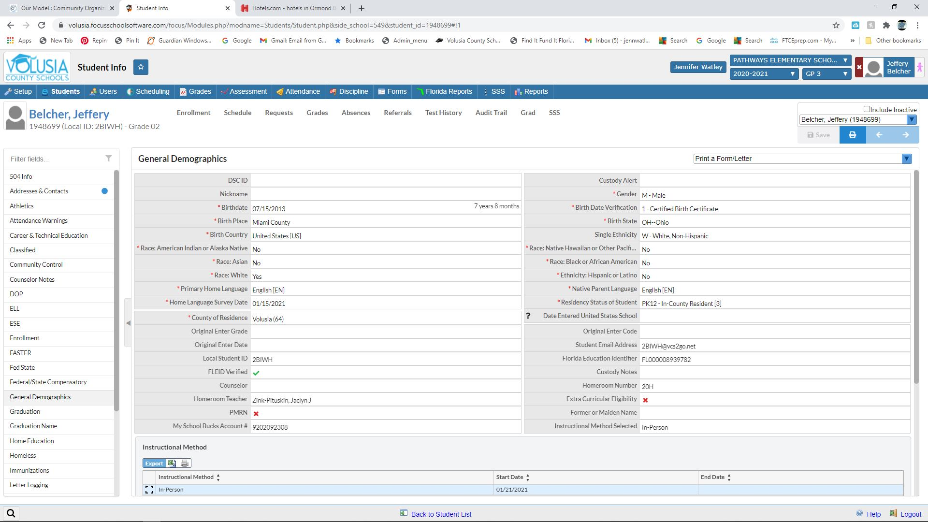
Identifying a Student as Homeless in FOCUS

Slide 14
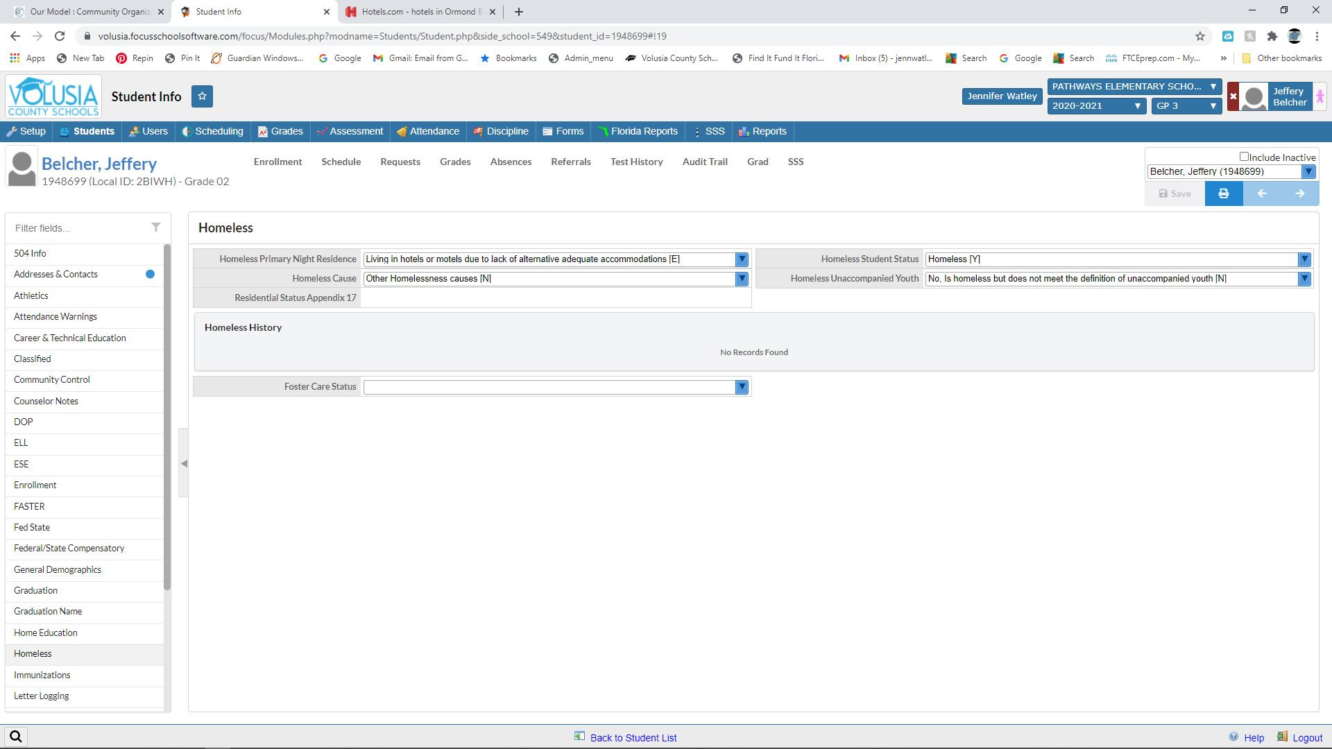















Click and Enter Data into the Homeless Tab

Slide 15
Determining Best Interest
In determining best interest:
Presume that keeping the student in the school of origin is in the student’s best interest.
Unless contrary to the request of the parent, guardian, or unaccompanied youth.
Consider student-centered factors, including the impact of mobility on achievement, education, health, & safety.
For preschool children, consider attachment to teachers; availability and quality of services in the new area; and travel time.
Give priority to the request of the parent/guardian.
Give priority to the request of an unaccompanied youth.

Slide 16
Immediate Enrollment
McKinney-Vento students are entitled to immediate enrollment in any public school that students living in the same attendance area are eligible to attend, even if:
Students do not have required documents, such as school records, records of immunization and other required health records, proof of residency, guardianship, or other documents; or
Students have missed application or enrollment deadlines during any period of homelessness.
Notes:
Comment that hopefully most students will remain in their schools of origin and not have to enroll in a new school.

Slide 17

Immediate Enrollment
“Enrollment” includes attending classes and participating fully in school activities.
The liaison must assist in obtaining immunization and other health records or screenings, and immunizations if needed; the student must be enrolled in the interim.
Enrolling schools must obtain school records from the previous school; the student must be enrolled while records are obtained.
Immediate enrollment applies even without parent or guardian.
  Typically, unaccompanied youth enroll themselves.

Slide 18

Free and Reduced Lunch
Once student is enrolled, alert your café manager of the enrollment to ensure the student receives lunch.

Slide 19

Transportation to the School of Origin
LEAs must provide transportation to and from the school of origin (including preschools), including until the end of the year when the student obtains permanent housing, at a parent’s or guardian’s request (or at the liaison’s request for unaccompanied youth).
If staying in the same LEA, that LEA must provide or arrange transportation to the school of origin.
If crossing LEA lines, both LEAs must determine how to divide the responsibility and share the cost, or they must share the cost equally.

Slide 20
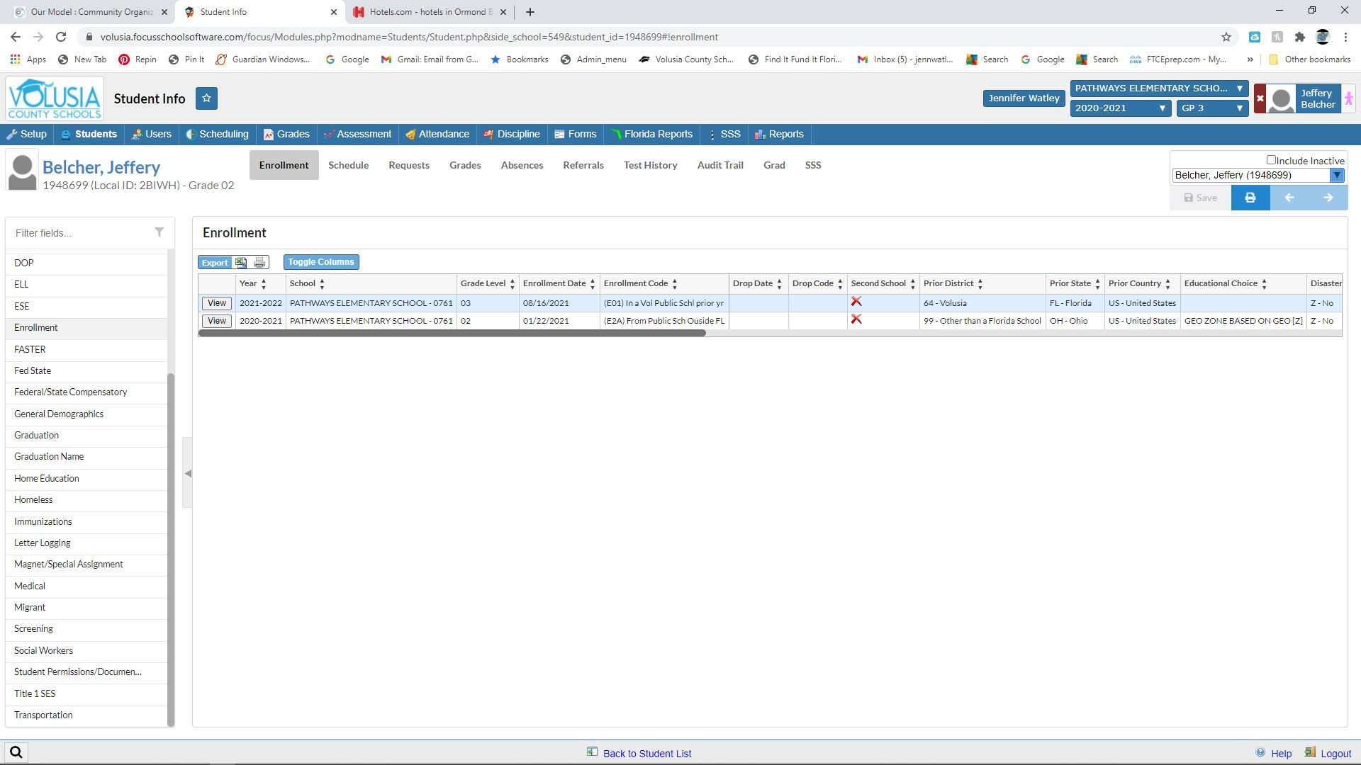












Requesting a Bus for the School of Origin

Slide 21
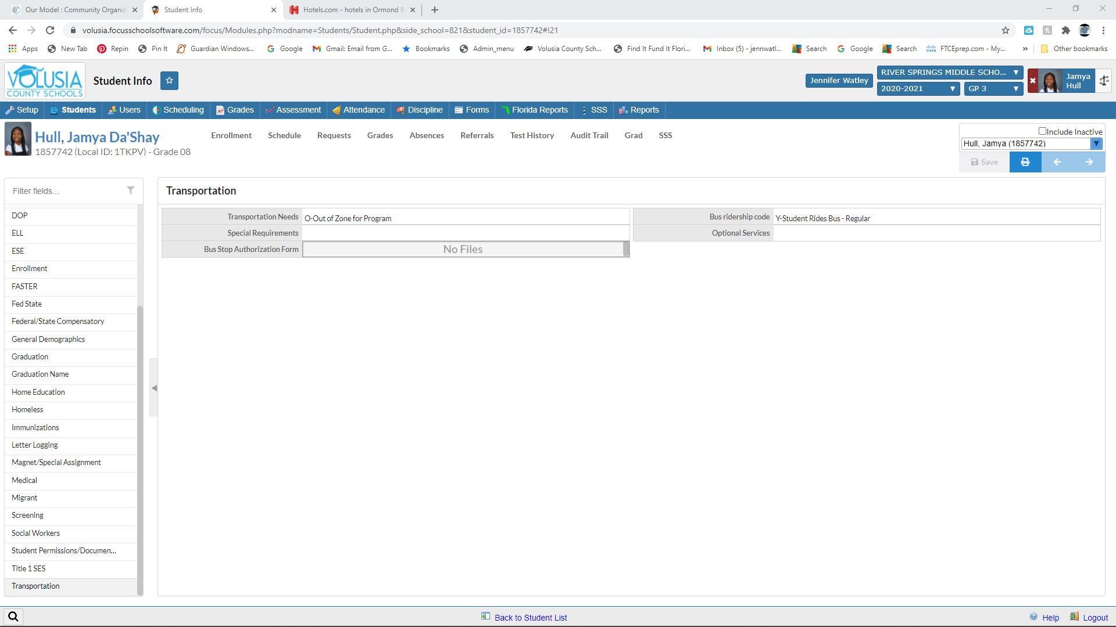














Focus: Out of Zone Bus Request

Slide 22

Support for Success:
Earning Credits
SEAs and LEAs must implement procedures to identify and remove barriers to McKinney-Vento students receiving appropriate credit for full or partial coursework completed at a prior school.
Quick Guide
for Counseling Staff:
https://www.schoolhouseconnection.org/quick-guide-for-counselors-working-with-students-experiencing-homelessness/

Slide 23

Support for Success:
Full Participation
Remove barriers to academic and extracurricular activities, including magnet school, summer school, career and technical education, advanced placement, online learning, and charter school programs.
  LEAs should anticipate and accommodate the needs of McKinney-Vento students to enter these programs and consider giving them priority on waitlists.
  SEAs and LEAs should develop policies to expedite full participation in extracurricular activities and work with athletic associations to adjust policies to facilitate participation.

Slide 24
Financial Aid for College
Liaisons must ensure unaccompanied youth are informed they qualify as independent students for the FAFSA (apply without parental information) and must assist the youth in obtaining verification of that status.
They need verification from a liaison, shelter provider, or financial aid administrator.
Sample letter for the FAFSA,
Pathways to Partnership, and more::
www.schoolhouseconnection.org/learn/higher-education/

Slide 25

Pop Quiz: True or False?
Most children and youth experiencing homelessness live in shelters and transitional living programs.
Lack of a high school degree is the greatest risk factor for young adult homelessness.
McKinney-Vento students can stay in the same school, even if they move out of district.
McKinney-Vento students should sit out of school while their school and health records are obtained.
McKinney-Vento applies to public preschools.
Notes:
False. Most are sharing the housing of others due to loss of housing, economic hardship, or a similar reason.
True. Youth without a HS degree are 3.5 times more likely to experience homelessness. (Chapin Hall, Voices of Youth Count)
True, as long as it is in their best interest to remain in the school of origin.
False. McKinney-Vento students must be enrolled in school immediately, even if they lack documents typically required for enrollment, including school and health records. Enrollment means attending classes and participating fully in school activities.
True.

Slide 26
Questions about students who may be experiencing homelessness or how to implement the law in your school?
Crystal Eubanks, MSW
Volusia County Schools
District Homeless Liaison
386-734-7190 ext…20856

Slide 27

Resources
SchoolHouse Connection: http://www.schoolhouseconnection.org/
Hidden in Plain Sight: http://www.americaspromise.org/report/hidden-plain-sight
National Center on Homeless Education:
https://nche.ed.gov
National Network for Youth: http://www.nn4youth.org
Education Leads Home:
https://www.educationleadshome.org/
Title I
  http://center.serve.org/nche/downloads/briefs/titlei.pdf
  http://www2.ed.gov/policy/gen/leg/recovery/guidance/titlei-reform.pdf
  http://www2.ed.gov/programs/homeless/homelesscoord0815.pdf
Early Childhood
  http://www.acf.hhs.gov/programs/ecd/expanding-early-care-and-education-for-homeless-children

