Slide 1
FEDERAL FUNDS 2023-2024
TUSCUMBIA CITY SCHOOLS PARENT ADVISORY MEETING
WEDNESDAY, MAY 15, 2024

Slide 2
2023-2024 ALLOCATION
Source | Amount
Title II | $67,304.00
Title II – Carryover | $7,515.23
Title I | $434,792.00
Title I – Carryover | $36,693.20

Slide 3

TITLE II FUNDS - PD
INCREASE STUDENT ACADEMIC ACHIEVEMENT THROUGH STRATEGIES SUCH AS IMPROVING TEACHER AND PRINCIPAL QUALITY AND INCREASING THE NUMBER OF HIGHLY QUALIFIED TEACHERS IN THE CLASSROOM AND HIGHLY QUALIFIED PRINCIPALS AND ASSISTANT PRINCIPALS IN SCHOOLS
IMPROVE ACADEMIC ACHIEVEMENT
SUBSTITUTES FOR PROFESSIONAL DEVELOPMENT FOR ALL SCHOOLS
PROFESSIONAL DEVELOPMENT OPPORTUNITIES

Slide 4

TITLE I FUNDS - Support Needy School
PROVIDE FINANCIAL ASSISTANCE TO LOCAL EDUCATIONAL AGENCIES (LEAS) AND SCHOOLS WITH HIGH NUMBERS (1593) OR HIGH PERCENTAGES OF CHILDREN FROM LOW-INCOME FAMILIES (65%) TO INSURE THAT ALL CHILDREN MEET CHALLENGING STATE ACADEMIC STANDARDS.

Slide 5
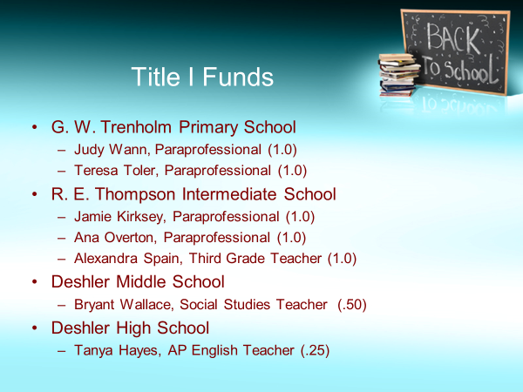
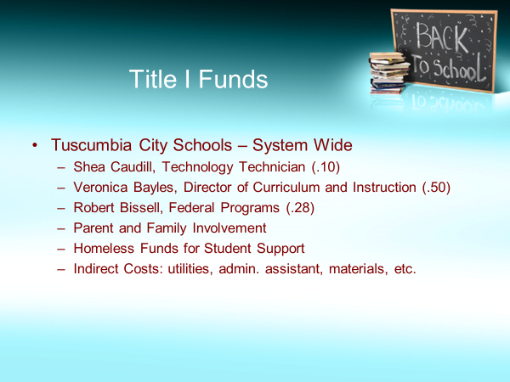
How Title I Funds are Spent

Slide 6
TITLE I PARENT SURVEY RESULTS
RANK FROM 1-5 (1 LOWEST AND 5 HIGHEST)
SCHOOL OVERALL SCORES:
  DHS – 3.88
  DMS – 3.93
  RET – 4.03
  GWT – 3.63
204 RESPONSES FOR ENTIRE DISTRICT

Slide 7
Survey Result Details
80% feel welcome, 74% feel encouraged to be involved
Commonly attended events: Math/Reading Nights and Teacher Conferences
74% know what is being taught, 88% understand grades and report cards
86% know about tutoring and extra help
89% feel teacher/parent communication is good and teachers cooperate
Emails and text messages are the best way to communicate with families
Event Calendars and reminders sent home would be helpful
Only 62% know how to be involved in planning/reviewing system programs

Slide 8
NEEDS FOR 2024-2025
EL PARAPROFESSIONAL TO SERVE ALL SCHOOLS
  Increasing English Language Learners in TCS
ONGOING PROFESSIONAL DEVELOPMENT FOR ALL FACULTY/STAFF
  New curriculum and state mandates
OTHER SUGGESTIONS?
  What would make TCS even better?

Slide 9
QUESTIONS/COMMENTS
rbissell@tuscumbia.k12.al.us
or
(256)389-2900 Ext. 9135
THANK YOU!

