Slide 1
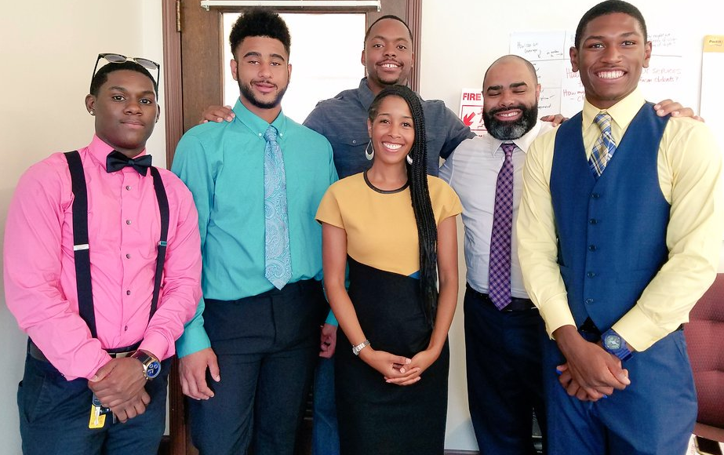
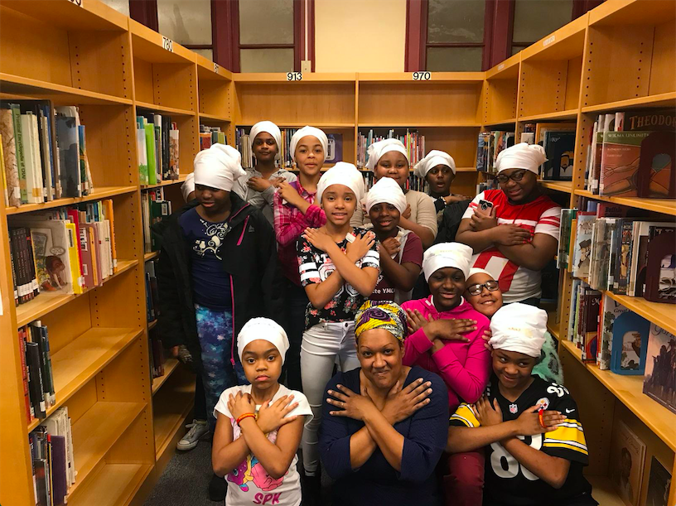

2019 Racial Equity Implementation Plan
Education Committee Meeting
March 5, 2019

Slide 2
Today’s Agenda
Equity Frame
Update on EAP Proposed Action Steps
District Equity Action Steps (Highlights)
We Promise Update
Notes:
For the purpose of this presentation and as a Condition of Courageous Conversations, we’re going to isolate race. While we acknowledge the broader scope of diversity and the variety of factors that contribute to a racialized problem, we are indebted to decades-long racial inequality and the persistent achievement disparity between Black and White students in the PPS. We find that the discriminatory treatment of Black students in our nation’s educational system warrants particular scrutiny.

Slide 3
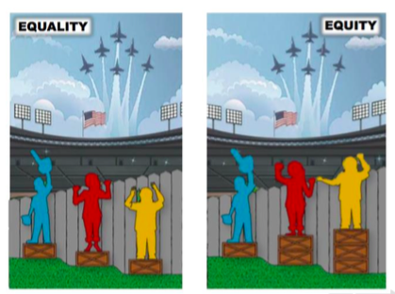
Equity Lens
PROVIDING ACCESS
Providing whatever supports and accommodations are necessary to ensure all students have access to the same opportunities; giving students whatever they need to achieve the outcome.
REMOVING BARRIERS
The elimination of policies, practices, attitudes and cultural messages that reinforce differential outcomes by race or fail to eliminate them—i.e., addressing the root cause of racial disparities.
(Source: Center for Assessment and Policy Development)
Notes:
The Uneven Ground represents historical patterns of racial discrimination, the inherent inequality that makes up our society.
The Fence represents barriers to success.
The Boxes represent access and work to provide equal opportunity to overcome barriers.
Due to structural racism, African Americans historically started at a lower place in society, with less political and economic power and less access to opportunities. We are not here by coincidence. We are here by design.
First, all forms of schooling were denied to captured Africans. It was illegal for Africans in America to learn to read or write.
After the Civil War, Black Codes restricted Africans in America from freedom and forced them to work in a labor economy based on low wages or debt. Opportunities to build wealth were denied to Black families. More white families had opportunities to build wealth through preferential access to the New Deal and the GI Bill.
Post-Reconstruction, funding and resources for the education of Blacks was intentionally limited at the expense of their White counterparts in legally segregated schools in the South and separate school attendance in the North, caused by residential segregation (White flight, redlining).
It took two U.S. Supreme Court decisions (Plessy v. Ferguson and Brown v. Board) to find school segregation unconstitutional. Still, compliance was difficult to enforce and many Black children experienced physical and emotional abuse in newly desegregated schools.
It’s important to historicize inequality to make plain that everybody is not running the same race. Structural racism ensured uneven starting points.
It’s 2019. Truly desegregated schools and equal treatment has not been achieved. Upon being integrated into white schools, black students have been disproportionately represented in special education, alternative placement, and discipline and suspension records, yet under-represented in gifted, honors, and AP courses. These are the barriers that African American children presently face. Starting from behind and then being excluded.
To offset this, we need to increase access and opportunity to African American families. It’s not special treatment; it’s leveling the playing field.

Slide 4
District Action Steps from EAP
The EAP requested the following actions steps be taken by the District:
Develop Implementation Plan for 2015 MOU
Develop (with input from the Equity Office) and approve an updated Equity Policy for immediate implementation
Create Formal Protocol for EAP Recommendations and Responses from Administration
Consult with the Association of Black Psychologists for Culturally Responsive Practices to Healing Violence and Trauma
Implement Culturally Responsive Education

Slide 5
2015-2020 MOU – Implementation Plan
“Within 9 months of the signing of this [MOU], the District will provide in writing to the EAP a detailed implementation plan [that] will detail action steps which the District will take in order to accomplish the terms under the MOU” (p. 2).

Slide 6
Organization of Implementation Plan
Board Support
Instructional Support
Equity in Discipline
Reducing the Achievement Gap
Equity in Special Education and Special Program Access
Monitoring
Administrative Support

Slide 7
Equity & Excellence in Education Policy
On October 24, 2018, under the leadership of then Board President, Dr. Regina B. Holley, the Board adopted the new comprehensive Policy 102.5 Equity and Excellence in Education.
On March 25, 2019, the proposed Administrative Regulations for the Equity and Excellence in Education Policy will be reviewed at the Pre-Policy Committee Meeting.
BOARD SUPPORT

Slide 8
Professional Learning for Culturally Relevant Pedagogy MOU Items: V.f, V.g, V.h, VII.a
Parameters to guide the District’s approach to professional learning on culturally relevant pedagogy:
Align to and support the understanding of PPS definition of Culturally Relevant Pedagogy (CRP) adapted from the work of Gloria Ladson-Billings
Align to and support the understanding of the Courageous Conversations About Race protocol
Align to published research and evidence-based practices for African-American learners.
Provide accompanying tools for practitioner use in understanding CRP at various points throughout the teaching and learning process: planning, teaching, observing, conferencing, feedback, and reflection.
INSTRUCTIONAL
SUPPORT
Notes:
PPS will explore and implement pedagogical strategies and professional learning that support teacher capacity to: • Demonstrate and foster a belief in the ability of all students to achieve at high levels, specifically students of
color and English Language Learners.
• Acknowledge and affirm the racial, cultural and linguistic experiences and perspectives of students. • Embed culturally relevant resources into the curriculum.
• Empower students to take on active roles in the class.

Slide 9
Improving 3G Indicators of Effectiveness
MOU Items: V.f, V.g.c
Objective: PPS teachers and instructional leaders will share a common understanding of the indicators and critical attributes of Culturally Relevant Pedagogy in theory and practice
Action Steps: To accompany the existing 3G component, PPS will provide critical attributes that provide essential guidance for observers in distinguishing between practice and adjacent levels of performance and possible examples for each level of performance that serve to illustrate the meanings of the rubric language, such as what practice might look like in a range of settings.
INSTRUCTIONAL
SUPPORT
Notes:
There is no common language around 3G among teachers, coaches, principals and central office staff. Informal reviews of classroom instruction across the District and principal feedback to teachers indicate an increasing need to ensure teachers and principals have a clear understanding of the 3G component—what it means and how it looks in practice.

Slide 10
Equity Training – Racial Equity Affiliates
MOU Items: V.d, V.f, V.g, VII.b
Objective: Build the capacity of PPS staff to lead ongoing racial dialogue and professional learning aimed at interrupting institutionalized racism.
Action Steps: The following activities will occur by Fall 2019:
All new Practitioner Affiliates will become trained and certified in the Courageous Conversations protocol and the framework for Systemic Racial Equity Transformation;
All new Affiliates will become familiar with the history of the Equity Advisory Panel, the current Memorandum of Understanding (MOU), and the connection between their work and the MOU;
All new Affiliates will learn and utilize the guidelines for equitable decision-making;
All Affiliates will participate in at least (2) whole group convenings, (1) Affinity group convening, and (3) professional learning seminars that isolate race (e.g., CUE Lecture Series).
INSTRUCTIONAL
SUPPORT
Notes:
The Affiliate Program with Pacific Educational Group provides a certification process to develop individuals to
lead Courageous Conversations About Race (CCAR) in the District. Racial Equity Affiliates are a cohort of leaders for racial equity charged with supporting the identification and interruption of institutionalized racism within our district in service of our goals of accelerating student achievement and eliminating racial disparities. Through providing professional learning opportunities, internalizing and facilitating the use of the Courageous Conversations About Race Protocol and Guidelines for Equitable Decision Making, advocating on behalf of students, families, communities, and employees of color, and modeling an equitable mindset in their practice, the Affiliates are positioned to help build the equity-focused knowledge-base and capacities of employees throughout the
district to create more equitable outcomes for the students and families whom we serve.

Slide 11
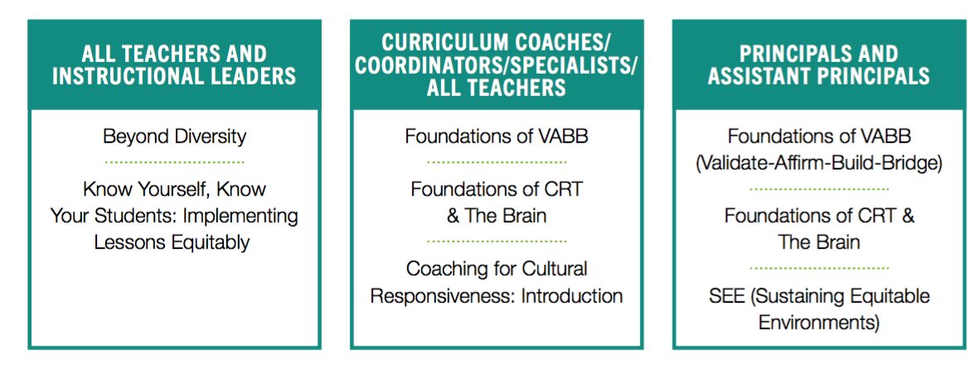
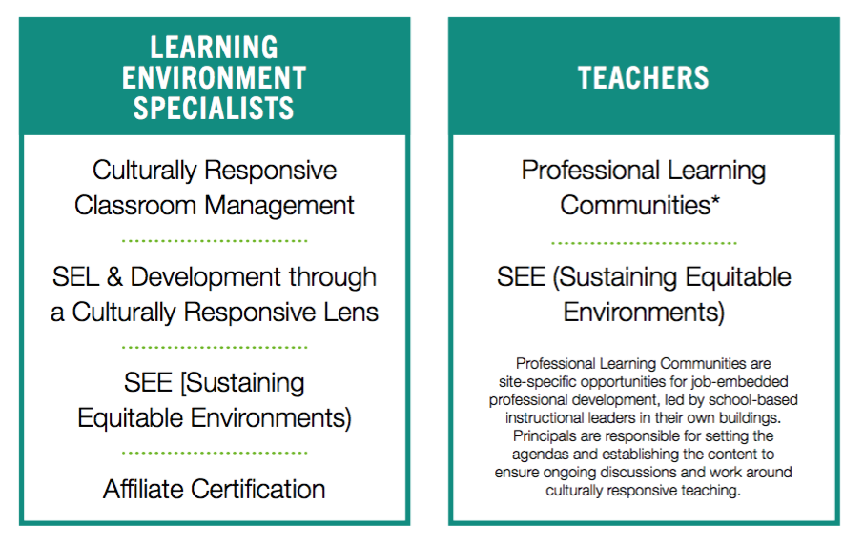
Equity Training – Professional Learning Modules
MOU Items: V.d, V.f, V.g, VII.b
Objective: To advance equity pedagogy through the development of teachers and instructional leaders
INSTRUCTIONAL
SUPPORT
Notes:
Staff across various stakeholder groups will participate in professional learning to advance equity in PPS. The following modules are broken down into levels that follow a sequence of learning. Level one covers foundational knowledge and serves as a prerequisite to more advanced material. Level two focuses on developing instructional leaders. Level three is more involved work, focusing on prolonged coaching to develop culturally responsive teachers on the ground and Equity Affiliates who can deepen and sustain the work.

Slide 12
Culturally Responsive Instructional Materials –
Ethnic Studies Curriculum
MOU Items: V.c, VI.b
Objective: To identify and utilize current and new curricular resources that are Pennsylvania standards-aligned and compatible with the learning styles, lived experiences, scholar identities, and educational and occupational aspirations of historically marginalized racial, ethnic, and cultural groups.
Action Steps:
All PPS students K–12 will experience an Ethnic Studies curriculum through the design and/or adoption of teaching and learning materials in Social Studies. The District will continue to provide exposure to culturally authentic text throughout the ELA curriculum.
INSTRUCTIONAL
SUPPORT
Notes:
Fifty-three percent of the students who attend Pittsburgh Public Schools are African American and another
fourteen percent identify as non-White, but some curricular resources are still outdated and do not consistently reflect the aforementioned representation making it difficult to engage all groups in equitable learning experiences.

Slide 13
Culturally Responsive Instructional Materials –
Ethnic Studies Curriculum
MOU Items: V.f, V.g.c
Objective: To control for racial, ethnic, and cultural biases in curricular materials.
Action Steps:
PPS will implement systems for the careful examination of curricular materials, such as texts, curriculum units, and assessments to ensure all students, regardless of their backgrounds, have a fair chance to access learning materials and demonstrate their knowledge.
Data Review Process for Group Irregularities (based on race, gender, IEP, ELL, ED)
Curriculum Audit
INSTRUCTIONAL
SUPPORT
Notes:
Fifty-three percent of the students who attend Pittsburgh Public Schools are African American and another
fourteen percent identify as non-White, but some curricular resources are still outdated and do not consistently reflect the aforementioned representation making it difficult to engage all groups in equitable learning experiences.

Slide 14
CULTURALLY RESPONSIVE PRACTICES TO
HEALING VIOLENCE AND TRAUMA
MOU Items: V.I.c.
Objective: To develop a model that enhances the safety and security of African American students in targeted schools by improving their psychological and educational well-being.
Action Steps:
Grant proposals submitted for partnership with the Association of Black Psychologist (ABPsi) for a Communiversity model and Level I certification in African/Black Psychology to District employees
EQUITY IN
DISCIPLINE
Notes:
The Communiversity, an interactive socio-emotional educational model rooted in empirically tested and ecologically sound principles of Black Psychology, will be tailored to address the district’s Strategic Plan outcome to eliminate the racial disparity in achievement levels of African American students by providing culturally competent programming and trauma-informed resources to students, teachers, school counselors/social workers/ psychologists, school administrators (i.e., school-based staff) and parents.
The ABPsi proposes to offer a Level I certification in African/Black Psychology that provides participants with knowledge about African culture, philosophy, and worldview; the impact of the enslavement of African people on the values, attitudes, behaviors, relationships, and functioning of African Americans; racism, sexism, classism, colorism and oppression; ecologically grounded Black child and adolescent development; and culturally congruent, trauma-informed intervention strategies for working with African American families and youth.

Slide 15
Protocol for EAP Recommendations and Responses from Administration
Objective: To normalize effective communication between the District and the Equity Advisory Panel.
Action Steps:
EAP meetings will close with recommended action items from EAP
EAP Chair will share with the Executive Director of Equity written recommendations
Executive Director of Equity will share recommendations with the Superintendent.
Within 30 days of the written recommendation, Executive Director will follow-up with the EAP Chair providing a status update, in writing.
ADMINISTRATIVE
SUPPORT
Notes:
The Communiversity, an interactive socio-emotional educational model rooted in empirically tested and ecologically sound principles of Black Psychology, will be tailored to address the district’s Strategic Plan outcome to eliminate the racial disparity in achievement levels of African American students by providing culturally competent programming and trauma-informed resources to students, teachers, school counselors/social workers/ psychologists, school administrators (i.e., school-based staff) and parents.
The ABPsi proposes to offer a Level I certification in African/Black Psychology that provides participants with knowledge about African culture, philosophy, and worldview; the impact of the enslavement of African people on the values, attitudes, behaviors, relationships, and functioning of African Americans; racism, sexism, classism, colorism and oppression; ecologically grounded Black child and adolescent development; and culturally congruent, trauma-informed intervention strategies for working with African American families and youth.

Slide 16
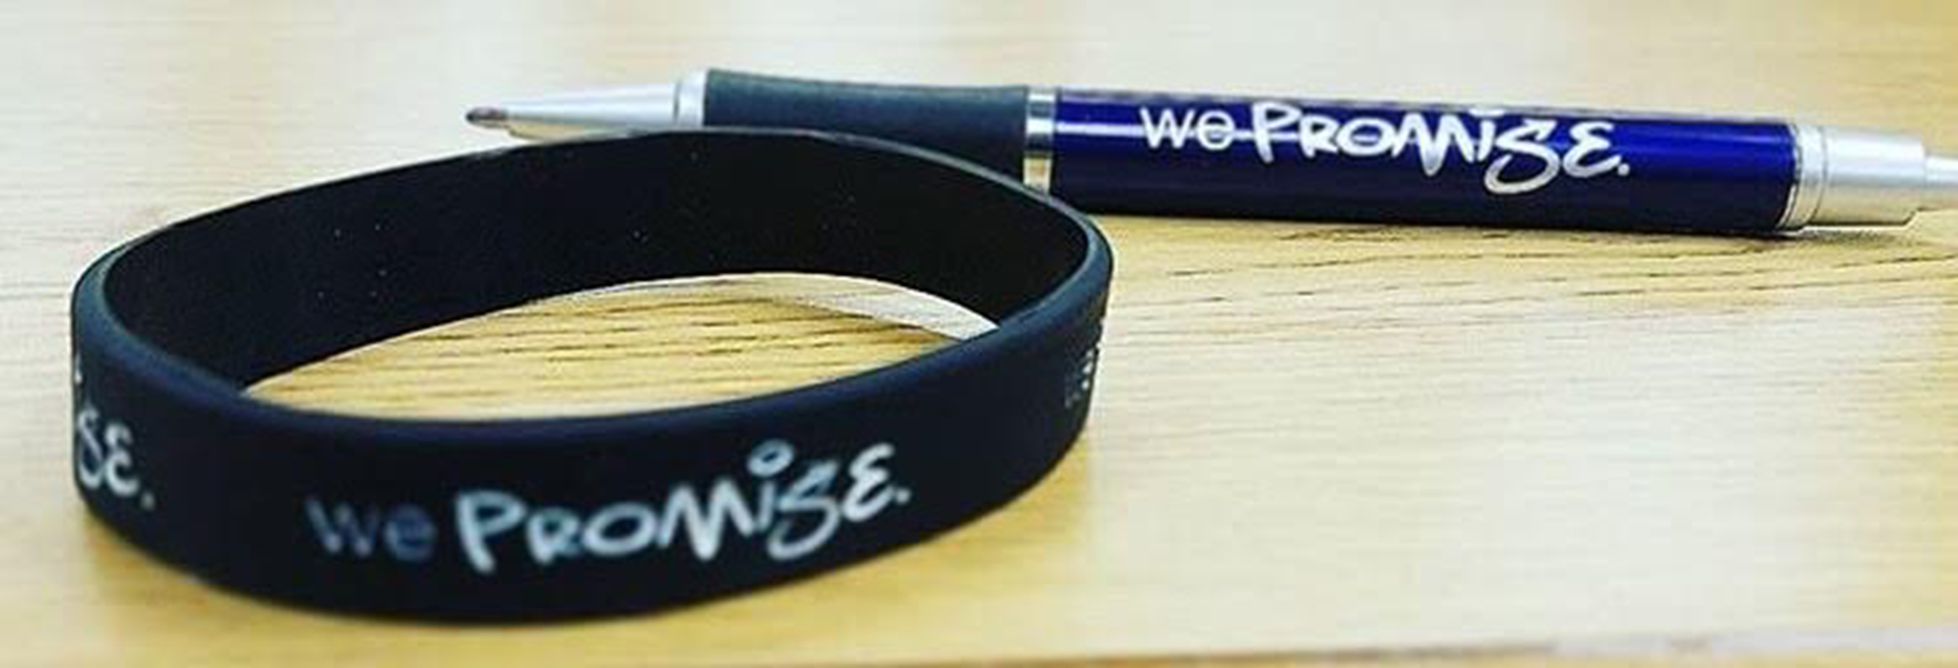


We Promise
Revamp Proposal

Slide 17
We Promise Historical Timeline
Fall 2012
Promise Eligibility Issue Identified
Winter 2013
1st We Promise Summit
Fall 2013
1st Project Manager Hired. Weekly Programming Begins

Slide 18
We Promise Historical Timeline
Fall 2014
2nd Project Manager Hired / Program Expansion
Spring 2015
1st We Promise Luncheon
Spring 2016
Environmental Changes Occur

Slide 19
We Promise Historical Timeline
Fall 2016
Project Managers moved to General Fund
Fall 2017
Site Based Audits begin
Fall 2018
Incremental Program Changes are rolled out

Slide 20
Promise Eligibility Rate Over Time

Slide 21
Current State
Current Operations
  8 Schools currently operating services targeting black males. Approximately 120 scholars being serviced
    Allderdice
    Brashear
    Carrick
    Milliones
    Obama
    Perry
    Sci-Tech
    Westinghouse

Slide 22
First 6 Year Impacts and Takeaways
Over 750 scholars received supports through We Promise
  85% of those scholars impacted saw increases in GPA
    Biggest jump in GPA has been 1.4 points
  Nearly 40% of impacted scholars achieved Pittsburgh Promise Eligibility
Conduct Standards
  We Promise hosted 12 Summits and 4 Luncheons
  Not one critical incident, referral, fight, etc.
  Redirection, when necessary, was culturally responsive and could be replicated in other spaces

Slide 23
First 6 Year Impacts and Takeaways
Original Goal of We Promise - Met
  The original goal of We Promise was to increase the Pittsburgh Promise Eligibility rate of Black Male scholars
  Across the district, this percentage doubled and have maintained at that level
Original Ask of Scholars – Not Met
  Our scholars stated that they lacked exposure and examples within their buildings
  We Promise sought to address this but with environmental changes, this has not been consistent
  Exposure and examples is not the same as mentoring

Slide 24
First 6 Year Impacts and Takeaways
Skeleton Crew Success
  2 Project Managers, a small number of community organizations hired at the school level, and PPS staff serving from the kindness of their hearts
Underlying Issues Not Addressed
  Trauma
    Neighborhood trauma, things going on at home, loss of loved ones to violence, etc.
  Lack of feeling psychologically and emotionally safe
    Our scholars describe not feeling a sense of safety and belonging in many of our spaces
  Critical Life Skill Development missing
    Social and Emotional skills aren’t addressed in our curriculum
    They are necessary equipment for our students to navigate our spaces and the spaces they will enter into once they leave our spaces

