Slide 1

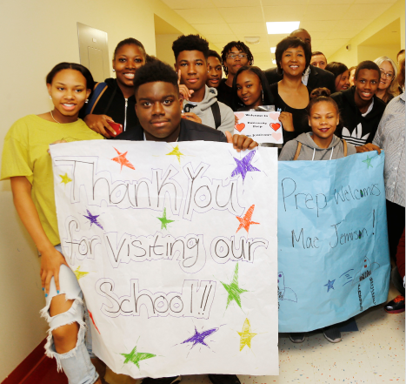
Update Proposed Reconfiguration
Pittsburgh Milliones 6-12
June 12, 2019

Slide 2
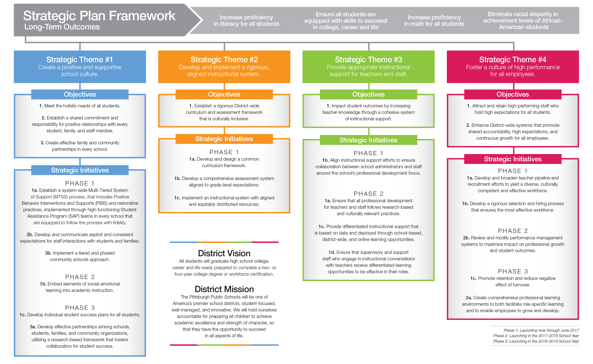
Our Strategic Plan: Expect Great Things

Slide 3

Proposed Recommendation
Transition students from grades sixth through eighth to Pittsburgh Arsenal 6-8
Narrow the focus at Pittsburgh Milliones (U-Prep) to grades 9-12 to build a more aligned campus to meet the academic needs of high school students

Slide 4
Why Reconfiguration?
Low enrollment in Pittsburgh Milliones middle school
Pittsburgh Arsenal 6-8 has the facility capacity to serve more students and;
Experienced staff who are ready and willing to welcome Pittsburgh Milliones students
Support middle school students while simultaneously improving the high school
Willingness to provide necessary supports
Currently within the Pittsburgh Milliones feeder pattern
Notes:
What is significant about Arsenal’s STAR status is that not only has the school ranked in the top 15 percent of the state for student growth. This growth has met , exceeded or far exceeded growth predictions based on the state’s PVAAS system.

Slide 5
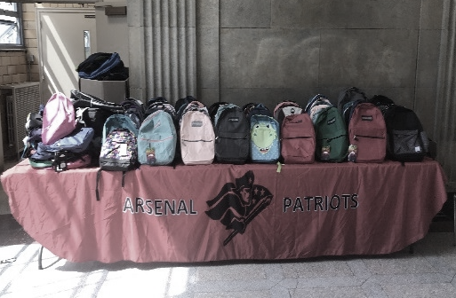

Pittsburgh Arsenal 6-8: Growth is our #1 Focus…
Overall proficiency in Reading is 43.8%.
  Five consecutive years as STAR school
  Outperforms PPS grades 6-8 African-American students in ELA by 10.9%
  Surpasses PPS grades 6-8 All students in mathematics by 8.3%
Overall proficiency in Math is 31.4%
  Differentiation is key – math growth is highest in district
  Tutoring available after school and during intervention
  Professional Development centered around Common Core and backward mapping concepts (what do they have to know to do this)
Supporting students
  School-wide culture of PBIS

Slide 6

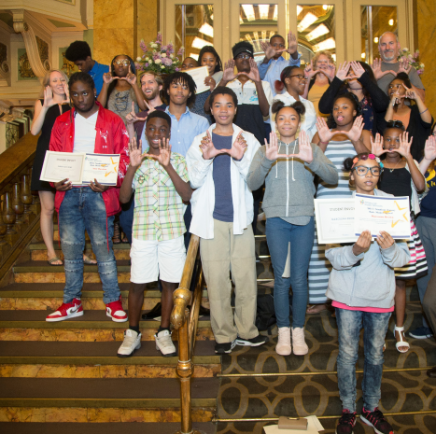
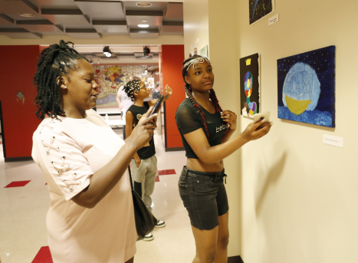
Culture, Systems and Structures
Academic Structure
Teaming
Enrichments

Slide 7
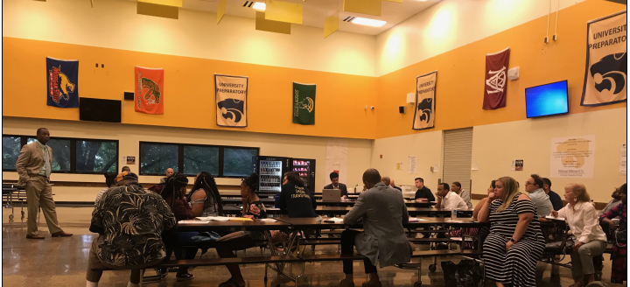
Community Feedback
Transportation Concerns
Parent Capacity
Transition Activities
Truancy
Academic Supports
Strengthening Programming at Pittsburgh Milliones

Slide 8

Pittsburgh Milliones 9-12
Narrow the focus to grades 9-12 to build a more aligned campus to meet the academic needs of high school students
Establish Memorandum of Understanding (MOU) with the Community College of Allegheny County (CCAC)
Structured Advisory Period
Align Heinz Fellows to School Mission

Slide 9
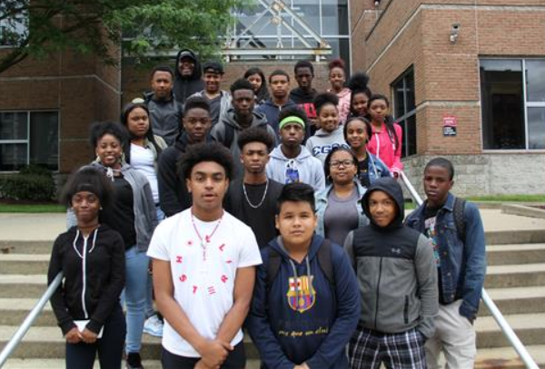

Early College High School
What is the benefit of the college course?
It allows students the opportunity to earn a passing grade (‘C’ or better) throughout the school year as opposed to “hoping” students will pass the AP exam at the end of the year. Teachers, families, students, and staff will have earlier opportunities for intervention to improve outcomes.
Notes:
Wouldn’t the AP test get the students the same credit as taking the ECHS course? Yes. However, data shows that PPS students (and students of low socioeconomic backgrounds) have a low passing rate on the AP exam. The ECHS model gives students the best chance to successfully pass the class and earn college-level credits.

Slide 10
School-wide English Progression
English 1
English 2
English 101
CCAC Course
English 102
CCAC Course
English 1
English 2
English AP Lang
English AP Lit
English 1
English 2
English 3
English 4

Slide 11
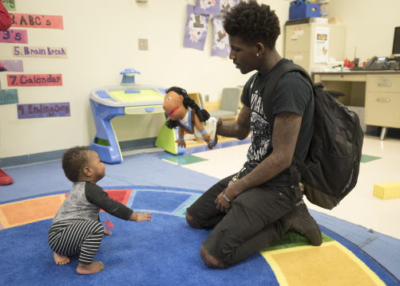
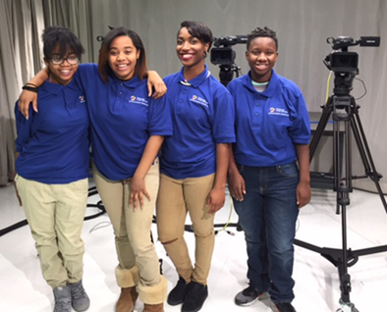
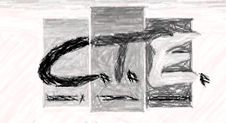

Career Technical Education (CTE) Offerings
New Early Childhood Education Program
Entertainment Technology

Slide 12
Leveraging Community Partners to Support Transition
Pittsburgh Arsenal 6-8 Transition Supports
Provider | Support
Macedonia Family and Community Engagement Center | Truancy Case Management
Jeron X. Grayson Community Center | Transportation Support
TBD | Hill District Cultural History
Malcolm Thomas (Sister I and Jonathan Covel) | Summer Transition Planning Support

Slide 13
Early College at U-Prep
U-Prep Early College Supports
Provider | Support
CCAC | Strengthen Early College
Advancement Via Individual Determination (AVID) | College readiness program designed to help students develop the skills they need to be successful in college.
Neighborhood Learning Alliance | Success Tutors (Early College)

Slide 14

Engagement
Meeting with Staff
Three Parent/Communities Meetings
Pittsburgh Arsenal 6-8 Visits for rising 6th graders from Pittsburgh Weil and Miller
Pittsburgh Arsenal 6-8 school visits for current Milliones 6th and 7th graders
Act 80 Days
Field Day
Camp Guyasuta

