Slide 1
Facilities Utilization Study Update
An introduction to ERS and the Proposed Study Approach
June 11, 2024

Slide 2

Every School. Every Child.
Ready for Tomorrow.
ERS is a national nonprofit that partners with district, school and state leaders to transform how they use resources (people, time, and money) so that every school prepares every child for tomorrow, no matter their race or income.

Slide 3
Our Shared Goal
Advance the community’s collective vision for equity, excellence and efficiency through changes to the design of PPS’ school portfolio

Slide 4









By “portfolio design” we mean…
9 | 10 | 11 | 12
K | 1 | 2 | 3 | 4 | 5
6 | 7 | 8
K | 1 | 2 | 3 | 4 | 5 | 6 | 7 | 8
Number & Size of Schools
Grade Configurations
Program Types
Locations
Transportation
Attendance & Feeder Zones
Enrollment & Admissions Policies
Connection to Community Resources
School Amenities

Slide 5
Small & Underutilized Schools: A Central Focus for Our Work
% Small Schools in Peer Districts
% Small Schools in Peer Districts
For analytic purposes, we define “small” as:
ES/K-8: 350 or smaller
MS/HS: 500 or smaller
62%
62%
52%
49%
48%
48%
46%
53%
50%
43%
42%
36%
40%
33%
36%
15%
11%
0%
Indianapolis (IN)
Portland (OR)
Toledo City (OH)
Akron City (OH)
Rochester (NY)
Buffalo (NY)
Cincinnati (OH)
Pittsburgh
Chambersburg
Bethlehem
Philadelphia
Lancaster
Scranton
Harrisburg
Allentown
Reading
Erie
Pittsburgh
Indianapolis (IN)
Portland (OR)
Toledo City (OH)
Akron City (OH)
Rochester (NY)
Buffalo (NY)
Cincinnati (OH)
Districts included in this chart are districts with a similar need profile and size as PPS (except for Portland, which is included due to their similarity to Pittsburgh in circumventing geographic barriers)
Source: NCES Enrollment Files for SY2022-23

Slide 6
Why are small and under-enrolled schools an issue?
Small schools are not inherently bad for kids and there are many in the field of education
who advocate for more small schools by design…
“Benefits of the small schools are wide ranging and include authentic relationships,
social inclusion, outstanding learning opportunities, excellent college placement rates, community identity/engagement,
as well as increased safety and comfort
for students, faculty and community.”
– Small School Coalition
“Small high schools – which typically enroll fewer than 600 students – promote academic rigor and personal relationships between students and faculty. These close-knit relationships help enrich student-teacher interaction and assist teachers
in assessing student need.”
– New Visions for Public Schools

Slide 7
The Problem: Small schools are often formed by default, not by design.
As a result, they face a unique set of challenges that make it hard to deliver a high-quality and equitable experience for students.
Notes:
What are these unique set of challenges?

Slide 8




For example…
Limited breadth of course offerings, enrichment opportunities and services
In the coming weeks, we will be conducting analysis to help understand challenges that are specific to the PPS community
Increased reliance on part-time staff that can be hard to attract, retain and assign
Class sizes that are very small OR very large depending on grade level enrollment
Increased number of courses that secondary teachers need to prepare for
Fewer options for teacher teaming and expert support

Slide 9
Key Questions
What are student and staff experiences every school in PPS should be able to provide?
What structural barriers make it hard to provide those student and staff experiences now?
Where are the disparities in access to those experiences for students from different backgrounds and neighborhoods?
In what ways could PPS change its school portfolio to improve student and staff experiences?

Slide 10


Our Work this Summer
Community & Stakeholder Engagement
Analysis & Scenario Modeling

Slide 11
Community & Stakeholder Engagement

Slide 12
What we’re trying to do:
Build authentic staff and community engagement focused on building the collective vision for reimagining district schools
Provide input and feedback regarding school designs and school experiences that would enable students to excel and thrive in PPS
Engage in collaborative discussions needed to align and integrate the vision and portfolio design

Slide 13
Stakeholder Engagement
Stakeholder Type | Frequency | Communication Purpose | Engagement Plans | Communication Tool
School Board | Monthly Board Engagement (June 11) | Share updates regarding analysis and community engagement Provide information to guide policy discussions and decisions | Partner with Board on community engagement Communicate early and often Share possible policy impacts | Meetings Work Sessions Presentations Memos
Union | Monthly status meetings (Completed; May 24) | Share updates regarding the Facilities Utilization project Provide information to share with members | Engage Union Leadership early Share information to inform members | Status Updates Focus Groups Gather Feedback
Senior Team | Twice a month work sessions (Completed May 6, May 20, June 3) | Provide detailed analysis regarding current school portfolio Provide status updates regarding the project and stakeholder engagement | Engage and support senior leadership Constant communication Align on the reason for change Review analysis and support discussion and dissemination of information | Detailed Work Sessions Capacity Building Analysis to support Decision Making

Slide 14
Stakeholder Engagement
Stakeholder Type | Frequency | Communication Purpose | Strategy and Engagement Approaches | Change/ Communication Tools
Principals/Asst. Principals School Leaders | Monthly Work sessions (Completed May 28, May 30) | Gather feedback from school leaders regarding the current and future use of resources in schools Provide process information so that they are aware of what is happening and when it is happening | Gather feedback and input Early engagement Understanding the process | Focus group participation Survey data Training/Capacity Building Communication tools such as emails/etc.
School Staff | Two sessions planned related to project (June 4 and August) Note: Will need a session before opening up to the public and final vote | Inform regarding the process so that they are aware of what is happening and when Share the need for change and why it is important to do this work now Gather feedback on opportunities for improved learning facilities | Gather input to inform larger community engagement plan Build awareness regarding the project and timeline for the work | Town halls Emails Website Focus Groups Survey
Students | Training May 30 Targeted focus groups Week of June 3 Week of June 10 | Gather feedback and ideas for future improvements (facilities, student experience, resources) | Gather input to shape future vision for facilities and resources | Focus groups Student survey Supt. Student Leaders
Operations Staff | Targeted listening sessions | Targeted sessions to inform operations staff regarding the Facilities Utilization initiative | Keep informed throughout project Sessions must be incorporated into existing training sessions | Targeted communication Info sessions

Slide 15
Stakeholder Engagement
Stakeholder Type | Frequency | Communication Purpose | Strategy and Engagement Approaches | Communication Tool
Advisory Committee | Bi-Monthly As needed | Building a cross functional team that can inform and guide the process throughout the timeline | Review detailed analysis and prioritize information Gather feedback Constant communication | Detailed Work Sessions Capacity Building Analysis to support Decision Making
Community At Large | A round of meetings in June/Early July A round of meetings in August/Sept | Inform regarding the process so that they are aware of what is happening and when Share the need for change and why it is important to do this work now Gather feedback on opportunities for improved learning facilities | Awareness Gather feedback on the desires of the community Address concerns Understanding the process | Town halls Emails Website Focus Groups Survey
Core Team Meetings | Weekly | Provide detailed analysis regarding current school portfolio Provide status updates regarding the project and stakeholder engagement | Review detailed analysis and prioritize information Plan Constant communication Review analysis and information | Detailed Work Sessions Capacity Building Analysis to support Decision Making

Slide 16
Stakeholder Engagement- Board Town Halls
Board Member | District | Date | Time | Location
Dr. Tracey Reed | 5 | Thursday, June 20, 2024 | 6:00 PM | Pittsburgh Minadeo
Devon Taliaferro | 2 | Saturday, June 22, 2024 | 10:30 AM | Pittsburgh Sunnyside
Gene Walker | 9 | Tuesday, June 25, 2024 | 6:00 PM | Pittsburgh Langley (Library)
Yael Silk | 4 | Thursday, June 27, 2024 | 6:00 PM | Pittsburgh Colfax (Gym)
Dwayne Barker | 8 | Friday, June 28, 2024 | 5:30 PM | Pittsburgh King (Library)
Jamie Piotrowski | 7 | Tuesday, July 9, 2024 | 6:00 PM | Pittsburgh Concord (Gym)
Emma Yourd | 6 | Wednesday July 10, 2024 | 6:00 PM | Pittsburgh West Liberty
Sylvia Wilson | 1 | Thursday, July 11, 2024 | 6:00 PM | Pittsburgh Obama
Sala Udin | 3 | Tuesday, July 16, 2024 | 5:30 PM | TBD
Gene Walker | 9 | Tuesday, July 23, 2024 | 6:00 PM | Morrow Intermediate (Library)

Slide 17
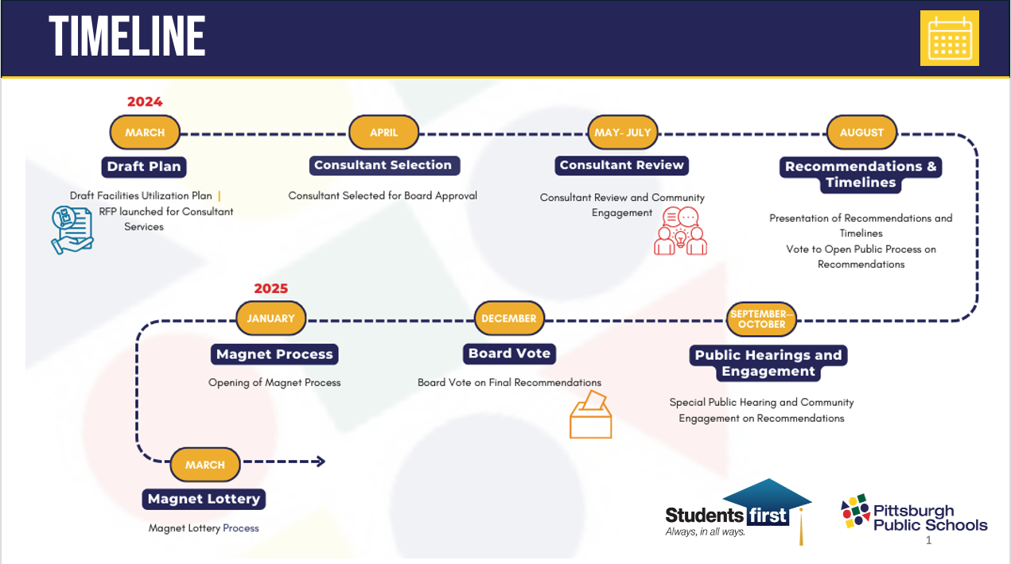

Slide 18
Analysis & Scenario Modeling

Slide 19
What we’re trying to do
Gather Data
Combine data from multiple sources to create a comprehensive source of information for our analysis
Conduct Analysis
Use data to find identify structural barriers that make it hard for PPS to provide the experiences students and staff deserve
Model Scenarios & Options
Test different scenarios for changing PPS’ portfolio of schools and evaluate their impact on student and staff experiences

Slide 20
Example of Analytic Questions
How well are schools able to…
Fully staff their schools with teams of excellent educators?
Provide a breadth of course offerings, enrichment opportunities and support services?
Create the individualized time and attention students need to excel?
Provide structures for teacher professional learning, including common planning time and expert support?
Ensure manageable teacher workloads by reducing the number of courses they need to prepare for?

Slide 21
Questions?

