Slide 1

Budget 101
Business/Finance Committee Meeting
October 6, 2014

Slide 2
The District Budget is Just Like a Household Budget
Household Budget
District Budget
Income
Bills
Savings
Revenues
  State and Local
Expenditures
  Fixed and Variable
Fund Balance
Notes:
The District’s budget is very similar to a household budget. The main difference is the size of the budget. As household budget has income while the District budget has revenues. While a household income is largely composed of wages that are earned by the members of a household, the District’s “income” or revenue is composed of taxes and subsidies that are received from various sources. Both a household and the District have bills. We just refer to our bills as expenditures. (variable and fixed). When a household has more income than expenses, the remainder can be placed in a savings account for emergency. The District’s savings account is known as its fund balance.

Slide 3
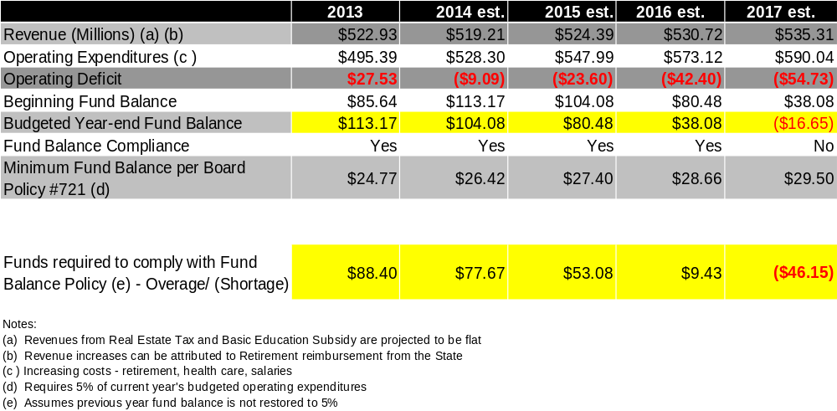
Our Financial Outlook if No Action is Taken
Notes:
Our revenues, expenditures, and fund balance are used to create this, our rolling forecast. This forecast is just a snapshot. It represents our financial outlook if no actions are taking. Actions such as reducing expenditures or increasing revenues. That means no cost increases or major reductions.

Slide 4
Factors That Make Up The Forecast
Revenue
Expenditures
Assumptions
Notes:
Now I will provide an overview of the factors that make up the forecast.

Slide 5
Breakdown of Revenue Sources
Total Projected Revenue: $519.2 Million
Notes:
52.8% of Revenue is from Local Sources
Includes Real Estate, Earned Income Tax, Real Estate Transfer Tax, etc.
46.2% of Revenue is from State Sources
Includes Basic Instructional Subsidy, Special Education, Retirement Reimbursement, Transportation, etc. (some of this items are reimbursement of Expenditures)
1.0% of Revenue is from Other Sources
Includes Subsidies, Sale of Fixed Assets, Tuition, etc.

Slide 6
Major Sources of Revenue
Total Projected Revenue: $519.2 Million
Notes:
Real Estate Revenue
$157.1 Million Projected for 2014 (30.2% of Total Revenue)
Earned Income Tax
$106.0 Million Projected for 2014 (20.4% of Total Revenue)
Basic Instructional Subsidy
$153.8 Million Projected for 2014 (29.6% of Total Revenue)
Special Education
$27.8 Million Projected for 2014 (5.3% of Total Revenue)
Retirement Payments
$20.1 Million Projected for 2014 (3.9% of Total Revenue)
Transportation
$13.7 Million Projected for 2014 (2.6% of Total Revenue)

Slide 7
Major Sources of Expenditures
Total Projected Expenditures: $528.3 Million
Notes:
Salaries
$170.2 Million Projected for 2014 (32.1% of Total Expenditures)
Special Education
$106.0 Million Projected for 2014 (20.4% of Total Expenditures)
Charter Schools
$53.0 Million Projected for 2014 (10.0% of Total Expenditures)
Health Insurance
$38.2 Million Projected for 2014 (7.2% of Total Expenditures)
Retirement Contributions (close to outpacing health care)
$36.1 Million Projected for 2014 (6.8% of Total Expenditures)
Transportation
$35.8 Million Projected for 2014 (6.8% of Total Expenditures)

Slide 8
Cost Drivers
Student Enrollment Decline
Charter School Enrollment
Rising costs of Salaries, Retirement, and Healthcare
Special Education Increases in Cost and Student Population
Transportation

Slide 9
Budget Assumptions
Revenue
Expenditures
Flat Real Estate Revenue
Increase in Earned Income Revenue (1.7% Tied to Index)
Flat Basic Education Funding
Stable enrollment
Stable workforce
Retirement increases tied to rising PSERS rates
Rising Healthcare costs around 5% annually
Rising Utility and Transportation costs
Notes:
Some of the main assumptions that are the basis for our forecast. Real Estate revenue is projected to be flat. There is no millage increase included in the forecast. The Board does have the ability to raise the millage up to the index (2.1%). Even though the District have increased the millage up to the index over the past years, real estate revenues are approximately $10 million below pre-reassessment levels. The forecast also assumes flat funding. There is current a hold harmless provision in the school code that ensures that school district do not receive a reduction in basic education funding. Recently the State established a Basic Education Funding Commission to develop a new formula for funding school districts. It is not certain how a new formula will affect our funding in the future. New sources of revenue are also not included. LERTA requests. Impact fee(?)

Slide 10
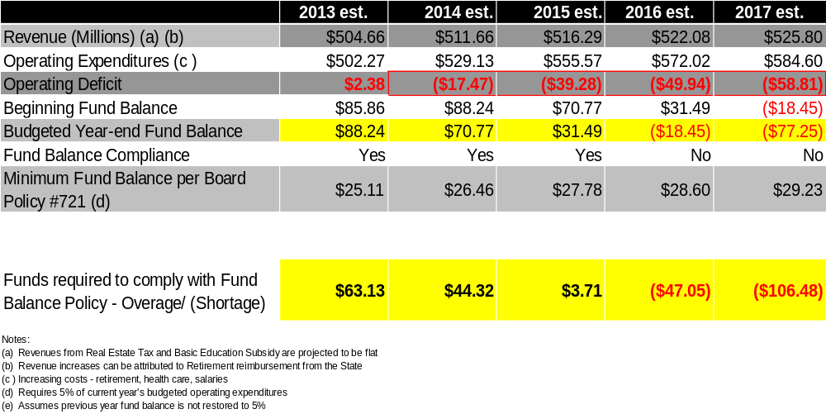
Forecast at Budget Adoption
Notes:
So we have our revenues, expenditures, fund balance and assumptions incorporated into the forecast. So we are done right? Not quite. The forecast is just a snapshot. The forecast is constantly updated. This means that depending on our tax collections, state budget, and expenditures the forecast will change throughout the course of the year.

Slide 11
Current 3-Year Forecast
Notes:
Our current forecast shows substantial improvement over the current year and that’s a good thing. Our goals is the improve our financial health and find ways to outperform the forecast so that we have a better outlook.

Slide 12
Major Changes Since
Budget Adoption
Earned Income Tax Revenue
  Adopted: $101.7 M Current: $106.0 M
  2015-17 were also increased
Salaries
  Adopted: $167.6 M Current: $170.2 M
Charter School Payments
  Adopted: $54.9 M Current: $53.0 M
Debt Service (Principal and Interest)
  Adopted: $53.0 M Current: $52.0 M
Notes:
Some of the major changes since about. The Board can expect at least two more financial updates prior to the close of the year.

Slide 13
2015 General Fund Budget Adoption Timeline
November 6, 2014 Committee Meeting/ Release of Preliminary Budget
November 24, 2014 Public Hearing
December 1, 2014 Budget Public Hearing
December 2, 2014 Committee Meeting
December 10, 2014 Agenda Review
December 15, 2014 Public Hearing
December 17, 2014 Regular Legislative Meeting – 2015 Budget Adoption
Notes:
Calendar of events

