Slide 1
Imagine PPS Strategic Plan: Student-Centered Design
February 1, 2021
Business Committee Meeting
Notes:
Zoey Mason, Kindergarten at Dillworth

Slide 2







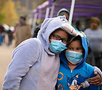


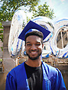
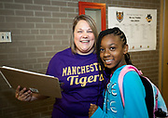


Slide 3











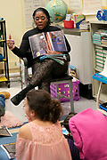

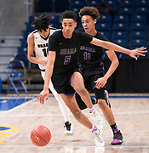

Slide 4
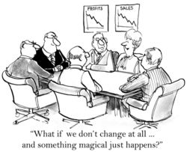

Slide 5
Current District Financial Forecast
 | Adopted | Projected | Adopted | Projected | Projected | Projected
 | Year Ended 2020 | Year Ended 2020 | Year Ended 2021 | Year Ended 2022 | Year Ended 2023 | Year Ended 2024
Total Revenues | $639,805,733 | $624,161,000 | $631,914,258 | $639,224,007 | $647,292,112 | $655,323,863
Total Expenditures | $664,814,155 | $639,761,677 | $671,348,058 | $678,204,994 | $683,951,236 | $691,892,941
Beginning Balance | $81,631,443 | $88,834,882 | $73,234,205 | $33,800,405 | ($5,180,582) | ($41,839,707)
Operating Surplus/(Deficit) | ($25,008,422) | ($15,600,677) | ($39,433,800) | ($38,980,987) | ($36,659,124) | ($36,569,078)
Ending Fund Balance | $56,623,021 | $73,234,205 | $33,800,405 | ($5,180,582) | ($41,839,707) | ($78,408,785)
Less Projected Reservations | ($2,500,000) | ($2,500,000) | ($2,500,000) | ($2,500,000) | ($2,500,000) | ($2,500,000)
Less Committed Fund Balance | $0 | $0 | $0 | $0 | $0 | $0
Less Assigned Fund Balance | ($20,879,089) | ($39,433,800) | (38,980,987) | (36,659,124) | (36,569,078) | ($34,614,013)
Unassigned Fund Balance | $33,243,933 | $31,300,405 | ($7,680,582) | ($44,339,707) | ($80,908,785) | ($115,522,797)
% Budgeted Expenditures | 5.00% | 4.89% | -1.14% | -6.54% | -11.83% | -16.70%
Minimum Fund Balance per Board Policy #721 | $33,240,708 | $31,988,084 | $33,567,403 | $33,910,250 | $34,197,562 | $34,594,647
Compliance with Fund Balance Policy | Yes | No | No | No | No | No
Funds needed to comply with Fund Balance Policy |  | $687,679 | $41,247,985 | $78,249,956 | $115,106,346 | $150,117,444
Notes:
Share promising data trends.

Slide 6
Our Financial Situation
Current projected deficit of $39.4 million for 2021
The adopted 2021 does not adhere to the Board fund balance policy
Based on our current forecast, the District will be unable to pass a balanced budget for 2022
Without reductions significant reductions or new revenue the District will run of the money by the end of 2022
We will be unable to do the following:
  Pay our employees
  Pay for goods and services
  Pay our creditors

Slide 7
Movement to Eliminate Hold Harmless
As recently as legislative session, a bill was introduced to eliminate the hold harmless provision for basic education funding
SB 362, sponsored by Senator Boscola, calls for expediting the implementation of the fair funding formula by increasing the share of total basic education funding distributed through the formula over a four year period. The bills calls for increasing the share to 25% in the first year, 50% in the second year, 75% in the third year, and 100% in the fourth year. This bill dramatically decreases the basic education funding that Pittsburgh will receive.
Similar bills will likely be introduced in upcoming State legislative sessions

Slide 8
Impact of Eliminating Hold Harmless
Pittsburgh Public Schools
SB 362 Basic Education Funding Analysis
Year | Basic Ed Funding | Increase/(Decrease)
2020-21 | 163,259,830.33 | -
SB 362 (Year 1) | 150,359,396.59 | (12,900,433.74)
SB 362 (Year 2) | 128,888,823.30 | (21,470,573.29)
SB 362 (Year 3) | 106,772,272.67 | (22,116,550.62)
SB 362 (Year 4) | 84,655,722.05 | (22,116,550.62)
Notes:
Share promising data trends.

Slide 9
Footprint and Reduction in Force
As a result of years of enrollment decline, we are attempting to consolidate the District’s footprint to better align to the District current enrollment
This consolidation will lead to a reduction and reconfiguration of District facilities
As a result, our workforce will need to be adjusted to meet the needs of our student population in our remaining facilities
Any reduction in school based staff will be tied to enrollment decline and/or the elimination of programs

Slide 10
PPS MUST EVOLVE!
“Insanity is doing the same thing over and over again and expecting different results.”
                Albert Einstein

Slide 11
“Our System Is Perfectly Designed To Get The Results That We Are Getting”

Slide 12
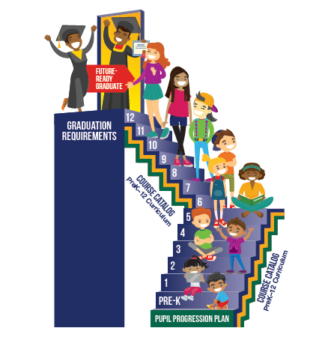
A Student Centered Approach: PPS Graduate Profile
We know students’ access to high-quality education shouldn’t depend on their zip code, or the color of their skin. To address inequities, we are redesigning our course catalog and changing graduation requirements.
Our new Graduate Profile, developed in collaboration with community members and regional employers, defines what every student should experience and develop on their pathway to success, regardless of the school they attend of the program they pursue.
By aligning the entire District to our Graduate Profile, we can ensure that course offerings create a pathway to success for every student in every school.

Slide 13

Imagine PPS Design Team Components
STUDENT PATHWAYS
POSITIVE STUDENT EXPERIENCE
UNDERPERFORMING SCHOOL STRATEGY
NEW SCHOOL/
PROGRAM DESIGN
Feeder Patterns
SYSTEM / STRUCTURAL IMPROVEMENTS
Technology Enhancements terns
Magnet
School
Funding Model r Patterns
Magnet
Capital Plan
Feeder Patterns
Magnet
Magnet Pathways terns
Magnet
Feeder Patterns terns
Magnet

Slide 14
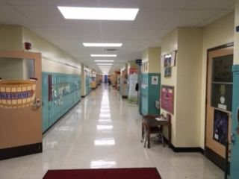
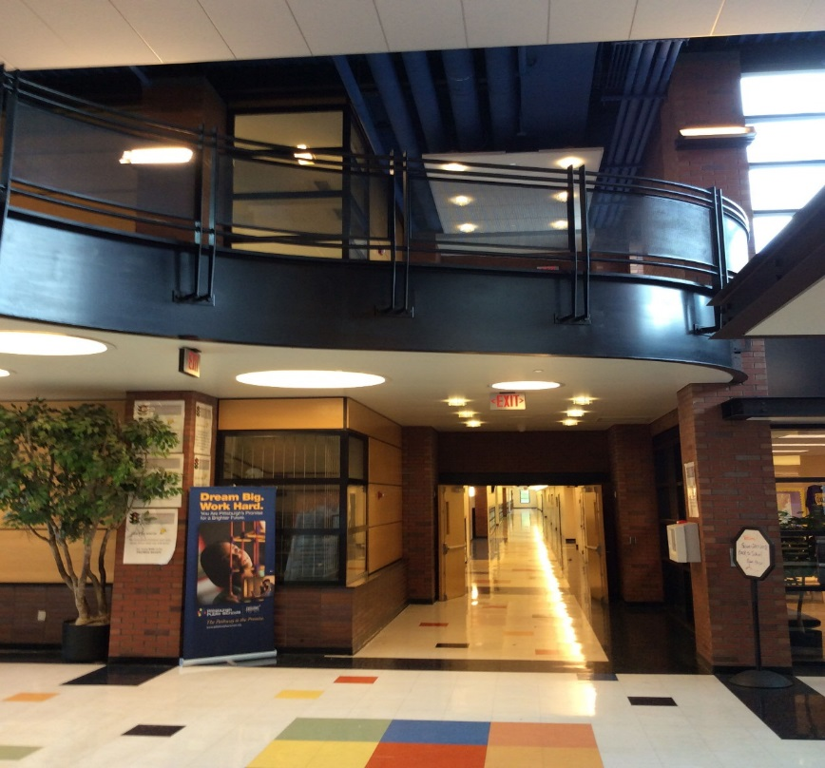
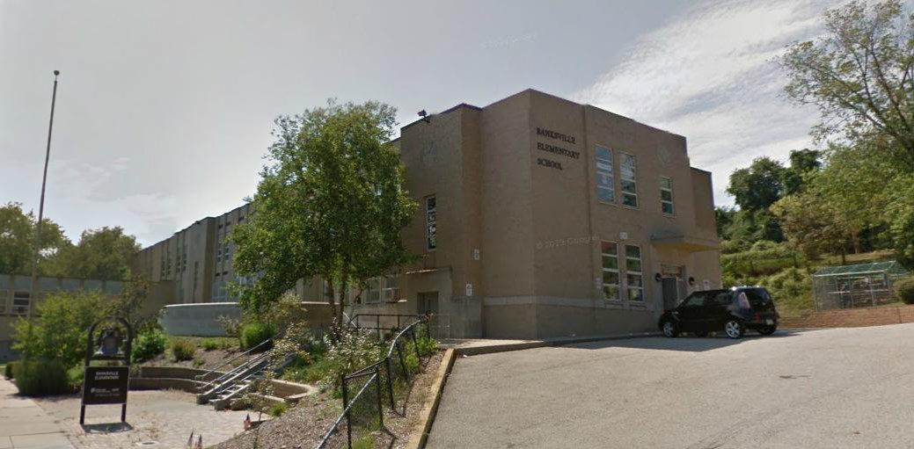
Pittsburgh Public Schools Facilities Department

Slide 15
Data Driven Analysis – FCI - EAI and Utilization
Historical Project Cost Data
  20 Years of Historical Project Cost Data
FCI - Facility Condition Index
  Walk-throughs
  Condition Surveys – Facilities and Maintenance
EAI – Educational Adequacy Index
  Internal Focus Groups
  Principal Surveys
Capacity and Utilization
  Updated Capacity and Utilization Study

Slide 16
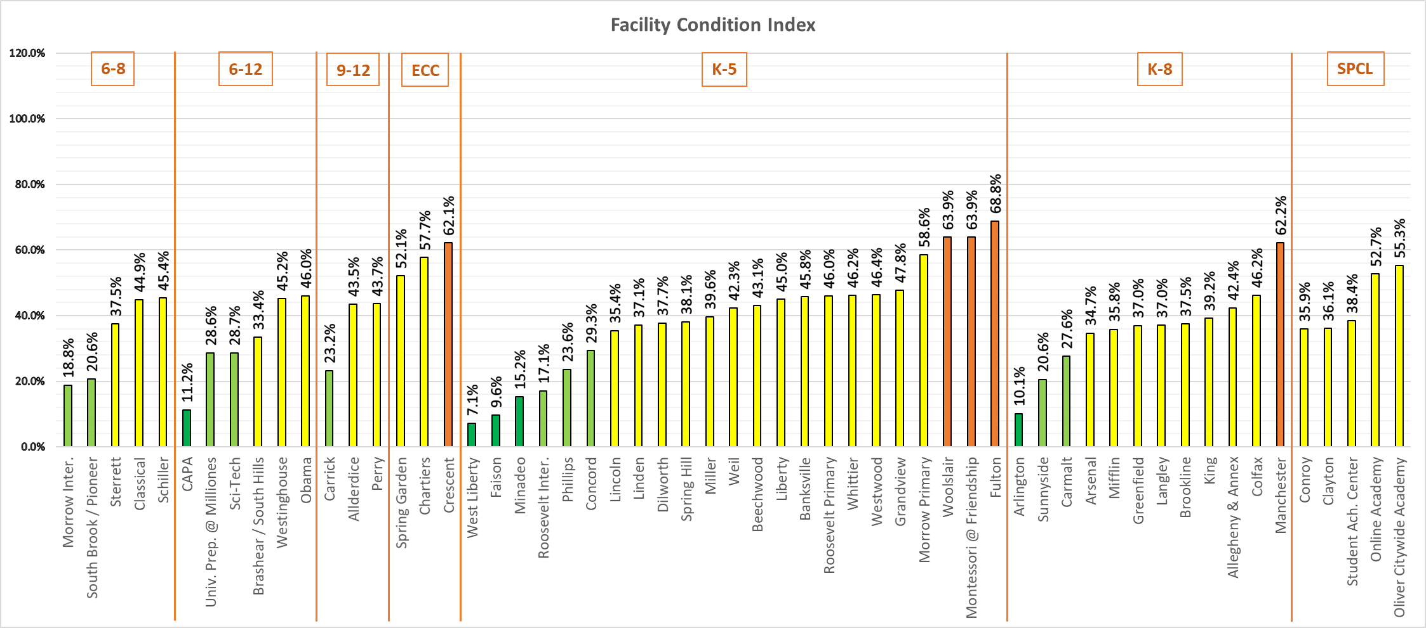
FCI District Overview

Slide 17
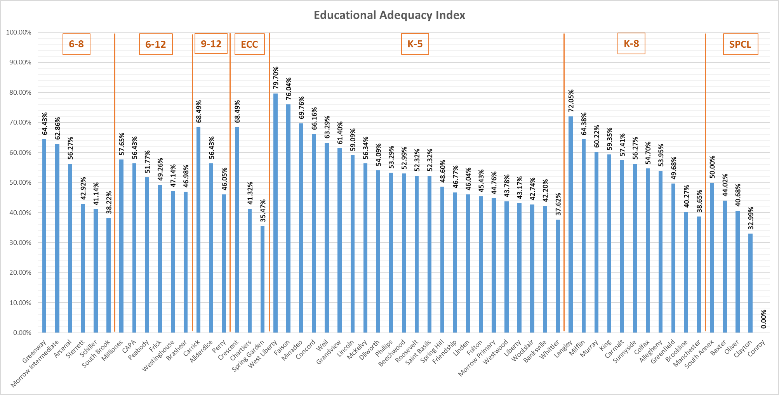
EAI District Overview

Slide 18

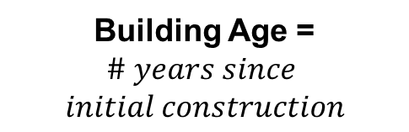
Building Age Summary
Rule | # Schools | Notes
20 years old or less | 3 | CAPA (18), Faison (17), South Brook (20)
Between 21 and 50 years old | 3 | Brashear/South Hills (45), Classical (Greenway, 47), King (48)
Between 51 and 100 years old | 34
More than 100 years old | 18 | Allegheny, Beechwood, Brookline, Colfax, Conroy, Dilworth, Fulton, Liberty, Linden, Miller, Montessori, Morrow Primary, Obama, Perry, Spring Hill, Sterrett, SAC, Woolslair
Building Age =
$$\# years since$$
$$initial construction$$
Average Building Age
$87$ years old

Slide 19
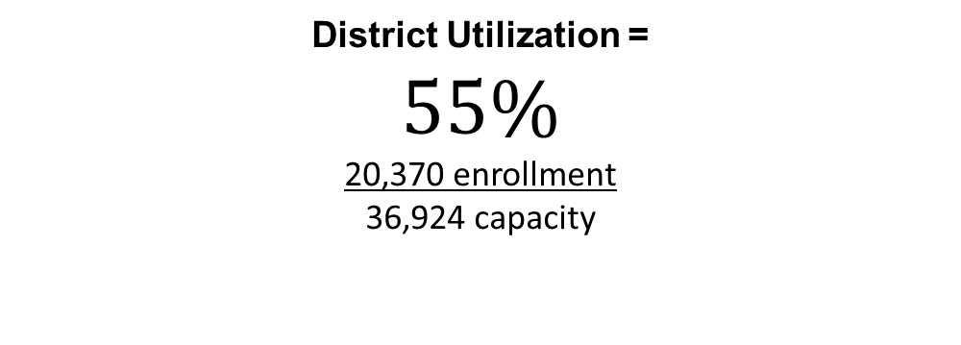
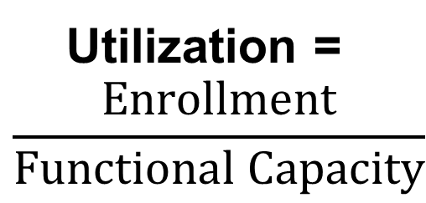
Capacity Summary
Utilization (UF) | Rule | # Schools | Notes
Over-utilized | UF > 100% | 1 | Allderdice*
Well Utilized | 80% < UF < 100% | 8 | Brookline, Colfax, Dilworth, Liberty, Online, Phillips, Sci-Tech, South Brook
Slightly Underutilized | 50% < UF < 80% | 40
Underutilized | UF < 50% | 12 | Allegheny, Arsenal, Clayton, King, Langley, Manchester, Miller, U-Prep, Oliver Citywide, Perry, SAC, Weil
Utilization =
$$\frac{Enrollment}{Functional Capacity}$$
District Utilization =
$$55\%$$
20,370 enrollment
36,924 capacity

Slide 20
Criteria for Decisions
Promote socio-economic, racial, educational program and facilities equity
Maximize Capital Spending by investing in buildings primed to support 21st century learning environments.
Improve student pathways
Eliminate substandard demountable structures
Optimize building utilization
Provide ADA accessible buildings
Increase efficiency through energy-saving projects
Impact of school size on educational programming

Slide 21
Additional Considerations
ECC classrooms will be reconfigured to support the areas they serve
Magnet Status and Programming will be considered if a school closes
Social Emotional Supports for Students, Families, and Staff will be planned
Continuum of special education services will be expanded in buildings to support the needs of students with disabilities.
Supports for a variety of diverse backgrounds, experiences, and cultures will be expanded to meet the needs of our English Learners.
Academic enhancements and programs at select schools will continue to provide opportunities for students to focus on specific areas of interests

Slide 22
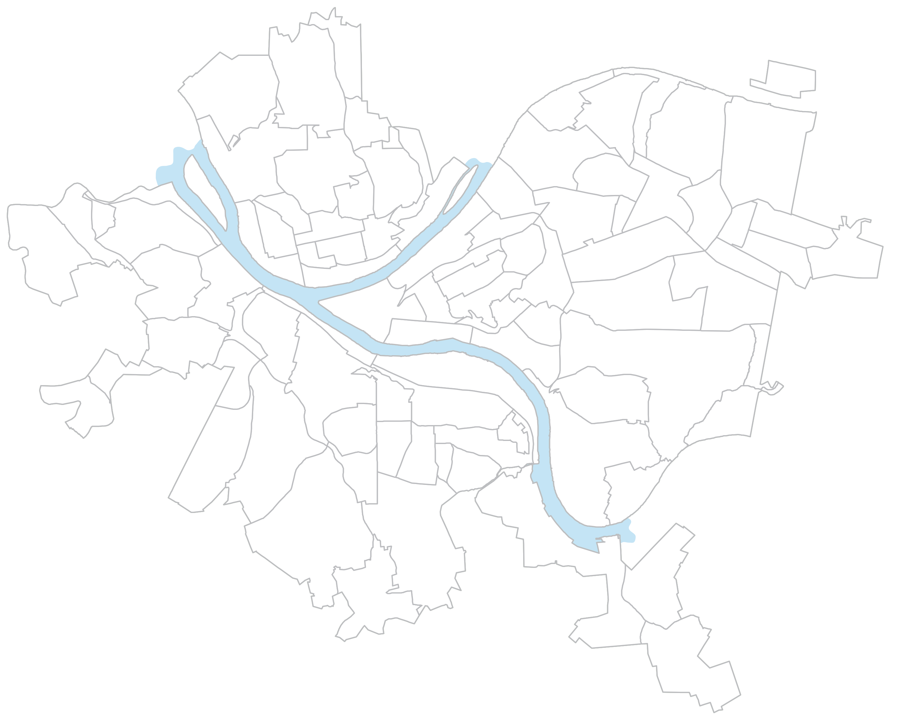










Current District Footprint
Perry HS
Morrow PreK-8
Sunnyside PreK-8
Fulton PreK-5
Spring Hill
K-5
Arsenal PreK-5
& 6-8
Dilworth PreK-5
Oliver Citywide
Academy
Clayton
Academy
Spring
Garden ECE
Woolslair PreK-5
Obama 6-12
Chartiers ECE
Montessori
PreK-5
Lincoln
PreK-5
Westinghouse
6-12
Langley K-8
Manchester
PreK-8
Allegheny
K-5 & 6-8
Schiller 6-8
Student Achievement
Center
Classical 6-8
Conroy
King
PreK-8
Liberty K-5
Faison K-5
Gifted Center
Miller PreK-5
Milliones 6-12
Sterrett 6-8
Crescent
ECE
CAPA 6-12
Weil PreK-5
SciTech 6-12
Linden K-5
Westwood PreK-5
Whittier K-5
Online
Academy
Colfax K-8
Phillips K-5
Greenfield
PreK-8
Allderdice HS
Grandview K-5
Brashear HS
Minadeo K-5
South Hills 6-8
Arlington PreK-2
& 3-8
Banksville K-5
Beechwood
PreK-5
Pioneer
Roosevelt PreK-1
Roosevelt 2-5
Brookline
PreK-8
South Brook 6-8
PreK-5
PreK-8
K-5
K-8
6-8
6-12
High Schools
Early Childhood
Special Schools
Carmalt
PreK-8
Carrick HS
Concord PreK-5
Mifflin PreK-8

Slide 23
Schools vs. School Buildings
Move From:
(60 schools in 57 buildings)
(55 schools in 52 buildings)
TO

Slide 24
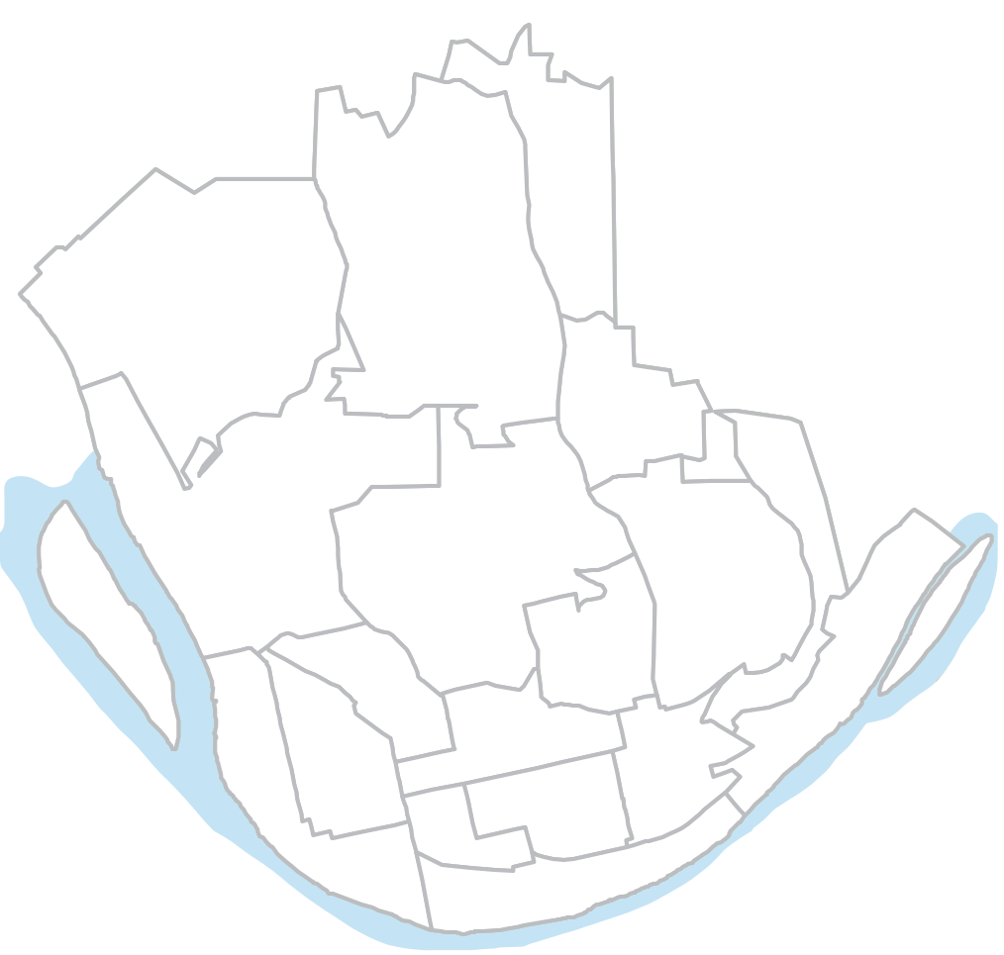
Northern Region:
Current View
Perry HS
Morrow PreK-8
Spring Hill
K-5
Oliver Citywide
Academy
Clayton
Academy
Spring
Garden ECE
Manchester
PreK-8
Schiller 6-8
PreK-5
PreK-8
K-5
K-8
6-8
6-12
High Schools
Early Childhood
Special Schools
Allegheny
K-5 & 6-8
Conroy
King
PreK-8

Slide 25
NORTH
School and Building Closings
Close 2 Schools | Close 2 Buildings | Add 2 New Schools
Allegheny 6-8* | Morrow Primary | Career Middle School @ Oliver
Manchester PreK - 8 | Manchester | Birth to 2nd Grade @ Northview
*Allegheny PreK-5 remains open
*Allegheny PreK-5 remains open

Slide 26
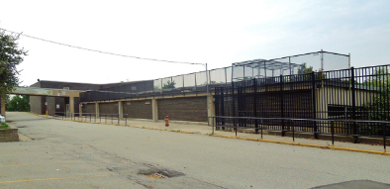
Birth - 2nd Grade
Increase the use of student-centered, play-based learning/ developmentally appropriate practice from birth through age 8

Slide 27
Focus Area: Birth-Age 8 Programming
Team Members
Name | Title | Department
Carol Barone-Martin | Executive Director Early Childhood Education | Early Childhood Education, PPS
Michelle Figlar | Vice President, Learning | Heinz Endowments
Jane Werner | Executive Director | Children’s Museum of Pittsburgh
Anna Arlotta-Guerrero | Assistant Professor of Practice/CASE Program Coordinator | Dept. of Psychology in Education/Univ. of Pittsburgh
Lesely Crawford | Owner and Director | ABK Learning & Development Center
Kim Dellefemine | Program Officer, Early Childhood Education | Early Childhood Education
Nancy Hill | Senior Program Officer, Early Intervention | Early Intervention, PPS
Kira Henderson | Principal, Weil PK-5 | School Performance, PPS
Kim Russo Joseph | Program Officer, Early Childhood Education | Early Childhood Education
Monica Lamar | Assistant Superintendent | School Performance, PPS
Tracy Larson | Director, Early Childhood Partnerships/Healthy Child | School of Education/Univ. of Pittsburgh
Emily Neff | Public Policy Associate | Trying Together
Ebony Pugh | Director Public Relations and Media Content | Communications Department, PPS
Jill Sarada | Assistant Director, Elementary Grades | Falk Laboratory School
Sally Rushford | Principal, Beechwood PK-5 | School Performance, PPS
Tiffani Simoneaux | Early Childhood Manager | Bureau of Neighborhood Empowerment, Office of the Mayor

Slide 28
Birth to 2nd Grade School
Existing Schools | Receiving School
King K-2 (Northview Feeder) | Birth to 2nd Grade @ Northview
Birth to PreK Children from Northview Heights and Nearby | Birth to 2nd Grade at Northview

Slide 29
Birth to 2nd Grade School
Grade configuration with full-time Community Programming
Northview:
Birth to -2nd grade
Northview heights students feeding into it
Potential Outside partners
Renovations needed
Some ESL Arsenal and King feeder students

Slide 30
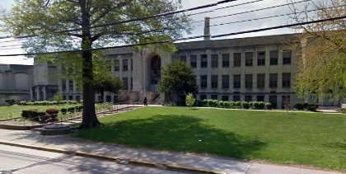
Career Exploration Middle School
Create a middle school environment with a physical and technological infrastructure that fosters career-focused experiential learning, critical thinking, collaboration, and innovation

Slide 31
Focus Area: Career Exploration Middle School
Team Members
Name | Title | Department
Angela Mike | Executive Director, Career and Technical Education | Pittsburgh Public
William Strickland | Chief Executive Officer | Manchester Bidwell
Vera Krekanova | Chief Strategy & Research Officer | Allegheny Conference
Ronald Joseph | Chief Financial Officer | Pittsburgh Public
Rodney Necciai | Assistant Superintendent | Pittsburgh Public
Paula Heinzman | Principal, Schiller Middle School | Pittsburgh Public
Pam Harbin | School Board, District Parent | Pittsburgh Public
Gregg Behr | Executive Director | Grable Foundation
Nina Esposito-Visgitis | President, Pittsburgh Federal of Teachers | Pittsburgh Public
Mike McNamara | Assistant Director of Facilities | Pittsburgh Public
Cindy Falls | School Board, Retired Teacher | Pittsburgh Public
Cassandra Tolbert | Program Manager, Career and Technical Education | Pittsburgh Public
Brie Adams | Supervisor, Career and Technical Education | Pittsburgh Public
Libya Moore | Stenographer, Career and Technical Education | Pittsburgh Public

Slide 32
NORTH – Career Middle School
School Changes SY2022-23
Existing Schools | Receiving School
Allegheny 6-8 | Oliver – Career Middle School
Arsenal 6-8 (King Feeder) | Oliver – Career Middle School
King 6-8 | Oliver – Career Middle School
Manchester 6-8 | Oliver – Career Middle School
Morrow 6-8 | Oliver – Career Middle School

Slide 33
NORTH
Additional Changes SY2022-23
Existing Schools | Receiving School
Manchester K-5 | Allegheny K-5
Morrow K-5 | Rooney Building
King K-5 | Remain at King
Oliver City-Wide | TBD

Slide 34
Northern Region:
Proposed View
Perry HS
Morrow PreK-5
Northview Heights
Birth to Grade 2
Spring Hill
K-5
Career Middle
School
Clayton
Academy
Spring
Garden ECE
PreK-5
PreK-8
K-5
K-8
6-8
6-12
High Schools
Early Childhood
Special Schools
Schiller 6-8
Allegheny
K-5
Conroy
King
PreK-5

Slide 35
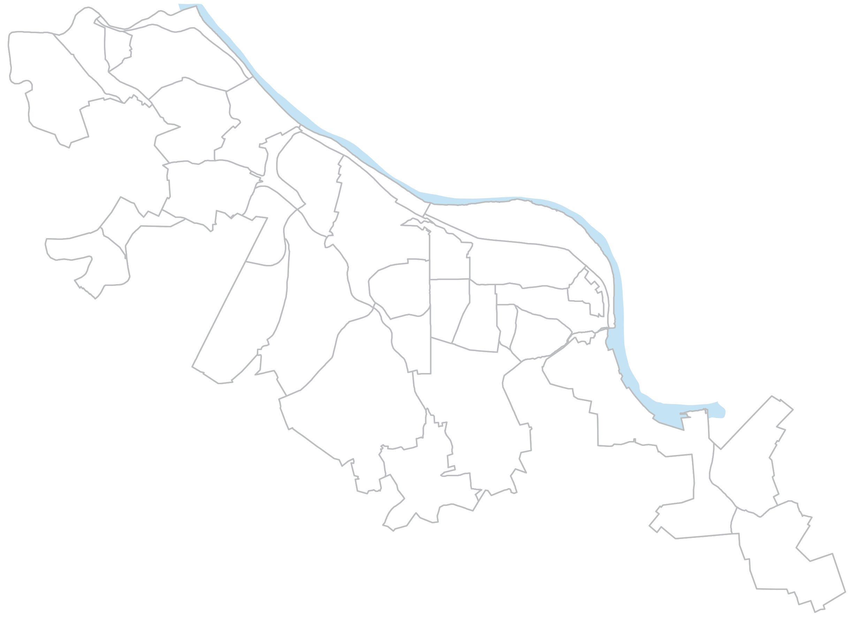
South/West Region:
Current View
Chartiers ECE
Langley K-8
Classical 6-8
Gifted Center
Westwood K-5
Whittier K-5
Online
Academy
Phillips
K-5
Grandview K-5
Brashear HS
South Hills 6-8
Arlington PreK-2
& 3-8
Banksville K-5
Beechwood
PreK-5
Pioneer
Roosevelt PreK-1
Roosevelt 2-5
South Brook 6-8
Brookline
PreK-8
Carmalt
PreK-8
Carrick HS
Concord PreK-5
PreK-5
PreK-8
K-5
K-8
6-8
6-12
High Schools
Early Childhood
Special Schools
Mifflin PreK-8

Slide 36
SOUTH
Brookline School Reconfiguration
Existing Program | Moving To
Brookline 6-8 | Carmalt PreK-8
Reasoning:
Relocate 6th – 8th grade students
Relocate students out of demountable classrooms
Brookline has elementary school amenities (small gym, etc.)
Implementation:
SY2022-23

Slide 37
South/West Region:
Proposed View
Chartiers ECE
Langley K-8
Classical 6-8
Gifted Center
Westwood K-5
Whittier K-5
Online
Academy
Phillips
K-5
Grandview K-5
Brashear HS
South Hills 6-8
Arlington PreK-2
& 3-8
Banksville K-5
Beechwood
PreK-5
Pioneer
Roosevelt PreK-1
Roosevelt 2-5
South Brook 6-8
Brookline
PreK-5
Carmalt
PreK-8
Carrick HS
Concord PreK-5
PreK-5
PreK-8
K-5
K-8
6-8
6-12
High Schools
Early Childhood
Special Schools
Mifflin PreK-8

Slide 38
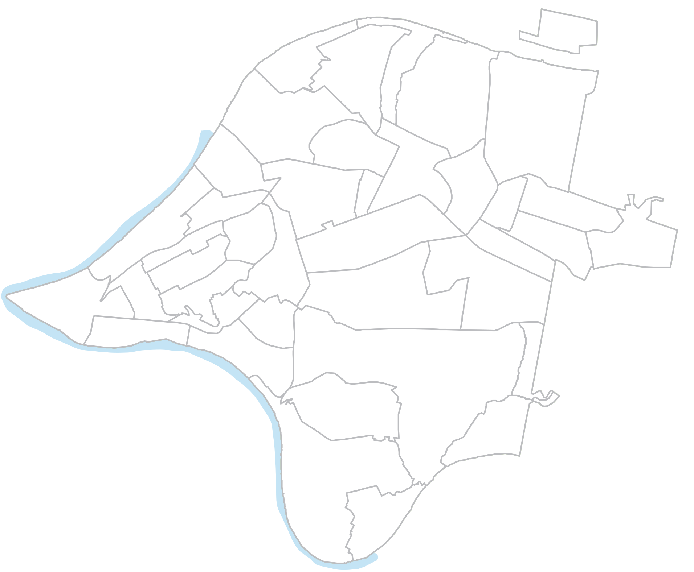
Central/East Region:
Current View
Sunnyside PreK-8
Fulton PreK-5
Arsenal PreK-5
& 6-8
Dilworth PreK-5
Woolslair K-5
Obama 6-12
Montessori
PreK-5
Lincoln
PreK-5
Westinghouse
6-12
Student Achievement
Center
Liberty K-5
Faison K-5
Miller PreK-5
Milliones 6-12
Crescent
ECE
Weil PreK-5
Linden K-5
Sterrett 6-8
CAPA 6-12
SciTech 6-12
Colfax K-8
Allderdice HS
Greenfield
PreK-8
PreK-5
PreK-8
K-5
K-8
6-8
6-12
High Schools
Early Childhood
Special Schools
Minadeo PreK-5

Slide 39
East
Woolslair Student Relocation
Existing School | Receiving School
Woolslair PreK-5 | Arsenal PreK-5
Woolslair Building Closed
Reasoning:
Woolslair has high operating costs and significant future capital investment needed
Consolidate students to provide additional supports programming
Implementation:
SY2021-22

Slide 40
East
New Minadeo Middle School 6-8
Existing Schools | Receiving School
Colfax 6-8 | New Middle School at Minadeo
Sterrett 6-8 | New Middle School at Minadeo
Reasoning:
Consolidate middle school students to provide additional supports and programming.
Minadeo recently received HVAC upgrades including Air Conditioning
Implementation:
SY2022-23
Notes:
Add implementation timelines

Slide 41
EAST
Montessori Relocation
Existing Schools | Receiving School
Pittsburgh Montessori PreK-5 | Sterrett Building
Friendship Building Closed
Reasoning:
Montessori (Friendship Building) requires significant Capital investment.
Historic nature of building complicates renovation and increases costs
Limited ADA accessibility without major investment
Implementation:
2022-23

Slide 42
East
Fulton Relocation
Existing School | Receiving School
Fulton PreK-5 | Sunnyside and Feeder Pattern
Fulton Building Closed
Reasoning:
Fulton has poor building resources and limited availability for improvement.
Structural ADA issues
Consolidate students to provide additional supports programming and amenities
Implementation:
SY2022-23

Slide 43
Central
Miller and Weil Consolidation
Existing School | Receiving School
Miller PreK-5 | Weil PreK-5
McKelvey Building Closed
Reasoning:
Miller (McKelvey Building) has high operating/maintenance costs and significant future capital investment needed
Consolidate students to provide additional supports and programming
Weil building recently received HVAC upgrade.
Implementation:
SY2022-23

Slide 44
Central/East Region:
Proposed View
Sunnyside PreK-8
Arsenal PreK-5
Dilworth PreK-5
Obama 6-12
Lincoln
PreK-5
Westinghouse
6-12
SAC
Liberty K-5
Faison K-5
Milliones 6-12
Montessori
PreK-5
Crescent
ECE
CAPA 6-12
Weil PreK-5
Linden K-5
SciTech 6-12
Colfax K-5
Allderdice HS
Greenfield
PreK-8
New Minadeo 6-8
PreK-5
PreK-8
K-5
K-8
6-8
6-12
High Schools
Early Childhood
Special Schools

Slide 45
School and Building Summary
Close Schools | Relocate 2 Schools | Reconfigure 2 Schools | Close 6 Buildings | Add 3 New Schools
Allegheny 6-8 | Montessori PreK-5 | Brookline PreK-5 | Fulton | Birth to 2nd Grade @ Northview
Arsenal 6-8 | Oliver Citywide Academy | Colfax PreK-5 | Friendship (Montessori) | Career Middle School @ Oliver
Fulton PreK-5 |  | King PreK-5 | Manchester | East End Middle @ Minadeo
Manchester PreK-8 |  |  | McKelvey (Miller)
Miller PreK-5 |  |  | Morrow
Minadeo Prek-5 |  |  | Woolslair
Sterrett 6-8
Woolslair PreK-5

Slide 46
Eliminating Excess Capacity
Move From:
17,128 empty seats
14,348 empty seats
TO

Slide 47
Summary of Capital Improvements
$ 83.5 Million Future Capital Costs Eliminated
$ 37.4 Million Future Capital Costs Created
$ 46.1 Million Net Savings
Notes:
28

Slide 48
Annual Operations Savings
$ 1,750,000 Reduction of Operations Staff (Security, Food Service, Custodians)
$ 250,000 Utilities
$ 550,000 Transportation
$2,550,000 Total Annual Savings
Notes:
28

Slide 49
Engagement Opportunities

Slide 50
Engagement Opportunities
Facebook
  Facebook Live
    45 minute to hour long listening session with Dr. Hamlet and community members in a Town hall setting (in-person).
    Questions will be taken through a form listed on website, Facebook, and/or Twitter.
Twitter
  Bi-weekly Q&A sessions
    Questions taken from a form submission
    Open thread for community questions and concerns
Instagram
  Instagram Live
    Hour long session(s)
    Share segments of Live video later to highlight important answers

Slide 51
Engagement Opportunities
Monthly Zoom Sharing and Listening Sessions
  First meeting is sharing session to lay foundation for following listening sessions for questions, ideas and suggestions
Old Fashion Call-in Days
  Dr. Hamlet to take calls from the public with a special call in number.
Individual one-on-one conversations with Superintendent and community member(s) via Zoom.
Live meetings with 10-15 people hosted in partnership with community groups.
A brief feedback form hosted on the PPS website.
Outreach to parent organizations of each school impacted by proposed changes in for listening conversations with Superintendent.
Board Public Hearings

Slide 52
Specific Topics for Engagement
Staff at sending and receiving schools can collaborate on programming
Transition Activities for Families and Students
Professional Development
Creative ideas about what happens with the buildings that are taken offline
Other ideas for Cost Savings
How feed patterns could be drawn

Slide 53
Feeder Patterns

Slide 54

Presentation

Slide 55
Timeline
Year
Actions
2020 - 2021
Approve opening of community input process February 2, 2021
Public Hearing February 23, 2021
Approve any changes in May, 26 2021
STUDENT PATHWAYS
NEW SCHOOL/
PROGRAM DESIGN
Woolslair to Arsenal Pre-K
OCA moves to a new Location
New Construction Starts on Oliver & Northview
2021 - 2022
All Other School Moves
2022 - 2023
Northview Birth – 2
Arsenal PreK-5
King Pre-K -5
Minadeo 6-8
Brookline Pre-K
Morrow K-5
Oliver 6-8
Colfax K-5

Slide 56
Our Framework
Engage in a highly collaborative process with the Board and other stakeholders to complete the final stages of Imagine PPS, our five-year strategic plan.
Align our system through a student-centered approach grounded by the PPS Graduate Profile.
Prioritize financial sustainability as an outcome that recognizes the long-term interests of students, teachers and taxpayers.
Act to enhance student educational programs and supports, modernize our footprint to launch facility renovation and school design, and feeder patterns efficiencies.

Slide 57
Next Steps
Financial Discussions
Staffing Discussions
Magnet and Programming Discussions
Transportation Discussion
Board discussion on empty buildings

Slide 58
