Slide 1

District Budget Overview

Slide 2
Agenda
Overview of District Funds
Review of 2022 General Fund Budget
Review of District Financial Outlook

Slide 3
Overview of District Funds

Slide 4
Overview of District Funds
District Fund Structure
General Fund | Supplemental Funds | Enterprise Fund | Internal Service Funds | Debt Service | Capital Projects
General Operating Fund Site-Based Budgets | Core Special Education Title 1 Title 2 ESSER Funds IDEA Funds Foundation Grants State Grants Federal Programs | Food Service | General Liability Self-Insurance Healthcare Workers’ Compensation Unemployment Compensation | Debt Service | Capital Improvement Fund Capital Reserve Fund

Slide 5
General Fund
Operates on a January 1st to December 31st fiscal year
Serves as the District’s general operating budget
Funded primarily by state and local revenue
Needs to be adopted by the Board annually by December 31st
Includes school-based budgets

Slide 6
General Fund Expenditures
Fixed Costs make up $189.9 million (28.5%)
  Utilities, debt service, charter, and other fixed costs
Special Education makes up $98.5 million (14.8%)
School-Based Budgets make up $223.3 million (33.5%)
Operations make up $95.4 millions (14.3%)
  Physical Plant, School Safety, and Transportation
Central Office Departments make up $58.6 million (8.8%)

Slide 7
General Fund Revenues
State Funding makes up $272.8 million (42.7%)
  Basic Ed, Special Ed, Retirement, Social Security and other subsidies
Local Funding makes up $364.6 million (57.1%)
  Real Estate, Earned Income, and Realty Transfer taxes
Federal Funding makes up $1.3 million (0.2%)
  Bond subsidies and fixed assets sales
$27 million from our fund balance is used to cover our operating deficit

Slide 8
Timeline for Completion of Departmental Budgets
June – Staff training on budget entry into Munis
July – Departmental budgets entered into Munis
August through September – Departmental budget review and approval

Slide 9
Site-Based Budget
Operates on a July 1st to June 30th fiscal year
Funded by the General Fund and operates as a subsidiary ledger of the general operating budget
Allocated to schools in accordance with the site-based budgeting model

Slide 10
Annual School-Based Budgeting Process
Site-Based and Title I Budgets are built using Enrollment Projections from the Data, Research, Evaluation and Assessment (DREA) Department.
Schools receive these in January, with the completed budgets going into effect in July for the following school year.
For the Site-Based Budget, each school receives a Per-Student Allocation. This is a starting point and is compared against the minimum standards as dictated by the district’s Service Delivery Model to ensure it can meet these thresholds with their Per-Student Allocation. All schools below these thresholds are funded so that they can meet these standards.
In order to account for this additional amount, all schools that have an allocation that exceeds their projected school operating cost must contribute a portion of their overage, though they are permitted to keep the remainder.

Slide 11
Annual Budgeting Process
Schools have approximately one month to review and complete these budgets and submit them to the Budget Office and their Assistant Superintendent for review and approval.
Human Resources begins the staffing process based on these submitted budgets in early March.
Schools are responsible for budgeting for the necessary staffing and non-staff needs for their school
  This does not include Special Education and English Language Learner (ELL) staff.
  Literacy and Math Coaches are also provided from Central budgets
  School-based Employees from the Food Service, Nursing, Custodial, School Safety, and Early Childhood departments are not part of these budgets, either. These are staffed according to the direction of the central office departments that oversee them.

Slide 12

Service Delivery Model
Counselors/Social Workers (Up to 700 Students)
Assistant Principal (500+ Students or Two Campuses)
Counselors/Social Workers (700+ Students)
Assistant Principal (700+ Students)
School Secretary (700+ Students)
SDSS (Up to 500 Students)
School Secretary
SDSS (+500 Students)
Principal
Librarians
K-5 Schools
K-8 Schools
6-8 School
1 | 1 | 2 | 1 | 2 | .5 | 1 | 2 | .5 | 1
1 | 1 | 2 | 1 | 2 | .5 | 1 | 2 | .5 | 1
1 | 1 | 2 | 1 | 2 | .5 | 1 | 2 | .5
  Certain schools may have additional Assistant Principals allocated to their school budget based on need. Money is added to the budget specifically for these positions and may not be re-purposed.
  Additional Assistant Principals that schools wish to budget beyond these levels must have Assistant Superintendent approval.

Slide 13
Service Delivery Model
Counselors (1,050-1,400 Students)
Counselors (700-1,050 Students)
Counselors (1,400+ Students)
Counselors (Up to 700 Students)
Social Worker
Assistant Principal (700-1,100 Students)
Assistant Principal (Up to 700 Students)
School Secretary (Up to 700 Students)
Assistant Principal (1,100 Students)
School Secretary (700+ Students)
SDSS (Up to 500 Students)
Activities Director
Principal
Librarians
6-12 Schools
9-12 Schools
1 | 1 | 2 | 3 | 1 | 1 | 2 | 3 | 4 | 1 | .5 | 1 | 2 | 1
1 | 1 | 2 | 3 | 1 | 1 | 2 | 3 | 4 | 1 | .5 | 1 | 2 | 1
  Certain schools may have additional Assistant Principals allocated to their school budget based on need. Money is added to the budget specifically for these positions and may not be re-purposed.
  Additional Assistant Principals that schools wish to budget beyond these levels must have Assistant Superintendent approval.

Slide 14


Service Delivery Model
Teacher Service Standards
Class Size Thresholds
Grades K-1: 25 Students
Grades 2-5: 27 Students
Grades 6-8: 29 Students
Grades 9-12: 30 Students
Non-Staff Costs: All schools must have a minimum of $100/ student in non-staff costs to budget

Slide 15
Supplemental Funding Sources
All Site-Based Budget Schools
Title I
Core Special Education Budget
Select Schools
Comprehensive Support and Improvement (CSI)
Additional Targeted Support and Improvement (A-TSI)

Slide 16
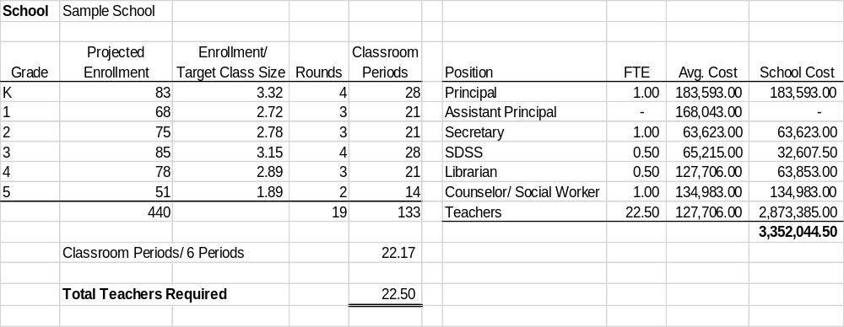
Sample School Staffing Estimate

Slide 17
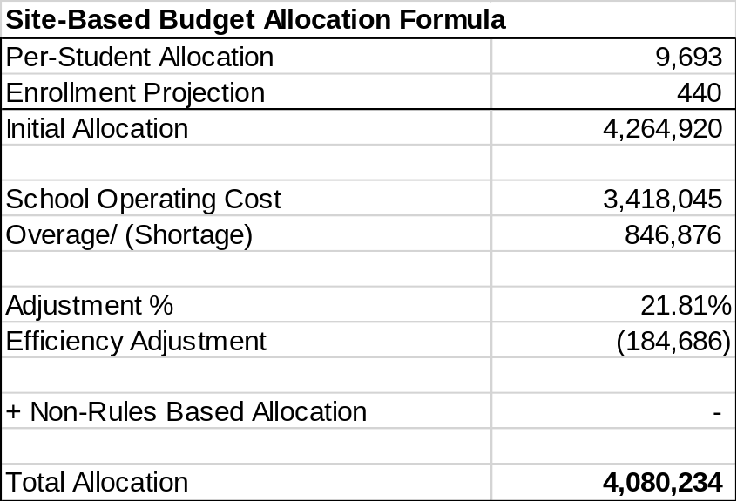
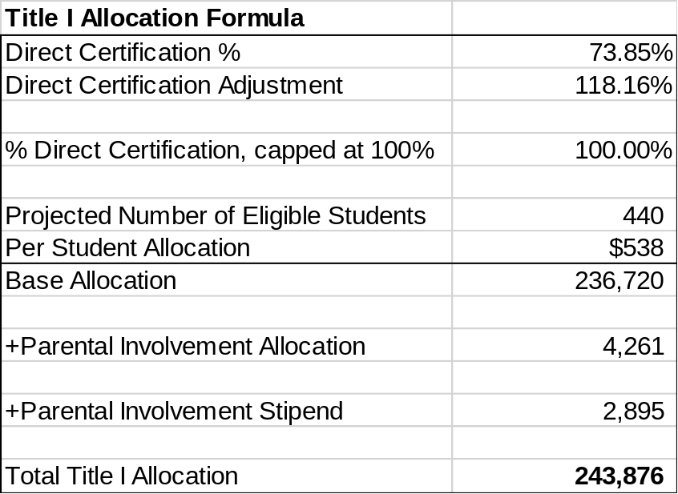
Sample School Allocation Calculation

Slide 18
Supplemental Funds
Supplemental funds have various fiscal years determined by the granting agency.
The acceptance of each supplemental fund must be approved by the Board.
The use of these funds is restricted to the terms of the grant agreement.
We receive funds from various entities including the PA Dept. of Education, US Dept. of Education, and Philanthropic Organization.

Slide 19
Supplemental Funds (continued)
Federal supplemental funds Include:
  Title 1, 2, 3, and 4
  Head Start
  Individuals with Disabilities Education Act (IDEA) Section 611 and 619
  Elementary and Secondary School Emergency Relief (ESSER)
State supplemental funds include:
  Ready to Learn
  Pre-K Counts
  Head Start Supplemental Assistance Program
The Core Special Education is our largest supplemental fund.
  Funded by General Fund contributions and State subsidies

Slide 20
Enterprise Fund
Operates on a January 1st to December 31st fiscal year
Food Service is the District’s enterprise fund
Funds the delivery of the school breakfast and lunch program
Funded solely by food service sales and state and federal subsidies

Slide 21
Capital Improvement and Capital Reserve Fund
Operates as a multi-year fund
The Capital Improvement Fund is approved annually by the Board in December.
  Funded by the issuance of general obligation bonds
The Capital Reserve is funded by general fund contributions and the proceeds from the sale of closed buildings.
Both funds are used to fund all District capital improvement and major maintenance projects.

Slide 22
Debt Service Fund
Operates as a multi-year fund
Used to account for funds designated for the repayment of long-term debt
Funded by the proceeds from the sale of closed buildings, the proceeds from the refunding of bonds, and contributions from the general fund

Slide 23
Internal Service Funds
Operate as multi-year funds
Funded by contributions from the General Fund
Funds account for operations of functions such of the payment of healthcare claims and workers’ compensation claims

Slide 24
Review of 2022 General Fund Budget

Slide 25
2022 General Fund Budget
Expenditures for 2022 are budgeted at $668.3 million:
  Represents a .83% decrease from 2021 adopted budget
  Includes an operating deficit of $27 million in 2022
  2021 adopted budget had an operating deficit of $39.4 million
  2021 unaudited financial expenditures are $638.3 million
    Operating deficit of $5.1 million
The 2022 Budget includes a tax increase of 3% (up to the Act 1 Index).
Over $21 million in ESSER III funding used to prevent large scale staff reductions.

Slide 26
2022 Revenue
Total Revenue $668,253,162
Prior Encumbrances $ 2,500,000
Deficit $ 27,001,834
Notes:
Feel free to include a photo of your school’s mascot, staff or students.

Slide 27
2022 Revenue

Slide 28
2022 Appropriations by Major Object
Notes:
Highlight key strengths/features of your school. Examples mission/moto, photos

Slide 29
2022 Appropriations by Function
Notes:
Highlight key strengths/features of your school. Examples mission/moto, photos

Slide 30
Options for Workforce Adjustment Using ESSER III Funding
  Option 1: All positions maintained through 2022-23 school year. Elimination of all appeal allocations and all allocations beyond the Base Service Delivery Model for 2023-24 and beyond. Estimated elimination of 161 school-based positions for 2023-24. Would require an estimated $33.7 million in total ESSER Funding beginning January 1, 2022.
  Option 2: Elimination of all Appeal Allocations for 2022-23 and all positions beyond district’s base Service Delivery Model eliminated for 2023-24 school year. Estimated elimination of 24 school-based positions for 2022-23, and 137 additional positions for 2023-24. Would require an estimated $30.4 million in total ESSER funding beginning January 1, 2022.
Budget Year | 2022 | 2023 | 2024
General Fund Cost Savings | $21,036,937 | $ 21,036,937 | $ 21,036,937
ESSER Funding Required | $21,036,937 | $ 12,622,162 | $ 0
Budget Year | 2022 | 2023 | 2024
General Fund Cost Savings | $21,036,937 | $ 21,036,937 | $21,036,937
ESSER Funding Required | $19,735,301 | $ 10,669,709 | $ 0

Slide 31
The 2022 Budget Included a 3% Millage Increase
2021-22 Act 1 Index for the district is 3.0%
2022 Millage rate is 10.25 Mills
% Increase | Mills | 2022 Estimated Real Estate Revenue | Increase over Existing Projection
No Increase | 9.95 | $ 183,623,498 | $ -
0.50% | 10.00 | $ 184,511,615 | $ 888,117
1.00% | 10.05 | $ 185,399,733 | $ 1,776,235
1.50% | 10.10 | $ 186,287,850 | $ 2,664,352
2.00% | 10.15 | $ 187,175,968 | $ 3,552,470
2.50% | 10.20 | $ 188,064,085 | $ 4,440,587
3.00% | 10.25 | $ 188,952,203 | $ 5,328,705

Slide 32
Review of District Finances

Slide 33
2022-23 State Budget
Basic Education Funding
  The 2022-23 Enacted Budget includes $7,625,124,000 for the Basic Education Funding appropriation and $225,000,000 to supplement those school districts with a higher at-risk student population. The total amount is a $767,820,000 (10.83%) increase over the 2021-22 fiscal year appropriation.
Special Education Funding
  The 2022-23 Enacted Budget includes $1,336,815,000 for the Special Education appropriation. This amount is a $100,000,000 increase (8.1%) over the 2021-22 fiscal year appropriation.
Ready to Learn Funding
  The 2022-23 Enacted Budget includes $295,500,000 for the Ready to Learn Block Grant. $100,000,000 of appropriated Ready to Learn was transferred to the School Safety Fund.

Slide 34
Impact of 2022-23 State Budget on PPS
 | 2021-22 |  | 2022-23 |  | VARIATION |  | % CHANGE
BASIC EDUCATION FUNDING | $163,710,576 |  | $168,670,990 |  | $4,960,414 |  | 3.03%
READY TO LEARN BLOCK GRANT | $4,955,423 |  | $4,955,423 |  | $0 |  | 0.00%
SPECIAL EDUCATION | $28,876,390 |  | $29,730,901 |  | $854,511 |  | 2.96%
TOTAL | $197,542,389 |  | $203,357,314 |  | $5,814,925 |  | 2.94%

Slide 35
Projected Increases in State and Local Revenue Have Improved Our Forecast
 | Adopted | Projected | Adopted | Projected | Projected | Projected
 | Year Ended 2021 | Year Ended 2021 | Year Ended 2022 | Year Ended 2022 | Year Ended 2023 | Year Ended 2024
Total Revenues | $631,914,258 | $633,263,128 | $638,751,328 | $646,386,474 | $657,390,048 | $665,127,757
Total Expenditures | $671,348,058 | $638,337,948 | $665,753,162 | $648,731,730 | $662,140,647 | $673,865,256
Beginning Balance | $73,234,205 | $91,701,905 | $86,627,084 | $86,627,084 | $84,281,828 | $79,531,229
Operating Surplus/(Deficit) | ($39,433,800) | ($5,074,821) | ($27,001,834) | ($2,345,256) | ($4,750,600) | ($8,737,500)
Ending Fund Balance | $33,800,405 | $86,627,084 | $59,625,250 | $84,281,828 | $79,531,229 | $70,793,729
Less Projected Reservations | ($2,500,000) | ($4,131,698) | ($2,500,000) | ($2,500,000) | ($2,500,000) | ($2,500,000)
Less Committed Fund Balance | $0 | $0 | $0 | $0 | $0 | $0
Less Assigned Fund Balance | (38,980,987) | (27,001,834) | (4,750,600) | (4,750,600) | (8,737,500) | ($12,709,588)
Unassigned Fund Balance | ($7,680,582) | $55,493,552 | $52,374,650 | $77,031,229 | $68,293,729 | $55,584,141
% Budgeted Expenditures | -1.14% | 8.69% | 7.87% | 11.87% | 10.31% | 8.25%
Minimum Fund Balance per Board Policy #721 | $33,567,403 | $31,916,897 | $33,287,658 | $32,436,586 | $33,107,032 | $33,693,263
Compliance with Fund Balance Policy | No | Yes | Yes | Yes | Yes | Yes
Funds needed to comply with Fund Balance Policy | $41,247,985 | ($23,576,654) | ($19,086,992) | ($44,594,642) | ($35,186,697) | ($21,890,878)

Slide 36
Revenue, Expenditure, and Fund Balance Trends

Slide 37
What is Fund Balance?
Think of fund balance as the District’s savings account.
The fund balance is increased or decreased by surpluses or deficits respectively.
The fund balance can be used to provide cash flow when funding is delayed or eliminated.
The fund balance can be used to fund deficits in the operating budget.
Board Policy no. 721 sets the acceptable range for the fund.

Slide 38
Components of Fund Balance
Total Fund Balance – the total of committed, assigned, and unassigned fund balance
Committed Fund Balance – a portion of the fund balance that is restricted for a specific purpose by resolution of the Board
Assigned Fund Balance – the portion of fund balance designated to fund a budget deficit
Unassigned Fund Balance – remaining fund balance net of amounts that are committed or assigned

Slide 39
We Are Still Using Our Reserves To Balance The Budget

Slide 40
Our Deficits Began in 2016

Slide 41
General Fund Performance Since 2013

Slide 42
Year to Date Local Revenue Collection Increased Over 2021
Notes:
Share promising data trends.

Slide 43
Year to Date Expenditures Through June
Notes:
Share promising data trends.

