Slide 1

November 29, 2022 Budget Workshop

Slide 2
Budget Workshop Goals
Provide an update on our finances
Presentation of the 2023 Preliminary General Fund Budget
Overview of Other Expenditure Categories
Overview of Instructional Unit Department Budgets

Slide 3
Our Current Financial Outlook Based on Actuals Through September 30, 2022
 | Adopted | Projected | Adopted | Projected | Projected | Projected
 | Year Ended 2021 | Year Ended 2021 | Year Ended 2022 | Year Ended 2022 | Year Ended 2023 | Year Ended 2024
Total Revenues | $631,914,258 | $633,263,128 | $638,751,328 | $663,135,532 | $666,742,835 | $674,744,097
Total Expenditures | $671,348,058 | $638,337,948 | $665,753,162 | $663,484,694 | $675,970,272 | $690,167,141
Beginning Balance | $73,234,205 | $91,701,905 | $86,627,084 | $86,627,084 | $86,277,922 | $77,050,485
Operating Surplus/(Deficit) | ($39,433,800) | ($5,074,821) | ($27,001,834) | ($349,162) | ($9,227,437) | ($15,423,043)
Ending Fund Balance | $33,800,405 | $86,627,084 | $59,625,250 | $86,277,922 | $77,050,485 | $61,627,442
Less Projected Reservations | ($2,500,000) | ($4,131,698) | ($2,500,000) | ($2,500,000) | ($2,500,000) | ($2,500,000)
Less Committed Fund Balance | $0 | $0 | $0 | $0 | $0 | $0
Less Assigned Fund Balance | (38,980,987) | (27,001,834) | (9,227,437) | (9,227,437) | (15,423,043) | ($24,394,449)
Unassigned Fund Balance | ($7,680,582) | $55,493,552 | $47,897,813 | $74,550,485 | $59,127,442 | $34,732,992
% Budgeted Expenditures | -1.14% | 8.69% | 7.19% | 11.24% | 8.75% | 5.03%
Minimum Fund Balance per Board Policy #721 | $33,567,403 | $31,916,897 | $33,287,658 | $33,174,235 | $33,798,514 | $34,508,357
Compliance with Fund Balance Policy | No | Yes | Yes | Yes | Yes | Yes
Funds needed to comply with Fund Balance Policy | $41,247,985 | ($23,576,654) | ($14,610,155) | ($41,376,250) | ($25,328,928) | ($224,635)

Slide 4
Revenue, Expenditure, and Fund Balance Trends

Slide 5
Both Real Estate and Earned Income Revenue Are Trending Above Budget

Slide 6
2023 Preliminary Budget
Expenditures for 2023 are budgeted at $676 million:
  Represents a 1.53% increase from 2022 adopted budget
  Includes an operating deficit of $9.2 million in 2022 which is $17.8 million less than the 2022 operating deficit of $27 million
Adheres to Board’s minimum 5 percent fund balance policy for the General Fund through 2024 based on assumptions to date
2022 Projections indicate final expenditures of $663.5 million and an operating deficit of $.3 million.
Does NOT include a millage increase.
Utilizes approximately $13 million in ESSER III funding to maintain continuity of services at the school level.

Slide 7
2023 Revenues

Slide 8
2023 Revenues
LOCAL SOURCES | PROJECTED REVENUES |  | PERCENT OF TOTAL
Real Estate | $196,281,964 |  | 28.94%
Earned Income Tax | $167,962,569 |  | 24.76%
Real Estate Transfer Tax | $16,000,000 |  | 2.36%
Other Local Revenues | $7,165,600 |  | 1.06%
Total - Local Sources |  | $387,410,133 |  | 57.12%
STATE SOURCES
Basic Instructional Subsidy | $168,870,990 |  | 24.89%
Special Education State Reimbursement | $29,730,901 |  | 4.38%
Transportation State Reimbursement | $8,596,088 |  | 1.27%
State Property Tax Reduction | $19,636,817 |  | 2.89%
Social Security Payments | $7,484,301 |  | 1.10%
Retirement Contributions | $41,699,052 |  | 6.15%
Other State Revenues | $2,670,965 |  | 0.39%
Total - State Sources |  | $278,689,114 |  | 41.07%
REVENUE FROM OTHER SOURCES | $643,588 |  | 0.09%
 |  | $643,588 |  | 0.09%
FROM FUND BALANCE | $9,227,437 |  | 1.36%
 |  | $9,227,437 |  | 1.36%
PRIOR YEAR ENCUMBRANCES | $2,500,000 |  | 0.37%
 |  | $2,500,000 |  | 0.37%
TOTAL |  | $678,470,272 |  | 100.0%

Slide 9
2023 Revenues

Slide 10
2023 Appropriations by Major Object

Slide 11
Major Changes by Object
Expenditure Category | 2022 | 2023 | Increase/(Decrease) | % Change
Salaries & Benefits | 320,678,803 | 329,465,337 | 8,786,534 | 2.74%
Special Education | 88,817,087 | 90,338,946 | 1,521,859 | 1.71%
Debt Service | 43,613,107 | 41,007,858 | (2,605,249) | -5.97%
Charter Schools | 117,331,930 | 120,851,888 | 3,519,958 | 3.00%
Transportation | 40,450,572 | 31,164,930 | (9,285,642) | -22.96%
Utilities | 9,937,804 | 10,641,602 | 703,798 | 7.08%
Purch. Prof. & Tech. Services | 9,669,072 | 9,799,689 | 130,617 | 1.35%
Purch. Prop. Services | 3,082,804 | 4,192,717 | 1,109,913 | 36.00%
Other Purch. Services | 14,138,681 | 14,903,739 | 765,058 | 5.41%
Supplies | 10,981,793 | 11,427,771 | 445,978 | 4.06%
Property | 3,302,938 | 4,407,341 | 1,104,403 | 33.44%
Other Objects | 3,169,371 | 7,439,657 | 4,270,286 | 134.74%
Other Finan. Uses | 579,200 | 328,800 | (250,400) | -43.23%
Total | 665,753,162 | 675,970,272 | 10,217,113 | 1.53%

Slide 12
Other Expenditures
Fixed Charges, Debt Service, Intersystem Payments, Charter Schools, Other Benefits, Contingencies

Slide 13
42% of Our Expenditures Are Non-Negotiable

Slide 14
Fixed Charges
The State's share of Social Security and Retirement Contribution for supplementally funded programs operated by the District are not included in individual funds but budgeted as both expenditures and the equal amount as revenue in the General Fund. The appropriation for the payment appears here, the State's share is recorded as revenue. In addition, parking lot contracts for the School District of Pittsburgh are included here.
Includes the following departments
  6900 – Fixed Costs
  6901 – Benefits

Slide 15
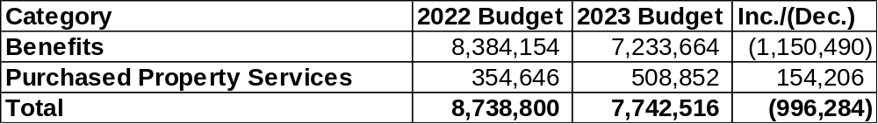
Fixed Charges

Slide 16
Other Fund Transfers
The other fund transfer line item contains the District’s contribution to the Education Leading to Employment and Career Training (ELECT) Program in the amount of $79,200 and monies for future sales of closed buildings.
Includes the following department(s)
  6902 – Other Fund Transfers

Slide 17
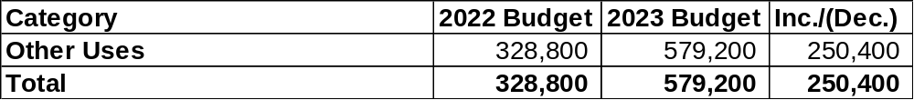
Other Fund Transfers

Slide 18
Debt Service
Debt Service provides for the payment of principal and interest on debt incurred to finance construction, renovation and the annual Major Maintenance Program costs.
Includes the following department(s)
  6904 – Debt Service – Principal
  6905 – Debt Service – Interest

Slide 19
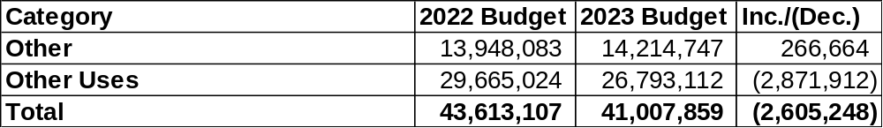
Debt Service

Slide 20
Intersystem Payments
The Intersystem payment includes the transfer of this revenue to the Special Education program along with the funding of the program beyond State allocations. The revenues for Special Education appear in the State Subsidy Revenue Section of the budget book under Other Program Subsidies.
Includes the following department(s)
  6907 – Intersystem Payments

Slide 21
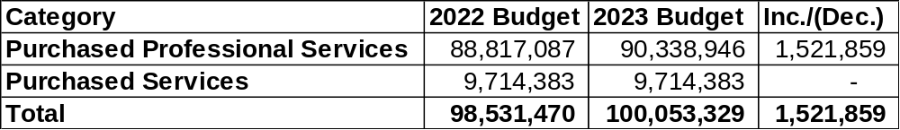
Intersystem Payments

Slide 22
Tax Refunds and Contingencies
Appropriations for contingencies and payments of refunds to taxpayers.
Includes the following department(s)
  6906 – Tax Refunds
  6908 – Contingencies

Slide 23
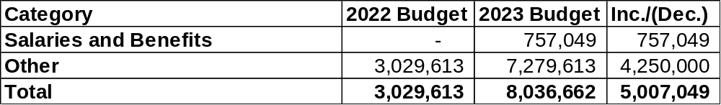
Tax Refunds and Contingencies

Slide 24
Charter School Payments
Tuition payments for district residents who attend charter schools, brick and mortar and cyber.
Includes the following department(s)
  6909 – Charter School Payments

Slide 25
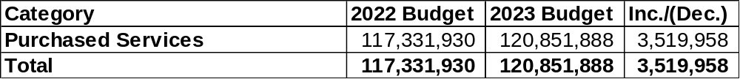
Charter School Payments

Slide 26
Instructional Units Represent 4% of the Budget

Slide 27
Office of School Performance:
Reporting Departments
Office of School Performance
Office of Professional Development

Slide 28
Office of School Performance
Services Provided
  Support to all 57 school sites.
  Support supervision and evaluation to all principals
  Provide professional development to school leaders through network structure
  Compliance monitoring of mandated local, state, and federal requirements
  Onboarding support for all new school-based administrators
  Mediate, problem solve, and resolve school-based parent issues and concerns
  Liaise with community partners and organizations to provide support and services to schools
  Plan, organize and facilitate High School Commencements
Staffing
  3.0 Assistant Superintendents
  1.0 Secretary
  1.0 Project Manager

Slide 29
Office of School Performance
Department Goals
  The Office of School Performance will use an equity lens for decision-making, professional development, data analysis and progress monitoring.
  All Assistant Superintendents will receive professional development, differentiated support, coaching, and feedback to directly support the District’s Theory of Action and Strategic Plan
  All principals will receive differentiated support, coaching and feedback to develop and enhance instructional leadership skills, to increase outcomes for all students and eliminate racial disparity from the Assistant Superintendent of Instructional Leadership.
  All schools will implement with fidelity the school improvement plan and progress monitoring of the plan based on current student and staff data.
  Assistant Superintendents will provide support while schools are operating in an in-person, e-learning or hybrid environment. Differentiated support and supervision will be provided either in person or virtually.
  In collaboration with various departments (i.e. Student Support Services, C&I, Professional Development, we support all schools in the implementation of MTSS, PBIS, Restorative Practices and PLC.
  Revise the evaluation and support structure for Assistant Superintendents to be in line with the Model Principal Supervisor Standards (Council of Chief State School Officers, 2015).
  The Office of School Performance will lead the rebound for School Leaders to rebuild agency, accelerate learning recovery and rethink schools.

Slide 30
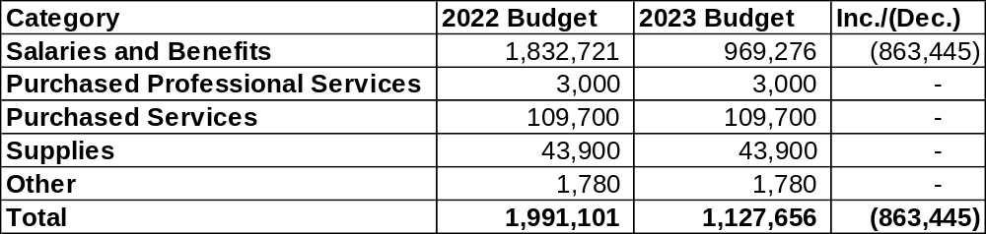
Office of School Performance

Slide 31
Office of Professional Development
Services Provided
  A Comprehensive system of support for professional learning to enhance the performance of all staff.
  Professional Learning Support Systems for:
    School and Central Office Leaders
    New Principals
    Instructional Teacher Leaders
    New Teachers
    Aspiring Principals
  Monitoring the utilization of the Professional Learning Management System
Staffing
  Assistant Superintendent for Professional Development and Special Programming
  Coordinator of Instructional Effectiveness
  Teacher Support Liaison
Department Goals
  Pittsburgh Public Schools strives to establish a culture of professional learning that enhances teacher content knowledge, instructional effectiveness, and cultural relevance to positively impact student outcomes through a coherent and relevant system of support. High-quality instruction is at the core of our work. We believe in the persistent pursuit of excellence in teaching and expertise in content to ensure that every child has a great teacher.

Slide 32
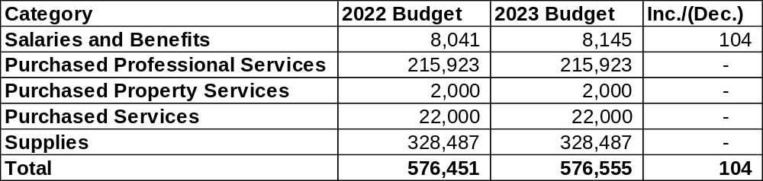
Office of Professional Development

Slide 33
Chief Academic Officer: Reporting Departments
Curriculum and Instruction
Career and Technical Education
Library Services

Slide 34
Curriculum and Instruction
Services Provided​
  Provide direct support to schools in in ELA, Mathematics, Science, STEAM, Visual and Performing Arts, Social Studies, World Languages, Health and Physical Education including supports for Gifted and Talented Students, English Learners and their families to include but not limited to :​
    Adopting curriculum materials to support core instructional programs​
    Monitoring student progress and implementing related improvement plans
    Designing and updating PA standards-aligned curriculum​
    Implementing effective coaching and teacher support models​
    Developing, coordinating, and facilitating professional learning​
    Utilizing a continuous improvement cycle ​that includes on-going data analysis
Staffing​
  Chief Academic Officer ​
  Executive Secretary
  Executive Directors of CTE, ELA, and Math​
  ELA, Math. Social Studies, Science Content Specialists​
  ELA and Math Instructional Coaches ​
  ​Senior Program Officer, Arts Education English as Second Language Director ​World Language Curriculum Supervisor Physical Education, Health, and Wellness Coordinator

Slide 35
Curriculum and Instruction
Department Goals​
  Update all outdated instructional resources to ensure that core text for the content area is aligned to current State or National Standards and ensure content reflects the demographics of Pittsburgh Public Schools.​
  Adopt new core curriculum materials in ELA K-5, ELA 6th-12th grade (Novels), and update supplemental materials in math, social studies, and science.​
  Launch a rich and robust summer program for K-12 students, and a summer institute for teachers in grades K-12. Summer programming will include opportunities for extended learning in math, ELA, and the arts. ​
  Provide training on the Science of Reading, culturally relevant instruction, student engagement strategies, formative assessment processes, and progress monitoring across all grade levels. ​
  Support teachers through data-informed, coordinated, and comprehensive professional development models. ​
  Utilize academic literacy and mathematics coaches to support, model, and coach instructional strategies using evidenced-based instructional best practices. ​
  Ensure curriculum and core materials are research and evidence-based, includes culturally relevant instructional strategies, and maintains alignment to Pennsylvania Core Standards (PA Core Standards).​
  Conduct focused school visits that include review of instructional practices, implementation of curriculum, and formative assessment processes.​
  Utilize professional learning communities and the continuous improvement cycle to support and strengthen instructional practices.​
  Implement data-analysis protocols to inform planning, professional development, parent and community engagement efforts.​
  Support schools district-wide with written and verbal translations as well as teacher and parent support.​
  Provide content and related pedagogy professional development to assistant principals and principals during Leading and Learning Institutes. ​
  Ensure that students have access to musical instruments and art equipment. ​
  Expand stakeholder awareness and direct involvement in supporting the district's teaching and learning goals. ​

Slide 36
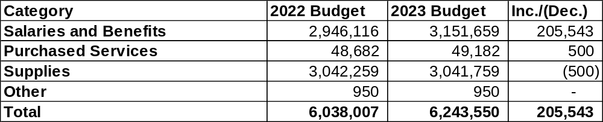
Curriculum and Instruction

Slide 37
Career and Technical Education
Services Provided
  Provide technical assistance and funding to support student certifications.
  Provide internal and external professional development opportunities for all teachers and staff.
  Provide state-of-the art, industry-recommended equipment and technology resources plus curriculum supports for all CTE courses.
  Provide teacher support/oversight in developing standards-aligned lesson plans and curriculum.
  Coordinate administration of end-of-program assessments (NOCTI, NIMS, etc.)
  Complete all state reports (PIMS, CATS, etc.)7. Prepare for all PDE-CTE audits (Perkins, Approved Program Evaluation, Civil Rights)
  Prepare for all PDE-CTE audits (Perkins, Approved Program Evaluation, Civil Rights)
  Provide preventative maintenance and repairs on all CTE equipment.
  Coordinate CTE partnerships with industry and business.
  Conduct stakeholder meeting with industry/business partners.
  Provide work-based learning experiences for CTE students.
  Administer CTE grant awards.
Staffing: 6.0 FTEs
Department Goals
  Prepare students for career pathways in the global marketplace by offering experiential learning, post-secondary credits, industry certifications, career counseling, and career planning and rigorous curricula.
  Expand partnerships with the City of Pittsburgh.
  Empower all CTE students to confidently and successfully transition into post-secondary and career opportunities and become positive, contributing members of society.
  Provide technical support and assistance as well as industry specific equipment/technologies to all schools which house CTE programs and electives.
  Continue development of online NOCTI toolkits and PDE competency task lists.
  Support and start-up CTE electives and programs.
  Develop new partnership with business, industry and post-secondary institutions.
  Monitor and support implementation of Approved Program Evaluation Corrective Action Plan

Slide 38
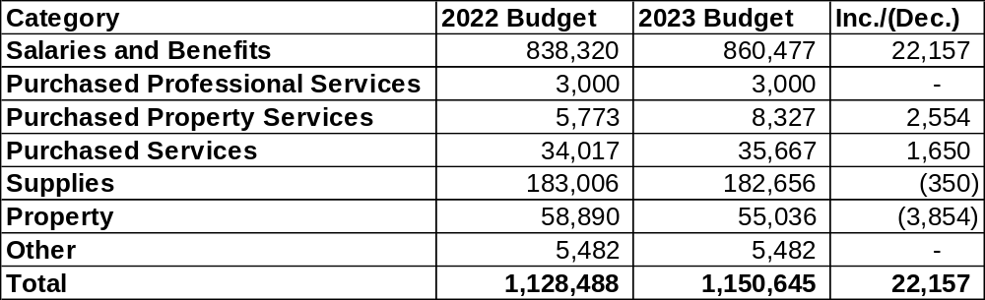
Career and Technical Education

Slide 39
Library Services
Services Provided
  Provide direct support to schools in in ELA, Mathematics, Science, STEAM, Visual and Performing Arts, Social Studies, World Languages, Health and Physical Education including supports for Gifted and Talented Students, English Learners and their families to include but not limited to:
    Secure and distribute reading materials.
    Develop and implement scope and sequence for library services.
    Develop, coordinate, and facilitate professional learning related to library services.
    Provide instruction, guidance and materials that increase students’ motivation and engagement of text through integrated literacy events and initiatives.
Staffing: Librarians are funded via school budgets.
Department Goals
    Provide additional training for new and seasoned librarians in collection development.
    Increase student’s interest in reading high quality fiction and non-fiction, as well as their ability to effectively conduct research using reputable sources.
    Ensure students are critical thinkers, collaborators, and active learners.
    Broaden access to literature for students through partnerships with local libraries, i.e., Carnegie Library of Pittsburgh.
    Create recommended reading lists for students by grade band to promote reading over the summer.

Slide 40
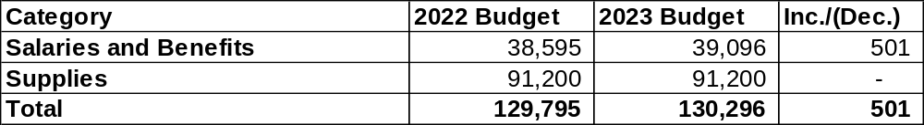
Library Services

Slide 41
Office of Student Support Services: Reporting Departments
Student Support Services
Health Services
Interscholastic Athletics
Early College High School

Slide 42
Student Support Services
Services Provided
  To pay for consultant contracts to provide crisis intervention services for individuals and groups of students and families. The incidents may be related to violence, tragedies, homelessness, and other situations that have serious effects on school and classroom learning environments. Funds will also be used for special student assistance projects in targeted populations of students.
  District’s student discipline hearing officer.
  Student Transportation.
  Funds will be used to purchase office supplies for Student Services, Discipline Office, Magnet Office, Attendance Office and for the Assistant Superintendent of Support Services, Magnet Fair supplies, signage, etc.
  Provide meals & refreshments for Retreats & meetings with Counselors & Social Workers, as well as activities/professional learning provided through our Queer Equity Committee (QEC) for students and staff.
  State Mandated SAP Training.
Staffing
  25 Full-time staff members
Department Goals
  To maintain the level of services necessary to ensure that students are supported in all facets of their academics, socio-emotional, and physical safety within the confines of this budget, as provided.

Slide 43
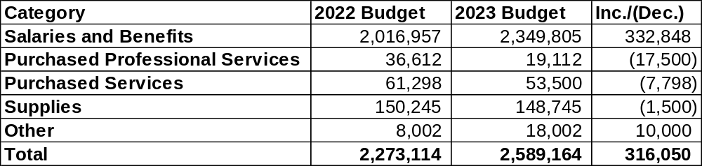
Student Support Services

Slide 44
Health Services
Services Provided
  Health Services is responsible for the administration of services for students to address disease prevention, health promotion, dental hygiene program, and mandated service provision through the Department of Health. In addition to our students, private and parochial schools within City limits receive mandated school health services as well. Health Services serves as a resource to parents when referring students for medical services and supporting documentation; collaborate with school social workers when helping parents to identify and secure services for health care needs.
  Central Office: process applications for homebound instruction and medical transportation, coordinate services with contracted agencies to help students with specific complex medical needs, review and determine if specialized one-on-one health care is needed based on the letter of medical necessity. Official and confidential health records for employees are maintained in Health Services, and student health records are maintained at their respective schools in the school nurse’s office.
  Support is provided to Human Resources and Employee Relations specific to new hires.
  Additionally, the Assistant for Health Services has specific duties with Student Services such as student residency issues, guardianship, foreign exchange students and student work permits. The Assistant is one of the district’s certified to serve as a Notary Public.
Staffing
  61 Full-time Staff members
Department Goals
  To ensure staffing meets need to adequately limit the spread of COVID-19 in our schools, promote continuity of care and management of student chronic health conditions, state mandated screenings and physicals, dental screenings, examinations and education, increase communication and clarify more unified direction of medical care for all students between families, healthcare providers and PPS staff leading toward providing services equitably and maintain, strengthen and develop partnerships that improve health, wellness and academic success.

Slide 45
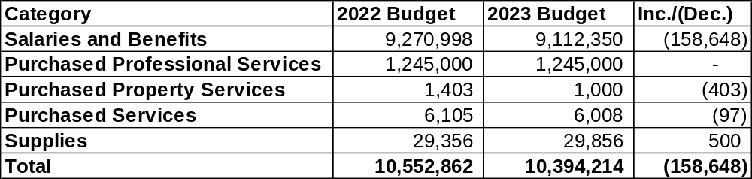
Health Services

Slide 46
Interscholastic Athletics
Services Provided
  Transportation and Officials for Athletics for middle and high school competitions
  Transportation for some elementary athletic events – track and field, swimming
  Maintenance/Replacement for washers, dryers and ice machines
  Maintenance/Replacement for athletic equipment
  Salaries for all middle and high school coaches
  Intramural pay for all schools
  Oversee the Special Olympics for middle school and high school Unified Bocce and high school Unified Track Program – MOU from Special Olympics
  Salaries for Concession Stand Manager and Concession Stand Workers
  Payment for Athletic Workers at various athletic events.
  Hotels, meals and transportation for teams in state playoffs.
  Membership Fees for PIAA and WPIAL.
Staffing
  1 Director of Athletics
  1 Secretary
  1 Maintenance/Repairman
Department Goals
  Continue to grow programs in athletics
  Looking to move Cheerleading for MS and HS into the Athletic department.
  Continue to build relationships with the community, college athletic programs and professional sports teams.

Slide 47
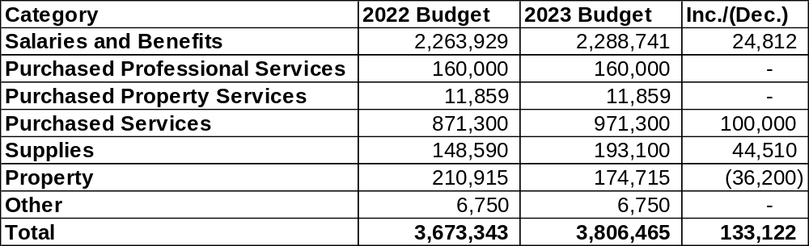
Interscholastic Athletics

Slide 48
Early College High School
Services Provided
  Provided students with an ongoing hybrid (in-person & virtual via Microsoft Teams) presence to assist them in navigating through their INDIVIDUALZED journeys to actualize their post-secondary academic & career goals via a Naviance-driven foundation & monthly in-person data chats.
  Offered rigorous University of Pittsburgh College in High School courses (Pittsburgh Milliones: COMMRC 0500—Argument, SOCWRK 1000—Introduction to Social Justice & HIST 0671—African American History; Pittsburgh Westinghouse: Introduction to Social Justice—SOCWRK 1000, Argument—COMMRC 0500, STAT 0200—Statistics & HIST 0671—African American History and Pittsburgh Perry: SOCKWRK 1000--Introduction to Social Work & STAT 0200—Statistics) in partnership with Justice Scholarship Institute that provided approximately 90 students with a scaffold-level support to enhance academic success in high school and college.
  Connected students to meaningful individualized social and emotional supports to enhance their ability persist towards graduation in high school & in college.
  Developed strong Dual Enrollment partnerships between K-12 and higher education institutions (University of Pittsburgh (Board-approved MOU with University of Pittsburgh/Justice Scholars Institute—August 2021 & MOU-draft pending Board-approval Carlow University—October 2022) & community organizations (University of Pittsburgh Black Alumni Association—September 2022 & Life X Labs—March 2022) to cultivate a college &career-going school/district-wide presence & culture.
Staffing
  1Coordinator, Early college in High School
Department Goals
  With an overall programmatic lens of enriching students’ educational prospects by providing a framework for academic achievement and skills for college & career—driven success, the following are the 4 goals of ECHS:
    Goal 1: Retention is the process of actively continuing to retain the enrollment of our current ECHS students
      Since August 2021, approximately forty-five 11th & 12th grade Pittsburgh Milliones ECHS students enrolled in University of Pittsburgh’s Justice Scholars Institute’s (JSI) courses.
    Goal 2: Reclamation is the action of actively identifying, attracting, & then re-enrolling our former ECHS students.
      Since August 2021, approximately forty-five 11th & 12th grade Pittsburgh Milliones ECHS students enrolled in University of Pittsburgh’s Justice Scholars Institute’s (JSI) courses.
    Goal 3: Recruitment is the action of attracting & then identifying new ‘ideal’ students to enroll in the ECHS program.
      Since August 2021, forty-five 11th & 12th grade Pittsburgh Milliones ECHS students enrolled in University of Pittsburgh’s Justice Scholars Institute’s (JSI) courses.
    Goal 4: Reposition is the process of revamping the current blueprint of ECHS in an effort to identify new/wider ideal student demographic at Pittsburgh Milliones as well as onboarding both Pittsburgh Perry H/S & Pittsburgh Westinghouse H/S.
      Since August 2021, approximately 78 eligible Pittsburgh Perry & Pittsburgh Westinghouse 11th & 12th graders enrolled in University of Pittsburgh’s Justice Scholars Institute’s (JSI) courses.

Slide 49
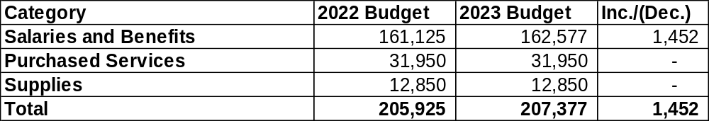
Early College High School

Slide 50
2023 Budget Adoption Timeline
November 16, 2022 – Preliminary Budget Released
November 29, 2022 – Budget Workshop #1
December 5, 2022 – Budget Public Hearing
December 6, 2022 – Budget Workshop #2
December 12, 2022 – Budget Workshop #3
December 19, 2022 – Public Hearing
December 21, 2022 – Legislative Meeting

