Slide 1

Financial Statements for the Month Ending April 30, 2023

Slide 2
Monthly Financial Reports
The Board is provided the following reports on a monthly basis:
  Financial Statements
  Controller’s Report
  EBE Report
  Travel Report
  Change Order Report
This presentation will focus on the key financial indicators and cash and investment information from the monthly financial statements

Slide 3
Review of Revenues and Expenditures

Slide 4
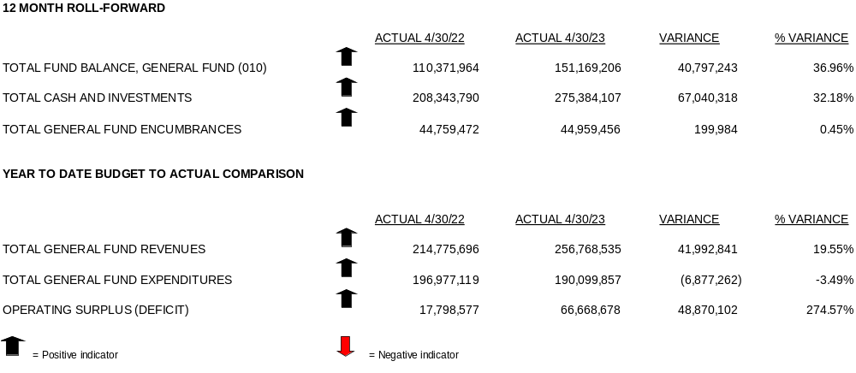
Key Financial Indicators April 2023

Slide 5
Financial Statement Highlights
REVENUES:
State Sources:
State subsidies accounted for 14% of District’s revenues.
Basic Education subsidy of $47.2 million was $24.5 million greater than the April 2022 subsidy. This difference is due to timing.
Other Sources:
Tuition from other Districts and federal grants accounted for less than 1% of total revenues.
EXPENDITURES:
Expenditures as a whole were $6.9 million or 3.49% less than 2022. Several factors to point out:
Charter School expenses saw an increase of $1.7 million or 3.73% over 2022.
Salaries continue to decrease with a loss of $4.3 million or 5.71% over the 2022 counterpart.

Slide 6
Financial Statement Highlights
4 MONTH ROLLFORWARD FOR THE GENERAL FUND:
During the 4-month period ending April 30, 2023, total General Fund balance was $151.2 million. For the same period in 2022, the fund balance was $110.4 million.
This fund balance has two major components: Total funds available for future spending are $101.2 million and total funds of $50.0 million are committed for specific uses.
GENERAL FUND:
Actual revenues of $256.8 million were greater than expenditures of $190.1 million by $66.7 million for the period January 1, 2023 – April 30, 2023.
REVENUES:
Revenues as of April 30, 2023 were $41.3 million or 19.55% greater than 2022 revenues.
Local Sources:
Local sources, such as taxes account for 86% of the District’s revenue.
Real Estate taxes were $2.1 million or 1.27% less than their 2022 counterpart.

Slide 7
Year to Date Comparison

Slide 8
Year to Date Comparison for Local Revenues

Slide 9
Year to Date Comparison for State Revenues

Slide 10
Year to Date Comparison for Expenditures

Slide 11
Current Forecast
 | Actual | Adopted | Actual | Projected | Projected
 | Year Ended 2021 | Year Ended 2022 | Year Ended 2022 | Year Ended 2023 | Year Ended 2024
Total Revenues | $633,263,128 | $638,751,328 | $652,954,802 | $672,791,871 | $689,306,479
Total Expenditures | $638,337,948 | $665,753,162 | $656,174,842 | $686,284,570 | $699,800,881
Beginning Balance | $91,701,905 | $86,627,084 | $86,627,084 | $83,407,045 | $69,914,346
Operating Surplus/(Deficit) | ($5,074,821) | ($27,001,834) | ($3,220,039) | ($13,492,699) | ($10,494,401)
Ending Fund Balance | $86,627,084 | $59,625,250 | $83,407,045 | $69,914,346 | $59,419,944
Less Projected Reservations | ($4,131,698) | ($2,500,000) | ($2,500,000) | ($2,500,000) | ($2,500,000)
Less Committed Fund Balance | $0 | $0 | $0 | $0 | $0
Less Assigned Fund Balance | (27,001,834) | (16,448,232) | (16,448,232) | (10,494,401) | ($17,126,121)
Unassigned Fund Balance | $55,493,552 | $40,677,018 | $64,458,813 | $56,919,944 | $39,793,823
% Budgeted Expenditures | 8.69% | 6.11% | 9.82% | 8.29% | 5.69%
Minimum Fund Balance per Board Policy #721 | $31,916,897 | $33,287,658 | $32,808,742 | $34,314,228 | $34,990,044
Compliance with Fund Balance Policy | Yes | Yes | Yes | Yes | Yes
Funds needed to comply with Fund Balance Policy | ($23,576,654) | ($7,389,360) | ($31,650,071) | ($22,605,716) | ($4,803,779)

Slide 12
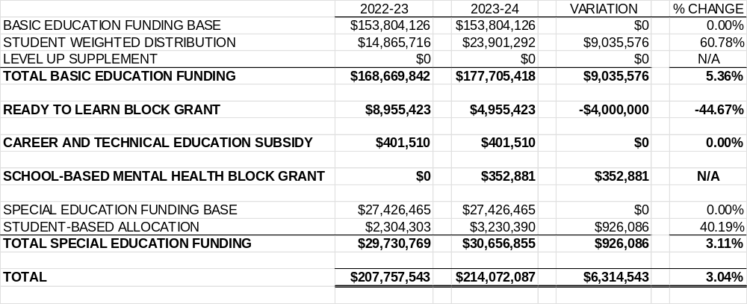
Proposed PPS Allocations

Slide 13
Cash and Investments

Slide 14
Cash Balances as of April 30, 2023
Based on the Districts unaudited financial statements as of April 30, 2023:
  Total cash balance in checking accounts is $184.1 million
    This balance is net of outstanding accounts payable check
  The current market value of investments is $91.3 million
  Total of cash and investment is $275.4 million

Slide 15
Investment Overview
Types of investments include but are not limited to:
  Time Money
    Investments that are longer than 30 days such as certificates of deposits (CDs)
  Repurchase Money
    Investments that are shorter than 30 days such as pooled investment trusts and liquid asset funds including PA INVEST, PA School District Liquid Assets Fund, and PA Local Government Investment Trust
The start of 2023 market value was $90.3 million
Current market value is over $91.3 million
Over a $1 million in interest/dividends earned to date

Slide 16
Investments Performance
Repurchase/Time Money Investments | Beginning Market Value | Purchases/Deposits | Redemption/Sales/Maturites | Closing Market Value | YTD Dividends/Income
PA Treasurer's INVEST Program for Local Governments | 22,171,275.52 | 319,705.28 | - | 22,460,980.80 | 331,951.33
PA Local Government Investment Trust (PLGIT)* | 13,779,100.10 | 15,679,036.37 | (11,981,204.18) | 16,931,537.03 | 206,897.19
PLGIT Bond Funds* | 36,150,010.17 | 495,558.28 | (3,303,668.68) | 33,881,295.03 | 495,558.28
Federated Investors | 257,339.90 | 3,750.21 | - | 261,090.17 | 3,750.21
PA School District Liquid Assest Fund | 6,702,533.72 | 98,611.34 | - | 6,801,145.07 | 98,611.34
 | 79,060,259.41 | 16,596,661.48 | (15,284,872.86) | 80,336,048.10 | 1,136,768.35
*Time Money Investments include CDs listed below
Standalone CD's | Maturity Date | Yield | Principal | Anticipated Interest | Maturity Value
First Commonwealth | 7/14/2023 | 0.05% | 5,228,069.89 | 1,303.44 | 5,229,373.33
First National Bank | 9/11/2023 | 0.05% | 1,047,418.14 | 523.71 | 1,047,941.85
 |  |  | 6,275,488.03 | 1,827.15 | 6,277,315.18
Portfolio Product | Beginning Market Value | Interest/Dividends | Changes in Value | Ending Market Value
FNB Wealth Management | 4,996,302.83 | 14,756.75 | 26,898.63 | 5,037,958.21

Slide 17
Questions?

