Slide 1

Planning for the 2025 General Fund Budget

Slide 2
Agenda
Issues with the 2024 Process
Timeline for Budget Development
Budget Workshops

Slide 3
What did we hear about the 2024 budget process?
The budget workshops occurred too late
The budget book was not transparent enough
Budget narratives were not present in the preliminary budget book
A listing of FTEs by department was not included in the budget book

Slide 4
What do YOU have to say about the 2024 budget process?
What do you dislike about the current budget development process?
What are some areas where the current process can be improved?
What is your ideal outcome for the budget process?

Slide 5
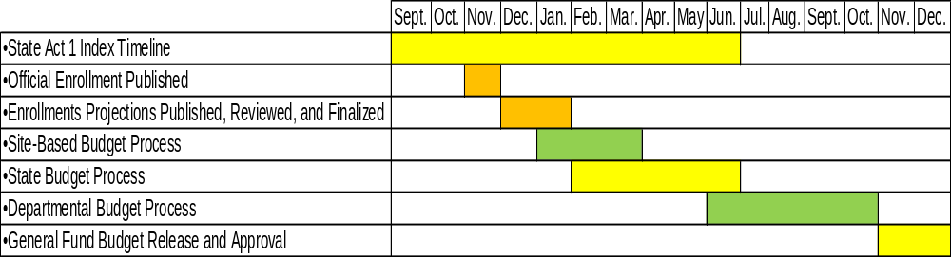
Budget Development Process/Timeline

Slide 6
Budget Development Process/Timeline
September – State releases the annual Act 1 Index
November – Official Enrollment published
December/January – Enrollments Projections published and reviewed
January – Principals receive Site-Based Budgets
February – Governor’s Budget Proposal
March – Site-Based Budgets provided to HR for staffing
June – Deadline to certify not to increase taxes beyond index
June – State Budget approved
June – August – Departmental Budgets entered
September – October – Department Budgets reviewed and finalized
November – Release of Preliminary General Fund Budget
December – Approval of the Final General Fund Budget

Slide 7
Budget Development Process/Timeline
September – State releases the annual Act 1 Index
November – Official Enrollment published
December/January – Enrollments Projections published and reviewed
January – Principals receive Site-Based Budgets
February – Governor’s Budget Proposal
March – Site-Based Budgets provided to HR for staffing
June – Deadline to certify not to increase taxes beyond index
June – State Budget approved
June – August – Departmental Budgets entered
September – October – Department Budgets reviewed and finalized
November – Release of Preliminary General Fund Budget
December – Approval of the Final General Fund Budget

Slide 8
Why are these dates important?
January – Principals receive Site-Based Budgets
  Site-based budgets account for over a third of the general fund budget
February – Governor’s Budget Proposal
  Provides a preview of potential changes to revenue received by the State
June – Deadline to certify not to increase taxes beyond index
  This action allows the District to adhere to the normal budget adoption timeline
June – State Budget approved
  Provides estimates for revenue from the State for the upcoming school year

Slide 9
Feedback on the process/timeline
Are there any dates missing from this timeline?
Should there be additional items/checkpoints added to the process/timeline?
Does the process/timeline require major changes?

Slide 10
Budget Workshops
Adopted February 26, 2020 via Board resolution
  The Board authorizes that Board Operational Guideline 004 BOG 1 of 1 – Role of the Board of Public Education be amended to require that no less than three (3) Budget Planning Workshops be held as a Committee of the Whole to assist the Board in its duties to approve an annual budget.
  That the Budget Planning Workshops described herein shall be scheduled by the Board President in consultation with the Superintendent.
  That the agenda for each Budget Planning Workshop shall be created by the Business Finance Committee in collaboration with Administration.

Slide 11
Goals for 2024 Budget Workshops
All budget workshops will occur prior to June 30, 2024
Budget workshops agendas will be based on feedback from Board Members
Budget workshops will encourage greater Board Member understanding of the budget and engagement in the budget development process

Slide 12
Planning for the 1st Budget Workshop
What topics do you want to discuss at the first budget workshop?
What information do you want to receive?
What is the desired format for the first budget workshop?

