Slide 1

2025 Budget Development Process

Slide 2
Agenda
Review Board Feedback From January
Revised Timeline for Budget Development
March Budget Workshop Agenda

Slide 3
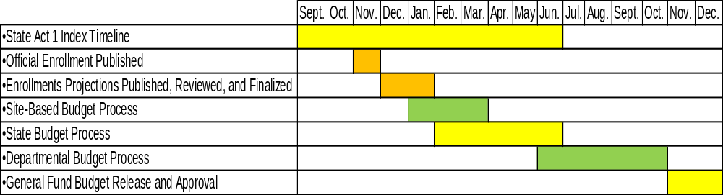
Budget Development Timeline

Slide 4
Budget Development Timeline
September – State releases the annual Act 1 Index
November – Official Enrollment published
December/January – Enrollments Projections published and reviewed
January – Principals receive Site-Based Budgets
February – Governor’s Budget Proposal
March – Site-Based Budgets provided to HR for staffing
June – Deadline to certify not to increase taxes beyond index
June – State Budget approved
June – August – Departmental Budgets entered
September – October – Department Budgets reviewed and finalized
November – Release of Preliminary General Fund Budget
December – Approval of the Final General Fund Budget

Slide 5
What YOU had to say about the budget development timeline
The timeline should reflect when site-based budgets are in effect
The timeline should include the Strategic Plan
The timeline should include the Equity Plan
Budget Workshops should be held quarterly
Would like to see key collective bargaining dates

Slide 6
Revised Budget Development Timeline
December 31, 2023 – Expiration of AFSCME Local 2924 Collective Bargaining Agreement
January 1, 2024 – First day of FY 2024
January 31, 2024 – Principals receive Site-Based Budgets
February 6, 2024 – Governor’s Budget Proposal
March 1, 2024 – Site-Based Budgets provided to HR for staffing
March 2024 – First Budget Workshop (Date to be determined)
March 15, 2024 – Deadline for Facilities Utilization Plan
March 20, 2024 – Close of FY 2023
June 2024 – Second Budget Workshop (Date to be determined)
June 30, 2024 – Deadline to approve Act 1 Resolution

Slide 7
Revised Budget Development Timeline (continued)
June 30, 2024 – Expiration of PFT Professional, Paraprofessional, and Technical Clerical Collective Bargaining Agreements
June 2024 – State Budget approved
June – August 2024 – Departmental Budgets entered
July 1, 2024 – Site-Based Budget Year Begins
September 2024 – Final Budget Workshop (Date to be determined)
September – October 2024 – Department Budgets reviewed and finalized
November 2024 – Release of Preliminary 2024 General Fund Budget
December 18, 2024 – Approval of the 2025 General Fund Budget and Tax Rates
December 31, 2024 – Deadline to adopt the 2025 Budget
December 31, 2024 – Expiration of Building Trades and AFSCME Local 297 Collective Bargaining Agreements

Slide 8
What is missing from the timeline?
Strategic Plan
  Strategic Plan update will be provided to the Board at the February 6, 2024 Education Committee Meeting
Equity Plan
  Action plans in response to the Equity Audit are currently in development
Community Engagement

Slide 9
Budget Workshops
Adopted February 26, 2020 via Board resolution
  The Board authorizes that Board Operational Guideline 004 BOG 1 of 1 – Role of the Board of Public Education be amended to require that no less than three (3) Budget Planning Workshops be held as a Committee of the Whole to assist the Board in its duties to approve an annual budget.
  That the Budget Planning Workshops described herein shall be scheduled by the Board President in consultation with the Superintendent.
  That the agenda for each Budget Planning Workshop shall be created by the Business Finance Committee in collaboration with Administration.

Slide 10
What YOU had to say about budget workshops
FY 2023 Recap
Understanding how site-based budgets affect the general fund budget
Discussion of educational outcomes
Sustaining our district long term

Slide 11
Planning for the 1st Budget Workshop
The 1st budget workshop will occur in March 2024
  Per the resolution, the date will be determined by the Superintendent and Board President
Topics will include:
  In-depth review of the 2024 General Fund budget
  Discussion of the District’s financial context
    Review of unaudited 2023 General Fund expenditures
    Long term financial projection
    Property Tax Appeals
    State and Federal Funding

Slide 12
Goals for 2024 Budget Workshops
All budget workshops will occur prior to September 30, 2024
Budget workshops agendas will be based on feedback from Board Members
Budget workshops will encourage greater Board Member understanding of the budget and engagement in the budget development process

