Slide 1

Fiscal Year 2023 Results

Slide 2
Agenda
Review of Unaudited General Fund Results
Review of State Funding
Review of Property Assessment Appeals

Slide 3
Review of Unaudited General Fund Results

Slide 4
Year to Date Comparison for Local Revenues

Slide 5
Year to Date Comparison for State Revenues

Slide 6
Year to Date Comparison for Expenditures

Slide 7
Fiscal Year 2023 Summary
Actual 2023 revenues as a whole are $29.3 million or 4.49% greater than 2022 revenues
  The District’s State revenue sources are $24.7 million or 9.45% greater than 2022
  Basic Instructional subsidy increased by $7.9 million or 4.7%
  2023 Real Estate Tax collections are $7.1 million or 3.65% lower than 2022 collections
    $4.1 million of this decrease is due to an increase in our State Property Tax Relief Allocation
  Collections of the Earned Income Tax are $8.5 million or 5.13% greater than 2022 collections
Actual 2023 expenditures as a whole are $22.7 million or 3.47% greater than 2022
  Salary expenditures declined by $5.53 million or 2.88% compared to 2022
    Approximately $10.3 million in salaries that were originally budgeted in 2023 were able to be funded by ESSER III and Ready to Learn funding
  Charter School payments are $14 million or 11.31% greater than 2022

Slide 8
Year to Date Comparison

Slide 9
Review of Property Assessment Appeals

Slide 10
Real Estate Revenue Over Time

Slide 11
Impact of Property Assessment Appeals
3,051 assessment appeals were filed for the 2022 and 2023 tax years
  Total tax base represented by these appeals is $3,557,933,788
  $36,498,821.33 is annual tax revenue
447 active appeals that still need to be resolved by the Board of Viewers and Board of Property Assessment and Appeals Review (BPAAR)
  Total tax base represented by these appeals is $366,340,652
  $3,754,991.68 in annual tax revenue
When applying the average reduction based on resolved appeals to the 447 active appeals
  The estimated reduction is the tax base is $67,040,339.32
  The estimated refunds due for the 2022 and 2023 tax years is $1,374,326.96
  The estimated reduction in tax revenue for the 2024 tax year is $687,163.48

Slide 12
Impact of Property Assessment Appeals
BPAAR has issued 491 decisions from 1/1/24 to 3/15/24
  For these 491 appeals, the tax base decreased from $1,794,116,432 to $1,465,768,235
  The estimated refunds due for the 2022 and 2023 tax years is $6,031,695.26
  The estimated reduction in tax revenue for the 2024 tax year is $3,365,569.02
The District may experience a $4,052,732.50 reduction in real estate revenue is need to pay $7,406,022.21 in tax refunds for the 2022 and 2023 tax years
The deadline to file assessment appeals for the 2024 tax year is March 31, 2024

Slide 13
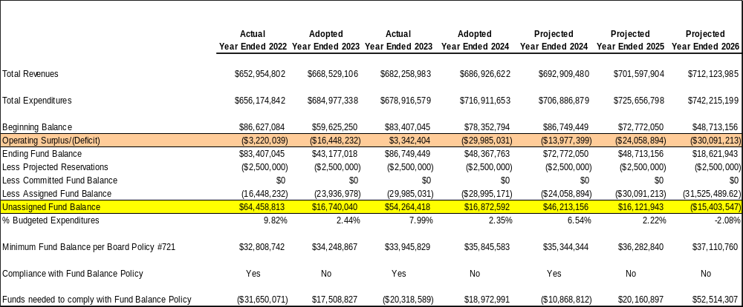
Our Current Financial Forecast

Slide 14
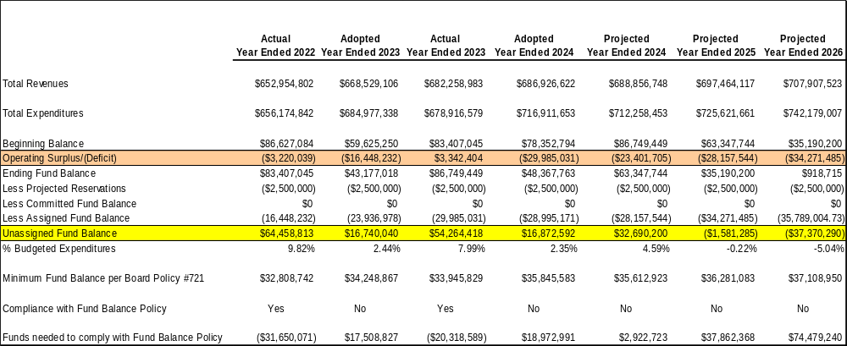
Possible Impact of Lowered Assessments and Refunds

Slide 15
Review of State Funding

Slide 16
Governor’s Budget
The Governor’s Education budget has a 13.62% increase in Basic Education Funding over 2023-24 appropriations, for a total of $1.07 Billion in new appropriations. This includes:
  An additional $200 million distributed through the student-weighted formula
  An $872 Million for an adequacy investment for basic education as recommended by the Basic Education Funding Commission
$50 Million statewide increase in Special Education Funding, a 3.61% increase over 2024-25. These dollars are distributed based on categories of support for students with disabilities.
The Governor’s proposed 2024-25 budget also includes
  $32.5 Million statewide increase for the Pre-K Counts program
  $2.7 Million statewide increase for the Head Start Supplemental Assistance program
  $17 Million statewide increase for Early Intervention
  Establishes a statewide cyber tuition rate of $8,000 per student per year
  This reform will save Pittsburgh Public Schools an estimated $13.3 million annually

Slide 17
Impact of Governor’s Budget
School District of Pittsburgh
Governor's Proposed Budget - 2024/25 |  |  |  |  |  |  | 2/14/2024
 | 2023-24 |  | 2024-25 |  | VARIATION |  | % CHANGE
BASIC EDUCATION FUNDING BASE | $153,804,126 |  | $177,716,944 |  | $23,912,818 |  | 15.55%
STUDENT WEIGHTED DISTRIBUTION | $23,912,818 |  | $2,337,857 |  | -$21,574,961 |  | -90.22%
ADEQUACY INVESTMENT | $0 |  | $0 |  | $0 |  | N/A
TOTAL BASIC EDUCATION FUNDING | $177,716,944 |  | $180,054,801 |  | $2,337,857 |  | 1.32%
READY TO LEARN BLOCK GRANT | $9,955,423 |  | $9,955,423 |  | $0 |  | 0.00%
CAREER AND TECHNICAL EDUCATION SUBSIDY | $484,296 |  | $484,296 |  | $0 |  | 0.00%
SPECIAL EDUCATION FUNDING BASE | $27,426,465 |  | $27,426,465 |  | $0 |  | 0.00%
STUDENT-BASED ALLOCATION | $2,652,452 |  | $2,841,601 |  | $189,149 |  | 7.13%
TOTAL SPECIAL EDUCATION FUNDING | $30,078,917 |  | $30,268,066 |  | $189,149 |  | 0.63%
TOTAL | $218,235,580 |  | $220,762,586 |  | $2,527,006 |  | 1.16%

Slide 18
Adequacy Investment
$872 million for basic education as recommended by the Basic Education Funding Commission
Establishes a spending (adequacy) target per school district and compares this target to net current expenditures
School districts with a net current expenditures less than their adequacy target (an adequacy gap) will receive an adequacy investment
Pittsburgh Public Schools will NOT receive an Adequacy Investment

Slide 19

Impact of Governor’s Budget on Our Forecast

Slide 20
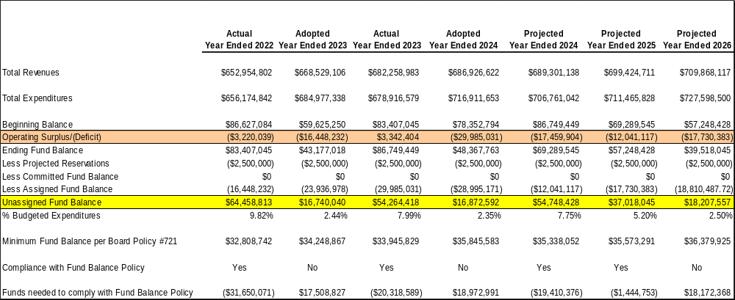
Impact of Statewide Cyber Charter Tuition Rate

Slide 21
Questions?

