Slide 1

June Board Budget Workshop

Slide 2
Agenda
Current Financial Outlook
Areas of Opportunity
Next Steps

Slide 3
Our Current Financial Outlook is Better Than Previously Projected
Projected 2024 expenditures are greatly improved based on actual expenses through April 2024
  Salary and benefit expenditures are lower due to the following:
    Vacancies
    Utilization of ESSER funding
    Utilization of Ready to Learn funding
Assessment appeals have reduced our projected real estate revenue and increased our projected expense for tax refunds

Slide 4
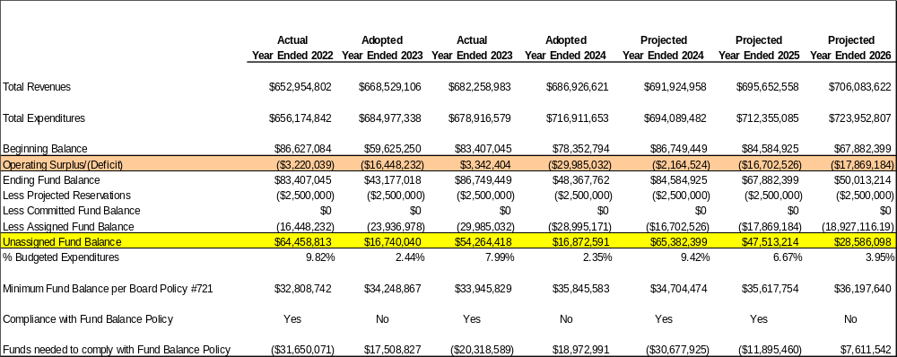
Our Current Financial Forecast

Slide 5
Areas of Opportunity - Revenue

Slide 6
2024 Revenues

Slide 7
2024 Revenues

Slide 8
Real Estate Revenue is the Only Local Tax Rate We Can Alter

Slide 9
Our Real Estate Declined in 2023 After a Decade of Increases

Slide 10
Impact of Property Assessment Appeals
$6,936,526.31 in tax refunds due for assessment appeals were filed for the 2022 and 2023 tax years
  $3,028,705.64 in refunds for 2022
  $3,907,820.67 in refunds for 2023
1,188 assessment appeals were filed for the 2024 tax year
  Total tax base represented by these appeals is $1,525,125,704
  $15,632,538.47 in annual tax revenue
When applying the average reduction based on resolved appeals for 2022 and 2023
  The estimated reduction in the tax base is $285,215,843
  The estimated reduction in tax revenue for the 2024 tax year is $2,902,962.39

Slide 11
Real Estate Revenue Scenarios

Slide 12
Impact of a Tax Increase on Projected Real Estate Tax Revenue

Slide 13
Our Current Financial Forecast

Slide 14
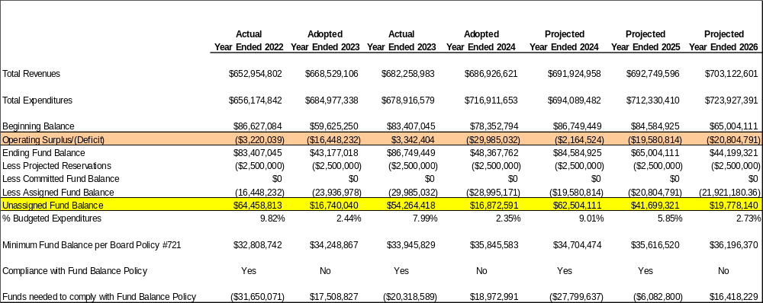
Projected Impact of Assessment Appeals

Slide 15
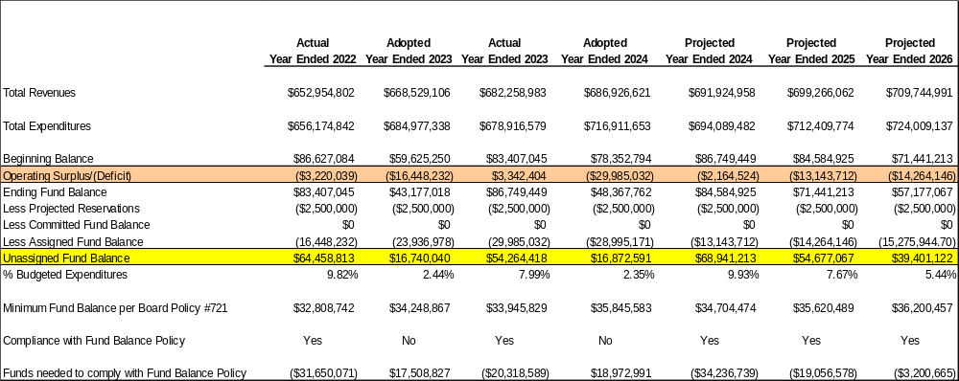
Projected Impact of 5.3% Millage Increase (Act 1 Index Limit)

Slide 16
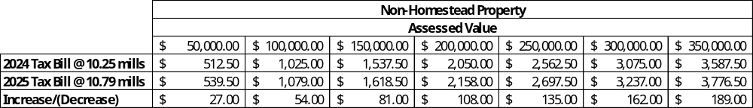
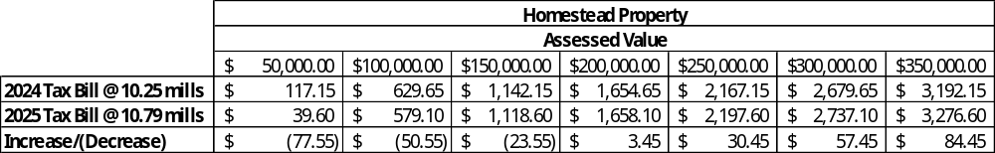
What Does This Mean For a Property Owner?

Slide 17
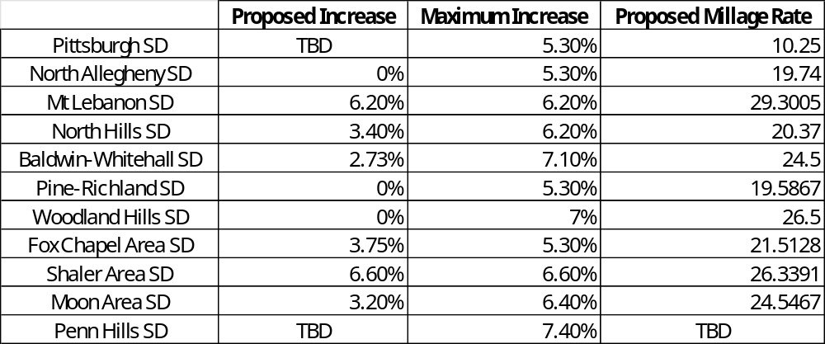
2024-25 Millage Rates of the Largest Districts in Allegheny County

Slide 18
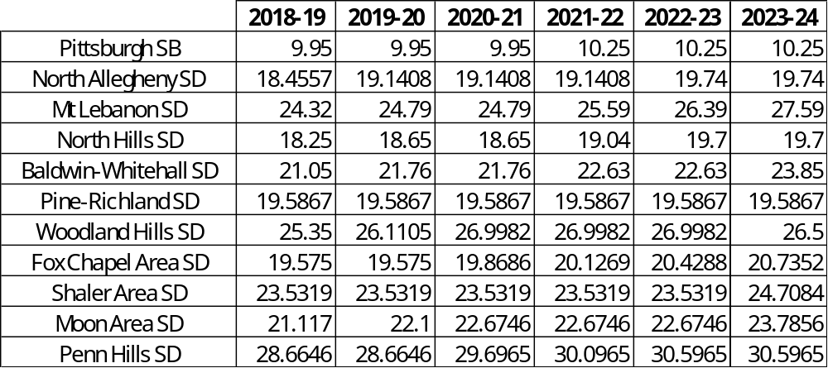
Area School District Millage Rates
2018-19 through 2023-24

Slide 19
Area School District Millage Rates
2018-19 through 2023-24

Slide 20
Areas of Opportunity - Expenditures

Slide 21
2024 Appropriations by Major Object

Slide 22
Salaries and Benefits
(Major objects 100 and 200)

Slide 23
Salaries and Benefits Account for 47% of Our Budget

Slide 24
Salary Expenditures Were Under Budget the Past 3 Years

Slide 25
Why Were 2023 Salaries Under Budget?
2023 General Fund salaries were under budget by $13.2 million due to the following:
  $7.1 million in budgeted salaries funded by ARP-ESSER
  $4.1 million in budgeted salaries funded by the Ready to Learn Grant
$2 million was likely due to vacant positions or other unspent salary appropriations

Slide 26
We Are Seeing A Similar Trend With Our Employee Benefit Expenditures

Slide 27
Vacant Positions

Slide 28
General Fund Vacancies
Currently 82.90 vacant central office positions that are budgeting in the general fund
These vacancies represent over $5 million in salaries that are budgeted in the general fund

Slide 29
Overtime

Slide 30
The District Paid $8.3 million in Overtime in 2023

Slide 31
We Have Seen Over a 42% Increase In Overtime Expenditures Since 2021

Slide 32
Contracted Services
(Major object 300 excluding objects 310 and 322)

Slide 33
Contracted Services Account for 1% of Our Budget

Slide 34
Spending on Contracted Services Have Increased by 34% Since 2021

Slide 35
Software
(Object 650)

Slide 36
Our Spending on Software Has Been At Least 26% Below Budget the Past 2 Years

Slide 37
Charter, Transportation, and Special Education Account for 38% of the Budget

Slide 38
These Expenditures Are Affected by Certain Factors
The following factors affect charter expenditures:
  Charter school enrollment
    5,372 students
      Current PPS K-12 enrollment is 18,312
  District expenditures
  Charter funding reform
The following factors affect transportation
  Negotiation carrier contracts
  District programming and how we assign students
Student needs and programming determine the cost of special education

Slide 39
Next Steps in the Budgeting Process
Continue to monitor assessment appeals and evaluate the need for a millage increase
Budgeting for Salary and Benefit Expenditures
  Review of Overtime Expenditures
  Review of Vacancies
Review of Budgeted Expenditures for Software
Review of Contracted Services Expenditures

Slide 40
Questions?

